Slide 1
Neural Networks
25 Dec 2020

Slide 2
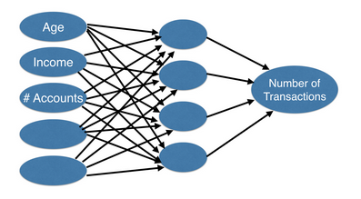
Interactions in Neural Network
Node
Represents an aggregation of information from our input data and each node adds to the model’s ability to capture interactions.
Input layer on the left represents predictive features like age or income.
Far right, the output layer, the prediction from our model, in this case, the predicted number of transactions.
All layers between these two layers are called hidden layers because we couldn’t observe directly from the world.
input layer
hidden layer
Output layer

Slide 3
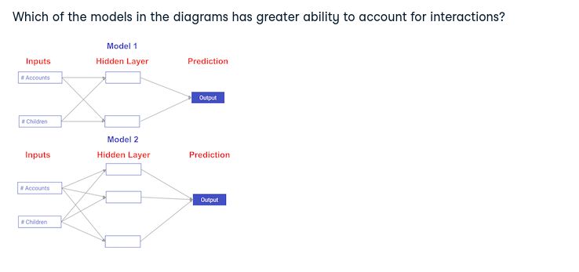
Q1

Slide 4
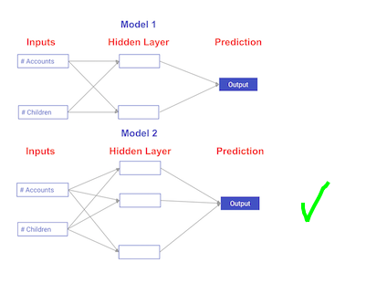
Model 2 has more nodes in the hidden layer, and therefore, greater ability to capture interactions.

Slide 5
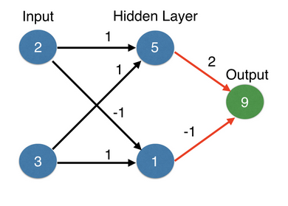
Forward propagation
Input layer
Number of children
Number of existing accounts
Graph shows a customer with 2 children and 3 accounts.
Forward-propagation algorithm will pass this information through the network to make a prediction in the output layer.
Weight indicating how strongly that input effects the hidden node.
Multiply and sum up (dot product)
Forward Prop.

Slide 6
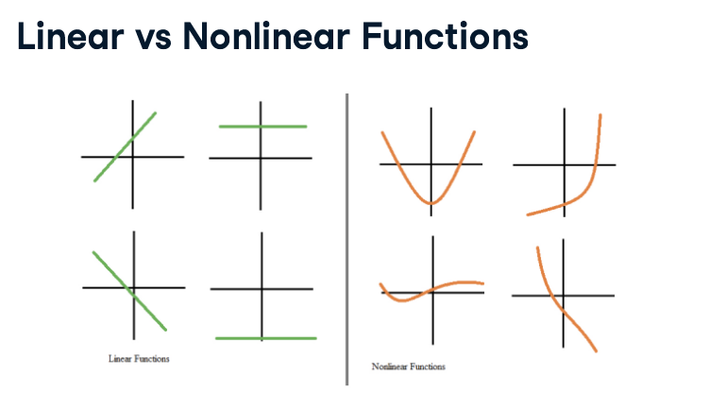
Activation functions
For neural networks to achieve their maximum predictive power, we must apply something called an activation function in the hidden layers.
An activation function allows the model to capture non-linearities.
We have examples of linear functions, straight lines on the left, and non-linear functions on the right. If the relationships in the data aren’t straight-line relationships, we will need an activation function that captures non-linearities. An activation function is something applied to the value coming into a node, which then transforms it into the value stored in that node, or the node output.

Slide 7
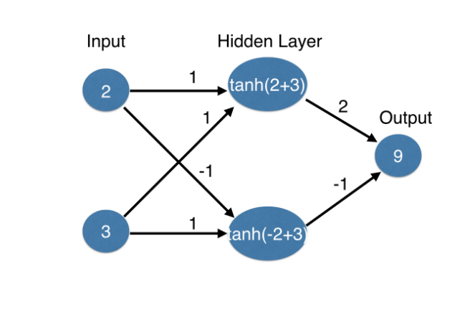
Activation functions
Modify our hidden layer with an activation function
For neural networks to achieve their maximum predictive power, we must apply something called an activation function in the hidden layers.
An activation function allows the model to capture non-linearities.
We have examples of linear functions, straight lines on the left, and non-linear functions on the right. If the relationships in the data aren’t straight-line relationships, we will need an activation function that captures non-linearities. An activation function is something applied to the value coming into a node, which then transforms it into the value stored in that node, or the node output.

Slide 8
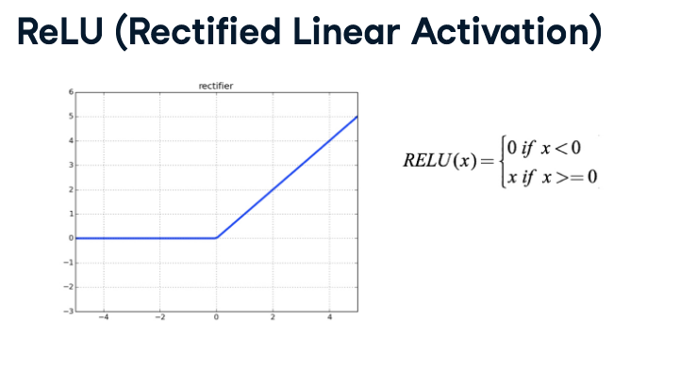
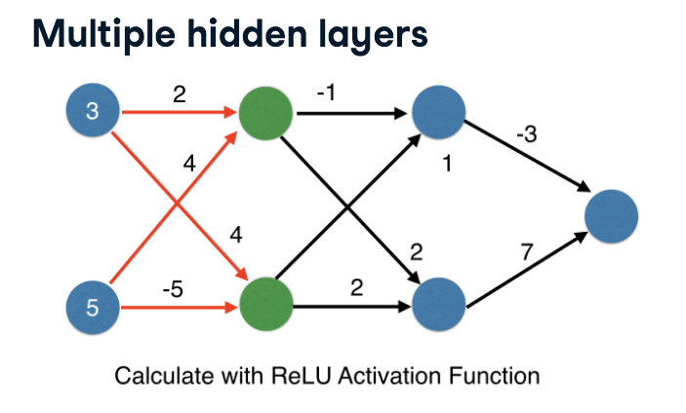
Deeper networks

Slide 9
Deepernetworks

Slide 10
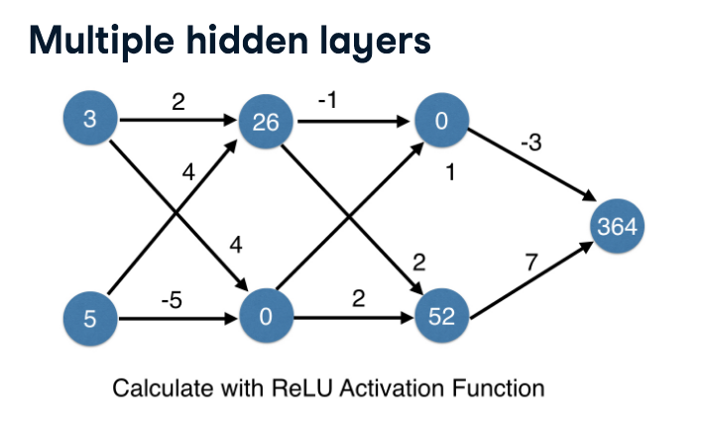
Solution

Slide 11
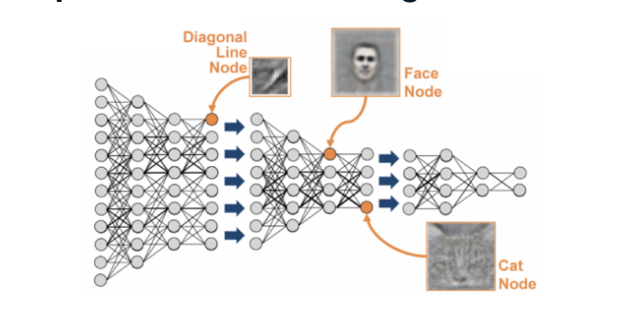
Representation learning
Deep networks internally build representations of patterns in the data.
Partially replace the need for a feature engineering.
Level of representation
Subsequent layers build increasingly sophisticated representations of raw data.

Slide 12

Q2
Which layers of a model capture more complex or "higher level" interactions?
The first layers capture the most complex interactions. press1
The last layers capture the most complex interactions. press2
All layers capture interactions of similar complexity. press3
The last layer

