Slide 1
ISS of PUNEH
M. Ali Saber

Slide 2
Outline
PUNEH
ISS of PUNEH
Results

Slide 3
System Hierarchy
System
PUNEH (16-bit Processor)
Register
Flag
Channel
Peripheral
USART
Mem. Controller
Memory

Slide 4
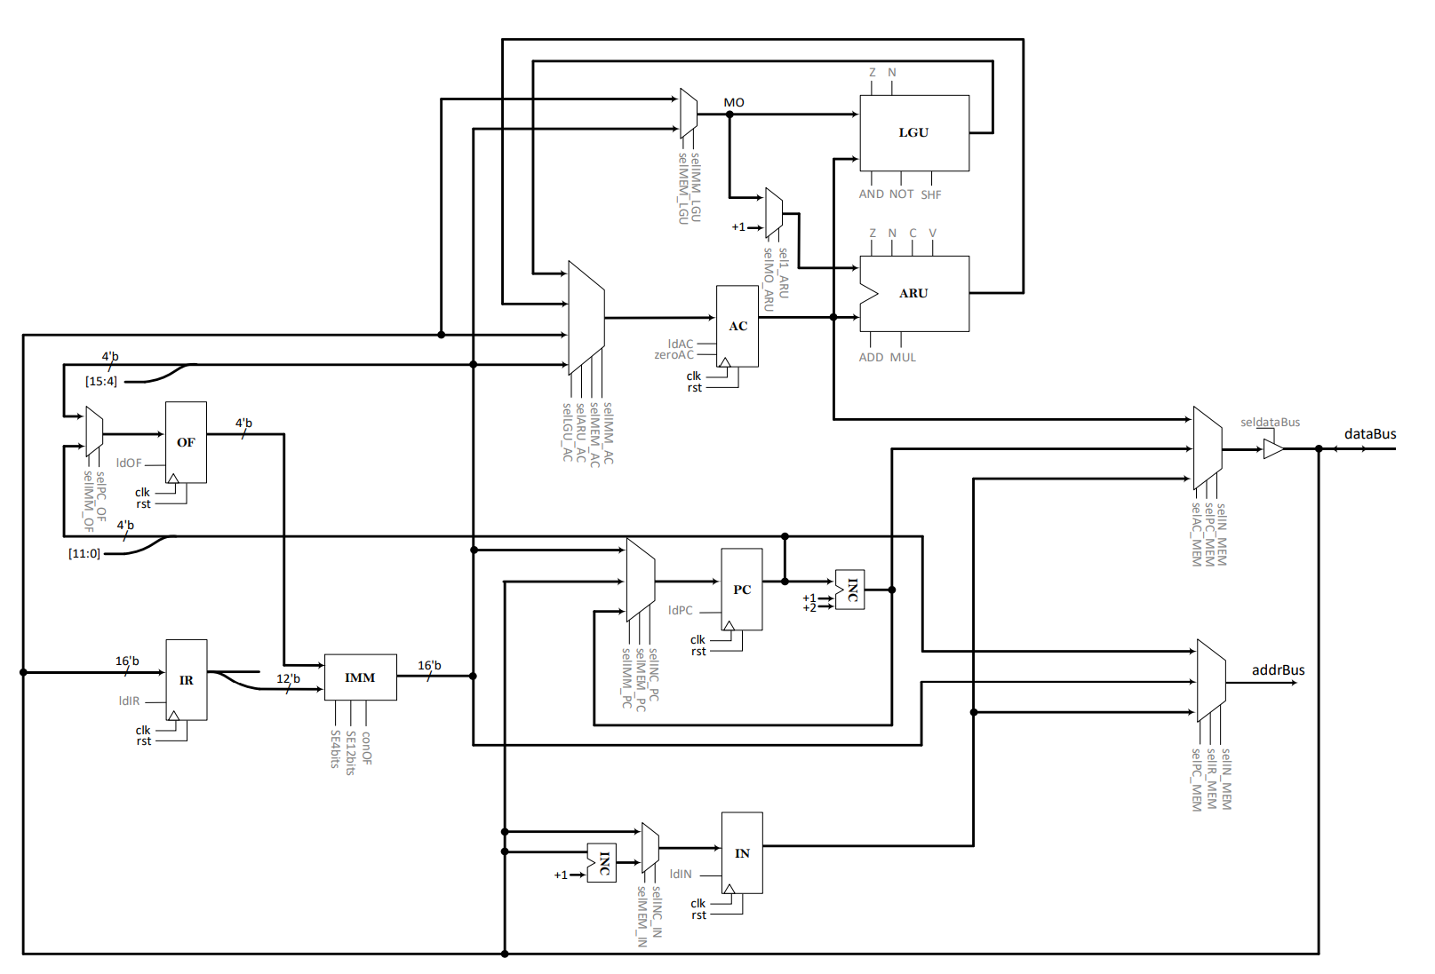
Data Path of PUNEH
16-bit Address Bus
16-bit Data Bus
16-bit Registers
PC
AC
IN
IR
OF
4-bit Registers
Status Register
Simple ALU

Slide 5
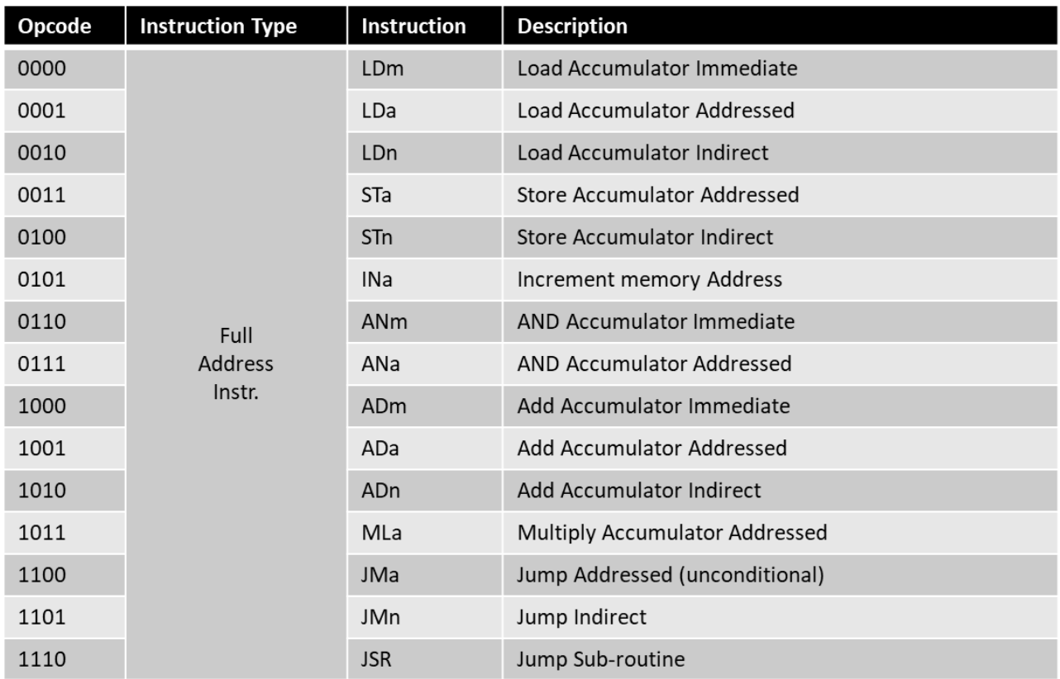
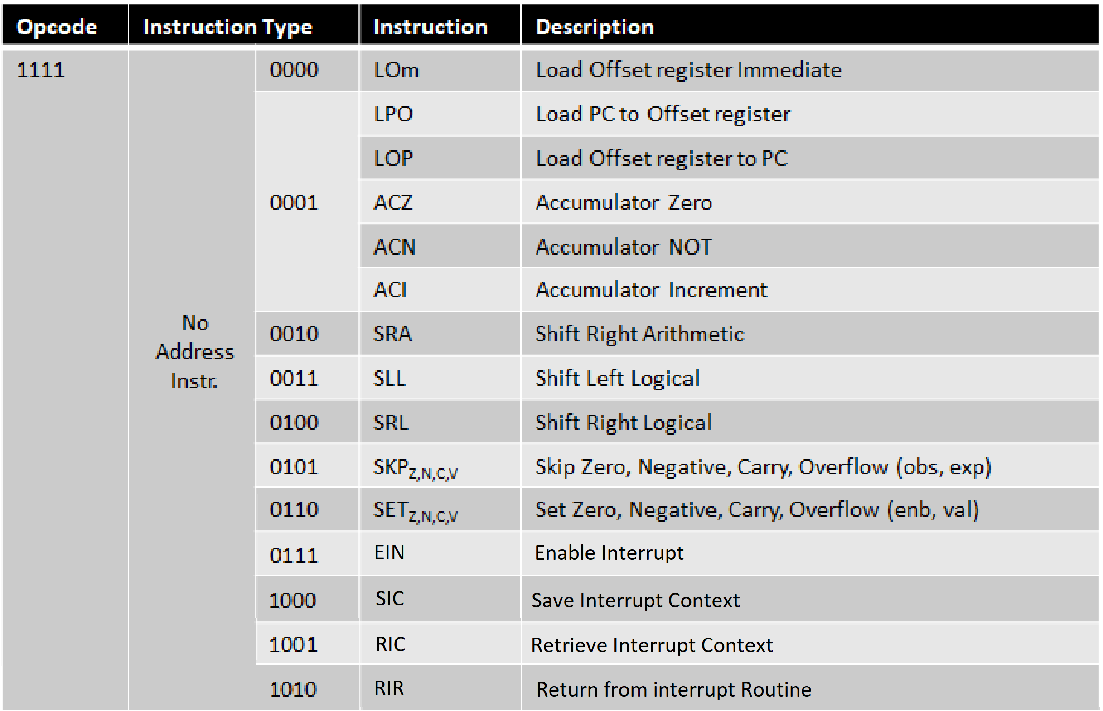
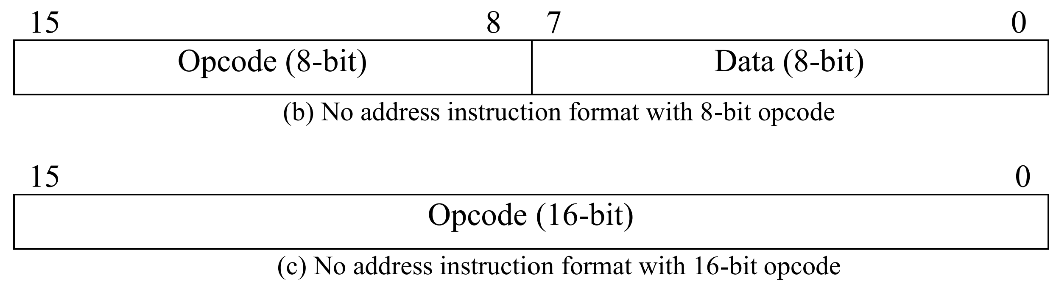
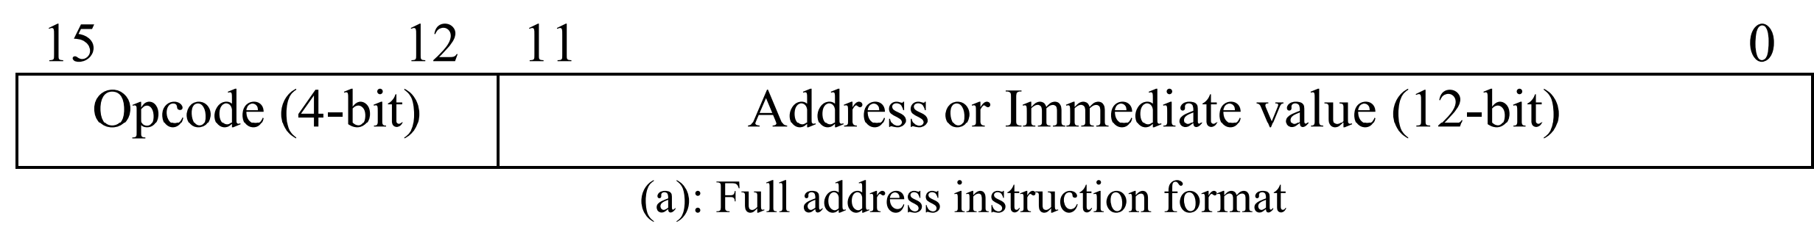
Instructions of PUNEH

Slide 6
Outline
PUNEH
ISS of PUNEH
Results

Slide 7
System

Slide 8
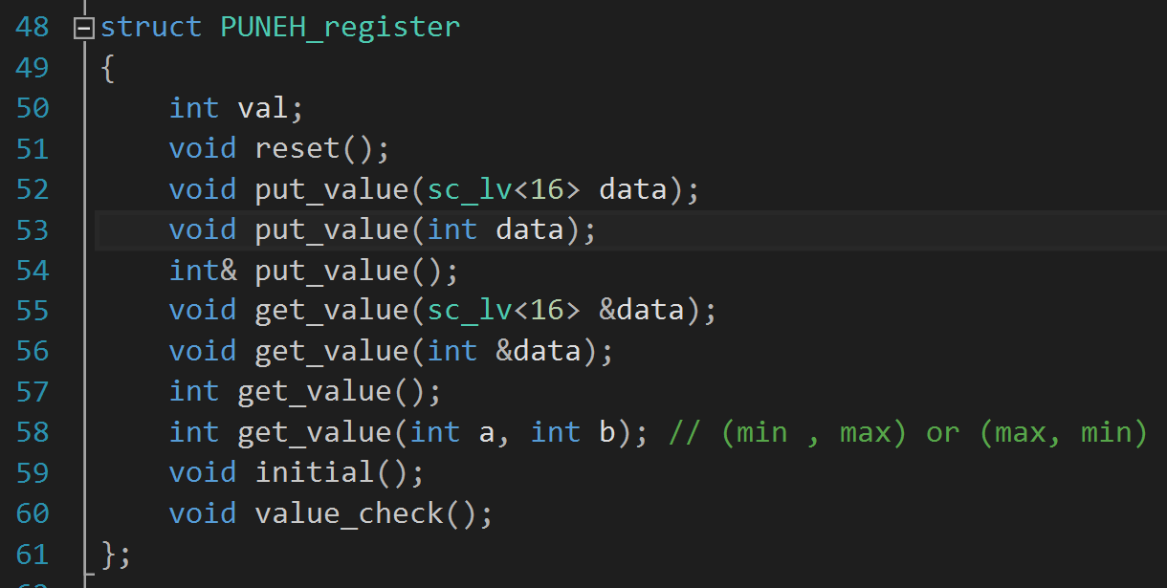
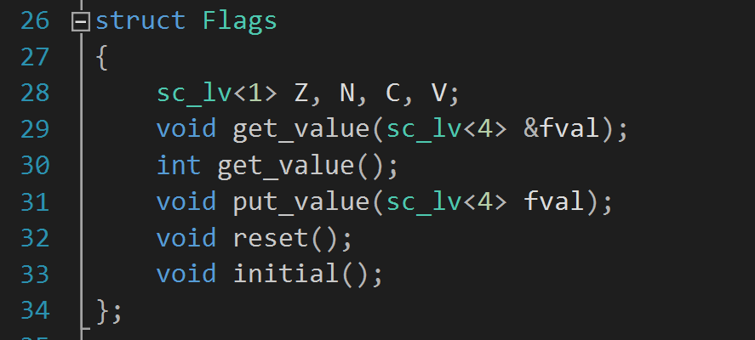
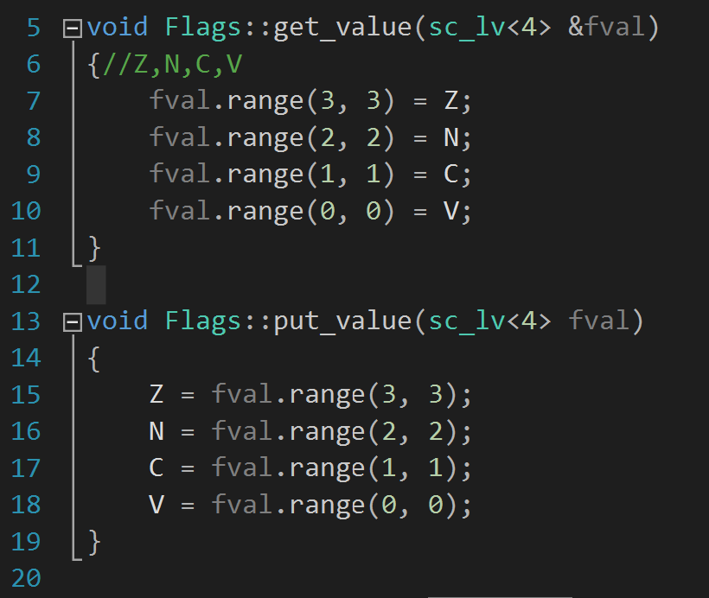
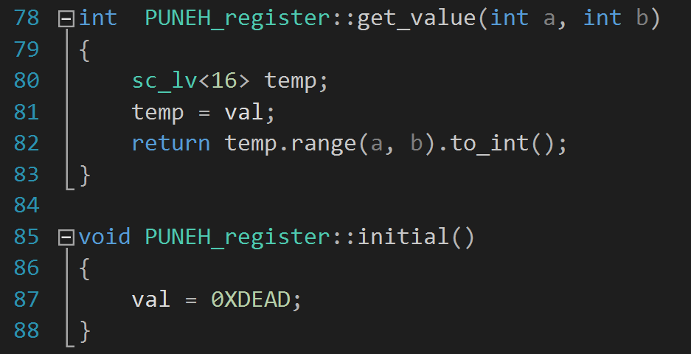
Register and Flag
Utilities.h
Utilities.h
Utilities.Cpp
Utilities.Cpp

Slide 9
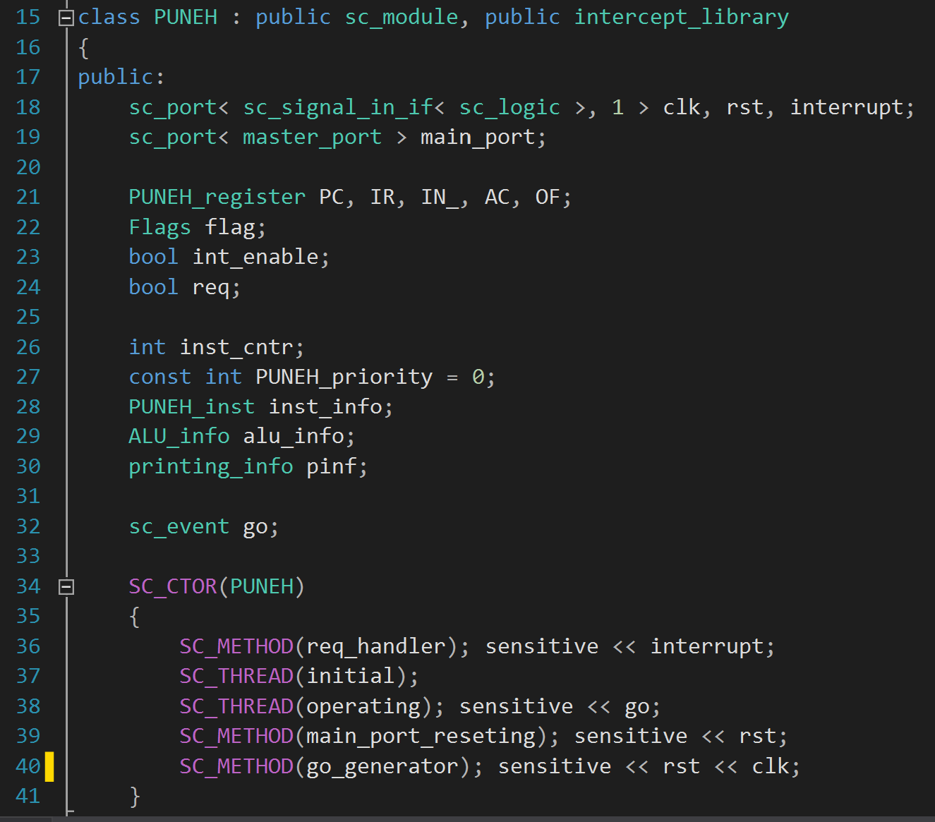
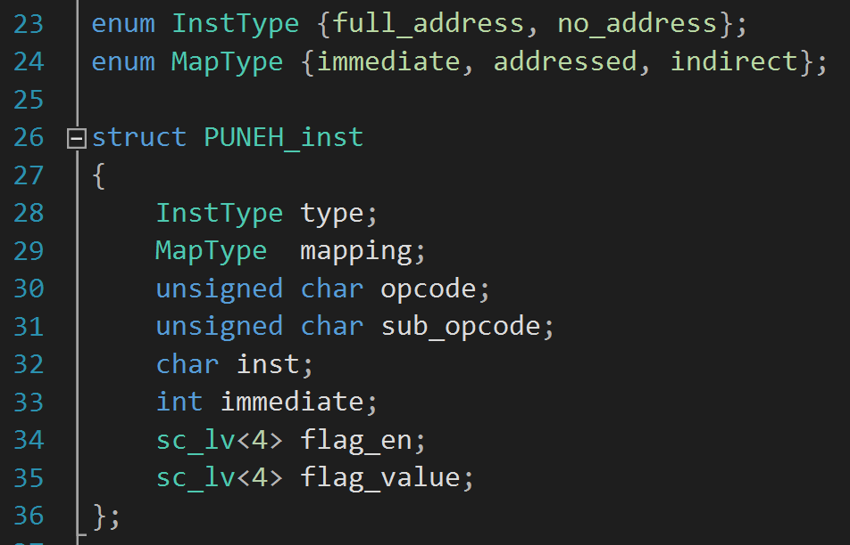
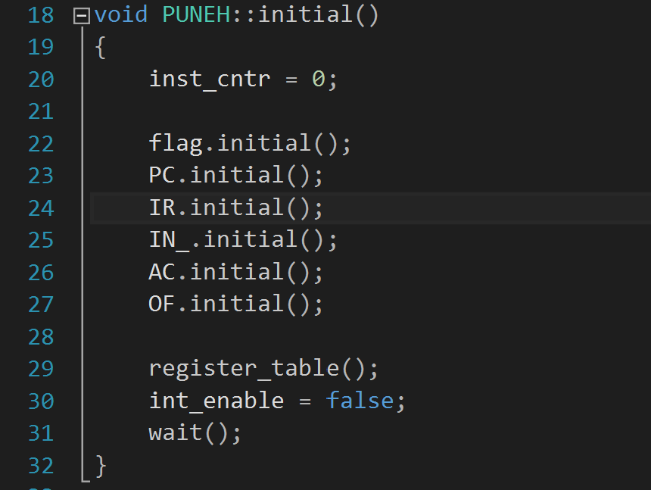
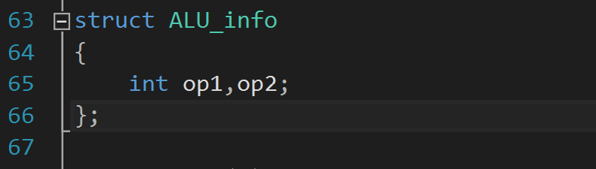
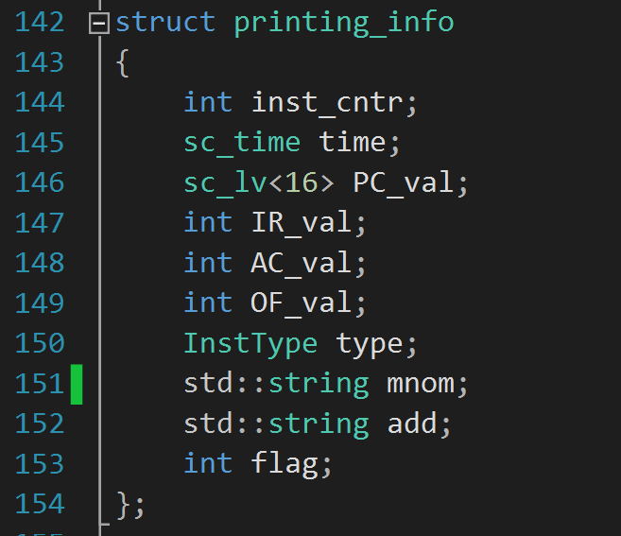
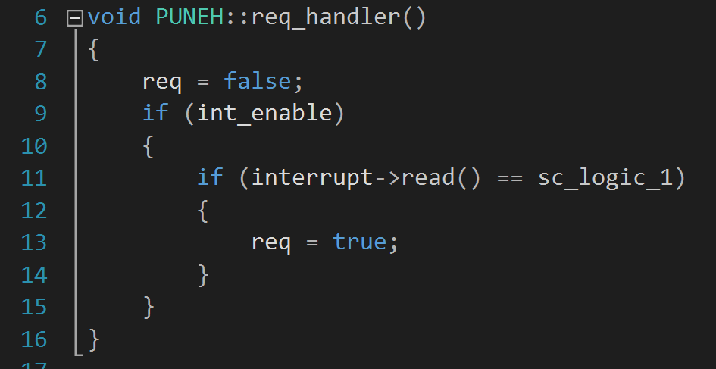
ISS of PUNEH
IR(15:12)
IR(11:8)
IR(7:0)
we need to save just operands, the result is always in AC register
IR(11:0)
IR(7:4)
IR(3:0)
PUNEH.cpp
PUNEH.h
Utilities.h

Slide 10
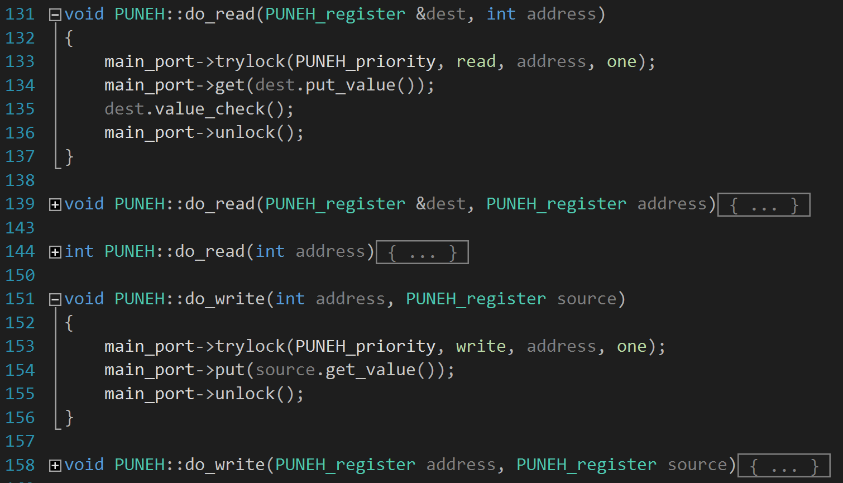
Main Port Operations
PUNEH.cpp

Slide 11
ISS of PUNEH (cont’d)
ISS Execution scheme
Hardware Execution scheme

Slide 12
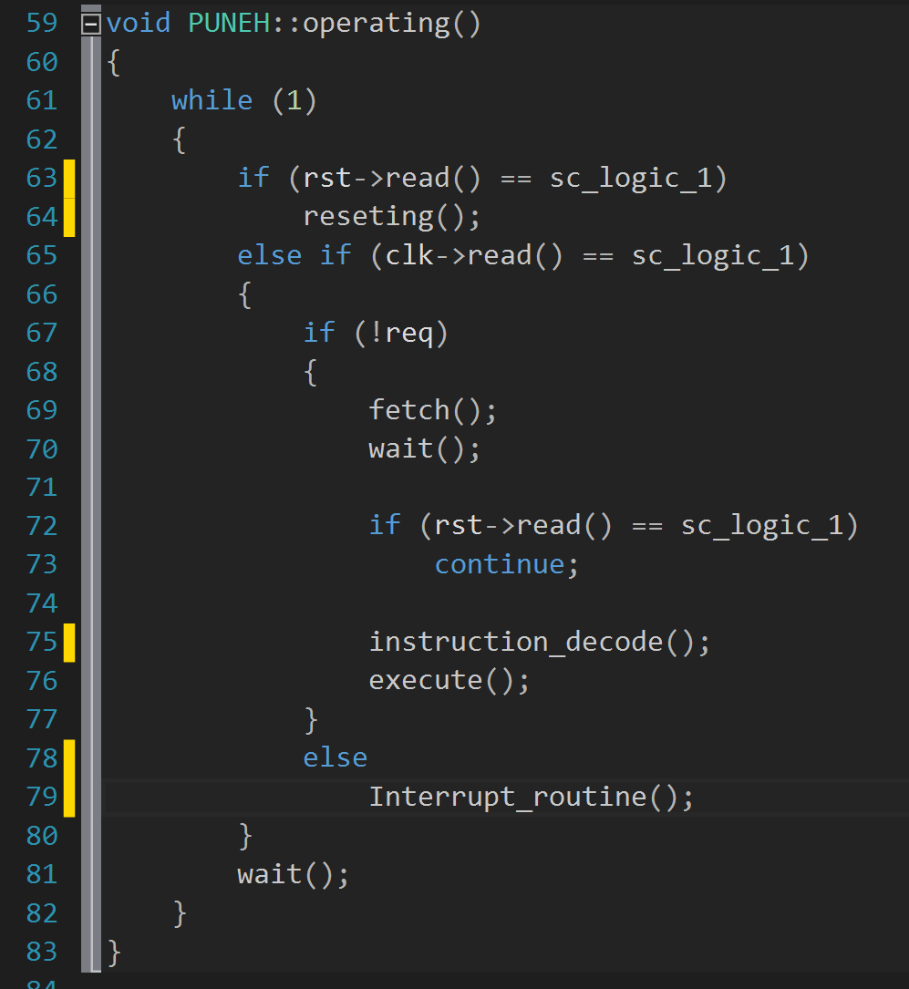
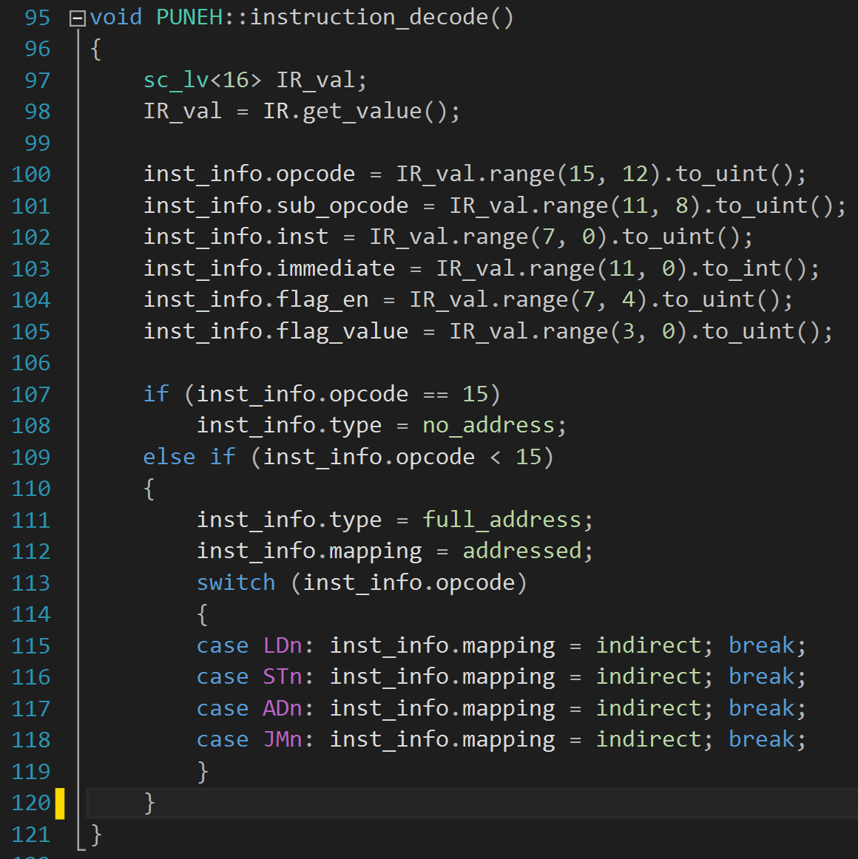
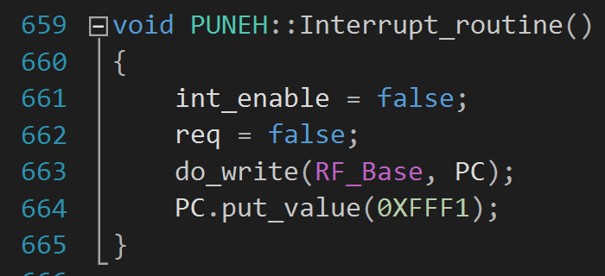
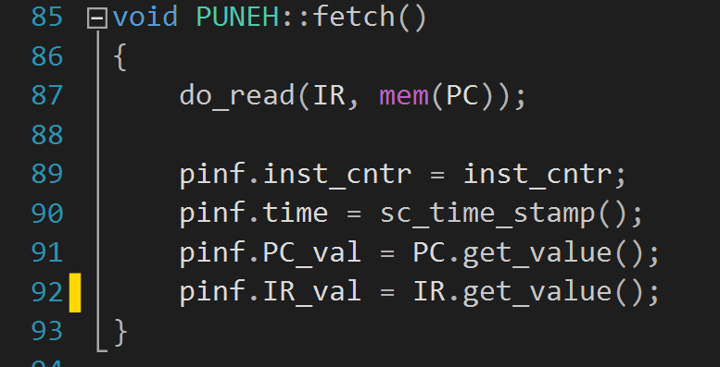
ISS of PUNEH (cont’d)
Instruction Decode
Interrupt Routine
Instruction Fetch
PUNEH.cpp

Slide 13
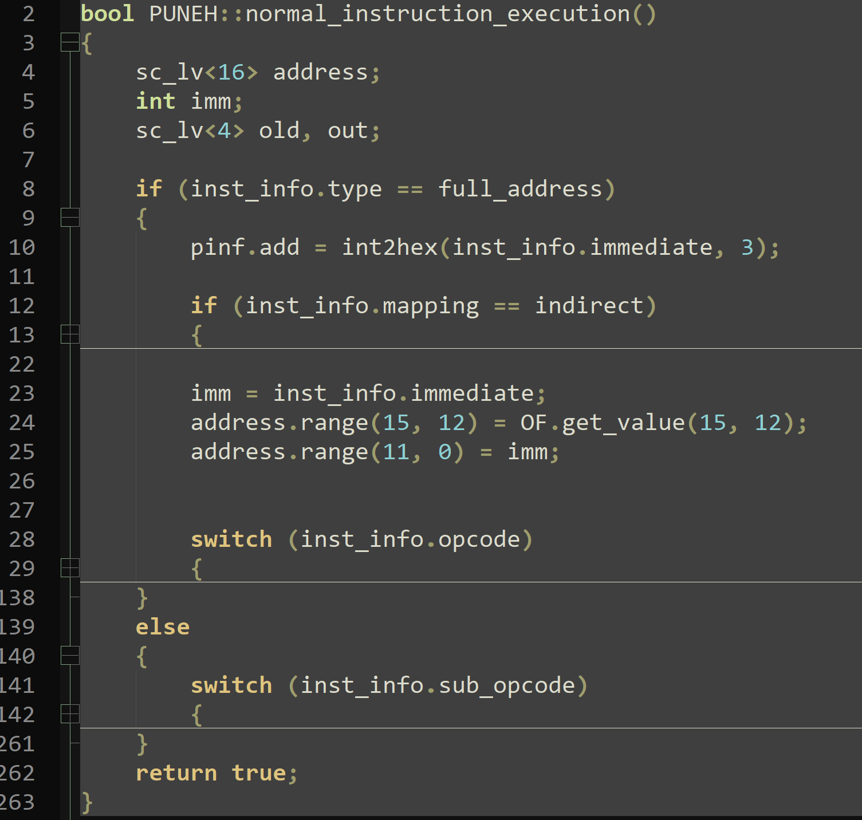
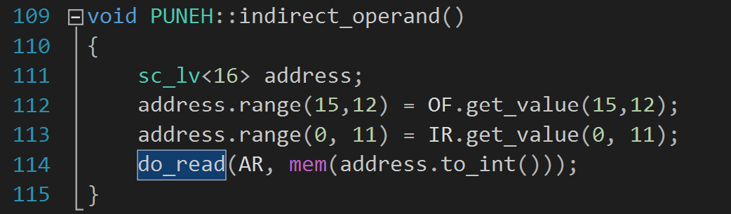
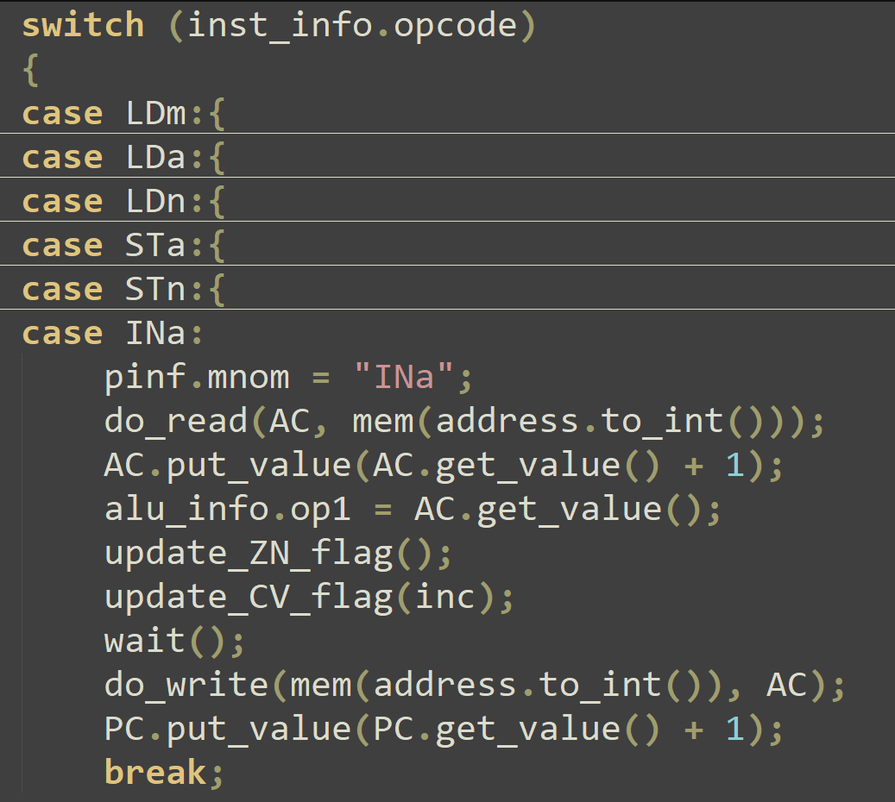
ISS of PUNEH (cont’d)
PUNEH.cpp

Slide 14
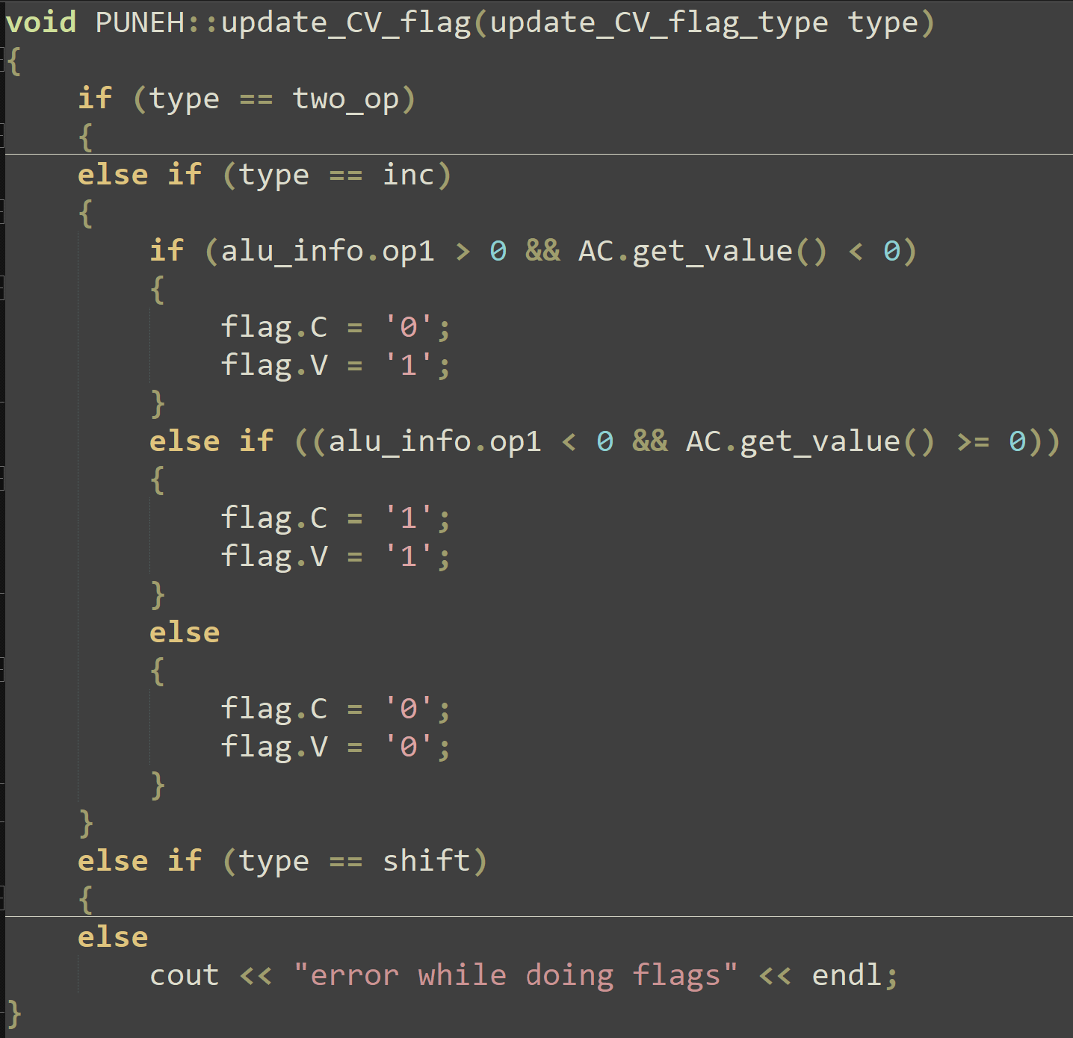
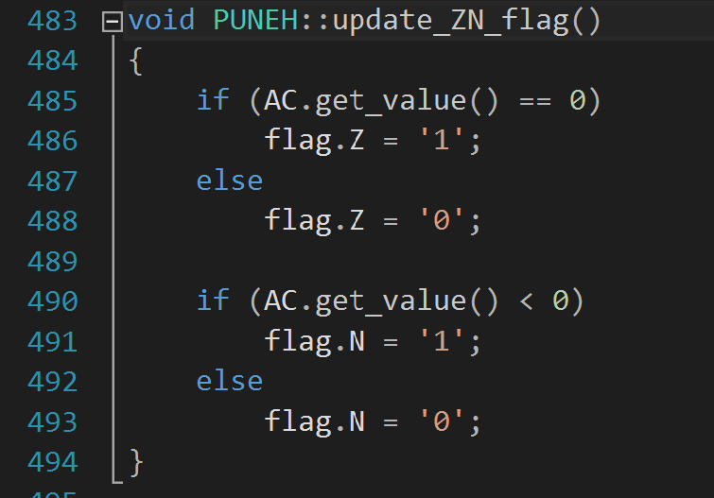
Update Flags
PUNEH.cpp

Slide 15
System

Slide 16
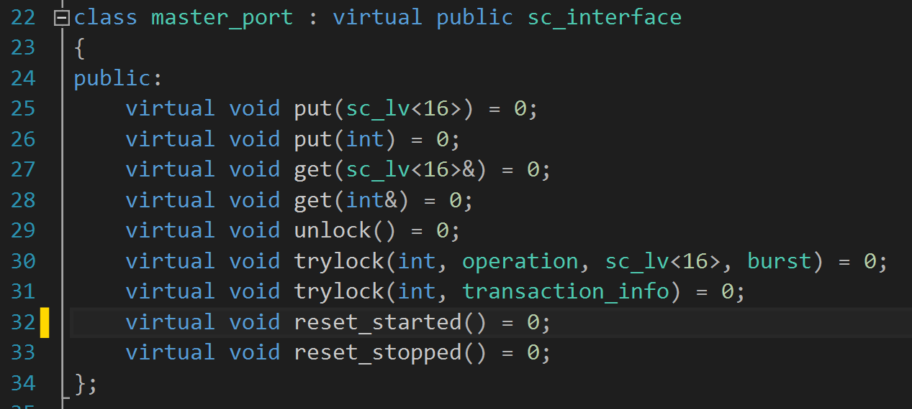
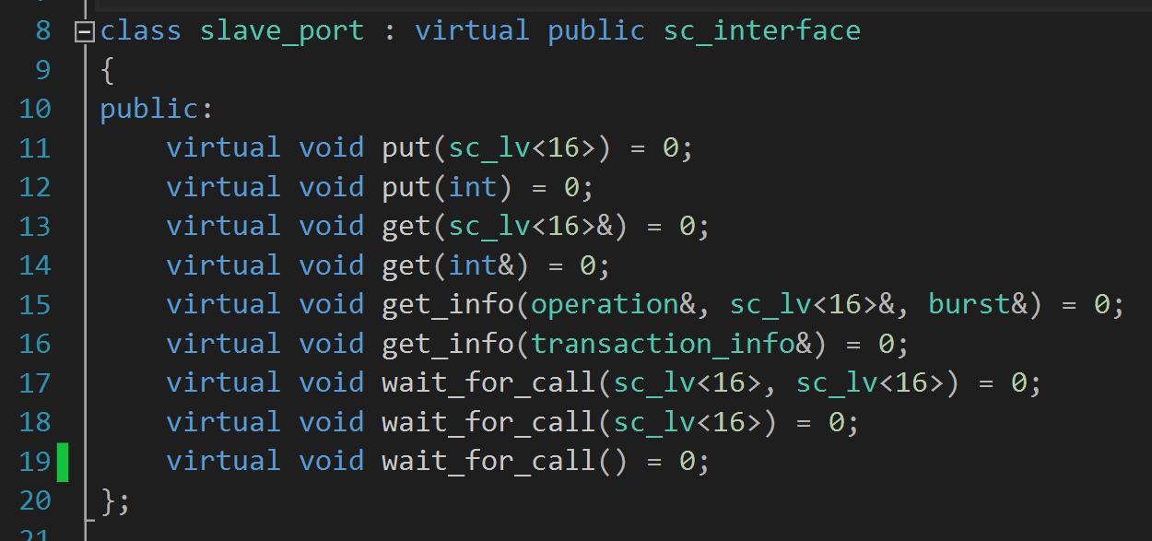
Shared Channel (cont’d)
Master Port
Slave Port
Channel.h

Slide 17
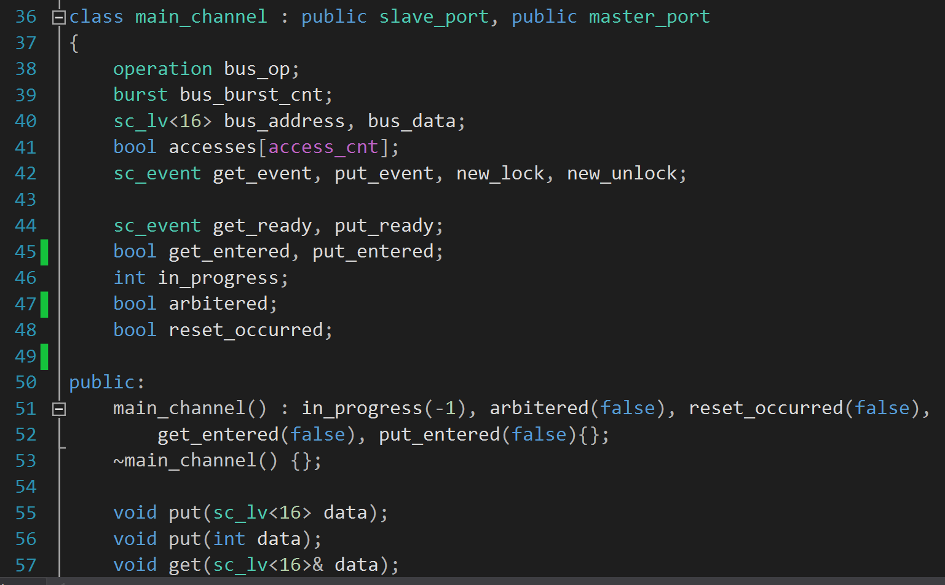
Shared Channel
Main channel
To Arbiture between several Masters
To Ensure that put and get execute concurrently
Channel.h

Slide 18
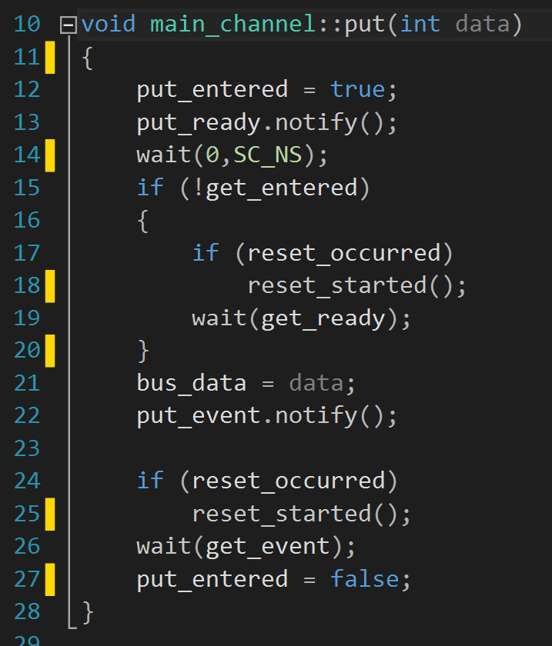
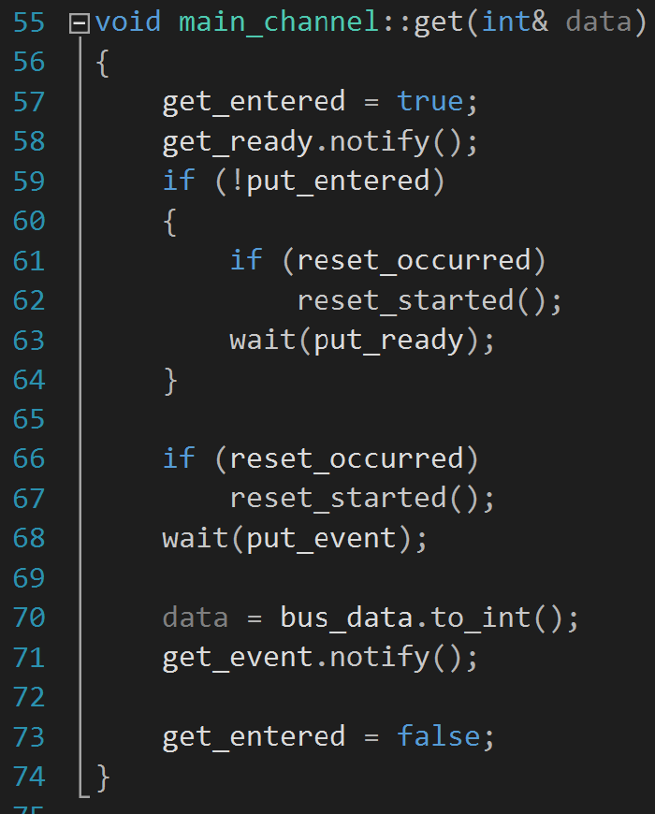
Shared Channel (cont’d)
PUT
GET
Synchronization dialog between Transmitter
& Receiver
Synchronization dialog between Transmitter
& Receiver
At this point, both
Transmitter and
receiver are sync.
Transmitter puts the data on the bus and notifies the put event
Receiver waits for transmitter to put the data on the bus
Tansmitter waits until the receiver gets the data.
Receiver get the data and notifies the Transmitter.
Channel.cpp

Slide 19
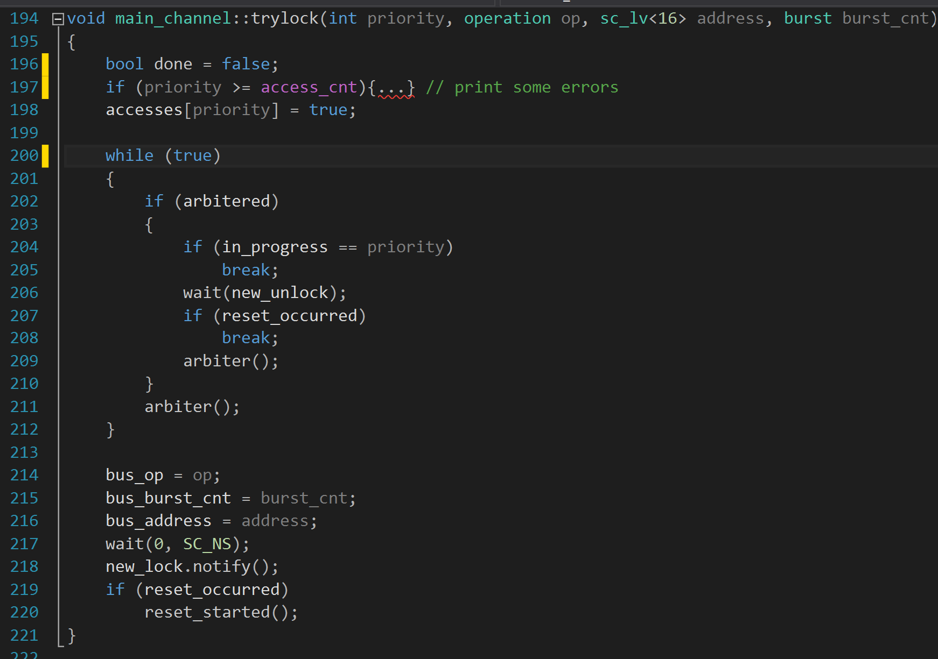
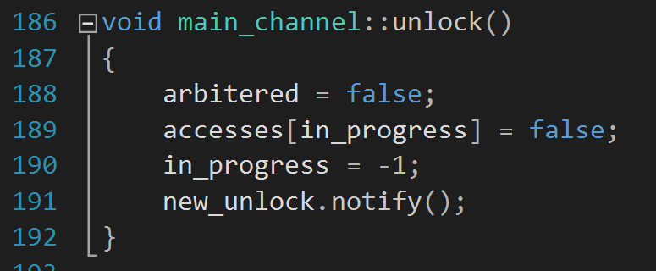
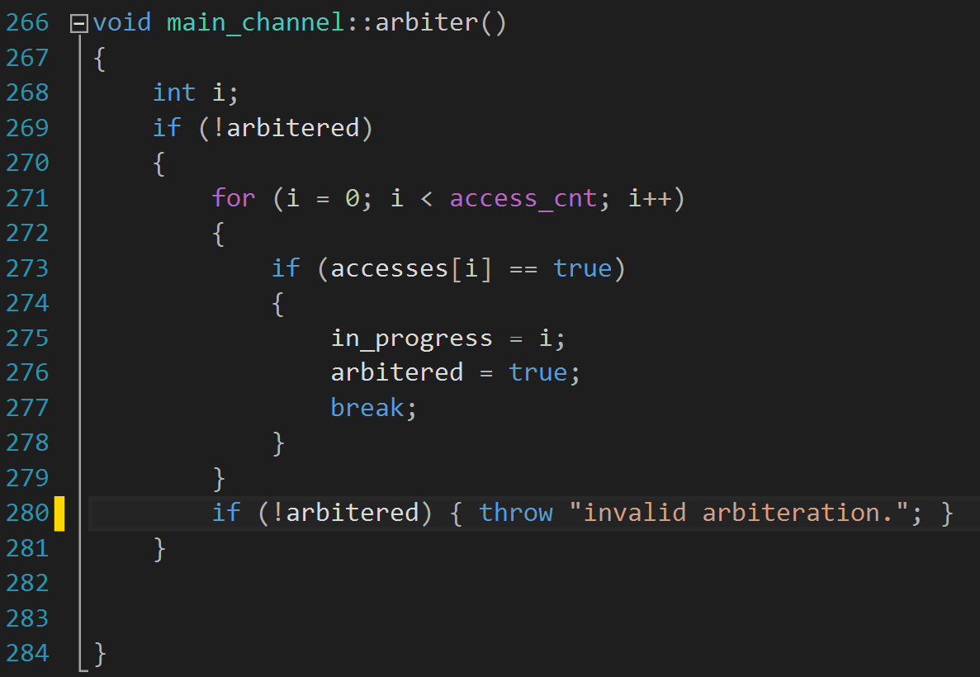
Shared Channel (cont’d)
Channel.cpp

Slide 20
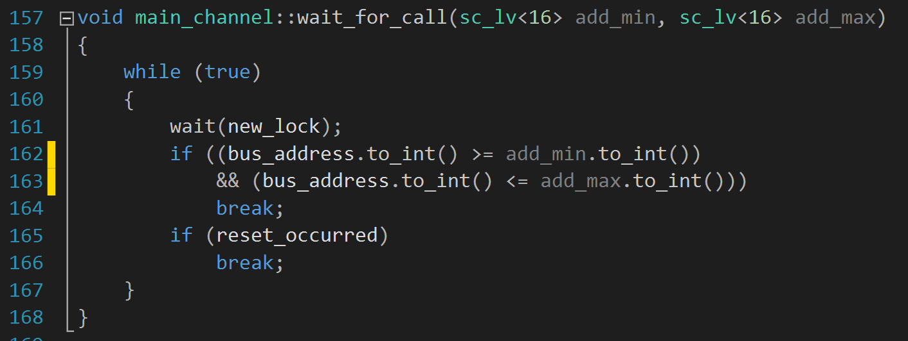
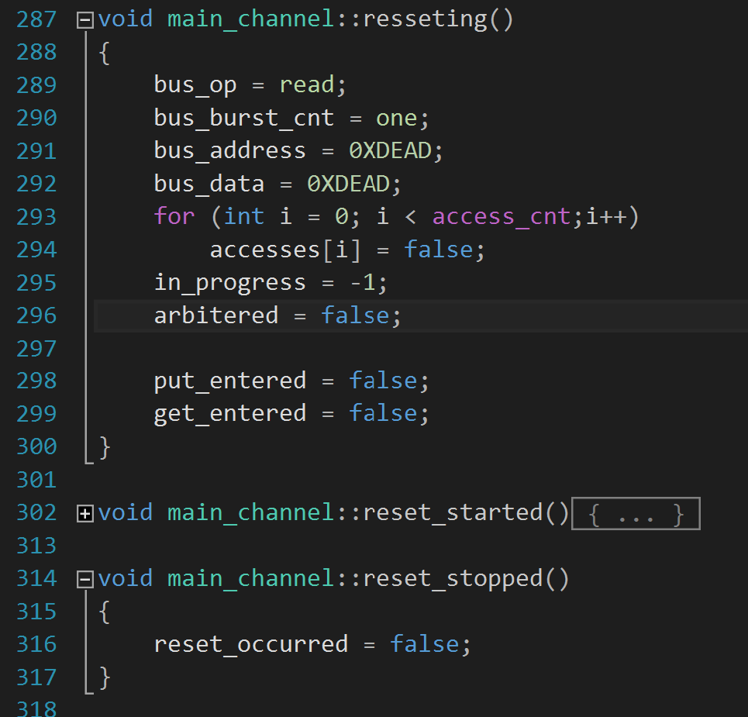
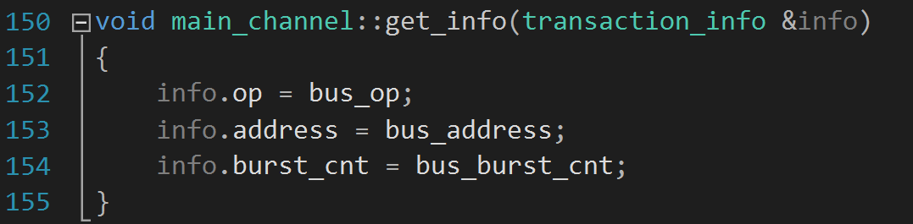
Shared Channel (cont’d)
Channel.cpp

Slide 21
Outline
PUNEH
ISS of PUNEH
Results

Slide 22
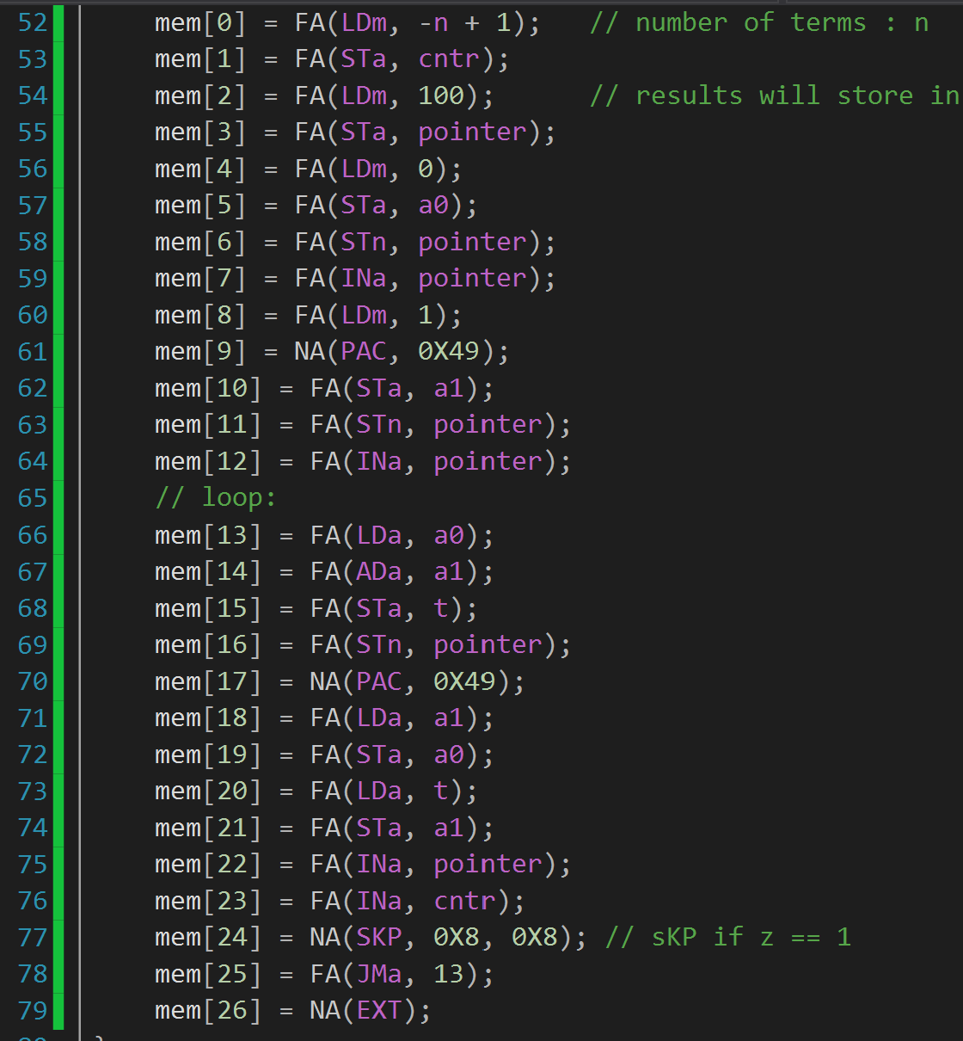
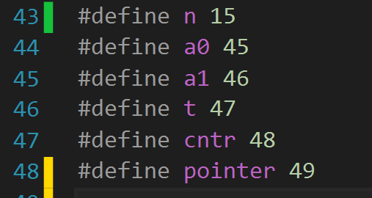
Results
Fibonacci Number
cntr ← -n + 2
pointer ← 64
a0 ← 0
mem[pointer++] ← a0
a1 ← 1
mem[pointer++] ← a1
Loop:
t ← a0 + a1
mem[pointer++] ← t
print(t)
a0 ← a1
a1 ← t
skip if ++cntr == 0
jump to Loop
Exit
n: number of terms
a0, a1, t: variable
pointer: pointer to output location
cntr: term counter

Slide 23
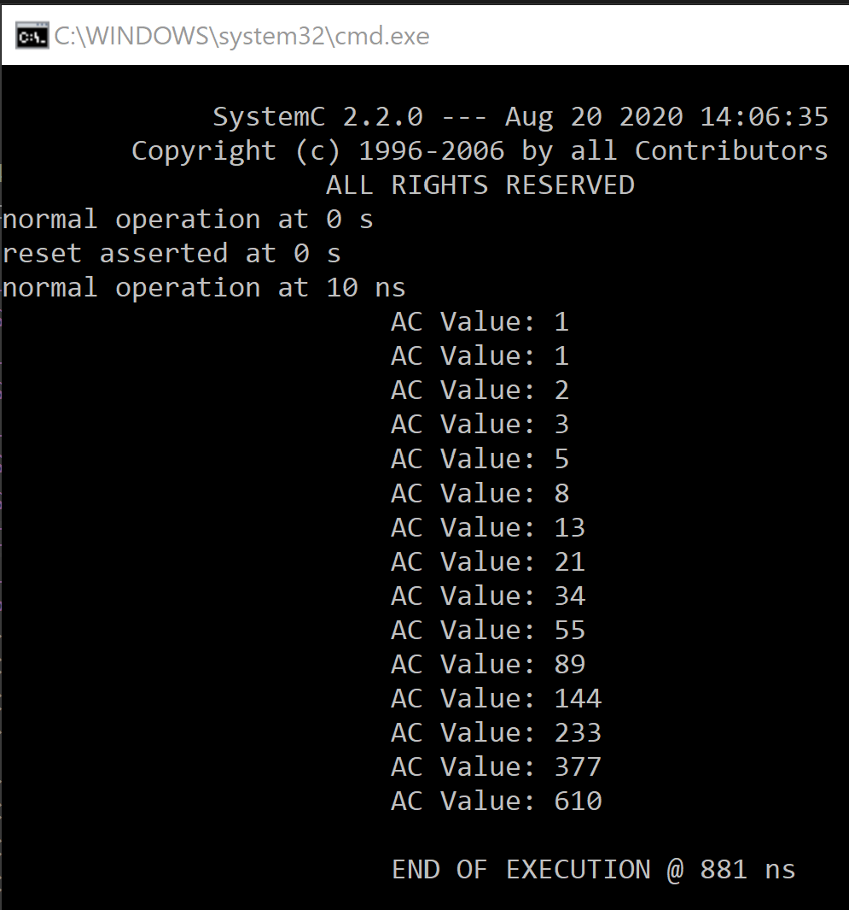
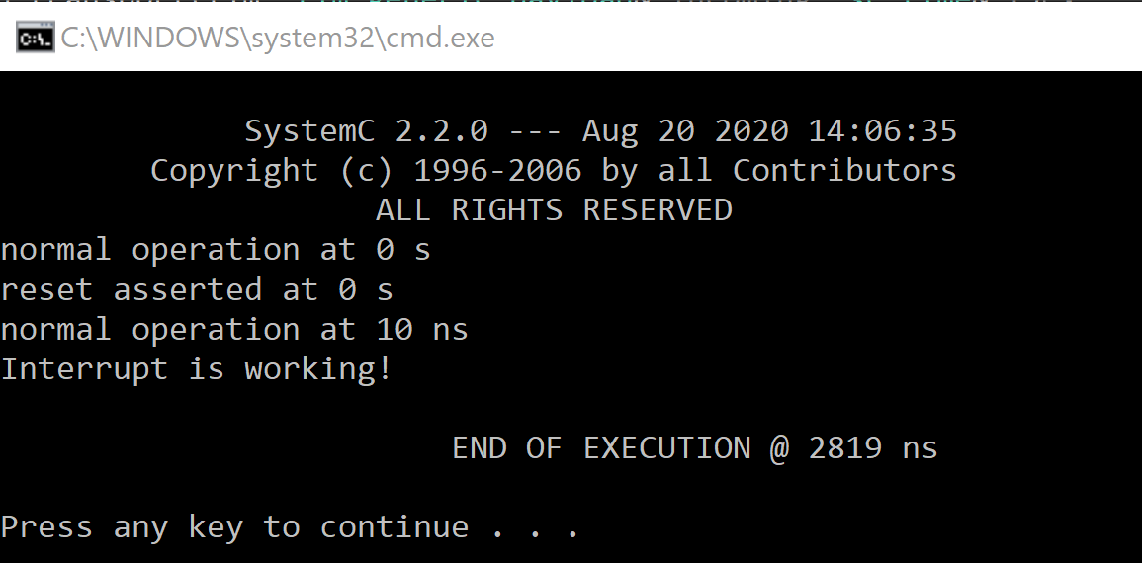
Results (cont’d)
Fibonacci Number
Interrupt

Slide 24

Thank You
Thank You

