Slide 1
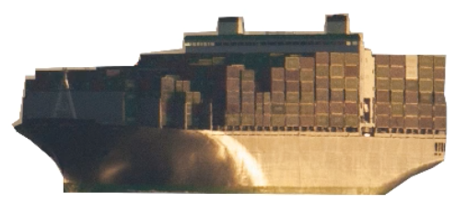
DOCKER

Slide 2
Agenda:
Brief introduction
What is Docker?
Virtualization v/s Containerization
Docker workflow
Build and run a docker image
Build and push docker image into IBM Cloud

Slide 3
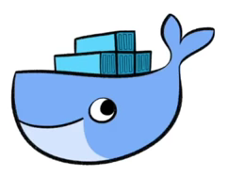
Where does docker operate?
Design
Development
Deployment
Testing
Release

Slide 4
What is docker?
A Docker is an open source platform for containers that provides a lightweight application isolated virtualization that reduces system overhead. It also enables to create, run, and deploy applications as a single package to any kind of environment, without the consideration of differences between build and production environments.

Slide 5
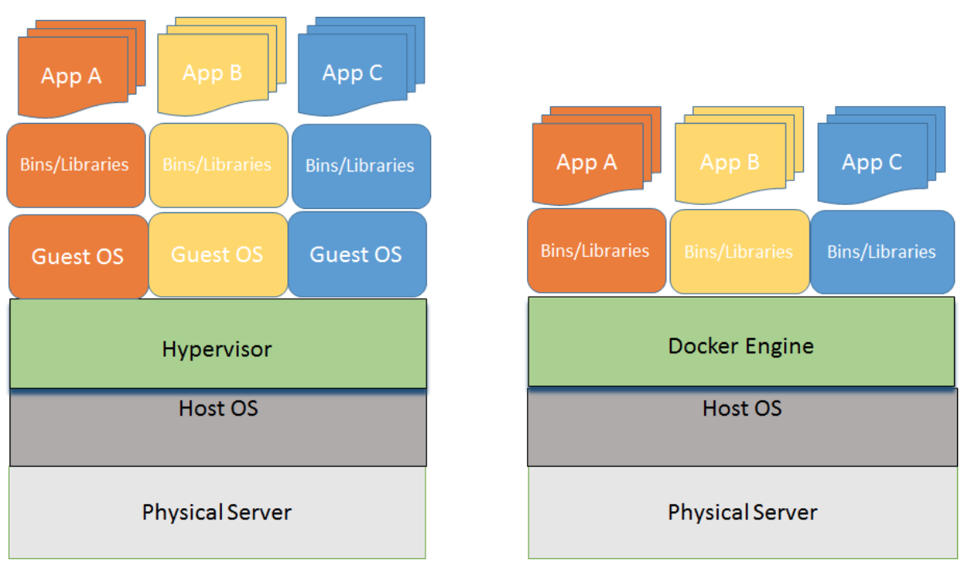
Virtualization v/s containerization

Slide 6
Docker relevance on dev-ops
Developers: The developers need not worry about setting up the specific development environment every time. Instead, they need to focus on building good quality code. This obviously leads to acceleration in the development efforts.
Operations: For IT operations team/Sysadmins, Docker makes it possible to set up environments that are exactly like a production server, and allow anyone to work on the same project with the exact same settings, regardless of the local host environment.

Slide 7
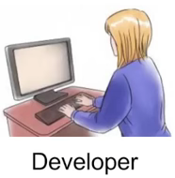

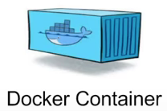
Docker workflow
Docker
Hub
Docker Image
Notes:
A developer defines all the application and dependencies into a Docker file.
This docker file is used to create a docker image.
When we run this docker image, we get a docker container.
Docker containers are runtime instances of a docker image.
This docker images can also be stored in an online repository at Docker hub

Slide 8
Install required tools
Install IBM Cloud tools
console.bluemix.net/docs/cli/index.html#downloads
Install Docker
docker.com (Download and install Docker community edition)
Install Kubernetes tools
kubernetes.io/docs/tasks/tools/install-kubectl/
Download the sample node js application
git clone https://github.com/DougTidwell/dWTVSimpleContainerApp.git
Notes:
Typically for linux variants we can run any of the below command to start docker:
- sudo systemctl start docker
- sudo service docker start

Slide 9
Logging into IBM cloud
Type “bx login” from command line
Install IBM Container Service ” bx plugin install container-service -r Bluemix”
Install IBM Registry Service “bx plugin install container-registry -r Bluemix”
To access docker images in the public registry of IBM Cloud, log into the container registry service “bx cr login”

Slide 10
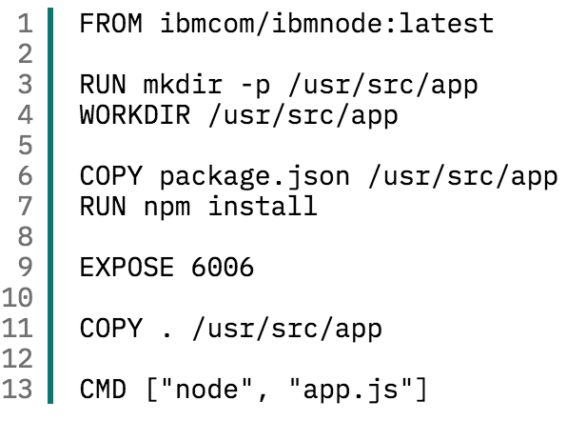
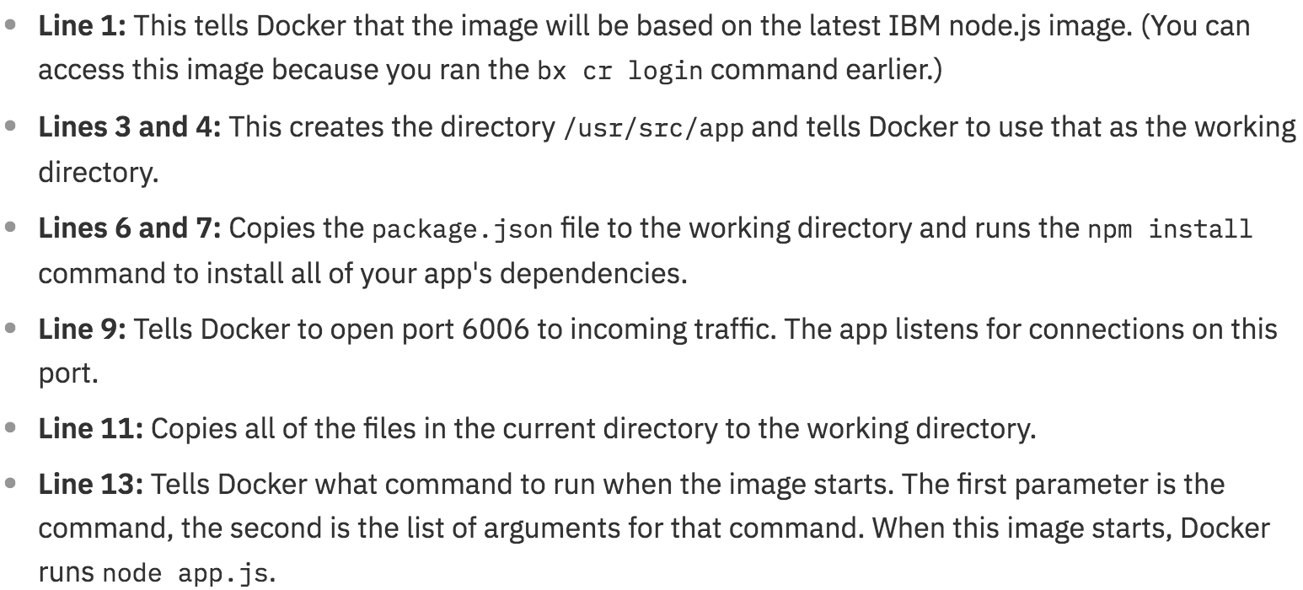
Building a docker image

Slide 11
Running docker image
Step -1: Build the docker image. (docker build -t basicapp:v1 .)
Step -2: Create container from the docker image. (docker create basicapp:v1)
Step -3: Use Kitematic tool for working with containers.

Slide 12
Push docker image into ibm cloud
Step -1: Create a namespace. (bx cr namespace-add meetupdocker)
Step -2: Execute this commands:
docker tag basicapp:v1 registry.ng.bluemix.net/mailbag/basicapp:v2
docker push registry.ng.bluemix.net/mailbag/basicapp:v2
Step -3: Use Kitematic tool for working with containers.

Slide 13
build docker image in ibm cloud
Step -1: Create a namespace. (bx cr namespace-add meetupdocker)
Step -2: Execute this commands:
bx cr build -t registry.ng.bluemix.net/mailbag/basicapp:v1 .
Bx cr build

Slide 14
Important links
Docker file reference https://docs.docker.com/engine/reference/builder/#usage

Slide 15
THANK YOU!!!

