Slide 1


Combinational Logic Design – BCD Adder, Multiplier
Dr. Chandan Karfa
Department of Computer Science and Engineering

Slide 2
Decimal adder
Arithmetic operations directly in the decimal number system represent decimal numbers in binary coded form
An adder for such a computer must employ arithmetic circuits that accept coded decimal numbers and present results in the same code.
A decimal adder requires a minimum of nine inputs and five outputs, since four bits are required to code each decimal digit and the circuit must have an input and output carry
Depends on the code used.

Slide 3
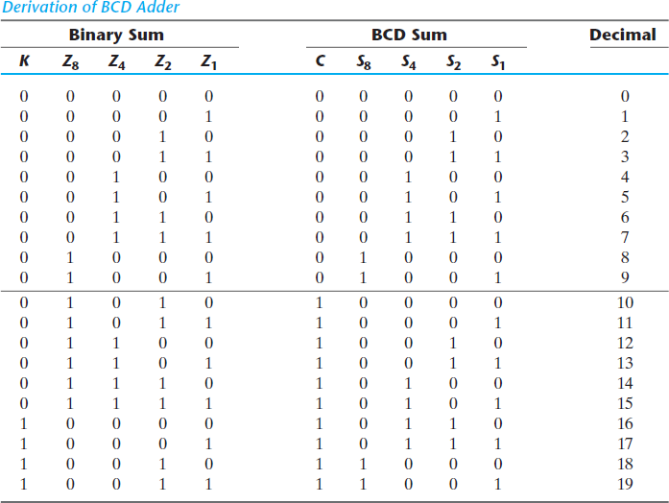
BCD adder
Numbers range 0-9.
Adder results: 0-19 (including input carry)
When the binary sum is equal to or less than 1001, the corresponding BCD number
is identical, and therefore no conversion is needed.
When the binary sum is greater than 1001, the addition of binary 6 (0110) to the binary sum converts it to the correct BCD representation and also produces an output carry as required

Slide 4
BCD Adder
Corrections needed when
K = 1.
The other six combinations from 1010 through 1111 that need
when 1 in position Z8.
To distinguish them from binary 1000 and 1001, which also have a 1 in position Z8, either Z4 or Z2 must have a 1.

Slide 5
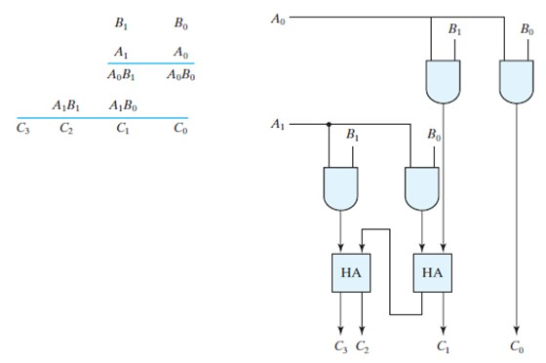
Binary Multiplier
A bit of the multiplier is ANDed with each bit of the multiplicand in as many levels as there are bits in the multiplier.
The binary output in each level of AND gates is added with the partial product of the previous level to form a new partial product.
The last level produces the product.
For J multiplier bits and K multiplicand bits, we need J * K2AND gates and (J – 1) * K bit adders to produce a product of (J + K) bits.
•

Slide 6
Thank You

