Slide 1
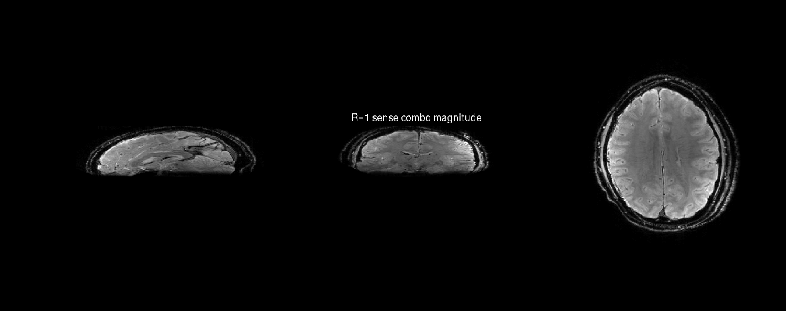
R=1 Normal GRE
1x1x2 mm @ 7T

Slide 2
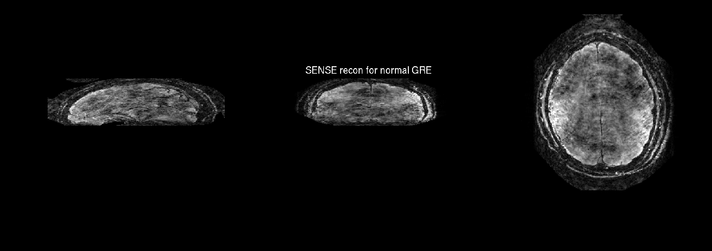
R=4x3 Normal GRE
1x1x2 mm @ 7T

Slide 3

R=1 Wave
1x1x2 mm @ 7T

Slide 4

R=4x3 Wave
1x1x2 mm @ 7T

