Slide 1
Feature Extraction from Face
deep neural network

Slide 2

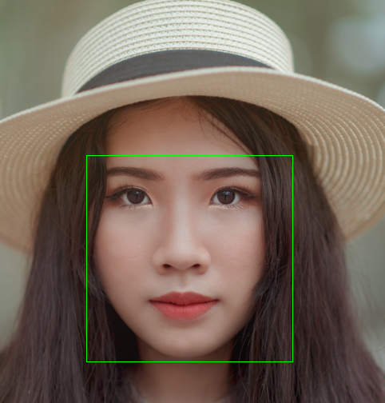

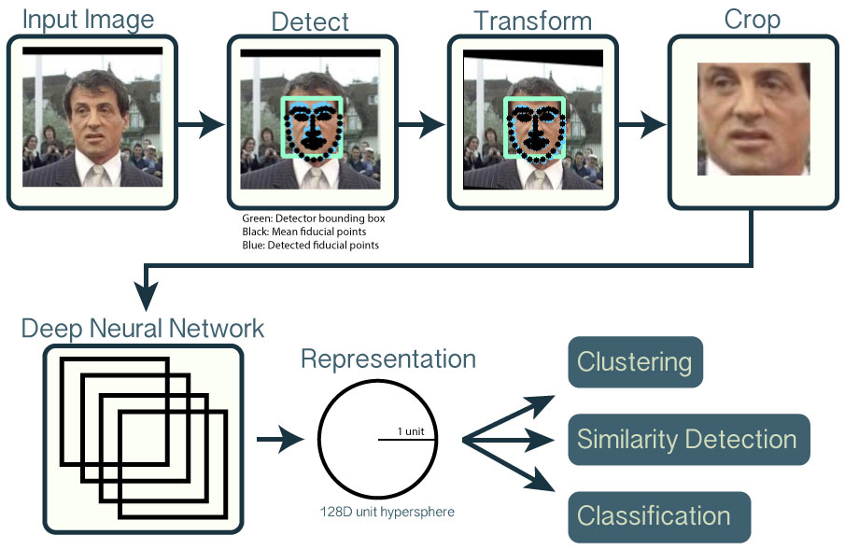
OpenFace Feature Extraction Method
Step-2: Crop
Step-3:
Shape
Predictor
Step-1: Face Detection

Slide 3
OpenFace Feature Extraction Method
Step-1: Face Detection

Slide 4
OpenFace Feature Extraction Method
Step-2: Crop
Step-1: Face Detection

Slide 5
OpenFace Feature Extraction Method
Step-3:
Shape
Predictor
Step-2: Crop
Step-1: Face Detection

Slide 6
OpenFace Feature Extraction Method
Step-2: Crop
Step-3:
Shape
Predictor
Step-1: Face Detection

Slide 7

OpenFace Feature Extraction Method
Step-2: Crop
Step-3:
Shape
Predictor
Step-1: Face Detection

Slide 8
Reference
URL: https://cmusatyalab.github.io/openface/

