Slide 1


Statistic Module End Exam
Topic:- Netflix Data EDA.
Team Members
Krushna Ramlu Chitepwad(21)
Lokesh Vasant Patil(22)
Malkeet Singh Rathod(23)
Mayur Nimrao Bele(24)
Mohit Dasharath Patil(26)

Slide 2
1.Understanding what content is available in different countries 2.Identifying similar content by matching text-based features 3.Network analysis of Actors/Directors and find interesting insights 4.Does Netflix has more focus on TV Shows than movies in recent years.
Problem Statement

Slide 3
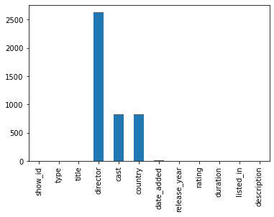
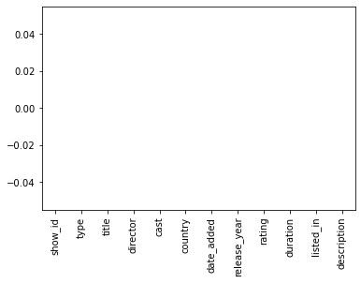
Dealing with Null Values in each columns:- Observation:-Here we can see most of the titles are without director,cast and country we have to deal with the null values. Solution:- Replacing with No values specified

Slide 4
Data is ready to be processed as we have dealt with null values

Slide 5
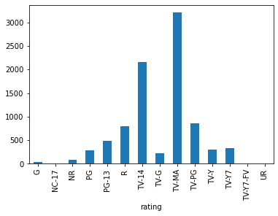
Lets find out distribution of movies on basis of ratings. Grouping by Ratings ratings = netflix.groupby(['rating'])['show_id'].count() We can see most of the movies are TV-MA rated on Netflix. But do we really under stand what these ratings Code stands for.

Slide 6
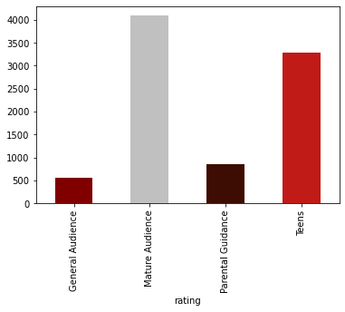
Observation:- We can see most of the movies on Netflix are for Mature Audience followed by Teens.
'TV-PG': 'Parental Guidance',
'TV-MA': 'Mature Audience',
'TV-Y7-FV': 'Teens',
'TV-Y7': 'Teens',
'TV-14': 'Teens',
'R': 'Mature Audience',
'TV-Y': 'General Audience',
'NR': 'Mature Audience',
'PG-13': 'Teens',
'TV-G': 'General Audience',
'PG': 'Teens',
'G': 'General Audience',
'UR': 'Mature Audience',
'NC-17': 'Mature Audience' .

Slide 7
We Know Netflix has expertise in customer engagement. Thus a question arrives that Does Netflix has more TV shows or Movies?
Lets check what data says

Slide 8
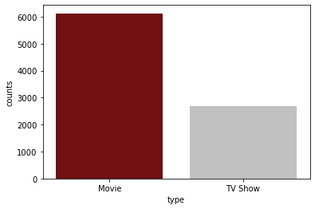
Plotting bar plot of count of Movies and TV Show realeased on Netflix till now sns.barplot(data=type1,x='type',y='counts',palette="Set2") Observation:- As we observed that till date there are more Movies than TV shows on Netflix lets us check that whether this trend changed in recent years

Slide 9
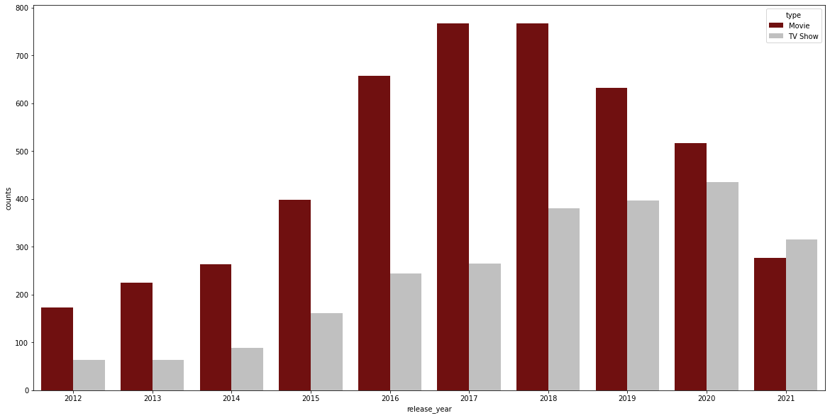
Distribution of Releases per year on Netflix: #Grouping based on release year releases = netflix.groupby(by=['release_year','type']).size().reset_index(name='counts') Last 2-3 years says a different story lets see closely

Slide 10
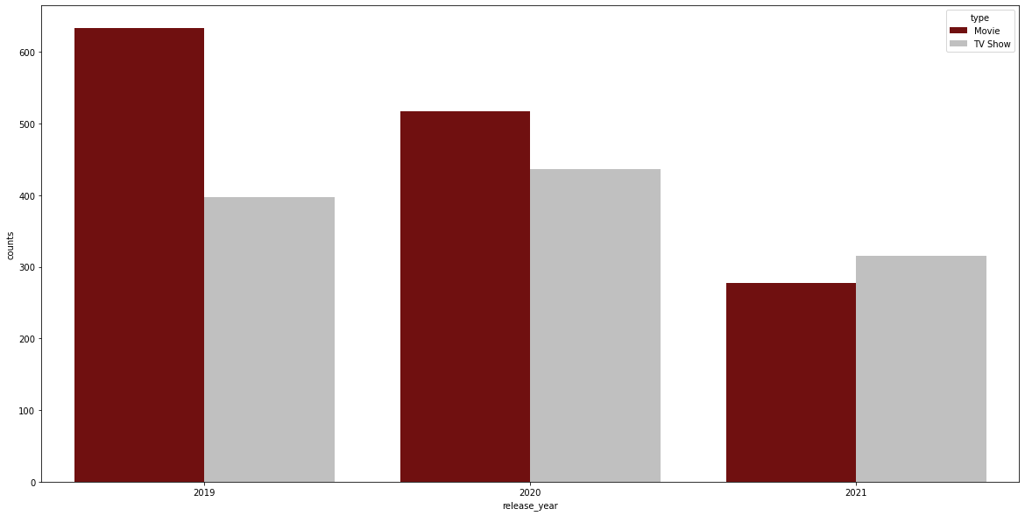
As we can see that from past 2-3 years TV shows and Movies are equally released on Netflix. In year 2021 TV shows counts surpasses the Movies count and we can see changing trends. We have realized that TV shows are more engaging than movies thus Netflix should emphasis more on TV-shows

Slide 11
Now we Know that TV show gained equal importance now Let us understand what content is available in different countries

Slide 12
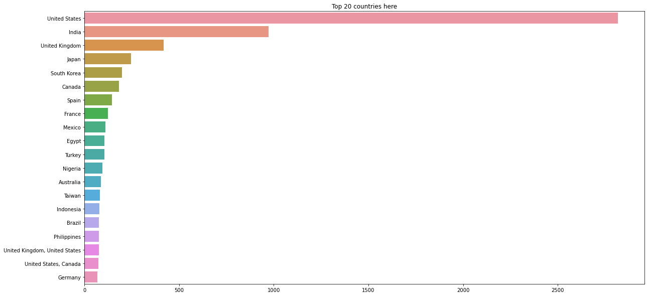
Country Wise content Distribution count = netflix['country'].value_counts().sort_values(ascending = False) sns.barplot(x = head20.values, y = head20.index)
Observation:-USA,India,UK,Japan,South Korea
are highest content producer on Netflix

Slide 13
Lets see how is Country-wise distribution on basis of Type of content
Dividing contents on basis of TV Show and Movies and plotting for countries.
#Movie Genres Analysis
movies = netflix[netflix['type'] == 'Movie']
movie_country = movies.groupby(by=['country'])['title'].size().reset_index(name='counts').sort_values(by='counts',ascending = False).head(30)
#TV Show Genres Analysis
tvshow = netflix[netflix['type'] == 'TV Show']
tvshow_country = tvshow.groupby(by=['country'])['title'].size().reset_index(name='counts').sort_values(by='counts',ascending = False).head(30)

Slide 14
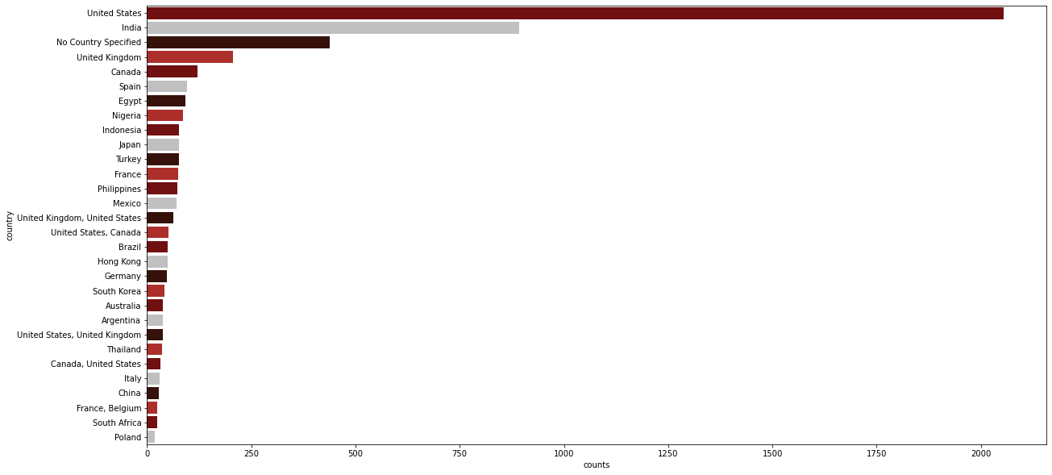
Movie Genre Country Wise sns.barplot(data=movie_country,y='country',x='counts')
Observation:- USA produces most movies followed by India

Slide 15
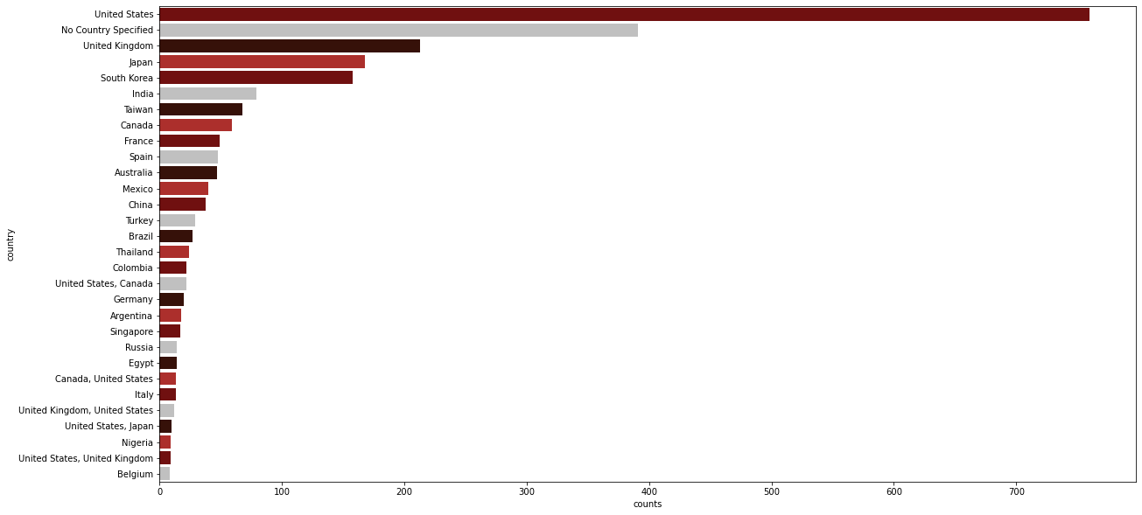
TV Show Genre Country Wise sns.barplot(data=tvshow_country,y='country',x='counts')
Observation:- USA produces most TV Show
Followed by UK

Slide 16
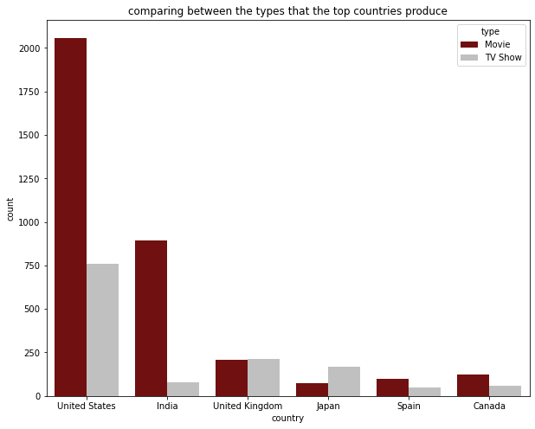
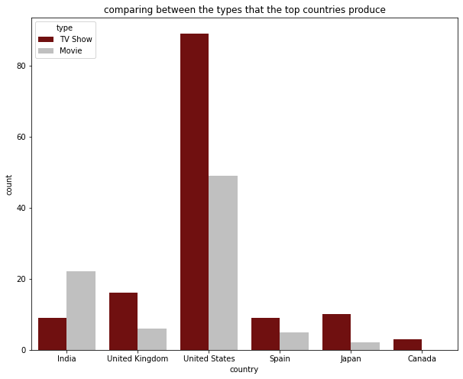
Like we know Trend changed in year 2021 let us see how tally works country wise
Observation:- In year 2021 count of TV Show increased in Most of the Countries

Slide 17
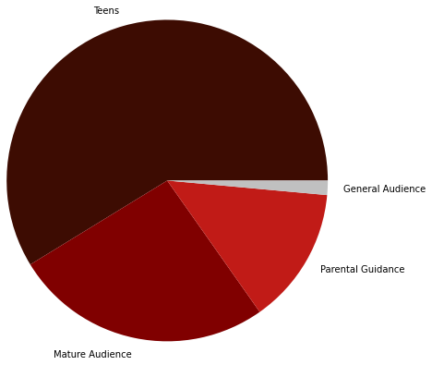
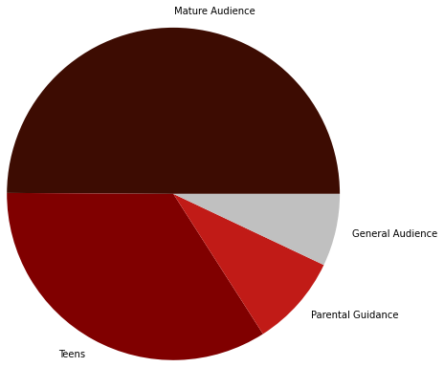
Lets check which Country has most viewers from which age group Observation:-Here we can see Mature Audience are most viewers of Netflix in USA where as in India, Teens are most viewers
India
USA

Slide 18
Let us check network analysis of Actors/Directors and find some interesting insights Finding Out who all are top 5 Director and What made them come on this list Finding Out who all are top 5 Actor which movies they worked in.

Slide 19
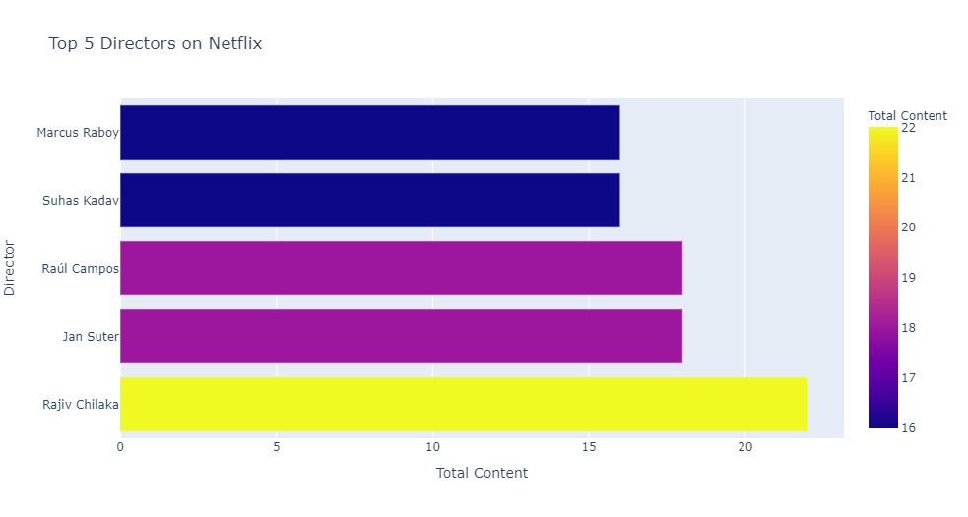
Top 5 Director on Netflix. Mr. Rajiv Chilaka who directed our beloved animation show “Chota Bheem” has topped this list.

Slide 20
So who do you think toped the Actors list?
1.He is Indian
2.He Has Appeared in More than 500 Films
3. Las Vegas Dedicated a Day to the Star
4. He played lead role in biopic of our former Prime Minister.
5. He was part of major hit films like DDJL, Hum aapke hai kaun.
No he is Not Shah Rukh Not Salman he is……………………

Slide 21
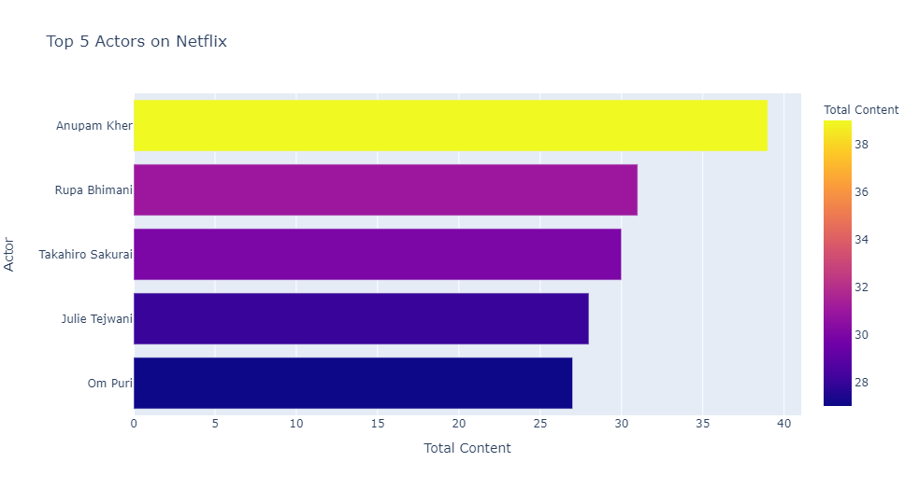
Top 5 Actor on Netflix. Anupam Kher appeared in 39 of Netflix Movies and TV Show

Slide 22
Conclusion
In the above exlopratory data analysis, we focused and analysed on the following topics:
Distribution of content type(Movie or TV Show) throughout past years and we saw change on trend in recent years.
Analysis on different contents bearing different ratings.
Popularity of top 5 directors, and actors in different content types
Popularity of top 15 countries

