Slide 1
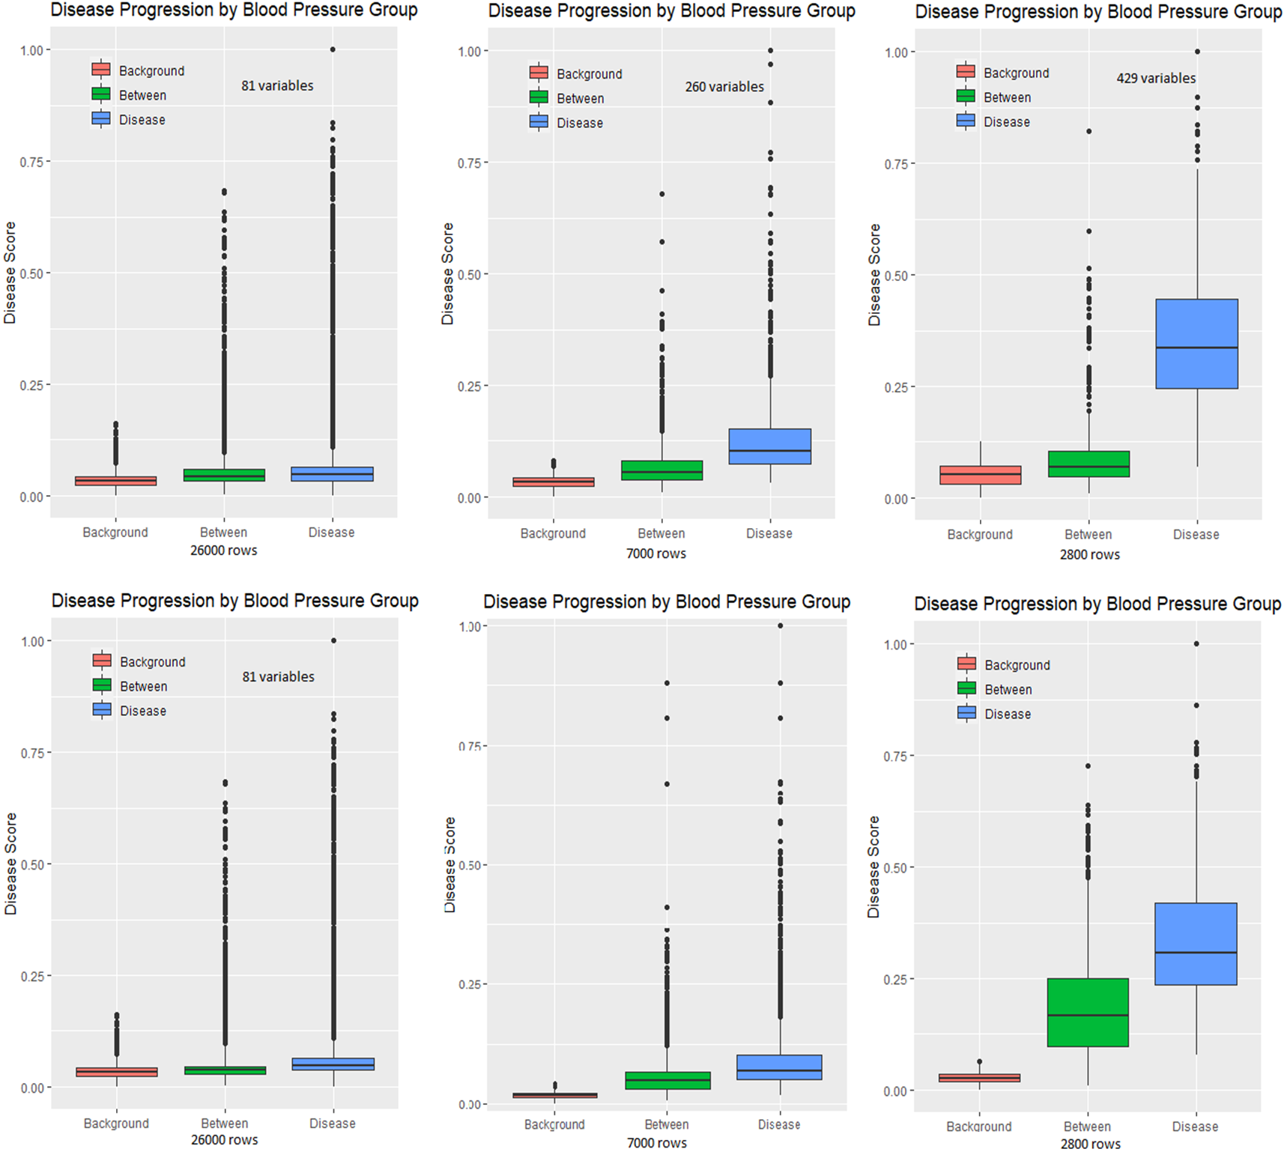
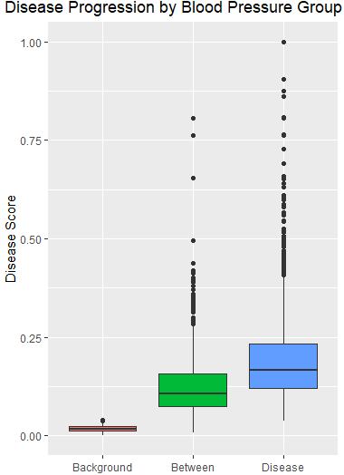
160/100
140/80
4900 rows (17.5%)

Slide 2
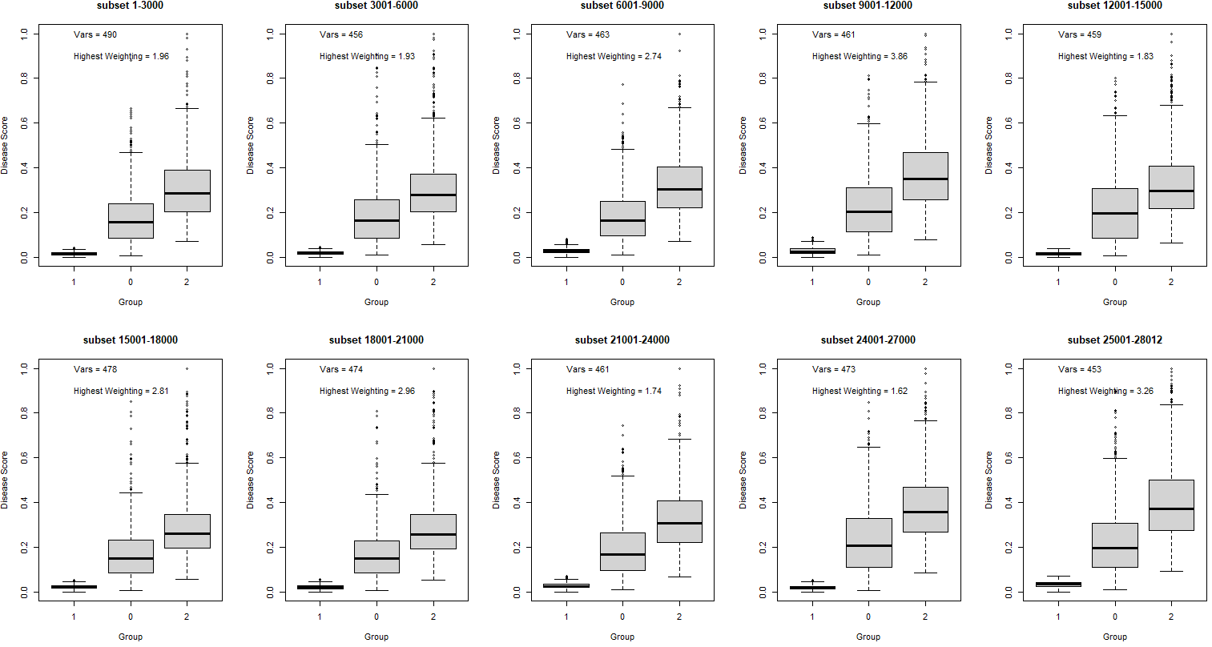
All 10 combination of 10% subset runs

Slide 3
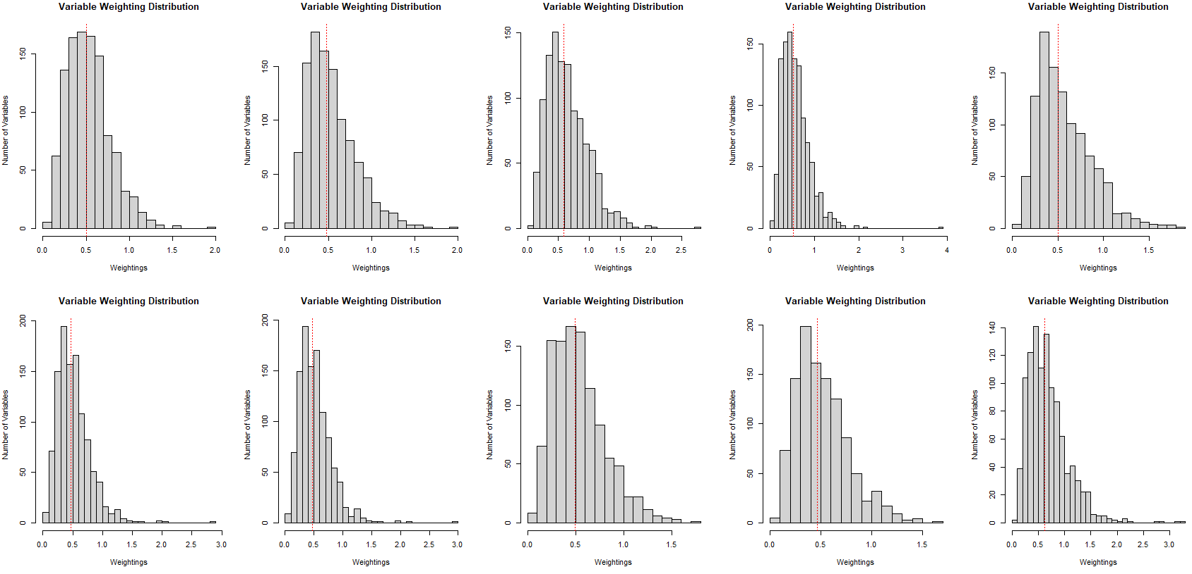
All 10 combination of 10% subset runs – variable weighting distribution

Slide 4
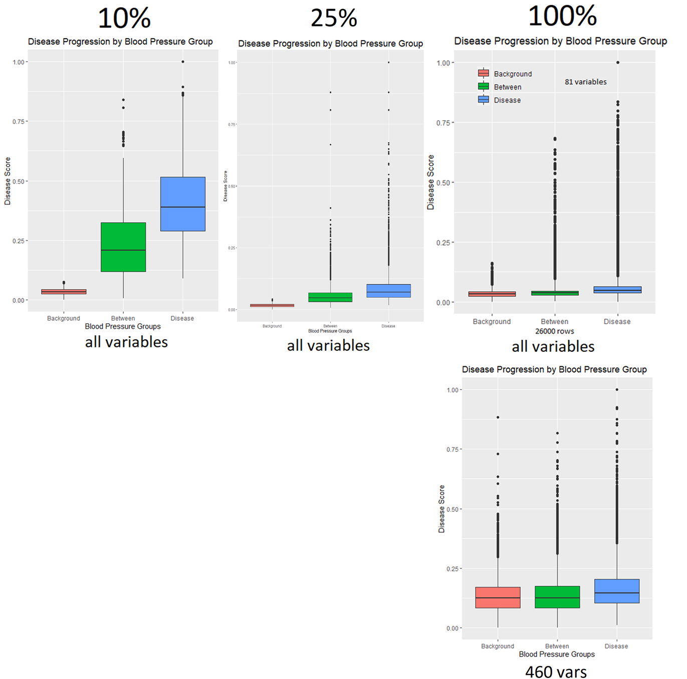
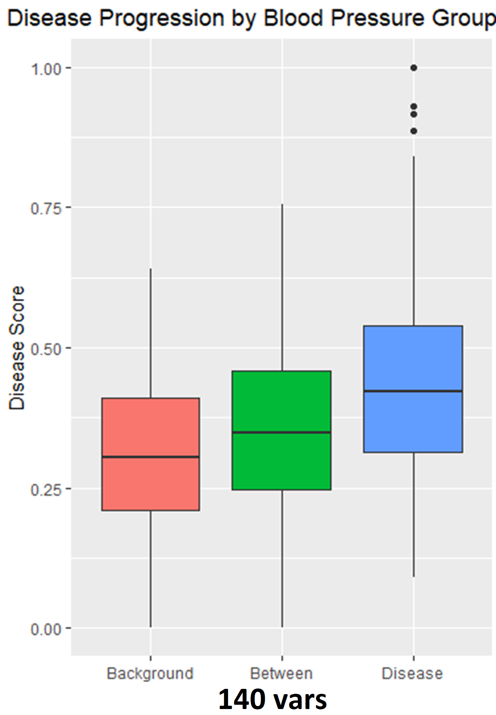
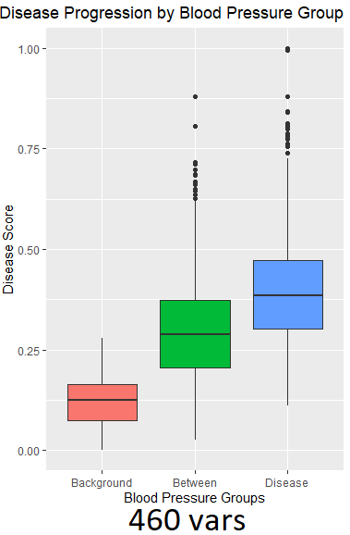
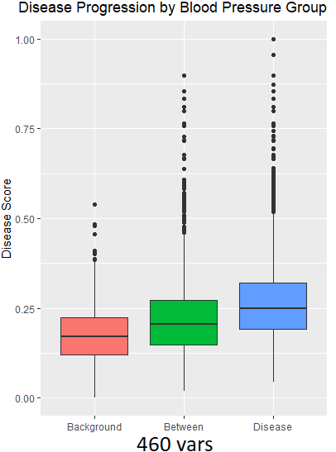
Runs when changing the number of variables (columns) inputted into the model with different subsets (rows)

Slide 5
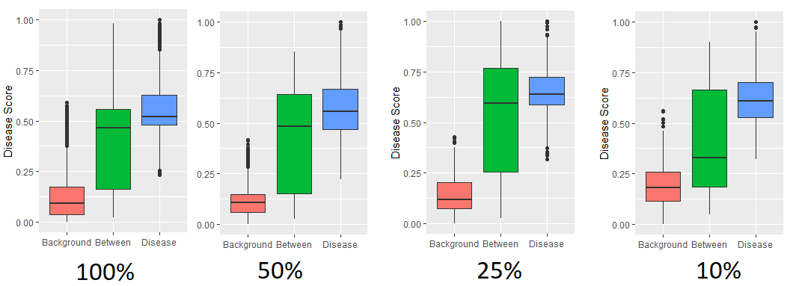
Runs on subsets of dataset (rows) when only using blood pressure (dia & sys) as inputs into the model

Slide 6
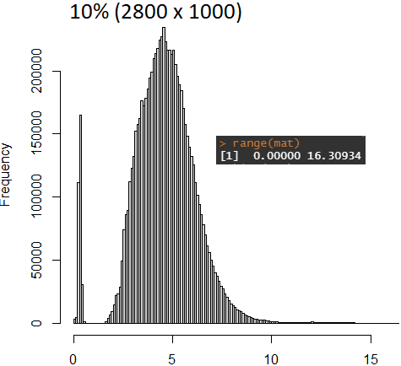
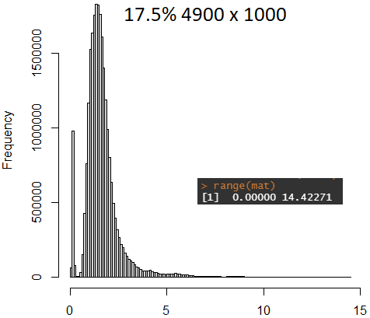
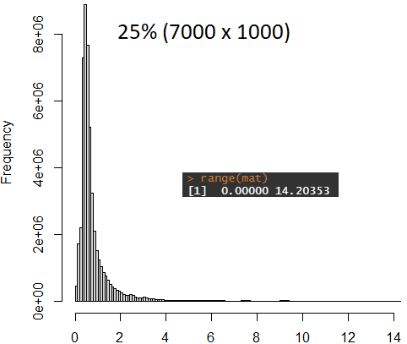
Distribution of values in distance matrix used for MST/shortest path trajectory calculation

