Slide 1
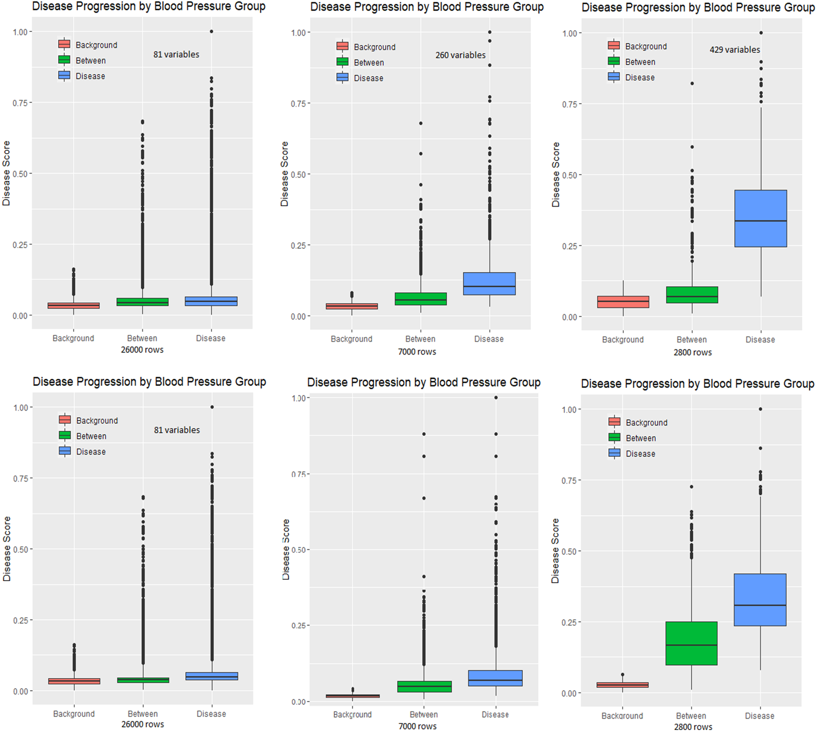
160/100
140/80

Slide 2
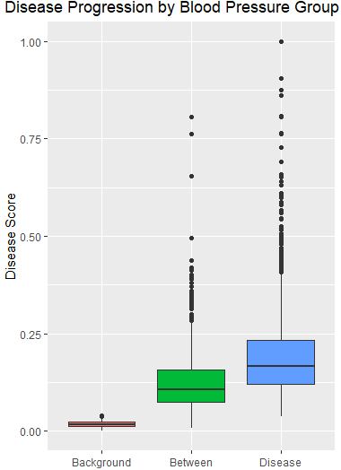
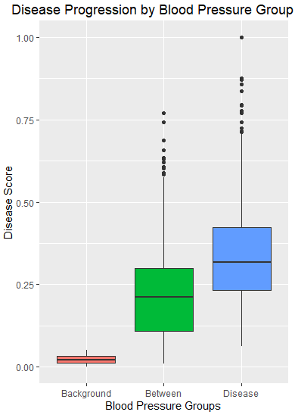
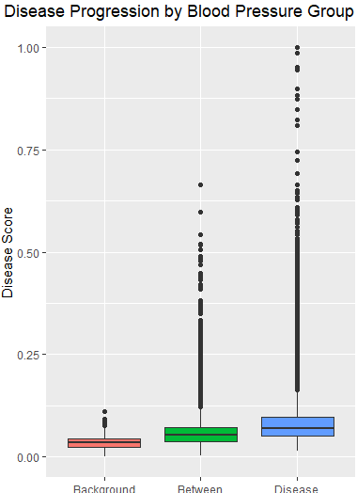
Target: >140/80
28000 rows (100%)
7000 rows (25%)
4900 rows (17.5%)
3500 rows (12.5%)
2800 rows (10%)
9300 rows (33.3%)

Slide 3
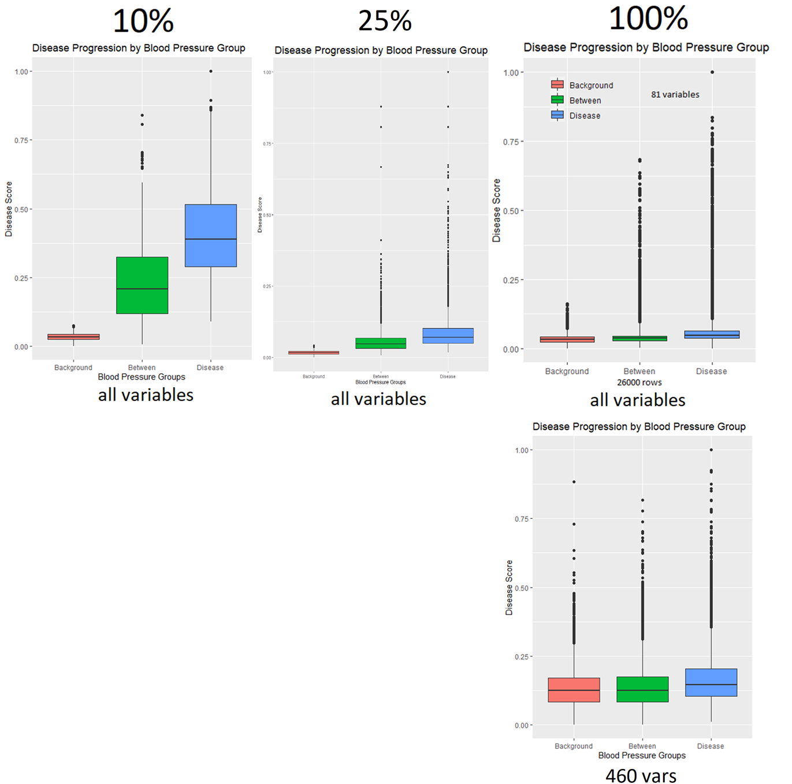
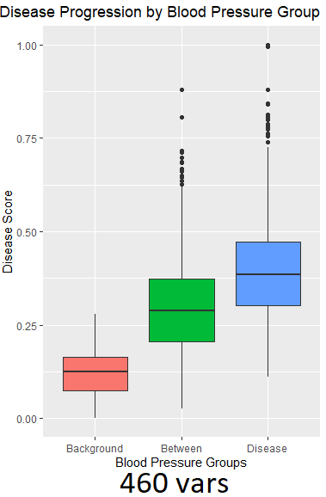
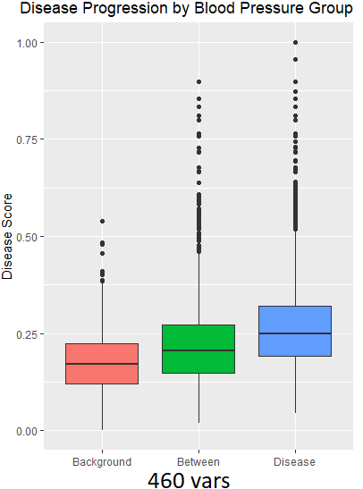
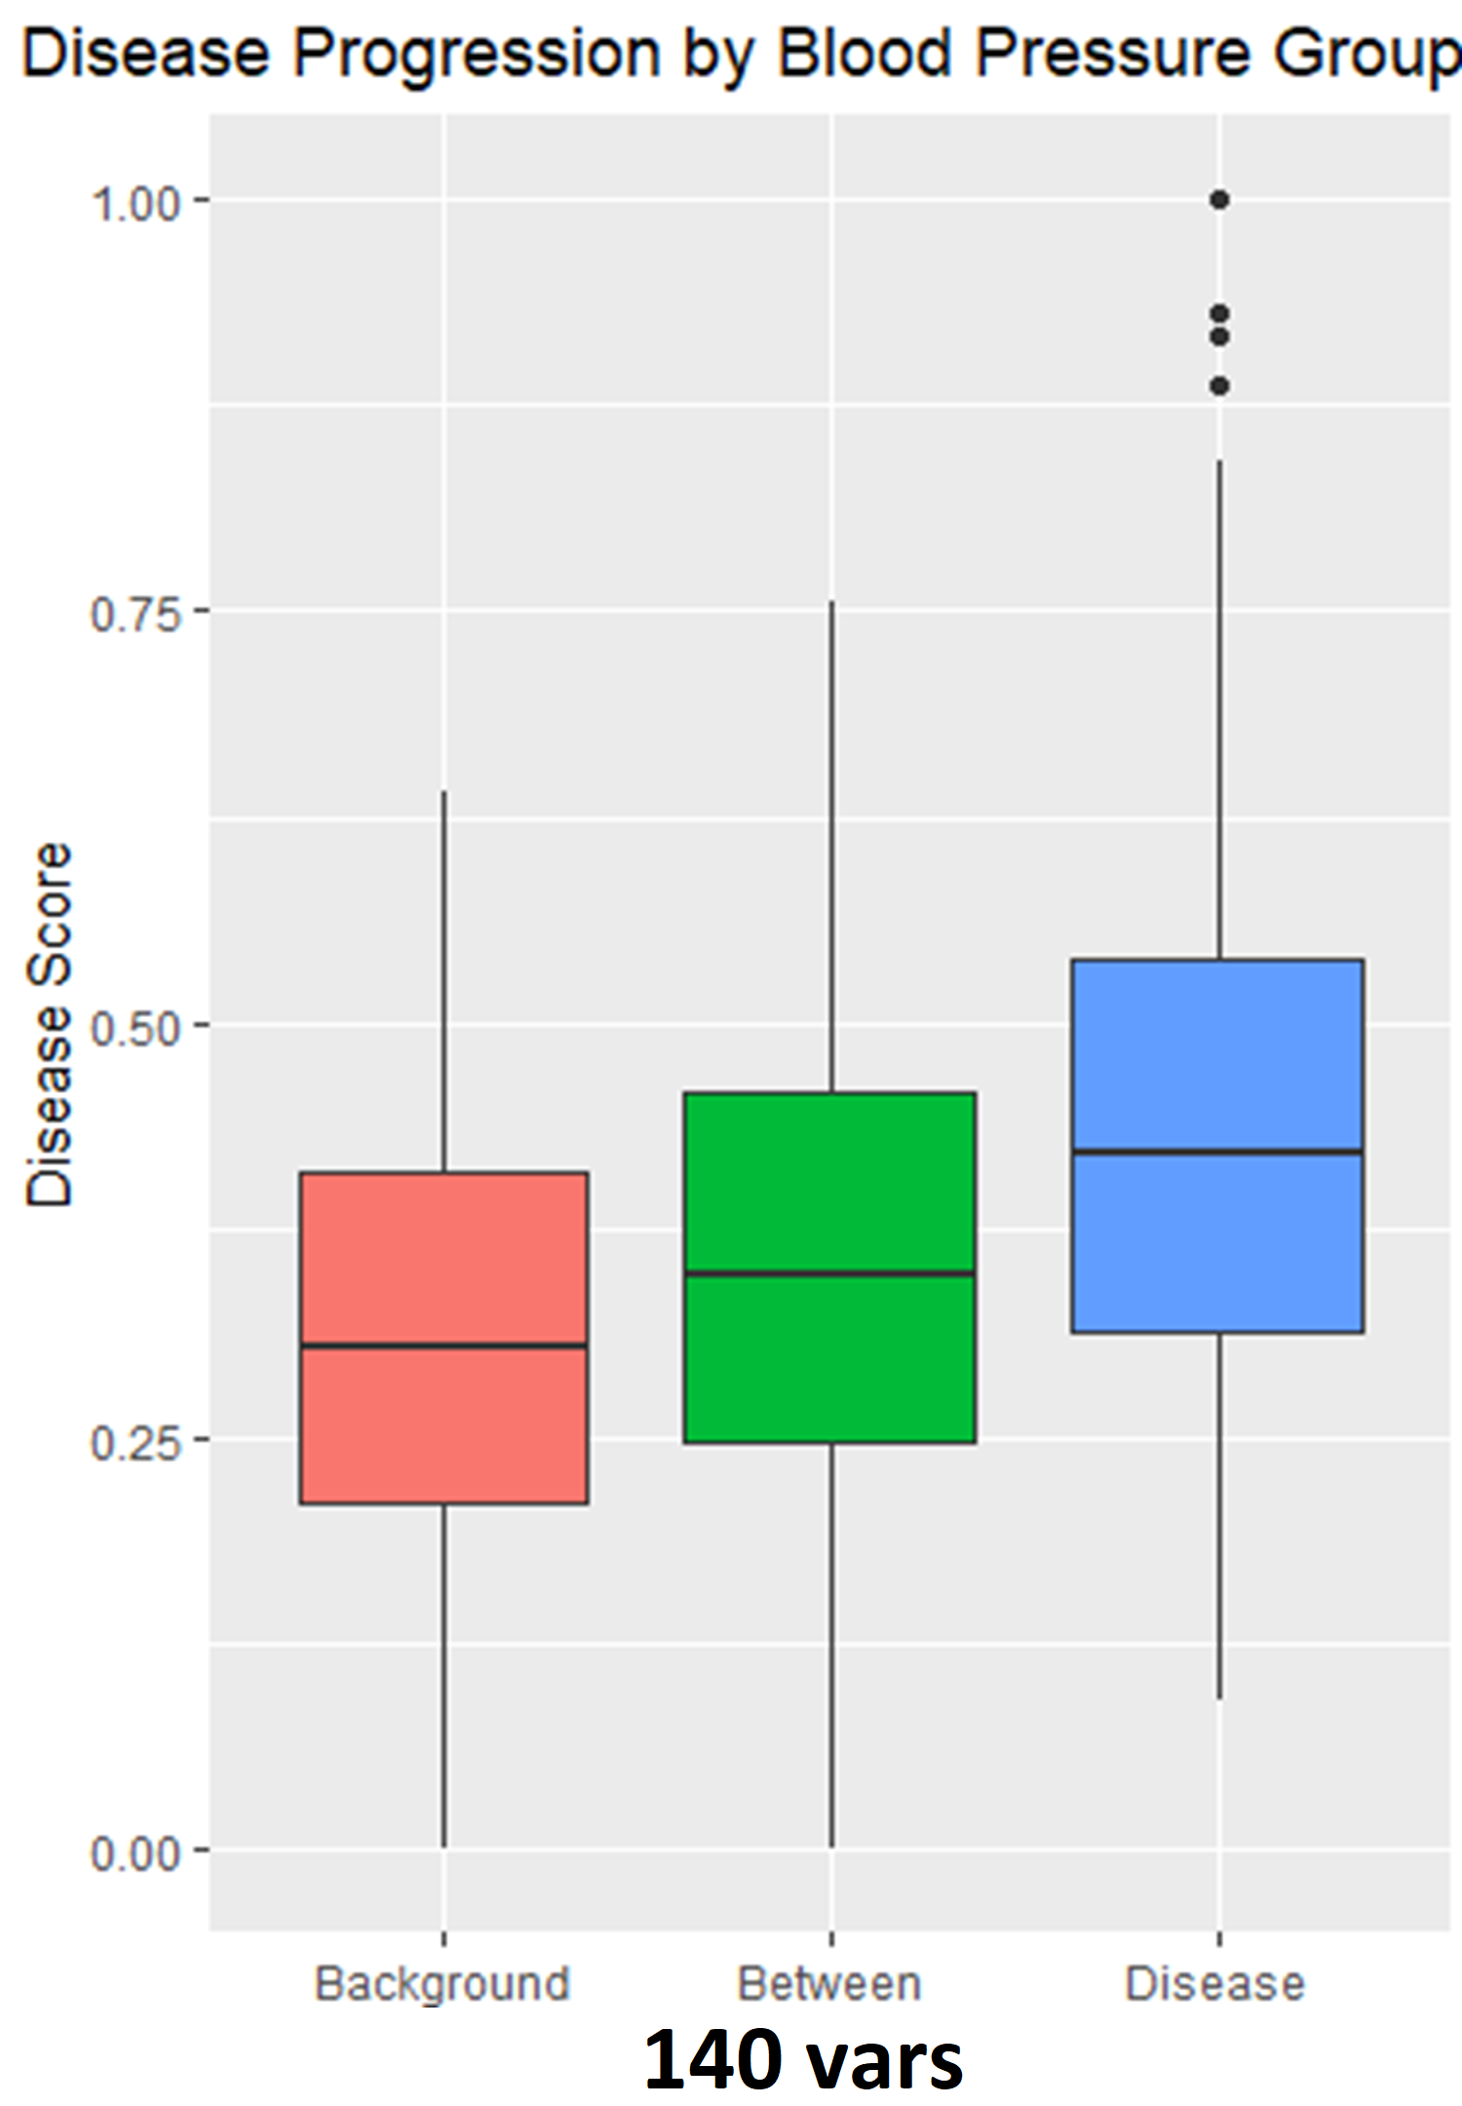
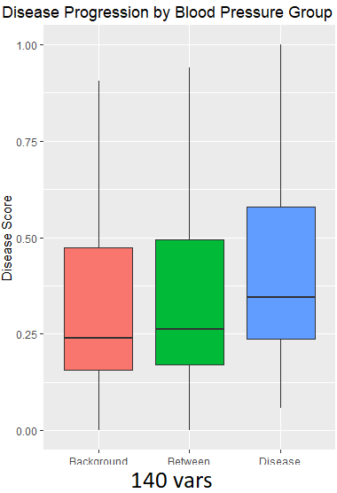
Runs when changing the number of variables (columns) inputted into the model with different subsets (rows)

Slide 4
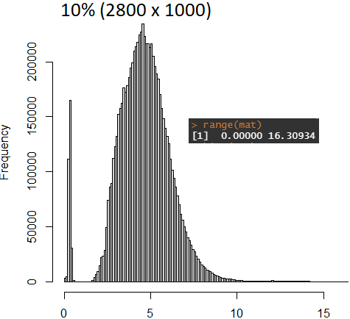
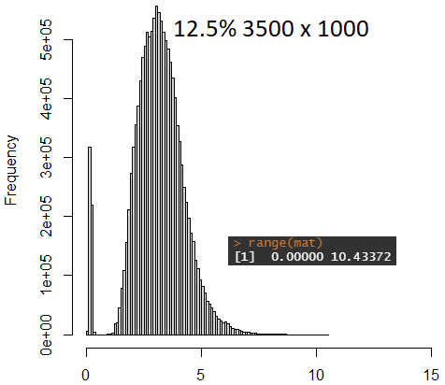
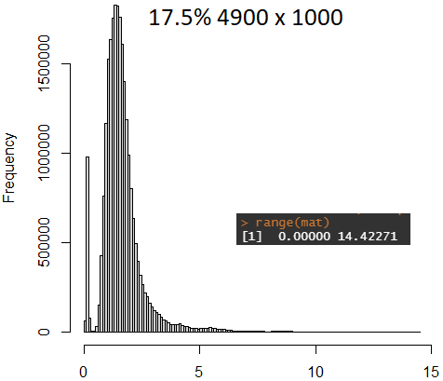
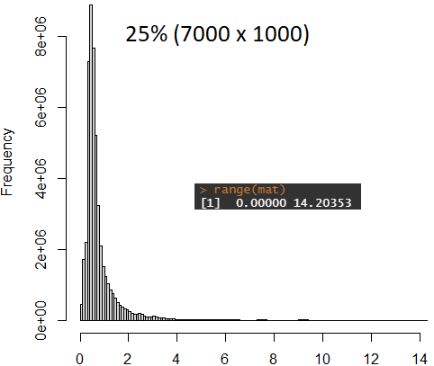
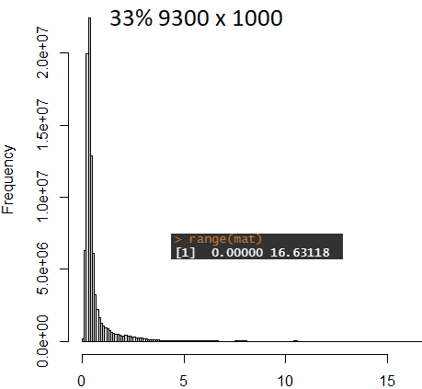
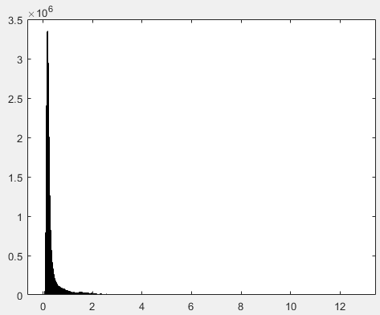
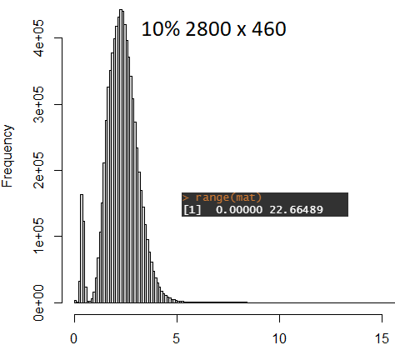
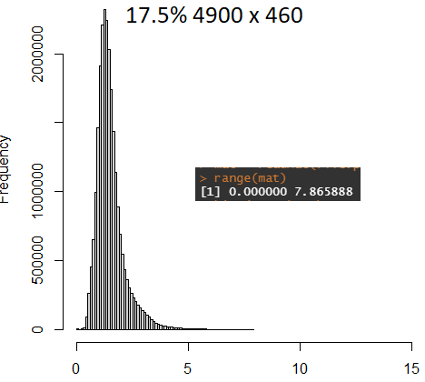
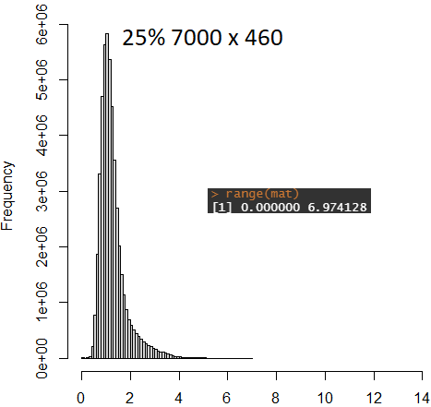
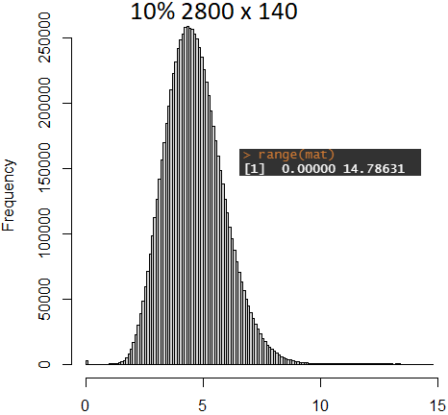
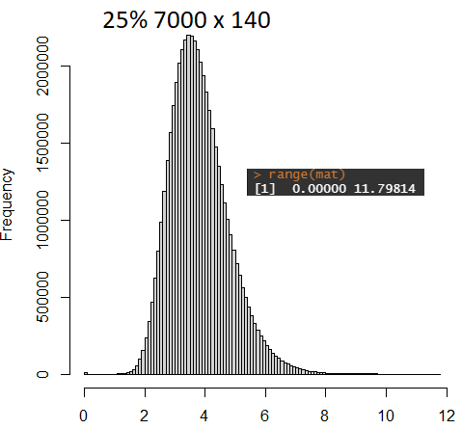
Distribution of values in distance matrix used for MST/shortest path trajectory calculation

Slide 5
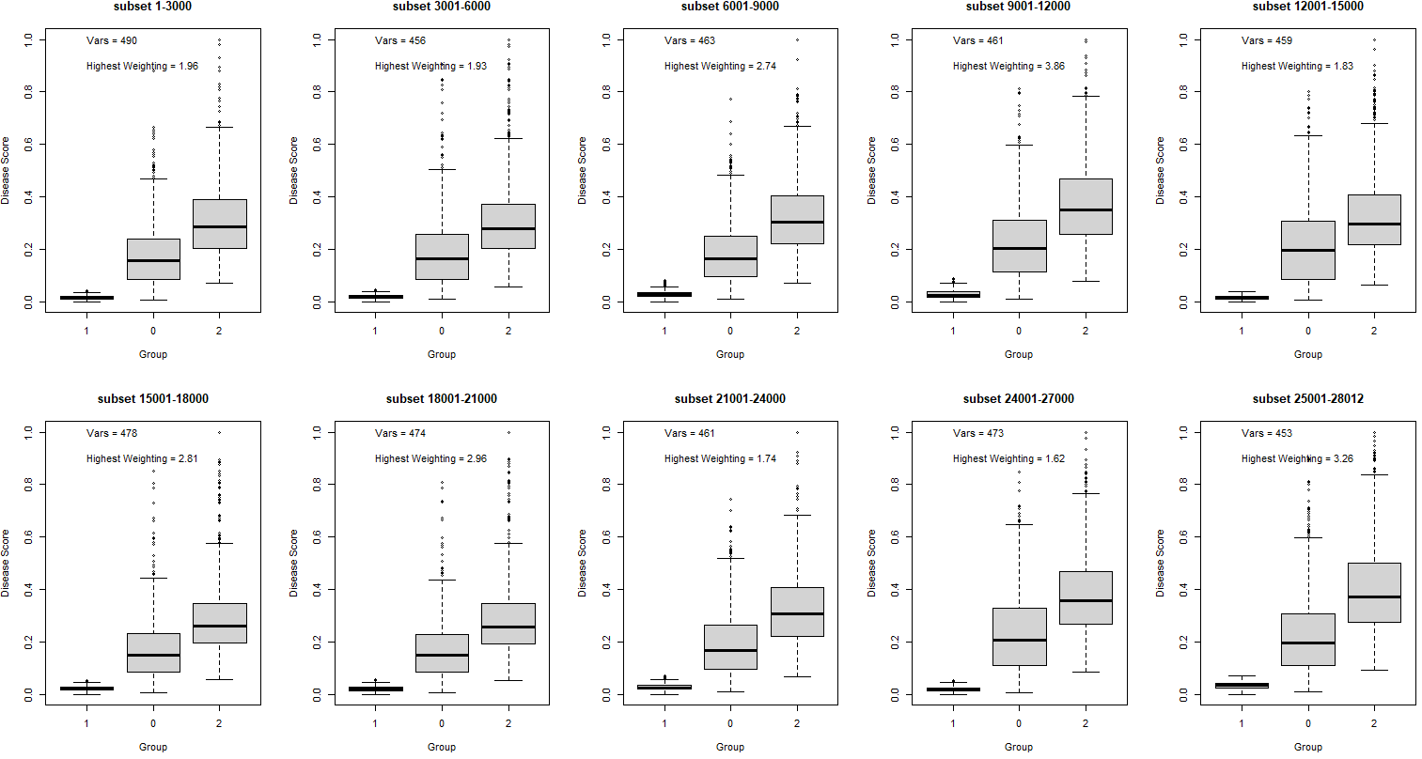
All 10 combination of 10% subset runs

Slide 6
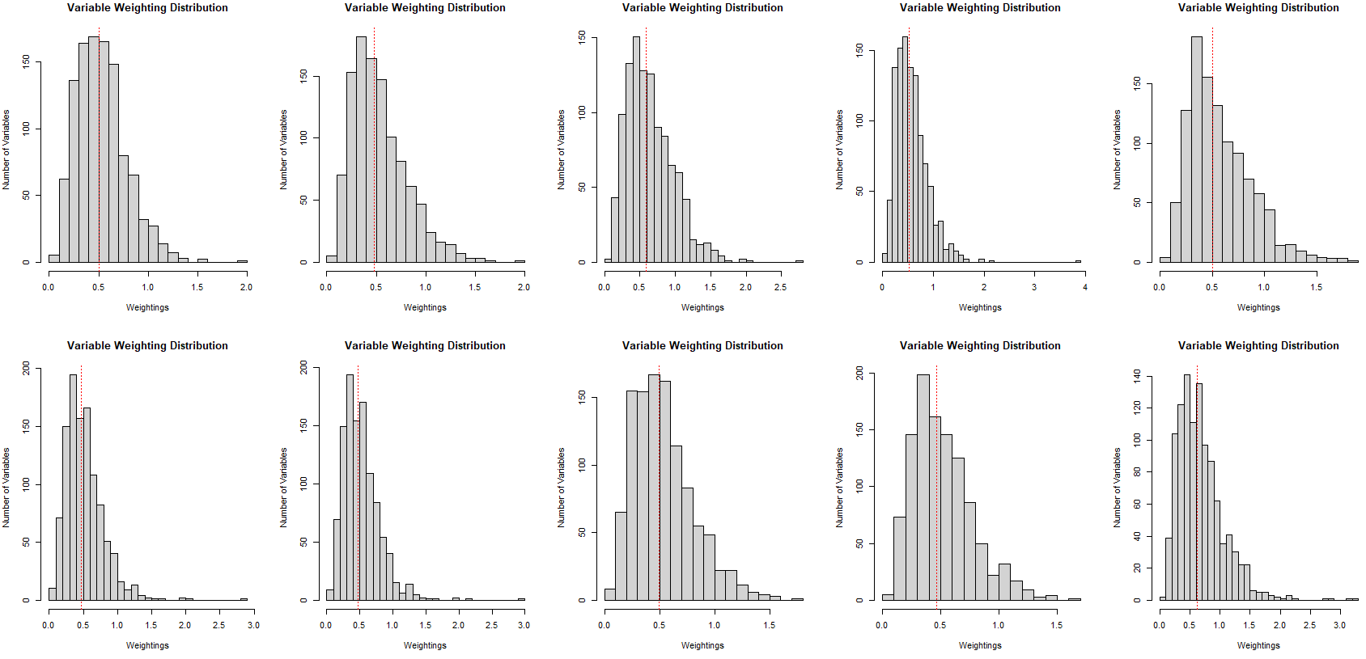
All 10 combination of 10% subset runs – variable weighting distribution

Slide 7
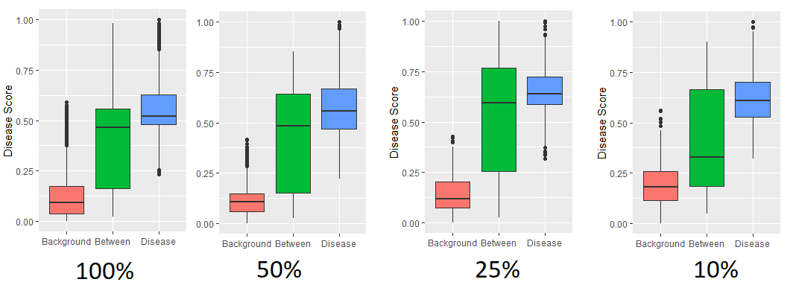
Runs on subsets of dataset (rows) when only using blood pressure (dia & sys) as inputs into the model

Slide 8
Summary
More rows cause distance of principle components of samples to diverge more, such that you have more extreme values in the distance matrix with the mean being smaller and smaller
Less columns causes better separation between groups as more degrees of freedom
Under ideal conditions, a focused subset of columns MAY produce a good model (as shown when BP was the only column used for prediction, the row issue disappears)

