Slide 1
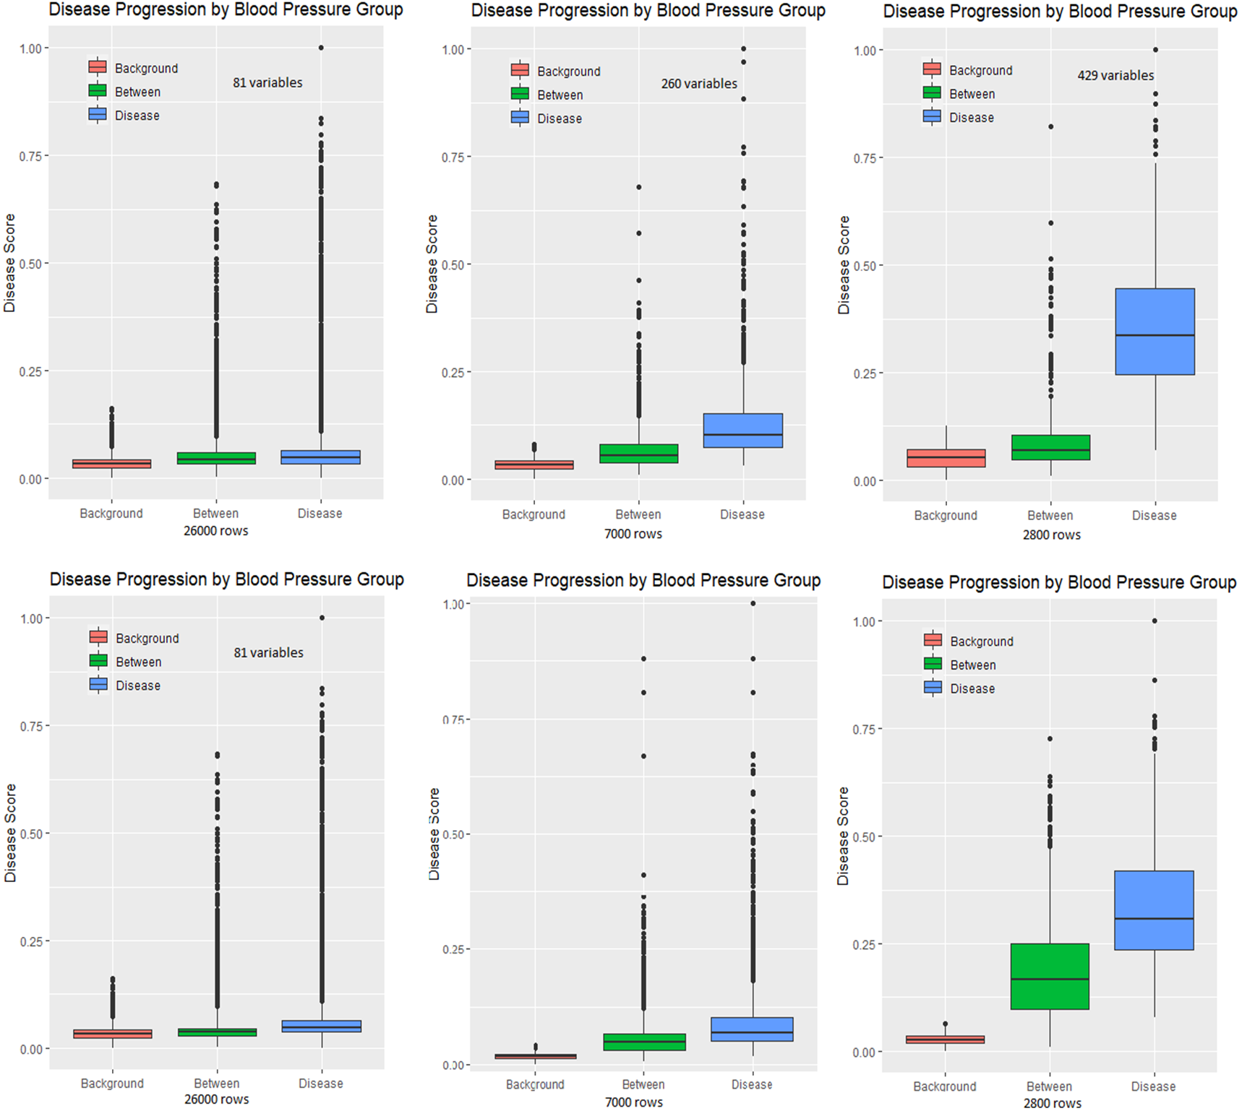
160/100
140/80

Slide 2
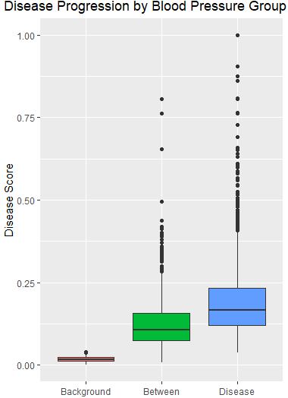
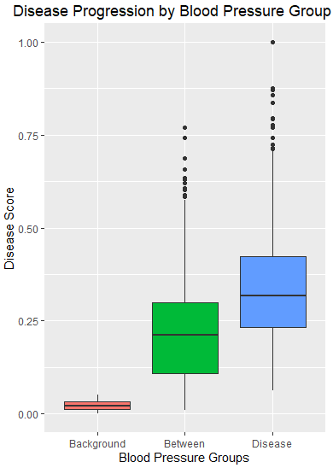
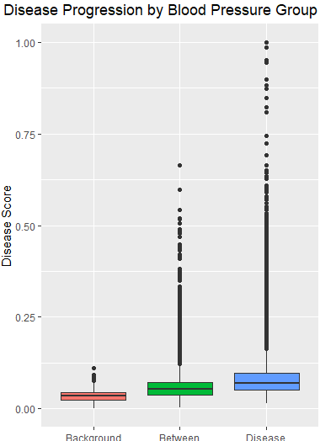
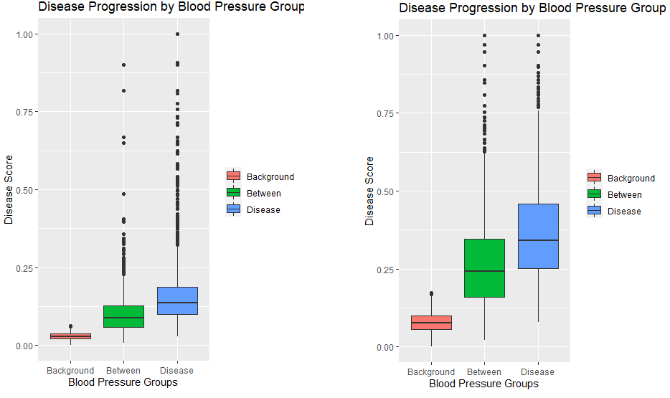
Target: >140/80
28000 rows (100%)
7000 rows (25%)
4900 rows (17.5%)
3500 rows (12.5%)
2800 rows (10%)
9300 rows (33.3%)
9300 rows (20%)

Slide 3
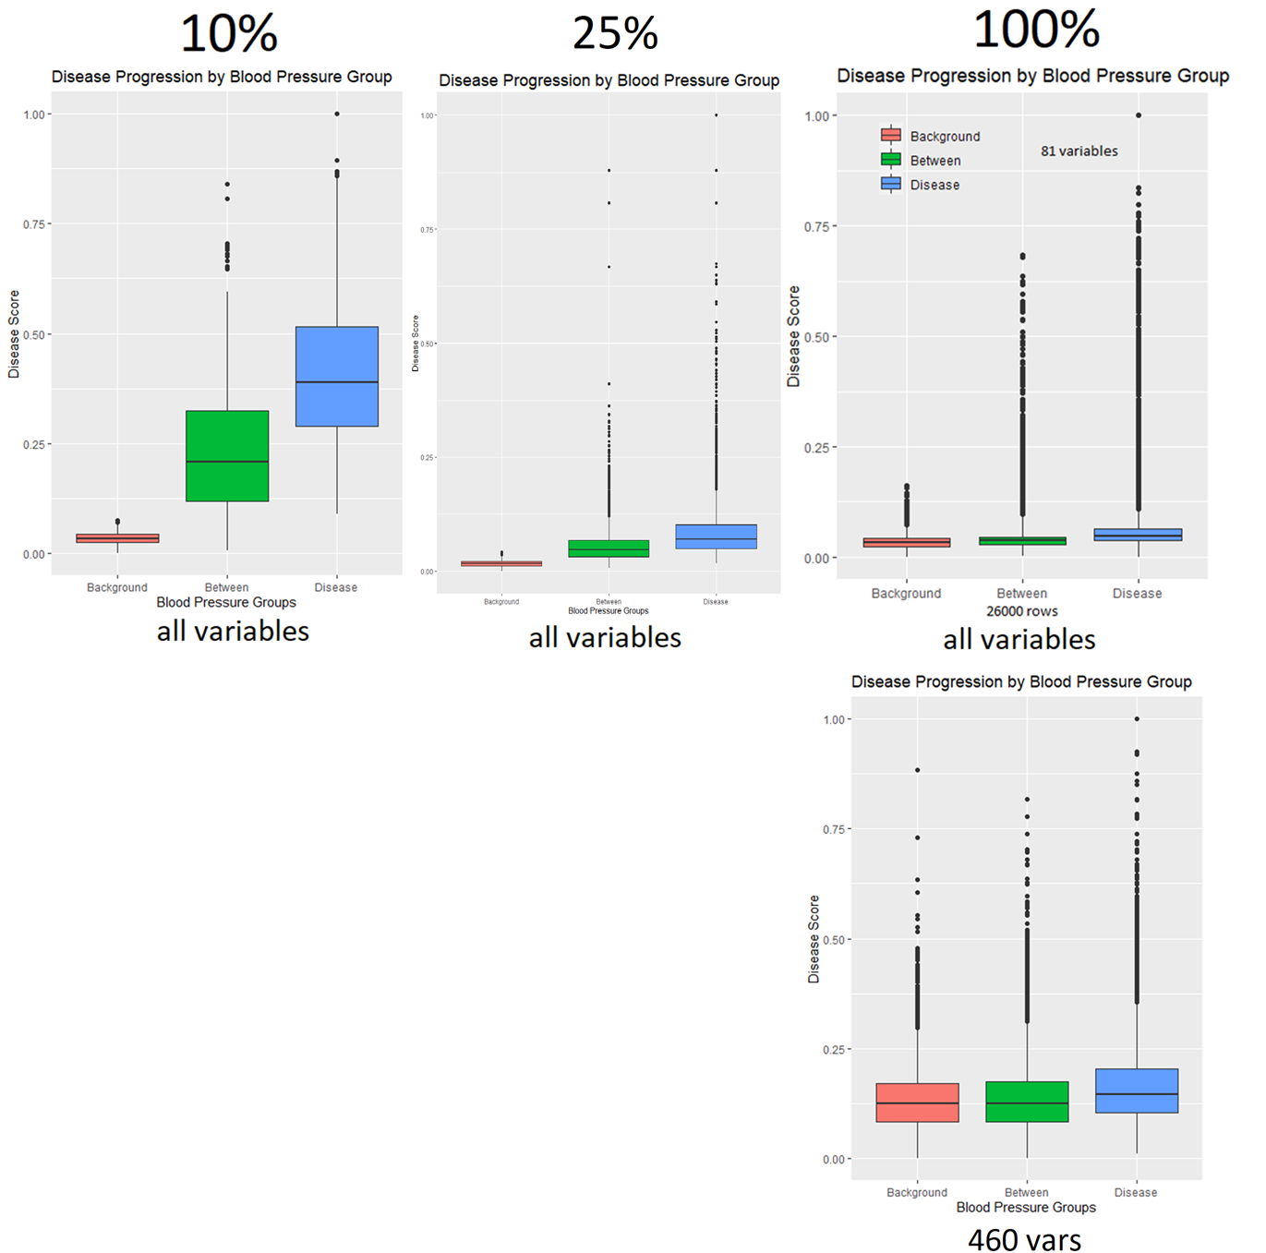
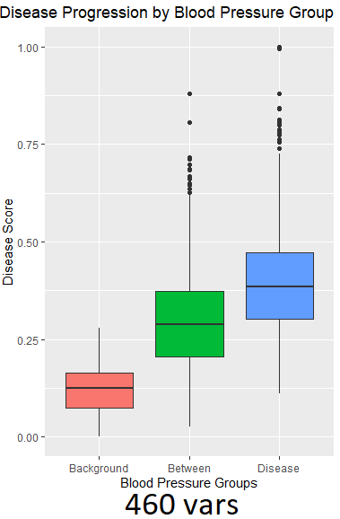
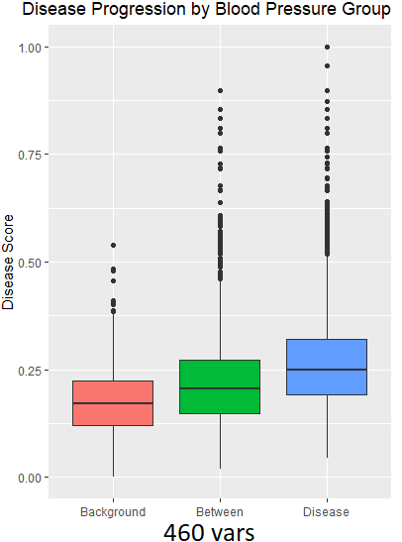
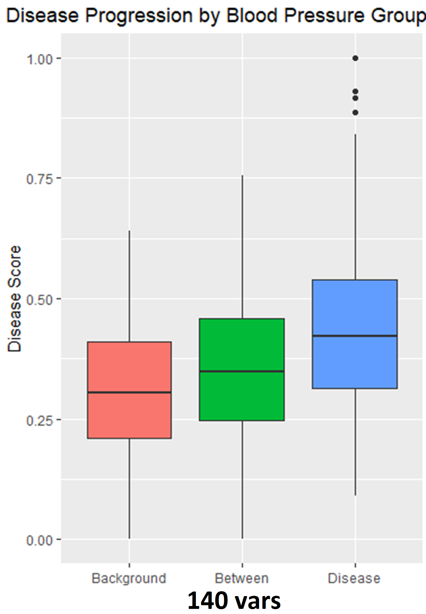
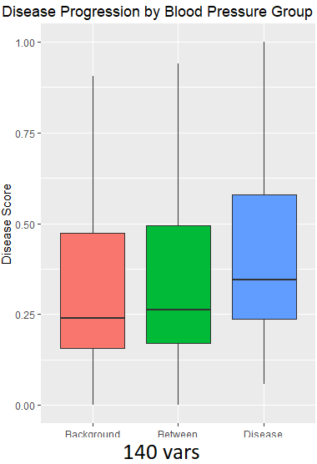
Runs when changing the number of variables (columns) inputted into the model with different subsets (rows)

Slide 4
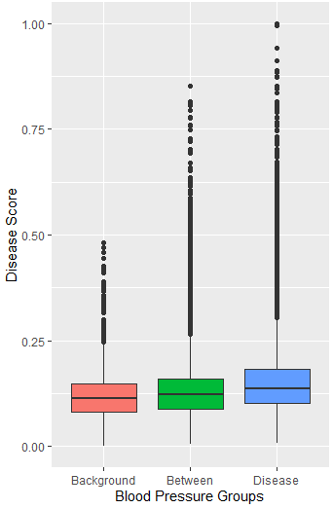
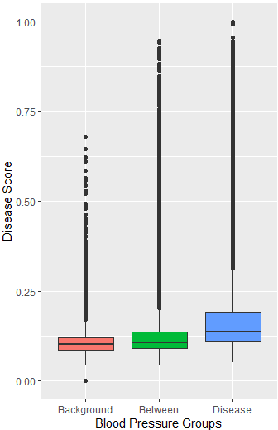
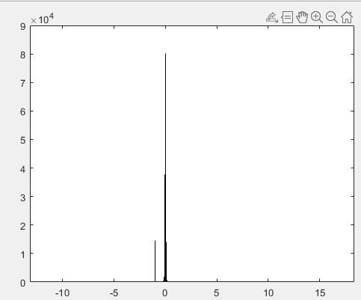
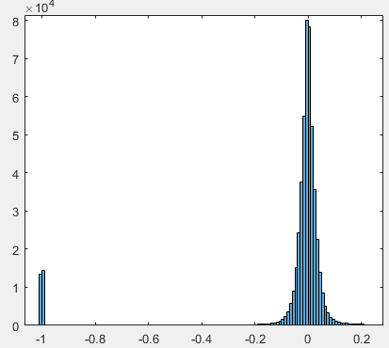
Distribution of values in cPC and results
Filter out cPCs (tests)
Raw cPC
Zoomed in

Slide 5
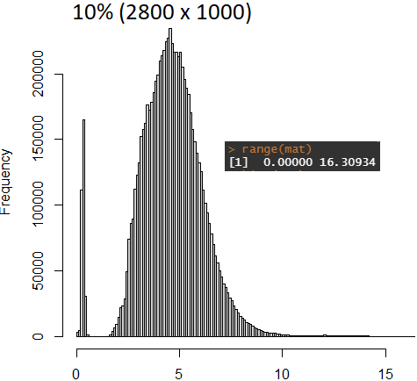
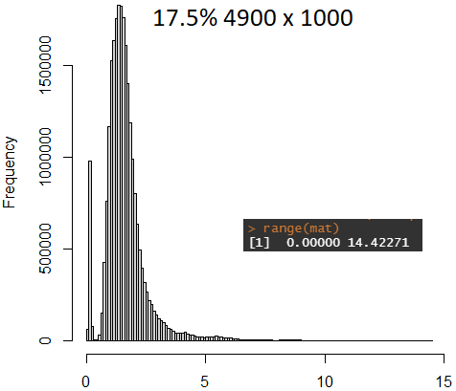
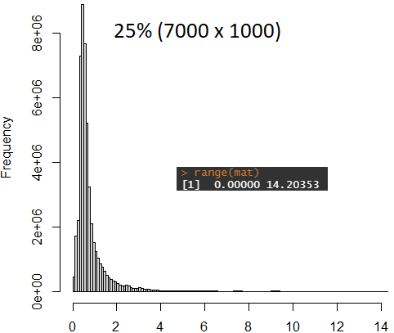
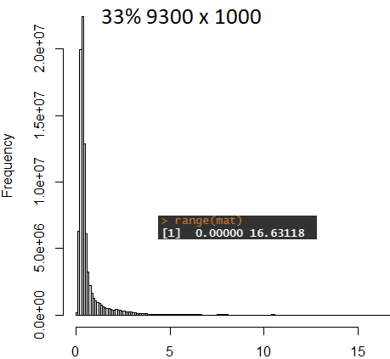
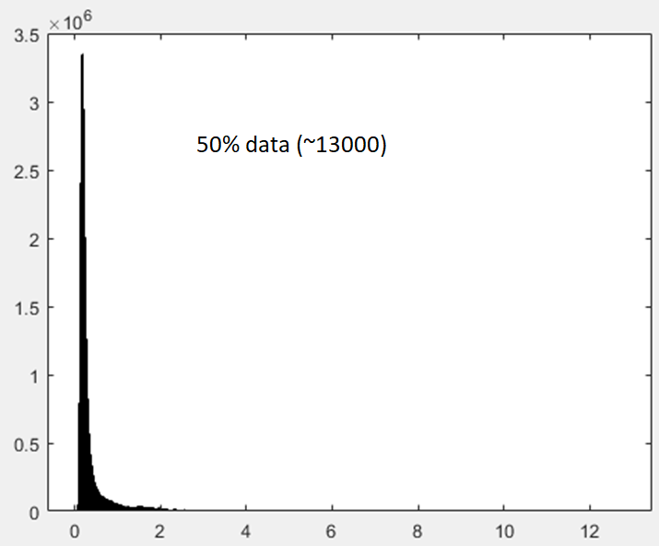
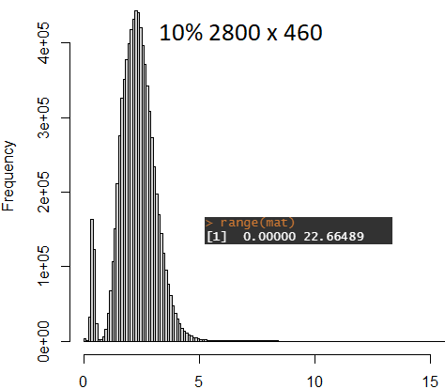
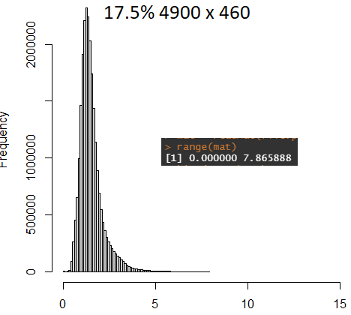
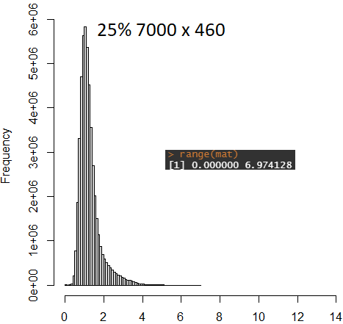
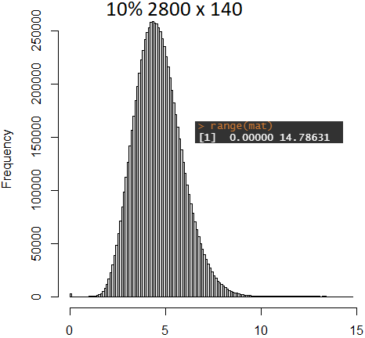
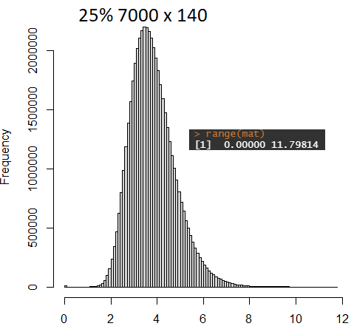
Distribution of values in distance matrix used for MST/shortest path trajectory calculation

Slide 6
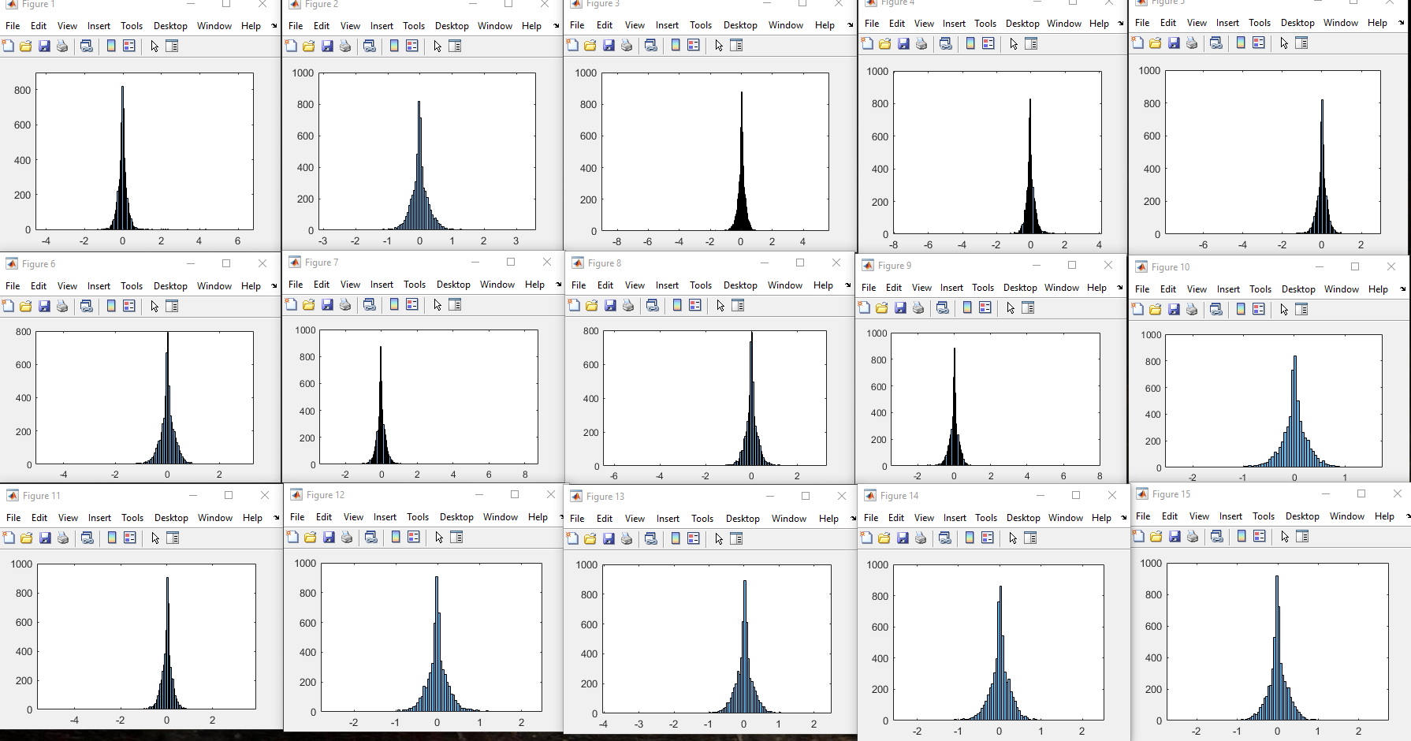
Distribution of Values for each contrastive principle component in a 20% subset run

Slide 7
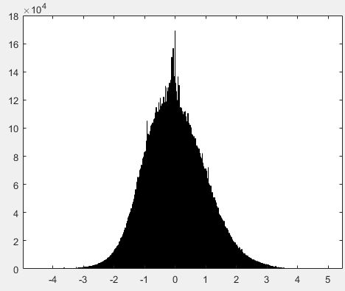
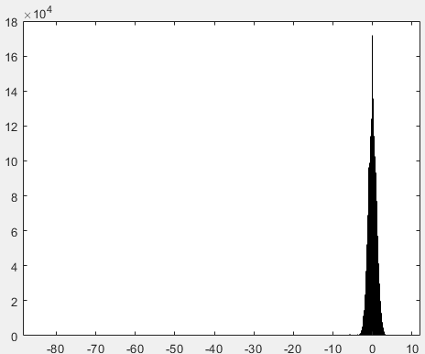
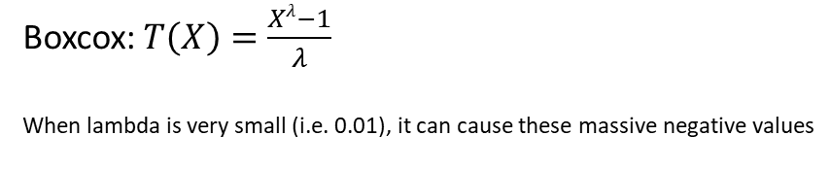
Boxcox Problems
Raw input data
Data after boxcox transformation
Boxcox:$T\left(X\right)=\frac{Xλ−1}{λ}$
When lambda is very small (i.e. 0.01), it can cause these massive negative values
Min = -80 ???

Slide 8
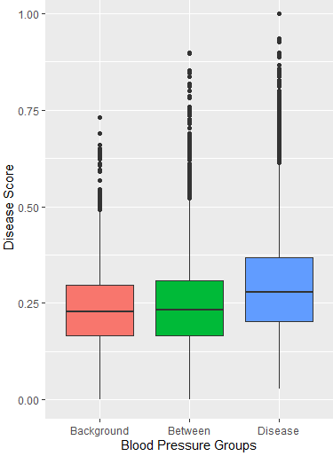
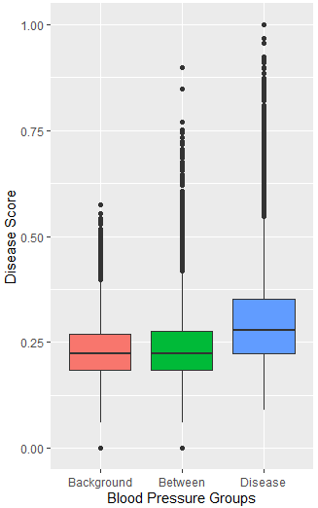
Issues with covariance matrix and eigen decomposition
Limited range for alpha to avoid large outliers seen at larger alphas
Filter out large values from eigen decomposition
Use shortest path tree instead

Slide 9
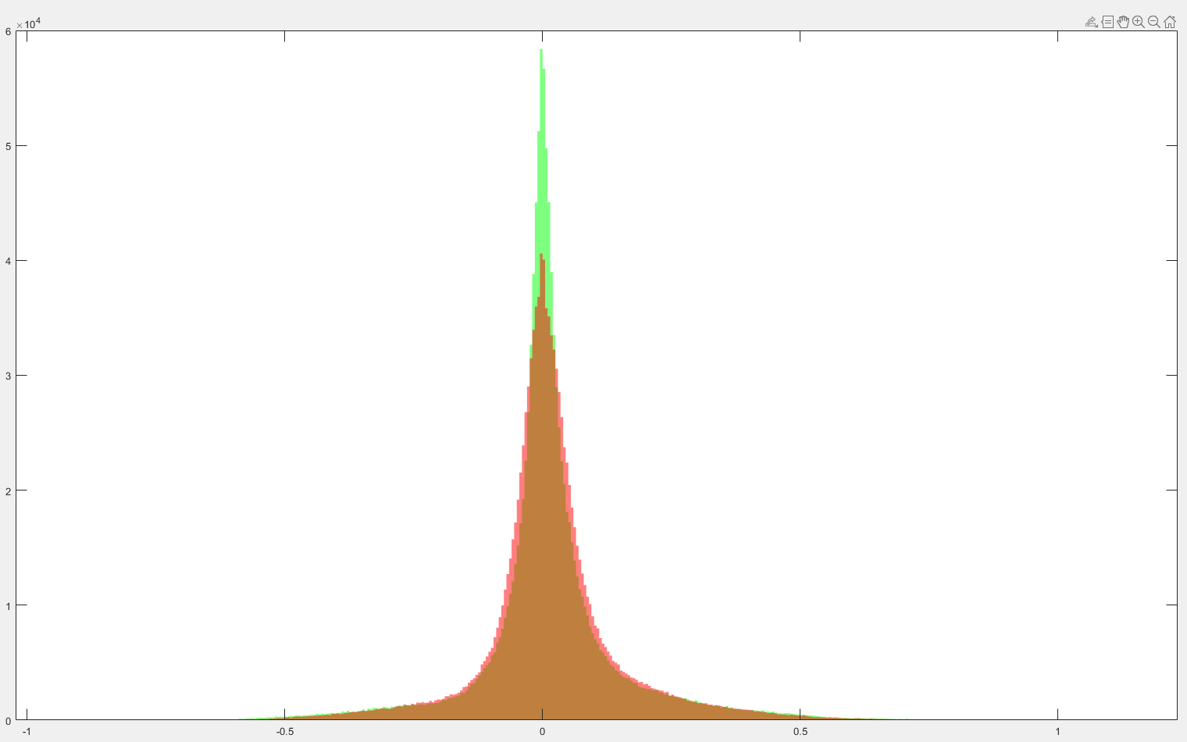
Covariance of background for full data (green) vs 10% data (red)

Slide 10
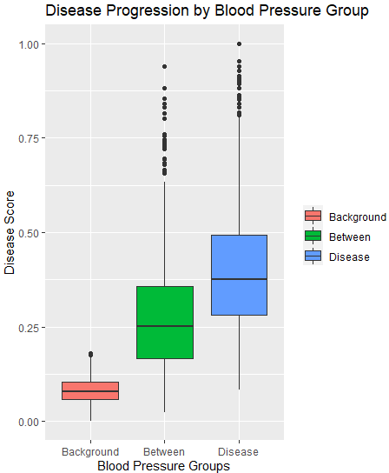
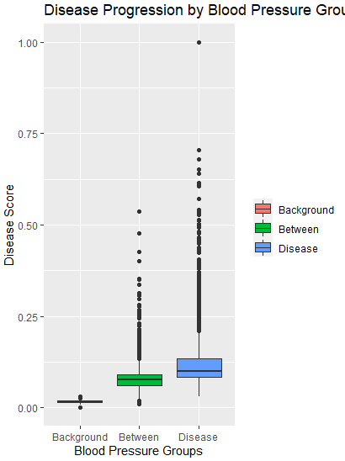
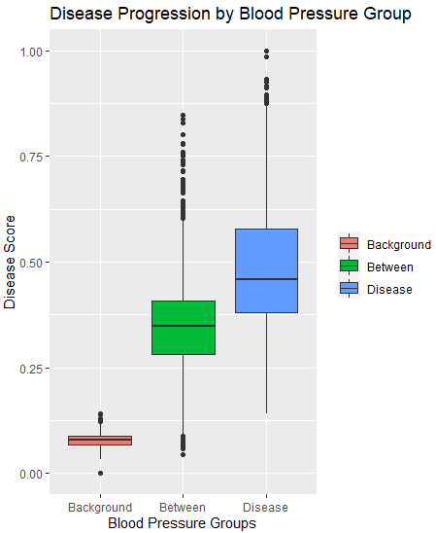
Handling abnormally high distance values in distance matrix (test on 20% subset ~5600 rows)
1) Original
(Minimum Spanning Tree)
2) Filter out large values in cPC space (set values above 3sd as the median)
3) Shortest Path Tree Instead of Minimum Spanning Tree
4) #2 (filter) + #3 (use shortest path tree)
Note that #2 is currently flawed as we cannot just reassign these abnormally large values in cPC space with the median (around 0), they should be instead replaced somehow by their next closest node ….

Slide 11
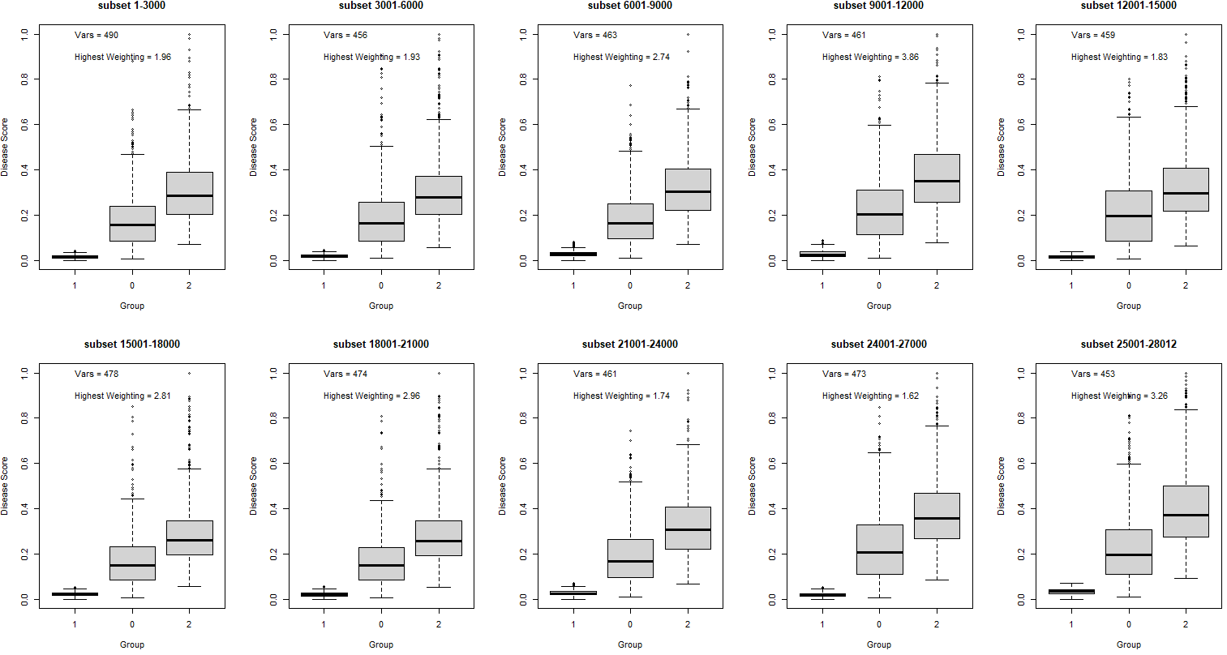
All 10 combination of 10% subset runs

Slide 12
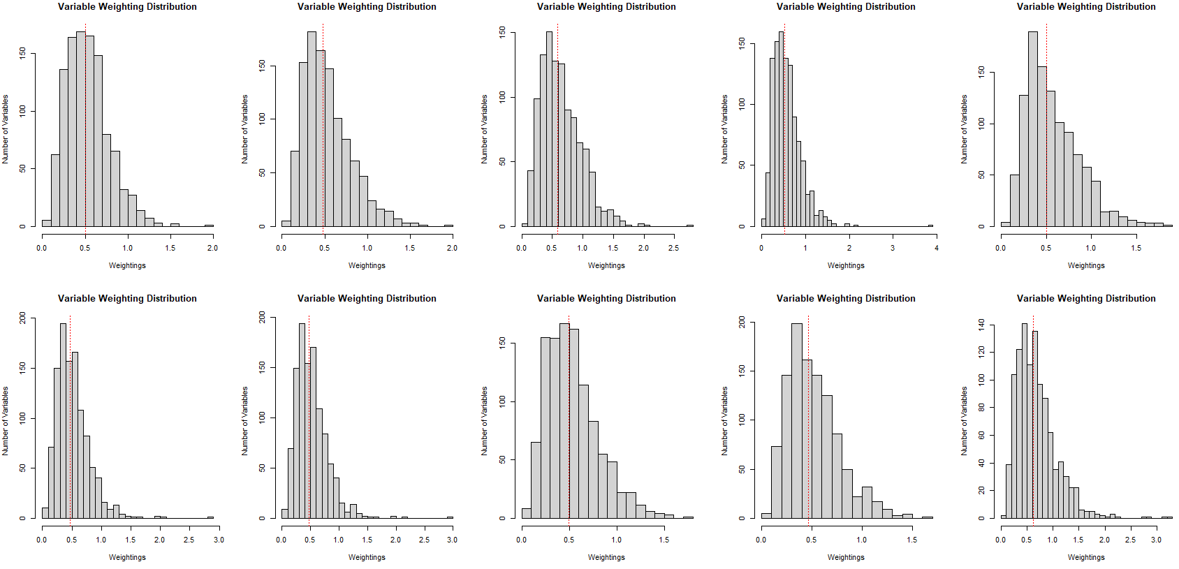
All 10 combination of 10% subset runs – variable weighting distribution

Slide 13
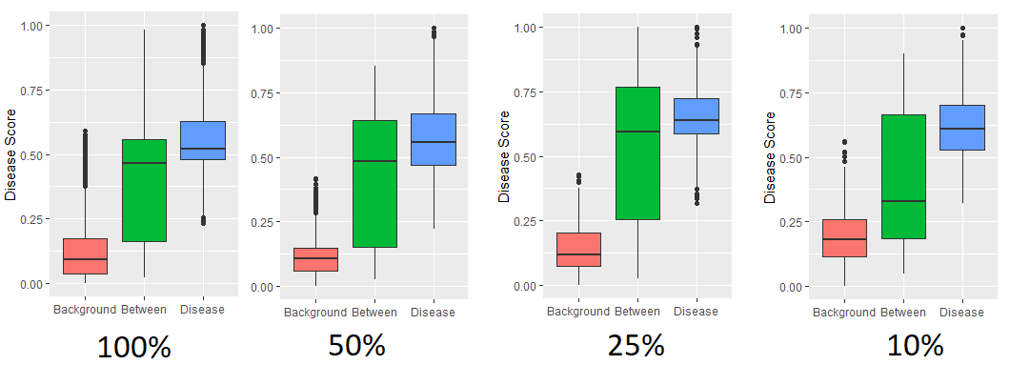
Runs on subsets of dataset (rows) when only using blood pressure (dia & sys) as inputs into the model

