Slide 1
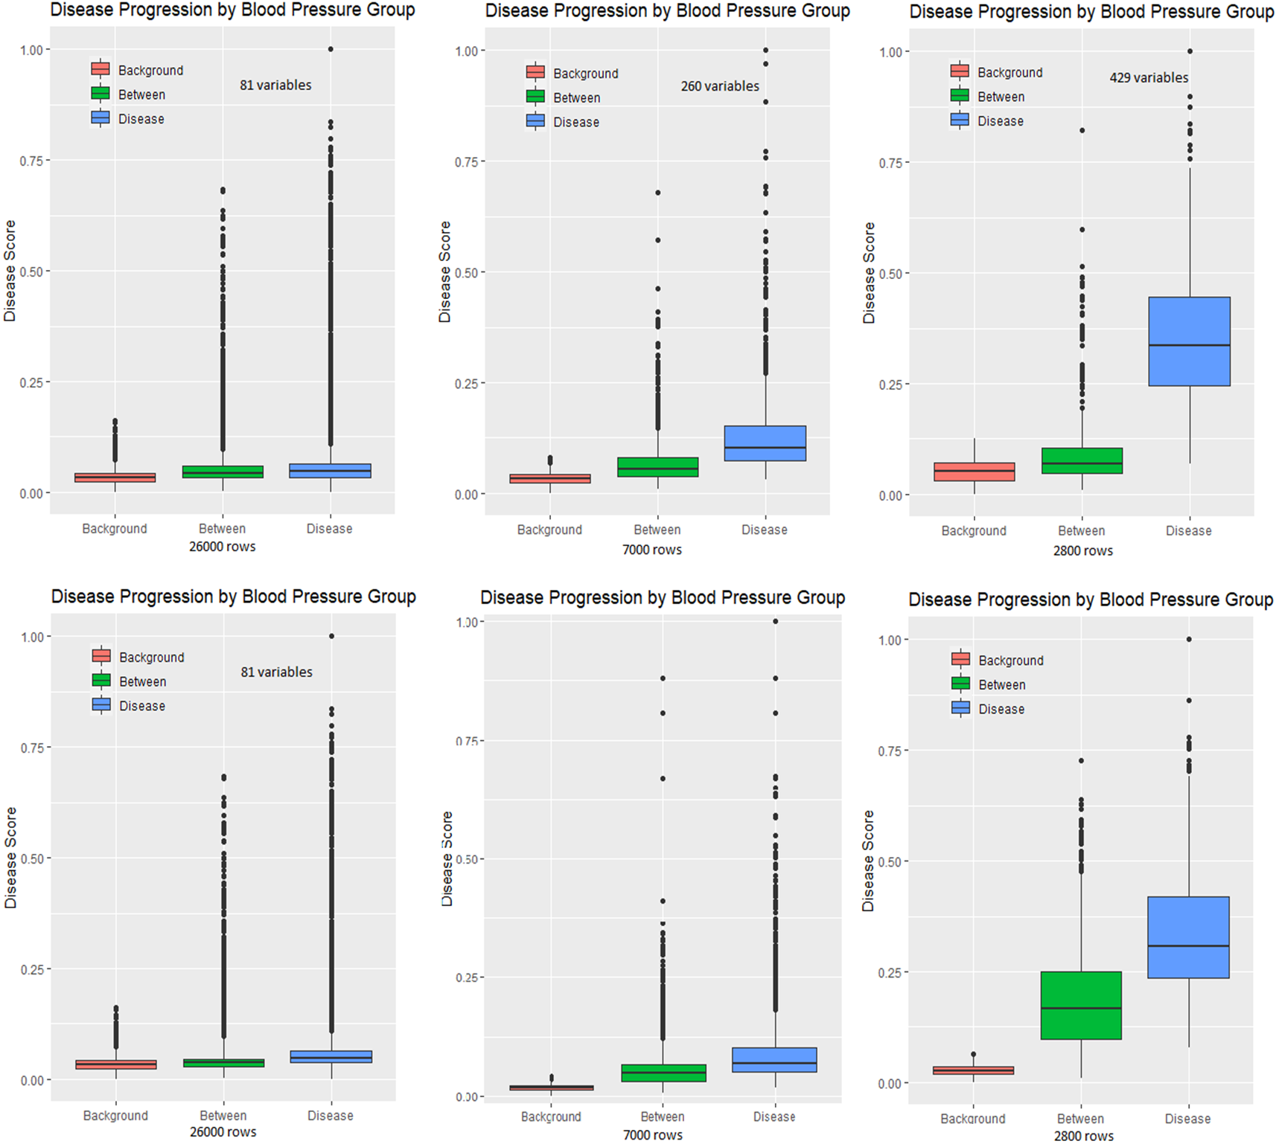
160/100
140/80

Slide 2
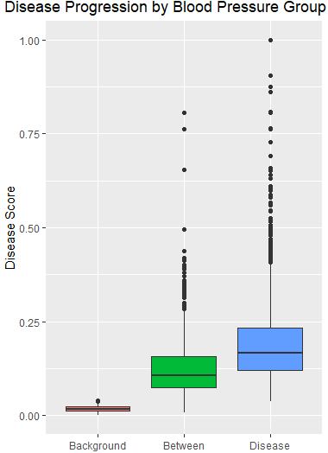
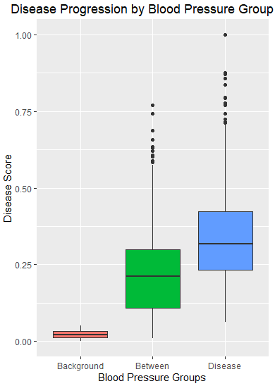
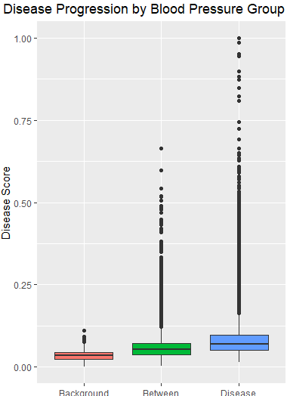
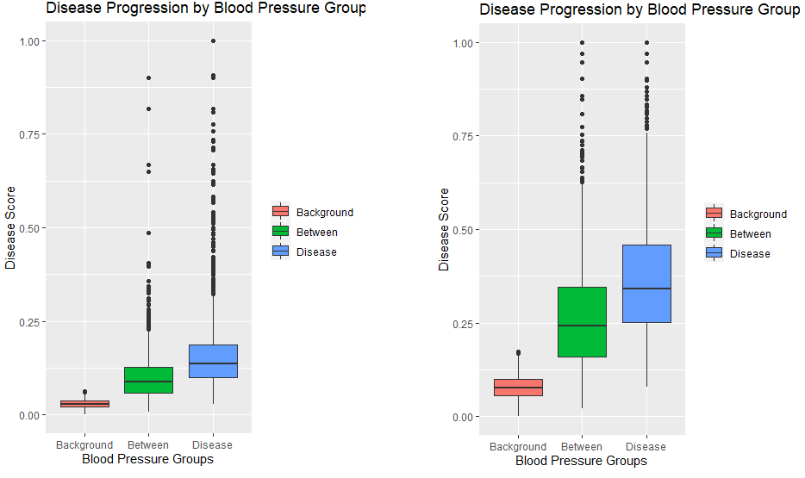
Target: >140/80
28000 rows (100%)
7000 rows (25%)
4900 rows (17.5%)
3500 rows (12.5%)
2800 rows (10%)
9300 rows (33.3%)
9300 rows (20%)

Slide 3
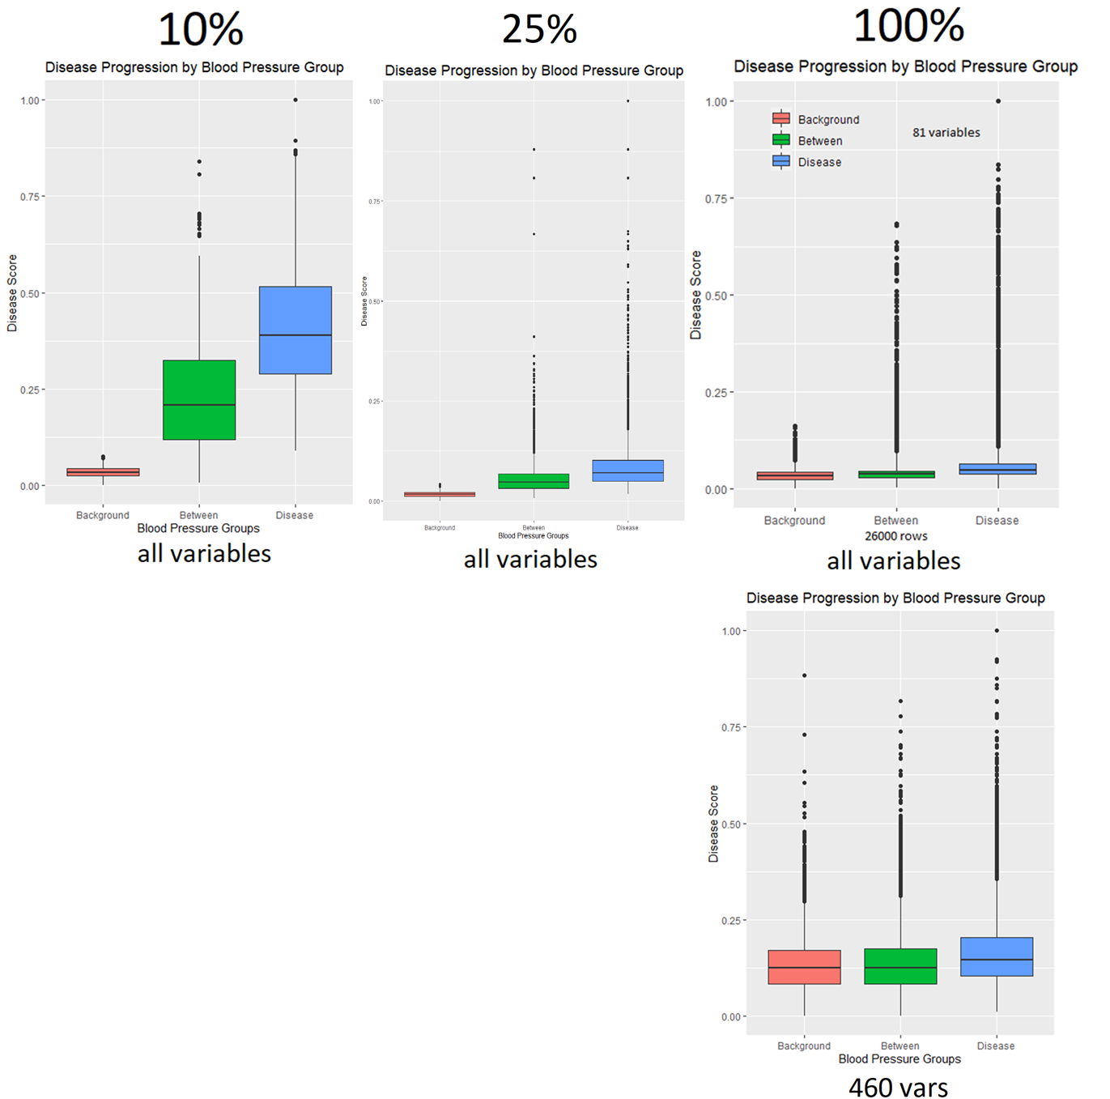
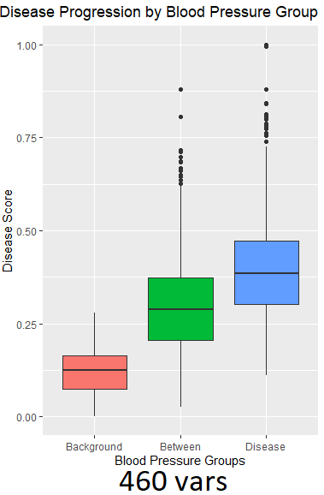
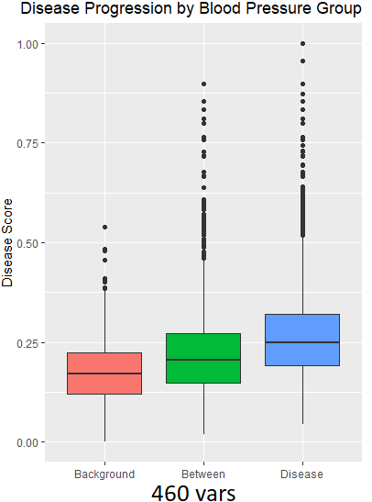
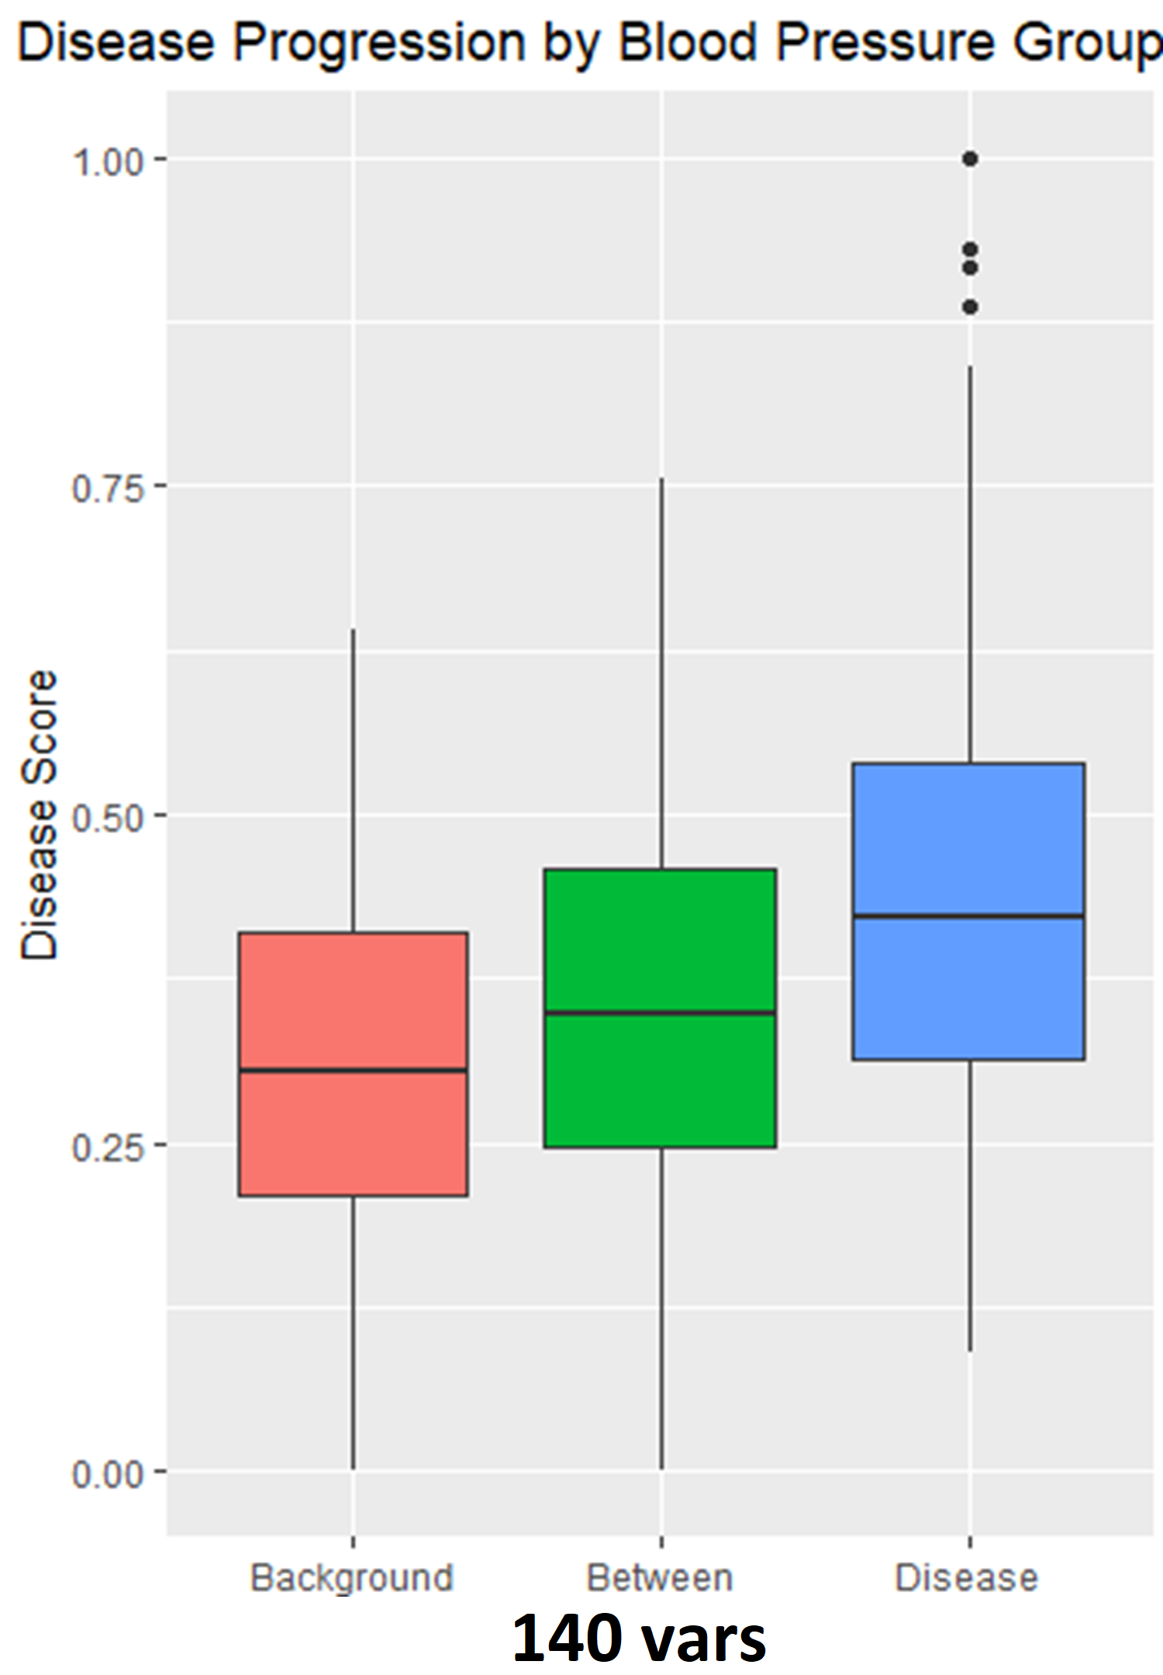
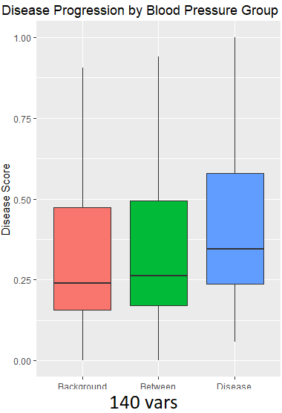
Runs when changing the number of variables (columns) inputted into the model with different subsets (rows)

Slide 4
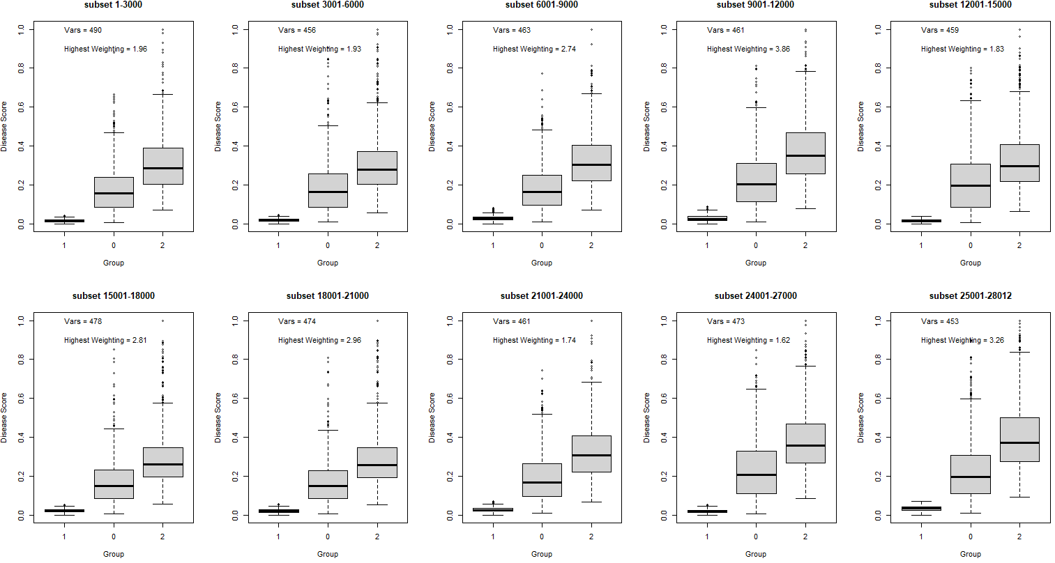
All 10 combination of 10% subset runs

Slide 5
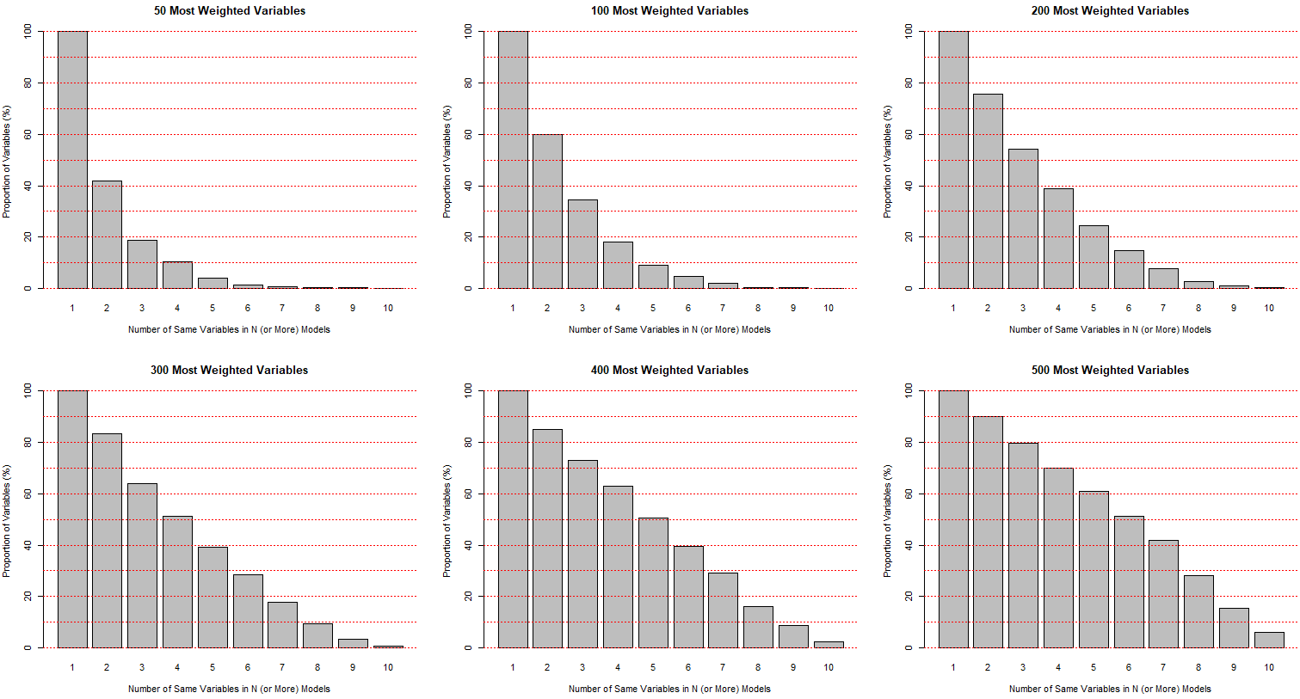

Slide 6
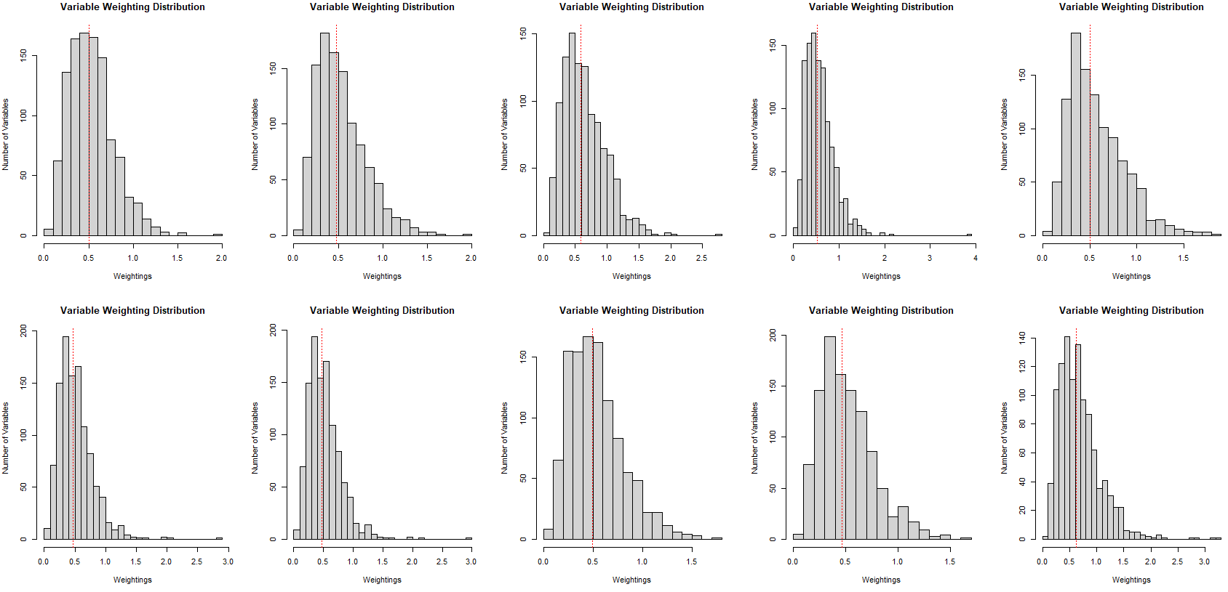
All 10 combination of 10% subset runs – variable weighting distribution

Slide 7
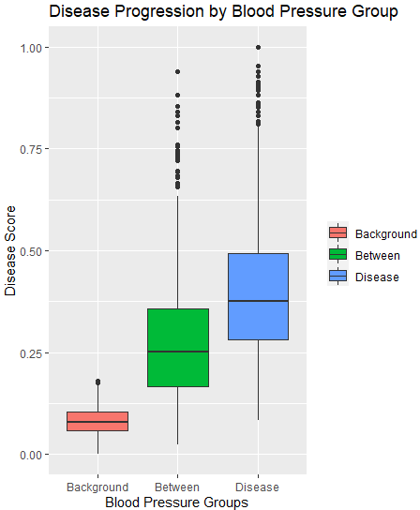
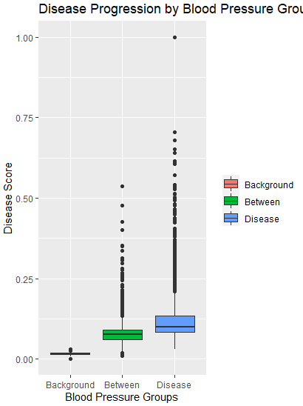
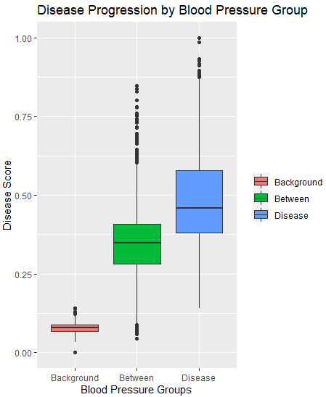
Handling abnormally high distance values in cPC (test on 20% subset ~5600 rows)
1) Original
(Minimum Spanning Tree)
2) Filter out large values in cPC space (set values above 3sd as the median)
3) Shortest Path Tree Instead of Minimum Spanning Tree
4) #2 (filter) + #3 (use shortest path tree)
DON’T USE SHORTEST PATH TREE AS THIS DOESN’T MAKE THE RIGHT TRAJECTORY GRAPH STOOOOOPID !!!!!!!!
Note that #2 is currently flawed as we cannot just reassign these abnormally large values in cPC space with the median (around 0), they should be instead replaced somehow by their next closest node ….

Slide 8
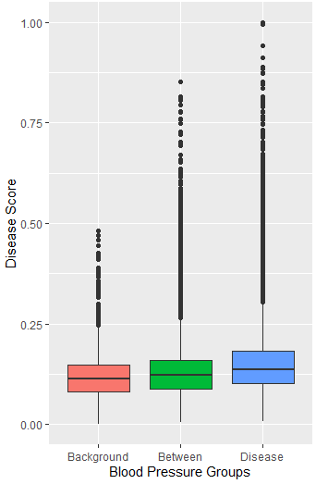
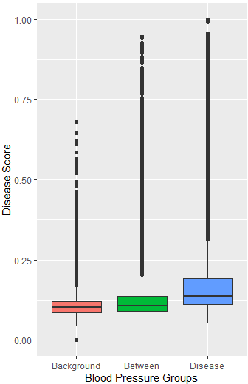
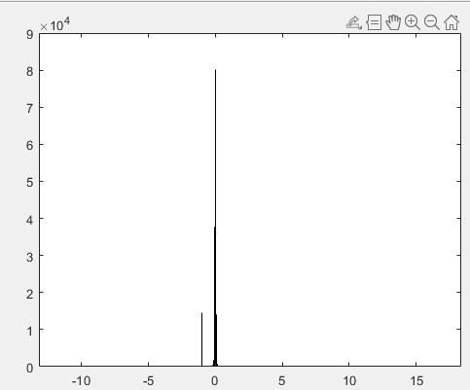
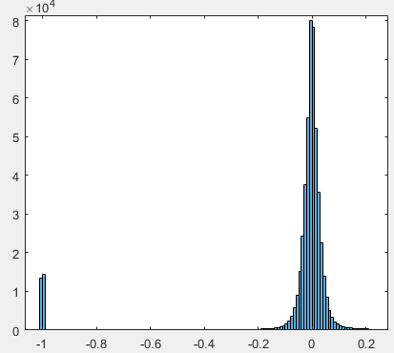
Distribution of values in cPC and results
Filter out cPCs (tests)
Raw cPC
Zoomed in

Slide 9
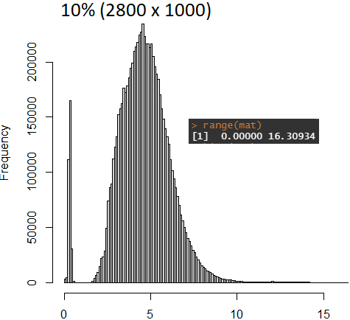
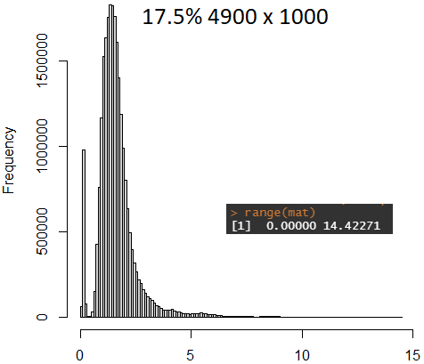
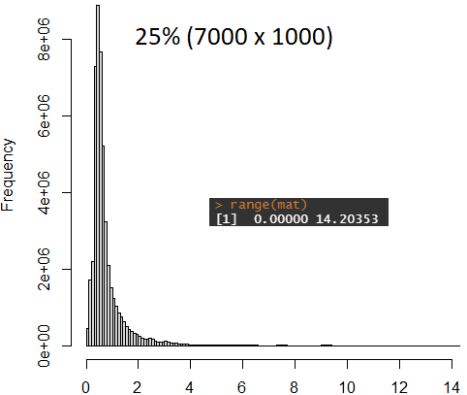
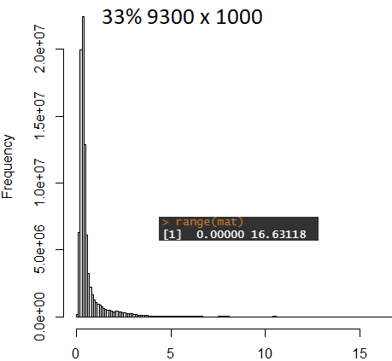
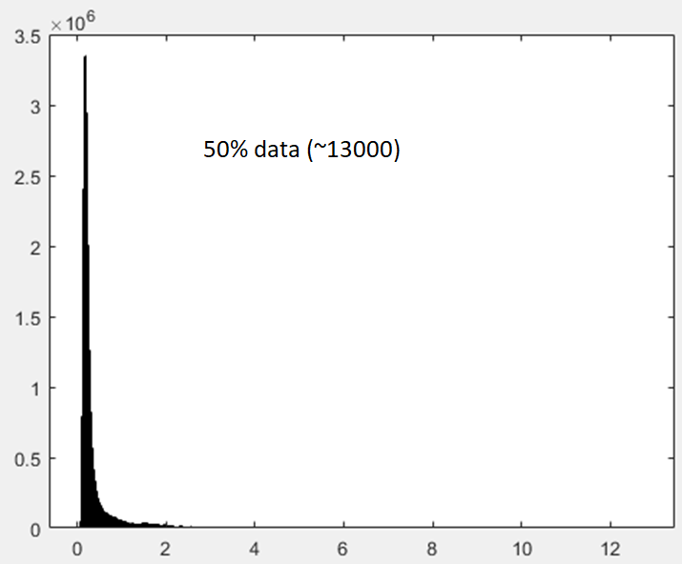
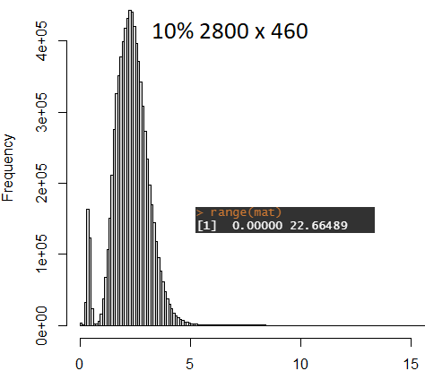
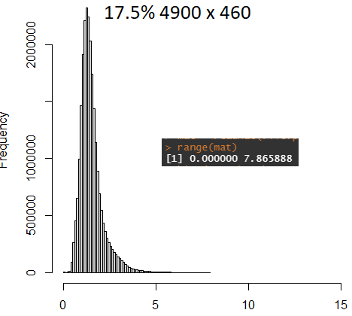
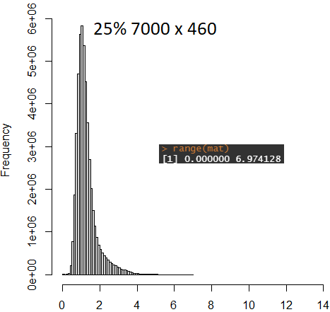
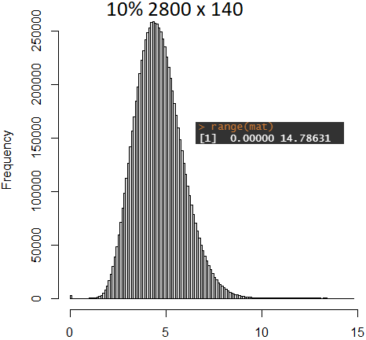
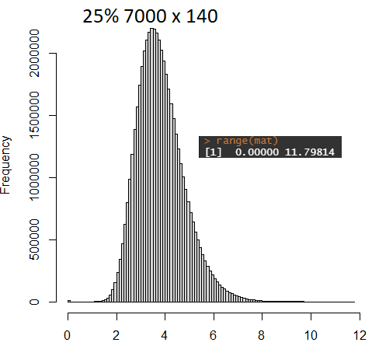
Distribution of values in distance matrix used for MST/shortest path trajectory calculation

Slide 10
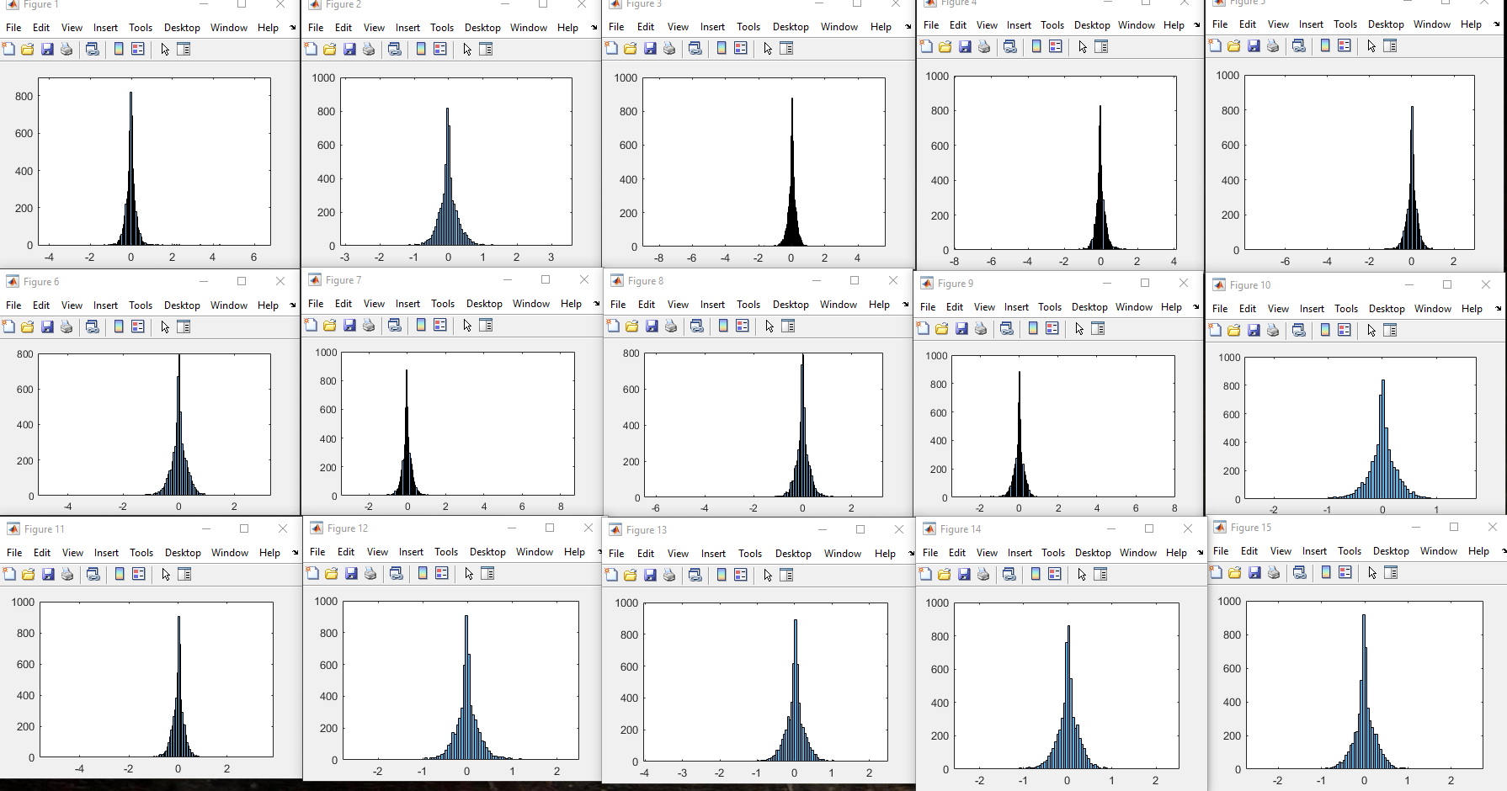
Distribution of Values for each contrastive principle component in a 20% subset run

Slide 11
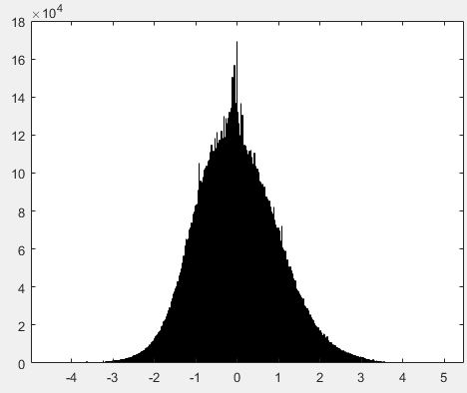
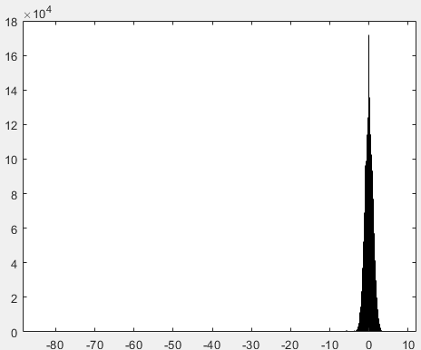
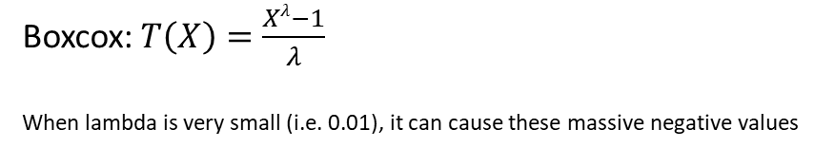
Boxcox Problems
Raw input data
Data after boxcox transformation
Boxcox:$T\left(X\right)=\frac{Xλ−1}{λ}$
When lambda is very small (i.e. 0.01), it can cause these massive negative values
Min = -80 ???

Slide 12
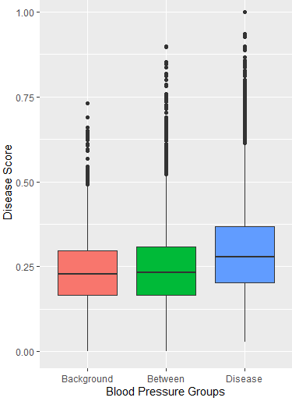
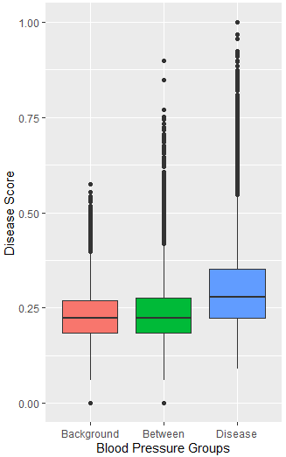
Issues with covariance matrix and eigen decomposition
Limited range for alpha to avoid large outliers seen at larger alphas
Filter out large values from eigen decomposition
Use shortest path tree instead

Slide 13
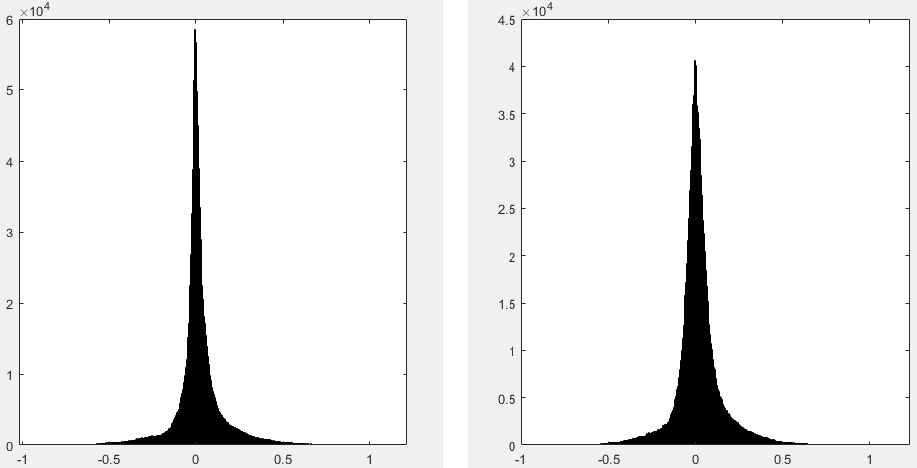
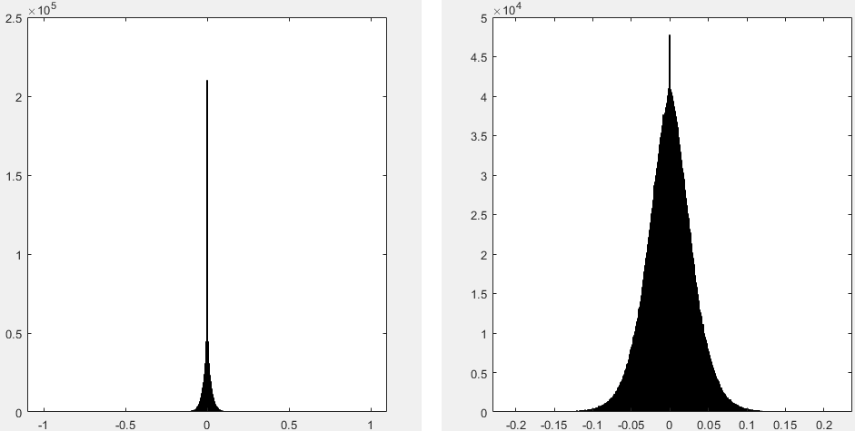
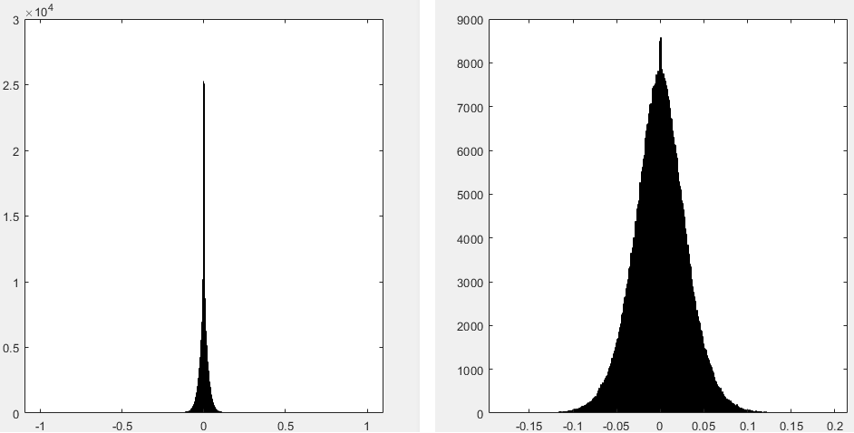
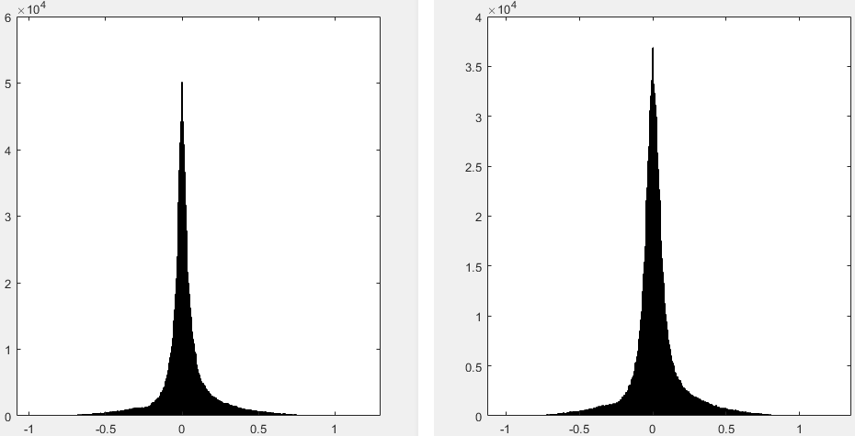
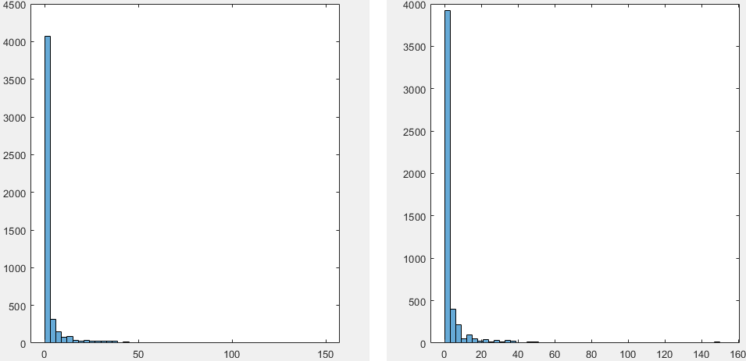
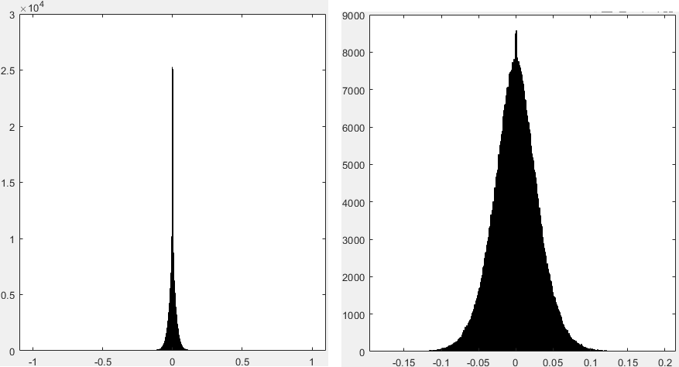
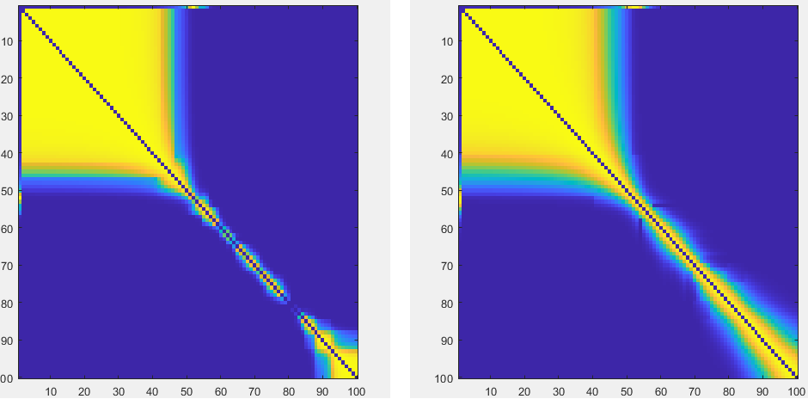
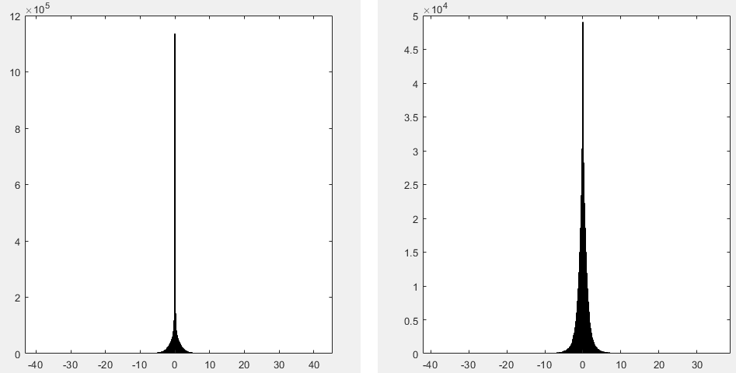
Compare Intermediate Results Pairs for 100% (left) vs 10% (right)
Covariance of Background Population
Eigen Decomposition for All Alpha
Eigen Decomposition Medoids (Nodal Weights) for all Alpha
Covariance of Target Population
Eigen Values for All Alpha
Medoids (Nodal Weights) for Best Alphas
Affinity Matrix
cPCs

Slide 14
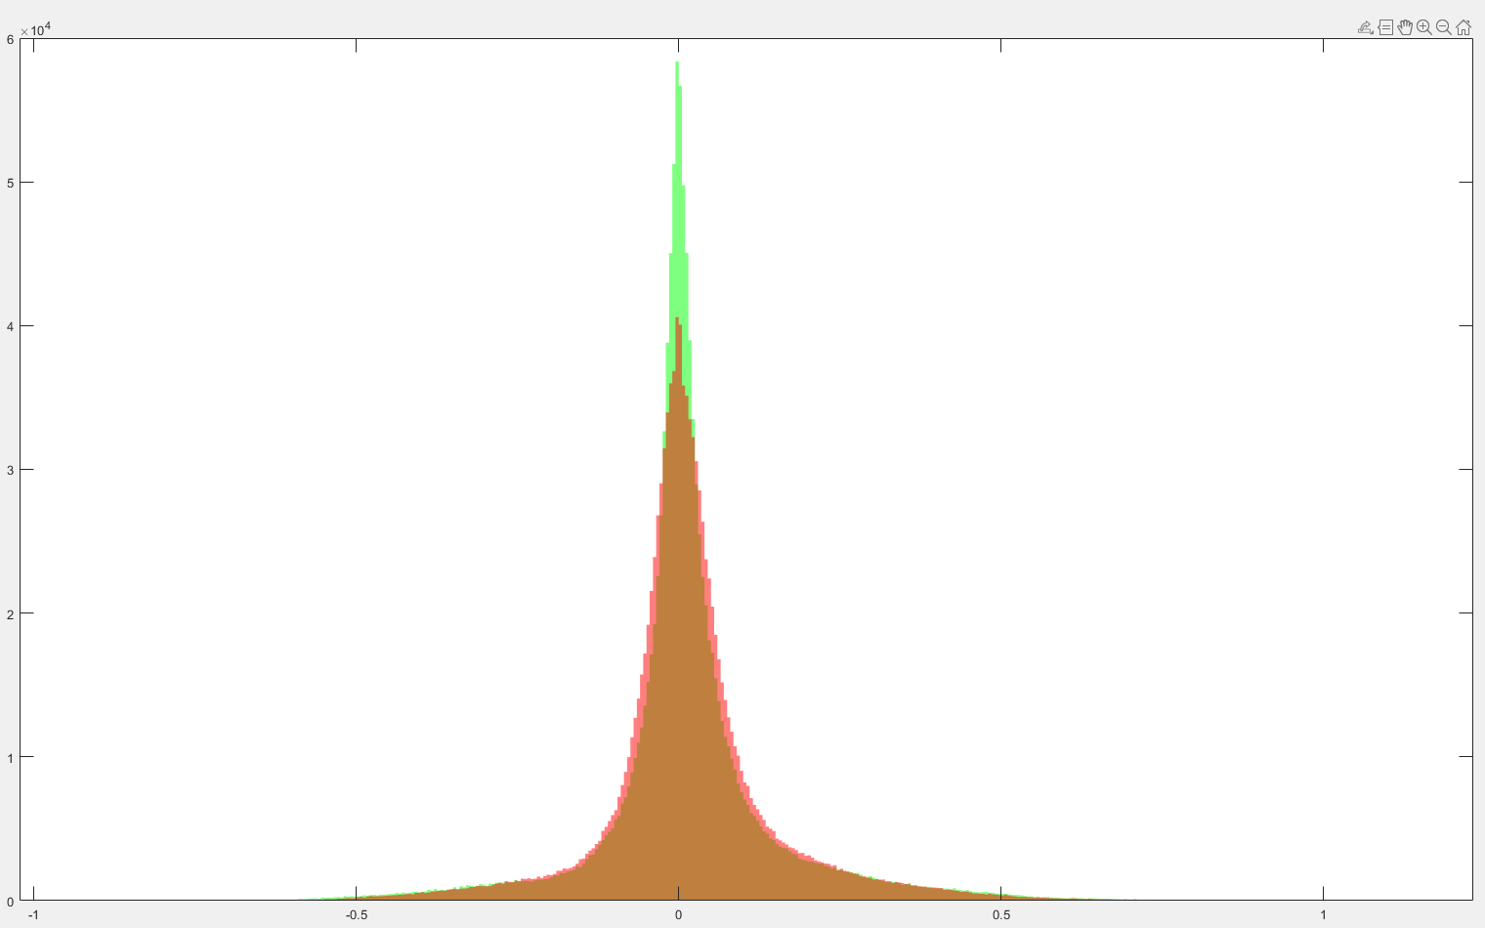
Covariance of background for full data (green) vs 10% data (red)

Slide 15
NeuroPM Toolbox Outline
Assumption: Given a large cohort of patients, we can assume they are at different stages of disease, and therefore produce a pseudo-temporal distribution of the progression of disease
Data: Given a matrix of N rows (patients) by M columns (features), separate rows into background/between/disease categories
Dimensionality Reduction
Compute the covariance matrix for the nodes in each of the background (C_{b}) or disease (C_{d}) categories
Define a range of values α = 10⁻² to 10²
For each α calculate a new combined covariance matrix where C = C_{d} – αC_{b} such that the C gets less/more weighted towards the covariance of the background category
Perform eigen decomposition to get the principle components (PC) for each C, each column is the eigen vector of each feature and the diagonal elements are the eigen values
For each α keep the PCs with the largest eigen values, the max number to keep is predefined
Compute affinity matrix of the PCs for each combination of α using cosine similarity
Use spectral clustering of the affinity matrix a pre-set number times and choose the cluster (set of α) with the highest value of clustering quality
For each unique group in the cluster
Identify the associated subset of the affinity matrix in the group and find the α corresponding to the maximum similarity
Find the eigen decomposition with the associated α computed from above, these are the PCs of interest for this cluster group
Perform matrix multiplication between the entire input dataset and the PC identified to project the data onto the α space and obtain the cPC
Use K-Means clustering on the rows in the cPC in the background/disease groups to compute the clustering tendency of the disease vs background
The final cPC is the cPC from the cluster group which produces the maximum clustering tendency of the background/disease groups as this means the values are clustered more tightly and the clusters have less overlap
TLDR: perform PCA on a range of weighted sums of the background/disease, the final cPC then corresponds to the weighting variable which produces the highest clustering tendency of the background/disease in the PC space
Tree Generation
Treat each row of the cPC space as a node
Define a complete graph where every node is connected where the weights of the branch is the L2 distance between the values in the cPC space, do this for only the background and disease nodes
Find the node in the background category which has the overall smallest distance to every other node, set this as the root node
Compute the minimum spanning tree starting from the root node across the entire graph (prims algorithm)
Trajectory Inference/Pseudo-Time Score Calculation
Calculate the pseudo-time (or disease progression) score for each node in the background/disease categories as the shortest distance (Dijkstra) from the node to the root node along the minimum spanning tree
The pseudo-time score of the nodes in the between category is then extrapolated as the pseudo-time score of the node in the background/disease categories with the shortest distance in the cPC space from the between node
The trajectories of disease progression are the major branches of the minimum spanning tree which is open for interpretation depending on how much variation you want to include

Slide 16
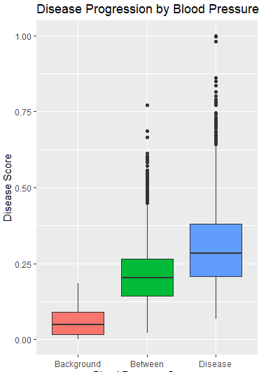
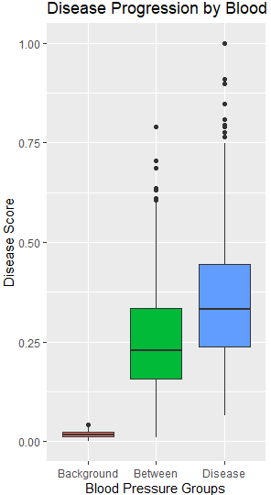
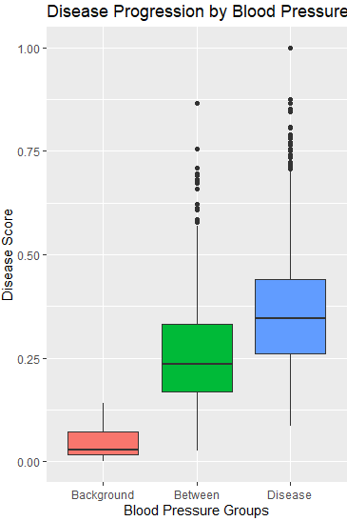

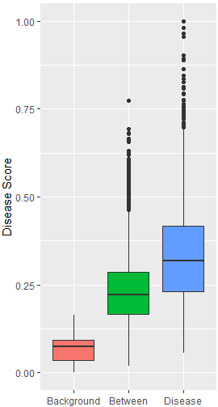
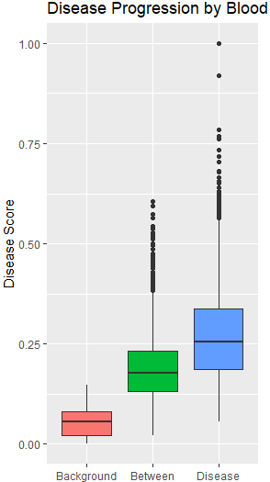

Combining the outputs of individual runs into one graph (concatenate outputs of cPCA function, sum variable contributions)
Merged 1-9000
1-3000
Merged 1-6000
Merged 1-6000
Fix Between Group A Bit (sometimes makes it better, sometimes doesn’t)
Merged 1-15000
Can further improve these by tuning tree generation, filter cPC outliers, (filter out eigen vectors), defining more extreme target population
3001-6000
Merged 1-12000

Slide 17


Trajectory plotting (basic plotting using Matlab)
3000 Patients (10%)
15000 Patients (50%)

Slide 18



Improving full cPCA runs (single batch) by changing the number of max cPCs and number of clusters
Best: max cPC = 250, filter out eigen vectors in cPCA with large values, 100 clusters for clustering tendency, 160/100 target
As Above
+ Filter out large eigen vec values
+ Eigen Value Threshold >0.01

Slide 19





Run cPCA on sub-batches and combine individual cPCs when generating the final tree/disease scores (140/80)
5 Batches
(6000 Patients Each)
10 Batches
(3000 Patients Each)
15 Batches
(2000 Patients Each)
20 Batches
(1500 Patients Each)
25 Batches
(1200 Patients Each)

Slide 20





Run cPCA on sub-batches and combine individual cPCs when generating the final tree/disease scores (160/100)
5 Batches
(6000 Patients Each)
10 Batches
(3000 Patients Each)
15 Batches
(2000 Patients Each)
20 Batches
(1500 Patients Each)
25 Batches
(1200 Patients Each)

Slide 21





Run cPCA on sub-batches and combine individual cPCs when generating the final tree/disease scores (160/100)
8 Batches
(3500 Patients Each)
13 Batches
(2200 Patients Each)
17 Batches
(1700 Patients Each)
22 Batches
(1300 Patients Each)
28 Batches
(1000 Patients Each)

Slide 22

Trajectory Visualization (Python Plotly)

Slide 23



Running Using Different Variable Subsets (10 batches) disease >160/100
(note row numbers are different as the same filtering conditions were using during sub setting to ensure minimal missing data)
Cardiac Variables
(23652 x 35)
Brain Variables
(34798 x 861)
Cardiac + Brain + Carotid Variables
(34597 x 895)

Slide 24

Running Using Different disease definitions (10 batches)
(using all rows and don’t exclude patients with events)
160/100 (filter out patients with events)
160/100 (all patients)
Event at time of imaging
No event at time of imaging but at follow up

Slide 25



Running Using Different row sub setting (10 batches) disease: > 160/100
Male only
Female only
No Events at time of Imaging
Female only, No Events at time of Imaging

Slide 26
10 – fold cross validation
cPCA 10 batches (Compare Folds Between Themselves):
Root Mean Squared Error is: 0.13 +- 0.07 [0.05, 0.31]
Mean Standard Deviation is: 0.05 +- 0.03 [0.02, 0.11]
full_cPCA (Compare Folds Between Themselves):
Root Mean Squared Error is: 0.09 +- 0.06 [0.05, 0.25]
Mean Standard Deviation is: 0.03 +- 0.02 [0.02, 0.08]
cPCA 10 batches (Compare Against Full Run):
Root Mean Squared Error is: 0.09 +- 0.05 [0.03, 0.23]
Mean Standard Deviation is: 0.05 +- 0.03 [0.02, 0.11]
iter_cPCA (Compare Against Full Run):
Root Mean Squared Error is: 0.06 +- 0.04 [0.02, 0.18]
Mean Standard Deviation is: 0.03 +- 0.02 [0.02, 0.08]
20 – fold cross validation
30 – fold cross validation
cPCA 10 batches (Compare Folds Between Themselves):
Root Mean Squared Error is: 0.13 +- 0.08 [0.04, 0.31]
Mean Standard Deviation is: 0.05 +- 0.03 [0.01, 0.11]
cPCA 10 batches (Compare Against Full Run):
Root Mean Squared Error is: 0.07 +- 0.04 [0.02, 0.17]
Mean Standard Deviation is: 0.05 +- 0.03 [0.01, 0.11]
cPCA 10 batches (Compare Folds Between Themselves):
Root Mean Squared Error is:
Mean Standard Deviation is:
cPCA 10 batches (Compare Against Full Run):
Root Mean Squared Error is:
Mean Standard Deviation is:

Slide 27
AUROC (Area Under Receiver Operating Characteristic Curve)
AUC = 0.99885
0.092
0.049

Slide 29



Testing subset 1:2800 vs 2:2802
Rows 1:2800
466 Variables Above Threshold
Rows 2:2801
464 Variables Above Threshold
Rows 3:2802
464 Variables Above Threshold
Even when we just have 1 patient different, the variables outputted by cPCA can change pretty significantly, refer to excel spreadsheet for comparison of individual variables sorted by their weighting

Slide 30

Runs on subsets of dataset (rows) when only using blood pressure (dia & sys) as inputs into the model

