Slide 1
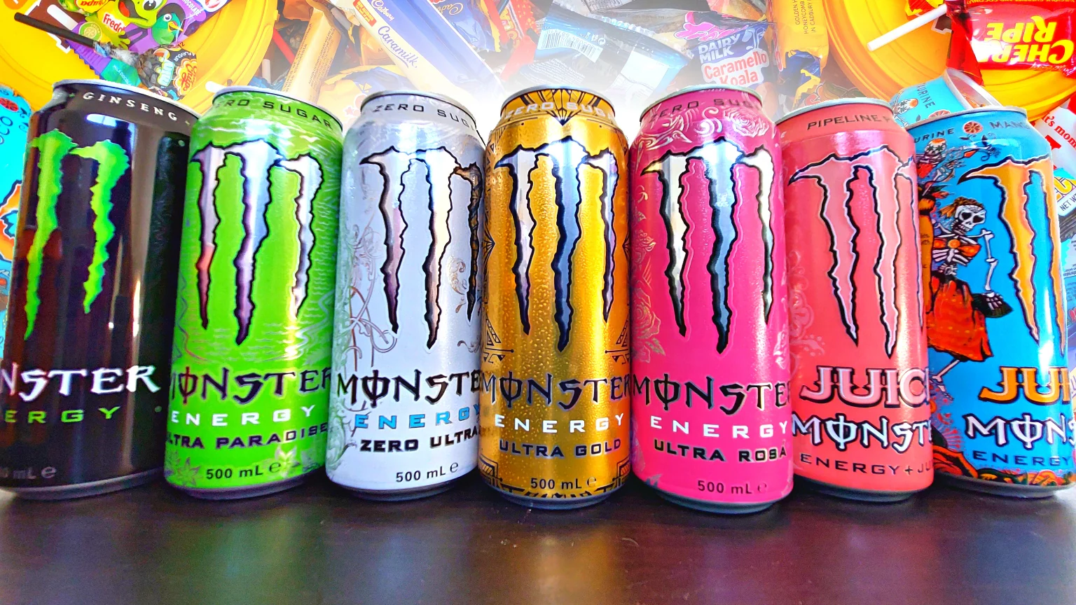
Boissons Energisantes.
ee

Slide 2
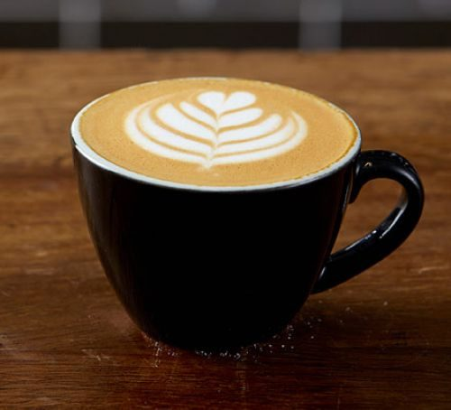
Not Enough.

Slide 3
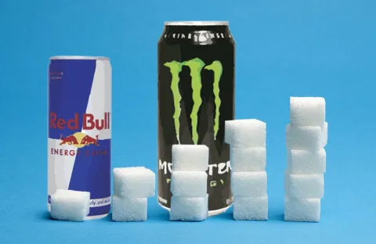
Bad For Health

Slide 4
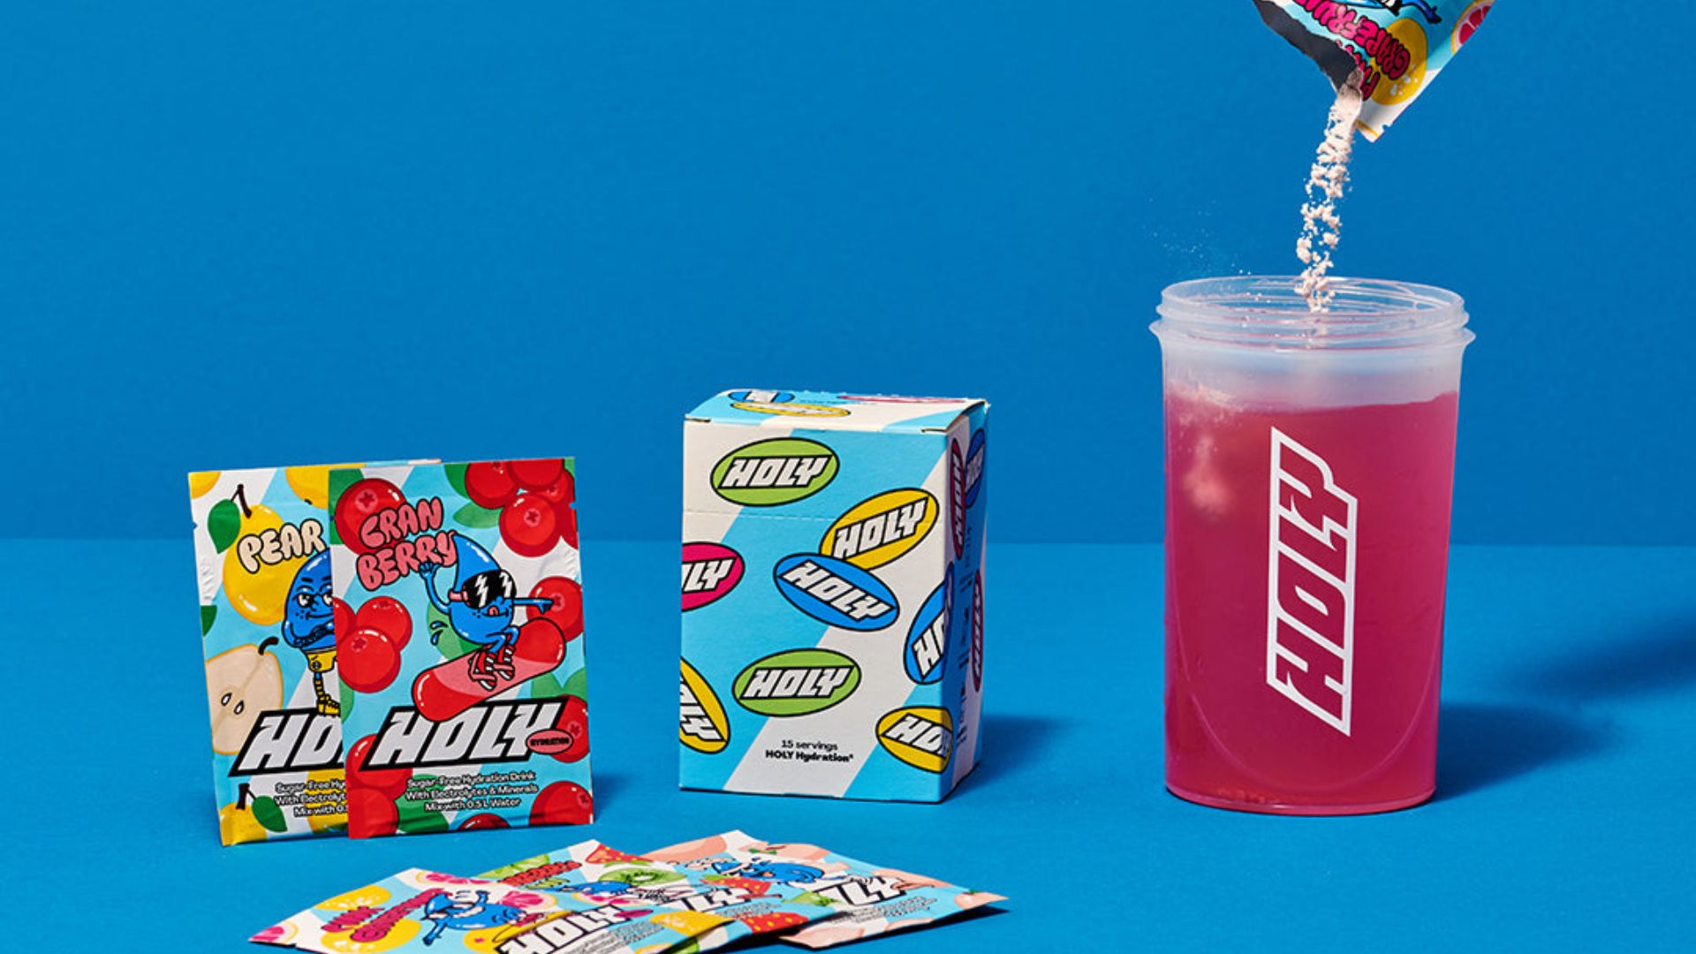
GOOD !

Slide 5
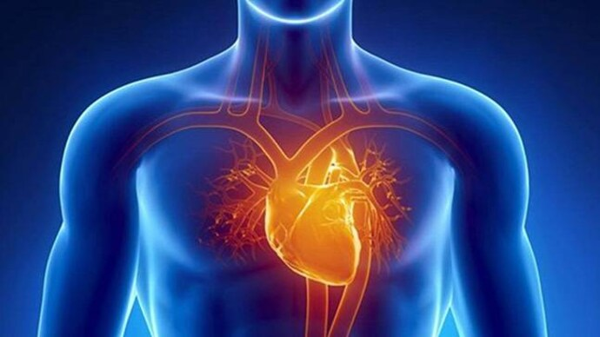
Life Expectancy

