Slide 1
Modelling Dengue Fever in Sri-Lanka to inform Study Design
Brian Brummer, Mariken de Wit, Manar Alkuzweny, and Robert Reiner

Slide 2
Table of contents
Introduction/Background
Research questions
Objectives
Methods
Deriving lambda and initial conditions for Colombo
Obtaining disease data for Colombo and Gampaha
Calculate Rho
Determine Lambda in Gampaha
Case definitions
Assumptions
Power Calculations
Equations
Results
Model output
Next Steps
References

Slide 3
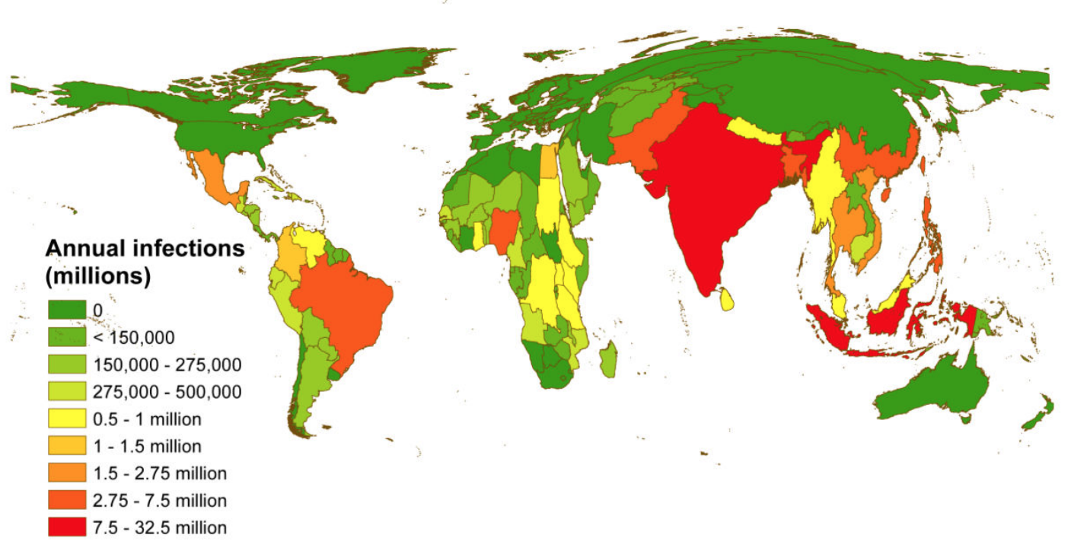
Introduction/Background
Dengue causes 400 million infections worldwide every year, leading to 100 million becoming ill and 21,000 deaths (making it the most impactful arboviral disease in humans). Case incidence is increasing exponentially, from 0.5 million cases in 2000 to 5 million in 2019.[1–3]
Four serotypes Second infection most severe Since early 2000s dengue outbreaks in Sri Lanka have become larger and multiple serotypes are now circulating [4] Vector control is main focus of prevention efforts [5,6].
Figure 1: Taken from Bhatt, et al. (2013) [3] , Shows ‘a cartogram of the annual number of infections for all ages as a proportion of national or sub-national (China) geographical area.’

Slide 4
Research questions

Slide 5
Objectives
Know S4 in Colombo for age ranges (find the Lambda in Colombo)
Get disease data for Colombo and Gampaha
Link lambda with disease in Colombo (find Rho)
Using the Rho from Colombo, find the number of, passive surveillance cases, acive surveillance cases and Infections (through seroprevalence. Find Lambda with disease in Gampaha with the Rho of Colombo
Calculate the number of participants needed in a cluster randomised trial.

Slide 6
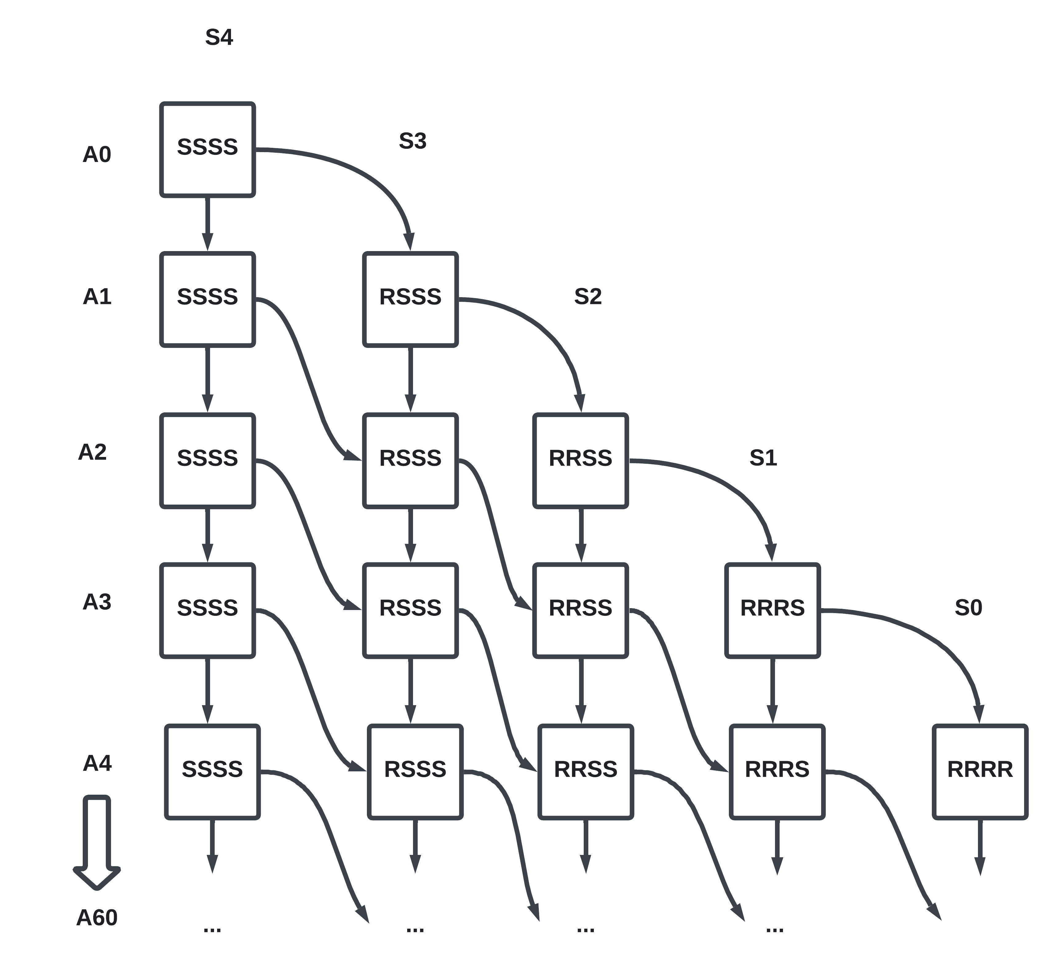
Methods
Figure 2: SLADE model diagram. Note: Time steps nor all compartments are displayed.

Slide 7
Deriving lambda and initial conditions for Colombo
We take the probability of first infection of ~ 14.1%.[4],
$$ P(First\;Infection|No\;Infection) = 1 - (1 - \lambda)^{4}= 0.141\ \\\ \\ therefore \; \lambda = 0.037 $$
We ran the simulation for 100 years, as the burn-in period. We determined the proportion of each susceptibility status per age.

Slide 8
Obtaining disease data for Colombo and Gampaha
Annual reported cases averaged over 5 years per 10 000 population is 100/10 000 pop. in Colombo and 77/10 000 pop in Gampaha. (ref)

Slide 9
Calculate Rho
$$ρ=P\left(case|I2\right)=casedetectionproportion/I2$$

Slide 10
Determine Lambda in Gampaha
We estimated the relationship between force of infection and reported cases in Colombo, assuming all reported cases are due to secondary infections. We also assumed the force of infection to case relationship is the same in both areas.
Case definitions
We assume 100% Sensitivity and specificity in all diagnostics.
Passive surveillance case - Symptomatic infections that presents to a health facility in Gampaha in year x.
$$PassiveCase=I2*P\left(case|I2\right)$$
Infection Surveillance - Any positive identified by Dengue IgG or IgM in Gampaha in year x.
$$InfectionCase=I2$$

Slide 11
Assumptions
We assume age distribution in Gampaha and Colombo are the same.

Slide 12
Power Calculations
Equations
$$n={\left(Z_{\frac{α}{2}} + Z_{β}\right)}^{2}\frac{π_{0}\left(1−π_{0}\right)+π_{A}\left(1−π_{A}\right)}{{\left(π_{0}−π_{A}\right)}^{2}}$$
$$\text{assuming} n \text{individuals per cluster, the necessary number of clusters is calculated:}$$
$$c=1+{\left(Z_{\frac{α}{2}} + Z_{β}\right)}^{2}\frac{\frac{π_{0}\left(1−π_{0}\right)}{n}+\frac{π_{A}\left(1−π_{A}\right)}{n}+k^{2}\left(π_{0}^{2}+π_{A}^{2}\right)}{{\left(π_{0}−π_{A}\right)}^{2}}$$

Slide 13
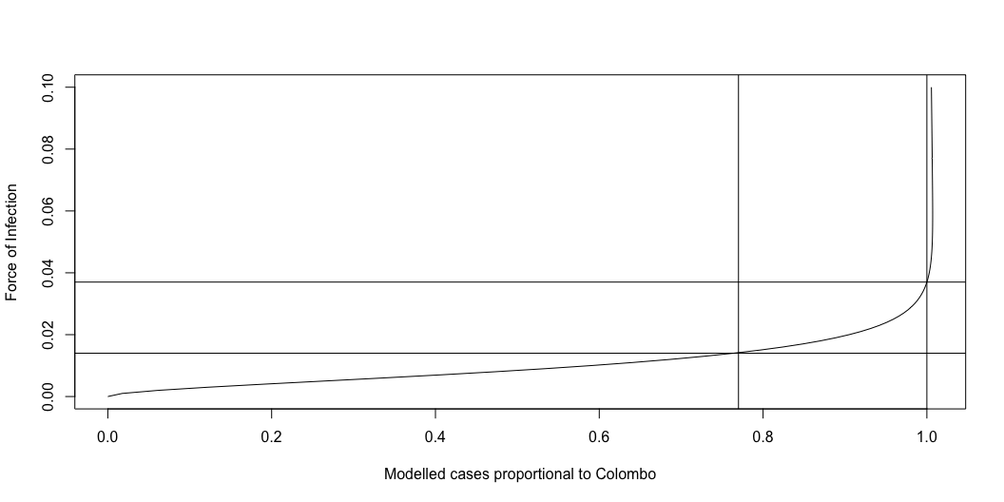
Results
Figure 3: DIagram of the proportion of estimated to Colombo with varying Force of infection. We assume Colombo has a lambda of 0.037 ( derived from Primary infection incidence) and that Gampaha has 77% of the cases in Colombo. We also assume that cases are secondary infections.

Slide 14
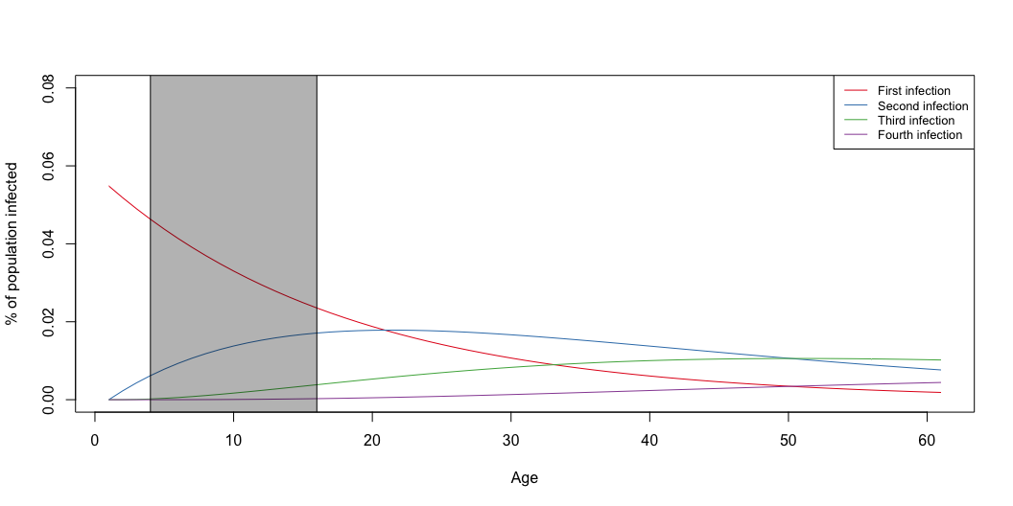
Model output
Figure 4: Output

Slide 15
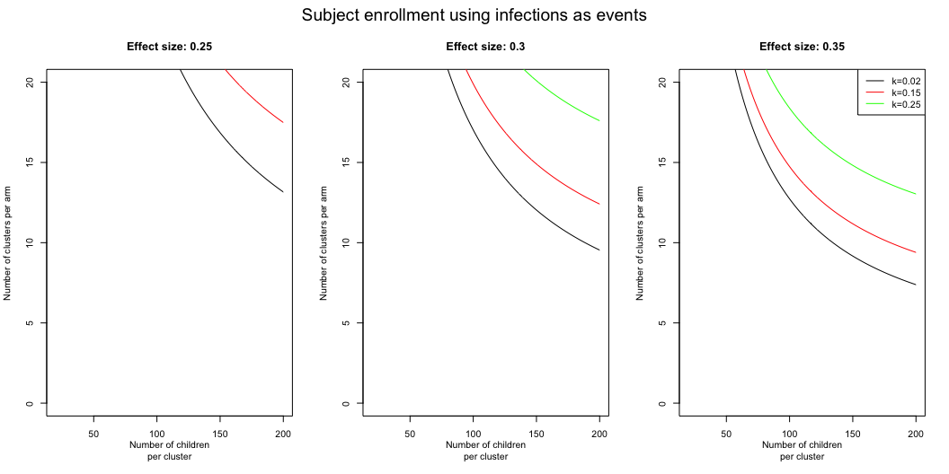
Figure 5: The sample sizes needed to show pi sample size for k clusters and n participants.

Slide 16
Figure 6: The Sample sizes needed to show pi sample size for k clusters and n participants.

Slide 17
We present the samples size on the x axis and clusters on the y axis for varying effect size $π_{diff}$ and inter-cluster coefficient $k$.

Slide 18
Next Steps

Slide 19
References
[1] W.H. Organization, Dengue and severe dengue, World Health Organizatin (WHO), 2023.
[2] S.A. Kularatne, C. Dalugama, Dengue infection: Global importance, immunopathology and management, Clin Med. 22 (2022) 9–13. https://doi.org/10.7861/clinmed.2021-0791.
[3] S. Bhatt, P.W. Gething, O.J. Brady, J.P. Messina, A.W. Farlow, C.L. Moyes, J.M. Drake, J.S. Brownstein, A.G. Hoen, O. Sankoh, M.F. Myers, D.B. George, T. Jaenisch, G.R.W. Wint, C.P. Simmons, T.W. Scott, J.J. Farrar, S.I. Hay, The global distribution and burden of dengue, Nature. 496 (2013) 504–507. https://doi.org/10.1038/nature12060.
[4] C.C. Tam, H. Tissera, A.M. de Silva, A.D. De Silva, H.S. Margolis, A. Amarasinge, Estimates of Dengue Force of Infection in Children in Colombo, Sri Lanka, PLoS Negl Trop Dis. 7 (2013) e2259. https://doi.org/10.1371/journal.pntd.0002259.
[5] N.L. Achee, F. Gould, T.A. Perkins, R.C. Reiner, A.C. Morrison, S.A. Ritchie, D.J. Gubler, R. Teyssou, T.W. Scott, A Critical Assessment of Vector Control for Dengue Prevention, PLoS Negl Trop Dis. 9 (2015) e0003655. https://doi.org/10.1371/journal.pntd.0003655.
[6] N. Kanakaratne, W.M.P.B. Wahala, W.B. Messer, H.A. Tissera, A. Shahani, N. Abeysinghe, A.M. de Silva, M. Gunasekera, Severe Dengue Epidemics in Sri Lanka, 2003–2006, Emerg. Infect. Dis. 15 (2009) 192–199. https://doi.org/10.3201/eid1502.080926.

