Slide 1
Applet

Slide 2
Introduction
Small java program
Program transported over the network
Used for internet applications
Embedded in HTML page
Can be downloaded from the server and run on the client

Slide 3
Types of Java Programs
Standalone
Web based

Slide 4
Standalone program
Run on a single machine
Compiler – javac
Interpreter – java

Slide 5
Web Based Program
Compiler – javac
Intepreter – appletviewer or web browser
Must include Subclass of applet
Import java.awt

Slide 6
Different between applet and application
Applet | Application
The execution of the applet doe snot start from main() method as it does not have one. | The execution of an application program starts from main().
Applets cannot run on their own, that means they have to be embedded inside a web page to get executed. | These can run on their own. That means in order to get executed, they need to be embedded inside any web page.
Applets can only be executed inside a browser or applet viewer. | Application are executed at command line.
Applet executed under strict security limitations that disallow certain operations. | Application have no security restrictions.
Applets have their own life cycle init() → start() → paint() → stop → desktop() | Applications have their own life cycle. The execution begins with main().

Slide 7
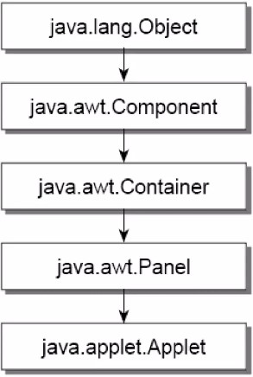
Applet classes
java.applet.Applet is the super class of the all the applets.
Applet class has a predefined hierarchy

Slide 8
Applet example
https://www.geeksforgeeks.org/different-ways-to-run-applet-in-java/

Slide 9
The output

Slide 10
Applet life cycle
An applet may move from one state to another depending upon a set of default behaviors inherited in the form of methods from “Applet” class.
The states are : Born, Running, Idle, Dead

Slide 11
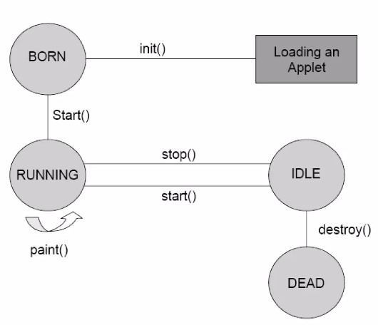
Applet State Diagram

Slide 12
Life Cycle of Applet
init()
Creates the objects needed by the object.
Sets up initial values, load font and images or set of colors
Called only once during the lifetime of an applet.
start()
Moves to this phase automatically after the initialization state.
If the applet is stopped or it goes to idle state, start() method must be called in order to force the applet again to the running state.
paint()
This method is called each time to draw and redraw the output of an applet.
stop()
Idle state, once it is stopped from running.
destroy()
An applet goes to dead state when it is destroyed by invoking the destroy() method.
It results in complete removal of applet from the memory.

Slide 13
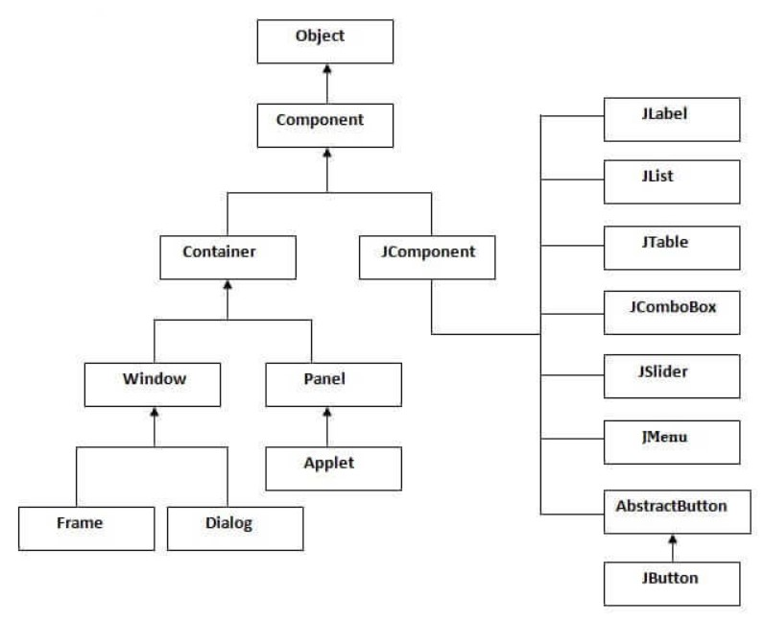
Swing Class Hierarchy

