Slide 1
JDBC

Slide 2
What is it?
Java Database Connectivity
Java API to connect and execute the query with the database
to execute queries on various databases
perform operations like SELECT, INSERT, UPDATE and DELETE
Part of Java SE
Uses JDBC drivers to connect with the database

Slide 3
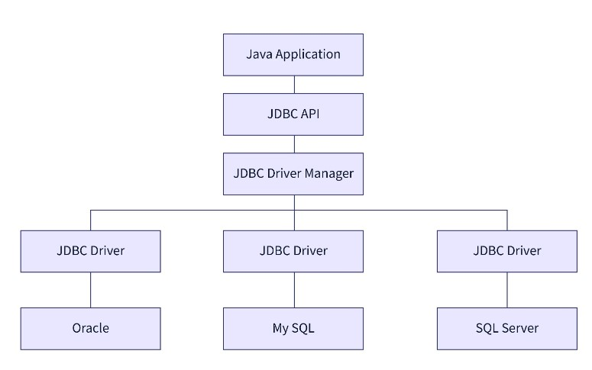
JDBC Architecture

Slide 4
JDBC Architecture Components
Application
The JDBC API
DriverManager
JDBC Drivers
Data Sources

Slide 5
JDBC Architecture Components : Application
java applications like applets or servlet that communicates with databases

Slide 6
JDBC Architecture Components : The JDBC API
Application Programming Interface used to create Databases
uses classes and interfaces to connect with databases
DriverManager class, Connection Interface, etc.

Slide 7
JDBC Architecture Components : DriverManager
used to connecting with data sources
Database specific drivers for Oracle, MSSQL, MYSQL, etc
Class.forName() method is used to load drivers in JDBC architecture

Slide 8
JDBC Architecture Components : Data Sources
the databases that we can connect using this API
Sources where data are stored

Slide 9
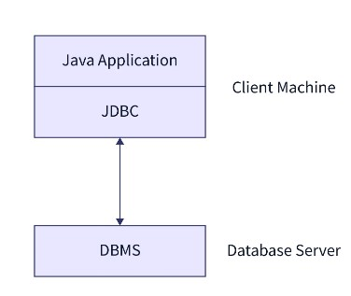
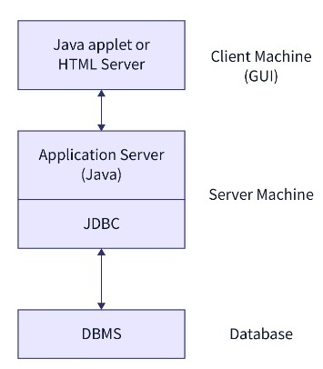
Types of JDBC Architecture
Two tier architecture
Three tier architecture

Slide 10
JDBC driver types
Are client-side adapters (installed on the client machine, not on the server) that convert requests from Java programs to a protocol that the DBMS can understand.
are the software components which implements interfaces in JDBC APIs to enable java application to interact with the database
4 types of JDBC drivers
Part of Java SE
acts as a middle-layer interface between Java applications and databases
Imported from java.sql and javax.sql packages
Connect to a data source, like a database.
Send queries and update statements to the database
Retrieve and process the results received from the database

Slide 11
JDBC driver types…. Contd…
Type-1 driver or JDBC-ODBC bridge driver
Type-2 driver or Native-API driver
Type-3 driver or Network Protocol driver
Type-4 driver or Thin driver

Slide 12
JDBC-ODBC bridge driver – Type 1 driver
uses ODBC (Open Database Connectivity) driver to connect to the database
also called Universal driver because it can be used to connect to any of the database
Advantages
This driver software is built-in with JDK so no need to install separately.
It is a database independent driver.
Limitations
in order to interact with different databases, the data transferred through this driver is not so secured.
driver is needed to be installed in individual client machines.
driver isn’t written in java, that’s why it isn’t a portable driver.

Slide 13
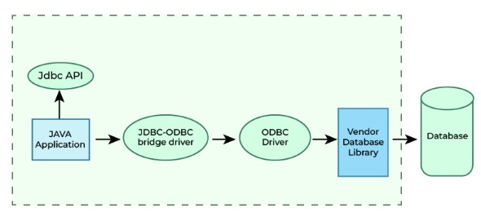
JDBC-ODBC bridge driver – Type 1 driver

Slide 14
Native-API driver – Type 2 driver ( Partially Java driver)
uses the client -side libraries of the database
converts JDBC method calls into native calls of the database API
In order to interact with different database, this driver needs their local API, that’s why data transfer is much more secure as compared to type-1 driver
driver is not fully written in Java that is why it is also called Partially Java driver
Advantages
Native-API driver gives better performance than JDBC-ODBC bridge driver.
Limitations
Driver needs to be installed separately in individual client machines
The Vendor client library needs to be installed on client machine.
Type-2 driver isn’t written in java, that’s why it isn’t a portable driver
It is a database dependent driver.

Slide 15
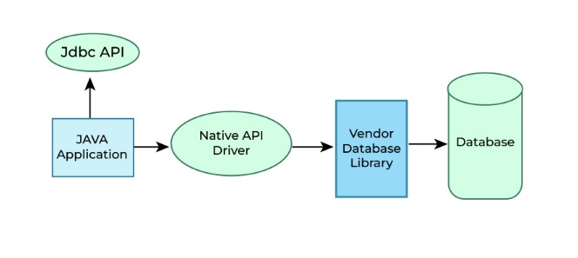
Native-API driver – Type 2 driver ( Partially Java driver)

Slide 16
Network Protocol driver – Type 3 driver (fully Java driver)
Driver uses middleware (application server) that converts JDBC calls directly or indirectly into the vendor-specific database protocol
all the database connectivity drivers are present in a single server, hence no need of individual client-side installation
Advantages
Type-3 drivers are fully written in Java, hence they are portable drivers.
No client side library is required because of application server that can perform many tasks like auditing, load balancing, logging etc.
Switch facility to switch over from one database to another database.
Limitations
Network support is required on client machine.
Maintenance of Network Protocol driver becomes costly because it requires database-specific coding to be done in the middle tier.

Slide 17
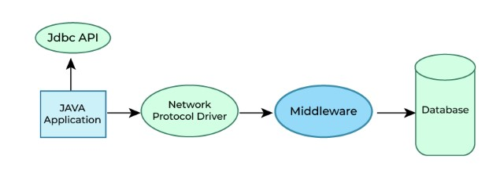
Network Protocol driver – Type 3 driver (fully Java driver)

Slide 18
Thin driver – Type 4 driver (fully Java driver)
driver is also called native protocol driver
this driver interact directly with database
does not require any native database library, that is why it is also known as Thin Driver
Advantages
Does not require any native library and Middleware server, so no client-side or server-side installation.
It is fully written in Java language, hence they are portable drivers.
Limitations
If the database varies, then the driver will carry because it is database dependent.

Slide 19
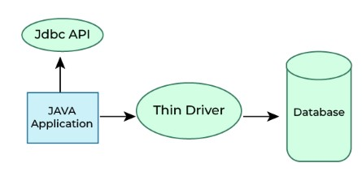
Thin driver – Type 4 driver (fully Java driver)

Slide 20
When to use which driver?
The type 1 driver is not considered a deployment-level driver, and is typically used for development and testing purposes only.
Type 2 drivers are useful in situations, where a type 3 or type 4 driver is not available yet for your database.
If your Java application is accessing multiple types of databases at the same time, type 3 is the preferred driver.
If you are accessing one type of database, such as Oracle, Sybase, or IBM, the preferred driver type is type-4.

Slide 21
Thank you !!!

