Slide 1

AeDAM: An Event-Driven Architecture Mapping exploration tool
MSc Thesis Defense
Naga Subhash Malladi
Student No: 6006388
Computer and Embedded Systems Engineering
Supervisors: Dr. Rajendra Bishnoi & Kanishkan Vadivel
Thesis Advisor: Prof. Said Hamdioui
External Committee member: Dr. R.R Venkatesha Prasad
Hardware Efficient AI Group, IMEC Netherlands | Computer Engineering, TU Delft, The Netherlands
Notes:
Good morning, everyone. Thank you for being here today—supervisors, committee members, colleagues, family, and friends.
Today I will present my master's thesis work on AeDAM, an Event-Driven Architecture Mapping exploration tool. This research addresses a critical gap in the design space exploration tools available for emerging neuromorphic and event-driven computing architectures.
There is substantial ground to cover, so let us begin.

Slide 2

















AI is Everywhere
Agriculture
Cyber Security
Justice
Business
Transportation
Manufacturing
Logistics
Tourism
Ecommerce
Sports
Retail
Education
Banking
Data Analytics
Healthcare
Customer Service
Notes:
Artificial intelligence is everywhere in our world today. From transportation and healthcare to retail and manufacturing.
These systems are used in self-driving cars, medical diagnosis, online shopping recommendations, smart farming, banking services, and many other applications.
However, this growth in AI creates major challenges, especially when we need to run these intelligent systems on devices with limited power and processing capabilities.
This is an edge computing challenge.

Slide 3
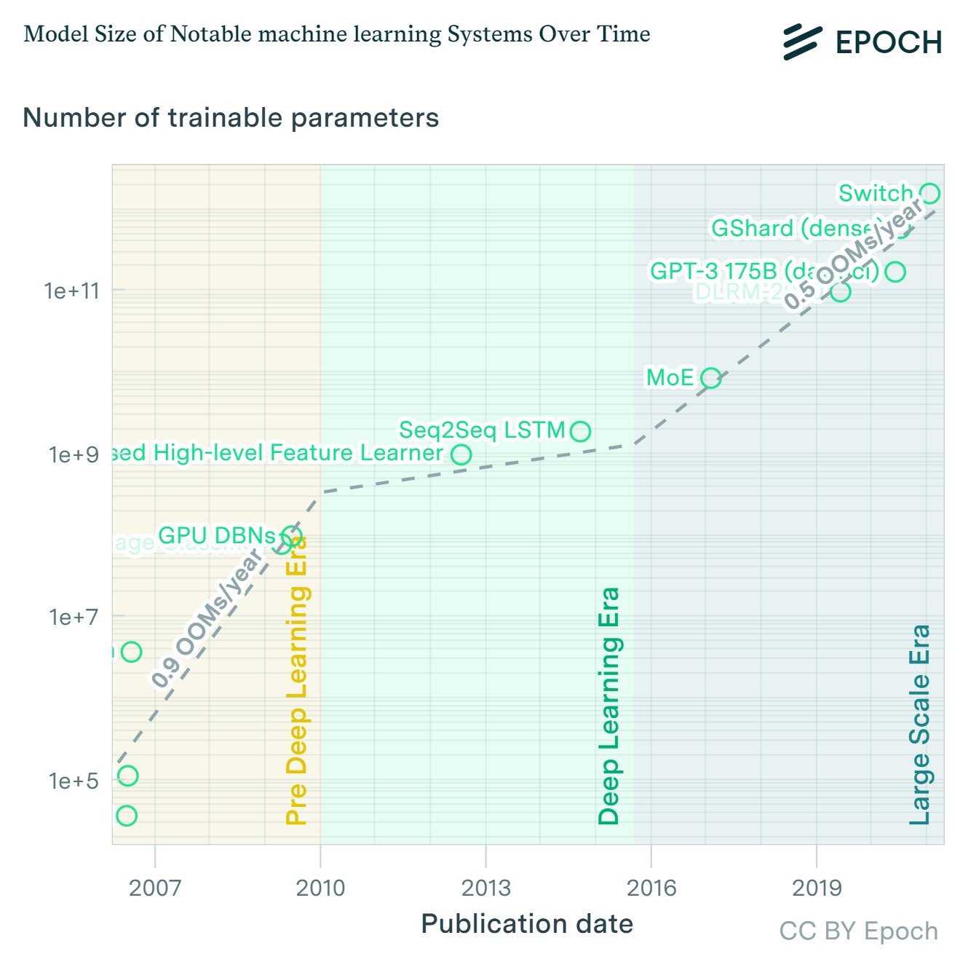
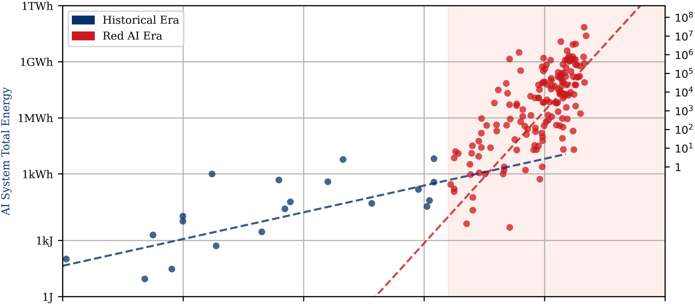
AI is Everywhere
The Edge Computing Challenge
AI models are scaling exponentially
From millions to billions of parameters in just over a decade
Energy consumption follows the same trend
Red AI Era" - absolute energy costs rising with model scale
Harsh resource constraints on edge hardware
Bottleneck at memory, energy, processing power [1]
[1] Alsamhi, S. H., et al. (2025). "Optimizing Edge AI: A Comprehensive Survey on Data, Model, and System Strategies. [2] Epoch AI (2024) [3] Brownlee et al. (2024)
Notes:
This widespread AI adoption creates a serious problem.
AI models are growing at an incredible rate - from millions to billions of parameters in just over a decade.
Energy consumption is following the same trend upward. We are now entering what experts call the 'Red AI Era' where energy costs rise dramatically with model size.
Meanwhile, edge devices face harsh limits on memory, energy, and processing power
Is there a solution?

Slide 4
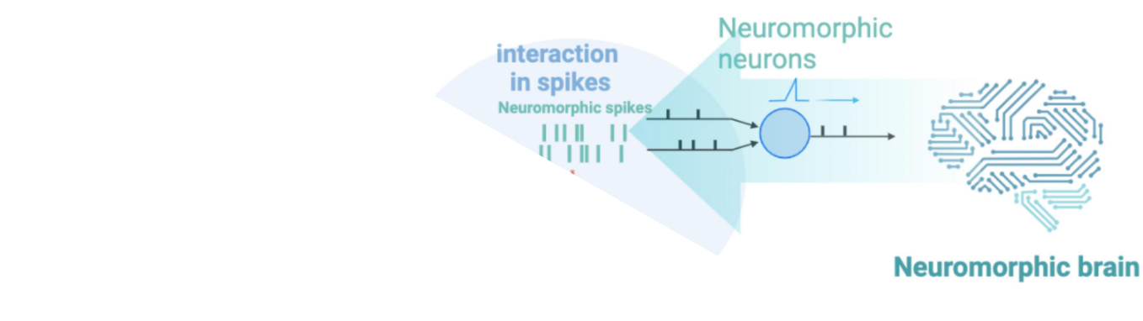
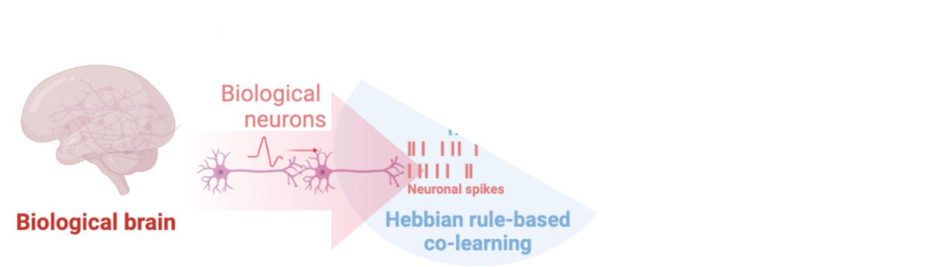
AI is Everywhere
Is there a solution?
Bio inspired Techniques
Asynchronous
Analog
Circuits
Event driven
Co-located processing and memory
Spiking Neural Networks
Hardware
Software
https://www.frontiersin.org/journals/neuroscience/articles/10.3389/fnins.2023.1153985/full
Notes:
Is there a better solution?
Our brain processes complex tasks using only twenty watts of power. Inspired by this efficiency, neuromorphic computing emerged.
This approach uses bio-inspired techniques including asynchronous processing, analog circuits, event-driven computation, co-located memory and processing, and spiking neural networks.
These methods process information only when changes occur, dramatically improving energy efficiency for edge applications.
Full Presentation Notes (for preparation):
The key insight comes from studying biological systems. The human brain demonstrates remarkable efficiency, performing complex cognitive tasks while consuming approximately twenty watts of power. This efficiency stems from several fundamental principles that differ dramatically from traditional computing approaches.
Neuromorphic computing emerged from studying these biological principles. The brain operates asynchronously, meaning different regions process information independently without requiring global synchronization. Processing occurs only when neurons receive sufficient input to generate spikes, creating an event-driven system that avoids unnecessary computation.
Five core bio-inspired techniques enable this efficiency. Asynchronous processing eliminates the need for global clocks, allowing independent computation across different system components. Analog circuits provide continuous signal processing that more closely resembles biological neuron behavior. Event-driven processing triggers computation only when changes occur, significantly reducing energy consumption. Co-located processing and memory integration eliminates the energy overhead of constantly moving data between separate processing and storage units. Finally, spiking neural networks use the timing of discrete events to encode and process information, closely mimicking biological neural communication.
These principles collectively address the fundamental energy efficiency challenges facing edge AI deployment by processing information only when necessary, rather than continuously consuming power regardless of computational requirements.

Slide 5
Event Driven Paradigm
Paradigm Shift from Frame-Based to Event-Based Processing
Traditional Frame-Based Computing
Processes whole data frames continuously
16.7ms temporal resolution (60fps standard)
High bandwidth requirements (184 Mpix/s data stream)[1]
Event-Driven Computing Paradigm
Only processes changes when they occur
~1µs latency [2]
Sparse data: 1-10 MEPS typical (vs 30 MEPS max)[3]
The advantage
500mW → 3mW sensor power (150× reduction)[4]
Perfect for edge application
[1] DS-CAM-600 datasheet (DeWESoft, 2020) [2] Event camera latency review (zlthinker.github.io)
[3] DAVIS-240C specifications (iniVation, 2019) [4] Prophesee GenX320 specifications (Prophesee, 2024) [5] https://prg.cs.umd.edu/EVDodgeNet
Notes:
Traditional computing processes every pixel in every frame continuously, handling 184 million pixels per second even when nothing changes.
Event-driven computing processes only changes when they occur, reducing data to just 1-10 million sparse events per second.
This paradigm shift delivers microsecond latency response times with 150 times less sensor power consumption, making it perfect for edge applications.
Full Presentation Notes (for preparation):
The fundamental difference between traditional and event-driven computing lies in their processing philosophy. Traditional frame-based computing operates on a fixed schedule, continuously processing complete data frames regardless of whether changes have occurred. This approach processes whole data frames every 16.7 milliseconds at standard 60 frames per second, resulting in high bandwidth requirements of 184 million pixels per second data streams.
Event-driven computing represents a paradigm shift that processes information only when changes occur in the environment. Rather than continuously analyzing static data, this approach responds exclusively to changes, reducing the data load to approximately 1-10 million events per second compared to the maximum 30 million events per second capability. This selective processing approach dramatically reduces computational overhead.
The performance improvements are substantial and measurable. Event-driven systems achieve approximately one microsecond latency compared to the 16.7 millisecond temporal resolution of traditional systems. Power consumption drops dramatically, with sensor power reducing from 500 milliwatts to just 3 milliwatts, representing a 150-fold improvement in energy efficiency.
This efficiency gain makes event-driven processing particularly suitable for edge applications where power constraints are critical. The sparse nature of event data means processing resources are utilized only when environmental changes require attention, eliminating the energy waste associated with continuously processing unchanged information.

Slide 6
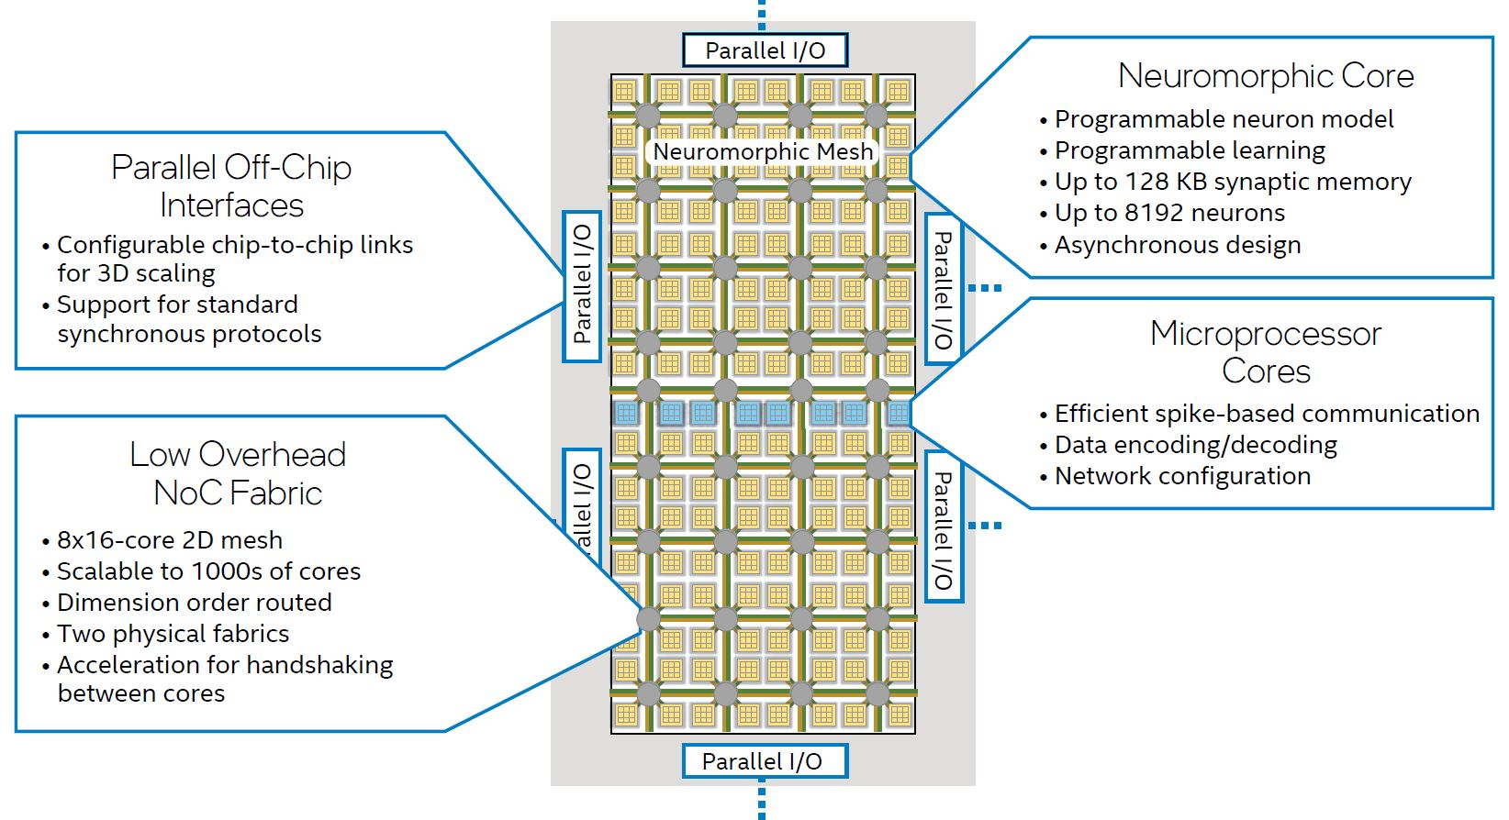
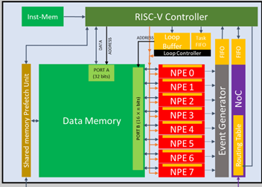
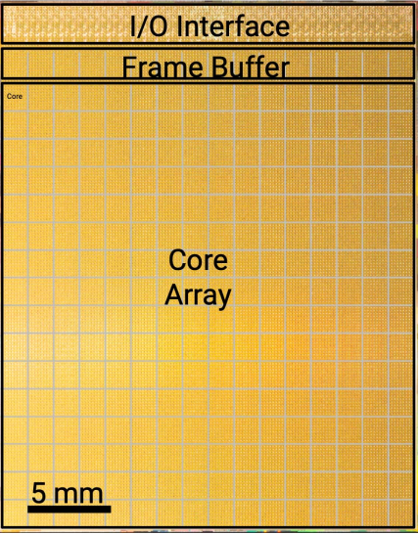
Neuromorphic Architecture Landscape
Every accelerator architecture is unique
Memory elements
Memory elements
PE & Memory elements
PE
Packets
generated
Interconnect s
Interconnects
Interconnects
Each architecture has many Design Space exploration points........
Memory elements
Memory elements
PE
Interconnects
Interconnects
Intel Loihi
IMEC Seneca
IBM Northpole
[1] https://www.servethehome.com/intel-loihi-2-neuromorphic-compute-tile-on-intel-4/intel-loihi-2-chip-architecture/
[2]SENECA: building a fully digital neuromorphic processor, design tradeo sandchallenges
[3]4 IBM NorthPole: An Architecture for Neural Network Inference with a 12nm Chip
Notes:
While event-driven computing offers a solution, implementing it creates new challenges.
The neuromorphic architecture landscape shows tremendous diversity. Intel Loihi, IMEC Seneca, and IBM Northpole each use completely different approaches for organizing processing elements, memory systems, and interconnects.
Every architecture has countless design space exploration points including processing elements, memory configurations, interconnect strategies, and other architectural components.
Full Presentation Notes (for preparation):
Animation 1 - Architecture Diversity: Event-driven computing provides the theoretical solution to edge AI challenges, but implementing these systems reveals significant complexity. The neuromorphic architecture landscape demonstrates remarkable diversity across different implementations. Three major examples illustrate this variety: Intel Loihi focuses on programmable neuron models with extensive synaptic memory, IMEC Seneca emphasizes fully digital neuromorphic processing with RISC-V controllers, and IBM Northpole integrates massive core arrays with distributed memory systems.
Animation 2 - Component Highlighting: Each architecture makes fundamentally different decisions about core components. Processing elements vary dramatically in their organization, capabilities, and interconnection strategies. Memory systems range from distributed local storage to centralized shared resources with different bandwidth and latency characteristics. The physical arrangement of these components creates unique trade-offs in energy efficiency, performance, and area utilization.
Animation 3 - Design Space Explosion: This architectural diversity creates an explosion of design space exploration points. Every architecture presents numerous configuration options for processing element arrangements, memory hierarchy organization, interconnect topologies, and specialized functional blocks. The challenge becomes systematically exploring these vast design spaces to identify optimal configurations for specific applications and constraints.
This complexity motivates the need for specialized exploration tools that understand the unique characteristics of event-driven architectures, rather than trying to adapt tools designed for traditional synchronous systems.

Slide 7
Exploration should be Science based not an Art
Notes:
With so many architectural choices and design options, how do we find the best configuration?
This process should be science-based, not an art form relying on intuition. We need systematic, analytical mapping exploration tools that can methodically evaluate different configurations.
Rather than guessing or using trial-and-error approaches, we require rigorous scientific methods to guide architectural decisions.“
Full Presentation Notes (for preparation):
The complexity we just observed in neuromorphic architectures presents a fundamental challenge for system designers. With countless configuration options across processing elements, memory hierarchies, and interconnect strategies, the question becomes: how do we systematically identify optimal designs?
Traditionally, architecture exploration has often relied on expert intuition, rules of thumb, and iterative trial-and-error approaches. Designers would make educated guesses about promising configurations, implement prototypes, and refine their designs based on experimental results. While this approach can work for simple systems, it becomes completely impractical when dealing with the vast design spaces characteristic of neuromorphic architectures.
The solution requires transforming architecture exploration from an art form into a rigorous scientific discipline. This transformation demands analytical mapping exploration tools that can systematically evaluate design alternatives using quantitative methods. These tools must be capable of modeling complex architectural interactions, predicting performance and energy characteristics, and identifying optimal configurations through systematic search rather than intuitive guesswork.
Scientific exploration tools provide several critical advantages: they can exhaustively examine design spaces that would be impossible to explore manually, they eliminate human bias and subjective preferences from the optimization process, and they provide reproducible results that can be validated and compared across different research efforts.
This scientific approach becomes the foundation for my research contributions, which focus on developing specialized exploration tools for event-driven architectures.

Slide 8
Scope of Research
Problem Statement
Mapping Exploration tools designed for synchronous accelerators are inefficient for event-driven architectures.
Research Gap
No End-to-End Event driven Exploration tool
My Contributions
An Exploration tool which performs the following:
Event driven intra-core spatial and temporal mapping exploration
Design Space exploration of Event driven architectures
Different memory configuration
Different PE arrangements
Notes:
Problem statement: Current mapping exploration tools are mainly focused on the Frame based accelerator and are in efficient for the event driven architecture exploration and optimization
Leads to
Research gap:
Not having an end to end tool (That considers Sparsity and event driven dataflow modelling for single and multi core architectures)
Address this
My contributions:
Proposing an exploration tool which performs
Event driven intra-core spatial and temporal mapping explorations
Performing the Design space exploration and optimizing of Event driven architectures on the basis of
Different memory configuration and PE arrangement

Slide 9
Outline
Introduction
Background
Exploration process
Different dataflow strategies
Related work
Thesis Contribution & Proposed AeDAM framework
Results
Conclusion and Future Work

Slide 10
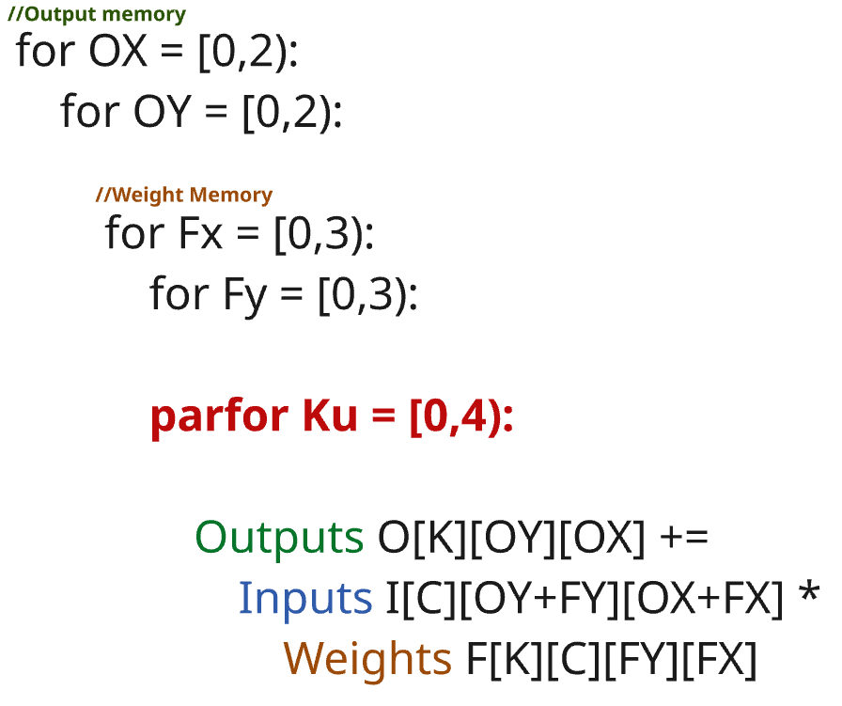
Mapping CNNs to Hardware: Spatial & Temporal Unrolling
Hardware Mapping: Spatial & Temporal Unrolling
C
C
K
Temporal unrolling
K
B
B
OY
FY
IY
Spatial unrolling
OX
FX
IX
Convolution Layer
Convolution to Nested loops
Notes:
Before delving deep into the intriceses of the Mapping exploration tool, let me explain how neural networks map to hardware.
Convolution operations involve multiple nested loops across different dimensions like batch size, channels, and spatial coordinates.
Hardware accelerators use two key strategies: spatial unrolling distributes computation across multiple processing elements simultaneously, while temporal unrolling sequences operations over time to optimize memory usage and performance.

Slide 11
What is Exploration ?
Execution of the Workload on the Accelerator
Many more combinations are possible ….
Output reuse mapping
Notes:
In the animation, The output stationary mapping is being executed on the hardware where the partial sums are constant in the PE and the weights and inputs are accessed continuously to perform the final output.
Here the spatial unrolling is across the output channels and they are computed in parallel as shown This shows how the mapping exploration process executes workloads on the target accelerator architecture..

Slide 12
Different Dataflow strategies
From Traditional Approaches to Event-Driven Execution
Stationary element: Partial Sums
Stationary element: Filter weights
Stationary element: Input Activations
Stationary element: Non zero activation
Output Stationary
Weight Stationary
Input Stationary
Event driven
Notes:
Traditional dataflow strategies keep different data types stationary to optimize memory access.
Output stationary minimizes partial sum movement, weight stationary reduces filter reloading, and input stationary optimizes input reuse.
Event-driven dataflow represents a fundamental shift: it keeps only non-zero activations stationary, completely skipping zero computations. This sparse processing paradigm requires entirely different mapping and scheduling approaches
Output stationary – Partial sums
Weigh stationary – Weights
Input stationary – Inputs are accessed by unrolling themspatially
Event stationary – Where are single event is accessed one by one

Slide 13
Outline
Introduction
Background
Exploration process
Different dataflow strategies
Related work
Thesis Contribution & Proposed AeDAM framework
Results
Conclusion and Future Work

Slide 14
Related works
Capabilities and Limitations Analysis
Framework | Primary Focus | Event-driven Capabilities | Multi-core Support | Sparsity Support | Framework relationship
Timeloop | Dense tensor modelling | Traditional | Single core | None | Foundation
Zigzag | Memory centric DSE | Traditional | Single core | None | Foundation
Convfusion | Layer fusion optimisation | Traditional | Single core | None | Foundation
Stream | Multi-core exploration | Traditional | Yes | None | Built on Zigzag
Sparseloop | Sparse tensor modelling | Traditional | Single core | Weight and input sparsity | Built on Timeloop
Frame based dataflow architecture model
Our goal: A sparsity-aware, event-driven mapping exploration tool for single-core and multicore design space optimization
Multi core frame based dataflow
[1] Parashar et al., "Timeloop: A Systematic Approach to DNN Accelerator Evaluation," ISPASS 2019 [2] Mei et al., "ZigZag: Enlarging Joint Architecture-Mapping Design Space Exploration for DNN Accelerators," IEEE Trans. Computers 2021 [3] Waeijen et al., "ConvFusion: A Model for Layer Fusion in Convolutional Neural Networks," IEEE Access 2021
[4] Symons et al., "Towards Heterogeneous Multi-core Accelerators Exploiting Fine-grained Scheduling of Layer-Fused Deep Neural Networks," arXiv 2022 [5] Wu et al., "Sparseloop: An Analytical Approach to Sparse Tensor Accelerator Modeling," MICRO 2022
Notes:
Existing state-of-the-art exploration tools address different aspects of accelerator design but share a fundamental limitation:
all focus exclusively on traditional frame-based dataflow architectures. Timeloop handles dense tensors, Zigzag emphasizes memory-centric design, Sparseloop adds sparsity support, and Stream enables multi-core exploration.
However, none provide event-driven capabilities. Our goal addresses this critical gap with comprehensive event-driven exploration.
1. Current SoTA tools focus on the modelling on the Frame based dataflow architectures.
2. Stream which is capable of performing multicore exploration, works only for frame based architectures
Our goal is to provide a sparsity-aware, event driven mapping exploration tool for single-core and multi core design space optimisation.

Slide 15
Outline
Introduction
Background
Exploration process
Different dataflow strategies
Related work
Thesis Contribution & Proposed AeDAM framework
Results
Conclusion and Future Work

Slide 16
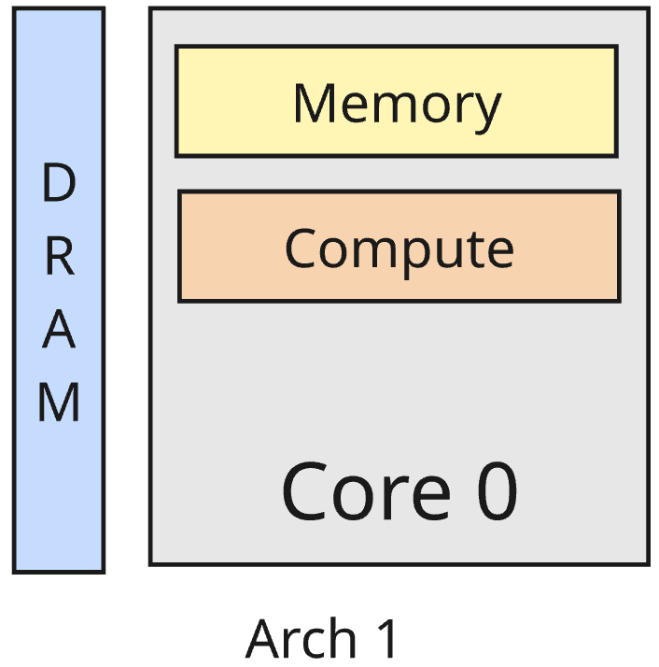
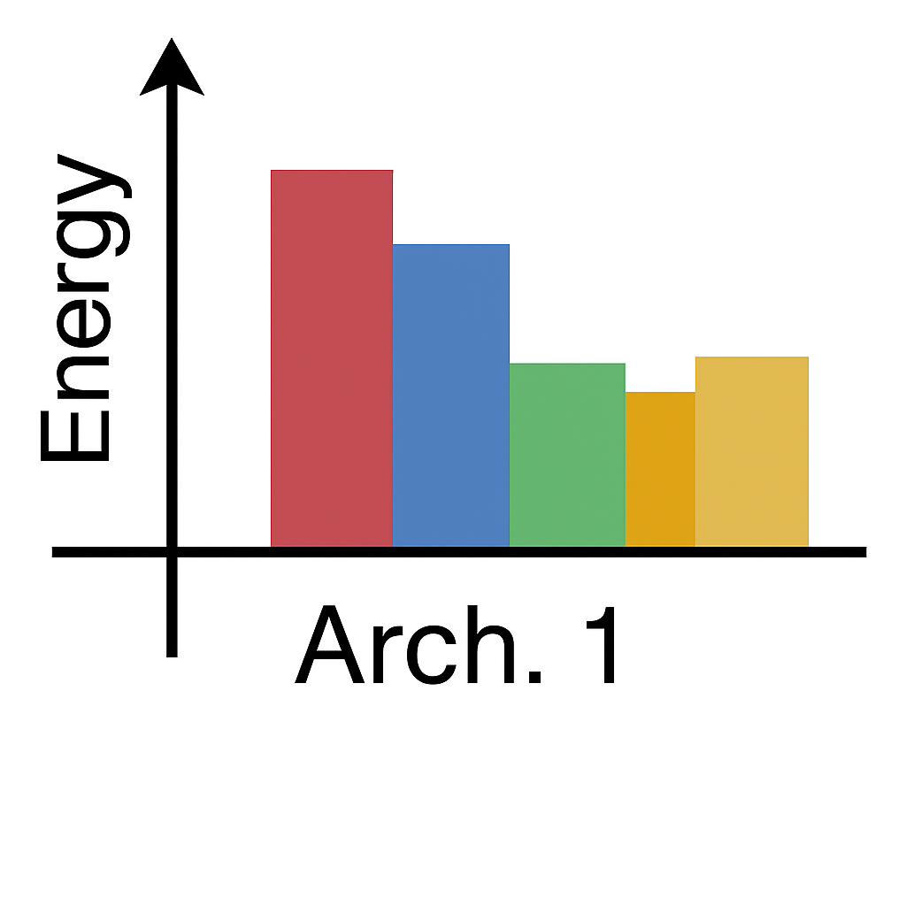
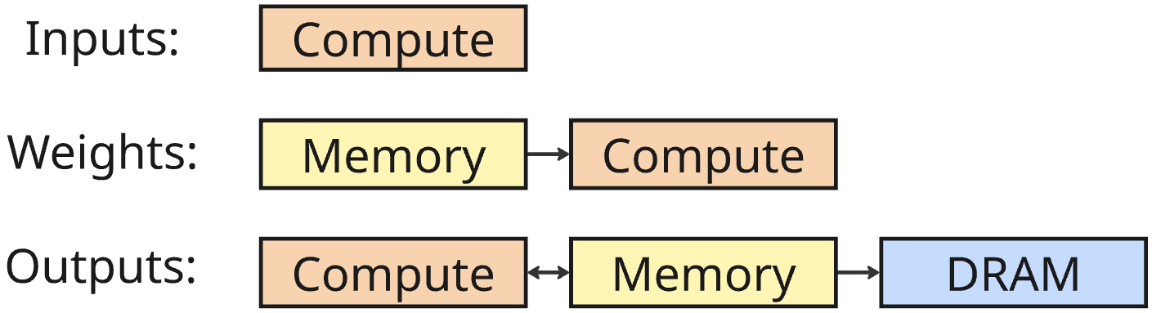
Thesis Contributions: Overview
Comprehensive Event-Driven Architecture Exploration Framework
Architecture Configuration
Energy and Latency
Workload Configuration
Event driven core modelling
Multi core exploration
Sparsity awareness
Final mapping Schedule
Spatial unrolling:
D1: K,8 Temporal ordering:
IX,5
IY,5
FY,3
FX,3
Memory utilization:
Inputs: {}
Weights: {}
Outputs: {}
Spatial utilisation:
PE utilisation: {}
Resource Utilizations
Mapping
Notes:
Here is the overall ideal high level view of the AeDAM framework, which is developed with the goal to meet the end – end requirements of the event driven architecture exploration
It takes into consideration:
Singe core event driven modelling
Extends it to mutli core exploration
Finally considers the sparsity in inputs and weights

Slide 17
AeDAM Implementation Scope
Single-Core Event-Driven Mapping Exploration Focus
Energy and Latency
Architecture Configuration
Workload Configuration
Event driven core modelling
Final mapping Schedule
Spatial unrolling:
D1: K,8 Temporal ordering:
IX,5
IY,5
FY,3
FX,3
Memory utilization:
Inputs: {}
Weights: {}
Outputs: {}
Spatial utilisation:
PE utilisation: {}
Mapping
Resource Utilizations
Notes:
Out of the three goals of an ideal end to end exploration tool:
The main focus is Event driven core modelling only , This exploration deals with finding the best possible mapping schedule of a given workload, layer by layer on an single core event driven architecture.
Let’s understand the internal working on this particular block

Slide 18
I
AeDAM Framework

Slide 19
AeDAM Component Overview
Mapping space generation
Best mapping schedule for workload
Event driven core
modelling
Mapping search Engine
Resources utilisation stats
Inputs: 1. Architecture Configuration
2.Workload Configuration
3.Mapping
Analytical cost model
Overall latency and energy stats
Notes:
This exploration block consists of
Three main compnenets
Map space generator
Map Search Engine
Analytical cost model for evaluating the mappings in the mapspace
This finally gives the outputs
Best mapping schedule on the workload on the architecture being modelled
Energy and latency stats along with the resource utilisation stats

Slide 20
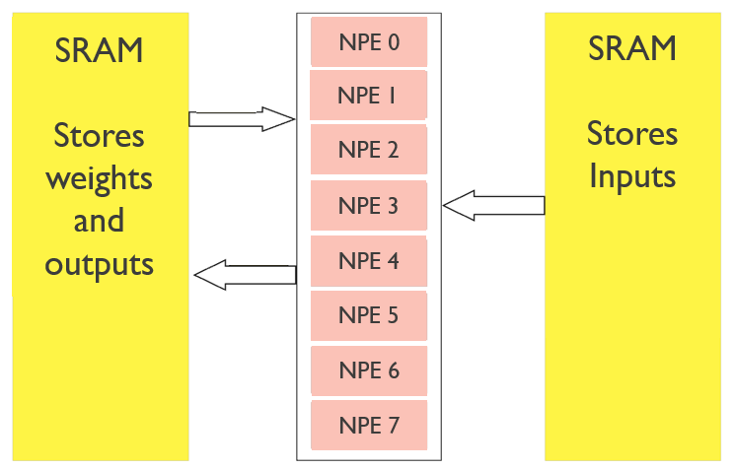
Architecture and Workload Specification
C
C
K
Inputs
K
B
B
OY
Mapspace generation
FY
IY
OX
Analytical cost model
FX
IX
Operational Array: //MAC units
Memories: // Different memories level
//For each memory level
Size
R/W bandwidth
R/W Energy data
Area
Ports
Latency
Dimension_relation: [ox = S*ix-fx, oy=S*iy-fy]
Loop dimension: [B,K,IX,IY, C, FX, FY]
Loop sizes: [b,k,ix,iy,c,fx,fy]
Where b,k,ix,iy,c,fx,fy are workload dimensions
Mapspace search engine
Outputs
Notes:
Architectures is modelled with two major components
i.E PE units and the Memory units and each have its individual parameters like Size, R/W bandwidth, R/W energy data, Area, ports, latency
Workload is modelled with the associated Kernel and input dimensions

Slide 21
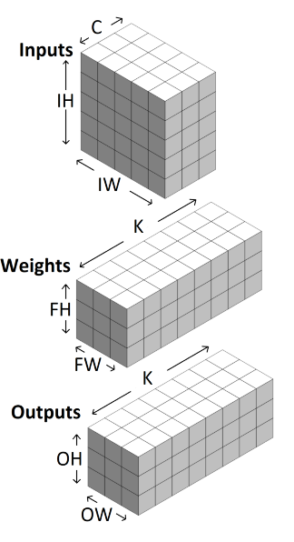
Event-Driven Mapping Space Generation
Across K, FH, FW
Temporal Ordering for iw in IW:
for ih in IH:
for c in C:
for fw in FW:
for fh in FH:
parfor for k in K:
Output [k][ix-fx][iy-fy] = Inputs [c][ix][iy]* Weights [k][fx][fy]
Inputs
Mapspace generation
Analytical cost model
Mapspace search engine
Outputs
Workload
Spatial Unrolling
Temporal Ordering
Notes:
Event-driven mapping requires strategic spatial and temporal configuration decisions.
The workload defines standard convolution dimensions including input height, width, channels, filter dimensions, and output channels. Spatial unrolling occurs across filter dimensions and output channels to enable event-driven behavior.
Temporal ordering ensures each input event triggers all associated computations simultaneously, maximizing efficiency through parallel processing of related operations.
Consider the workload represented in the standard form with inputs interms of IH,IW, C; weight FH, FW, K and Outputs as OH, OW and K
First the spatial unrolling dimension is select: To achieve the event driven behaviour the spatial unrolling should be across K,FH, FW
Then the map space is developed with all the valid event driven temporal ordering where the inputs dimension are arranges such that each event is accessed only once and the all the respective computations associated with it are parallelised across the spatial unrolling dimension, In this example the spatial unrolling is across “K”

Slide 22
Comprehensive Cost Analysis Pipeline
Data path and memory utilization
Word access calculation
Latency model
- Memory Bandwidth
- Data size
- Memory movement per operand
- Memory utilization
- Word access
- Memory Bandwidth
Overall latency analysis
Inputs
Mapspace generation
Energy model
- Mapspace
- Architecture
- Workload
- Word access count
- R/W port cost
Analytical cost model
Overall energy analysis
Mapspace search engine
Outputs
Area model
Architecture configuration
Area breakdown
Notes:
The cost model is made up of three major models i.e latency, the energy model and the area then there are two associated block to support in the calculation of the energy, latency and the other resources utilisation stats like the memory, area etc..,
The Datapath and memory utilisation block takes in the Input workload, architecture and the map space generated to determine the data path along with the memory utilised at each memory block.
Then Data path of each operand the word access count is determined for each operand across each memory level
This word access count is then utilised to determine the dynamic power consumed by each operand acoss each memory level
The latency is determined by the help of the previously computed units like mapping, memory utilisation and the wordaccess count. This block give the onloading, offloading and the computational latency.
Finally the area model computes the area breakdown based on the architecture configurations which are input to the tool

Slide 23
Optimization-Driven Mapping Selection
Inputs
Event driven mapspace
Best mapping possible for the workload
Mapspace generation
Cost analysis of the mapping available
Mapspace search engine
Analytical cost model
Mapspace search engine
Optimisation criteria
i.e Latency, Energy, EDP
Utilisation stats of the final mappings
Outputs
Notes:
From the cost analysis of each map in the mapspace, search process is conducted based on the optimisation parameter selected i.e latency, energy or the EDP. This give the best mapping schedule of the workload along with its resource utilisation stats

Slide 24
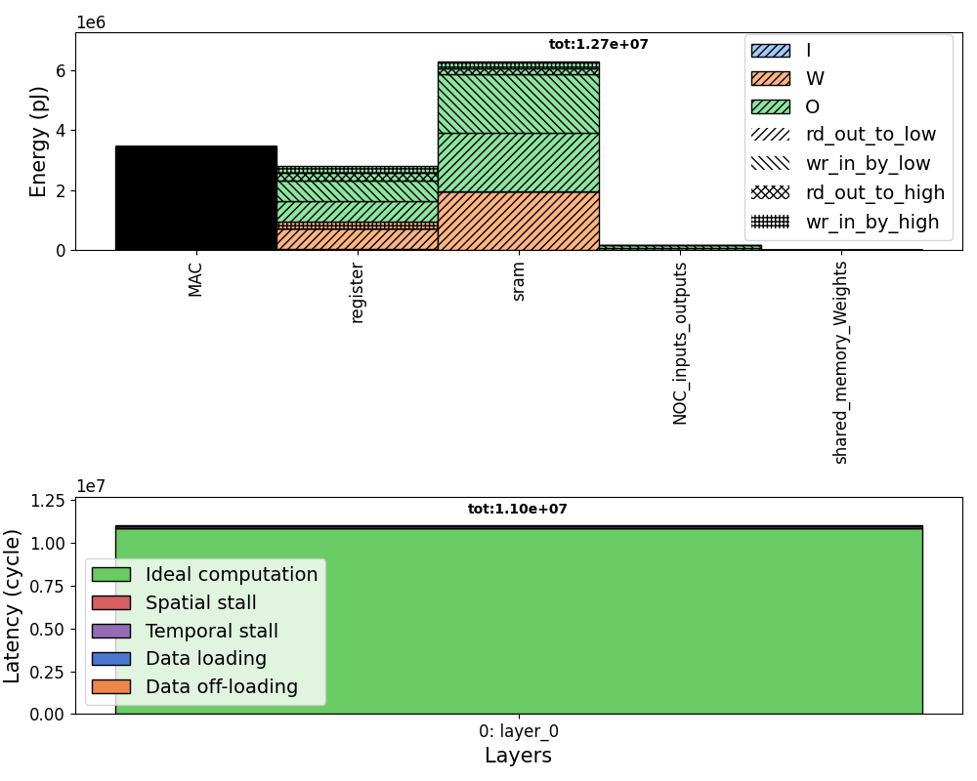
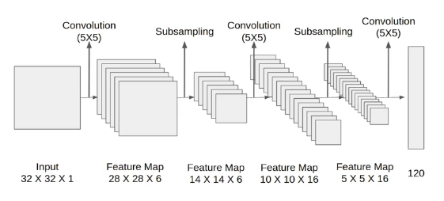
Framework Results and Analysis
Energy & Latency stats
Inputs
Mapspace generation
Architecture
AeDAM
Analytical cost model
Best mapping
Mapspace search engine
Outputs
Memory utilization:
Inputs: {}
Weights: {}
Outputs: {}
Word access:
Spatial utilisation:
PE utilisation: {}
Workload
Overall utilisation stats
Notes:
The final output of the framework after aggregating all the blocks is
Best mapping of the input workload on the architecture
Energy and latency stats
Overall resource utilisation by the workload on the architecture when it is executed as per the output map

Slide 25
Outline
Introduction
Background
Exploration process
Different dataflow strategies
Related work
Thesis Contribution & Proposed AeDAM framework
Results & Analysis
Conclusion and Future Work

Slide 26
Analysis overview
Validation process
Comparison with SoTA
Mapspace generated
Performance
Word access
Latency
Energy
Case study
Exploration of the SRAM configurations
Exploration of the PE configuration
Final configuration of the event driven architecture for VGGnet model

Slide 27
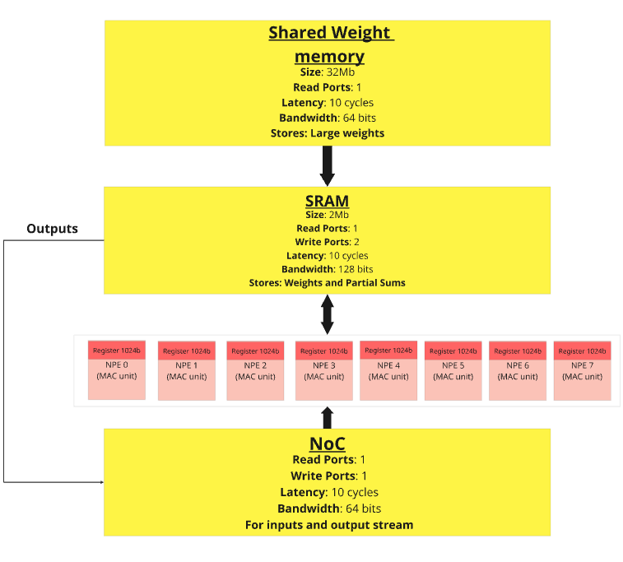
Target Architecture: SENECA Platform
Modelling in AeDAM
Single core Seneca Architecture
https://www.frontiersin.org/journals/neuroscience/articles/10.3389/fnins.2023.1187252
Notes:
Modelling of the single core of the SENECA
Single-Core Event-Driven Processor Modeling

Slide 28
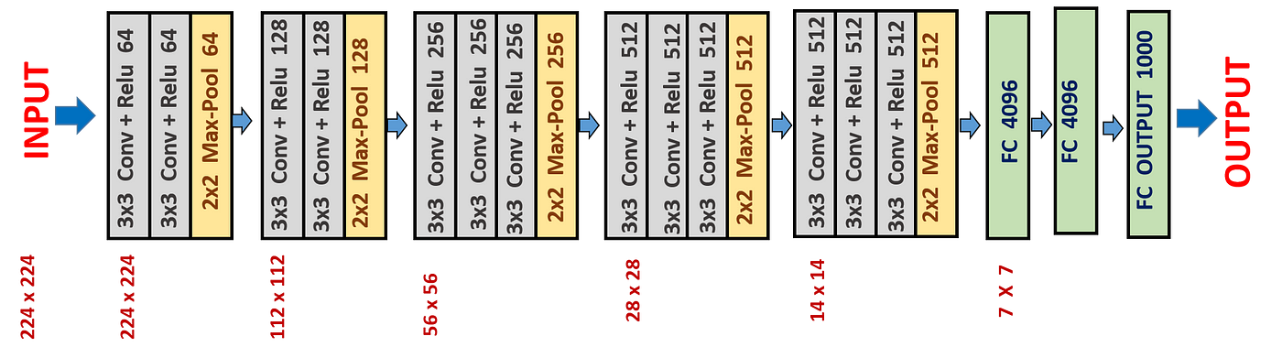
Benchmark Neural Network: VGGNet-16
VGGnet 16 Architecture
Application: Image Classification
Architecture: 16 layers with 3×3 Conv filters
Notes:
Modelling of the 1st layer of the VGGNet model

Slide 29
Validation process
Four stage validation process
Inputs: - Architecture: Seneca Single core - Workload: 1st layer of the VGGnet model
Data Path Validation
Word access Validation
Latency Validation
Energy Validation
Flow verification of: Inputs Weights Outputs
Manual calculation vs AeDAM output comparison
True cycles, Stalls, Data transfer timings
MAC operations and Memory Access energies
Notes:
The validation process is divided in four stage based on the blocks implemented in the exploration tool.
For the Seneca architecture and the 1st layer of the VGGnet as the input, the Data path validation which is the flow of inputs, weights and outputs; Word access validation with the manual verification of the mapping with the AeDAM implemented formulas and finally the Latency model and the Energy models are validated respectively by evaluating the True cycles, Stalls and Data transfer timings and the Mac opearions and the memory access energies.

Slide 30
Comparison with SoTA
AeDAM Capabilities Relative to Existing Tools
Framework | Primary Focus | Event-driven Capabilities | Multi-core Support | Sparsity Support | Framework relationship
Timeloop | Dense tensor modelling | Traditional | Single core | None | Foundation
Zigzag | Memory centric DSE | Traditional | Single core | None | Foundation
Convfusion | Layer fusion optimisation | Traditional | Single core | None | Foundation
Stream | Multi-core exploration | Traditional | Yes | None | Built on Zigzag
Sparseloop | Sparse tensor modelling | Traditional | Single core | Weight and input sparsity | Built on Timeloop
AeDAM | Event driven exploration | Fully Event driven | Single core | None | Utilise parts of Zigzag
Notes:
On revisiting the related works, but this time adding AeDAM to the able that is able to modes the full event driven architecture and also perform the mapping exploration of the single core architecture for input neural networks

Slide 31
ZigZag Integration and Extensions
Component Reuse and Novel Contributions
Event stationary dataflow modelling is achieved by extending and resusing the parts of Zigzag exploration tool
Mapping space generation
Event driven core modelling
Architecture Generator
Mapping Search Engines
ZigZag
Hardware Cost Estimators
Mapping search Engine
Inputs: 1. High level Architecture Representation
2.Model configuration
3.Mapping constraints
Single core spatial and temporal mapping
Technology dependent and independent stats
Analytical cost model
ZigZag: A Memory-Centric Rapid DNN Accelerator Design Space Exploration Framework
Notes:
To develop this complete flow, parts of zigzag were utilised as follows

Slide 32
Taken from Zigzag
Contribution 1
Inputs: 1. High level Architecture Representation
2.Model configuration
3.Mapping constraints
Energy and latency estimations
Reuse
Hardware Cost Estimators
Mapping space generation
Mapping Search block
Cost analysis & Stats calculations
Optimal event driven map
Reuse
Extend
Extend
Extend
Reuse
Overall Utilisation Statistics
Extend
Notes:
Mapping space generation, Mapping seach block and the cost stats and calculation are extended to implement the event driven behaviour

Slide 33
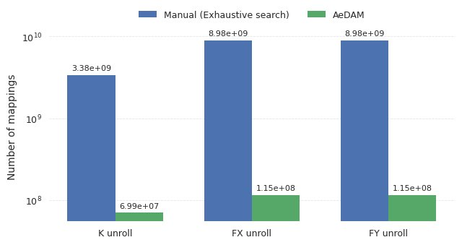
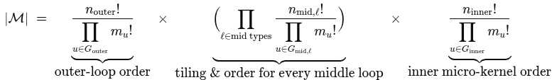
Mapping Space Optimization
Heuristic Reduction of Exhaustive Search Complexity
Optimisation Criteria: Lump the smallest Loop Prime Factors (LPFs) of the loop type with the most factors while preserving large LPFs individually [1]
LOMA: Fast Auto-Scheduling on DNN Accelerators through Loop-Order-based Memory Allocation
Notes:
The key trend shows dramatic reduction in mapping space complexity.
Manual exhaustive search requires exploring billions of configurations, while AeDAM reduces this to hundreds of millions through intelligent heuristics. The optimization lumps smallest loop prime factors while preserving large factors individually.
This achieves 10-100x reduction in search complexity without compromising solution quality, enabling practical exploration times.
The heuristic recognizes that small prime factors often produce similar performance characteristics when combined, making exhaustive exploration of these combinations inefficient. By contrast, large prime factors typically create significant performance differences and merit individual evaluation. This selective exploration strategy maintains solution quality while dramatically improving exploration tractability.

Slide 34
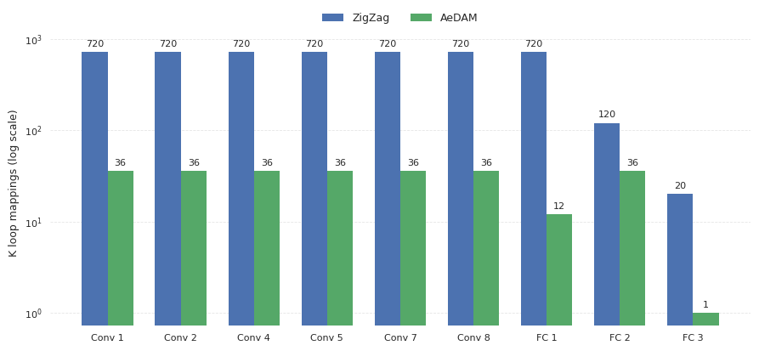
Mapping Space Efficiency Analysis
AeDAM vs ZigZag: Specialized vs General-Purpose Exploration
AeDAM's specialized event-driven map space results in fewer total options than zigzag.
Notes:
The trend reveals AeDAM generates significantly fewer mapping options than ZigZag across all network layers. ZigZag produces 720 mappings for convolution layers while AeDAM generates only 36, representing a 20× reduction.
This occurs because AeDAM specializes in event-driven mappings, focusing only on relevant configurations, while ZigZag explores all possible traditional dataflow patterns including unsuitable options for event-driven architectures.

Slide 35
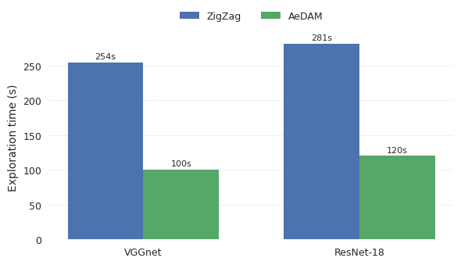
Exploration Performance Comparison
AeDAM vs ZigZag: Speed and Efficiency in Mapping Exploration
Exploration time
Word access count
Latency breakdown
Energy breakdown
Notes:
Due to this specialised map space search, AeDAM perform around 2 times faster than zigzag for VGGnet and Resnet architectures.

Slide 36
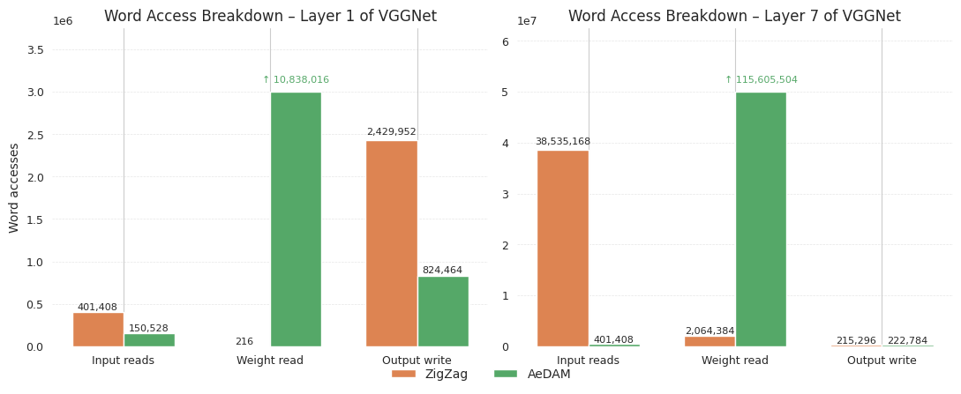
Word Access comparison Results
AeDAM vs ZigZag: Memory Access Count for VGGNet Layers
Exploration time
Word access count
Latency breakdown
Energy breakdown
Word access comparison showing AeDAM achieves lower memory accesses especially for input and output than ZigZag across VGGNet layers
Notes:
The comparison of the word access of best map produced by the zigzag and the AeDAM.
Zigzag produces a weight stationary map for the layer 1 and the output stationary map for the layer 7 when forced to produce an event driven map.
The AeDAM on the other hand produces a perfect event driven map where each input is accessed event by event and the weights are accessed as per the computations available and finally the output are written to the NOC

Slide 37
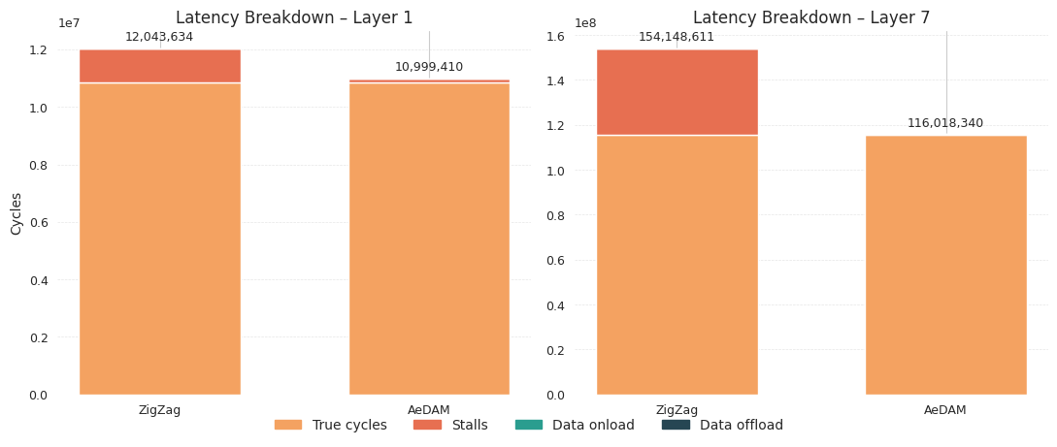
Latency Performance Analysis
AeDAM vs ZigZag: Execution Cycle Reduction for VGGNet Layers
Exploration time
Word access count
Latency breakdown
Energy breakdown
Latency comparison showing AeDAM achieves lower cycle counts than ZigZag for both VGGNet layers.
Notes:
AeDAM’s best map in comparison with the Zigzag for the layer 1 and layer 7 produces a 1x times better event driven map than the zigzag for same layers

Slide 38
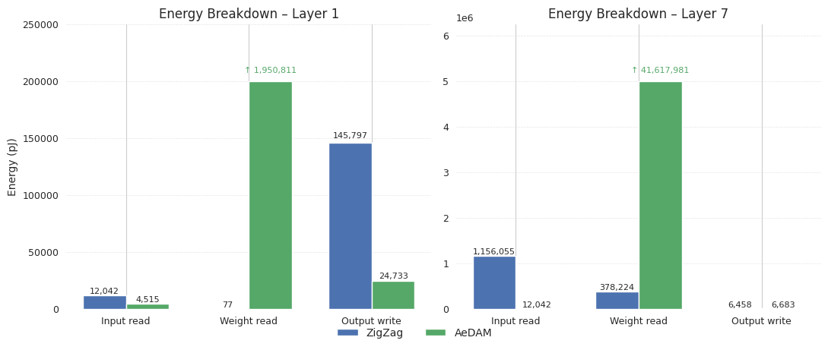
Energy Consumption Trade-offs
AeDAM vs ZigZag: Energy Efficiency Analysis for VGGNet Layers
Exploration time
Word access count
Latency breakdown
Energy breakdown
Energy breakdown showing AcDAM reduces input/output energy consumption but increases weight access energy compared to ZigZag.
Notes:
Now, Coming to the energy computations, The map generated by AeDAM consumes ~2x and ~5x times less energy for the inputs read and output write than zigzag, the weight energy is higher compared to the zigzag being the weights are accessed again and again for every computation and this value will drop once the sparsity in the data is introduced.

Slide 39
Comparision Summary
Quantified Performance Improvements and Architectural Trade-offs
Metric | Zigzag | AeDAM | Improvement
Mapspace | 720 maps (Input, Weight and output stationary mapspace) | 36-1 maps (Event stationary mapspace) | 20-720× less mapspace to search for
Exploration Time | 254s (VGGNet) 281s (ResNet-8) | 100s (VGGNet) 120s (ResNet-8) | 2.3-2.5× Faster exploration
Latency (Cycles) | L1: 12.0M L7: 154.1M | L1: 11.0M L7: 116.0M | 1.1-1.3× Better mapping
Energy | Lower weight access Higher I/O energy | Higher weight access Lower I/O energy | 2-5× (I/O) Better energy savings Trade-off (weights)
Architecture | General purpose | Event-driven specialized | Targeted
Notes:
Final comaprision b/w both the tools in terms of Hardware design space, Mapping space, Mapping search strategies, Cost estimation.

Slide 40
Design Space Exploration Case Study
SENECA Architecture Optimization for VGGNet
Goal: For a given NN, optimal configuration of the SENECA
For the VGGnet model
SRAM Configuration [Capacity & Bandwidth]
PE arrangement

Slide 41
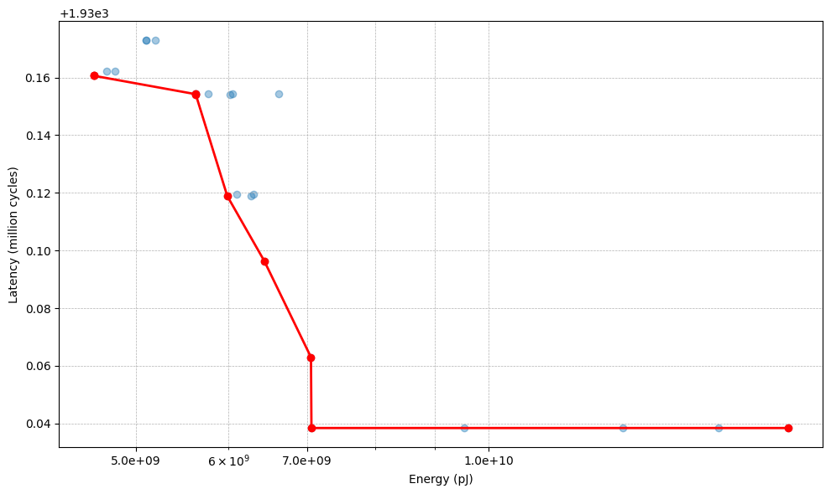
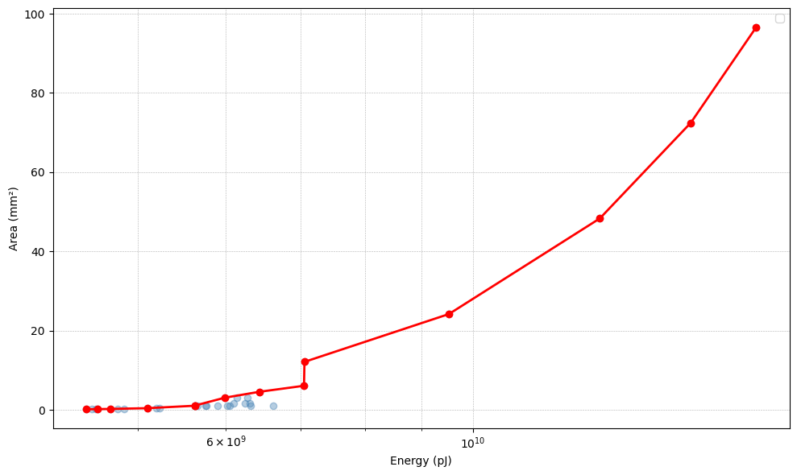
SRAM Configuration Analysis
Capacity and Bandwidth Trade-off Evaluation
Energy vs Latency plot of varying SRAM configurations (Capacity & Bandwidth)
Energy vs area plot of varying SRAM configurations (Capacity & Bandwidth)
Capacity: 96 KB – 256 KB Bandwidth: 64, 128, 256 bits Area: 0.14 mm2 – 0.43 mm2
Capacity: 512 KB – 3MB Bandwidth: 128 - 1024 bits Area: 0.97 mm2 – 4.57 mm2
Capacity: 4MB – 64 MB Bandwidth: 128 bits Area: 6.08 mm2 – 96.60 mm2
Notes:
From left to right as the size increase there is no major changee

Slide 42
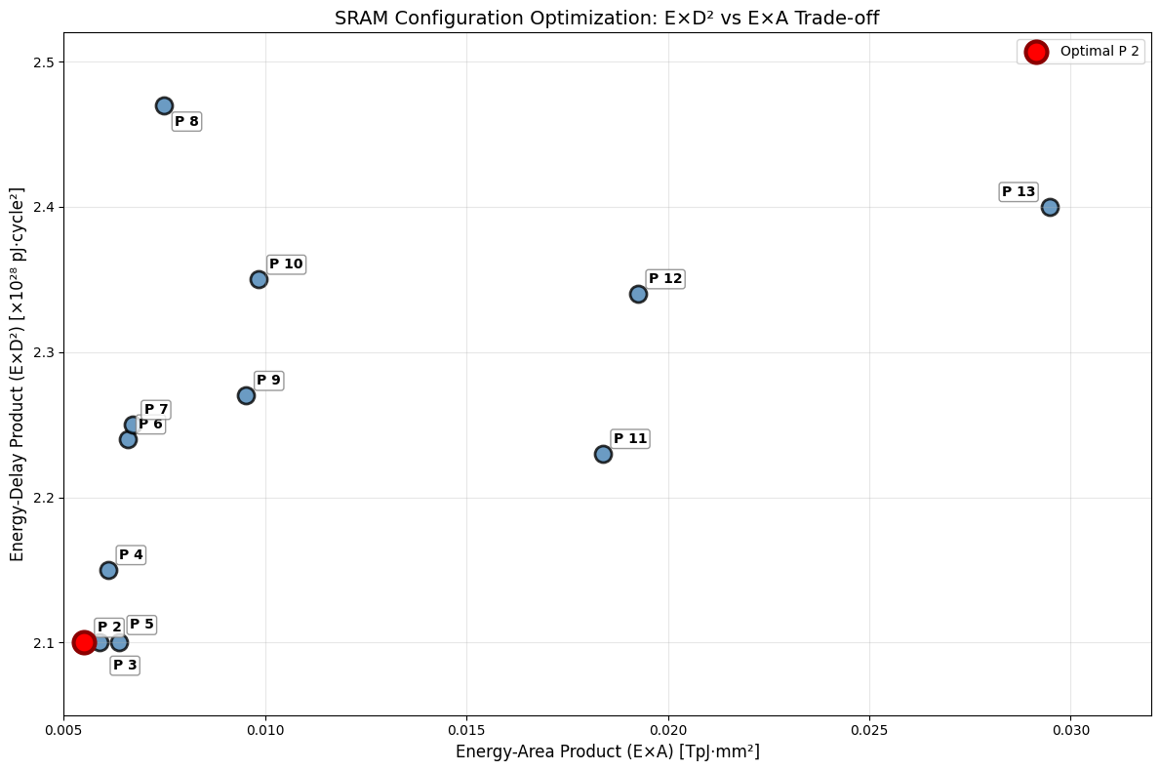
SRAM Optimization Results
Identifying Efficiency Saturation Points
Observed latency drop is insignificant but, bandwidth increase caused the energy to increase
Capacity increase led not only increase in the energy but also increase in the area this indicated a saturation.
Capacity 4Mb & 128 bits bandwidth
Left → Right: Capacity Increase [512 KB – 3 MB] Bottom → Top: The bandwidth increases [128 bits – 1024 bits]

Slide 43
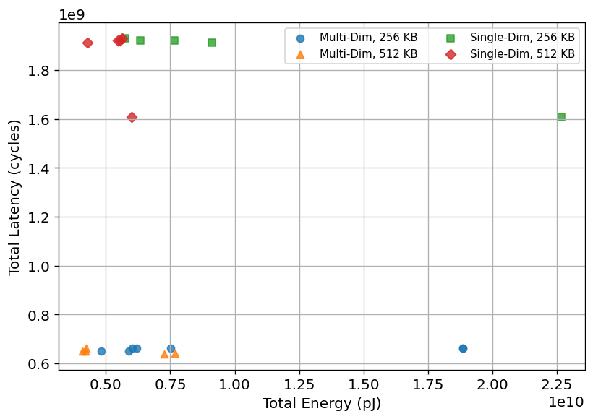
Processing Element Configuration Study
Single vs Multi-Dimensional Array Performance
Region 1: Singe Dimension PE arrangement:
Total latency ranges from - 1.85 – 1.93 × 10⁹ cycles
~3× higher EDP → wastes energy
Energy rises but latency hardly drops → memory-bound
Region 2: Multi Dimension PE arrangement:
Total latency ranges from - 0.63 – 0.66 × 10⁹ cycles
~3× lower EDP → best performance per joule
Latency flat while energy scales → hides memory stalls
Region 1
Region 2
Left → Right: The PE count increases: Single row [8 – 256] Multi dimension [8*3 – 16*64]

Slide 44
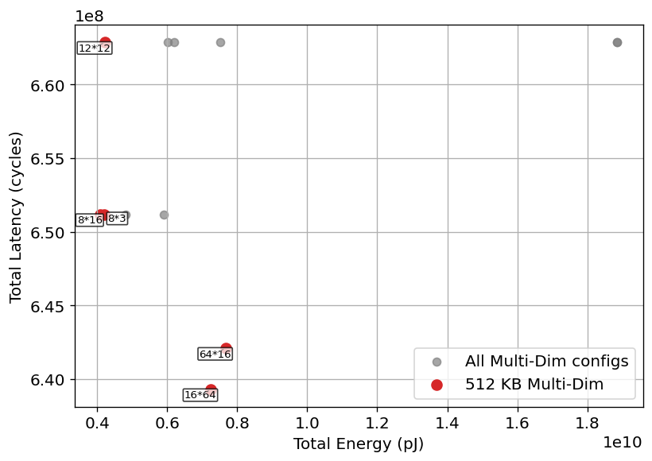
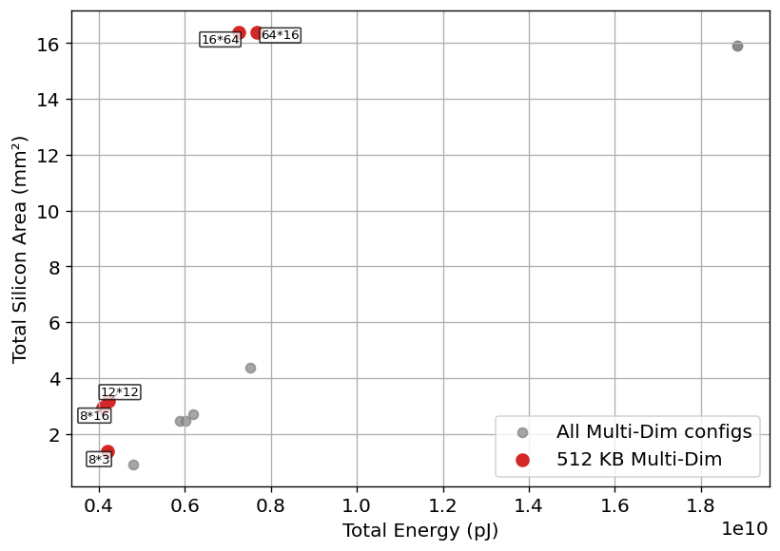
PE Arrangement Optimization
Energy-Latency Trade-off Analysis
Energy vs Latency plot of varying PE configurations
Area vs Energy plot of varying PE configurations
The PE configuration 8*3 is optimal
Left → Right: adding more PEs pushes energy up almost in a straight line.
Bottom → Top: adding more PEs hardly speeds things up because the 512 KB SRAM, not the compute array, limits latency.

Slide 45
Optimal Architecture Configuration
Quantified Performance Improvements and Design Trade-offs
Metrics | Baseline | Optimal | Changes (Optimal vs Baseline)
Configuration | PE: 8 | PE: 8*3 | SRAM capacity increased by 2× Energy per bit increased by 1.42×
 | SRAM Capacity: 256 KB | SRAM Capacity: 512 KB
 | Bandwidth: 128 bits | Bandwidth: 128 bits
 | E_bit: 0.18 Pj | E_bit: 0.255 Pj
Latency (cycles) | 1,930,172,842 | 651,109,076 | 2.96× reduction in latency
Energy (pJ) | 5,099,335,477 | 4,203,655,191 | 1.21× reduction in total energy
Area (mm²) | 0.6577 | 1.3860 | 2.11× increase in area
ExD² | 2.14E+28 | 1.78E+27 | 12.0× reduction in E×D²
ExA | 3,781,880,057 | 5,826,224,444 | 1.54× increase in E×A

Slide 46
Outline
Introduction
Background
Exploration process
Different dataflow strategies
Related work
Thesis Contribution & Proposed AeDAM framework
Results & Analysis
Conclusion and Future Work

Slide 47
Conclusion
Problem Statement
Mapping tools designed for synchronous accelerators are inefficient for event-driven architectures.
My Contributions
An Exploration tool which performs the following:
Event driven intra-core spatial and temporal mapping exploration
Design Space exploration of Event driven architectures
Different memory configuration, PE arrangements, memory technology
KPIs
Performance: ~2x faster than SoTA exploration tool for VGGnet
Quality of Exploration results:
Latency: ~1x better mapping than the SoTA for VGGnet
Energy: ~2x less input energy consumption and ~5x less output energy consumption mappings than the SoTA for the VGGnet
DSE
SRAM: Three distinct operational regimes with clear efficiency transition points and saturation boundaries.
PE: Multi-dimensional arrays consistently outperform single-dimension architectures in energy-delay optimization.
Overall: Memory-compute co-optimization reveals significant architectural synergy opportunities.
Notes:
Revisiting the contributions again:
An event driven architecture exploration tool is developed for the single core architectures
And on comaparision with the SoTA: AeDAM produces a better mapping schedule than the vanilla zigzag and also performs the exploration process faster than it.

Slide 48
Future work
Integration of event driven dataflow exploration for Multicore architectures
Implement weight and input sparsity for event driven dataflow architectures
Extend the sparsity model to adapt for dynamic input sparsity
Extend the support for SNNs

Slide 49
Thank you
Notes:
With this introduction about importance of AI, benefits of using Neuromorphic architectures for edge application and there is a huge design space to explore to benefit that particular architecture.
Let’s discuss about the tools that are existing right now to help in the exploration

Slide 50
Q&A
Notes:
With this introduction about importance of AI, benefits of using Neuromorphic architectures for edge application and there is a huge design space to explore to benefit that particular architecture.
Let’s discuss about the tools that are existing right now to help in the exploration

Slide 51
Backup
Notes:
With this introduction about importance of AI, benefits of using Neuromorphic architectures for edge application and there is a huge design space to explore to benefit that particular architecture.
Let’s discuss about the tools that are existing right now to help in the exploration

Slide 52
Architecture model

Slide 53
Different Dataflow strategies
Weight stationary, Output stationary, Input stationary and Event driven dataflow
Stationary element: Partial Sums
Implementation via Unrolling:
Spatial: K, X', Y' Temporal: C, R, S
Key Advantages
Efficient reduction of PSum movement
Key Disadvantages:
May require high weight & input BW if PSums not buffered
May need large RF
Stationary element: Filter weights
Implementation via Unrolling:
Spatial: K, R,S Temporal: X, Y, C
Key Advantages
Minimizes repeated weight fetches
Key Disadvantages:
May require high input/output BW if weights not buffered
Stationary element: Input Activations
Implementation via Unrolling:
Spatial: C, Y, X Temporal: K, R, S
Key Advantages
Minimizes repeated input fetches
Key Disadvantages:
May require high weight/PSum BW if inputs not buffered
Stationary element: Non zero activation
Implementation via Unrolling:
Spatial: K, R,S Temporal: X, Y, C
Key Advantages
Triggered only when there is a non zero value, PEs only run on real data,
Key Disadvantages:
irregular execution adds control overhead
Output Stationary
Weight Stationary
Input Stationary
Event driven
Notes:
Output stationary – Partial sums
Weigh stationary – Weights
Input stationary – Inputs are accessed by unrolling themspatially
Event stationary – Where are single event is accessed one by one

Slide 54
3. Analytical cost model
Data path and memory utilization
Word access calculation
Energy model
Input: Mapspace, Architecture and workload​
Output: Data size, memory movement per operand.​
Input: Memory bandwidth, memory movement
Output: Word access in four direction for each memory level
Input: Word access count, r/w ports energy (pJ)
Output: Overall energy analysis
Inputs
Mapspace generation
Analytical cost model
Latency model
Mapspace search engine
Input: Memory utilisation, shared memory, double buffer flag, Word access count, memory bandwidth
Output: Overall latency analysis
Outputs
Area model
Notes:
The cost model is made up of three major models i.e latency, the energy model and the area then there are two associated block to support in the calculation of the energy, latency and the other resources utilisation stats like the memory, area etc..,
The Datapath and memory utilisation block takes in the Input workload, architecture and the map space generated to determine the data path along with the memory utilised at each memory block.
Then Data path of each operand the word access count is determined for each operand across each memory level
This word access count is then utilised to determine the dynamic power consumed by each operand acoss each memory level
Finally the latency is determined by the help of the previously computed units like mapping, memory utilisation and the wordaccess count. This block give the onloading, offloading and the computational latency.

Slide 55
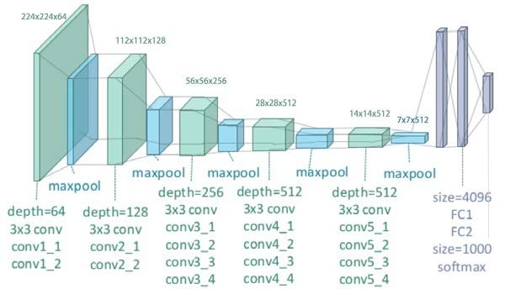
Workload
A single layer from the VGGnet-19 Architecture
VGGnet 19 Architecture
Layer Configuration
Inputs (B,C,IX,IY) | (1,3,224,224)
Weights (K,C,FX,FY) | (64,3,3,3)
Outputs (B,K,OX,OY) | (1,64,224,224)
Total MACs | 86704128
Notes:
Modelling of the 1st layer of the VGGNet model

Slide 56
Event driven datapath validation
Events, weights, partial sum and output datapaths
SENECA
AeDAM Implementation
NoC
NOC_inputs_outputs
Inputs
RISC-V Controller
Weights
Task FIFO
Partial Sums
Loop Controller
Outputs
NPE Register
Register
MAC Units
MAC Unit
Notes:
Validation of the datapath for input reads, Weight reads, Partial sum generation and the output writes in comparison with the actual SENECA architecuture
1. Inputs are Streamed event by event to the registers and are utilised for the computations

Slide 57
Event driven datapath validation
Events, weights, partial sum and output datapaths
SENECA
AeDAM Implementation
Shared_memory_Weights
Inputs
SRAM (DMEM)
SRAM
Weights
Loop Controller
Partial Sums
NPE Register
Register
Outputs
MAC Units
MAC Units
Notes:
Required weights for the MAC operation are continuously accessed from SRAM to RF

Slide 58
Event driven datapath validation
Events, weights, partial sum and output datapaths
SENECA
AeDAM Implementation
Inputs
MAC Units
MAC Units
Weights
NPE Register
Register
Partial Sums
SRAM
SRAM
Outputs
Notes:
The computed partial sums are written to SRAM and are read again based on the output value being computed

Slide 59
Event driven datapath validation
Events, weights, partial sum and output datapaths
SENECA
AeDAM Implementation
NPE Register
Inputs
Event Generator
Weights
Output FIFO
SRAM
Partial Sums
RISC-V
Outputs
NoC
NOC_inputs_outputs
Notes:
Finally, each output after the accumulation is written to the NOC

Slide 60
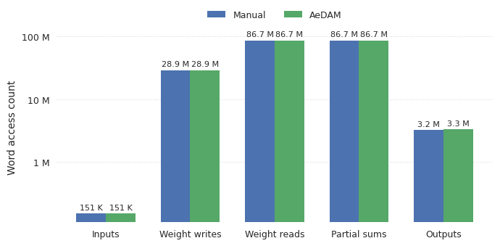
Word access Validation
Comparison of Manual verification and AeDAM access counts
Word_Accesses = ⌈(Elements × Precision) / Word_Size⌉ × Bandwidth_Efficiency ×
Periods ×
Spatial_Units
Elements: Data elements moved per period
Precision: Bits per element (8/16/32 bits)
Word_size: Bandwith of the memory
Bandwidth_Efficiency: min_bandwidth/max_bandwidth
Spatial_units: No.of Parallel units
AeDAM validation against manual verification shows close agreement across memory operations.
Notes:
A_dir = ceil(A_elem * p / BW_min) * (BW_min / BW_max) * P * UC
Period is the no.of times the inner loops repeats

Slide 61
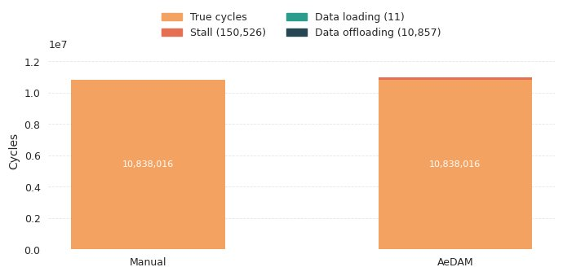
Latency Validation
Comparison of Manual verification and AeDAM Latency stats
C_ideal = ⌈N_MAC / N_unit⌉ × C_op
C_temp = C_map × C_op
U_spatial = C_ideal / C_temp
L₀ = C_temp + SS_comb
L₁ = L₀ + C_onload
L₂ = L₁ + C_offload
U_i = C_ideal / L_i (i = 0,1,2)
N_MAC – total operations in the layer
N_unit – physical MAC units in the array
C_op – cycles per single MAC
C_ideal – Ideal cycles
C_map – total temporal operations
SS_comb – combined stall/slack from all memory ports
L0: Total computational latency with stalls
L2: Overall latency (onloading, offloading, computation)
Manual vs AeDAM latency comparison showing validated true cycles (10,838,016) with perfect agreement.

Slide 62
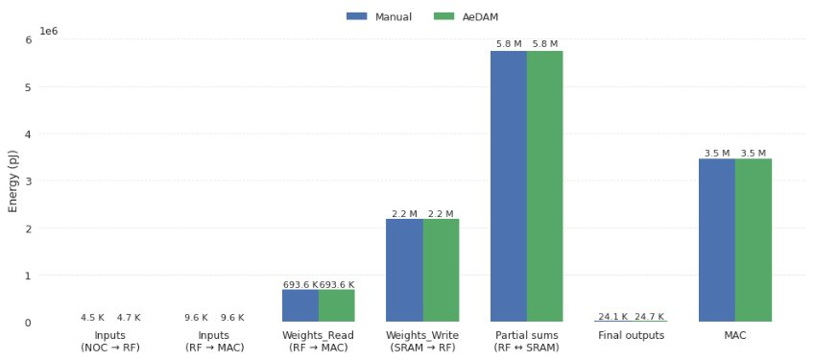
Energy Validation
Comparison of Manual verification and AeDAM Energy stats
Dynamic Energy: 1. Total_Energy = MAC_Energy + Memory_Energy
2. MAC_Energy = Single_MAC_Energy × Total_MAC_Operations
3. Memory_Energy = Σ(Read_Energy + Write_Energy) per level
Read_energy: Read_accesss * Read_energy_per_access
Write_energy: Write_access * Write_energy_per_access
This access energy is across the four directions
Manual vs AeDAM dynamic energy validation showing close agreement across all components from inputs to MAC operations.

Slide 63
Detailed analysis of each of the cost model
Dynamic Energy: 1. Total_Energy = MAC_Energy + Memory_Energy
2. MAC_Energy = Single_MAC_Energy × Total_MAC_Operations
3. Memory_Energy = Σ(Read_Energy + Write_Energy) per level
Static Energy:
Static_Energy = Total_Static_Power × Total_Execution_Time_with_Idle
Total_Execution_Time_with_Idle = (Active_Cycles + Idle_Cycles) / Clock_Frequency
Idle_Cycles = Active_Cycles × (1 - Activity_Factor) / Activity_Factor
Activity_Factor = ZigZag_MAC_Utilization_with_stalls

Slide 64
Why the optimised search works ?
Exhaustive vs AeDAM mapspace
Optimisation Criteria: Lump the smallest Loop Prime Factors (LPFs) of the loop type with the most factors while preserving large LPFs individually [1]
Criteria | Small LPFs (2, 2, 3, 5) | Large LPFs (16, 32, 64, 128) | Reason
Energy Impact on Final Mapping | Minimal contribution to energy savings | Major impact on energy consumption | Optimal mapping consists of fewer loops of larger iteration size
Data Reuse Opportunities | Limited reuse potential per factor | Significant reuse potential | Larger loops create more substantial data reuse patterns
Combinatorial Explosion Source | Major contributor to search space explosion | Individual preservation manageable | 10 LPFs: 10! = 3.6M → After lumping: ~12,600 orderings
Optimality Risk When Combined | Very low - minimal performance loss | High - significant performance loss | <3% optimality loss with 6 LPF limit
[1]: LOMA: Fast Auto-Scheduling on DNN Accelerators through Loop-Order-based Memory Allocation
Notes:
During the map space generation: Lump the smallest Loop Prime Factors (LPFs) of the loop type with the most factors while preserving large LPFs individually, this leads to a much smaller mapspace with no significant loss in the performance as the lumping is done with the small loops which have less impact on the overall performance.

Slide 65
Difference b/w the AeDAM and Zigzag mapspace
ZigZag mapspace
AeDAM mapspace
Output Stationary
Weight Stationary
Input Stationary
Event driven
Notes:
AeDAM being focused on the event driven architecture generates the specialised map space due to which the overall mapspace quantity is less than the zigzag

Slide 66
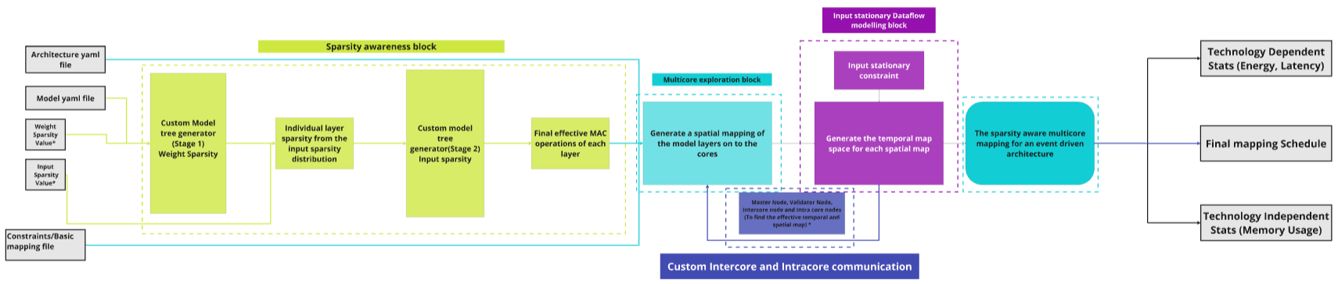
AeDAM Complete toolflow

