Slide 1
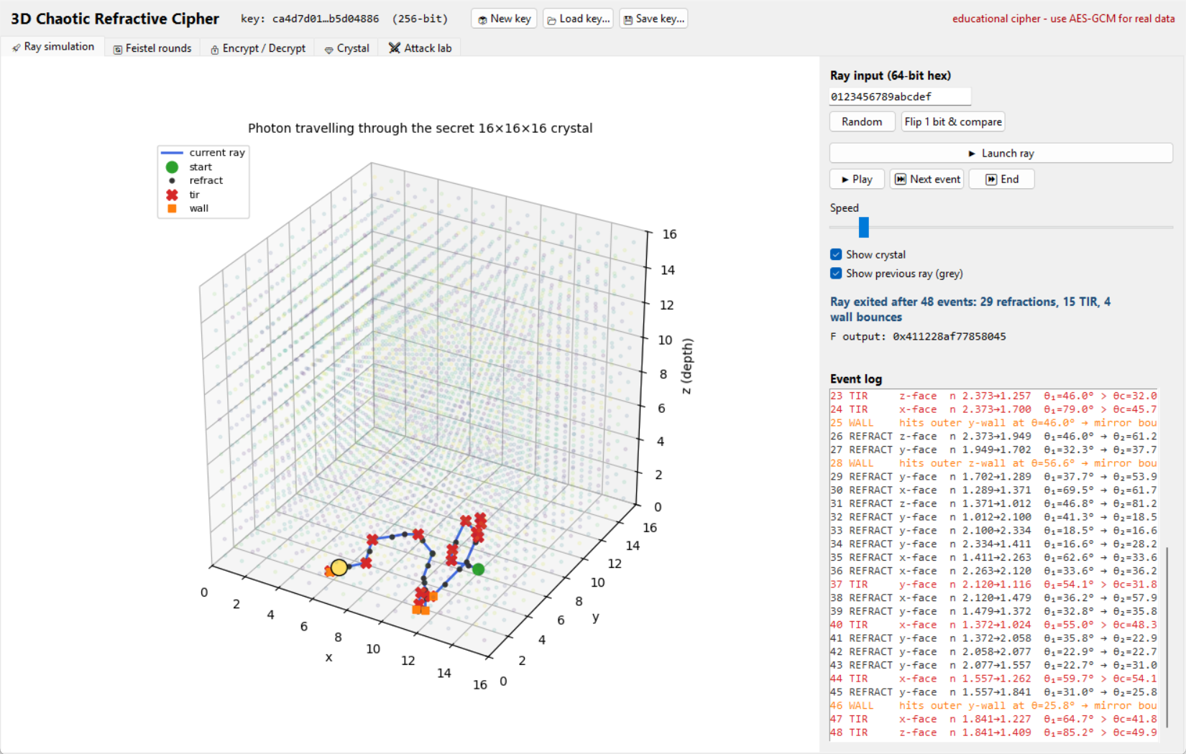
CRYPTOGRAPHY PROJECT
3D Chaotic Refractive Cipher
Encrypting data with light bending through a secret crystal
Malladi Nagarjuna
C11 · Python simulation GUI
github.com/malladinagarjuna2/crypto-project
Notes:
Hello everyone. My project is an encryption algorithm that uses the physics of light: refraction and total internal reflection inside a secret 3D crystal. I built it in C, tested it, attacked it myself, and made a simulation GUI to show it working.

Slide 2
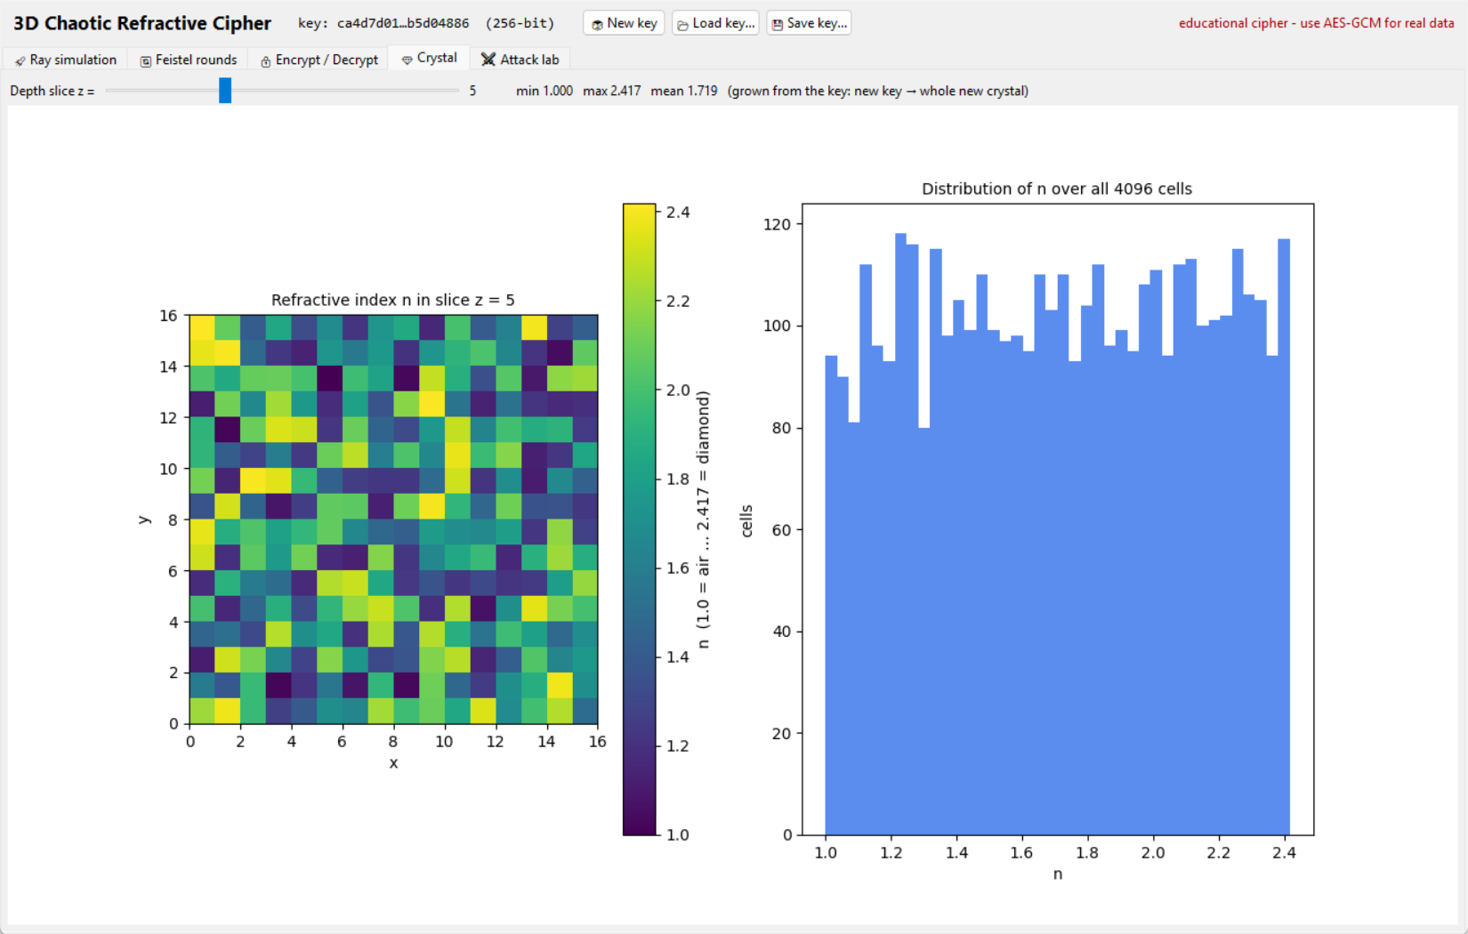
MOTIVATION
The idea: hide data in the path of light
• Secret crystal: 16×16×16 = 4,096 glass cubes, each with its own refractive index n (1.0 = air … 2.417 = diamond)
• The key builds the crystal: the same key always gives the same crystal; a different key gives a completely different one
• Data steers a light ray: entry point + angle come from the data
• Physics scrambles it: the ray bends (Snell's law) or bounces back (total internal reflection) at every cube face
• Exit state → random-looking bits that encrypt the message
One depth slice of a real key-generated crystal (from the GUI)
3D Chaotic Refractive Cipher · Malladi Nagarjuna
1
Notes:
Imagine a glass cube made of 4096 small blocks, each bending light differently. The key decides the pattern. Data decides where and at what angle a laser enters. Without the key you cannot predict where it exits. That unpredictability is turned into a cipher.

Slide 3
DESIGN REVIEW
Reviewing the first plan: 6 key flaws, 6 fixes
Original idea | Problem | Fix in final design
Encrypt 1 byte per ray | Only 256 inputs → a lookup table breaks it | 128-bit blocks in a Feistel network
Decrypt by tracing backwards | Fixed-point rounding makes the path drift | Feistel: F only ever runs forwards
XOR with previous ciphertext | Attacker can undo it; no IV | CTR mode + random 96-bit nonce
No integrity check | Bits can be flipped silently | Encrypt-then-MAC (HMAC-SHA256)
Q16.16 range 100000–241700 | That's decimal scaling, not Q16.16 | 65536–158401 (= 1.0–2.417)
Security from chaos alone | Fixed-point chaos falls into cycles | Chaos ⊕ HMAC stream per cell
3D Chaotic Refractive Cipher · Malladi Nagarjuna
2
Notes:
The first plan looked impressive but had real flaws. The biggest: encrypting one byte per ray is just a 256-entry lookup table, so 256 chosen bytes break it completely. My attack suite later proved this: 100% of a secret message recovered. Every fix on the right is in the final design.

Slide 4
HOW IT WORKS
Architecture
256-bit key
secret
HKDF-SHA256
key derivation
Crystal
chaos ⊕ HMAC
S-box
key shuffle
16 round keys
64-bit each
MAC key
256-bit
Encrypted file
"RFC1" ‖ nonce (12 B) ‖ ciphertext ‖ tag (32 B)
Always exactly 48 bytes bigger than the original.
Ray tracer = round function F
48 refraction / TIR events + S-box
16-round Feistel
128-bit block cipher
HMAC-SHA256 tag
tamper detection
CTR mode
nonce ‖ counter → keystream
3D Chaotic Refractive Cipher · Malladi Nagarjuna
3
Notes:
Here is the whole pipeline. The 256-bit key goes through HKDF to produce four independent subkeys. The crystal and S-box feed the ray tracer, which is the round function F of a 16-round Feistel cipher. CTR mode turns it into a stream cipher for files of any size, and an HMAC tag detects tampering.

Slide 5
KEY SCHEDULE
Growing the secret crystal
• HKDF-SHA256 turns one key into independent subkeys (labels: grid, sbox, round, mac)
• 4D hyperchaotic Lorenz system, integrated with fixed-point RK4
  – ẋ = a(y−x)+w, ẏ = cx−y−xz, ż = xy−bz, ẇ = −yz+rw
• Each cell: chaos sample ⊕ HMAC stream → n ∈ [1.0, 2.417]
• Q16.16 fixed-point: value × 65536 stored as an integer
  – bit-identical results on every CPU (floats are not)
• Key avalanche: 1 key bit flipped → 100% of cells change
Real value | Q16.16 integer
1.0 | 65,536
1.5 | 98,304
2.417 (diamond) | 158,401
1.5 × 1.5 | (98304² ≫ 16) = 147,456 = 2.25
Why not floats?
x86, ARM and different compilers round floats slightly differently. One bit off in the crystal = a file that can never be decrypted on another machine.
3D Chaotic Refractive Cipher · Malladi Nagarjuna
4
Notes:
Fixed-point is essential: floats round differently on different CPUs, and a cipher must be bit-exact everywhere. The chaotic map gives structure, but because chaos in finite precision repeats, I XOR in HMAC output so security never depends on the chaos.

Slide 6
RAY TRACING
The physics: Snell's law & total internal reflection
r = n₁ / n₂ c₁ = −N·I k = 1 − r²(1 − c₁²)
k ≥ 0 → refract: R = r·I + (r·c₁ − √k)·N
k < 0 → total internal reflection: R = I + 2c₁·N
No sin/cos/arcsin needed, only an integer square root
Worked example | n₁ → n₂ | Angle in | Result
Glass → air | 1.5 → 1.0 | 30° | refracts to 48.6°
Air → glass | 1.0 → 1.5 | 30° | refracts to 19.5°
Glass → air | 1.5 → 1.0 | 50° | TIR (θc = 41.8°)
• Unit tests check these exact numbers in Q16.16 (to within ±0.002)
• Branchless: both outcomes are computed and one is selected with a bit mask, so there is no secret-dependent if
• Fixed 48 events per ray: running time doesn't depend on the data
3D Chaotic Refractive Cipher · Malladi Nagarjuna
5
Notes:
I use the vector form of Snell's law because it needs no sine or arcsine, only a square root, which I compute with integers. If k is negative the ray cannot pass: total internal reflection. Worked example: glass 1.5 to air 1.0 at 30 degrees exits at 48.6 degrees; at 50 degrees it reflects.

Slide 7
ROUND FUNCTION
The ray tracer is the cipher's round function F
• Input (64 bits):
  – 20 + 20 bits → entry x, y
  – 12 + 12 bits → tilt angle
• 48 events via 3D voxel walk (DDA)
• Secret S-box mixed in at every step
• Output: 64-bit digest of position, direction and path history
• 1 input bit flipped → ~50% of the 64 output bits change
3D Chaotic Refractive Cipher · Malladi Nagarjuna
6
Notes:
This is the ray tracer running in my simulation GUI. 64 input bits choose the entry point and angle. The ray makes exactly 48 boundary events. Black dots are refractions, red crosses are total internal reflections, orange squares are wall bounces. At every step a secret S-box is mixed in, and the whole journey is compressed to 64 output bits.

Slide 8
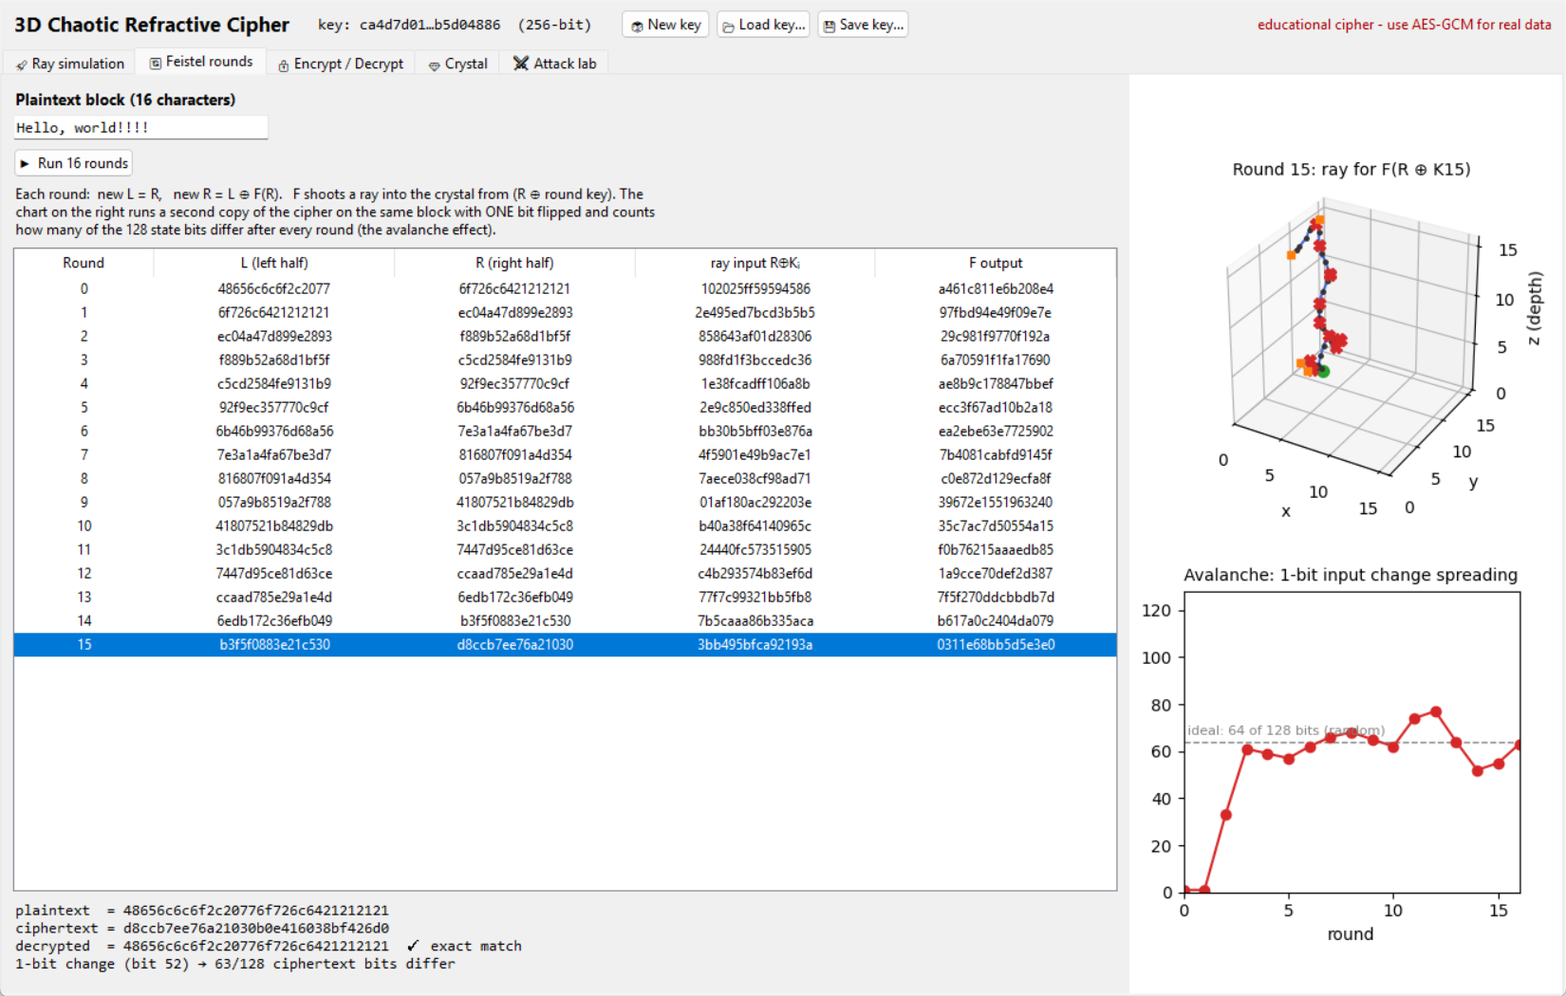
BLOCK CIPHER
Feistel network: why decryption is always exact
Encrypt: Lᵢ₊₁ = Rᵢ Rᵢ₊₁ = Lᵢ ⊕ F(Rᵢ, Kᵢ)
Decrypt: Rᵢ = Lᵢ₊₁ Lᵢ = Rᵢ₊₁ ⊕ F(Lᵢ₊₁, Kᵢ)
• F is only ever run forwards, so it may round, branch, even collide
• Backward ray tracing would drift due to fixed-point rounding
• 16 rounds on 128-bit blocks (DES-style structure; Luby–Rackoff)
• Tested: 200 random blocks plus all reduced-round versions decrypt exactly
3D Chaotic Refractive Cipher · Malladi Nagarjuna
7
Notes:
Why Feistel? Tracing a fixed-point ray backwards does not work, because rounding errors make it drift. In a Feistel network decryption only needs F running forwards, so decryption is always exact. The chart shows one flipped input bit spreading to about half of all 128 bits within two rounds.

Slide 9
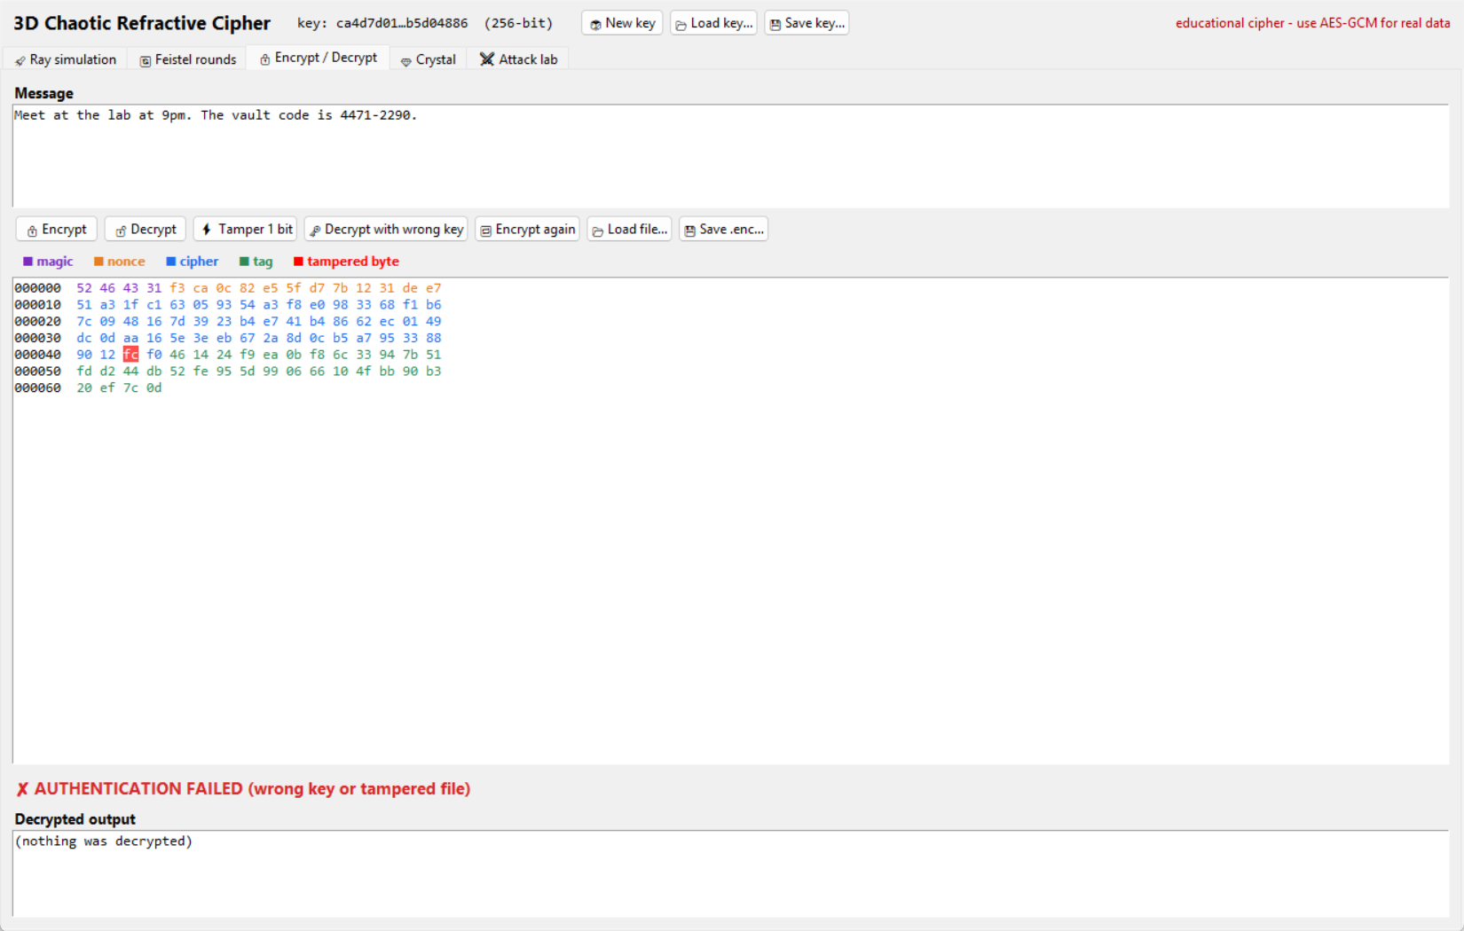
MODE OF OPERATION
Encrypting real files: CTR mode + HMAC
RFC1
4 B
nonce
12 B random
ciphertext
same size as message
HMAC tag
32 B
• CTR: keystreamᵢ = Feistel(nonce ‖ counterᵢ), then ciphertext = message ⊕ keystream
• New random nonce every time: same file → ~50% of bits differ
• Encrypt-then-MAC: the tag covers magic + nonce + ciphertext
• Tag checked first, in constant time: tampered or wrong key → nothing is decrypted
3D Chaotic Refractive Cipher · Malladi Nagarjuna
8
Notes:
A block cipher alone always maps the same input to the same output. CTR mode with a fresh random nonce means the same file encrypts differently every time. The HMAC tag is checked before decryption: flip a single bit anywhere and the file is rejected and nothing is output.

Slide 10
VERIFICATION
Testing at three levels: everything passes
67 / 67
19 / 19
All PASS
unit tests
end-to-end CLI checks
automated attack suite
SHA-256, HMAC, HKDF official vectors · fixed-point maths · Snell/TIR physics · round trips · tamper rejection at every byte
empty / text / 200 KB files · +48-byte overhead · fresh nonce · wrong key & tampered file rejected
avalanche matrix · linearity / impulse · codebook attack · entropy, χ², correlation, NIST monobit & runs
3D Chaotic Refractive Cipher · Malladi Nagarjuna
9
Notes:
I tested at three levels. Unit tests check every building block against official test vectors and the physics against worked examples. CLI tests run the real program on real files. And a separate attack program tries to break the cipher. All passed.

Slide 11
ATTACK RESULTS
Avalanche: one flipped bit reaches 50% after 3 rounds
• 1 round: 75% of SAC-matrix cells badly off, correctly flagged as weak (the test works)
• 3+ rounds: 50.0%; worst cell only 0.117 from ideal
• We use 16 rounds, a 5× safety margin
• Key avalanche: 1 key bit → 50.3% of ciphertext bits change
3D Chaotic Refractive Cipher · Malladi Nagarjuna
10
Notes:
Strict avalanche criterion: flip one input bit, and every output bit should flip with 50% probability. With one round, only 13% flip: that is correctly flagged as weak, which proves the test works. From three rounds on the cipher is at 50%. We use 16 rounds for a large safety margin.

Slide 12
ATTACK RESULTS
Codebook attack: original breaks, final holds
% of a secret sentence recovered without the key
Linearity test | Relation holds
1 round, sparse impulses | 100% (caught)
16 rounds, sparse | 0%
16 rounds, random pairs | 0%
Why it matters
Every attack is shown to succeed on a deliberately weak version first, so a pass on the real cipher means something. 1.4% is chance level (1 of 71 bytes).
3D Chaotic Refractive Cipher · Malladi Nagarjuna
11
Notes:
This is the most important result. I implemented the original byte-per-ray design and attacked it with a codebook: encrypt all 256 bytes once, then read any message. 100% recovered, no key needed. The same attack on the final cipher recovers 1.4%, which is just chance on a 71-byte message. The linearity test also catches a 1-round cipher 100% of the time, and 16 rounds 0%.

Slide 13
ATTACK RESULTS
Statistics on 10 MB: ciphertext looks like pure noise
Test (10 MB) | Plaintext (repeated sentence) | Ciphertext | Ideal / pass condition
Shannon entropy | 4.44 bits/byte | 7.999984 bits/byte | > 7.999 (max 8)
Chi-square (255 dof) | 168,251,837 (p = 0) | 221.5 (p = 0.936) | p between 0.001 and 0.999
Serial correlation | −0.126 | −0.00016 | ≈ 0
NIST monobit p-value | 0.000 | 0.558 | > 0.001
NIST runs p-value | 0.000 | 0.790 | > 0.001
Passing statistical tests rules out obvious flaws. It does not prove a cipher is secure.
3D Chaotic Refractive Cipher · Malladi Nagarjuna
12
Notes:
I encrypted 10 megabytes of a repeating English sentence: very low entropy input. The ciphertext scores 7.999984 bits per byte, a normal chi-square, no correlation, and passes two NIST tests. Important: passing statistical tests shows no obvious flaw. It does not prove security.

Slide 14
CONTEXT
Honest comparison with AES-256
 | Refractive cipher (this project) | AES-256
Block / key size | 128-bit / 256-bit | 128-bit / 256-bit
Structure | 16-round Feistel, ray tracer as F | 14-round substitution-permutation network
Speed (measured, same laptop) | ~0.14 MB/s | ~7,400 MB/s (AES-GCM with AES-NI)
Security proof | None | Provable bounds vs differential / linear attacks
Public cryptanalysis | Only my own attack suite | 25+ years worldwide; NIST FIPS 197
Best known attack | Unknown (unstudied) | ≈ 2²⁵⁴·⁴ (essentially brute force)
Timing side channels | Table lookups depend on secrets | Constant time with AES-NI
Takeaway: use AES-GCM for real data. This project is a working demonstration of how ciphers are designed and attacked.
3D Chaotic Refractive Cipher · Malladi Nagarjuna
13
Notes:
Honest comparison. Same block and key size, both look random. But AES has 25 years of public cryptanalysis and proven bounds, and with hardware support it runs about 50,000 times faster on my laptop. With a 256-bit key no cipher can beat brute force, and AES is already essentially there.

Slide 15
CONTEXT
Related research and limitations
Related research
Limitations
• Optical encryption (DRPE), Réfrégier & Javidi 1995
  – broken: optics is linear → chosen/known-plaintext attacks
• Optical PUFs, Pappu et al., Science 2002
  – light through a real random token; mine is computed from the key
• Chaos-based ciphers, since Matthews 1989
  – many broken; Alvarez & Li (2006) list the common mistakes
• Feistel networks, Luby & Rackoff 1988
• No independent cryptanalysis yet
• Cache-timing leaks from secret-dependent lookups
• ~50,000× slower than AES with hardware support
• Core mixing (SplitMix64) is not a vetted crypto primitive
• Whole file loaded into memory
3D Chaotic Refractive Cipher · Malladi Nagarjuna
14
Notes:
My idea combines three existing research areas. Optical encryption (DRPE) was broken because optics is linear. Optical PUFs use a real physical token, while mine is computed from the key. Many chaos ciphers were broken by finite-precision effects. My design avoids each of these specific mistakes.

Slide 16
DEMO
Live demo: simulation GUI
• Ray simulation: animated photon, each event explained
• Feistel rounds: live table + avalanche chart
• Encrypt / Decrypt: tamper 1 bit → rejected
• Crystal: explore the key-generated crystal
• Attack lab: run the real attack suite
mingw32-make all
python tools/refcrypt_gui.py
github.com/malladinagarjuna2/crypto-project
3D Chaotic Refractive Cipher · Malladi Nagarjuna
15
Notes:
Now a live demo. I'll launch a ray and step through refractions and total internal reflections, flip one bit to show a completely different path, run the Feistel rounds with the avalanche chart, then tamper with a ciphertext and show it being rejected.

Slide 17
SUMMARY
Conclusion
Built
a complete cipher in C11: crystal, ray tracer, Feistel, CTR + HMAC, CLI
Fixed
6 design flaws in the original plan, and proved the main one with a real attack
Verified
67 unit tests, 19 CLI checks, all attack-suite checks pass (10 MB)
Learned
complexity ≠ security; trust comes from public analysis, so AES stays the choice for real data
3D Chaotic Refractive Cipher · Malladi Nagarjuna
16
Notes:
Summarise the four takeaways, then open for questions.

Slide 18
Thank you
Questions?
github.com/malladinagarjuna2/crypto-project · Malladi Nagarjuna
Notes:
Thank the audience and take questions.

