Slide 1

Team Roles
Team Roles
Project Manager: Mallah-Divine Mallah
Administrator: Randall Da Costa
Chief Architect: Caden Hong
IT Support Team:
Anjuli P, Brian Louie, Chanesh Mahadeo

Slide 2
Objective
Objective: Create a LMS Application
Purpose: Create a more user-friendly experience
Goal: Highly scalable

Slide 3
Moodle
Learning platform designed to provide educators, administrators and learners with a single robust, secure and integrated system to create personalized learning environments
Open Source
Delivers a powerful set of learner-centric tools and collaborative learning environments that empower both teaching and learning

Slide 4
Creating a CI/CD Pipeline
Jenkins
Terraform
AWS Services: RDS, EC2, S3, DynamoDB, Fargate/ECS, and CloudWatch
GitHub
Docker
Docker image
Docker hub

Slide 5
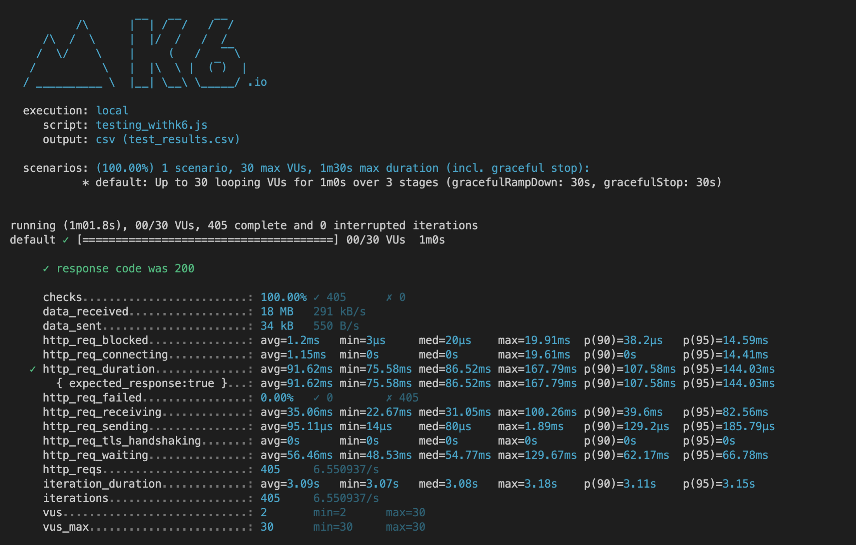
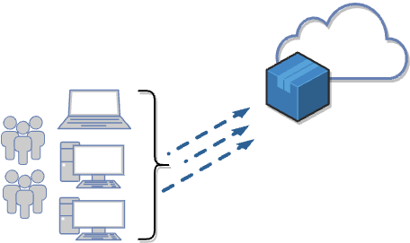
Testing

Slide 6
Outcome
Create a learning system that can meet the needs of Kura Labs
Ease of access
Free with no licensing fees
100% online courses

