Slide 1
A Graph Model for RDF
Based on a Diploma Thesis by J.Hayes, Universidad de Chile, 2004
Shima Dastgheib
Mehdi Allahyari
Advanced Database Management Systems
Spring 2012

Slide 2
Introduction
A graph is a generalization of the simple concept of a collection of nodes, connected pair-wise by edges.
very common to represent structures of any sort as graphs, because many practical questions can be reduced to graph problems.
first contributions to graph theory is Leonhard Euler’s discussion of the Seven Bridges of K¨onigsberg.

Slide 3
Web and RDF
Web was built principally for human consumption, but due to its enormous size
to make use of software agents for organizing, searching, and processing its content.
Although the data displayed on the Web is machine-readable, it is not machine understandable, fundamental requirement for meaningful processing of it.

Slide 4
RDF
A commonly accepted solution:
enrichment of human-targeted Web resources (Web pages, etc.) with machine-intelligible information, also referred to as metadata annotation.
The RDF provides a simple triple syntax to express such annotations:
a resource (the subject) is described by a property (the predicate) and its property value (the object).

Slide 5
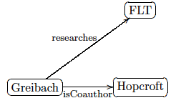
RDF
directed labeled graphs can be employed to represent RDF.

Slide 6
RDF Graph Model (pros and cons)
various purposes for this:
data can be conveniently visualized
Results for problems stated for graphs in general apply equally to RDF graphs.
Whether an RDF graph contains a certain type of pattern.
Programming libraries providing graph data structures and algorithms are available to facilitate the implementation of applications using RDF.

Slide 7
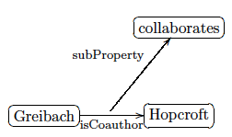
RDF Graph Model (pros and cons)
graph representation has certain limitations:
RDF permits properties to be described just like other resources.
Example: <isCoauthor subProperty collaborates>

Slide 8
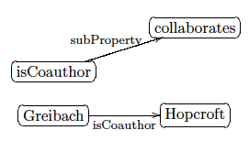
RDF Graph Model (pros and cons)
somewhat strange: one of the edges connects an edge label with a node.
The definition of graphs, however, implies that nodes and edges are distinct sets.
Another way:

Slide 9
RDF Graph Model (pros and cons)
avoids the non-standard edges of the previous example. Edges connect only nodes, but the labels of edges and nodes intersect.
The disadvantage :
obtained graph does not truly represent the connectivity of the RDF data.
property isCoauthor is related to collaborates
Solution: Bipartite graph for representing RDF

Slide 10
RDF Concept
Formal Definition:
“uris” be the set of URIs, “blanks” the set of blank node identifiers, and “lits” the set of possible literal values of whatever datatype.

Slide 11
RDF Graph
RDF Graph T is a set of RDF statements:
univ(T): set of all values occurring in all triples of T.
vocab(T): set of all values of the universe that are not blank nodes
V be a set of URIs and literal values:
set of all RDF Graphs with a vocabulary included in V

Slide 12
RDF Data
RDF statements are triples consisting of subject , predicate and object .
URI references may occur as any part of a triple.
Any collection of RDF data is an RDF Graph.
convincing for intuitive understanding
not compatible with the definition of a graph in a mathematical sense

Slide 13

Definition of Graph:
A graph is a pair G = (N,E), where N is a set whose elements are called nodes, and E is a set of unordered pairs {u, v}, u, v ∈ N

Slide 14
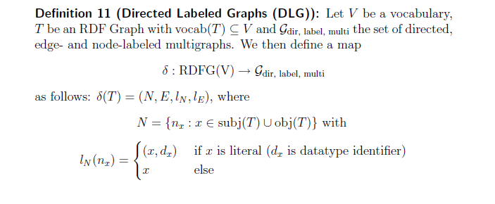
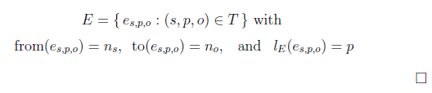
Formal Definition of the Representation of an RDF Graph

Slide 15
Shortcomings of Directed Labeled Graphs
in a given set of RDF data a URI reference may
occur at the same time as the predicate of one statement and as the subject or object of others
every reification of a statement lets the statement’s property appear as the object(subject) of another statement.

Slide 16
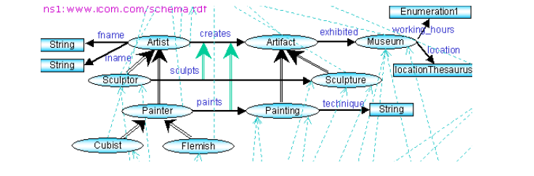
Solution 1)
Notes:
Allowing arcs connecting nodes with other
arcs can lead to puzzling drawings. What is more, the graph drawn this way
has sets of arcs and nodes which intersect, which does not correspond to the
commonly accepted definition of graphs.

Slide 17
Issues
Puzzling drawings
Sets of arcs and nodes which intersect
does not correspond to the commonly accepted definition of graphs.
Reduces the task from graph representation to visualization for humans and gives
Notes:
You cannot take advantage of true graphs!

Slide 18
Solution 2)
The information resource p occurs multiple times in the graph:
once for each usage as a predicate (as edge label)
once for all uses as a subject or object (as node).

Slide 19
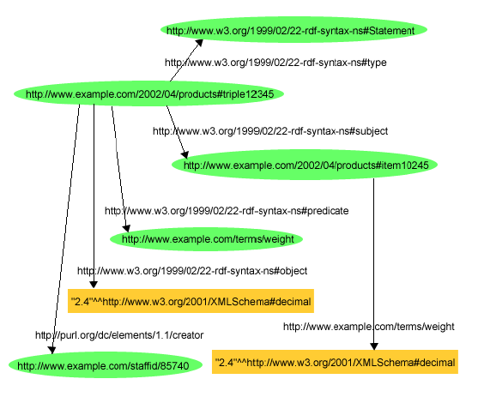

Slide 20
Issues
Duplicating properties in the graph representation of an RDF Graph makes it unsuitable for the study of connectivity.
Information about a property (its sub- and super-properties, its domain and range) are disconnected from the actual usage of the property. This might result in users drawing
misleading conclusions;
Notes:
What is the concept of connectivity? It asks for the minimum number of elements (nodes or edges) which need to be removed to disconnect the remaining nodes from each other

Slide 21
From Binary to Ternary
RDF triples establish ternary relations which cannot be truly represented by the binary edges of classic graphs.
Labeling the edges neglects the fact that properties are information resources in their own right.
a proposed approach based on ternary edges (hypergraphs)
Beyond the scope of this presentation

Slide 22
Reference
J. Hayes, A Graph Model for RDF, Diploma Thesis, Technische Universitt Darmstadt/ Universidad de Chile, 2004.

