Slide 1
SPARQL
Shima Dastgheib
Mehdi Allahyari
CSCI 8370 Advanced Database Systems
Spring 2012

Slide 2
Presentation outline
Brief introduction to RDF triple pattern
SPARQL
Introduction to SPARQL
How to write a SPARQL query? (Demo)
Comparing some different approaches in RDF Storage and query processing based upon

Slide 3
RDF triple pattern
Subject Predicate Object
we will shed light on the RDF graph next week

Slide 4
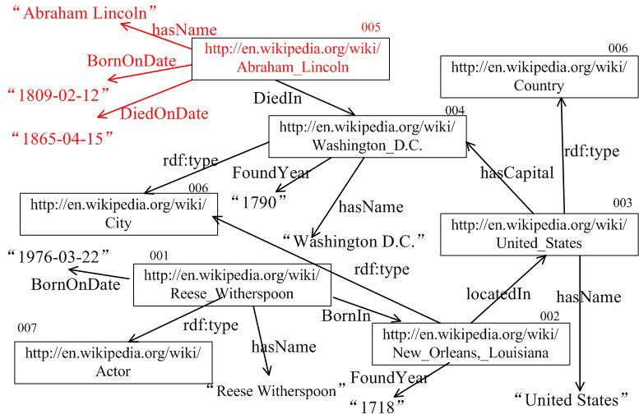
SPARQL is about matching triple patterns

Slide 5
Something to know beforehand :
URI
<http://dbpedia.org/resource/Barack_Obama>
Prefix : for abbreviating URIs
Prefix dbpedia: <http://dbpedia.org/resource/>
dbpedia : Barack_Obama

Slide 6
one useful property from RDF
rdf : type → a property between an instance and the class it belongs to
Example: UGA rdf:type University

Slide 7
SPARQL Recipe

Slide 8
Ingredients & Formulation
# prefix declarations
PREFIX foo: <http://example.com/resources/>
...
# dataset definition
FROM ...
# result clause
SELECT ...
# query pattern (one or more triple patterns)
WHERE {
...
}
# solution modifiers
ORDER BY / LIMIT/OFFSET

Slide 9
Do more than SELECT
ASK
CONSTRUCT
DESCRIBE

Slide 10
SPARQL
By Example
http://www.cambridgesemantics.com/2008/09/sparql-by-example/#q12
Notes:
Slide 16 (Query 3) to (Query8)
Query 10,11,12 ask,construct,describe
SPARQL 1.1 : Slides 36,37,38
Federation :Slide 51(Query 18)

Slide 11
SPARQL 1.1
Some new features:
Update (INSERT/DELETE)
Subqueries
Aggregation (MAX,MIN,SUM,COUNT,etc)
Federation
And more

Slide 12
Demo
SPARQLing ProkinO
http://gumbo.cs.uga.edu/prokino2/about/browser

Slide 13
Comparing some approaches regarding
RDF Storage and Querying based upon
Based on gstore paper

Slide 14
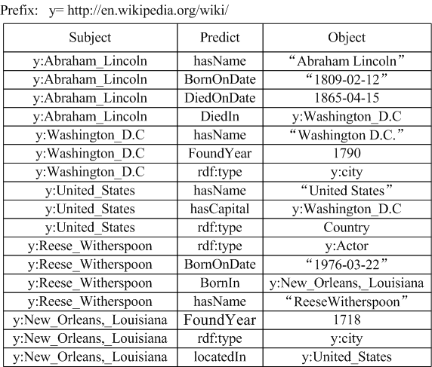
Naïve Triple Store
SPARQL Query:
Select ?name Where { ?m <hasName> ?name. ?m <BornOnDate> “1809-02-12”. ?m <DiedOnDate> “1865-04-15”. }
Too many Self-Joins
SQL:
Select T3.Subject
From T as T1, T as T2, T as T3
Where T1.Predict=“BornOnDate” and T1.Object=“1809-02-12” and T2.Predict=“DiedOnDate” and T2.Object=“1865-04-15” and T3. Predict=“hasName” and T1.Subject = T2.Subject and T2. Subject= T3.subject
Notes:
So, the naïve solution is to store all RDF triples in one giant table. Then, a SPARQL query can be translated into a SQL query. However, the SQL may have many self-joins. For example, we have two self-joins in this example. Since the table is very large, the query performance is not good.

Slide 15
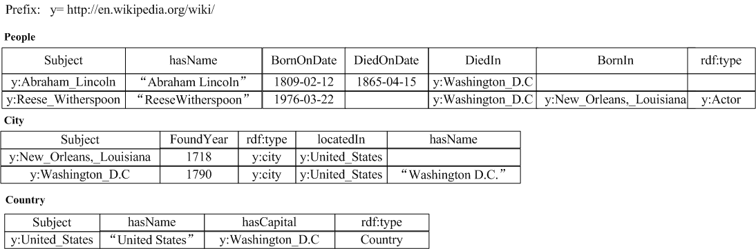
Property Table
Reducing # of join steps
SPARQL Query:
Select ?name Where { ?m <hasName> ?name. ?m <BornOnDate> “1809-02-12”. ?m <DiedOnDate> “1865-04-15”. }
SQL:
Select People.hasName from People where
People.BornOnDate = “1809-02-12” and People.DiedOnDate = “1865-04-15”.
Notes:
This is an example for property tables. According to different classes, RDF triples are clustered into different groups. There are three kinds of classes in this example, thus, we have three property tables. In one class, each property corresponds to one column. The benefit of this method lies in reducing the number of join steps. For example, the sample SPARQL query can be translated into this SQL query, which has only selection operations, no join steps. But, if the query is about two ore more classes, the benefit of this method is not clear.

Slide 16
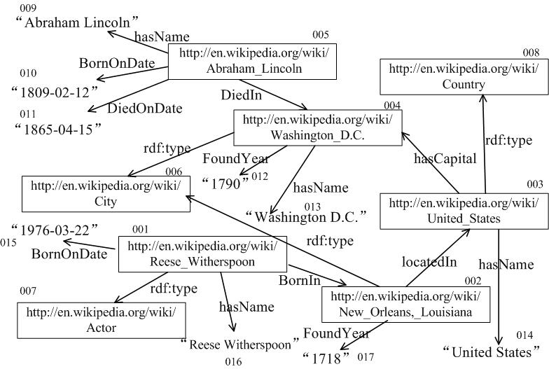
gStore
Literal Vertex
Entity Vertex
Notes:
First, we present the storage schema in our method. There are two kinds of vertices, that are entity vertices and literal vertices.

Slide 17
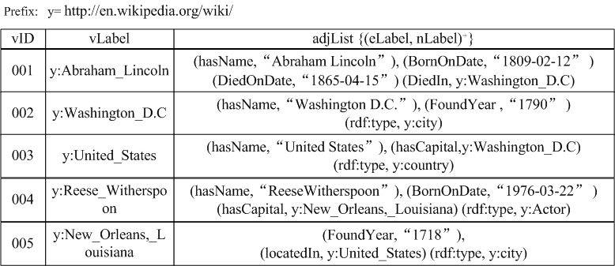
Adjacency List

Slide 18
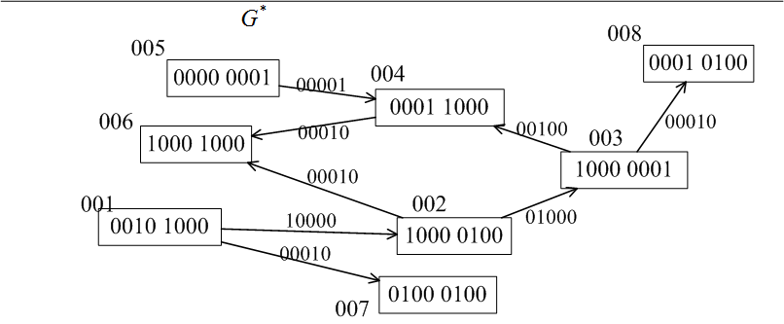
Signature Graph G*

Slide 19
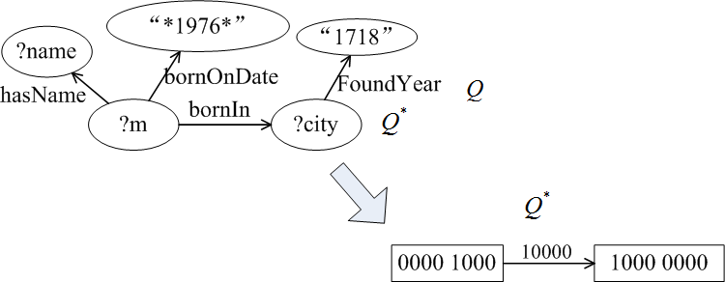
Query Signature Q*

Slide 20
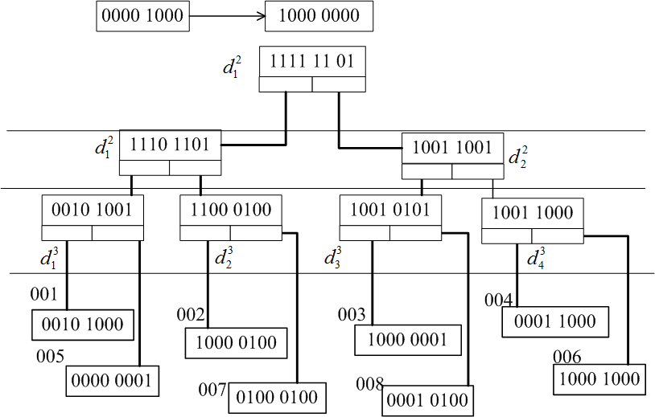
A Straightforward Solution (1)
u₁
u₂
001
004
006
002
003
006
L₁
L₂
Notes:
We can organize all vertex signatures by a Signature Tree (S-tree), which is a height-balanced tree, like B+-tree. S-tree can support inclusion queries efficiently. For example, given a signature in vertex u1, we can find all compatible vertices efficiently. So, for u1 and u2, we can find two lists of vertices, which correspond to u1 and u2, respectively.

Slide 21
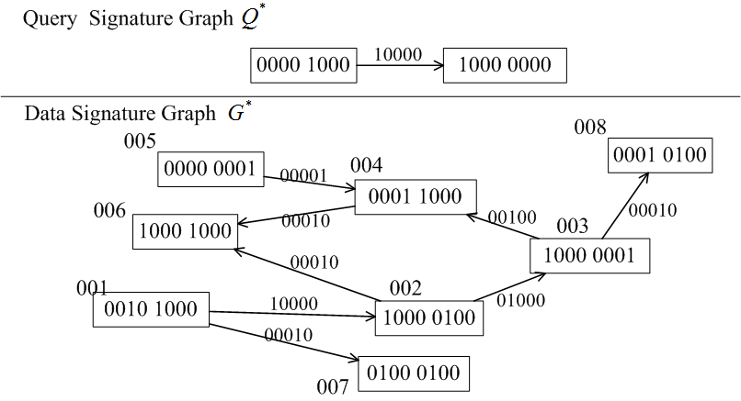
A Straightforward Solution (2)
L₁
L₂
001
004
006
002
003
006
Large Join Space ! ☹
Notes:
Then, we join two lists to form the matches of query Q* in the signature graph G*. But, the join space is large. Therefore, we propose some pruning techniques based on multi-resoulation summary graph techniques.

Slide 22
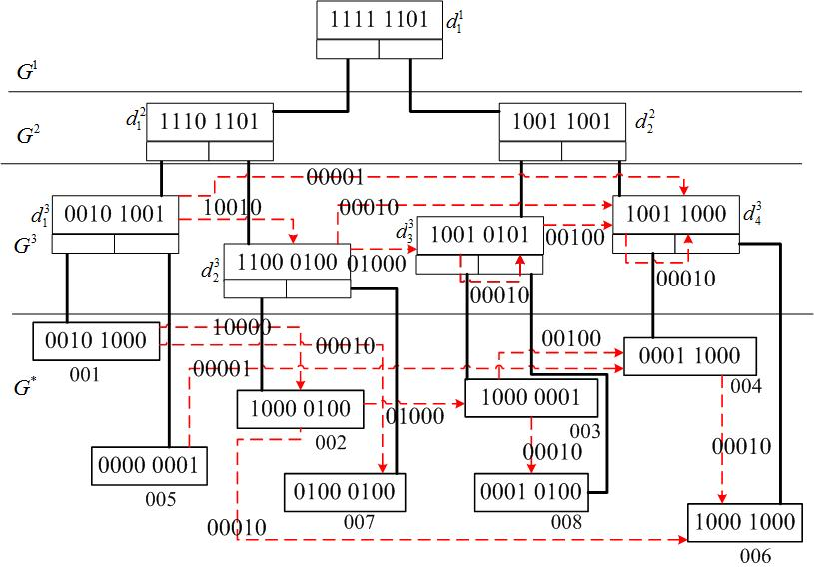
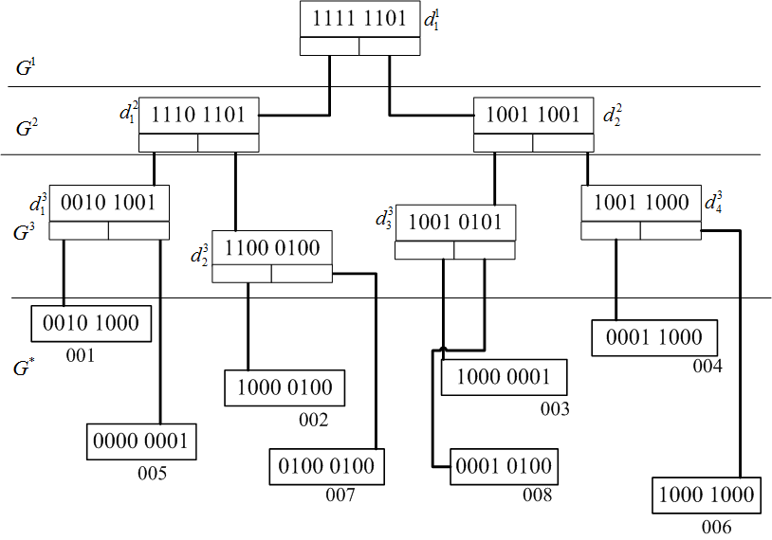
VS-Tree
Notes:
In order to further reduce the join space, we propose a vertex-signature tree, VS-tree.
Actually, VS-tree is a multi-resolution summary graph. Initially, we link all leaf nodes according to signature graph G*’s structure.
Actually, the leaf level in VS-tree is a signature graph.
Then, we introduce one supper edge between two non-leaf nodes, if there is at least one edge between their child nodes. In this way, we can build VS-tree by bottom-up strategy.

Slide 23
References
http://www.cambridgesemantics.com/2008/09/sparql-by-example/
http://gumbo.cs.uga.edu/prokino2/about/browser
L. Zou, J. Mo, L. Chen, M.  Ozsu, and D. Zhao.gStore: Answering SPARQL Queries via Subgraph Matching. PVLDB, 4(8), 2011.

