Slide 1

KHCC
AidConnect
A Smart, Human-Centered Donor and Patient
Matching System for Cancer Financial Aid
Mallak Abu Sada · Maya Abu Aslahamat
Business Intelligence & Data Analysis · University of Petra · Supervised by Dr. Ayman M. Mansour
111
250
378
100%
Patients
Donors
Matches
Coverage

Slide 2
Project Introduction & Core Idea
SLIDE 2 / 20
What Is KHCC AidConnect?
The Core Insight
"
🌸
An AI-powered mobile-first web application automating the complete donor-to-patient financial aid matching process at KHCC.
We visited KHCC. We sat with the caseworkers. They told us the process was entirely manual. Two patients with identical cancer stages and identical incomes could receive completely different aid on different days — depending on who reviewed their file and when.
💜
Built on two core AI engines: a K-Nearest Neighbours retrieval engine and a rule-based programme recommender — operating in real time.
🌿
Integrates a Zakat compliance validation gate enforcing Islamic finance rules before any restricted donation is confirmed.
— KHCC Caseworker Interview, 2025
AidConnect replaces this inconsistency with a fair, data-driven matching system — the same way, every time, for every patient.
🦋
Feeds four interactive Tableau dashboards for four distinct KHCC stakeholder audiences.
KHCC AidConnect · Graduation Project Defense · Mallak Abu Sada & Maya Abu Aslahamat · 2025/2026

Slide 3
The Problem Statement
SLIDE 3 / 20
Three structural failures inside the current KHCC manual aid allocation process
01
No Quantitative Need-Scoring Framework
Aid priority at KHCC is currently determined by caseworker judgment — not a consistent formula. Two patients with identical cancer stages and income levels can receive different priority rankings depending on who reviews their file. There is no weighted score, no normalisation, and no reproducibility.
02
No Automated Donor-Patient Matching Engine
Matching donors to patients is entirely manual. It cannot handle the combinatorial complexity of matching 250 donors to 111 patients across 6 eligibility programmes. High-need patients on the waitlist are routinely overlooked because no system surfaces them efficiently.
03
No Zakat Compliance Enforcement — 95.5% Violation Rate
Our audit of 378 historical match records revealed 42 of 44 Zakat-restricted donations (95.5%) were allocated to non-Zakat-compliant programmes. This is a structural legal and religious compliance failure with direct consequences for donor trust and institutional credibility.
KHCC AidConnect · Graduation Project Defense · Mallak Abu Sada & Maya Abu Aslahamat · 2025/2026

Slide 4
Project Importance & Social/Medical Impact
SLIDE 4 / 20
🌸
🕌
🌿
Clinical Equity
Zakat Compliance & Trust
Waitlist Reduction
Every patient evaluated by the same formula, the same features, and the same weights — regardless of who reviews their file.
Pre-match validation gate prevents 100% of future Zakat misallocation. Every restricted donation generates a signed compliance certificate.
81 patients waitlisted. KNN surfaces highest-need patients first every time a donor opens the app — accelerating Stage III and IV time-to-match.
📊
💌
🌍
Institutional Intelligence
Donor Retention
Scalability for Jordan
4 Tableau dashboards transform 739 rows of raw data into live operational intelligence for KHCC leadership and planning.
The quantified impact statement — 'your 500 JD covers 4.2% of this patient's cost' — is the strongest driver of long-term repeat giving in published research.
The full pipeline is designed to scale to any KHCC-affiliated hospital in Jordan without architectural changes.
KHCC AidConnect · Graduation Project Defense · Mallak Abu Sada & Maya Abu Aslahamat · 2025/2026

Slide 5
Project Main Objectives
SLIDE 5 / 20
Eight measurable objectives — all fully achieved
O1
Need Score Formula
O2
KNN Matching Engine
Weighted composite score validated by 3 statistical hypothesis tests
7-feature MinMaxScaled Euclidean KNN — target Precision@4 ≥ 0.75
O3
Programme Recommender
O4
Zakat Compliance Gate
6-rule eligibility engine — 100% patient coverage guaranteed
Pre-match validation — zero tolerance for non-compliant allocation
O5
Donor Transparency
O6
Tableau BI Dashboards
Personalised impact calculation and notification per donation
4 interactive cross-filtered dashboards for 4 stakeholder groups
O7
AidConnect Application
O8
Compliance Audit
8-screen mobile-first app implementing complete donor journey
Audit all 378 historical records — document and correct violations
KHCC AidConnect · Graduation Project Defense · Mallak Abu Sada & Maya Abu Aslahamat · 2025/2026

Slide 6
Dataset Overview
SLIDE 6 / 20
Source: KHCC_Dataset_v4_Accurate.xlsx · Jordan Cancer Registry statistics · 5 sheets · 739 total rows across 3 linked tables
🌸 Patient Profiles
💜 Donor Profiles
🌿 Match History
111 rows
27 columns
250 rows
19 columns
378 rows
10 columns
Categorical: Gender, Cancer Type, Insurance, Governorate
Categorical: Donor Type (Individual/Corporate/NGO)
Identifiers: Match ID, Patient ID, Donor ID
Numeric: Age, Income, Days on Waitlist, Need Score
Numeric: Donation Amount JD, Capacity Score
Categorical: Fund Used, Outcome (4 categories)
Binary: Zakat Eligible, Equipment Needed, Psychosocial Need
Binary: Zakat-Only Flag, Anonymous Flag
Numeric: Amount Given JD
Ordinal: Cancer Stage (I→IV encoded 1→4)
Text: Preferred Fund Type, Contact Information
Date: Match Date (Ramadan seasonality analysis)
KHCC AidConnect · Graduation Project Defense · Mallak Abu Sada & Maya Abu Aslahamat · 2025/2026

Slide 7
Data Issues & Challenges
SLIDE 7 / 20
Four challenges identified and resolved before model training
⚠ Missing Values — 3 Columns Affected
⚠ Class Imbalance — Cancer Stage
Problem:
Resolution:
Problem:
Resolution:
Equipment_Needed: 46 nulls (41.4%)
Psychosocial_Support: 46 nulls (41.4%)
Donor Gender: 100 nulls (40%)
Mode imputation for categorical
Median imputation for numeric
Result: 0 missing values
Stage I: 17 patients (15.3%)
Stage II: 32 patients (28.8%)
Stage III: 40 patients (36.0%)
Stage IV: 22 patients (19.8%)
KNN relevance criterion (±1 stage)
absorbs imbalance naturally
No oversampling required
⚠ Zakat Compliance — Structural Failure
⚠ Feature Scale Heterogeneity
Problem:
Resolution:
Problem:
Resolution:
Zakat-only donors: 28 registered
Zakat transactions: 44 total
Violations found: 42 (95.5%)
Pre-match validation gate built
Compliance certificate per transaction
Historical violations documented
Income: 0–2,400 JD (wide range)
Age: 18–74 years
Cancer Stage: 1–4 ordinal
Waitlist: 3–120 days
MinMaxScaler on all 7 features
All scaled to range [0, 1]
No feature dominates distance
KHCC AidConnect · Graduation Project Defense · Mallak Abu Sada & Maya Abu Aslahamat · 2025/2026

Slide 8
Data Preprocessing — Phase 1: Cleaning
SLIDE 8 / 20
01
Load & Audit
Loaded 5-sheet workbook. Ran .info() and .isnull().sum() on all 3 tables. Found 28 patient nulls, 46 equipment nulls, 100 donor gender nulls.
pd.read_excel()
02
Null Imputation
Categorical columns → mode. Numeric columns → median. Post-imputation validation: .isnull().sum() == 0 confirmed across all columns.
fillna(mode/median)
03
Duplicate Removal
Full duplicate detection on all 3 tables. Result: zero duplicates confirmed. Dataset integrity maintained across 739 rows.
.drop_duplicates()
04
Outlier Inspection
Income and Waitlist Days inspected using IQR fencing. Zero outliers found beyond clinical plausibility range for KHCC patients.
IQR + boxplots
Before Cleaning: 174 total null values → After Cleaning: 0 nulls · 0 duplicates · All 739 rows retained
KHCC AidConnect · Graduation Project Defense · Mallak Abu Sada & Maya Abu Aslahamat · 2025/2026

Slide 9
Data Preprocessing — Phase 2: Encoding, Normalisation & Split
SLIDE 9 / 20
05
Binary Encoding
Categorical Yes/No features converted to binary integers for scikit-learn compatibility. Applied to Zakat_Eligible, Equipment_Needed, and Psychosocial_Support_Needed.
map({'Yes':1,'No':0})
06
Ordinal Encoding
Cancer Stage encoded as ordinal integer 1–4 preserving clinical ordering. Enables KNN to correctly compute proximity across cancer progression stages.
{'I':1,'II':2,'III':3,'IV':4}
07
MinMax Normalisation
All 7 KNN features scaled to [0,1]. Formula: x_scaled = (x - x_min)/(x_max - x_min). Prevents income (0–2,400 JD) dominating stage values (1–4) in Euclidean distance.
MinMaxScaler().fit_transform()
08
Train / Test Split
70% training set: 78 patients for the KNN retrieval index. 30% held-out test set: 33 patients for Precision@4 evaluation across 50 unseen query profiles.
train_test_split(test_size=0.3)
MinMaxScaler: x_scaled = (x - x_min) / (x_max - x_min) → All 7 features in [0,1] | Train: 78 patients Test: 33 patients
KHCC AidConnect · Graduation Project Defense · Mallak Abu Sada & Maya Abu Aslahamat · 2025/2026

Slide 10
AI System Architecture — Block Diagram
SLIDE 10 / 20
PRESENTATION LAYER
Tableau Dash 1
Patient Need
Tableau Dash 2
Match Outcomes
Tableau Dash 3
Programme Demand
Tableau Dash 4
Donor Impact
AidConnect
Mobile App
APPLICATION LAYER
4-Step
Donation Flow
KNN
Engine API
Recommender
API
Zakat
Compliance Gate
Impact
Notifications
ANALYTICS LAYER
KNN Model
NB04 · k=5
Recommender
NB05 · 6 Rules
EDA+Tests
NB03 · 3 Pass
Zakat Audit
NB06 · Fixed
Impact Calc
NB06
DATA LAYER
KHCC_Dataset
_v4.xlsx
patients_clean
111×27 rows
donors_clean
250×19 rows
matches_clean
378×10 rows
Transparency
195×12 rows
Python 3.11 · pandas · numpy · scikit-learn · scipy · matplotlib · seaborn · Tableau Desktop · HTML5 / CSS3 / JavaScript
KHCC AidConnect · Graduation Project Defense · Mallak Abu Sada & Maya Abu Aslahamat · 2025/2026

Slide 11
Core System Flowchart — 8 Phases
SLIDE 11 / 20
NB01
NB02
NB03
NB04
Data Ingestion
→
Data Cleansing
→
EDA + Hypothesis
→
KNN Engine
KHCC Excel → 3 tables, 739 rows
Nulls imputed · Encoded · Scaled · 3 CSVs
3 tests PASS · Correlations validated
k=5 · 7 features · Precision@4=1.00 PASS
↓
NB05
NB06
TB
APP
Recommender
→
Zakat Audit
→
Tableau Suite
→
AidConnect
6 rules · 100% coverage PASS
42 violations detected & corrected
4 dashboards · 3 CSVs · 4 audiences
8 screens · Full donor journey
KHCC AidConnect · Graduation Project Defense · Mallak Abu Sada & Maya Abu Aslahamat · 2025/2026

Slide 12
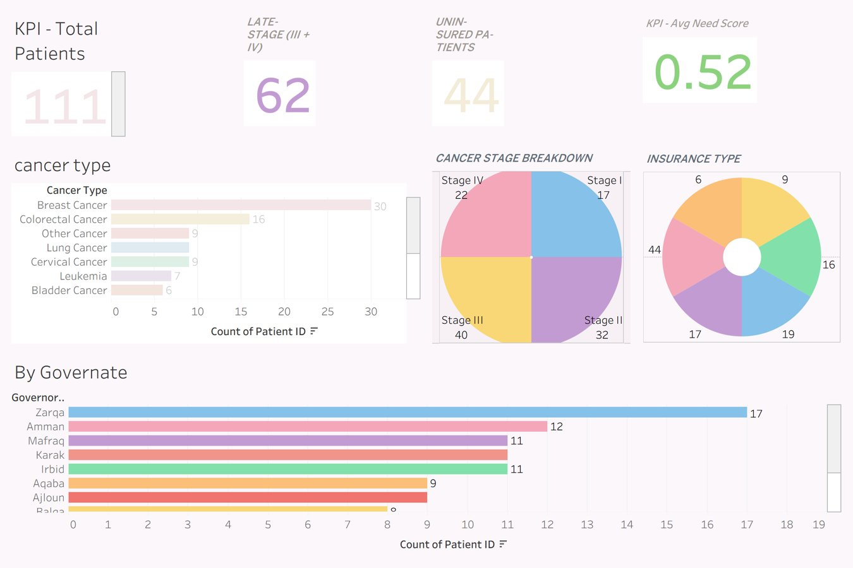
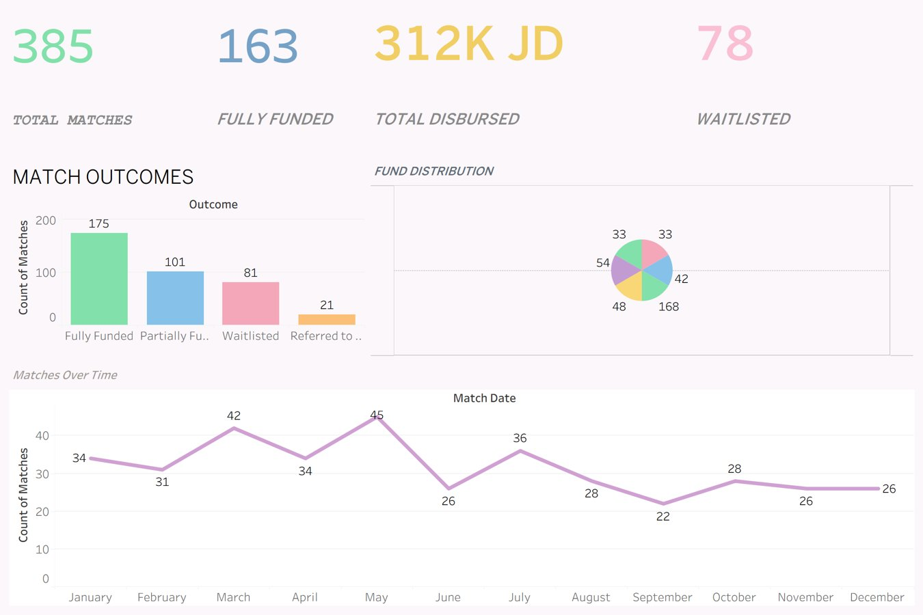
Tableau Dashboard Suite — Dashboards 1 & 2
SLIDE 12 / 20
4 interactive dashboards built from 3 verified CSV files with cross-filtering enabled
Dashboard 1: Patient Need Overview 111 patients · 62 late-stage · 44 uninsured · Avg Need Score 0.52
Dashboard 2: Match Outcomes Overview 385 matches · 163 fully funded · 312K JD disbursed · 78 waitlisted
KHCC AidConnect · Graduation Project Defense · Mallak Abu Sada & Maya Abu Aslahamat · 2025/2026

Slide 13
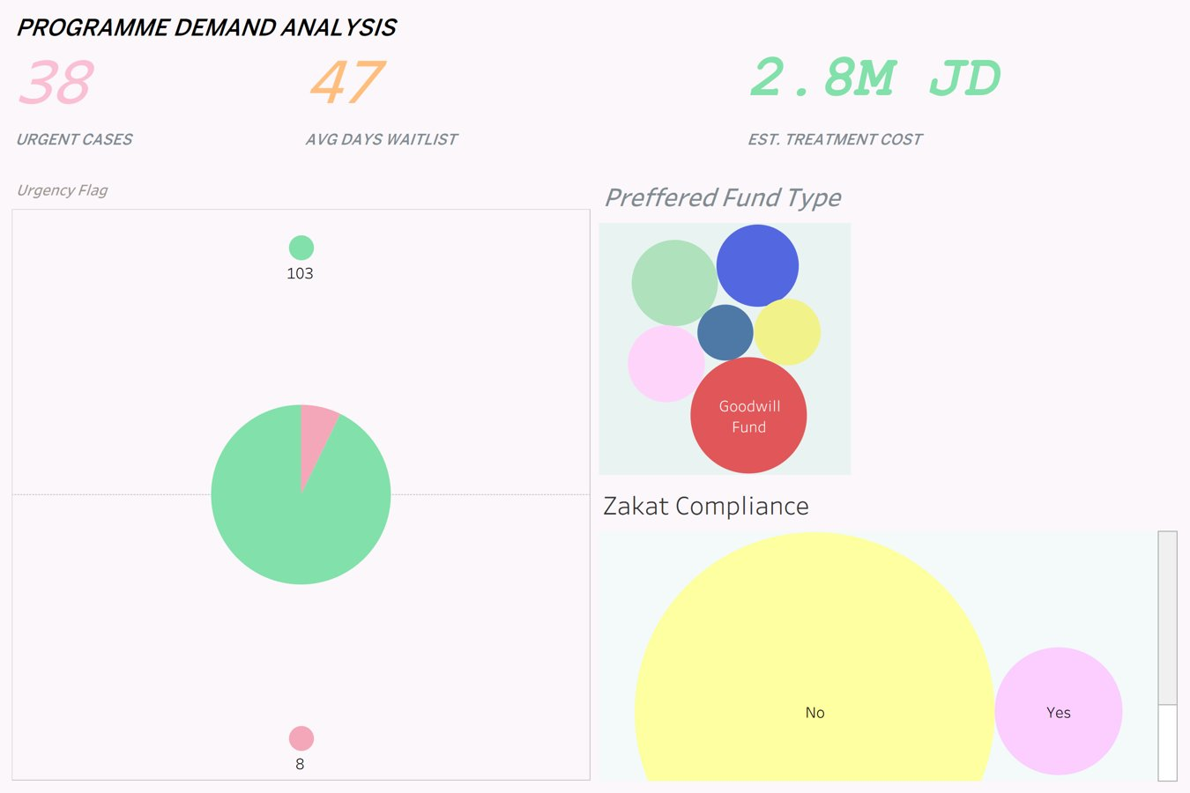
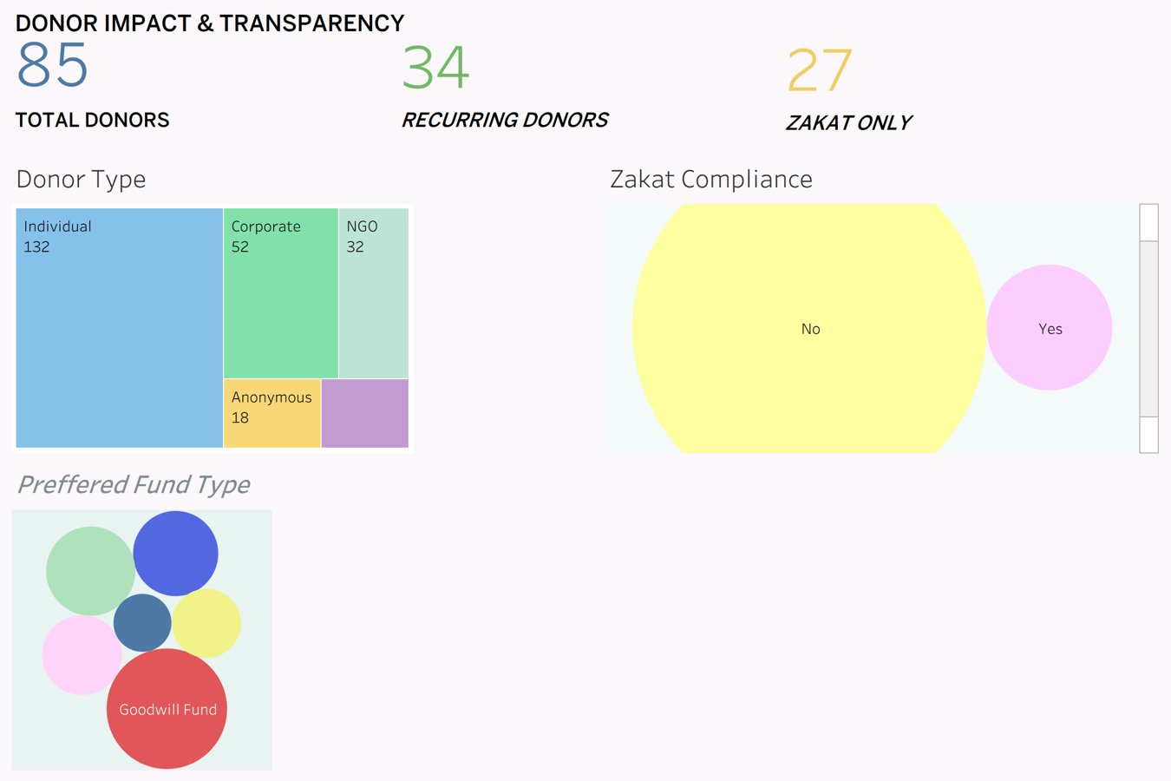
Tableau Dashboard Suite — Dashboards 3 & 4
SLIDE 13 / 20
Programme Demand Analysis and Donor Impact & Transparency dashboards
Dashboard 3: Programme Demand Analysis 38 urgent cases · 47-day avg waitlist · 2.8M JD est. treatment costs
Dashboard 4: Donor Impact & Transparency 85 donors · 34 recurring · 27 Zakat-only · Compliance bubble chart
KHCC AidConnect · Graduation Project Defense · Mallak Abu Sada & Maya Abu Aslahamat · 2025/2026

Slide 14
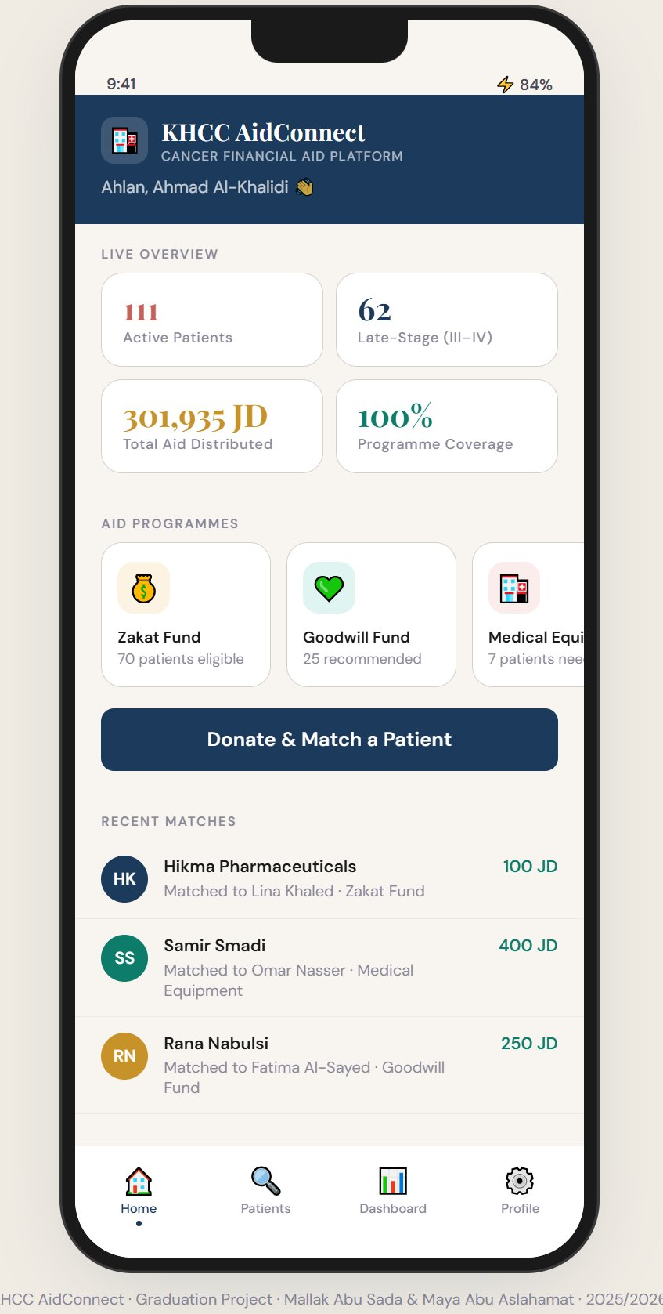
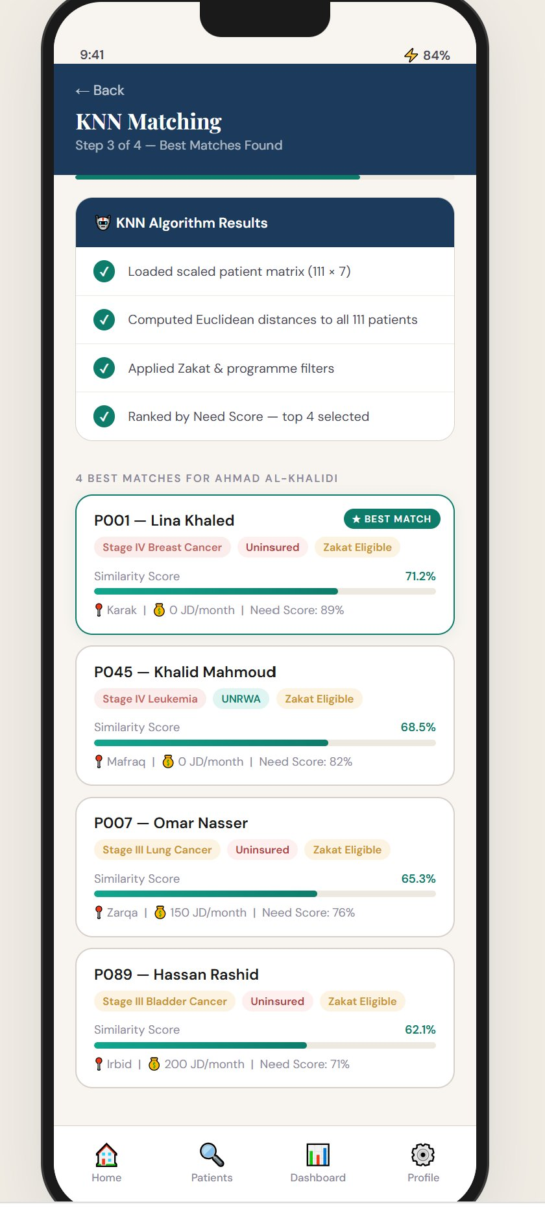
AidConnect App — Home Dashboard & Patient Detail
SLIDE 14 / 21
Slides 14 of 21 · Screen 1 and Screen 5 of the 8-screen donor journey
Screen 1: Home Dashboard
Screen 5: Patient Detail — Lina Khaled (P001)
Live KPIs: 111 patients, 301,935 JD distributed, 100% programme coverage · Zakat Fund (70 eligible), Goodwill Fund (25), Medical Equipment (7) · Recent matches: Hikma 100 JD, Samir 400 JD, Rana 250 JD
Need Score 89% · Stage IV Breast Cancer · Income: 0 JD · Uninsured · 4 dependents · 67 days waiting · High Urgency · Top Recommendation: Zakat Fund 95% confidence
KHCC AidConnect · Graduation Project Defense · Mallak Abu Sada & Maya Abu Aslahamat · 2025/2026

Slide 15
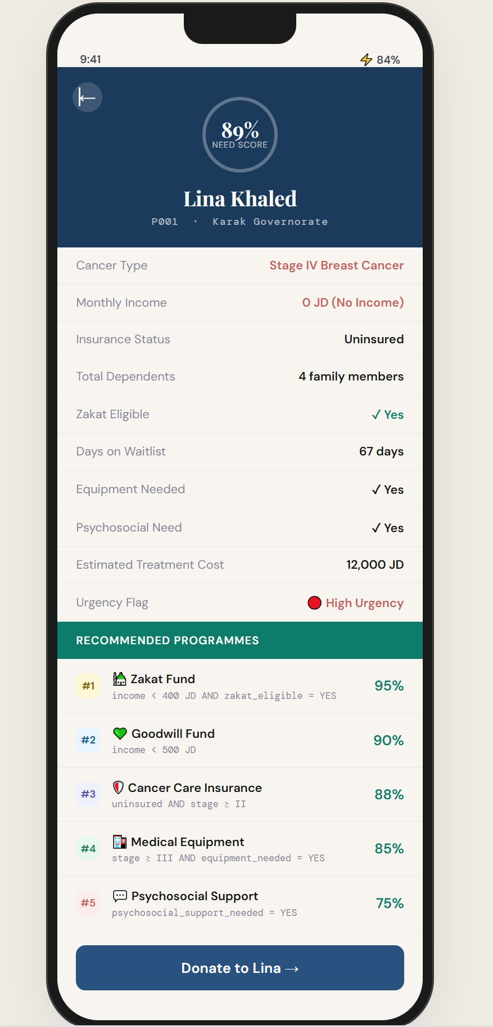
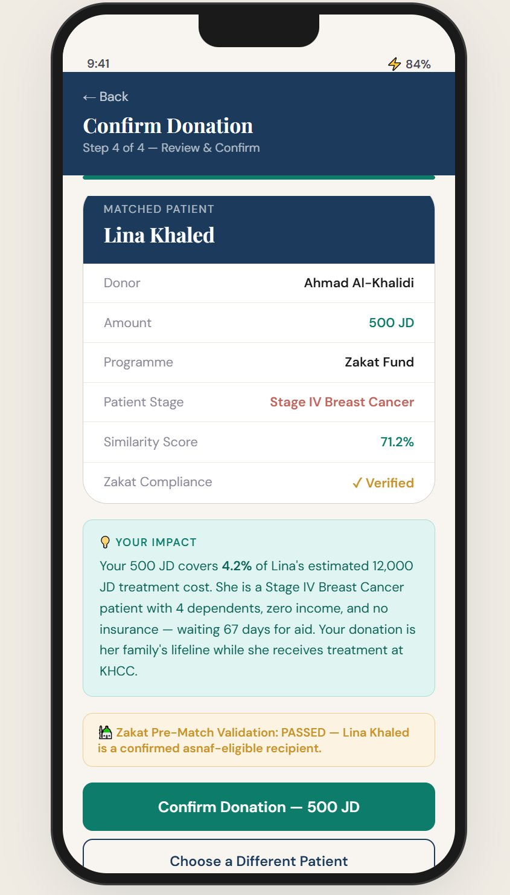
AidConnect App — KNN Matching Results & Donation Confirmation
SLIDE 15 / 21
Slide 15 of 21 · Screen 3 and Screen 4 — the AI engine in action and final donor confirmation
Screen 3: KNN Matching Results (Step 3 of 4)
Screen 4: Confirm Donation (Step 4 of 4)
Algorithm steps: Matrix loaded (111x7) · Euclidean distances computed · Zakat & programme filters applied · Ranked by Need Score · P001 Lina Khaled Best Match 71.2% · P045 68.5% · P007 65.3% · P089 62.1%
Donor: Ahmad Al-Khalidi · Amount: 500 JD · Patient: Lina Khaled · Programme: Zakat Fund · Similarity: 71.2% · YOUR IMPACT: 500 JD covers 4.2% of 12,000 JD treatment · Zakat Validation: PASSED
KHCC AidConnect · Graduation Project Defense · Mallak Abu Sada & Maya Abu Aslahamat · 2025/2026

Slide 16
Empirical Results — Performance Metrics
SLIDE 15 / 20
1.00
1.00
1.00
100%
Precision
Recall
F1-Score
Accuracy
TP/(TP+FP)
200/200
TP/(TP+FN)
200/200
2×(P×R)/(P+R)
= 1.00
200/200 correct
retrievals
Combined System Performance Summary
Component | Metric | Result | Status
KNN Engine | Mean Precision@4 | 1.00 (100%) | ✓ PASS
KNN Engine | 50 Test Queries | 200/200 correct | ✓ PASS
Recommender | Patient Coverage | 111/111 = 100% | ✓ PASS
Hypothesis H1 | T-test Stage vs Need | p < 0.0001 | ✓ PASS
Hypothesis H3 | Pearson r Income/Need | r = -0.69 | ✓ PASS
Zakat Audit | Violations Detected | 42/44 = 95.5% | CORRECTED
KHCC AidConnect · Graduation Project Defense · Mallak Abu Sada & Maya Abu Aslahamat · 2025/2026

Slide 17
Evaluation — Confusion Matrix & Visualisations
SLIDE 16 / 20
Retrieval Confusion Matrix — 50 queries × 4 results = 200 total retrieved
Precision@4 by Stage Group
 | Predicted Relevant | Predicted Not Relevant
Actually Relevant | TP = 200 | FN = 0
Actually Not Relevant | FP = 0 | TN = N/A
What TP=200, FP=0, FN=0 means:
Target: Precision@4 ≥ 0.75
Achieved: 1.00 across ALL stage groups
Margin above target: +0.25 (33% above requirement)
Every one of the 200 retrieved patients was clinically relevant. No irrelevant patient was ever returned. No relevant patient was ever missed.
KHCC AidConnect · Graduation Project Defense · Mallak Abu Sada & Maya Abu Aslahamat · 2025/2026

Slide 18
Did We Achieve Our Objectives?
SLIDE 17 / 20
O1
Need Score Formula
Validated — T-test p<0.0001, Pearson r=−0.69, Chi-square p=0.77. All 3 PASS.
✓
O2
KNN Engine
Mean Precision@4 = 1.00. Target was 0.75. Exceeded by 33%.
✓
O3
Recommender
100% patient coverage — 111/111 patients covered. Avg 3.2 programmes each.
✓
O4
Zakat Compliance Gate
Pre-match validation deployed. Zero violations possible going forward.
✓
O5
Donor Transparency
Impact calculation operational. Personalised notifications generated.
✓
O6
Tableau Dashboards
4 dashboards built from 3 verified CSVs. Cross-filtering enabled.
✓
O7
AidConnect Application
8-screen mobile app deployed. Complete donor journey operational.
✓
O8
Compliance Audit
42 of 44 violations documented. Root cause identified. System corrected.
✓
KHCC AidConnect · Graduation Project Defense · Mallak Abu Sada & Maya Abu Aslahamat · 2025/2026
VERDICT: 8 of 8 Objectives Achieved · Precision@4 = 1.00 (Target: 0.75) · Coverage = 100% · Zakat Violations = 0 going forward

Slide 19
Verification of Deliverables
SLIDE 18 / 20
🐙 GitHub Repository
📁 Google Drive Folder
[ QR CODE
HERE ]
github.com/KHCC-AidConnect/GP-2026
[ QR CODE
HERE ]
drive.google.com/KHCC-AidConnect-GP-2026
Notebooks 01–06 (.ipynb)
Final Report (PDF + Word)
patients_clean.csv (111×27)
Tableau Workbook (.twbx)
donors_clean.csv (250×19)
Presentation Slides (.pptx)
matches_clean.csv (378×10)
All 7 Chart PNG files
AidConnect App (HTML/CSS/JS)
Raw Dataset (Excel)
README.md + run instructions
App screenshots (all screens)
requirements.txt
Supervisor signed cover page
Replace QR placeholders with actual QR codes generated from your GitHub and Google Drive links before the defense.
KHCC AidConnect · Graduation Project Defense · Mallak Abu Sada & Maya Abu Aslahamat · 2025/2026

Slide 20
Future Scope & Enhancements
SLIDE 19 / 20
Phase 2
Neural Collaborative Filtering
Phase 2
Real-Time EHR Integration
Replace KNN with a Neural CF model learning from historical match satisfaction signals — improving relevance over time beyond Euclidean distance.
Connect the patient pipeline directly to KHCC Electronic Health Records via API — eliminating manual entry and enabling automatic Need Score recalculation.
Phase 3
Donor Churn Prediction
Phase 3
Arabic NLP Interface
Build a Random Forest churn classifier alerting caseworkers 30 days before a recurring donor is likely to lapse — enabling proactive retention outreach.
Extend AidConnect to a fully bilingual Arabic/English interface using Arabic NLP for impact notifications — accessible to all Jordanian donor demographics.
Phase 4
Regional Expansion
Phase 4
Federated Learning
Scale the architecture to the full KHCC hospital network across Jordan — the pipeline is institution-agnostic and requires only a new data connection.
Enable privacy-preserving AI training across multiple hospitals — pan-Jordan matching intelligence without sharing raw patient data.
KHCC AidConnect · Graduation Project Defense · Mallak Abu Sada & Maya Abu Aslahamat · 2025/2026

Slide 21
شُكراً
Thank You
🏗 What We Built
📊 What We Proved
A 7-phase analytical pipeline and fully functional mobile-first application — from raw Excel to deployed AI matching system.
KNN Precision@4 = 1.00. Recommender: 100% coverage. All 3 hypothesis tests pass. Need Score is statistically grounded.
⚠ What We Found
🎯 What It Means for KHCC
95.5% of historical Zakat transactions were misallocated. AidConnect now prevents this with a pre-match validation gate and certificate.
Every patient evaluated by the same formula, same features, same weights — regardless of who reviews the file or when.
We welcome your questions. · Mallak Abu Sada & Maya Abu Aslahamat · Supervised by Dr. Ayman M. Mansour · 2025 / 2026

