Slide 1

MultiThreading in python
Menaka malla

Slide 2
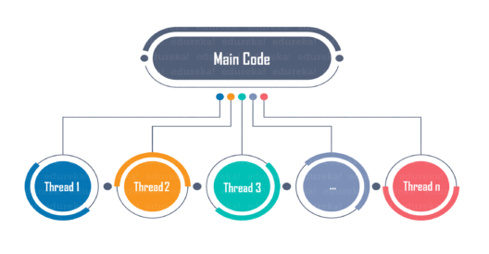

Slide 3
What is multithreading?
A thread has a starting point, an execution sequence, and a result. It has an instruction pointer that holds the current state of the thread and controls what executes next in what order.
The ability of a process to execute multiple threads parallelly is called multithreading.
Ideally, multithreading can significantly improve the performance of any program.

Slide 4
Advantage of Multithreading
Multithreading can significantly improve the speed of computation on multiprocessor or multi-core systems because each processor or core handles a separate thread concurrently.
Multithreading allows a program to remain responsive while one thread waits for input, and another runs a GUI at the same time. This statement holds true for both multiprocessor or single processor systems.
All the threads of a process have access to its global variables. If a global variable changes in one thread, it is visible to other threads as well. A thread can also have its own local variables.

Slide 5
Using a New Thread
It is achievable to execute functions in a separate thread using a module Thread. For doing this, programmers can use the function - thread.start_new_thread().
Syntax:
thread.start_new_thread(function, args[, kwargs])

Slide 6
Example
import threading def coder(number): print ('Coders: %s', number) return threads = [] for k in range(5): t = threading.Thread(target=coder, args=(k,)) threads.append(t) t.start()

