Slide 1

NOVA CYBERSECURITY
AI-Powered Threat Detection and Risk Assessment System
Student Name: [Your Name] | Course: B.Tech Cybersecurity | College: [Your College] | Year: 2024–2025

Slide 2





OVERVIEW
What is NOVA?
Suspicious Login Detection
Identifies abnormal login behavior in real-time
Risk Score Engine
Calculates a weighted score based on security factors
Automated Response
Enables rapid action against unauthorized access attempts
AI/ML Foundation
Built to evolve with machine learning security intelligence

Slide 3
Problem Statement
Weak Authentication
Unknown Devices
Impossible Logins
Attackers exploit poorly secured login mechanisms
Unfamiliar devices accessing accounts go unnoticed
Geographically distant logins remain undetected
Brute-Force Gaps
Slow Detection
Repeated failed attempts are not immediately flagged
Manual monitoring cannot respond to threats in real-time

Slide 4





PROJECT OBJECTIVES
What NOVA Sets Out to Achieve
1
2
3
Real-Time Detection
Risk Scoring
Risk Classification
Identify suspicious login activity as it happens
Calculate a comprehensive, weighted security risk score
Classify threat levels as LOW, MEDIUM, or HIGH
4
5
Automated Actions
Scalable AI Foundation
Trigger security responses and recommendations instantly
Establish groundwork for future ML model integration

Slide 5

SYSTEM WORKFLOW
How NOVA Works
Login
Collect Data
Score
Detect
Alert
Every login event passes through NOVA's six-stage pipeline — from data collection to an automated security decision.

Slide 6
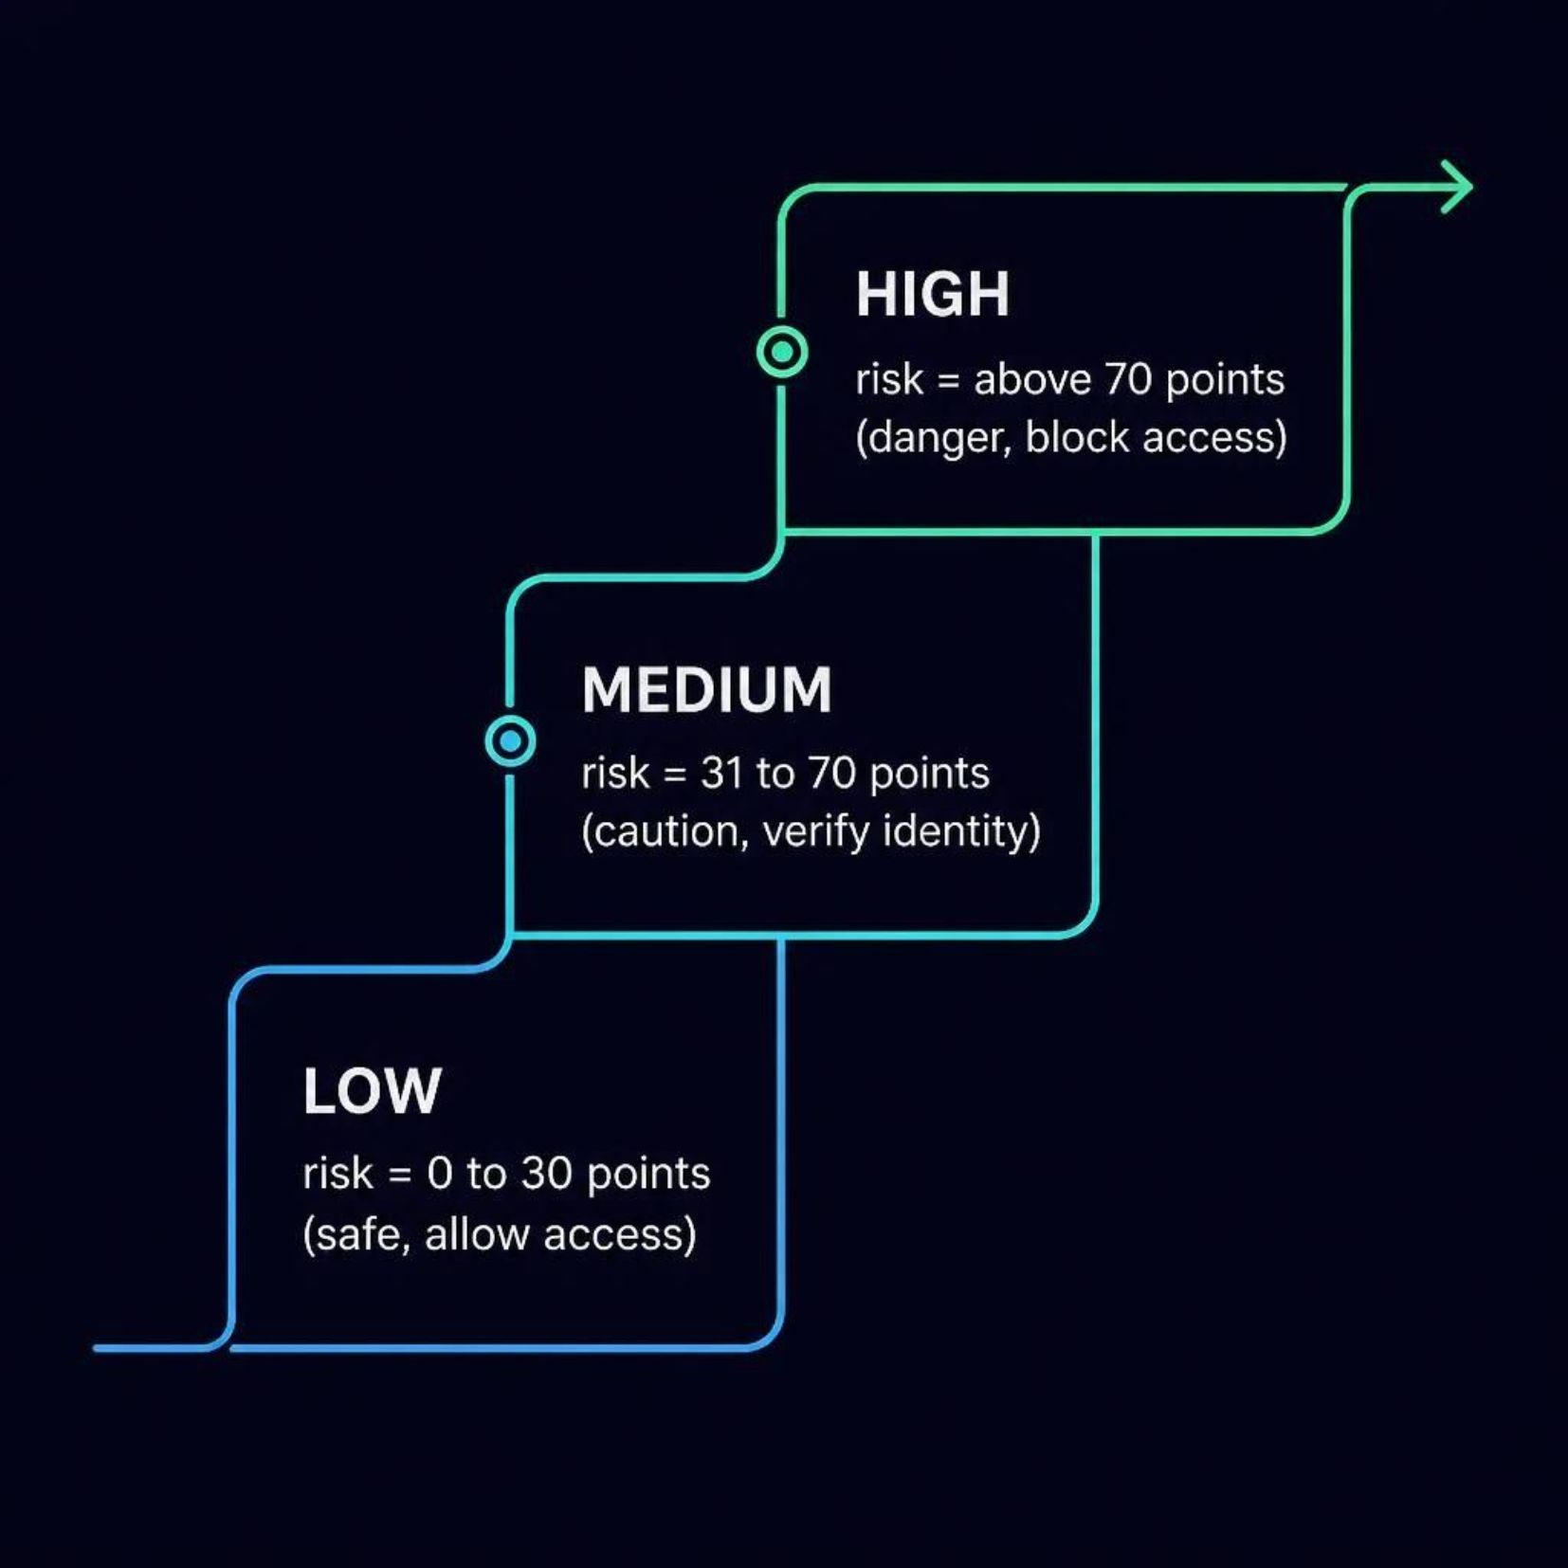



RISK ENGINE
Risk Scoring System
Each login event is scored based on three core threat signals. Scores accumulate and determine the response tier.
Scoring rules are continuously refined as new threat patterns emerge.
New Device
Unusual Location
5+ Failed Attempts
+30 points
+40 points
+30 points

Slide 7

RESPONSE PROTOCOL
Security Actions
LOW Risk
MEDIUM Risk
Allow login immediately — no friction added
Request additional verification — email OTP, security questions
HIGH Risk
Block login — notify user of suspicious activity instantly
All actions are logged for audit and forensic analysis. Users can report false positives to continuously improve system accuracy.

Slide 8





TECH STACK
Technology Stack
Backend
Database
Risk Engine
Python with Flask or Django framework
PostgreSQL or MongoDB for flexible data storage
Rule-based scoring (prototype), ML models (future)
Frontend
Security
React or Vue.js security dashboard
Encryption, secure APIs, and rate limiting

Slide 9

ROADMAP
Future Enhancements
NOVA is designed to evolve. The next phase unlocks intelligent, adaptive security beyond rule-based detection.
01
02
ML Anomaly Detection
Behavioral Biometrics
Train models to identify novel threat patterns automatically
Analyze typing patterns and user behavior for passive authentication
03
04
Threat Intelligence Feeds
MFA and Mobile Alerts
Integrate live global threat data for proactive defense
Multi-factor auth support and real-time mobile notifications

Slide 10

CONCLUSION
NOVA.
A practical, scalable solution to modern login security threats.
Practical Security
Intelligent Assessment
Real-world application of cybersecurity principles
Reduces unauthorized access through smart threat scoring
AI-Ready Foundation
Scalable by Design
Rule-based core built to evolve with machine learning
Architecture supports future integrations and expansion
Built for the future of intelligent cybersecurity — one login at a time.

