Slide 1
DrivenData Competition
DengAI: Predicting Disease Spread
Entering the Competition

Slide 2
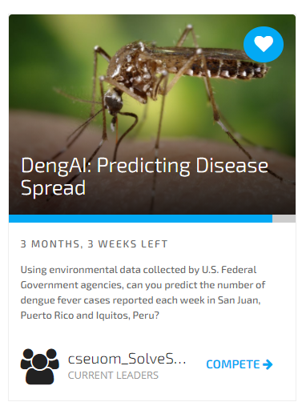
Entering the Competition
Signup at https://www.drivendata.org/
Enter DengAI: Predicting Disease Spread competition by clicking on ‘Compete’ button
Enter your username to Team 3 in the spreadsheet below
https://docs.google.com/spreadsheets/d/1_kRf72CdyNTKz1j8dMa10XlZ7Iefn5QluIcYJZYrGhA/edit#gid=1753650018
Mridula will create a team on DrivenData and add you to the team

Slide 3
DrivenData Competition
DengAI: Predicting Disease Spread
Competition Rules

Slide 4
Competition Rules
(Courtesy: DrivenData Website - https://www.drivendata.org/competitions/44/dengai-predicting-disease-spread/rules/)
One account per participant. Each Team member must be a single individual operating a separate DrivenData account.
You may not participate on more than one Team.
You must confirm your Team membership to make it official by responding to the Team notification message which will be sent to your Account.
Participating using more than one DrivenData account is deemed cheating and, if discovered, will result in disqualification from the Competition and any other affected Competitions and may result in banning or deactivation of affected DrivenData accounts.
Privately sharing code or data outside of team is not permitted.
OPEN-SOURCE CODE. A Submission will be ineligible to win a prize if it was developed using code containing or depending on software licensed under an open source license: other than an Open Source Initiative-approved license (see http://opensource.org/licenses); or an open source license that prohibits commercial use.
External data is not allowed unless otherwise noted explicitly on these competition pages. Participants agree to make no attempt to use additional data or data sources not provided on these competition pages.

Slide 5
Discussion
Team Name
Team meeting frequency and times
Preferred communication channels
Mode of work

