Slide 1
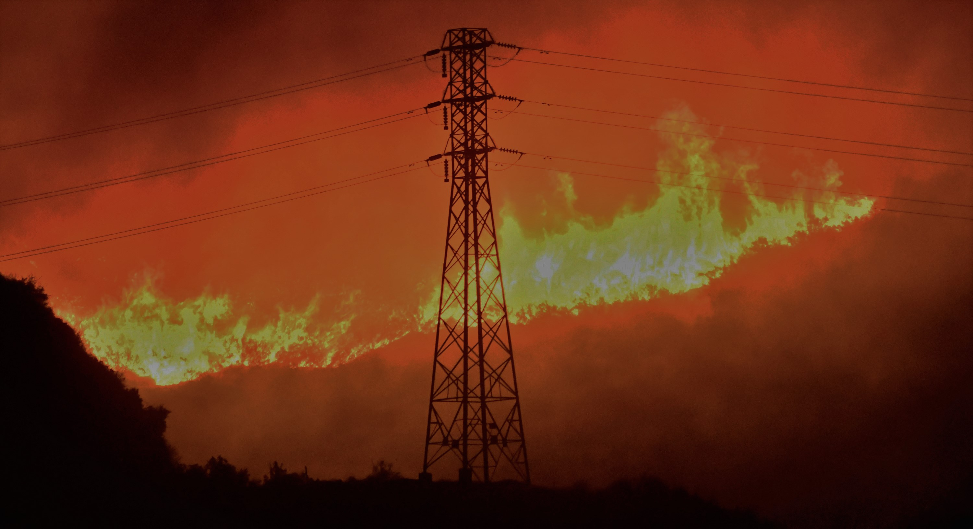
Wildfire Prevention by De-Energization
- 7Strangers

Slide 2
Data acquisition and cleaning
Data Sources:
https://www.cpuc.ca.gov/general.aspx?id=6442467662
https://www.cpuc.ca.gov/uploadedFiles/CPUCWebsite/Content/News_Room/NewsUpdates/2021/Jan.%2012-21,%202021%20SCE%20PSPS%20Post%20Event%20Report.pdf
In total, 574 rows were extracted from the historical reports.
Used the data from SCE PSPS Event reports from 2020 and 2021
NOTE: To train the model, we required some data where no de-energization was required, so we added 574 dummy values just to create normal scenarios.

Slide 3
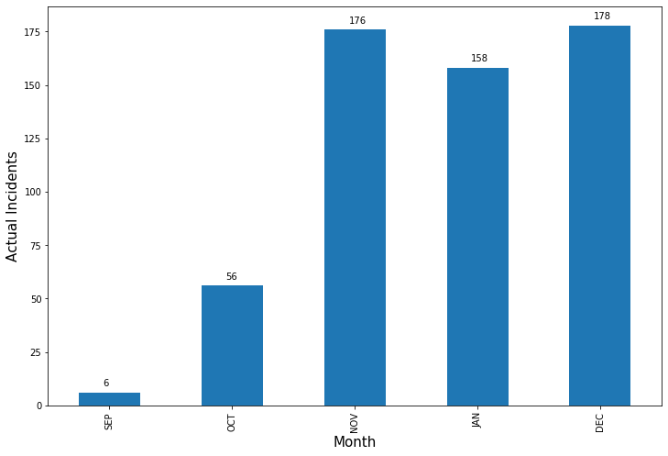
Data Visualization
Bar graph visualization of de- energized data extracted from SCE PSPS Report vs Month
December is the month where maximum number of the circuits were de- energized

Slide 4
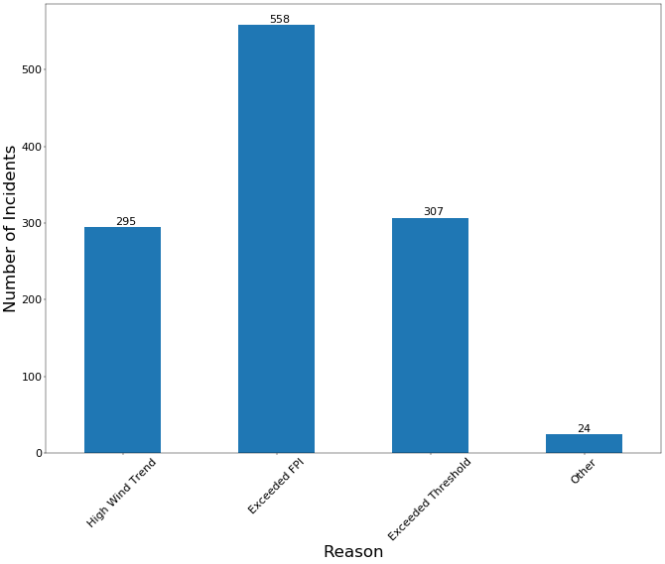
Number of Incidents vs Reason Graph

Slide 5
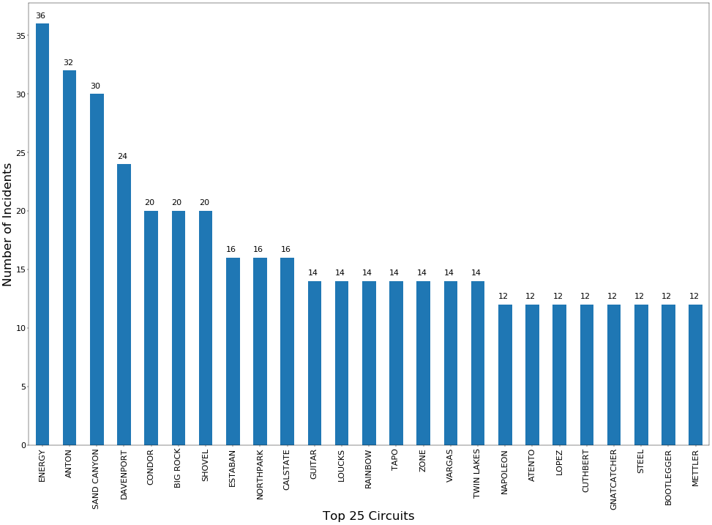
Top 25 Circuits vs Number of Incidents Graph

Slide 6
NEW FIELDS CALCULATED FROM RAW DATA
New fields added:
closeToWindThreshold: Comparison of Wind Sustained with Wind Threshold (%) Formula: (WindSustained / WindThreshold )*100
closeToGustThreshold: Comparison of Wind Sustained with Wind Threshold (%) Formula: (GustSustained / GustThreshold )*100
eFPI: Comparison of FPI with base factor of 12 (Low - 11.99, Elevated - 12-14.99, Extreme >= 15 ) Formula: FPI/12
eThres: Max of ratio of Gust Sustained / Gust Threshold and Wind Sustained / Wind Threshold Formula: Max(GustSustained / GustTheshold, WindSustained/ WindTheshold)

Slide 7
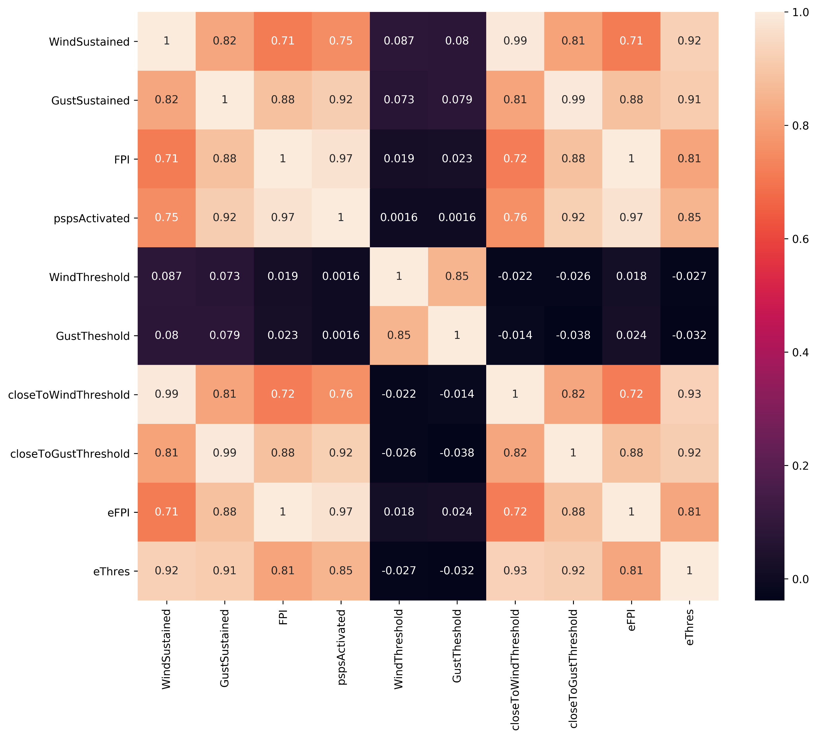
Correlation heatmap
Relevant fields for the de-energization (pspsActivated):
Wind Sustained
Gust Sustained
FPI
closeToWindThreshold
closeToGustThreshold
eFPI
eThres

Slide 8
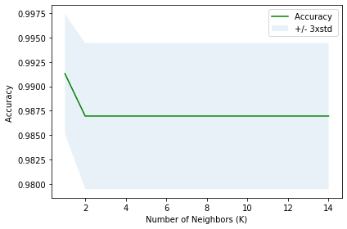
MACHINE LEARNING MODELS USED
K Nearest Neighbor (KNN)
Support Vector Machine
Logistic Regression
Linear Regression
Random Forest Regressor

Slide 9
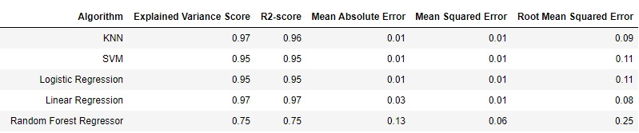
MODEL COMPARISON
As per the analysis, Linear Regression model is working better as compared to other models. Linear Regression will provide probability of de-energization required, which will give a clear picture as compared to Classification Model (KNN). So, Linear Regression model is selected for the Test Run

Slide 10
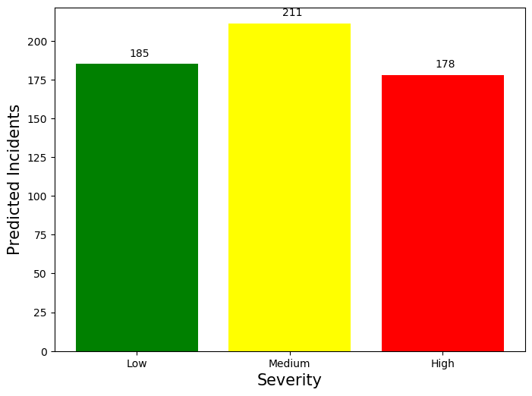
Predicted incidents With Severity
We created test data with random wind and FPI values and analyzed the output visually.
Categorical chart of the predicts level of severity for datapoints.

Slide 11
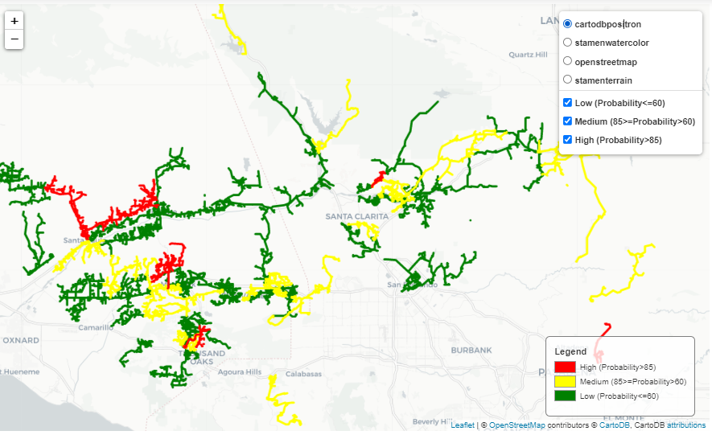
Map Generated from the report

Slide 12
Future Scope
Below are the some of the new fields that we can be used to optimise this model:
Voltage
Fuel moisture
High Fire Areas
Precipitation
Camping sites
UV Index
Dry Vegetation in that area
Thunderstorm
Time slider extension in map for visualisation of larger time aware datasets

Slide 13
Thank You

