Slide 1
Auto Inspection Tool
Team Mallax

Slide 2
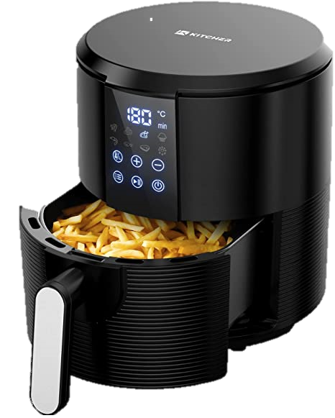

Slide 3
The Problem
About 30% of e-commerce sales are returned globally. Items sent back to the warehouse are then inspected to decide the fate of the item. In the US alone, 15 million tons of carbon emissions are generated due to return shipping every year.
Notes:
Sources:
https://www.clickpost.ai/ecommerce-returns
https://www.cnbc.com/2019/01/10/growing-online-sales-means-more-returns-and-trash-for-landfills.html
https://www.ftaccelerator.it/blog/environmental-impact-returns/

Slide 4
The Problem
Return ticket raised on system
Return label issued to customer
Customer deposits package to courier office
Package received at depot by courier company
Transit to the e-commerce company’s depot
Package inspected by the depot staff

Slide 5
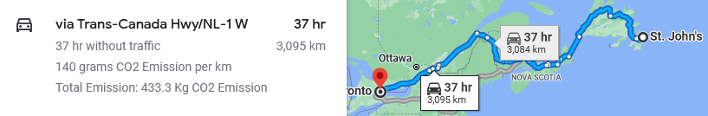
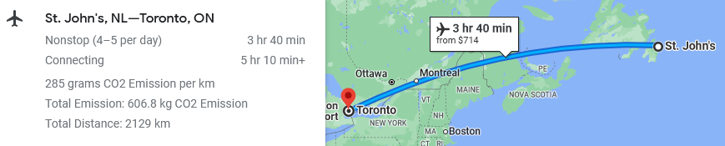
The Problem
Using land and sea transport
Using air transport
Notes:
If we were talking about Newfoundland and Labrador, we would assume that the goods would need to first travel by road to either the west coast of NL or the nearest port. The product is then transported to the Canadian mainland via container ships or ferries. Once it reaches the mainland, it takes a road transit to Ontario, where it arrives at the Amazon depot.

Slide 6
The Solution
An application at the user’s end that allows for automatic inspection of an item using computer vision techniques and eliminates the need to transport items back for inspection.
Notes:
About 25% of return items are discarded. (https://www.cnbc.com/2019/01/10/growing-online-sales-means-more-returns-and-trash-for-landfills.html)

Slide 7
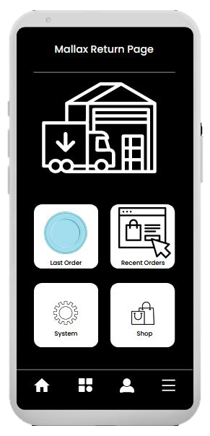
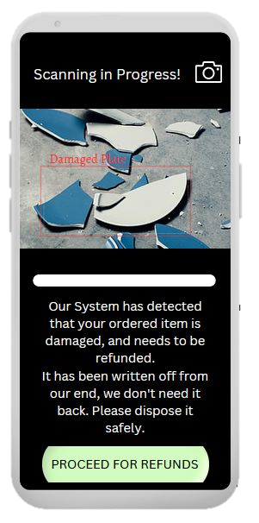

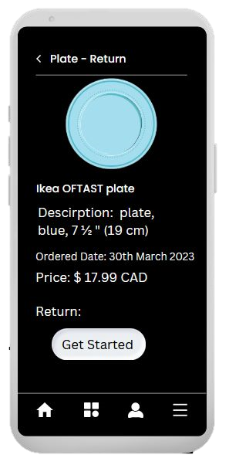
Scanning of objects using a mobile camera
Homepage
Mallax Return Page
Details of order

Slide 8
The opportunity
Cost of returning - $33 for a $50 product
in 2021, roughly $218 billion worth of products were returned.
Environmental aspect
16 million metric tons of Co2 emissions
5.8 billion pounds of landfill waste
Notes:
Source:
(1) https://www.forbes.com/sites/sap/2022/03/23/smart-tech-is-tackling-the-true-cost-of-returns-to-the-retail-industry/?sh=6792e2876c67

Slide 9
The team
Zeeshan Rizvi
MEng Electrical
Computer Vision Developer
Hisham Hafeez
Bachelor of Science
Computer Engineering Aspirant

Slide 10
Thank you!

