Slide 1
🏦
Product Overview & Capabilities Presentation
Banking AI Agent
Powered by Google Gemini AI
Intelligent Financial Analytics · AI-Powered Insights Budget Management · Forecasting · Chatbot Assistant
Spring Boot 3
React 19
PostgreSQL
Google Gemini AI
Docker
May 2026 · v1.0 · GitHub: https://github.com/mallemala/banking_ai_agent

Slide 2
Application Overview
AI-Powered Personal Finance Platform
What is Banking AI Agent?
👤 Standard User
Banking AI Agent is an intelligent financial analytics platform that enables users to upload bank statements and receive deep, AI-driven financial insights.
▸ Upload bank statements (PDF / CSV / XLSX / PNG / JPG)
▸ View AI-generated analytics dashboard
▸ Chat with AI Financial Assistant
It leverages Google Gemini AI to automatically:
▸ Manage monthly budgets & financial goals
✦ Extract & categorise transactions
▸ Download reports (PDF · CSV · Excel)
✦ Generate financial health scores
✦ Forecast future balances
✦ Provide personalised savings recommendations
🔐 Administrator
✦ Answer natural language financial questions
▸ Manage users & access roles
Designed for individuals who want full visibility and control over their finances without switching banks.
▸ View full audit logs
▸ Monitor AI usage & quotas
▸ System configuration management

Slide 3
Technology Stack
Modern, cloud-ready architecture built for scale
⚙️ Backend
🎨 Frontend
🗄️ Data & Cache
🤖 AI Layer
🐳 Infrastructure
• Java 21 (LTS)
• React 19 + TypeScript
• PostgreSQL (primary DB)
• Google Gemini 2.5 Flash/Pro
• Docker & Docker Compose
• Spring Boot 3.3
• Vite (build tooling)
• Redis (AI insight caching)
• gemini-2.5-pro-preview-05-06
• PostgreSQL container (port 5433)
• Spring Security + JWT
• Recharts (data visualisation)
• HikariCP (connection pool)
• Auto model fallback on quota
• Redis container
• Spring Data JPA / Hibernate 6
• Custom dark UI design system
• Spring Cache abstraction
• Prompt engineering + JSON parsing
• CI/CD ready structure
• Apache PDFBox & POI (file parsing)
• Axios (HTTP client)
• Maven build system

Slide 4
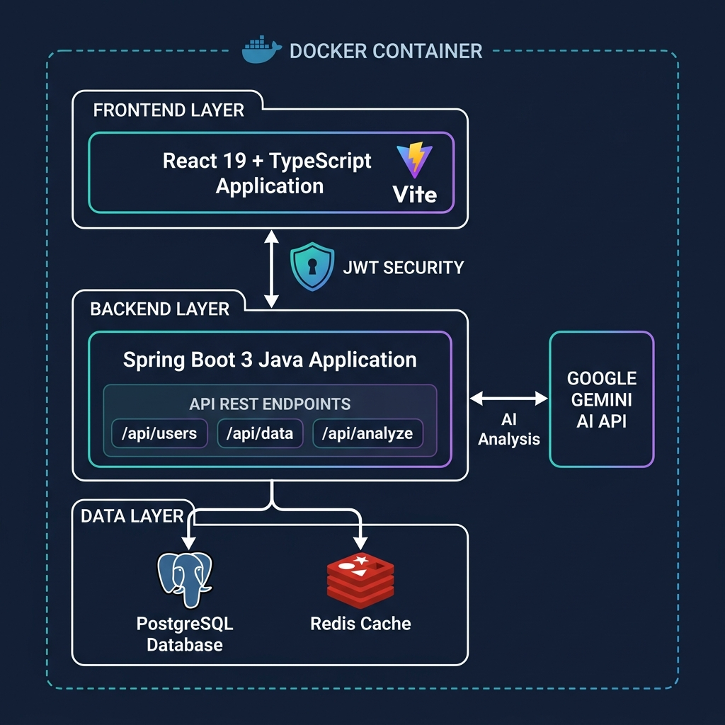
System Architecture
How the components connect
Key Design Decisions
◆ Stateless API
JWT-authenticated REST — every request is self-contained
◆ AI Caching
Gemini responses cached in DB; evicted on data change
◆ Model Fallback
Auto-switch Gemini models on 429/quota errors
◆ Deduplication
SHA-256 file hash prevents re-processing identical statements
◆ Separation
Frontend served independently; backend exposes /api/*
◆ Docker
Fully containerised — DB, cache, and app in compose

Slide 5
Current Features
What the application delivers today
📤
Statement Upload
🔍
AI Transaction Extraction
📊
Analytics Dashboard
💬
AI Chatbot Assistant
PDF · CSV · XLSX · PNG · JPG Multi-file batch, deduplication via SHA-256
Gemini parses raw text into structured rows: Date · Merchant · Category · Amount · Balance
Opening/closing balance · income/expense totals Financial health score 0–100 with AI insight
Natural language Q&A on your own transactions 'How much on Tesco last month?'
📂
Transaction Management
🎯
Budget Management
🏆
Goal Planning
🔮
Balance Forecasting
Paginated list · search · sort · filter by category Manual category correction with cache eviction
Per-category monthly budgets Progress tracking with overspend alerts
Financial goals with target amounts Progress tracking & monthly contribution guide
AI forecasts next-month balance + confidence score Insight narrative from Gemini
💡
Savings Recommendations
📤
Report Exports
🔐
Security & Audit
👨‍💼
Admin Panel
Personalised tips via Gemini Subscription detection · spending pattern analysis
Download transactions as PDF · Excel · CSV Formatted with Apache PDFBox & POI
JWT auth · role-based access · full audit log All actions tracked with timestamp
User management · audit trail viewer System health & AI usage monitoring

Slide 6
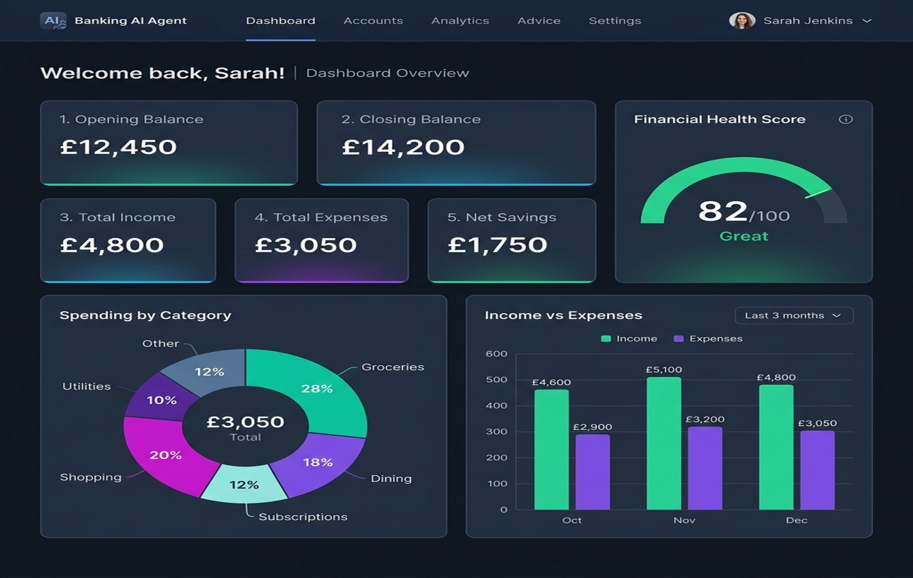
Dashboard
At-a-glance financial overview powered by AI
Dashboard Highlights
📌 6 KPI summary cards (balance, income, expenses, health score)
📈 Spending by Category pie chart
📊 Income vs Expenses bar chart (monthly)
🔮 Balance Trend line chart
🏥 AI Financial Health Score 0-100 with Gemini narrative
⚡ Cached AI insights — sub-second reloads
🔄 Auto cache-eviction on new uploads

Slide 7
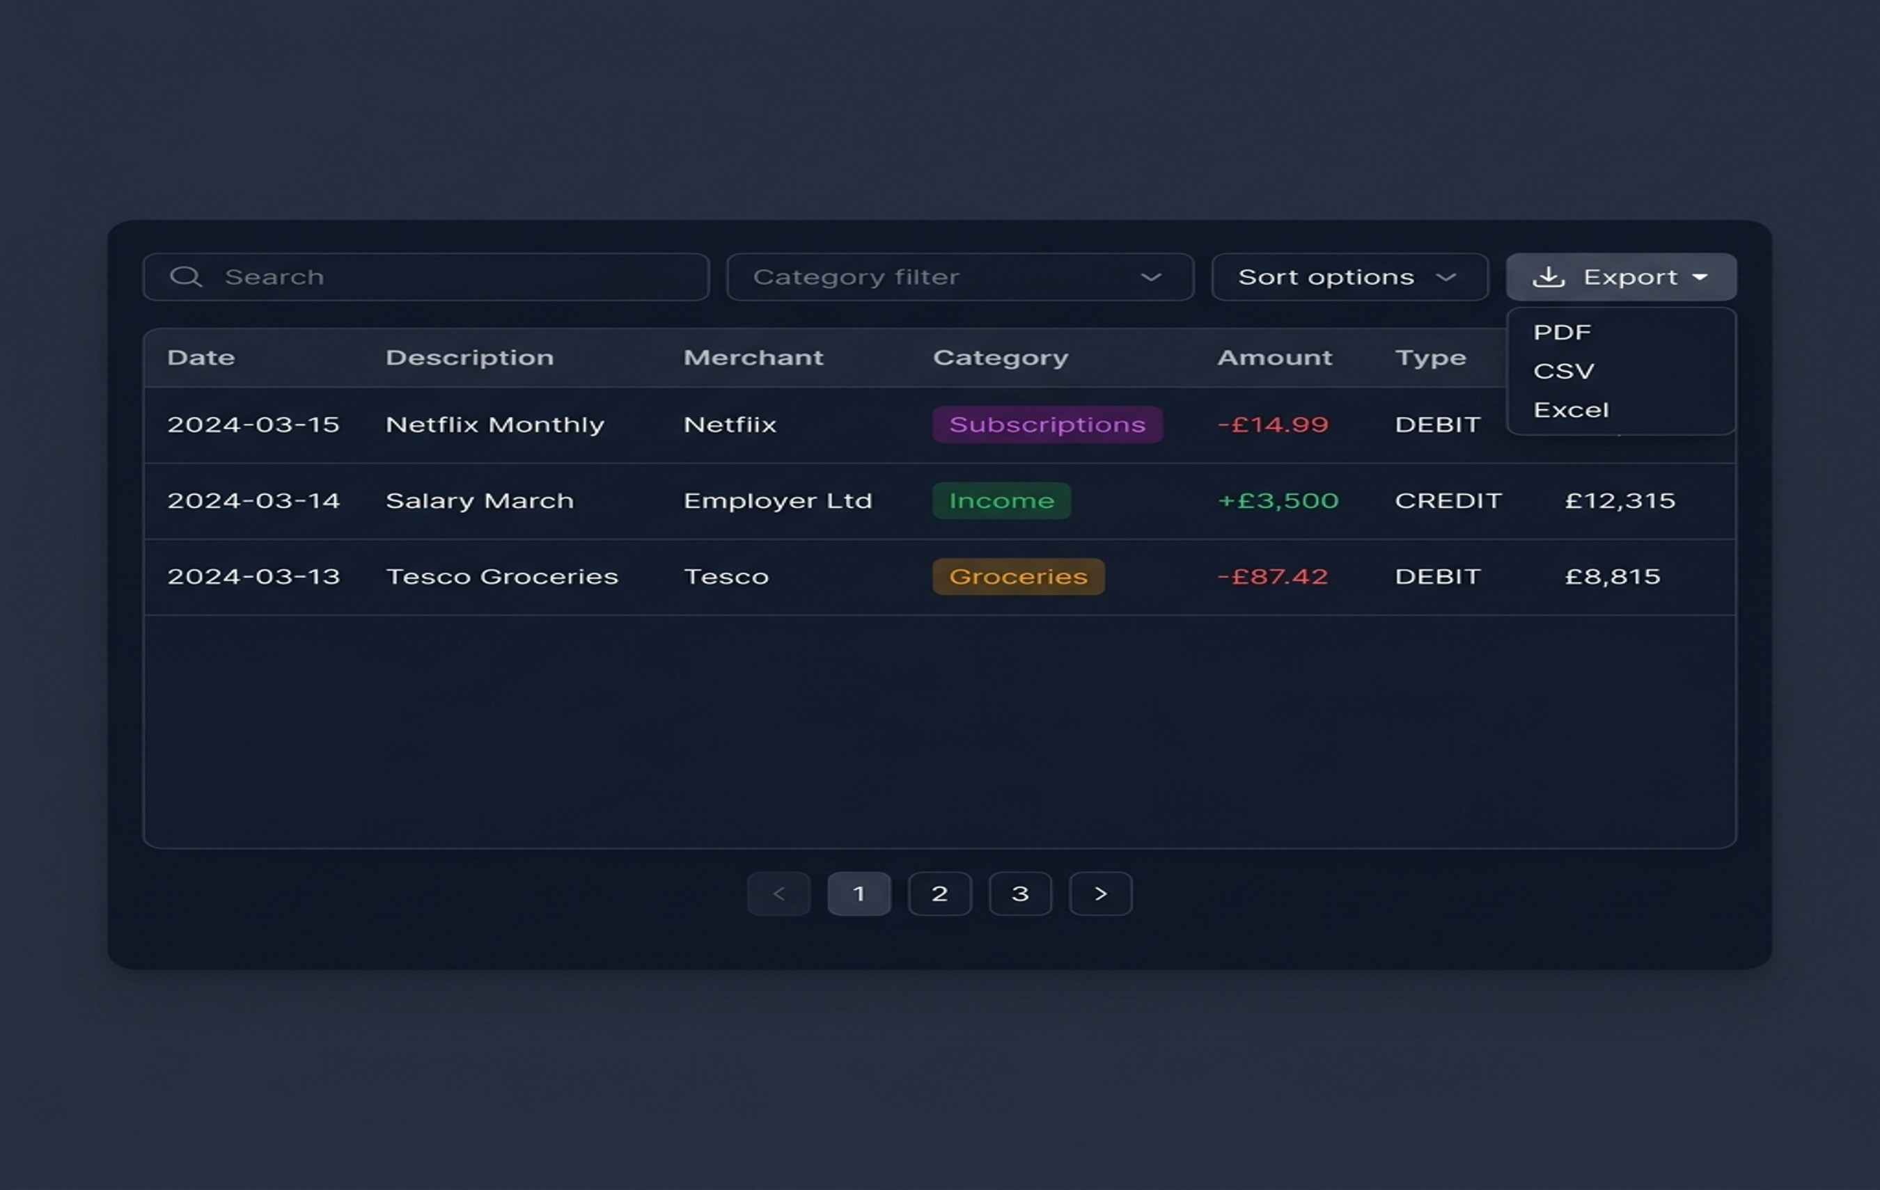
Transaction Management
Search, sort, filter and categorise every transaction
Transaction Features
🔍 Full-text search across description, merchant & category
↕️ Sort by date, amount, merchant or category
🏷️ Colour-coded category badges
✏️ Manual category correction with AI cache-evict
📄 Pagination (configurable page size)
📥 Export: PDF · Excel · CSV
🔒 User-scoped — each user sees only their data
🐛 Fixed: PostgreSQL lower(bytea) search bug

Slide 8
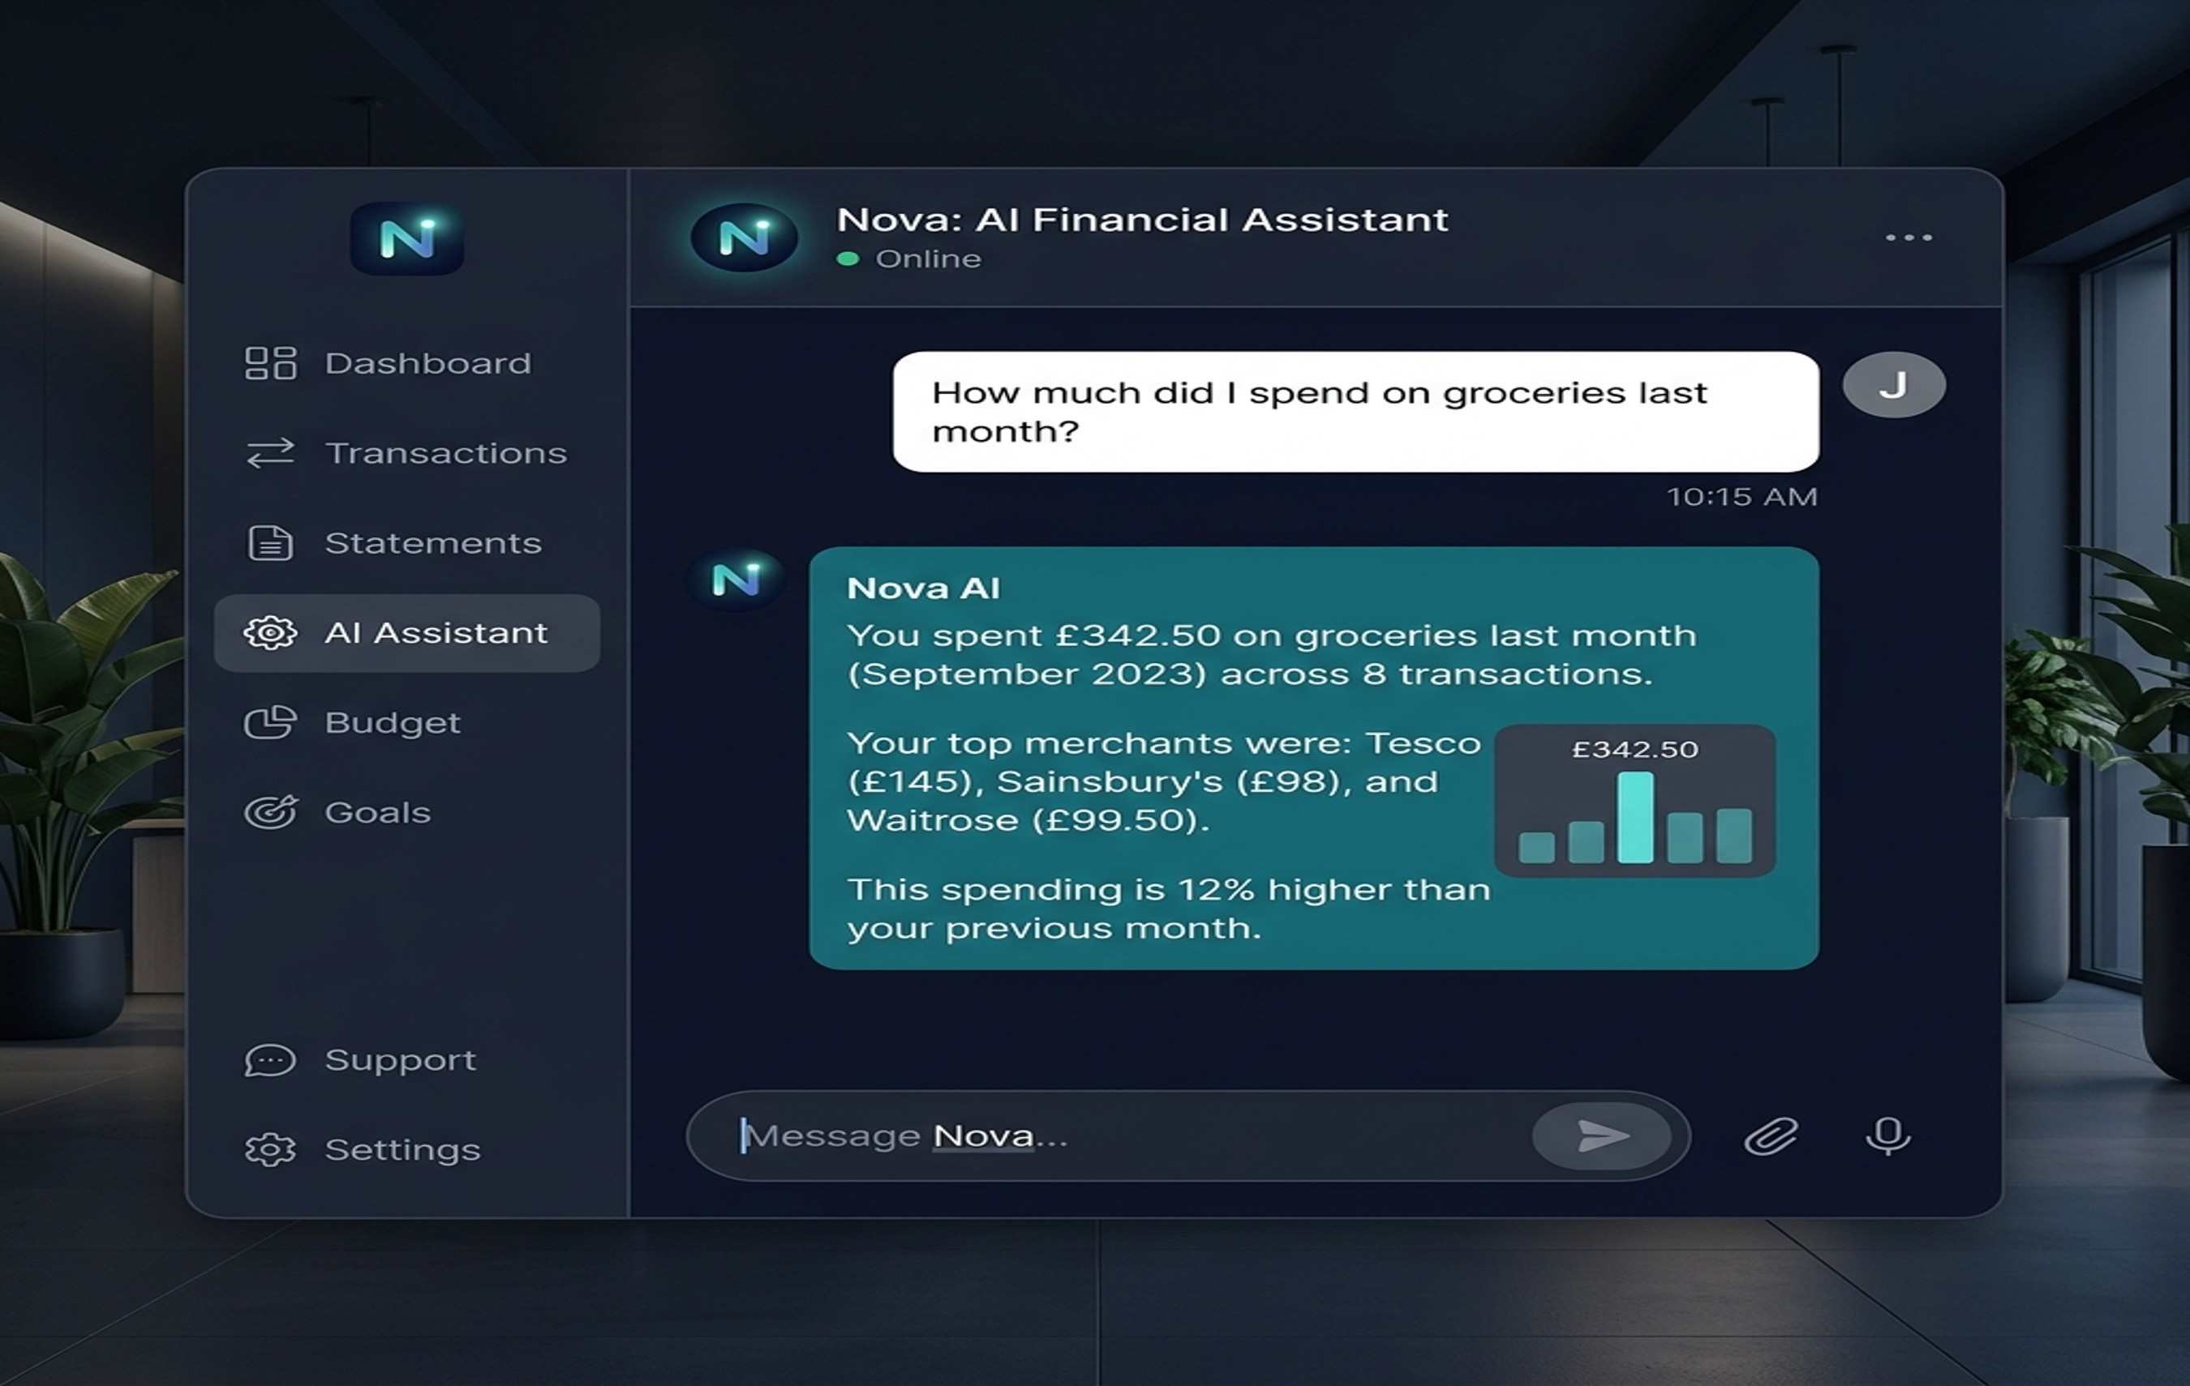
AI Financial Assistant
Ask your finances anything — in plain English
Chatbot Capabilities
🤖 Powered by Google Gemini 2.5 Flash/Pro
📋 Full transaction context injected per query
💬 Persistent conversation history in session
📊 Can compute totals, averages and trends on the fly
🔁 Auto model fallback on API quota limits
Sample queries:
• 'What subscriptions can I cancel?'
• 'Show my top 5 spending merchants'
• 'How much did I spend on Amazon this month?'
• 'Am I over budget on dining?'

Slide 9
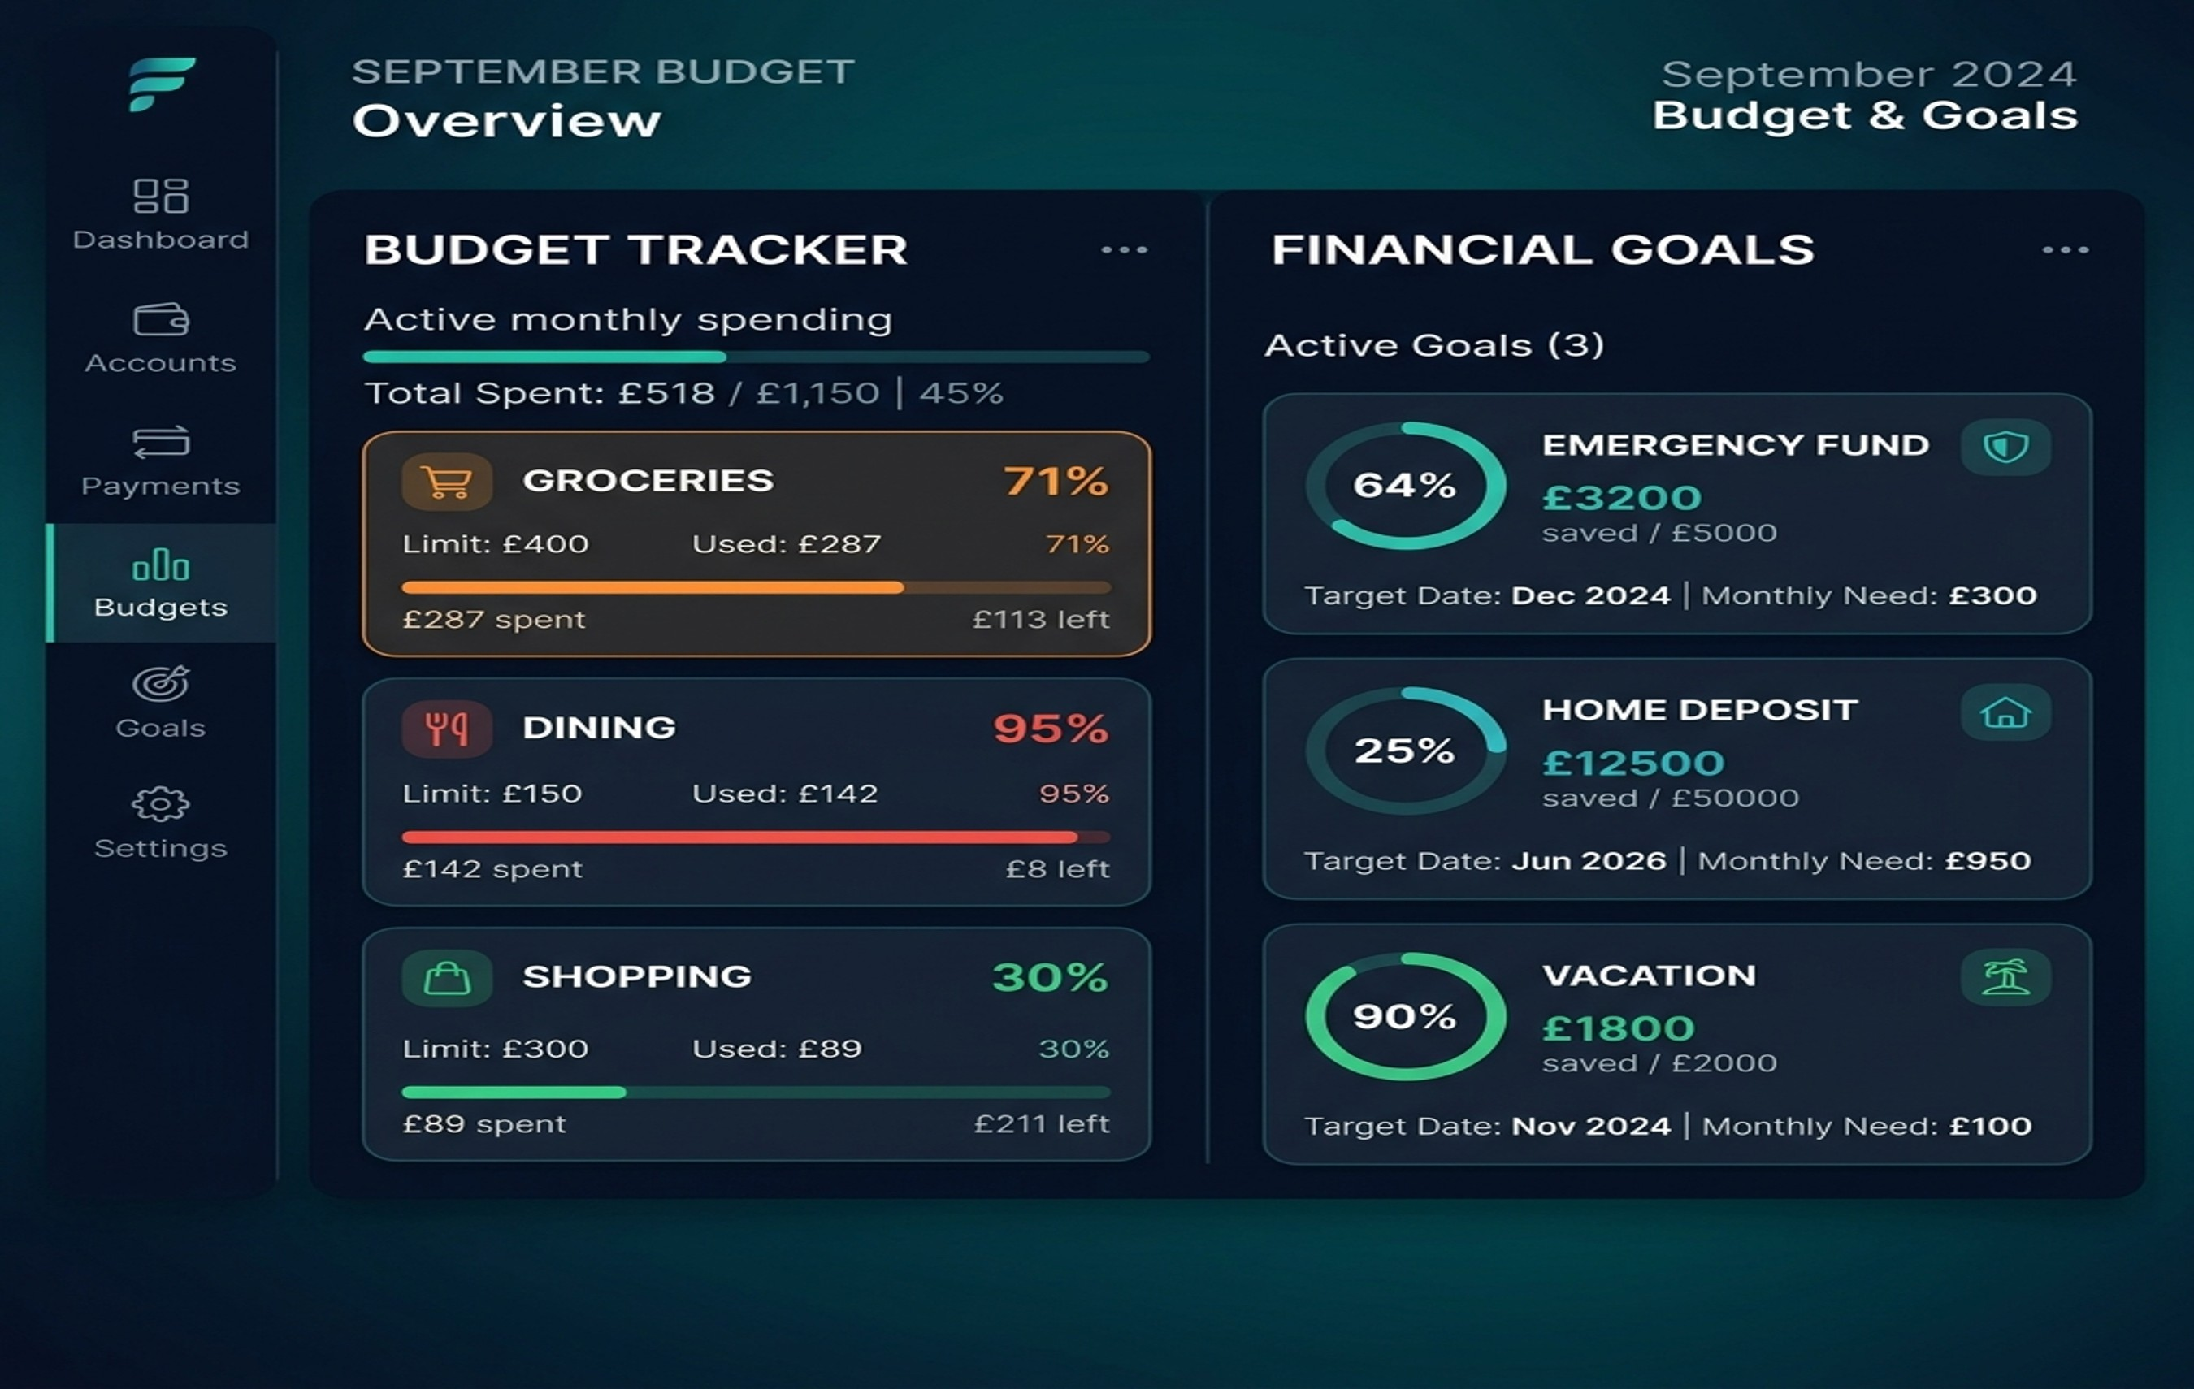
Budget Management & Goal Planning
Stay on track — month by month
Budget Features
▸ Per-category monthly spend limits
▸ Real-time progress bars
▸ Warning at 80% utilisation
▸ Alert at 100% (overspend)
Goal Planning
▸ Create named financial goals
▸ Set target & current saved amounts
▸ Visual circular progress tracking
▸ AI monthly contribution suggestions
▸ Examples: Emergency Fund, Home Deposit, Vacation

Slide 10
Statement Upload & Parsing
Intelligent ingestion with deduplication safeguards
📁
🔐
🤖
🏷️
💾
📊
Select File(s)
→
SHA-256 Hash
→
Gemini Parse
→
Categorise
→
Save to DB
→
Dashboard
PDF · CSV · XLSX PNG · JPG
Duplicate check before processing
Extract transactions with AI
14 spending categories
PostgreSQL transaction store
Instant analytics updated
🛡️ Deduplication Engine
🔄 AI Model Fallback
▸ SHA-256 hash computed from raw file bytes before any DB write
gemini-2.5-flash (primary)
▸ If hash matches a SUCCESS record → reject with informative error message
gemini-2.5-pro
gemini-3.5-flash
▸ If hash matches a FAILED record → delete old record, re-process cleanly
gemini-3.1-pro-preview
▸ Prevents duplicate transactions from inflating analytics
gemini-2.0-flash (last resort)
Auto-rotates on HTTP 429 / RESOURCE_EXHAUSTED errors

Slide 11
Security & Reliability
Enterprise-grade safeguards built in from day one
🔑
JWT Authentication
👥
Role-Based Access
Stateless JSON Web Token auth on every API request. Tokens expire and must be refreshed.
STANDARD_USER and ADMIN roles. Admins access user management and audit logs only.
📝
Audit Logging
🔒
User Data Isolation
Every significant action (upload, parse, category change, chatbot query) logged with timestamp and user email.
All queries scoped by authenticated user ID. Cross-user data access is rejected with SecurityException.
🛡️
Input Validation
📊
DB Connection Pooling
File type and size validated on upload. SQL injection prevented via JPA parameterised queries.
HikariCP with configured limits prevents connection exhaustion under load.
♻️
Cache Eviction
🐳
Container Isolation
AI insight cache automatically cleared when transactions are modified, ensuring fresh results.
PostgreSQL and Redis run in separate Docker containers with no direct host exposure.

Slide 12
Delivery Roadmap
Phased approach — value delivered incrementally
Phase 1 ✅ DONE
Phase 2 ✅ DONE
Phase 3 🔄 NEXT
Phase 4 ⭕ PLANNED
Phase 5 ⭕ FUTURE
• Statement Upload (PDF/CSV/XLSX/images)
• AI Chatbot Financial Assistant
• Balance Forecasting (Gemini)
• Multi-User Accounts
• Open Banking API Integration
• AI Transaction Extraction & Categorisation
• Transaction Search, Sort & Filter
• Savings Recommendations
• Real-Time Transaction Sync
• Analytics Dashboard + Health Score
• Budget Management
• Cash Flow Visualisations
• Proactive Spend Alerts
• Income & Spending Analysis
• Goal Planning & Tracking
• Multi-Statement Comparison
• JWT Auth + User Registration
• Admin Panel + Audit Logs
• Multi-file batch upload
• PDF / Excel / CSV Exports
• Custom Categories & Bulk
Updates
• Subscription Detection

Slide 13
🏦
Banking AI Agent
Thank You
GitHub: https://github.com/mallemala/banking_ai_agent
Built with
Opportunities
Spring Boot
React 19
Gemini AI
Open Banking
Mobile Apps
AI Copilot

