Slide 1
Hello, my name is [Michael Allen]. I was born in [San Francisco] and my people are from [California]. (Fourth Generation Californian)

Slide 2
One useful thing I was excited to have learned is [more comfort with Markdown].

Slide 3
One thing I’ve used on this project from outside this class has been [the creation of PowerPoints to document the beginning of my learning process for future teaching]

Slide 4
If this project was a movie it would be called [What Not To Do for Implementing PowerPoint/Jupyter Notebooks/ReadMe as Learning Tools at the Same Time].

Slide 5
I started this project [six days] ago.

Slide 6
I am doing it because I [am] a [Technology Teacher] of sorts…

Slide 7
Who wants to be able to [teach Survey Analysis].

Slide 8
So that they can [learn] and I can make some $$$.

Slide 9
In order to do this project I had to learn about [Survey Design and Markdown/ReadMe].

Slide 10
The most exciting outcome of this project was [I am waiting for that still… Though happy to see the results in Markdown]

Slide 11
3 words/emojis that would best describe how I felt during and after this project are [perplexed], [progress], [pleased].

Slide 12
I was most frustrated by [getting the shortcut for links to work].

Slide 13
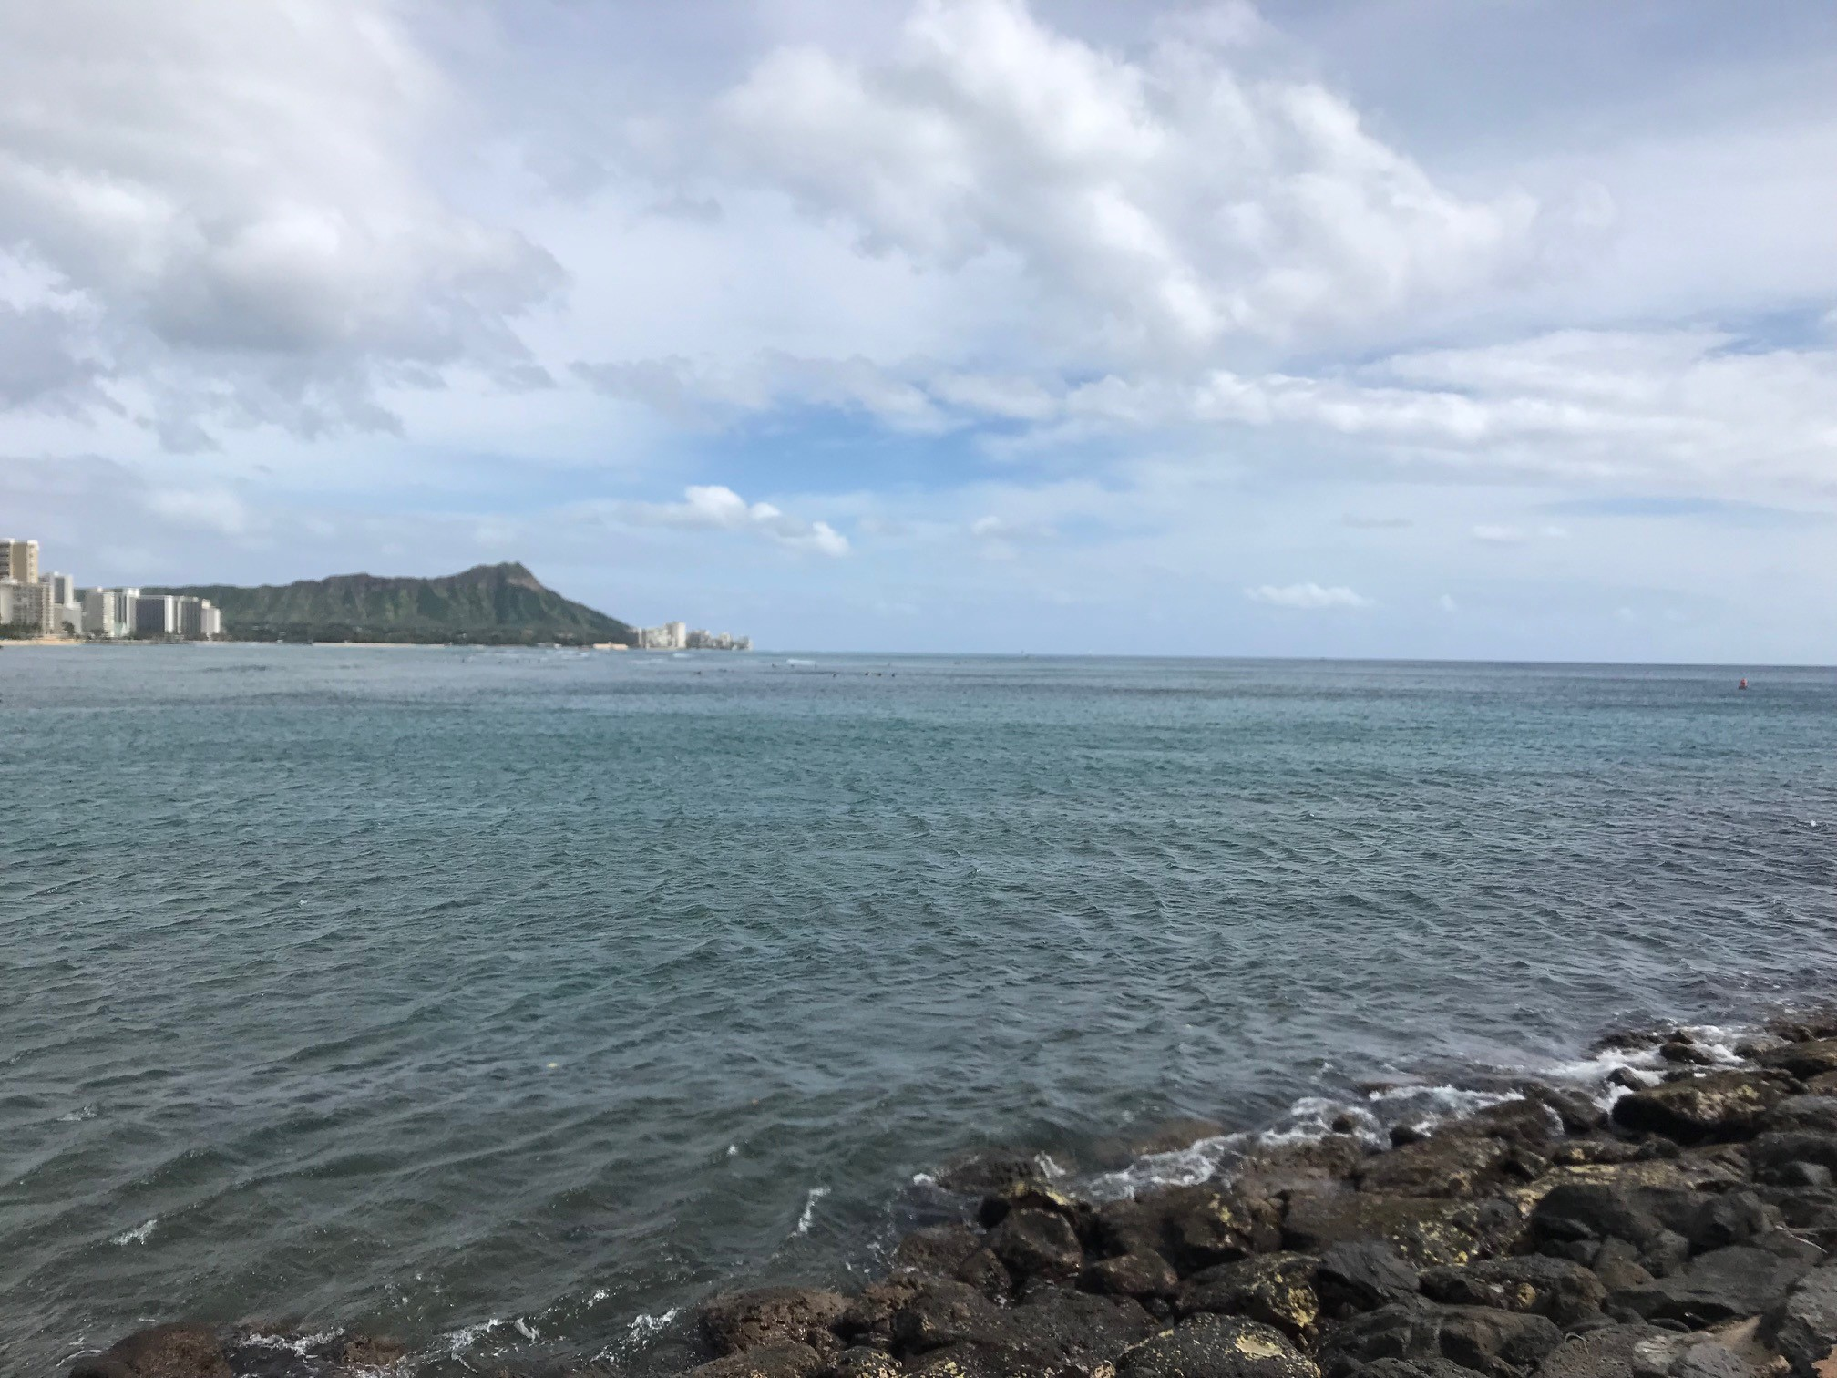
This is a screenshot of my moment of greatest joy

Slide 14
I can imagine using [Markdown] to do [essentially course advertisements] in the future

Slide 15
If I had more time, I would also do [a Lead-In for the Next Step of My Survey Design & Analysis Course].

Slide 16
The next thing this has gotten me interested in learning is [to actually see my presentation looking over the shoulder of someone else].

Slide 17
If you want to learn more about this project you can [sit tight]

Slide 18
Let’s take a look!

