Slide 1
Cellular automata for sandpiles

Slide 2
Outline

Slide 3
Introduction
1/f noise
in resistors

Slide 4
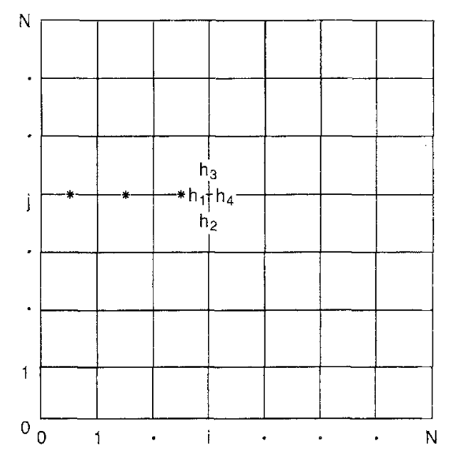
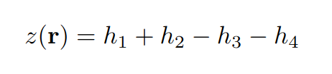

Cellular automaton
d-dimensional grid
Grid size N
Assign integer value z(r) to each point
Average slope:
Relax grid if:
Notes:
M

Slide 5



Relaxation and boundary conditions
Relaxation:
Closed boundaries: on boundaries
Open boundaries:
on boundaries, where
Notes:
M

Slide 6


Perturbation mechanism
Random perturbations of the system
Conservative perturbation:
Non conservative perturbation:
Notes:
M

Slide 7


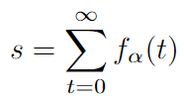
Derived quantities - I
Indicator function:
Instantaneous dissipation rate:
Total dissipation rate
Notes:
M

Slide 8

Derived quantities - II
Lifetime:
Linear spatial size:

Slide 9
Distributions
Scaling relations:
Conditional expectation values:
Notes:
M

Slide 10
Algorithm
Notes:
S

Slide 11
Steady state
Erklären + animation
Notes:
S

Slide 12
Parameter selection
Notes:
S

Slide 13
Simulations
Which simulations?
Why more for 2d?
What parameters?
Notes:
S

Slide 14
Results
Which parameters do we determine?
Reziproke parameter

Slide 15
Systematical uncertainties
Which are there?
Full range plot
Notes:
S

Slide 16
Statistical significance
Systematische fehler >> statistische fehler

Slide 17
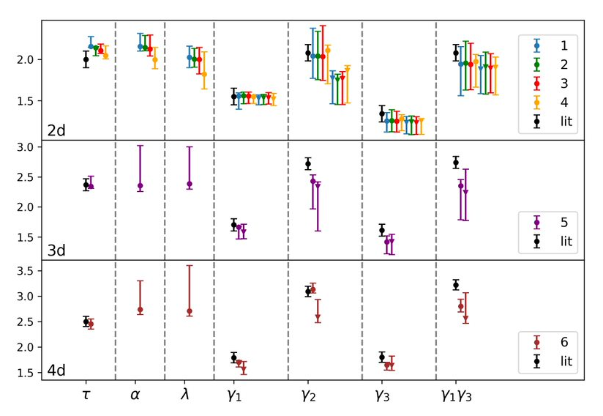
Results
Reciprocal relation validated
Systematic deviation from literature
Coefficients independent of scale
Coefficients dependent on dimensions

Slide 18
Summary + Outlook

