Slide 1
Cellular automata for sandpiles

Slide 2
Outline

Slide 3
Introduction
1/f noise present in self-organized critical systems
small perturbations lead to states of instability avalanches
properties of the systems are independent of initial configuration

Slide 4
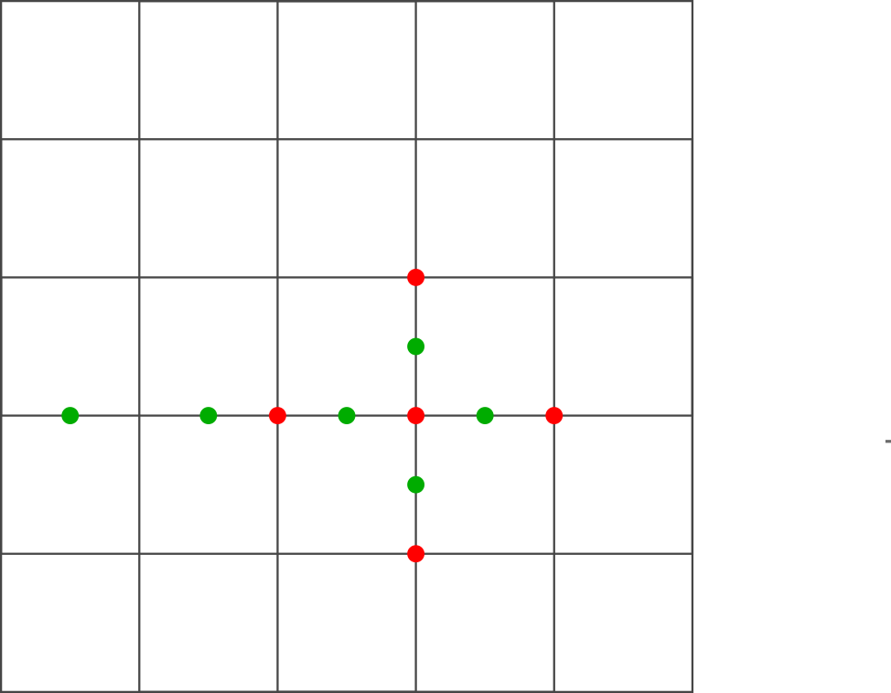
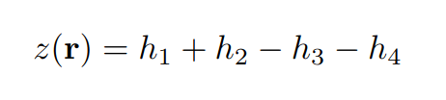





Cellular automaton
d-dimensional grid
Grid size N
Assign integer value z(r) to each point
Average slope:
Relax grid if:
$$h_{3}$$
$$h_{1}$$
$$h_{4}$$
$$h_{2}$$
Notes:
M

Slide 5



Relaxation and boundary conditions
Relaxation:
Closed boundaries: on boundaries
Open boundaries:
on boundaries, where
+1
+1
-4
+1
+1
Notes:
M

Slide 6

Perturbation mechanism
Random perturbations of the system
Conservative perturbation:
-1
+2
+1
+1
-1
Notes:
M

Slide 7

Perturbation mechanism
Random perturbations of the system
Conservative perturbation:
Non conservative perturbation:
+1
+1
+1
+1
Notes:
M

Slide 8


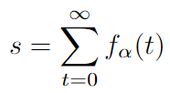
Derived quantities - I
Indicator function:
Instantaneous dissipation rate:
Total dissipation rate
Notes:
M

Slide 9

Derived quantities - II
Lifetime:
Linear spatial size:

Slide 10

Distributions
Scaling relations:
Conditional expectation values:
Also:
Notes:
M

Slide 11
Algorithm
Notes:
S

Slide 12
Steady state
Erklären + animation
Notes:
S

Slide 13
Parameter selection
Notes:
S

Slide 14
Simulations
Which simulations?
Why more for 2d?
What parameters?
Notes:
S

Slide 15
Results
Which parameters do we determine?
Reziproke parameter

Slide 16
Systematical uncertainties
Which are there?
Full range plot
Notes:
S

Slide 17
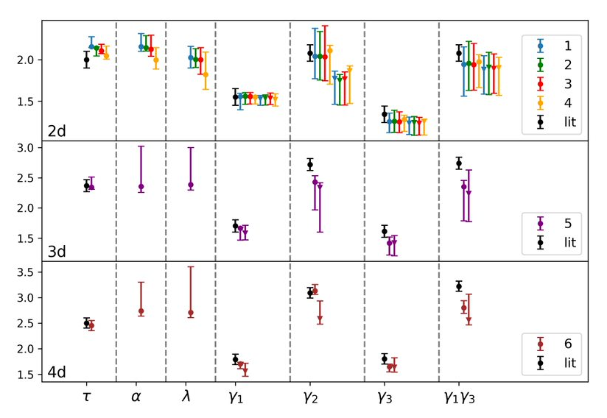
Results
Coefficients independent of scale
Coefficients dependent on dimensions
Reciprocal relation validated
Systematic deviation from literature

Slide 18
Summary + Outlook

