Slide 1
CSE570 Spring 2020 Wireless and Mobile Networks TCP Over Wireless
Mallesham Dasari

Slide 2
Project Ideas
Propose a system, implement and show the performance with a comparison
Perform measurement studies and show interesting insights
Take a paper and try to reproduce the results of the paper
Create tools that will be useful to realize other projects and show with an example
https://docs.google.com/document/d/1bNjJiNwpSYHhG2-vVebjTwvGpeytg1f9a-Ja67jeF10/edit?usp=sharing

Slide 3
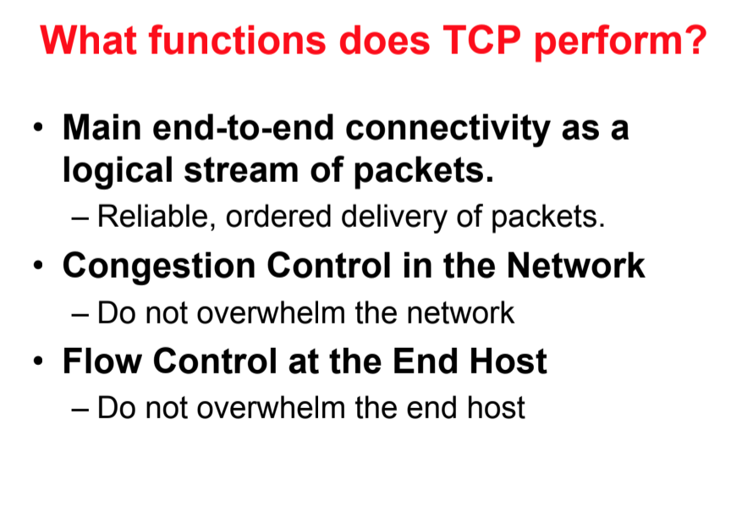

Slide 4
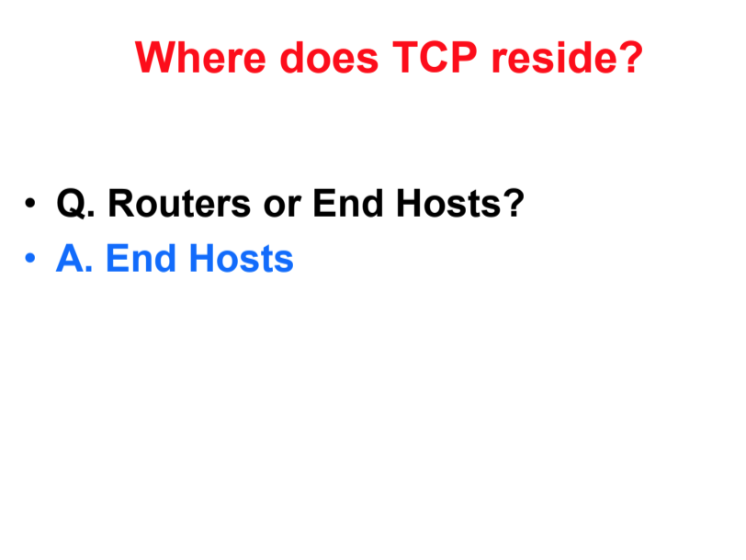

Slide 5
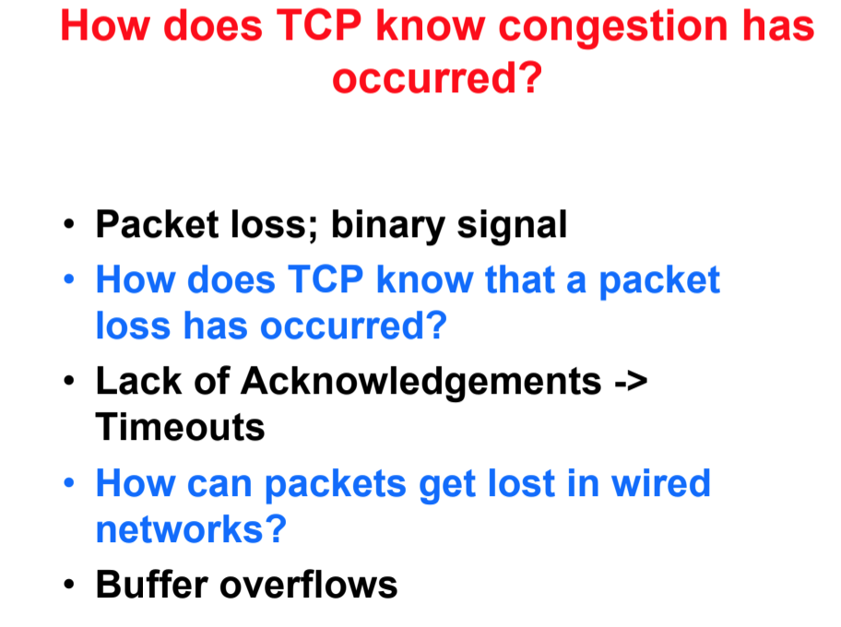

Slide 6
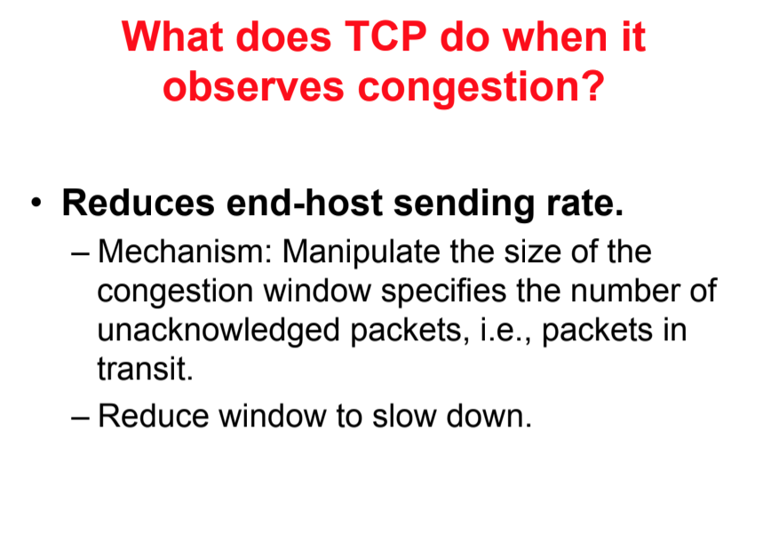

Slide 7
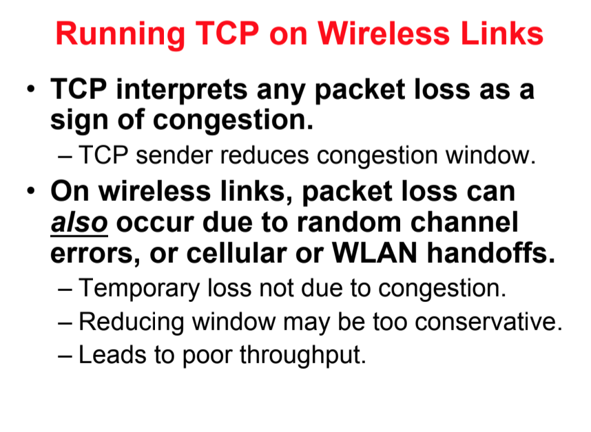

Slide 8
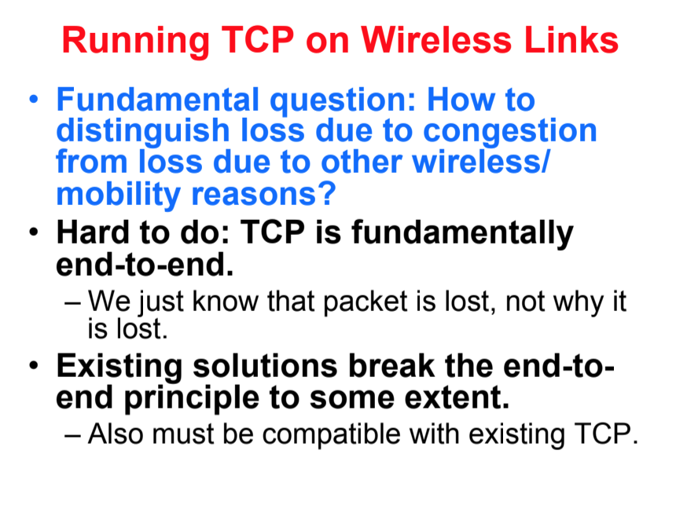

Slide 9
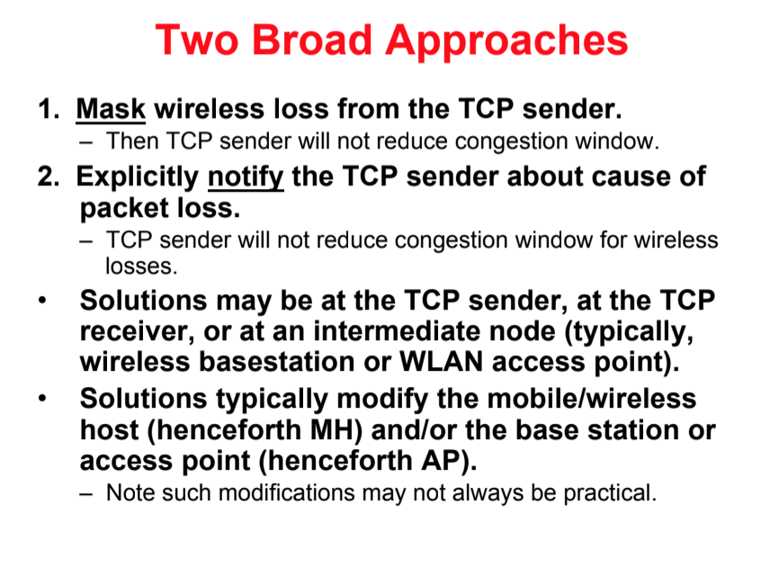

Slide 10
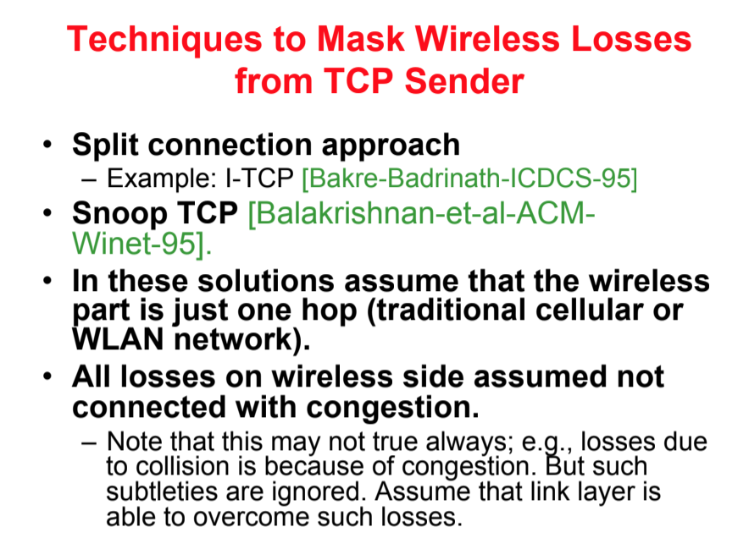

Slide 11
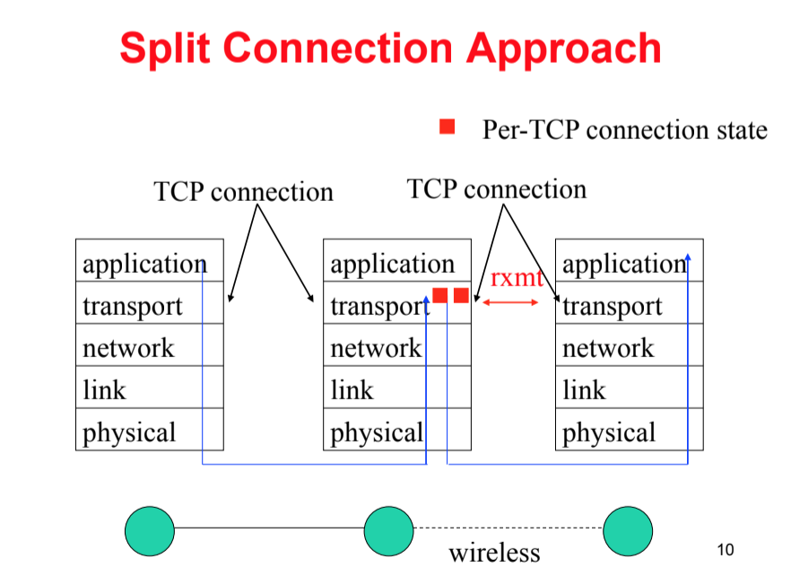

Slide 12
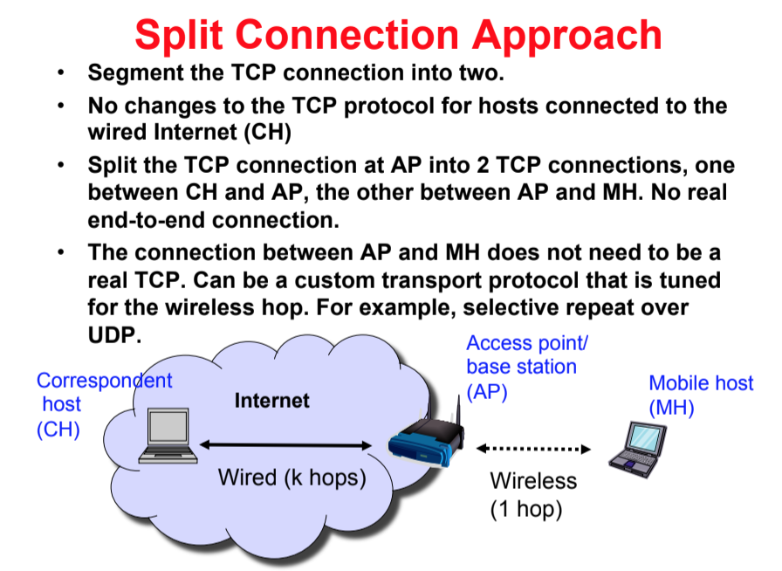

Slide 13
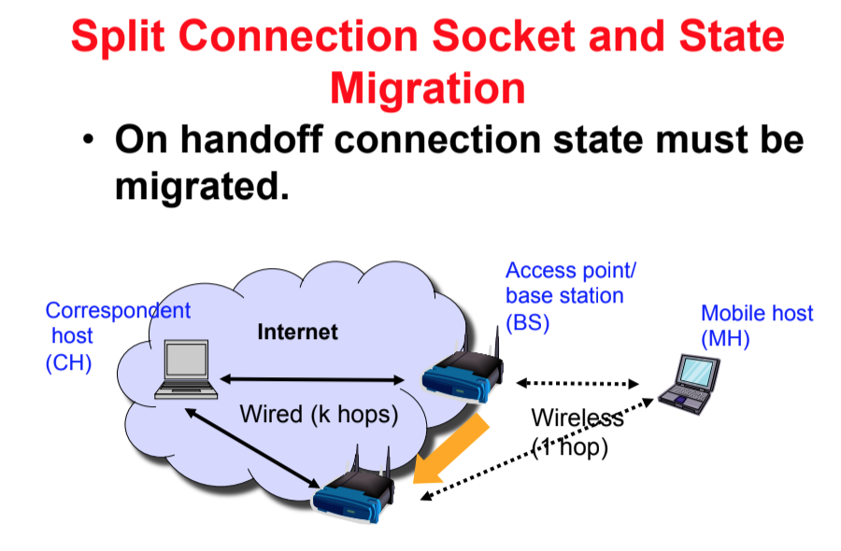

Slide 14
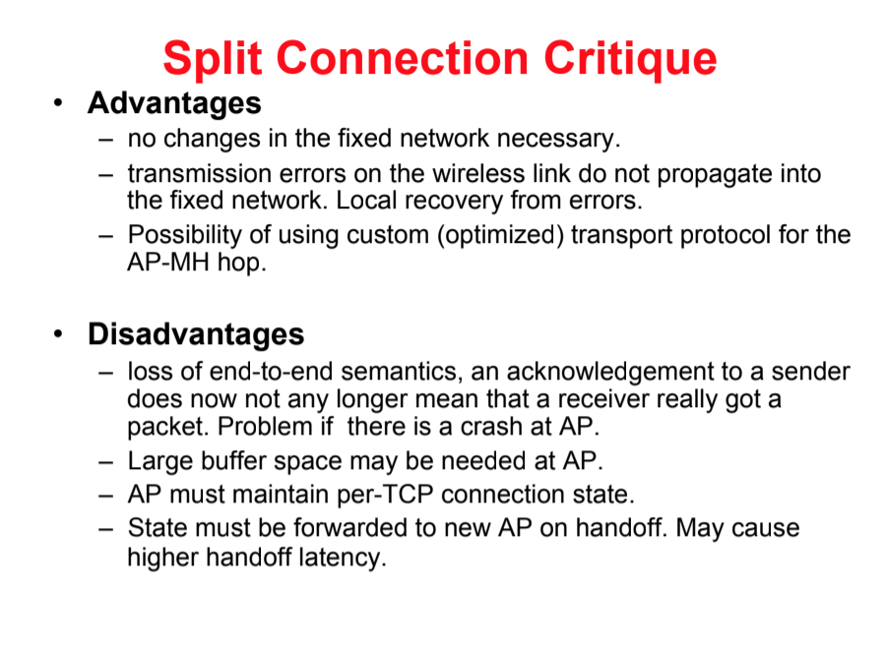

Slide 15
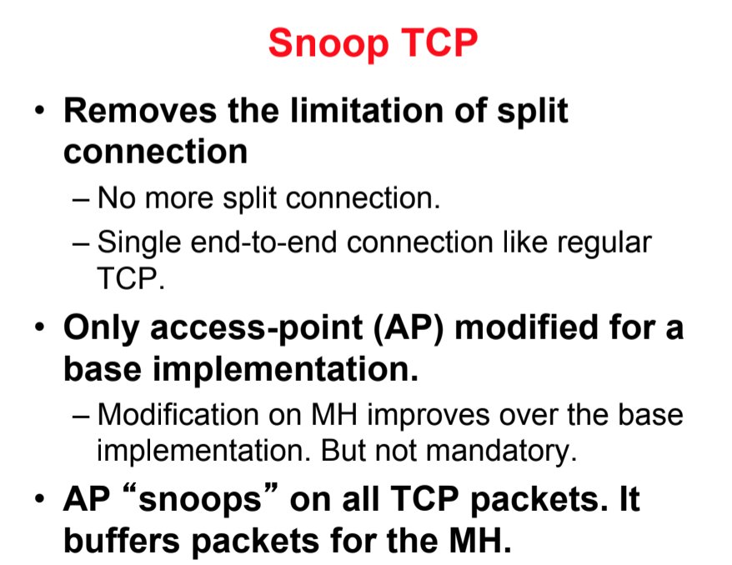

Slide 16
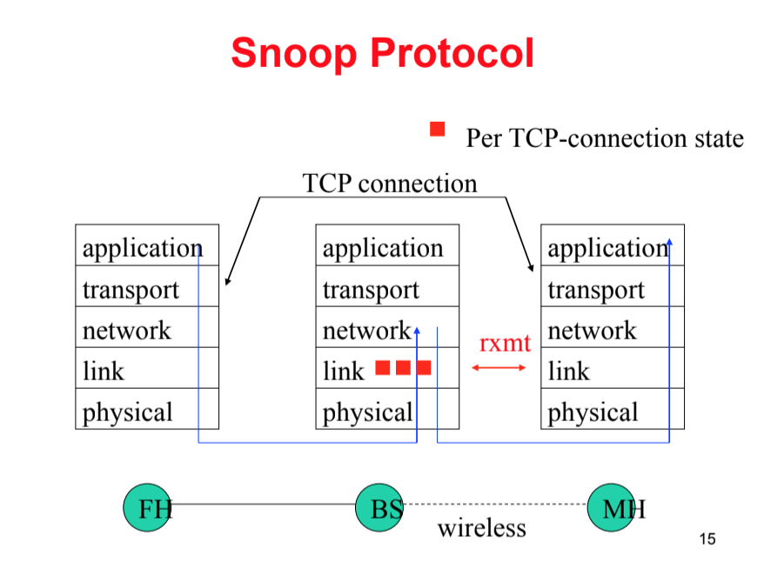

Slide 17
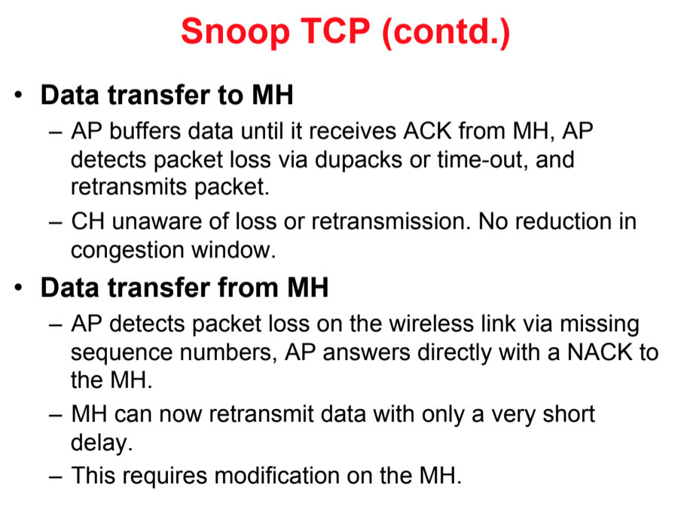

Slide 18
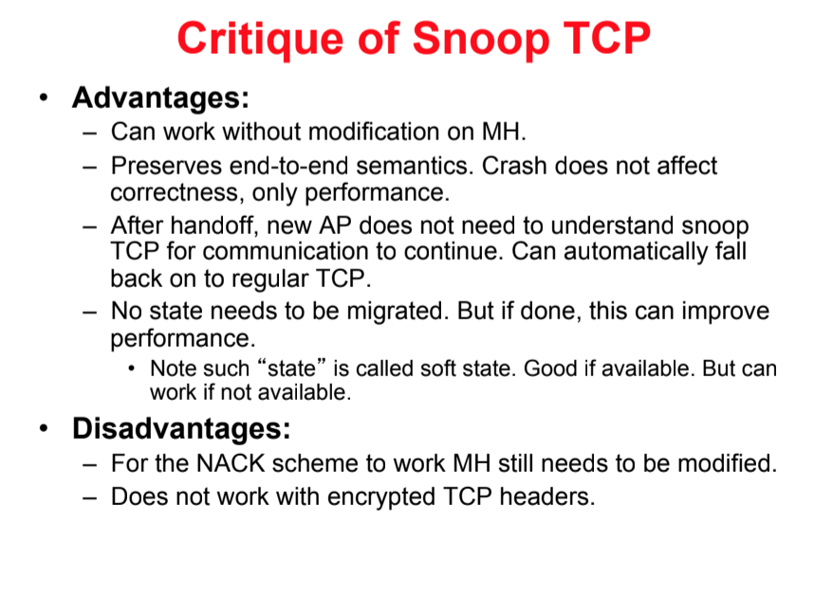

Slide 19
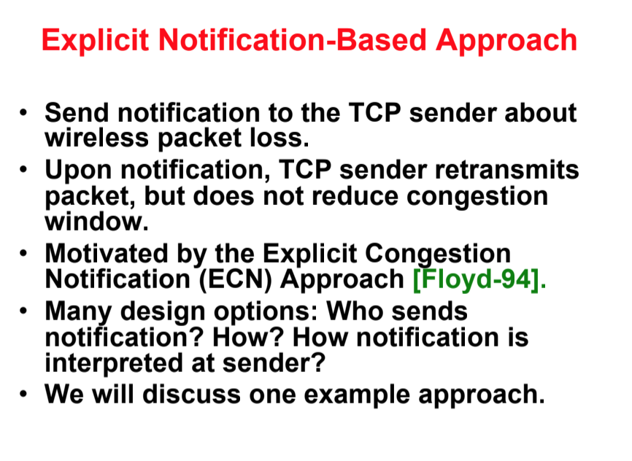

Slide 20
