Slide 1

Swift: Adaptive Video Streaming with Layered Neural Codecs
Mallesham Dasari, Kumara Kahatapitiya,
Samir R. Das, Aruna Balasubramanian, Dimitris Samaras
NSDI 2022
Stony Brook University
Notes:
Thank you, Shivaram for the introduction. Hi everyone, I am going to present my work on swift, which is an adaptive video streaming system using layered neural video codecs. This work is in collaboration with my colleagues Kumara, Samir, Aruna, and Dimitris from stony brook university, where I recently graduated with a phd in computer science.

Slide 2
Video Streaming Today
Fundamental Problems
Limited Bandwidth
Variability in Bandwidth
Adaptive Video Streaming
Solution
Notes:
So, let’s start by looking at some of the fundamental problems that video streaming is facing today, okay. Particularly in the networking community, we identify two problems. One of them is the limited bandwidth, where the Internet has only a certain capacity through which the video needs to be transmitted. Second, and more pressing problem is variability or the fluctuations in the bandwidth. The problem with this fluctuating bandwidth is that the video bitrate needs to constantly change to fit within the limited varying capacity. Its actually not really a new problem, it has been there for a while, and people have started using adaptive streaming solutions to adapt the video bitrate w.r.t throughput.

Slide 3

Adaptive Video Streaming
Adaptive Bitrate (ABR) Algorithms
Undershoot
(Poor Quality)
Poor Quality
Overshoot
(Stall)
Quality_N (4K/8K)
. . .
. . .
Quality_2 (640x480)
Quality_1 (352x288)
Video Client
Video Server
Bitrate Selection: A Decade-long Research!
(e.g., Festive [CoNEXT’12], MPC [SIGCOMM’15], BOLA [INFOCOM’16], Pensieve [SIGCOMM’17], Fugu [NSDI’20])
Notes:
In adaptive video streaming, the content is compressed at the server to fit within the limited network capacity, by dividing it into a temporal segments and each segment is compressed into a different quality. For example, here the red, yellow and the green blocks represent multiple renditions of the same video segment. Now, the client requests these video segments over a variable network, assuming poor client. Now, the way they adapt is by deploying an adaptive bitrate algorithm that observes the throughput and requests a video segment with a suitable quality that fits well within the network capacity. Simple right. But the problem here is that, it is extremely difficult to predict the network bandwidth. So, you often some delay in reacting to the network fluctuations. This is a fundamental problem in adaptive streaming that is being addressed for almost the past entire decade.

Slide 4
Limitations of Today’s ABR Algorithms
Throughput trace is from ACM/IEEE TON’2020
Notes:
That was a toy example, okay. Let me show you how the actual network throughput trace and some of the well knows industry and academic state-of-the art solutions work.

Slide 5
Limitations of Today’s ABR Algorithms
75sec

Slide 6
Limitations of Today’s ABR Algorithms
Slow
Reaction
75sec
50sec

Slide 7
Limitations of Today’s ABR Algorithms
75sec

Slide 8
Limitations of Today’s ABR Algorithms
75sec
Fast
Reaction
25sec
Bandwidth
waste
Discard
poor quality chunks

Slide 9
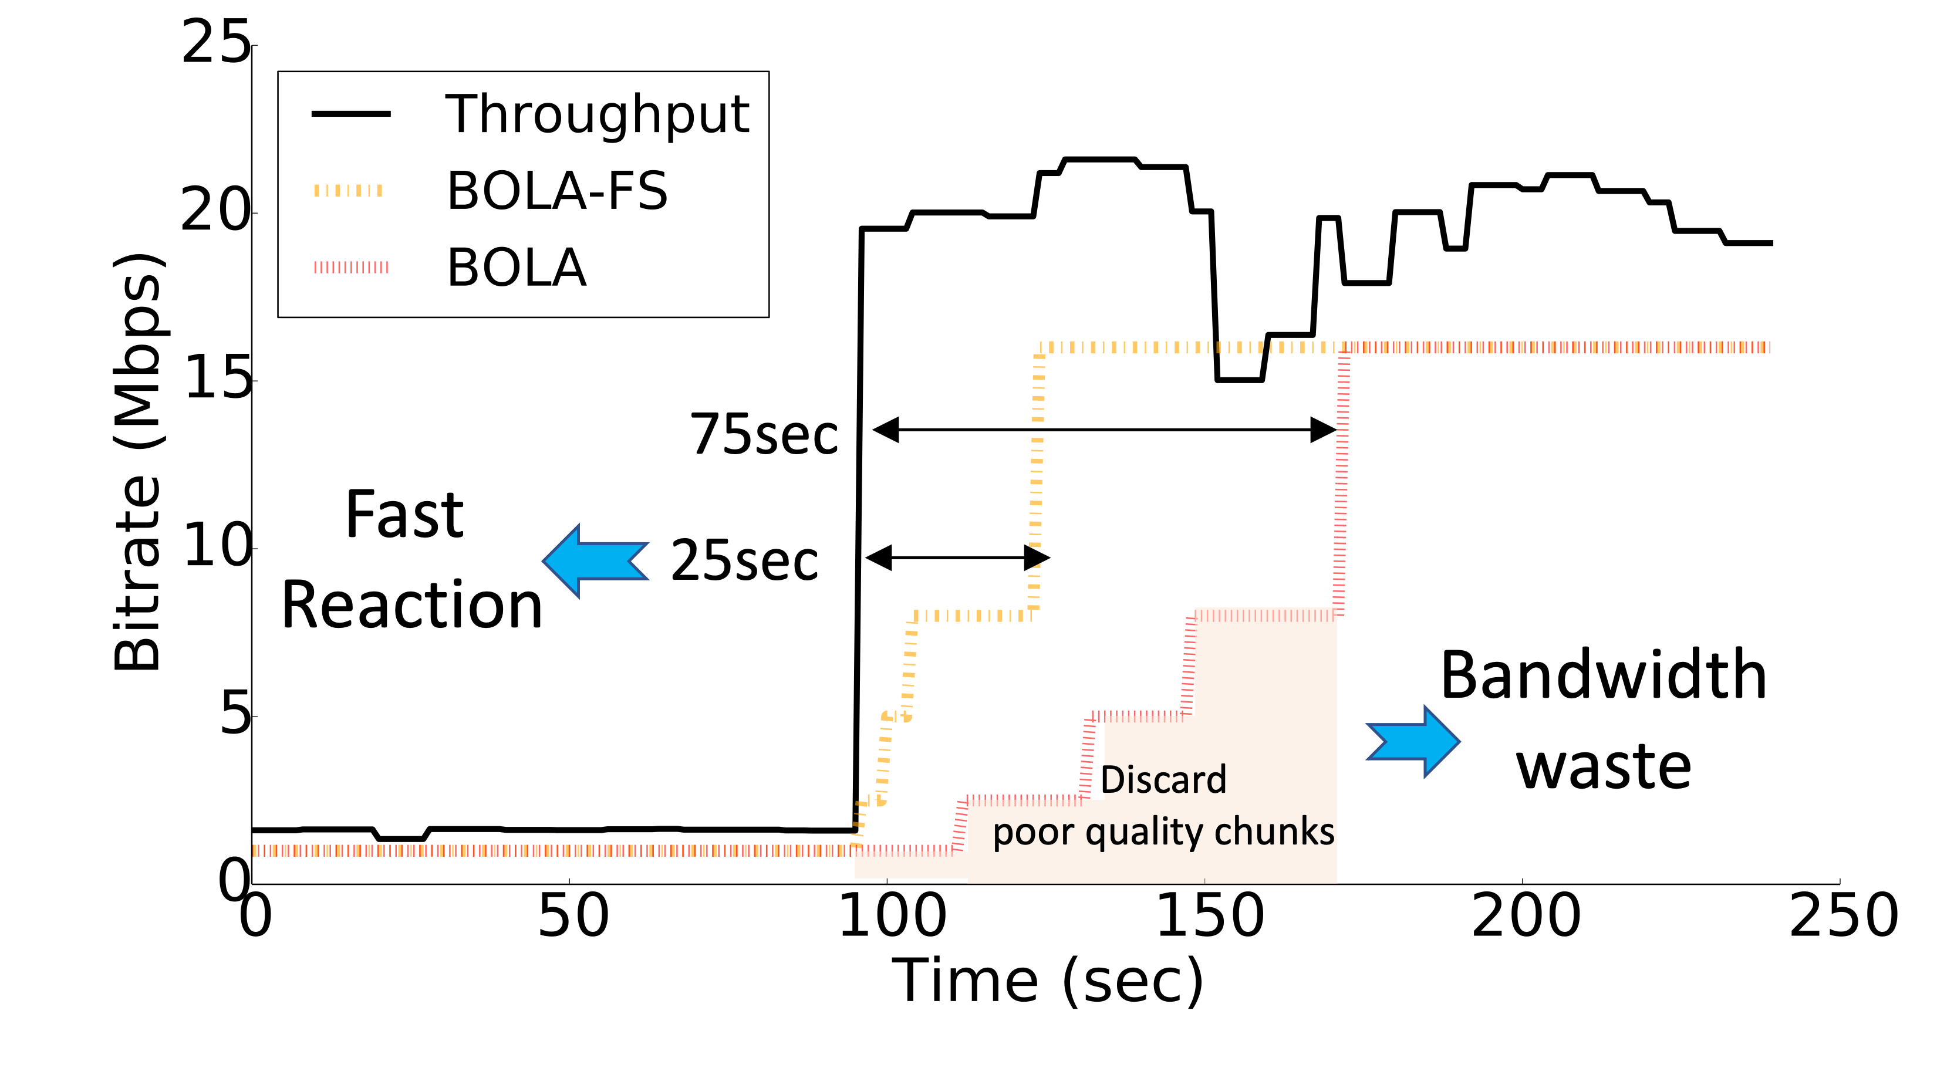
Limitations of Today’s ABR Algorithms

Slide 10
Limitations of Today’s ABR Algorithms
Bandwidth Efficient
Slow Reaction -> Poor QoE
BOLA, Pensieve
Bandwidth Inefficient
Fast Reaction -> Better QoE
BOLA-FS

Slide 11
Alternative: Layered Video Streaming
Layered Coding
A well-suited technique for streaming variable network conditions
25Mbps
4K/8K
. . .
. . .
2Mbps
640x480
1Mbps
352x288
~1Mbps
Layer_L
(c_{L})
4K/8K
(c₀+ c₁+..+c_{L})
..
..
..
..
~1Mbps
Layer_2
(c₁)
640x480
(c₀+ c₁)
1Mbps
Layer_1
(c₀)
352x288
(c₀)

Slide 12
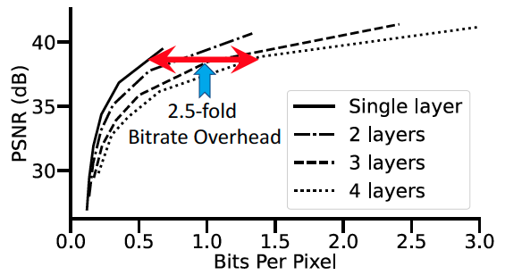
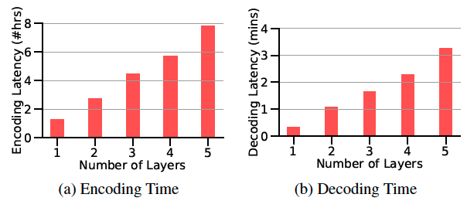
Alternative: Layered Video Streaming
Challenges of using layered coding in practice
Cross Layer Compression Overhead
High Coding Latency

Slide 13
Alternative: Layered Video Streaming
Challenges of using layered coding in practice
Cross Layer Compression Overhead
High Coding Latency
Remains an open problem & Not used in practice!

Slide 14
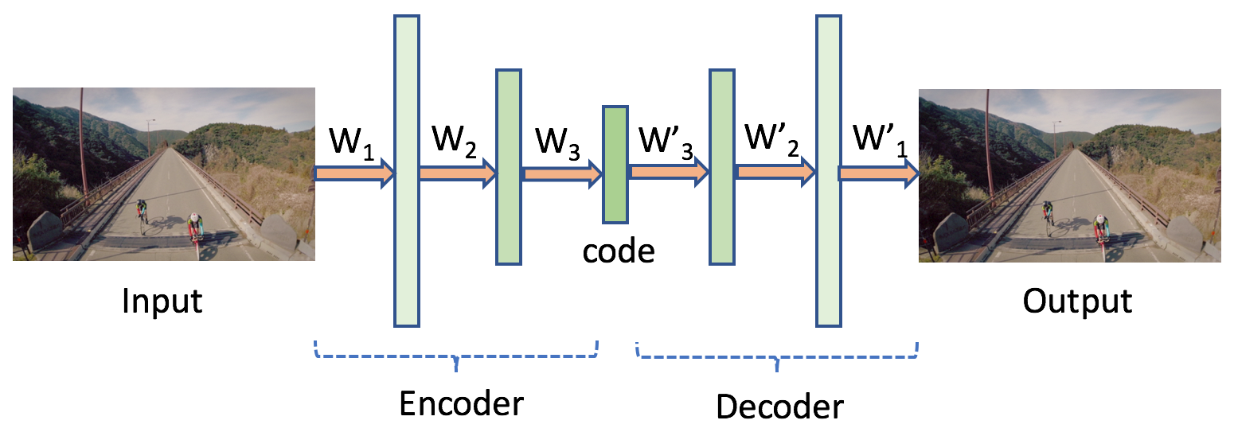
Neural Video Coding
e.g., AutoEncoder

Slide 15
Neural Video Coding
e.g., AutoEncoder

Slide 16
Neural Video Coding
e.g., AutoEncoder
Question: Can we design Layered Coding on top of Neural Video Codecs?

Slide 17

























Layered Neural Encoder (using residual codes)
Iter L
$r$
E
Entropy Encoder
Entropy Decoder
$\hat{r}$
L
$$cL$$
L
$r$
$r$
_
=
$\hat{r}$
_{L}
_{L-1}
_{L-1}
h_{L}
h_{L}
h₁
h₁
$$⊕$$
$\hat{I}$
$r$
Entropy Encoder
Entropy Decoder
$\hat{r}$
L
Iter 2
E
1
$$c1$$
1
$r$
$r$
_
=
$\hat{r}$
$$⊕$$
$\hat{I}$
₁
₀
₀
h₀
h₀
1
$\hat{r}$
$\hat{I}$
Iter 1
$r$
E
Entropy Encoder
Entropy Decoder
0
0
0
$$r$$
=I
$$c0$$
₀
Layered codes transmitted over network

Slide 18




Layered Neural Decoder
1. Iterative Decoding is Slow
Need real-time decoding for playback
Code Not
Available
00..
h_{L}
Pad
zeros
Entropy Decoder
ss
h₂
$$⊕$$
$\hat{I}$
$$c1$$
L
Single-shot Decoder
Entropy Decoder
h₁
$$c0$$

Slide 19
Layered Neural Decoder
2. Compute Resource Contention
Need to scale well with other applications
Code Not
Available
00..
h_{L}
Pad
zeros
Entropy Decoder
ss
h₂
$$⊕$$
$\hat{I}$
$$c1$$
L
Entropy Decoder
h₁
$$c0$$

Slide 20
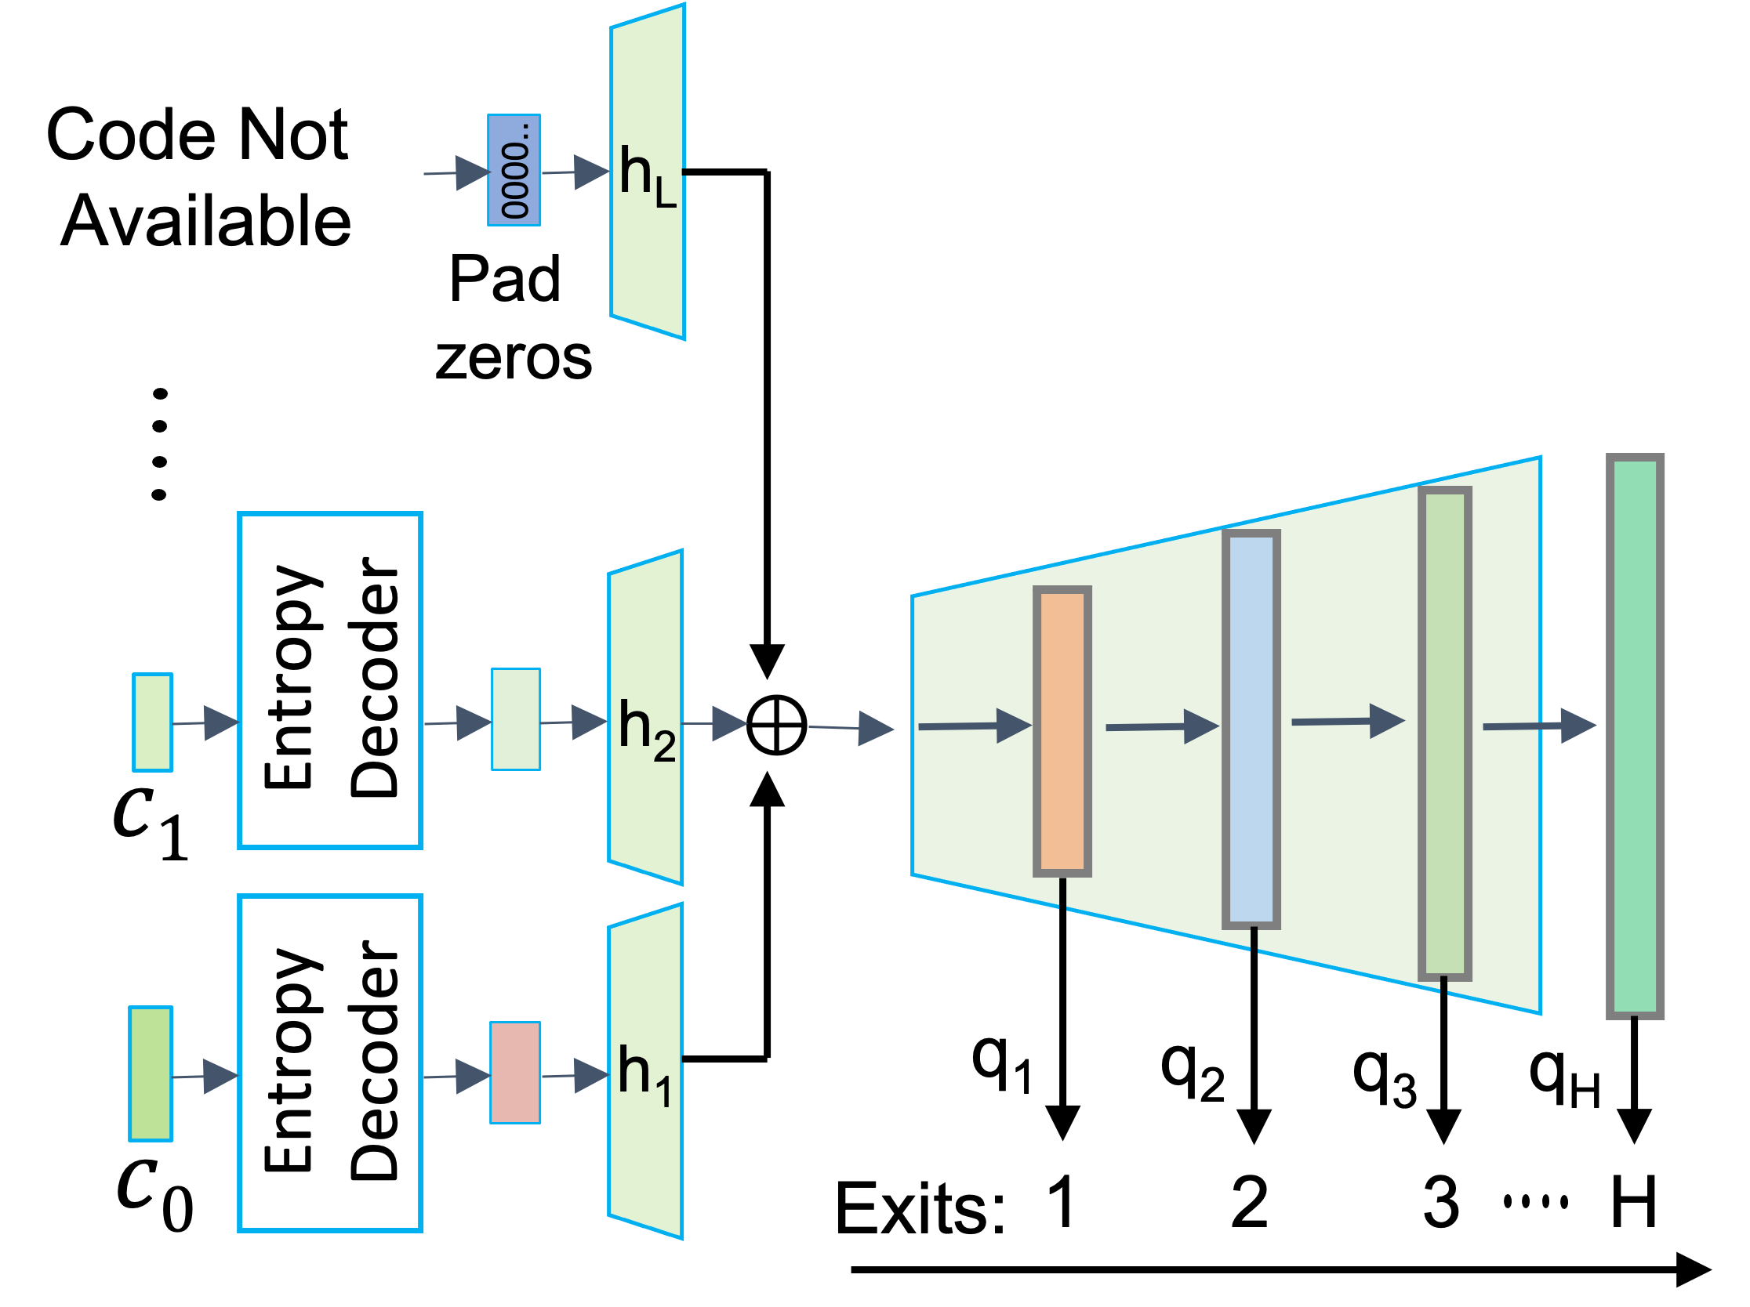
Layered Neural Decoder
2. Compute Resource Contention
Need to scale well with other applications
Multiple Exits

Slide 21
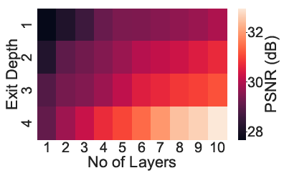
Layered Neural Decoder
2. Compute Resource Contention
Need to scale well with other applications
Multiple Exits

Slide 22
Streaming Protocol/Algorithm (ABR)
Goal
Maximize QoE i.e., F(Quality, Stalls, Smoothness)
Network history
Buffer occupancy
ABR
Enhance or fresh download?
Download qualities
How many layers?
Compute history
Decoded qualities
Playback times
Quality matrix for next segment

Slide 23
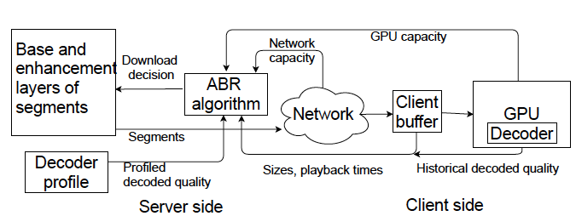
Putting Everything Together: Swift
Compression Baselines
H.264
SHVC
Streaming Baselines
BOLA, BOLA-FS
Pensieve
Grad

Slide 24
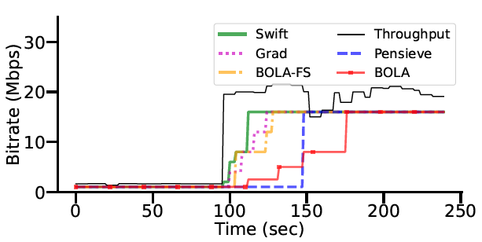
Swift’s Performance

Slide 25
Swift’s Performance
Swift’s faster reaction improves QoE by 45% while saving the bandwidth by 18%

Slide 26
Summary
Video streaming is fundamentally limited by network throughput and its fluctuations
The idea of layered coding is well suited for fine-grained rate adaptation but is nontrivial to devise an algorithm
Neural video codecs are becoming popular and can efficiently realize layered coding

Slide 27
Thank you!
Questions? malleshd@andrew.cmu.edu
Notes:
With that I would like to take any questions from the audience. Thank you.

