Slide 1
Springboard-Data Science Career Program
Capstone Project # 2 – Predicting house price in Ames, Iowa
Malleswari Gelli
March 2022

Slide 2
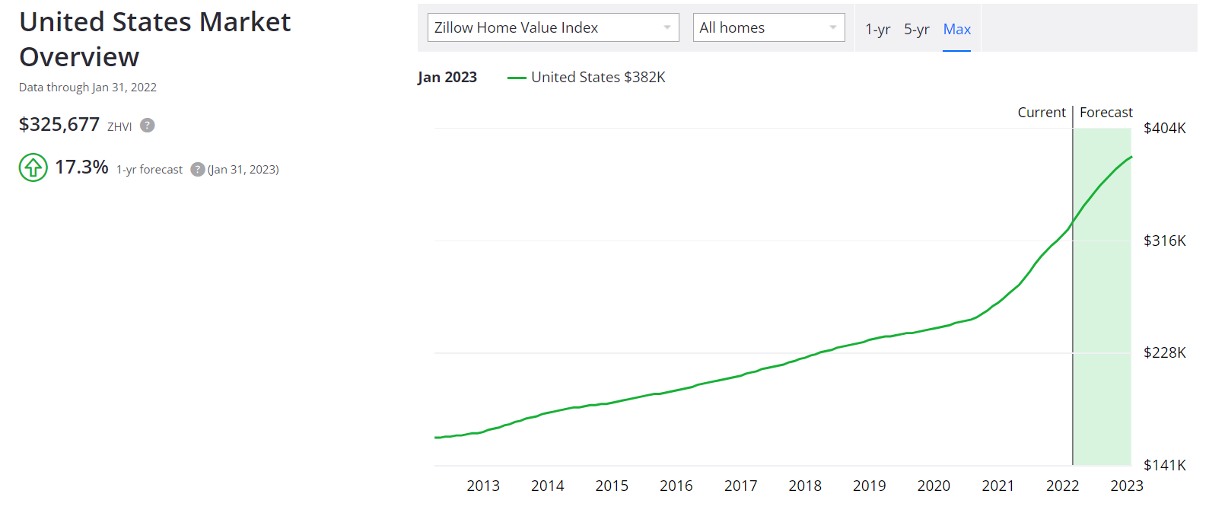
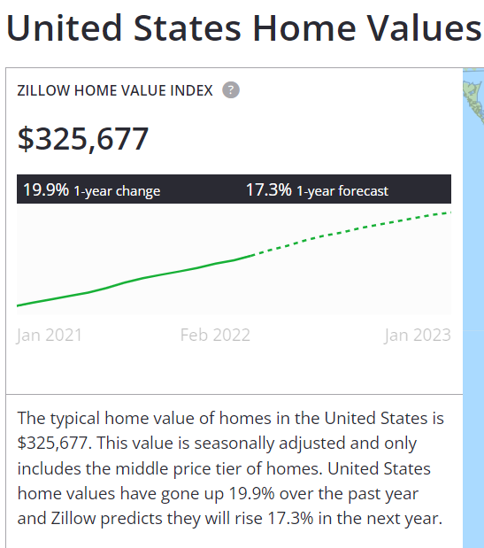
House prices are increasing…forecast to raise 17.3% in 2023

Slide 3
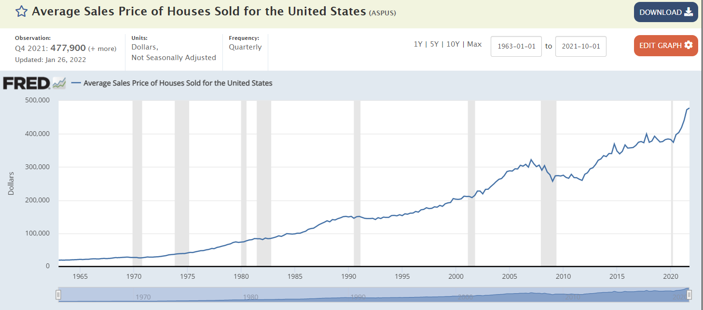
Average Sale Price of house is increased over years upto 478 k in 2022
But, what features of house are important price factors?
(Source: https://fred.stlouisfed.org/series/ASPUS)

Slide 4
Goal for this project is to build an end-to-end solution or application that can predict house prices better than individuals/humans.
Rationale
I will be building ML models to predict median house prices in Iowa considering 79 explanatory variables describing (almost) every aspect of residential homes in Ames, Iowa.
This is supervised learning problem as data set consists of labelled observations and it does looks like multivariate regression, but I will explore multiple ways of building model and finally pick one with lowest error rate RMSE (Root Mean Square Error) or MAE (Mean Absolute Error) or any or metrics to predict/validate new datasets in future.

Slide 5
Data Source
House price dataset from Kaggle competition
https://www.kaggle.com/c/house-prices-advanced-regression-techniques/data
Train.csv, contains several features including target variable SalePrice of house. Use this dataset to train machine learning regression model.
Test.csv, contains all 80 features in train.csv file except target variable. So, predict SalePrice of houses using best model trained on train.csv dataset.

Slide 6
Features of dataset
Exterior1st: Exterior covering on house
Exterior2nd: Exterior covering on house (if more than one material)
MasVnrType: Masonry veneer type
MasVnrArea: Masonry veneer area in square feet
ExterQual: Exterior material quality
ExterCond: Present condition of material on exterior
Foundation: Type of foundation
BsmtQual: Height of basement
BsmtCond: General condition of basement
BsmtExposure: Walkout or garden level basement walls
BsmtFinType1: Quality of basement finished area
BsmtFinSF1: Type 1 finished square feet
BsmtFinType2: Quality of second finished area (if present)
BsmtFinSF2: Type 2 finished square feet
BsmtUnfSF: Unfinished square feet of basement area
TotalBsmtSF: Total square feet of basement area
Heating: Type of heating
HeatingQC: Heating quality and condition
CentralAir: Central air conditioning
Electrical: Electrical system
1stFlrSF: First Floor square feet
2ndFlrSF: Second floor square feet
LowQualFinSF: Low quality finished square feet (all floors)
GrLivArea: Above grade (ground) living area square feet
BsmtFullBath: Basement full bathrooms
BsmtHalfBath: Basement half bathrooms
FullBath: Full bathrooms above grade
HalfBath: Half baths above grade
Bedroom: Number of bedrooms above basement level
Kitchen: Number of kitchens
KitchenQual: Kitchen quality
TotRmsAbvGrd: Total rooms above ground (does not include bathrooms)
Functional: Home functionality rating
Fireplaces: Number of fireplaces
Train.csv: 81 features including Target variable: SalePrice
Test.csv contains 80 features as train.csv but doesn't contain Target variable
Features
SalePrice - sale price in dollars (target variable)
MSSubClass: building class
MSZoning: general zoning classification
LotFrontage: Linear feet of street connected to property
LotArea: Lot size in square feet
Street: Type of road access
Alley: Type of alley access
LotShape: General shape of property
LandContour: Flatness of property
Utilities: Type of utilities available
LotConfig: Lot configuration
LandSlope: Slope of property
Neighborhood: Physical locations within Ames city limits
Condition1: Proximity to main road or railroad
Condition2: Proximity to main road or railroad (if a second is present)
BldgType: Type of dwelling
HouseStyle: Style of dwelling
OverallQual: Overall material and finish quality
OverallCond: Overall condition rating
YearBuilt: Original construction date
YearRemodAdd: Remodel date
RoofStyle: Type of roof
RoofMatl: Roof material
FireplaceQu: Fireplace quality
GarageType: Garage location
GarageYrBlt: Year garage was built
GarageFinish: Interior finish of the garage
GarageCars: Size of garage in car capacity
GarageArea: Size of garage in square feet
GarageQual: Garage quality
GarageCond: Garage condition
PavedDrive: Paved driveway
WoodDeckSF: Wood deck area in square feet
OpenPorchSF: Open porch area in square feet
EnclosedPorch: Enclosed porch area in square feet
3SsnPorch: Three season porch area in square feet
ScreenPorch: Screen porch area in square feet
PoolArea: Pool area in square feet
PoolQC: Pool quality
Fence: Fence quality
MiscFeature: Miscellaneous feature
MiscVal: $Value of miscellaneous feature
MoSold: Month Sold
YrSold: Year Sold
SaleType: Type of sale
SaleCondition: Condition of sale

Slide 7
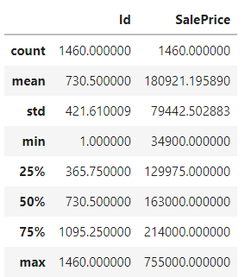
Data Munging
Since Train.csv and Test.csv contains same features and Id column is consecutive,
I concatenated the two data frames by separating target variable from Train.csv into Target data frame.
Target data frame contains Id, SalePrice columns from Train.csv.
Having Id column helps later if data frame merging is required
No missing data in Target variable

Slide 8
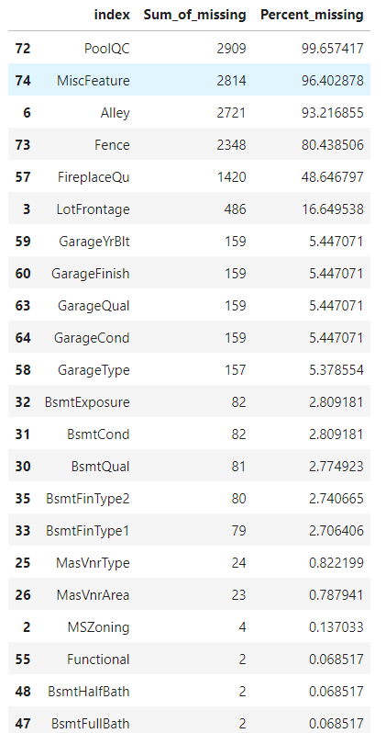
Missing data in features
18 features contain >23 missing values, also these are not important features determining house prices. So, dropped these 18 features from combined df and train df.

Slide 9
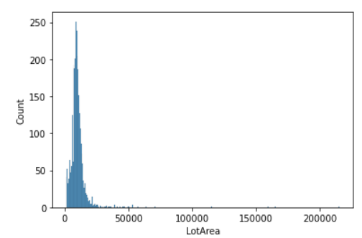
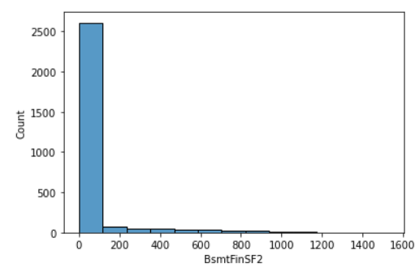
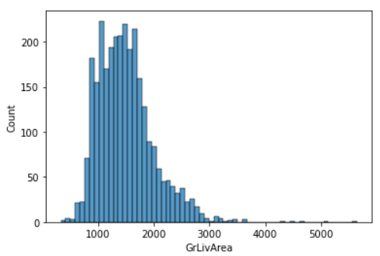
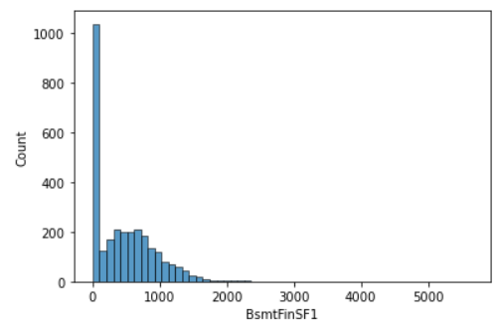
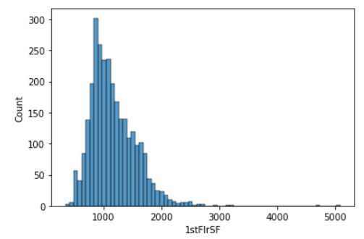
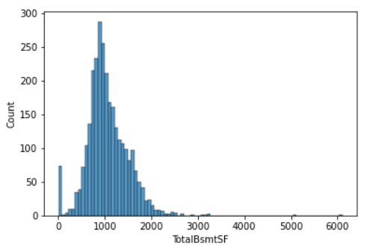
Understand how variables are distributed and how they interact
• Histogram of numeric features had skewed distribution; may require log transformation

Slide 10
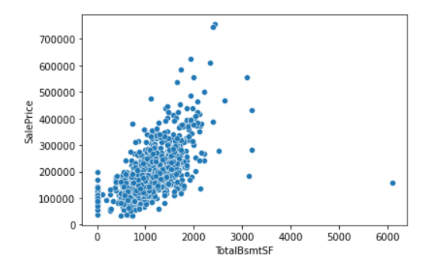
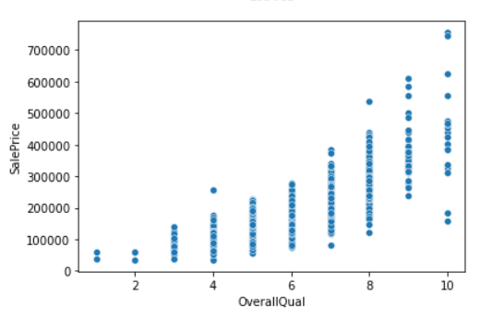
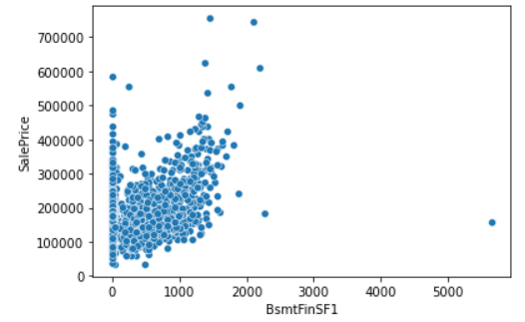
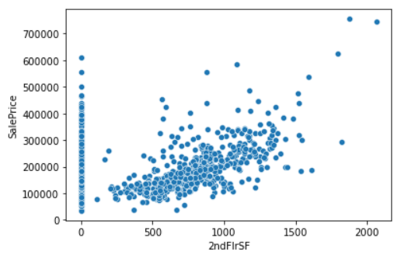
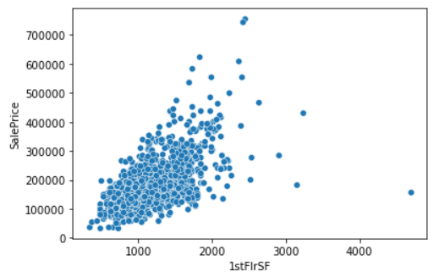
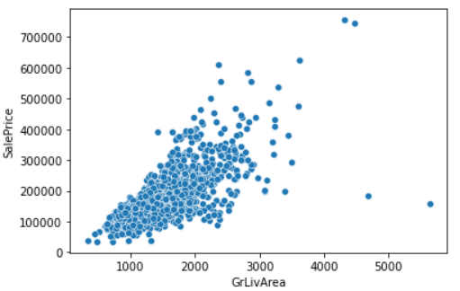
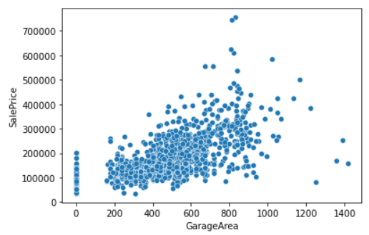
Bivariate plots/scatter plots show that TotalBmsSF, OverallQual, BsmtFinSF1, 1stFlrSF, 2ndFlrSF, GrLivArea, GarageArea related linearly with SalePrice

Slide 11
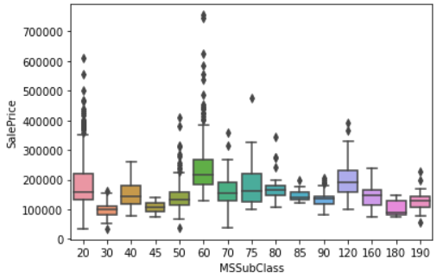
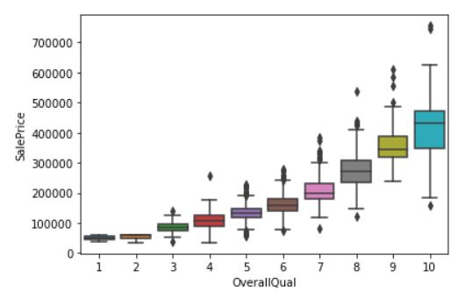
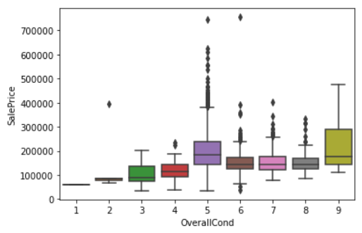
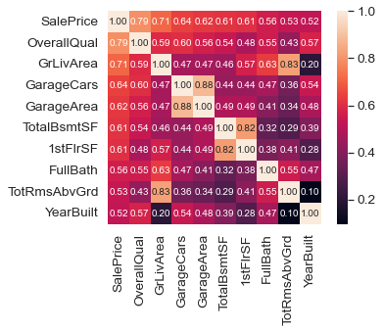
Since some numeric features contain discrete values. BoxPlotting of those features with Sale price showed better distribution of SalePrice across different groups of features.
For example: MSSubClass, OverallQual and OverallCond had several discreate values; created new feature by grouping the values.
With Correlation matrix, found top10 predictive features of SalePrice

Slide 12
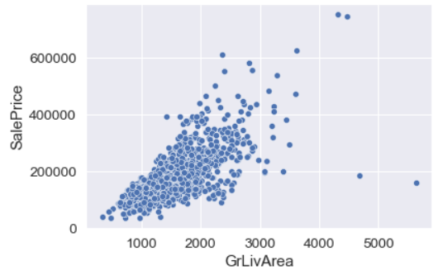
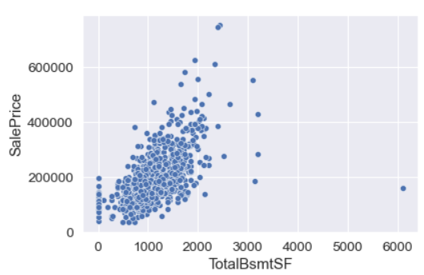
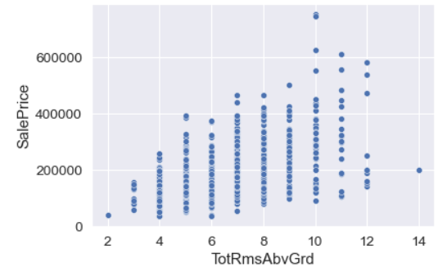
Outliers are detected with GrLivArea >4500; TotalBsmtSF>6000; TotRmsAbvGrd>12.
Dropped outliers from combined and trained_data_sets

Slide 13
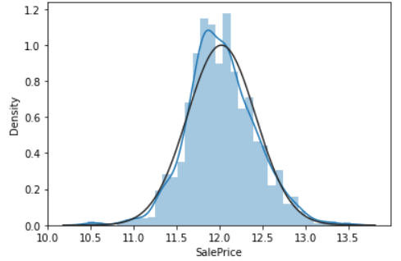
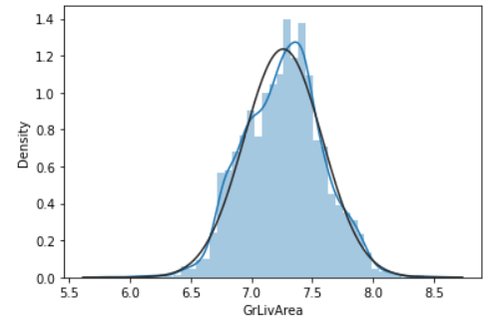
4. Preprocessing
Applied different transformations before training machine learning models
4.1 Log transformation
Log transformation improved the distribution of features. For example: Distribution of SalePrice, GrLivArea features are normal with log transformation
4.2 converted the categorical data to a numerical form using “Dummies function” from Pandas.
4.3 split the data into train and test set (30%) to evaluate the performance of models
4.4 MinMaxScaler used is fit to train data and transform the scaling to test dataset

Slide 14
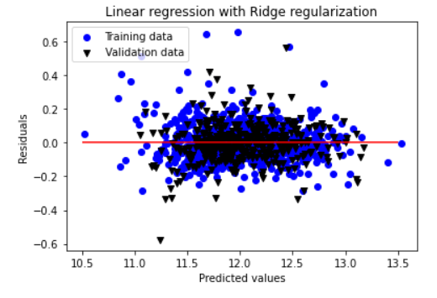
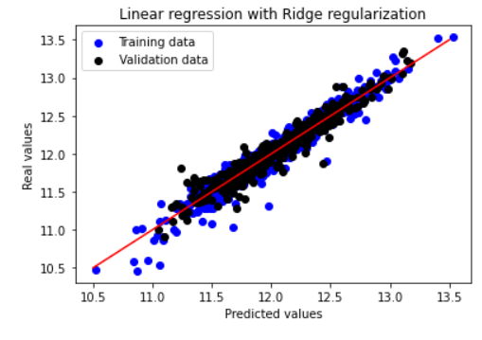
5. Modeling
Multiple Linear Regression model is applied
y= a1x1 + a2x2 + a3x3+....+b (linear regression minimizes a loss function (OLS) while choosing coefficients for fitting the model in sklearn.
R^2: -8.145738372417883e+20
Root Mean Square Error: 11235213346.399387
Five-fold cross validation is applied for evaluating the model.
5-fold cross val scores (i.e R^2 values):[0.91369528 0.90455213 0.90121937 0.91505553 0.90773841] with mean R^2 value: 0.908.
Large coefficients can lead to overfitting of Linear Regression;
So, Regularization is required to penalize overfitting by handling collinearity
Ridge Regression is applied with varied alpha values
Best alpha 1.0, R^2 value:0.93 and RMSE: 0.1063
Then, Lasso Regression is applied
R^2 value:0.913

Slide 15
Conclusions and feature work
Among different regression models, Ridge regression had higher accuracy, so it is applied to predict the SalePrice of new test dataset.
Future work could include:
Validate the predicted values with real/observed data generated in few years.
Size of the dataset could be increased by considering historical data from several years, it helps determining trends of house price fluctuations
More features of the data can be incorporated. For example: demographics, income of the household, tourism spots, schools, neighborhood etc to determine what features driving the house prices
Since the dataset I tested is just from Ames, Iowa and it’s difficult to say how high or low is the house price in Ames vs other cities of Iowa and/or other states in mid-west. So, these models can be validated in datasets from other cities and applied to predict the house prices.
Id | SalePrice_Predicted
1461 | 118720.5656
1462 | 156135.08
1463 | 179447.3656
1464 | 199282.5903
1465 | 200419.6403
1466 | 171829.6411
1467 | 186329.1327
1468 | 163471.3694
1469 | 181862.8317
1470 | 117323.5398
1471 | 191815.038
1472 | 98292.00855
1473 | 94786.50368
1474 | 141592.0418
1475 | 108703.9287
1476 | 362271.3124
1477 | 242325.0901
1478 | 280057.9213
1479 | 284195.9474
1480 | 516098.7007
1481 | 302456.7289
1482 | 196721.5953
1483 | 171980.7382
1484 | 161623.5816
1485 | 185160.2263
1486 | 194732.4221
1487 | 335331.4329
1488 | 228509.4116
1489 | 194149.9981

