Slide 1
Springboard-Data Science Career Program
Capstone Project # 3
Group or cluster soybean genotypes based on genetic similarity
Malleswari Gelli
March 2022

Slide 2
1. Background
Understanding the genetic structure of germplasm collections is a prerequisite for effective and efficient use of crop genetic resources.
Hierarchical clustering using all genotype data has a long history and remains a popular way of representing genetic relations between individuals (Odong et al., 2011a).
Goal of this study:
Clustering of USDA soybean germplasm collection based on genetic similarity (https://soybase.org/snps).
This soybean Germplasm includes 18,480 domesticated and 1168 wild soybean accessions introduced from 89 countries or developed in the United States, consists of wild, landrace and North American cultivars https://www.ars.usda.gov/midwest-area/urbana-il/soybeanmaize-germplasm-pathology-and-genetics-research/
This collection was genotyped with the SoySNP50K Bead Chip consists of >50K single-nucleotide polymorphisms (SNPs) (Song et al., 2015)

Slide 3
2. Data Sources
2a) The SoySNP50K iSelect BeadChip has been used to genotype the USDA soybean germplasm (Song et al., 2015). Complete data set for 20,087 G. max and G. soja accessions genotyped with 42,509 SNPs is available for Wm82.a2 in vcf format https://soybase.org/snps/soysnp50k_wm82.a2_41317.vcf.gz.
2b) Minor Allele Frequencies (MAF) of SoySNP50K SNPs. Contains 40,841 of the 47,337 SNPs (86%) had minor allele frequencies >10% among the landraces, elite cultivars and the wild soybean accessions https://soybase.org/snps/snp50k_maf.txt
2c) Table S1, from Song et al., 2015. Fingerprinting soybean germplasm and its utility in genomic research. G3: Genes| Genomes| Genetics 50(10):1999-2006.).
Table S1. Description of 19,648 Glycine max and G. soja accessions genotyped with the SoySNP50K BeadChip. Data include the PI (Plant Introduction) number, Species (G. max vs. G. soja), Country of origin, Cultivar name if applicable, Maturity Group, 99.9% similar to another accession (Y/N), Landrace or North American Elite cultivars used for analysis and seed weight of accessions used in the association analysis of seed weight.
2d) List of 19649 soybean accessions tested in this study. Soy_USDA_Accessions_descritpion.xlsx

Slide 4
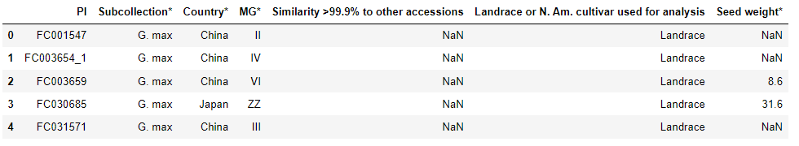
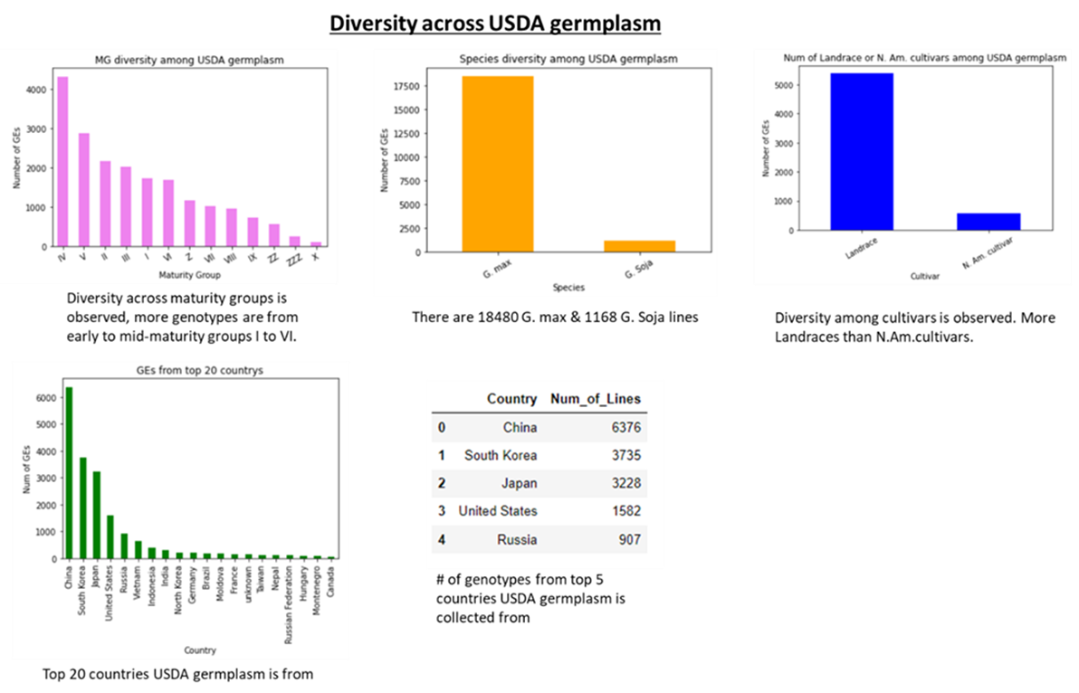
3.Data wrangling/Exploratory data analysis:
3a) Soybean USDA accessions Soy_USDA_Accessions_descritpion.xlsx contains
This dataset consists of 19649 soybean accessions coming from 89 countries
• Observed the following diversity among USDA accessions

Slide 5
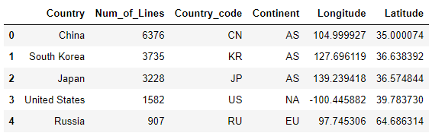
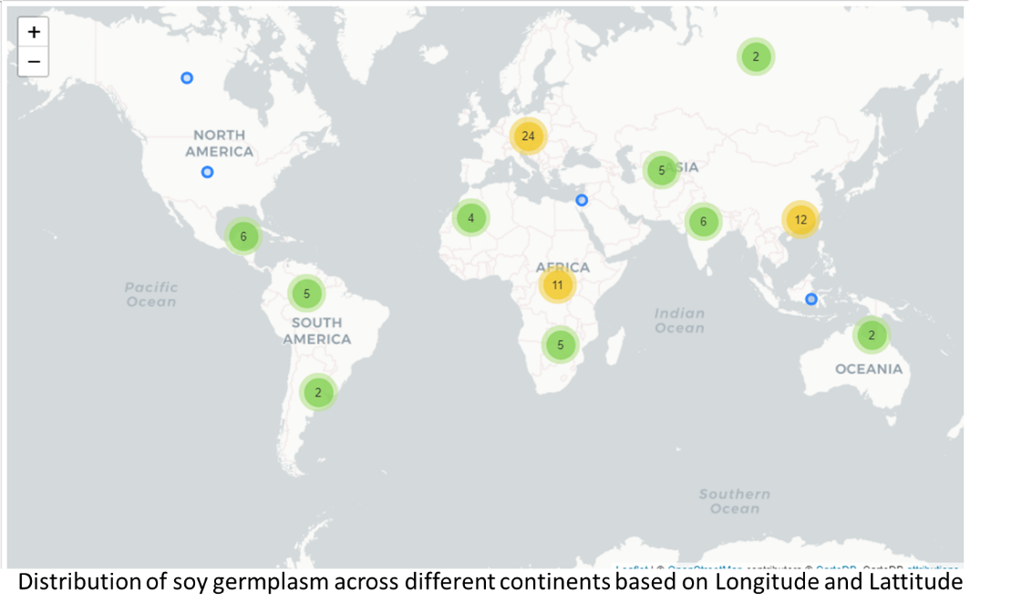
Checked the geographic distribution of the USDA accessions

Slide 6
Soybean USDA accessions filtering
There are 691 samples having >10% missing (138 samples with 15% missing, 20 samples having >20% missing data).
Since there aren't many samples with higher missing data, I dropped samples with >10% missing data.
After dropping samples with >10% missing data, 19396 samples are left.
Table. Number of accessions in the USDA Soybean Germplasm Collection with similarity >99% based on SNP comparisons
Similarity Among Accessions | G.Soja | G.max
Accessions >99% similar to another accession | 362 | 4299
Proportion of accessions with >99% similar (% | (362/1168) =31% | (4299/18480) =23.26
• A total of 18480 G. max & 1168 G. Soja accessions were used for further analysis.

Slide 7
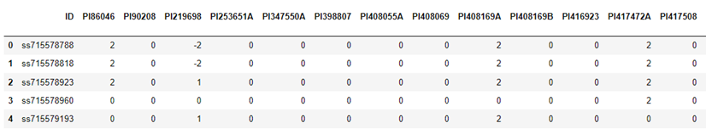
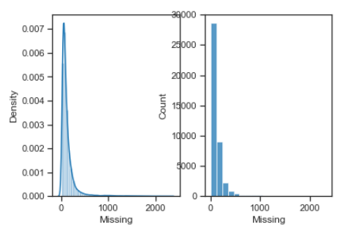
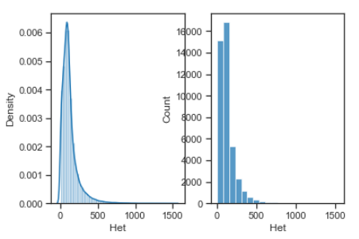
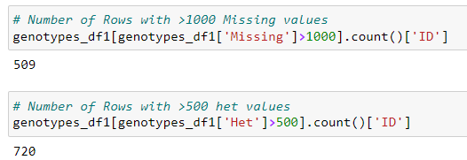
Soybean 50k SNP data
Distribution of Missing and Het values

Slide 8
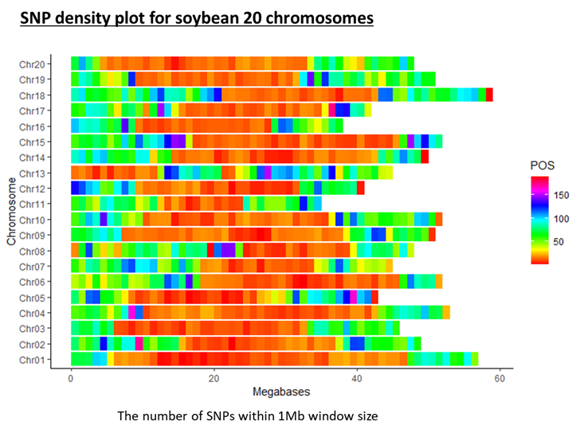
Soy 50K data/SNP Filtering
Filtered SNPs and 36729 SNPs remained after dropping SNPs with >10% missing data, monomorphic SNPS, MAF<0.05
Distribution of the filtered SNPs across 1 mega base region of 20 chromosomes of soybean is shown below.

Slide 9
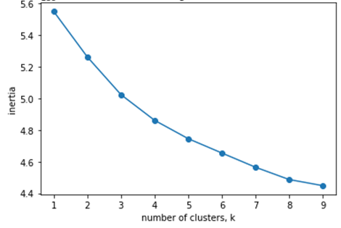
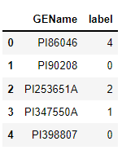
Machine learning models implemented
Since this dataset doesn’t have labels, I implemented Unsupervised Learning (USL).
USL is a class of machine learning technique used to find patterns in data instead of predicting target variable like in supervised learning.
Cluster analysis (KMeans)
Grouping/clustering the genotypes/accessions based on similarity/patterns.
I implemented KMeans clustering model from python’s sklearn library, partitions dataset into k clusters based on similarity in which each observation belongs to the cluster with nearest mean.
Plot of inertia values of clustering with different K values showed that K means model with 5 clusters had relatively low inertia, so it looks like 5 clusters would be a good choice for this dataset.
• Grouped accessions into 5 clusters and predicted the label/cluster for each line.

Slide 10
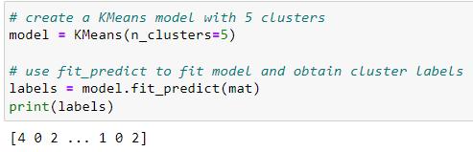
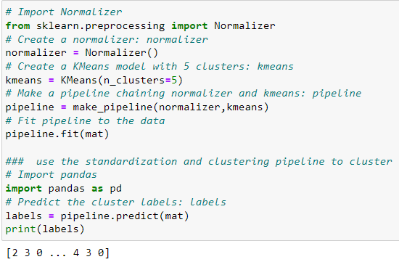
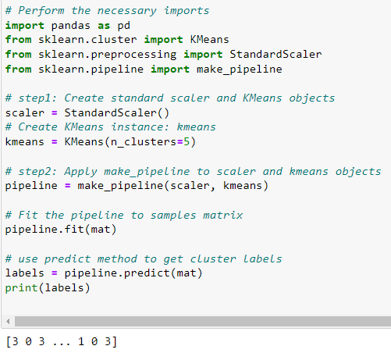
Kmeans Clustering methods tested

Slide 11
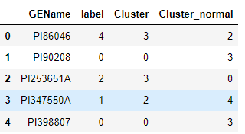
Kmeans clustering with or without transformations (StandardScaler or Normalization)
Kmeans with StandardScaler
Kmeans with Normalization
Kmeans clustering
Cluster number of GEName changed with different Kmeans algorithm
BUT, GENames were in grouped together though they fall in different cluster number with different KMeans

Slide 12
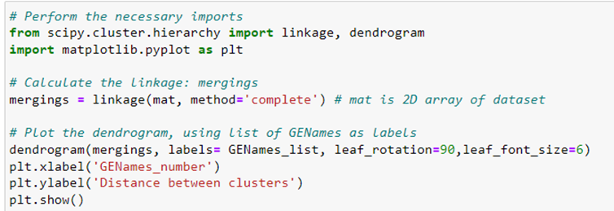
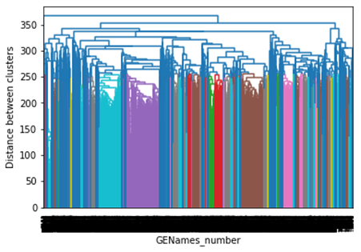
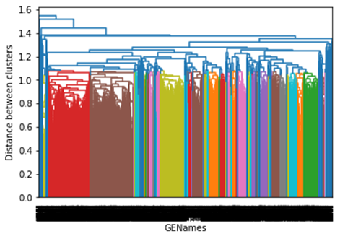
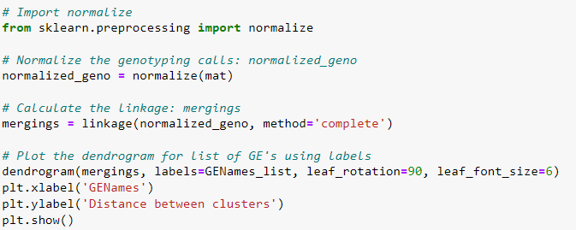
Hierarchial clustering
• SciPy hierarchical clustering doesn't fit into a sklearn pipeline, so I used normalize() function from sklearn.preprocessing instead of Normalizer
Since there are 19,400 GENames/accessions to cluster, the hierarchical clustering results seem clumsy.

Slide 13
So, I exported the clusters and grouped them based on Species, Cultivar and Relative Maturity groups.
Species: All clusters except 3, had higher G.max accessions. Cluster 3 had G.soja accessions.
Cultivar: All clusters had mostly Landraces.
Relative maturity:
Cluster 0: Many mid-maturity group (IV, V, VI)
Cluster 1: Many early maturity group accessions (I, II)
Cluster 2: Spread across mid to early-late maturity groups (IV to IX)
Cluster 3: Group IV, V
Cluster 4: Spread across maturity groups.

Slide 14
Conclusions and future work:
The United States Department of Agriculture (USDA), Soybean Germplasm Collection includes 18,480 domesticated soybean and 1168 wild soybean accessions introduced from 84 countries or developed in the United States. This collection was genotyped with the SoySNP50K BeadChip containing greater than 50K single-nucleotide polymorphisms.
Filtering of 50K SNPs in this dataset showed well distribution of 36.7k SNPs across 1 mega base region of 20 chromosomes A total of 18480 G. max & 1168 G. Soja accessions were used for further analysis.
Since this dataset doesn’t have labels, I implemented Unsupervised Learning (USL). Implemented KMeans clustering algorithm.
Plot of inertia values of clustering with different K values showed that K means model with 5 clusters had relatively low inertia, so it looks like 5 clusters would be a good choice for this dataset.
In this dataset, I implemented clustering with KMeans and also used transformations like StandardScaler and Normalizer (n_clusters=5). The cluster labels generated with Kmeans, with and without StandardScaler/Normalizer, are different. However, same GENames were grouped together though the cluster label is different with transformations.
Also implemented hierarchical clustering along with and without Normalizer. Since there are 19,400 GENames/accessions to cluster, the hierarchical clustering seems clumsy. So, I exported the clusters and grouped them based on Species, Cultivar and Relative Maturity groups

Slide 15
For future work, will perform clustering with Principal Component Analysis (PCA).
Validate the cluster groups found in this study by applying the KMeans, Hierarchial models to the established germplasm from NA breeding programs and evaluating the genetic similarity of the accessions used in this study to the products/varieties released using these accessions as parents.
Also evaluating the association of genetic similarity with traits/phenotypes measured on these accessions would give more value to these accessions for breeding programs.
Besides, research showed that population structure is more efficiently captured by PCA-reduced data (Patterson et al., 2006) while improving hierarchical clustering (van Heerwaarden et al., 2013). There is a growing interest in PCA-based clustering (Lee et al., 2009; Paschou et al., 2007; van Heerwaarden et al., 2010) calls for an understanding of the potential benefits of PCA-based data reduction for improving hierarchical clustering. So, I am planning to evaluate if PCA

