Slide 1
IOT based Robotic ARM
IoT 25-05
K Mallikarjuna Reddy 21121A3516
CHATTA NAVEEN 21121A3504
T KUSHAL KUMAR 21121A3545
GIDDALURI STEVEN 21121A3509

Slide 2
Contents
Abstract
problem Statement
Introduction
Implementation
Robotic ARM Mechanics
Theritical Analysis
References

Slide 3
Abstract
This project focuses on developing a robotic arm using Arduino and Potentiometer technology, specifically designed for surgical applications and industrial applications. The arm, capable of precise multi-directional movement through servo motors, is controlled by an Arduino UNO board, converting analog signals into digital commands for accurate manipulation. Unlike expensive surgical robots like the Da Vinci System, this project aims to create a more affordable and customizable alternative. The goal is to enhance precision and control in minimally invasive surgeries, making advanced surgical tools accessible, especially in resource-limited settings. This project contributes to the future of medical automation, offering a cost-effective solution to improve the accuracy and efficiency of surgical procedures.

Slide 4
Problem Statement
The COVID-19 pandemic has highlighted the critical need to minimize direct human interaction in high-risk environments such as hospitals and medical facilities. To protect healthcare workers and patients alike, reducing human touch during medical procedures has become a priority. However, many essential tasks—such as administering injections, drawing blood, dressing wounds, and handling sensitive medical instruments—still require a high degree of precision and care that currently depends on human intervention.
This challenge calls for the development of an advanced, autonomous robotic arm specifically designed for the medical field.

Slide 5
Introduction
The robotic arm is designed to perform delicate, minimally invasive surgeries with enhanced precision. By harnessing the power of Arduino to control servo motors, the arm can mimic the fine motor skills of a human hand, ensuring accuracy and reducing surgeon fatigue.
This innovation not only democratizes access to advanced surgical tools but also represents a significant step forward in the future of medical automation and industrail automation.
This project aims to address this challenge by developing a robotic arm using Arduino and Potentiometer technology, offering a cost-effective and customizable solution for surgical applications.

Slide 6
Why we need robotic arm?
Robotic arms are used in various industries and applications due to their precision, efficiency, and ability to handle repetitive or dangerous tasks.
Repetitive and Monotonous Tasks
Automation and Efficiency
Precision and Accuracy
Handling Hazardous Tasks
Flexibility
Enhanced Quality Control

Slide 7
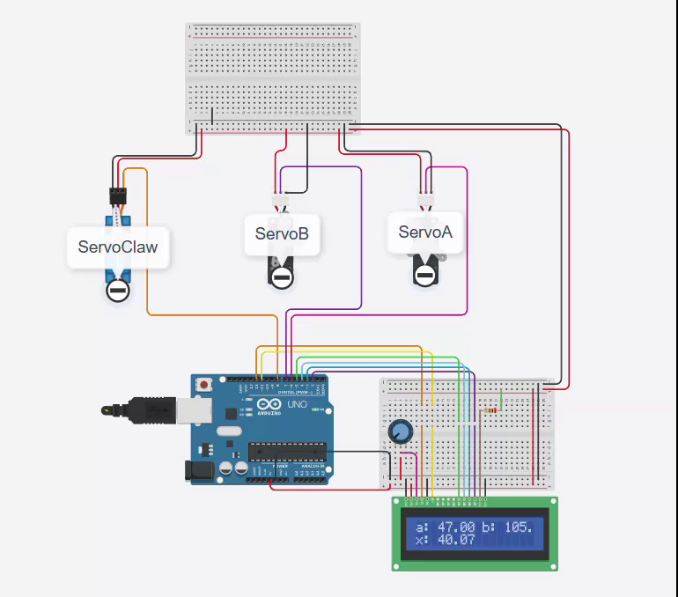
Implementation

Slide 8
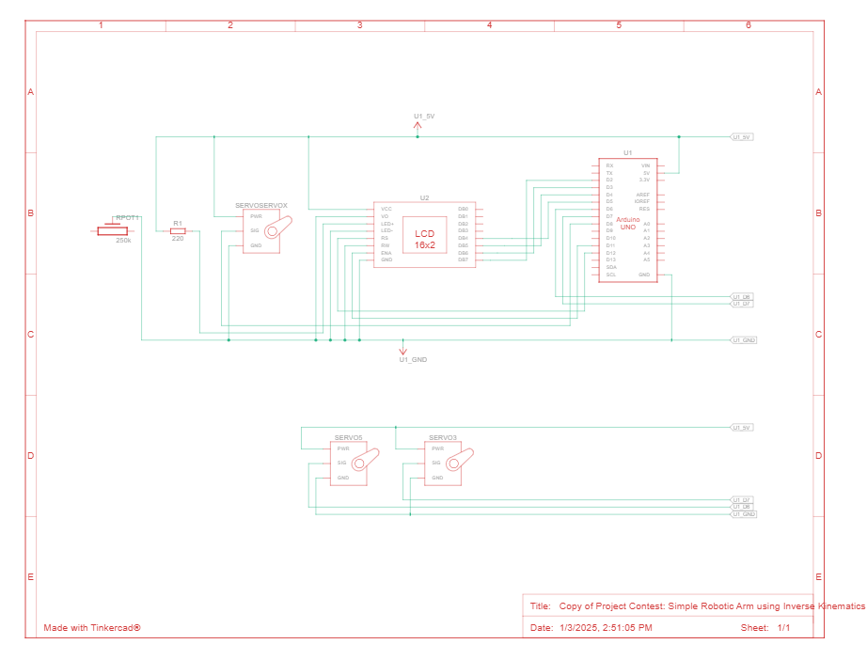
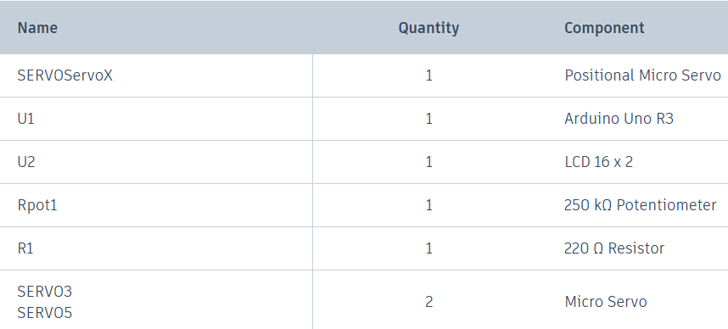
Robotic ARM Schematics

Slide 9
Robotic ARM Mechanics
To understand the mathematical foundations and how the Jacobian matrix relates to the movements in the robotic arm, let’s break down the key formulae used in the code and how they connect with kinematic theory. Specifically, we’ll explain the trigonometric relationships for inverse kinematics, the Jacobian matrix, and how they relate to the movements of the robotic arm.
1. Inverse Kinematics:
The code performs inverse kinematics to calculate the joint angles alpha and beta that are needed to position the robotic arm at a specific horizontal distance x (the position of the end-effector). The two links (upper arm of length L1 and forearm of length L2) form a planar two-link arm.

Slide 10
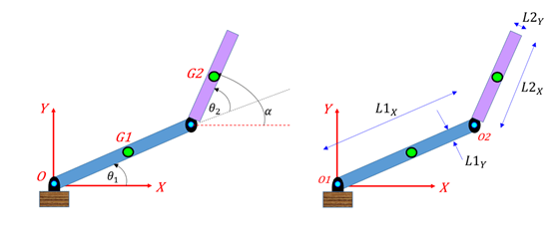
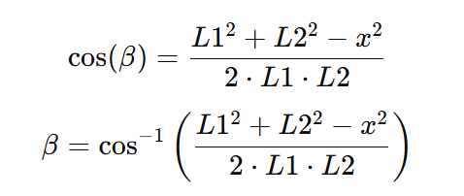

Cosine Law for Inverse Kinematics:
The inverse kinematics formula used in the code to calculate alpha is derived from the cosine law applied to the triangle formed by the upper arm (L1), forearm (L2), and the horizontal distance (x):
Thus, the angles alpha and beta can be determined from the horizontal distance x.

Slide 11
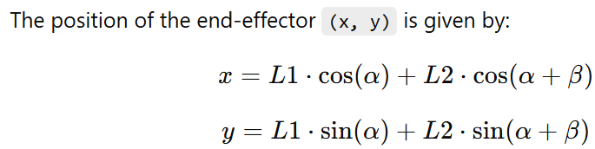
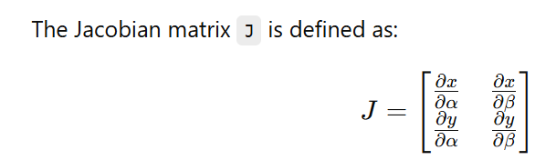
2. Jacobian Matrix:
In robotics, the Jacobian matrix relates the joint velocities (or rate of change of the joint angles) to the velocity of the end-effector. For a two-link planar arm, the Jacobian matrix J can be used to express the relationship between joint velocities and end-effector velocity.

Slide 12
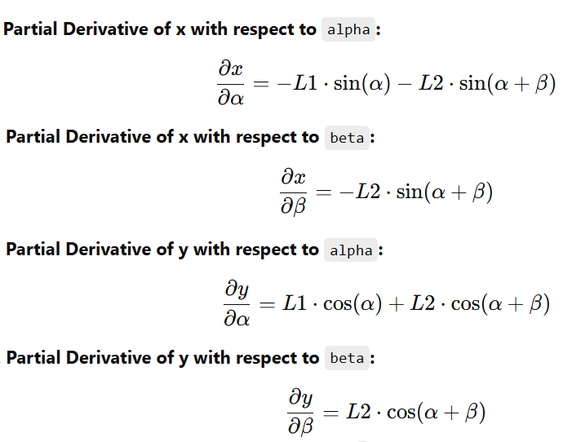

Thus, the Jacobian matrix becomes:

Slide 13
Objectives
Design and Construction: Develop a functional robotic arm using Arduino and Potentiometer technology, capable of precise multi-directional movement.
Integration of IoT: Implement IoT capabilities to enable remote monitoring and control of the robotic arm, enhancing its applicability in surgical environments.
Cost-Effectiveness: Create a more affordable alternative to high-end surgical robots, making advanced surgical tools accessible in resource-limited settings.

Slide 14

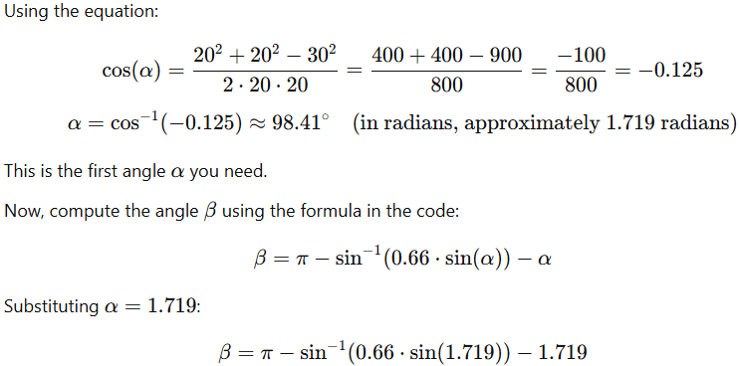
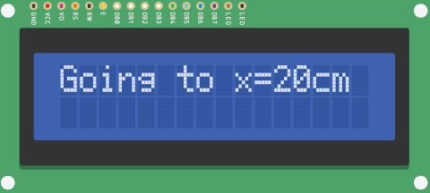
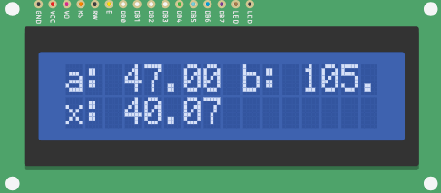
Theritical Analysis
In the code, the key part of the kinematic calculation involves the function x2alpha(), which is derived from the law of cosines to compute the angle for a given horizontal distance 𝑥
The law of cosines used to compute 𝛼is:

Slide 15
Code Verification:
The code performs the same calculations in the function alpha(α) to determine alpha(α), which is then used to calculate the corresponding servo angles. The angles alpha(α) and beta(β) are then converted to degrees and used to control the servo motors, which is verified through the LCD and serial printouts.
Summary:
The theoretical and experimental calculations for α\alphaα and β\betaβ using the provided values of L1​=20, L2=30,should be consistent if the code correctly implements the inverse kinematics.
The servo angles are correctly adjusted using the computed angles, and the experimental verification should match the theoretical results as demonstrated through the serial monitor and the LCD output.

Slide 16
Reference
Sanket S Unde, F.: Theoretical and experimental investigation on direct kinematic of pick and place 4R robotic arm using algebraic and software approach.Springer Journal 2(5), 99–110 (2024).
Navin Kumar Agrawal, Vinay Kumar Singh, Vinay Singh Parmar, vijay Kumar Sharma, Dipti Singh, Muskan Agrawal, Design and Development of IoT based Robotic Arm by using Arduino, Proceedings of the Fourth International Conference on Computing Methodologies and Communication (ICCMC 2020) IEEE Xplore Part Number:CFP20K25-ART; ISBN:978-1- 72814889-2
K. Rahul, Hifjur Raheman, Vikas Paradkar, Design and development of a 5R 2DOF parallel robot arm for handling paper pot seedlings in a vegetable transplanter, Computers and Electronics in Agriculture 166 (2019) 105014Author, F.: Contribution title. In: 9th International Proceedings on Proceedings, pp. 1–2. Publisher, Location (2010).

Slide 17
Thank You

