Slide 1
IOT based Robotic ARM
IoT 25-05
K Mallikarjuna Reddy
6th International Conference on Data Science, Machine Learning & Applications

Slide 2
Contents
Abstract
problem Statement
Introduction
Objectives
Motivation
References
6th Edition of International Conference on Communications and Cyber-Physical Engineering

Slide 3
Abstract
This project focuses on developing a robotic arm using Arduino and Potentiometer technology, specifically designed for surgical applications. The arm, capable of precise multi-directional movement through servo motors, is controlled by an Arduino UNO board, converting analog signals into digital commands for accurate manipulation. Unlike expensive surgical robots like the Da Vinci System, this project aims to create a more affordable and customizable alternative. The goal is to enhance precision and control in minimally invasive surgeries, making advanced surgical tools accessible, especially in resource-limited settings. This project contributes to the future of medical automation, offering a cost-effective solution to improve the accuracy and efficiency of surgical procedures.

Slide 4
Problem Statement
The COVID-19 pandemic has highlighted the critical need to minimize direct human interaction in high-risk environments such as hospitals and medical facilities. To protect healthcare workers and patients alike, reducing human touch during medical procedures has become a priority. However, many essential tasks—such as administering injections, drawing blood, dressing wounds, and handling sensitive medical instruments—still require a high degree of precision and care that currently depends on human intervention.
This challenge calls for the development of an advanced, autonomous robotic arm specifically designed for the medical field.

Slide 5
Introduction
The robotic arm is designed to perform delicate, minimally invasive surgeries with enhanced precision. By harnessing the power of Arduino to control servo motors, the arm can mimic the fine motor skills of a human hand, ensuring accuracy and reducing surgeon fatigue.
This innovation not only democratizes access to advanced surgical tools but also represents a significant step forward in the future of medical automation.
This project aims to address this challenge by developing a robotic arm using Arduino and Potentiometer technology, offering a cost-effective and customizable solution for surgical applications.

Slide 6
Why we need robotic arm?
Robotic arms are used in various industries and applications due to their precision, efficiency, and ability to handle repetitive or dangerous tasks.
Repetitive and Monotonous Tasks
Automation and Efficiency
Precision and Accuracy
Handling Hazardous Tasks
Flexibility
Enhanced Quality Control

Slide 7
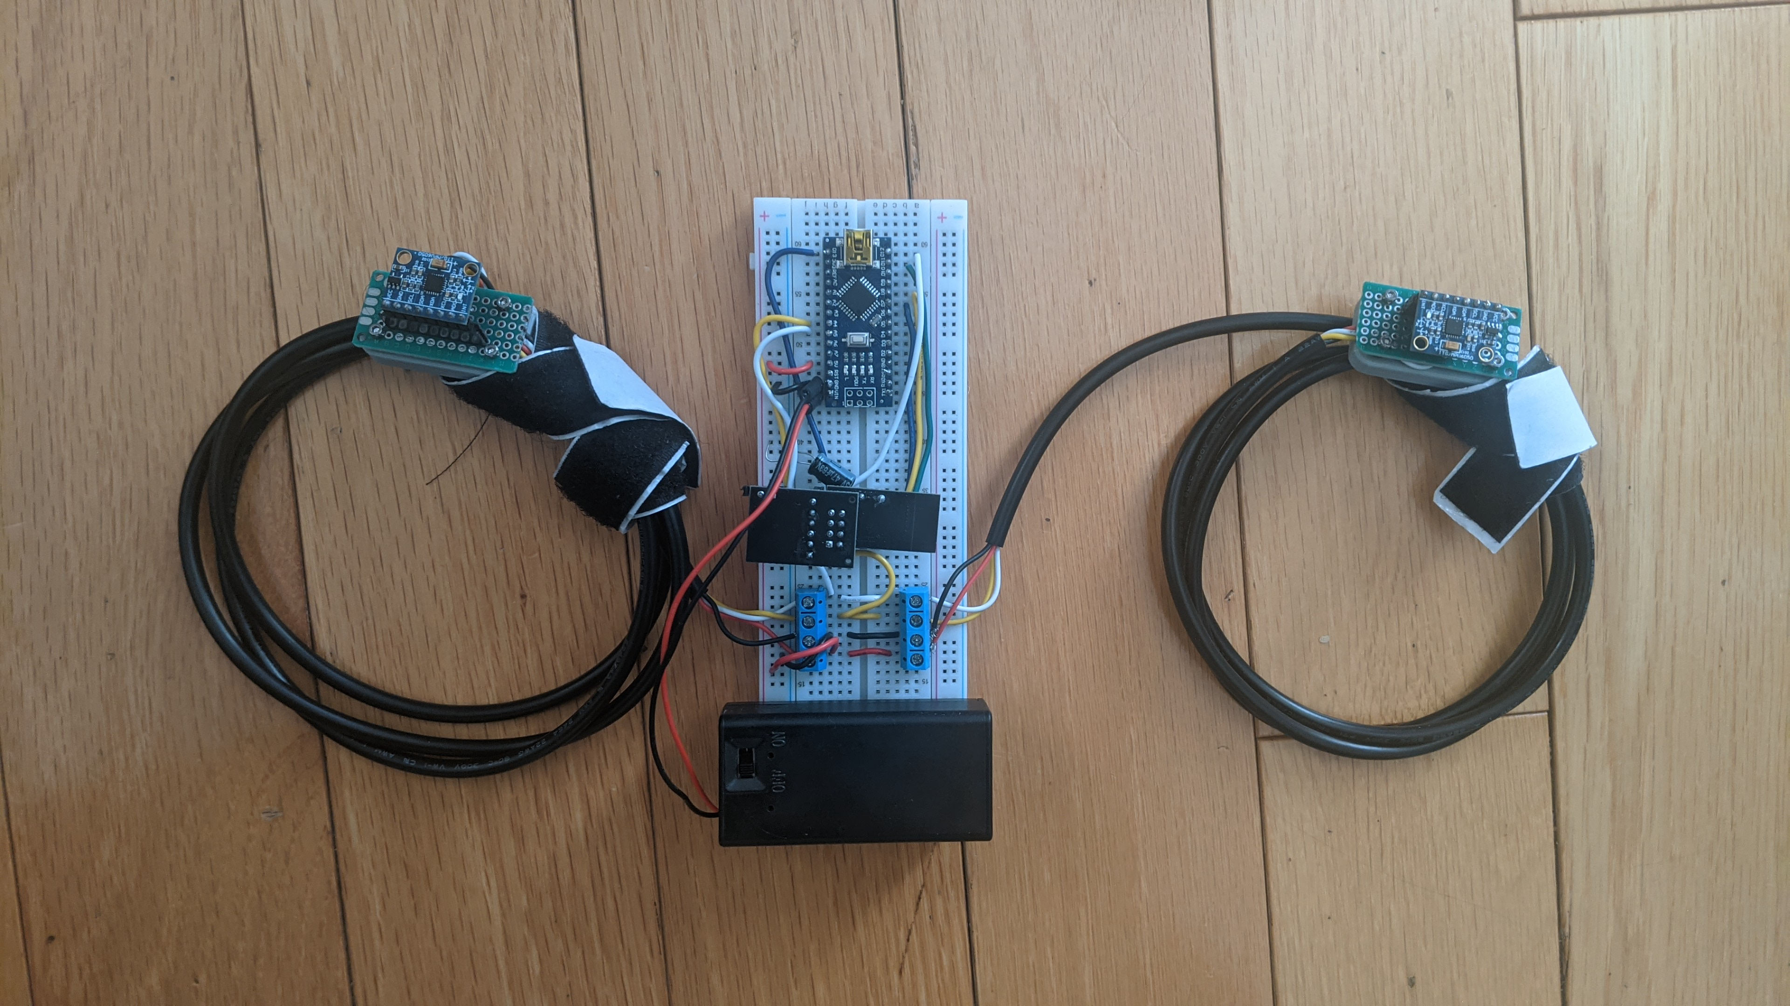
Implementation
There are 2 parts to this project. The 1st part is the robotic arm itself, which has 5 DOF (5 servos / 5 "Degrees of Freedom") and uses an Arduino Nano, a Dedicated Servo Driver, and an NRF24L01 for recieving signals.
The 2nd part is a gesture controller that straps onto the user's body. It has an Arduino Nano, an NRF24L01 module for transmitting data to the robotic arm, and 2 MPU6050's. The MPU6050s are velcroed onto the user's wrists, and then each direction of motion the user moves an arm in, causes a servo to move.
A picture of the Gesture Controller

Slide 8
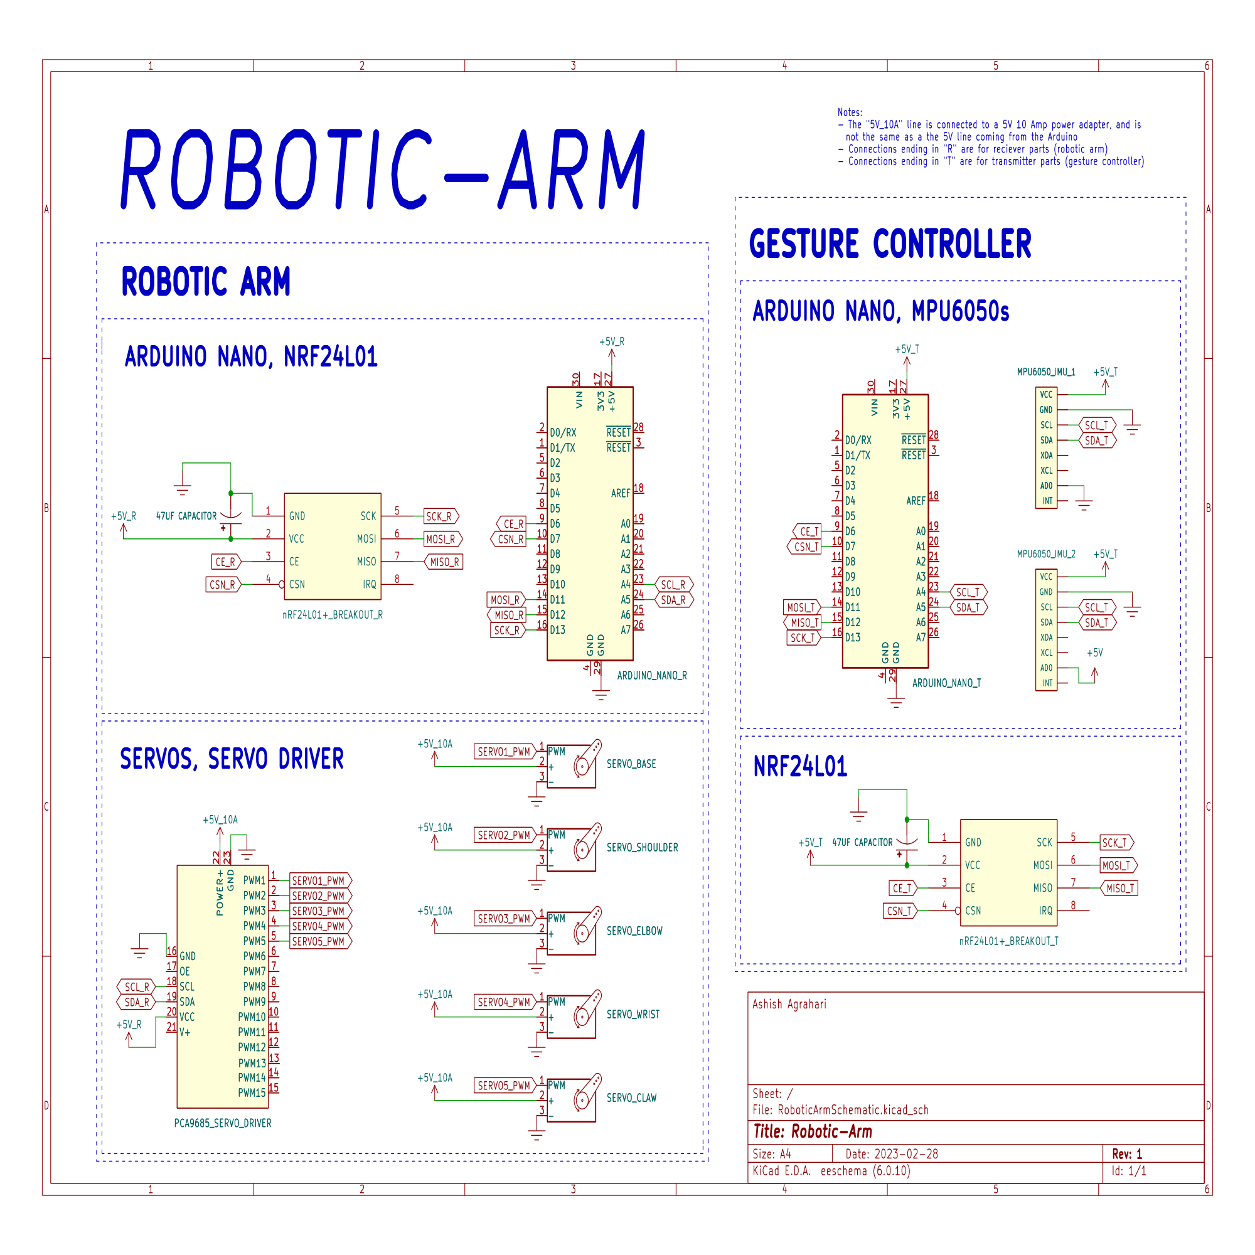
Robotic ARM Schematics

Slide 9
Objectives
Design and Construction: Develop a functional robotic arm using Arduino and Potentiometer technology, capable of precise multi-directional movement.
Integration of IoT: Implement IoT capabilities to enable remote monitoring and control of the robotic arm, enhancing its applicability in surgical environments.
Cost-Effectiveness: Create a more affordable alternative to high-end surgical robots, making advanced surgical tools accessible in resource-limited settings.

Slide 10
Motivation
The rising demand for precision in surgical procedures, coupled with the high cost of existing surgical robots, highlights the need for more accessible and affordable alternatives.
This project is driven by the desire to bridge this gap by developing a cost-effective, IoT-enabled robotic arm using Arduino technology. By making advanced surgical tools more accessible, we aim to empower healthcare professionals to deliver high-quality care, regardless of their location or financial constraints.

Slide 11
Reference
Sanket S Unde, F.: Theoretical and experimental investigation on direct kinematic of pick and place 4R robotic arm using algebraic and software approach.Springer Journal 2(5), 99–110 (2024).
Navin Kumar Agrawal, Vinay Kumar Singh, Vinay Singh Parmar, vijay Kumar Sharma, Dipti Singh, Muskan Agrawal, Design and Development of IoT based Robotic Arm by using Arduino, Proceedings of the Fourth International Conference on Computing Methodologies and Communication (ICCMC 2020) IEEE Xplore Part Number:CFP20K25-ART; ISBN:978-1- 72814889-2
K. Rahul, Hifjur Raheman, Vikas Paradkar, Design and development of a 5R 2DOF parallel robot arm for handling paper pot seedlings in a vegetable transplanter, Computers and Electronics in Agriculture 166 (2019) 105014Author, F.: Contribution title. In: 9th International Proceedings on Proceedings, pp. 1–2. Publisher, Location (2010).

Slide 12
Thank You

