Slide 1
MapReduce
Session Four

Slide 2
MapReduce Overview
  MapReduce one of the core parts of Apache Hadoop.
  MapReduce is simple Programming Model.
  Hadoop MapReduce is a software framework for easily writing
  applications which process vast amounts of data (multi-terabyte data-sets)
  in-parallel on large clusters (thousands of nodes) of commodity hardware
  in a reliable, fault-tolerant manner.
  A MapReduce job usually splits the input data-set into independent chunks
  which are processed by the map tasks in a completely parallel manner. The
  framework sorts the outputs of the maps, which are then input to the
  reduce tasks. Typically both the input and the output of the job are stored
  in a file-system. The framework takes care of scheduling tasks, monitoring
  them and re-executes the failed tasks.

Slide 3
Components of MapReduce
  The MapReduce Programming Model In Hadoop implemented as Java
  framework. This framework is categorized into three parts.
  The end-user MapReduce API for programming the desired MapReduce application.
  The MapReduce framework, which is the runtime implementation of various phases such as the map phase, the sort/shuffle/merge aggregation and the reduce phase.
  The MapReduce system, which is the backend infrastructure required to run the user’s MapReduce application, manage cluster resources, schedule thousands of concurrent jobs etc.

Slide 4
Building blocks of MapReduce
The following are the building blocks of the MapReduce programs. It has a
template/Skeleton which contains the following components.
Mapper
Reducer
Combiner
Partitioner
Context
Shuffle
Record
Hadoop Data Types
Hadoop Serialization
Hadoop Streaming

Slide 5
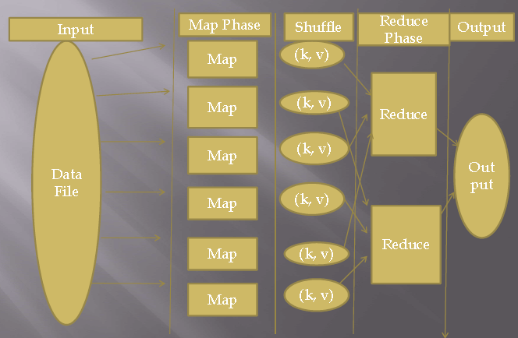
MapReduce Flow

Slide 6
Hadoop Input/Output
Input Split
Record Reader
Record Writer
InputFormat
  TextInputFormat
  KeyValueTextInputFormat
  SequenceFileInputFormat
  CustomInputFormat
  HCatInputFormat
OutputFormat
  TextOutputFormat
  SequenceFileOutputFormat
  CustomOutputFormat
  HCatOutputFormat

Slide 7
Configuration and Job Objects
In MapReduce program, we have basically three things Mapper Class, Reducer
Class and Main class which contains MapReduce Driver.
The Driver contains mainly two things Configuration, Job objects.
Configuration Object: This is used to read all the hadoop configuration
parameters and job specific parameters
Job Object: This object is used to Plug all the input and output stuff.
These include: Mapper Class, Combiner Class, Reducer Class, Job Name, Key-
Value Output Classes, Input/Output Format types, and Input/Output file path
locations.
GenericOptionsParser: This class is used to read all the Generic Options
available with Hadoop like –D key = value, JT <hostname: port> etc.

Slide 8
Job Management and Monitoring
Job Creation
Job Execution
Speculative Execution
Task Execution
Re-launching failed tasks
Compression
JVM Reuse
Task Logs
Adding Third Party Libraries
Job Scheduling
Distributed Cache
Counters
Many more …

