Slide 1
Object Persistence

Slide 2
Introduction
One of the most critical tasks that applications have to perform is to save and restore data
Persistence is the storage of data from working memory so that it can be restored when the application is run again
In object-oriented systems, there are several ways in which objects can be made persistent
The choice of persistence method is an important part of the design of an application

Slide 3
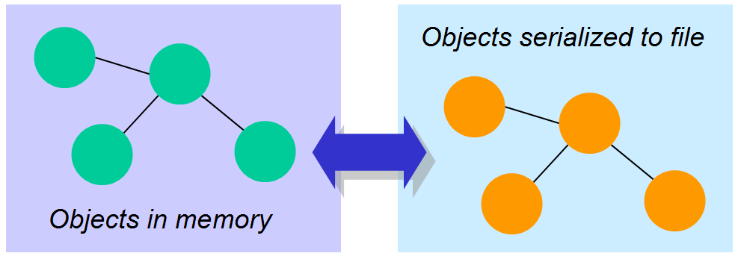
Object Serialization

Slide 4
Object Serialization
Simple persistence method which provides a program the ability to read or write a whole object to and from a stream of bytes
Allows Java objects to be encoded into a byte stream suitable for streaming to a file on disk or over a network
The class must implement the Serializable interface (java.io.Serializable), which does not declare any methods, and have accessors and mutators for its attributes

Slide 5
Object Serialization
// create output stream
File file = new File("teams_serialize.ser");
String fullPath = file.getAbsolutePath();
fos = new FileOutputStream(fullPath);
// open output stream and store team t1
out = new ObjectOutputStream(fos);
out.writeObject(t1);

Slide 6
Using Databases
Most Client-Server applications use a RDBMS as their data store while using an object-oriented programming language for development
Objects must be mapped to tables in the database and vice versa
Applications generally require the use of SQL statements embedded in another programming language
“Impedance mismatch”

Slide 7
Using Databases
Goal of object-oriented design is to model a process
Goal of relational database design is normalisation
The mapping from objects to tables can be difficult if the model contains
  complex class structures
  large unstructured objects
  object inheritance
The resulting tables may store data inefficiently, or access to data may be inefficient

Slide 8
Using Databases
There are essentially three approaches which have been developed for the management of object storage in databases:
the Object-Oriented Database Management System (OODBMS)
the Object-Relational Database Management System (ORDBMS)
Object Relational Mapping

Slide 9
Data Models: 1st Generation
Hierarchical Data Model
implemented primarily by IBM’s Information Management System (IMS)
allows one-to-one or one-to-many relationships between entities
an entity at a “many” end of a relationship can be related to only one entity at the “one” end
this model is navigational – data access is through defined relationships, efficient if searches follow predefined relationships but performs poorly otherwise, e.g for ad-hoc queries.

Slide 10
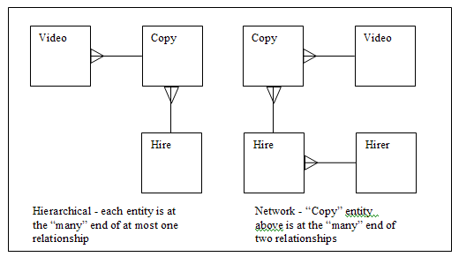
Data Models: 1st Generation
Network Data Model
standard developed by the Committee on Data Systems Languages (CODASYL)
allows one-to-one or one-to-many relationships between entities
allows multiple parentage – a single entity can be at the “many” ends of multiple relationships
navigational

Slide 11
Data Models: 2nd Generation
Relational Data Model
  developed by Edgar Codd (1970)
  data represented by simple tabular structures (relations)
  relationships defined by primary keys and foreign keys
  data accessed using high-level non-procedural language (SQL)
  separates logical and physical representation of data
  highly commercially successful (Oracle, DB2, SQL Server, etc)
SQL is not computationally complete
does not have the full power of a programming language
Applications generally require the use of SQL statements embedded in another programming language.

Slide 12
Data Models: 3rd Generation
most programming languages are now object-oriented
Object Data Model
  offers persistence to objects, including their associations, attributes and operations
  requirements specified by Atkinson in 1989, standards proposed by Object Data Management Group (ODMG)
  navigational – a step backwards from the relational model in some ways
Object-Relational Model
  hybrid (or “post-relational”) model – objects can be stored within relational database tables
  proposed by Stonebraker (1990)
  no accepted standards, but ORDBMS features supported by major commercial RDBMSs such as Oracle

Slide 13
Object Relational Mapping
Most business database applications use relational databases
Need to map the objects in the application to tables in the database
Sometimes be a simple matter of mapping individual classes to separate database tables
However, if the class structure is more complex, then the mapping must be carefully considered to allow data to be represented and accessed as efficiently as possible

Slide 14
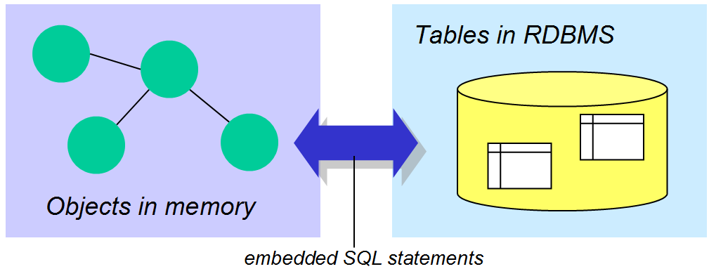
Object Relational Mapping

Slide 15
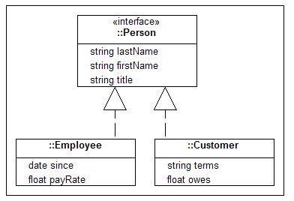
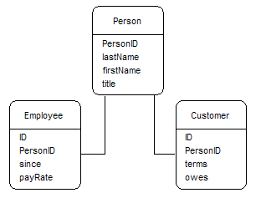
OR Mapping: Inheritance
Vertical mapping

Slide 16
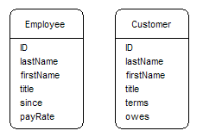
OR Mapping: Inheritance
Horizontal mapping

Slide 17
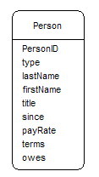
OR Mapping: Inheritance
Filtered mapping

Slide 18
OR Mapping: Guidelines
Use Vertical mapping when:
  there is significant overlap between types
  changing types is common
Use Horizontal mapping when:
  there is little overlap between types
  changing types is uncommon
Use Filtered mapping for:
  simple or shallow hierarchies with little overlap between types

Slide 19
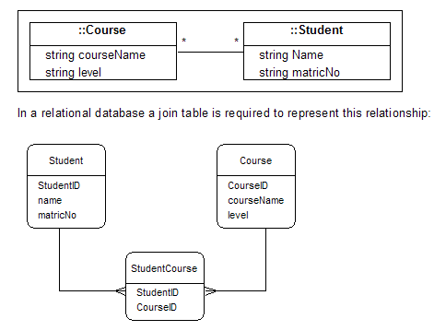
OR Mapping: Many-to-Many

Slide 20
Object Data Model
Object-oriented database systems are based on the concept of persistent objects
Use class declarations similar to those used by object-oriented programming languages
Class declarations should additionally indicate relationships between objects.
The system must be able to represent traditional database relationships and also relationships unique to the object-oriented model, such as inheritance

Slide 21
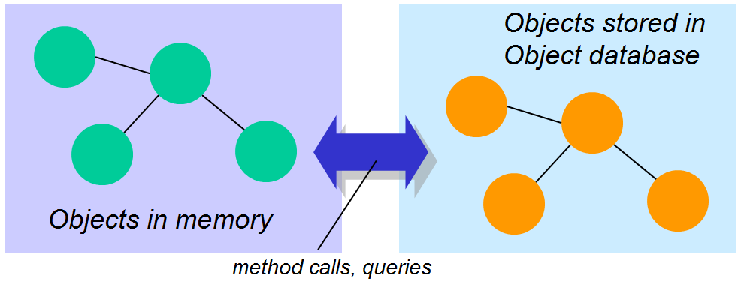
Object Data Model

Slide 22
Object Identifiers
RDBMS
  entities are uniquely identified by primary keys
  relationships are represented by matching primary key-foreign key data
  Identification depends on the values in the key fields
Object-oriented database
  stores object identifiers (OIDs) within an object to indicate other objects to which it is related.
  The object identifier is not visible to the user or database programmer
  An object remains the same object even when its state takes on completely new values

Slide 23
Object Identifiers
The fact that an object’s identity is distinct from its values means that the concepts of equivalence and equality are different:
Equivalent: same OID
Equal: same state values
Equality can exist at different levels:
Shallow equality same state values (e.g. two CustomerOrder objects have same values)
Deep equality same state values and related objects also contain same state values (e.g. two CustomerOrder objects have same values and all their related OrderItem objects have same values)

Slide 24
Objects and Literals
Objects can change their state values, and are described as being mutable
Another component of the object data model is the literal, which represents a value or set of values which cannot be changed
A literal is described as being immutable. Literals do not have OIDs.

Slide 25
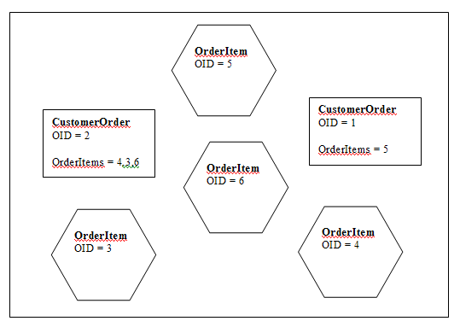
Representation of Relationships

Slide 26
Representation of Relationships
In the diagram all relationships have inverse relationships.
Inverse relationships are optional but can be used to enforce relationship integrity
Without an inverse relationship, there is nothing to stop an OrderItem being referenced by more than one Order
The inverse ensures that an OrderItem is associated with only one Order.

Slide 27
Representation of Relationships
Only relationships predefined by storing OIDs can be used to query or traverse the database
The database is therefore navigational
Object-oriented databases are generally not as well suited to ad-hoc querying as relational databases
However, performance can be better than a relational database for predictable access patterns which follow predefined relationships

Slide 28
Relationships: One-Many
unlike relational model, the object data model allows multi-valued attributes (known as sets and bags)
class at “many” end has attribute to hold OID of parent (see OrderItem in the figure above)
class at “one” end has attribute to hold a set of related OIDs (see CustomerOrder in the figure)

Slide 29
Relationships: Many-Many
object data model allows direct many-to-many relationships
in contrast, relational model requires the use of composite entities to remove many-to-many relationships
each class has an attribute to hold a set of OIDs

Slide 30
Relationships: “Is A” & “Extends”
These relationships can be represented because the object-oriented paradigm supports inheritance
For example, a company needs to store information about Employees. There are specific types of employee, such as SalesRep. A SalesRep has an attribute to store a sales area, e.g. North, West
This situation can be modelled easily in an object-oriented system. For example in Java:
  public class Employee {
  String name;
  String address;
  …
  }
  public class SalesRep extends Employee {
  String area;
  }

Slide 31
Relationships: “Whole-Part”
A whole-part relationship is a many-to-many relationship with a special meaning
It is useful in a manufacturing database which is used to track parts and subassemblies used to create products. A product can be made up of many part and subassemblies. Also, the same part or subassembly can be used in many products
This type relationship is represented as a many-many relationship using sets of OIDs in two classes
This type of relationship is very awkward for a relational database to represent.

Slide 32
Orthogonal Persistence
Orthogonality can be described by saying that feature A is orthogonal to feature B if you don't have to care about feature A while thinking about feature B.
Orthogonal persistence is a form of object persistence which adheres to the following principles (Atkinson & Morrison, 1995):
principle of persistence independence
  programs look the same whether they manipulate long-term or short-term data
principle of data type orthogonality
  all data objects are allowed to be persistent irrespective of their type
principle of persistence identification
  the mechanism for identifying persistent objects is not related to the type system

Slide 33
Object Database Standards
The Object Oriented Database Manifesto (1989)
Mandatory features:
Complex objects (OO feature)
  objects can contain attributes which are themselves objects.
Object identity (OO)
Encapsulation (OO)
Classes (OO)
Inheritance (OO): class hierarchies
Overriding, Overloading, Late Binding (OO)
Computational completeness (OO
Persistence (DB)
  data must remain after the process that created it has terminated
Secondary Storage Management (DB)
Concurrency (DB)
Recovery (DB)
Ad hoc query facility (DB)
  not necessarily a query language – could be a graphical query tool

Slide 34
Object Database Standards
The ODMG Proposed Standard
One of the crucial factors in the commercial success of RDBMSs is the relative standardisation of the data model
The Object Data Management Group (ODMG) was formed by a group of industry representatives to define a proposed standard for the object data model.
It is still far from being as widely recognised as the relational database standards.
The ODMG proposed standard defines the following aspects of an OODBMS:
  basic terminology
  data types
  classes and inheritance
  objects
  collection objects (including sets, bags, lists, arrays)
  structured objects (Date, Interval, Time, Timestamp – similar to SQL)
  relationships
  object definition language (ODL)
  object query language (OQL)

Slide 35
Advantages of OODBMS
Complex objects and relationships
Class hierarchy
No impedance mismatch
No need for primary keys
One data model
One programming language
No need for query language
High performance for certain tasks

Slide 36
Disadvantages of OODBMS
Schema changes
Lack of agreed standards
Lack of ad-hoc querying
In general, RDBMSs are probably more suitable for databases with a variety of query and user interface requirements (i.e. most mainstream business applications), while OODBMSs are appropriate for applications with complex, irregular data, where data access will follow predictable patterns (e.g CAD/CAM systems, manufacturing databases)

Slide 37
OODBMS Users
The Chicago Stock Exchange - managing stock trades
CERN in Switzerland - large scientific data sets
Radio Computing Services – automating radio stations (library, newsroom, etc)
Adidas – content for web site and CD-ROM catalogue
Federal Aviation Authority – passenger and baggage traffic simulation
Electricite de France – managing overhead power lines

Slide 38
OODBMS Products
Versant
ObjectStore and PSE Pro from eXcelon
Objectivity/DB
Intersystems Cache
POET fastObjects
db4o
Computer Associates Jasmine
GemStone

Slide 39
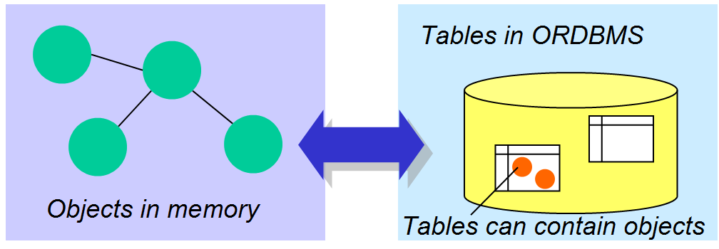
The Object Relational Model

Slide 40
The Object Relational Model
The object relational model is an extension of the relational model, with the following features:
  a field may contain an object with attributes and operations.
  complex objects can be stored in relational tables
  the object relational model offers some of the advantages of both the relational and object data models
has the commercial advantage of being supported by some of the major RDBMS vendors
An object relational DBMS is sometimes referred to as a hybrid DBMS

Slide 41
ORDB Example - Oracle
CREATE TYPE Name AS OBJECT (
first_name CHAR (15),
last_name CHAR (15),
middle_initial CHAR (1);
MEMBER PROCEDURE initialize,;
Code to define operations – in this case simply a class constructor
CREATE TYPE BODY Name AS
MEMBER PROCEDURE initialize IS
BEGIN
first_name := NULL;
last_name := NULL;
middle_initial := NULL;
END initialize;
END;
Using the new type in a table
CREATE TABLE person(
person_ID NUMBER;
person_name Name,
PRIMARY KEY (person_ID));

Slide 42
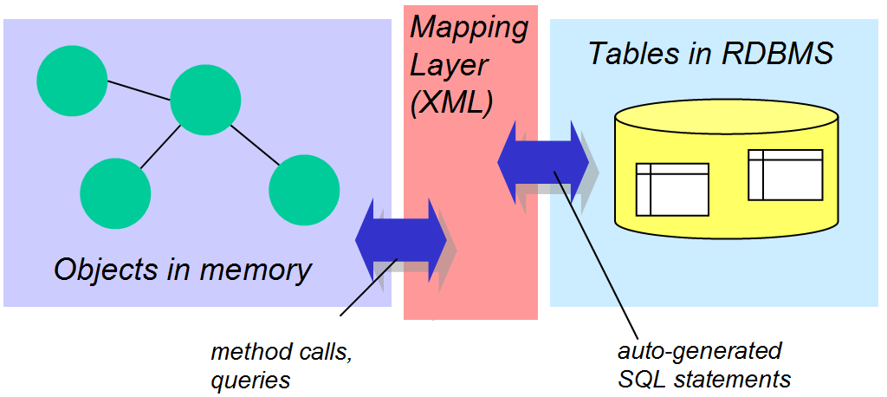
OR Mapping Frameworks

Slide 43
OR Mapping Frameworks
Most databases are relational
Much effort has been put in recently to making OR mapping more convenient
Transparent persistence

Slide 44
OR Mapping Frameworks
Key features:
  the programmer can work only with objects – no SQL statements in the code
  selected objects are initially marked as being persistent – thereafter, changes in those objects are transparently changed in the database, and the programmer does not have to write code specifically to update the database
  the framework handles the mapping of the objects to relational database tables where they are actually stored
  mapping of objects to database tables is usually defined in XML descriptor files

Slide 45
OR Mapping Frameworks
Java Data Objects (JDO
  Applications written to use JDO for persistence can be used with any database for which a JDO implementation is available.
  Queries are written in a Java-like language JDO Query Language (JDOQL).
  Mapping of objects to database tables is defined in XML descriptor files
Some OODBMS vendors, including POET and Versant have released products which are based on JDO.

Slide 46
OR Mapping Frameworks
Sun’s Enterprise JavaBeans (EJB), an advanced server-side Java component architecture, has its own persistence mechanism, Container Managed Persistence (CMP)
There are also open-source OR mapping frameworks which work in a similar way to JDO, including Hibernate, ObJectRelationalBridge (OJB) and Castor.
Commercial products such as Toplink make it easier to define mappings.
Some OR frameworks, including Hibernate and OJB, are compliant with the ODMG 3.0 standard for interfacing with a database.

Slide 47
Hibernate Mapping Example
<?xml version="1.0"?>
<!DOCTYPE hibernate-mapping PUBLIC
"-//Hibernate/Hibernate Mapping DTD 2.0//EN"
"http://hibernate.sourceforge.net/hibernate-mapping-
2.0.dtd">
<hibernate-mapping>
<class name="Team" table="teams">
<id name="id">
<generator class="native"/>
</id>
<property name="name" column="team_name"
type="string"/>
<property name="stadium" column="stadium"/>
<bag name="players" lazy="true" inverse="true"
cascade="save-update">
<key column="team"/>
<one-to-many class="Player"/>
</bag>
</class>
</hibernate-mapping>

Slide 48
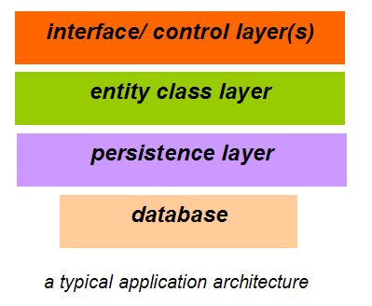
Writing a Persistence Layer

Slide 49
Advantages of Persistence Layer
Entity classes can be re-used in other applications which use different databases
Entity classes are easier to read and understand without any database access code in them
You can easily change the database you are using without changing the entity classes

Slide 50
Persistence Layer Example
Class Player
Has attributes name and squadNumber
The application needs to store information about players in an ODBC database.
How do we do this?

Slide 51
Persistence Layer Example
Firstly, we do not add database access code to this class.
Secondly, we must decide what information will need to be stored or retrieved
In this case, we probably would want to be able to do the following database actions:
  Store a Player object
  Retrieve the Player with a specified name

Slide 52
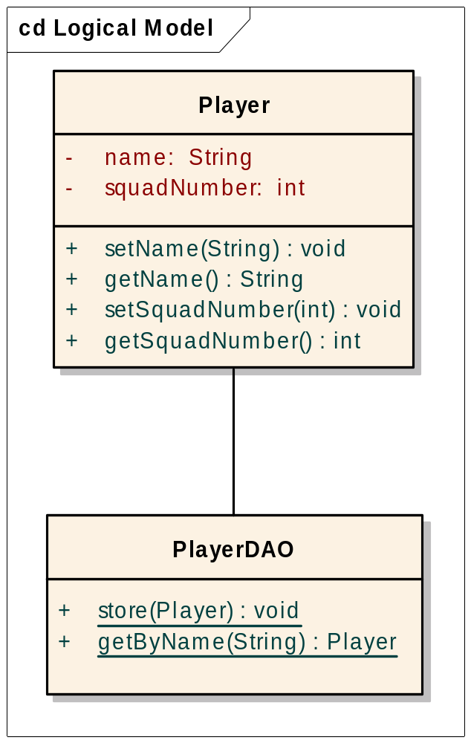
Persistence Layer Example
To do this, we write a Data Access Object (DAO) class which can perform these actions
Each entity class in the system which needs to be persistent should have a DAO associated with it
The DAO for Player must have a method to perform each database action

Slide 53
Persistence Layer Example
public static void store(Player p) throws Exception {
…
try{
stmt = con.createStatement();
String insertQuery =
"INSERT INTO PLAYERS (name, squadnumber) " +
"VALUES ('" + p.getName() + "', " +
p.getSquadNumber() +")";
stmt.executeUpdate(insertQuery);
…
}

Slide 54
Changing the Database
Since only the PlayerDAO class contains any reference to the database
So we can change the application to use a completely different persistence method without changing any other classes.
The following version of PlayerDAO uses db4o, an object database
db4o stores data using the object model in a single database file
Note that there is no SQL in this code – objects are stored and retrieved using set and get methods

Slide 55
Changing the Database
public static void store(Player p) throws Exception {
…
ObjectContainer db = Db4o.openFile(fullPath);
// store player - also stores associated players
db.set(p);
…
}

Slide 56

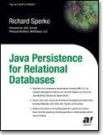
Further Reading

