Slide 1
Deformations, Strains and Rotations
Deformation gradient (for coordinates)
Displacement gradient

Slide 2
Deformations, Strains and Rotations
Deformation gradient (for coordinates)
Strain tensors

Slide 3
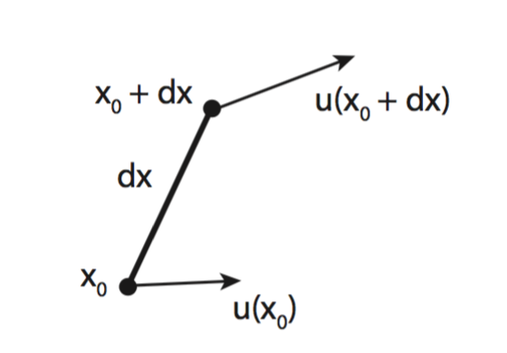
Deformations, Strains and Rotations
Infinitesimal deformation
Displacement field and its gradient (chain rule)
Displacement gradient

Slide 4
Deformations, Strains and Rotations
Infinitesimal strain tensor
For a 3 component displacement field, write out all components of the strain tensor
Split into an isotropic and deviatoric tensor

Slide 5
Deformations, Strains and Rotations
Rotation tensor (again)
strain tensor (symmetric)
rotation tensor
(skew-symmetric)
For a 3 component displacement field, write out all components of the rotation tensor. Can you represent this as a cross product?

Slide 6
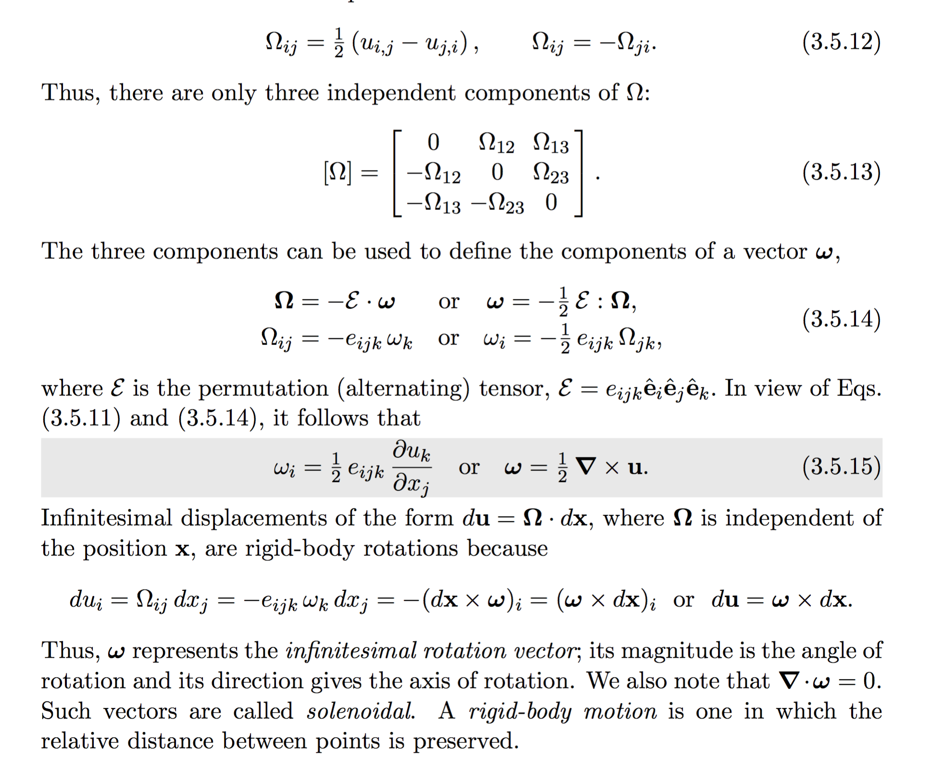
Deformations, Strains and Rotations
For a 3 component displacement field, write out all components of the rotation tensor. Can you represent this as a cross product?

Slide 7
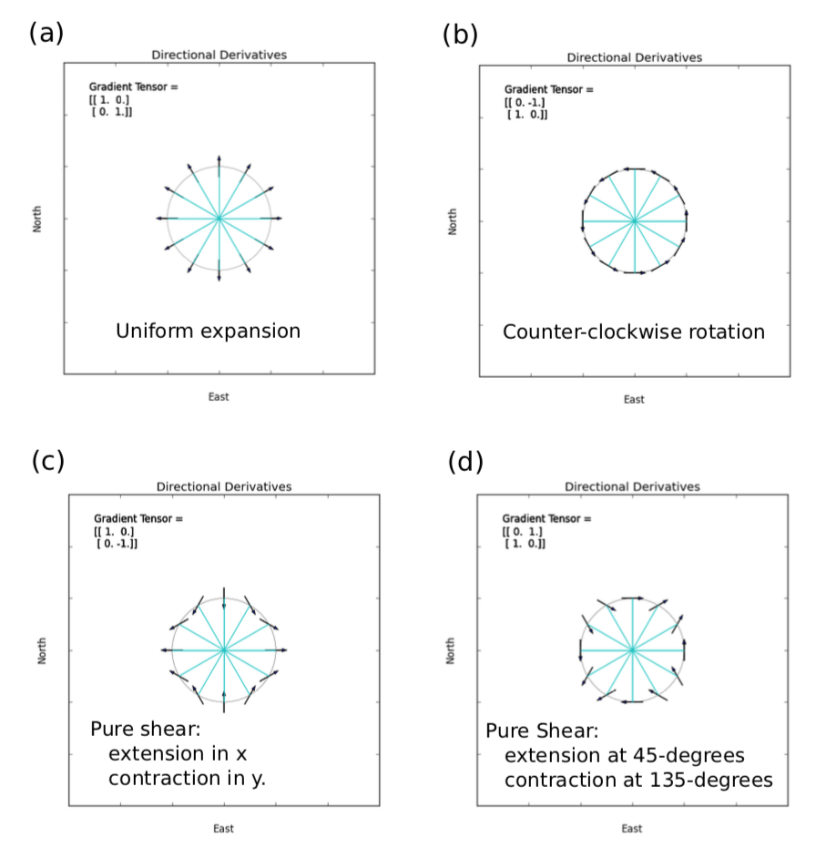
Decomposing the displacement gradient

Slide 8
Compatibility conditions
For a 3 component displacement field, we can easily compute its spatial derivatives => strains and rotations. But does it work vice versa?

Slide 9

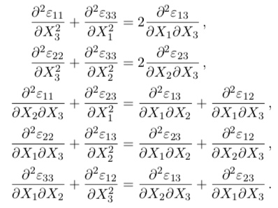
Compatibility conditions
For 6 independent strain components, there are 9 strain-displacement equations. How to solve?
This guarantees that the strains can be integrated to give a single-valued u, but it does not guarantee a unique u. Why?
Notes:
These 6 equations are interlinked, actually there are only 3 independent equations

Slide 10
Displacements from strains
Given a strain tensor (symmetric), first verify if it indeed represents a compatible strain tensor and then integrate it to compute displacements analytically (and numerically)
1-d problem, 0 < x < 5: ε_{xx} = log(x), compute u_{x}
2-d problem, 0 < x < 1, 0 < y < 1: e_{xx},e_{yy},e_{zz},e_{xy} = 0, e_{zx} = x/(x² + y²)
e_{zy} = y/(x² + y²), compute u_{z}
2-d problem, 0 < x < 1, 0 < y < 1: e_{zz} , e_{zx} , e_{zy} = 0,
e_{xx} = ((k+1)x²y + (k-3)y³)/(x² + y²)²
e_{yy} = ((k-3)x²y + (k+1)y³) /(x² + y²)²
e_{xy} = (4xy²)/(x² + y²)², compute u_{x} and u_{y} (for k = 4)

Slide 11
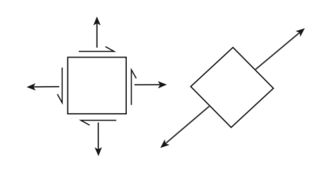
Principal Strains
The strain tensor can be rotated such that all the off-diagonal components vanish and we are left only with diagonal terms – principal strains
For any square matrix, we can compute ‘eigenvalues’ and ‘eigenvectors’ – characteristic polynomial

Slide 12
Principal Strains
The strain tensor can be rotated such that all the off-diagonal components vanish and we are left only with diagonal terms – principal strains

Slide 13
Principal Strains
The strain tensor can be rotated such that all the off-diagonal components vanish and we are left only with diagonal terms – principal strains

Slide 14
Principal Strains
2
2
Find the rotation angle that makes shear strain 0 and then what are the other components?
What is the maximum shear strain for this system?

Slide 15
Strain invariants

Slide 16
Assignments
Using the data given to you, first plot the elevation grid and overlay it with the displacement vectors. Make sure the vectors are visible.
Project the displacements on to the elevation gradient direction (unit vector) – to do this you will have to resample either the displacements or the elevation data. Plot transects of this projected quantity and discuss what you observe.
Estimate the elevation change due to materials moving. Hint: to do this you will have to use div(u) = 0 in 3-d. Think about and discuss what this assumption implies. You are free to come up with any other method of estimating elevation change as well.
Strains
Calculate the horizontal strain components from the displacement field
Plot the trace of the strain tensor and overlay it with displacement field. What does the trace represent?
Bonus: plot the principal strains at each point (maybe not each point because that will look overcrowded)

Slide 17
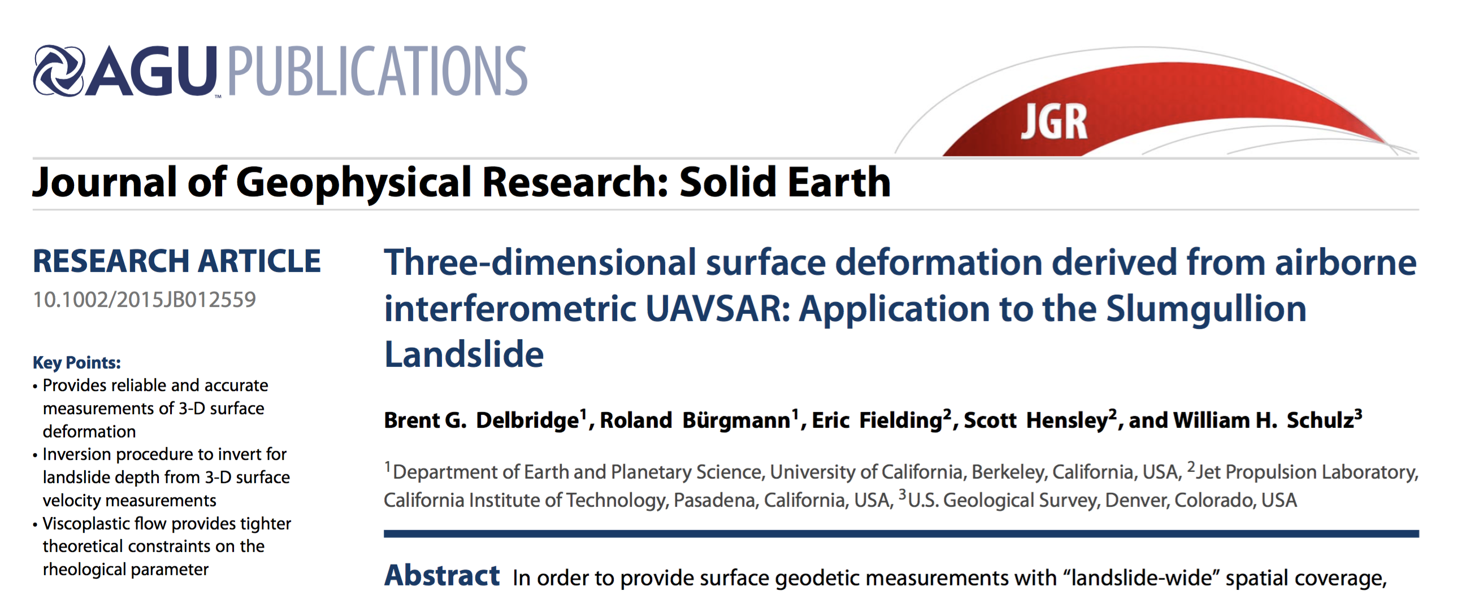
Assignments
Reading Assignment:
Delbridge, B. G., R. Bürgmann, E. Fielding, S. Hensley, and W. H. Schulz (2016), Three-dimensional surface deformation derived from airborne interferometric UAVSAR: Application to the Slumgullion Landslide, J. Geophys. Res. Solid Earth, 121, 3951–3977, doi:10.1002/2015JB012559.

