Slide 1
Introduction to Solid Mechanics
Displacements and deformation
Strains and rotations

Slide 2
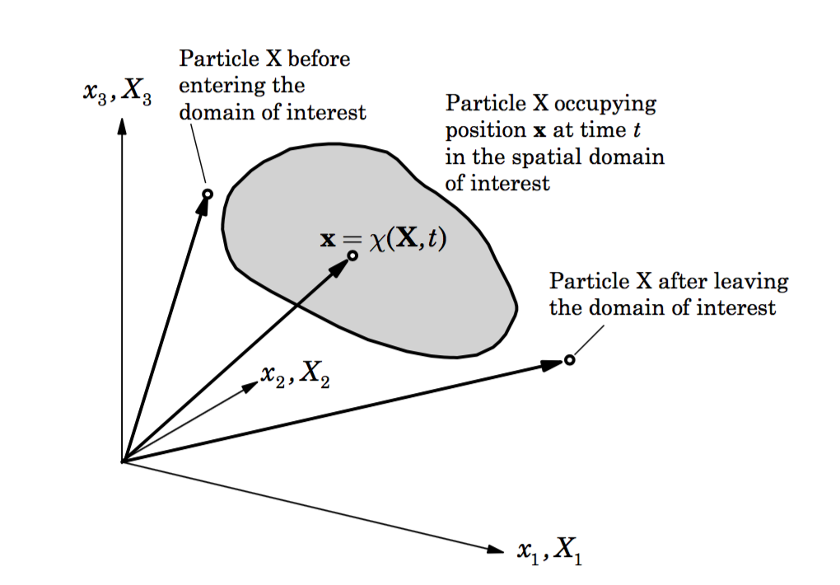
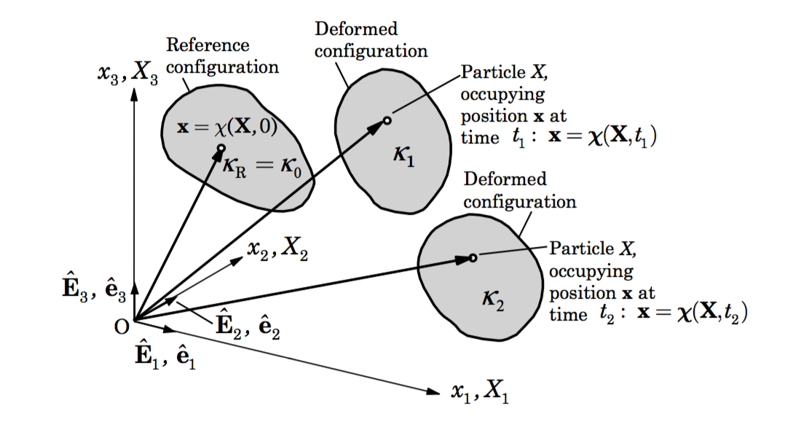
Displacements and deformations
Material and Spatial descriptions
X – undeformed configuration
x – deformed configuration

Slide 3
Displacements and deformations
Displacement field
Lagrangian – GPS, levelling, weather balloons, device moves with the medium
Eulerian – pitot tubes, air temp, OBP, common in fluid mechanics (maybe InSAR)
In typical geophysical studies, displacements are small such that the material and spatial descriptions are nearly identical. But in geodynamics, where we simulate large deformations and changing configurations, this distinction is important.
advection

Slide 4
Deformations, Strains and Rotations
Deformation gradient (for coordinates)
Displacement gradient
What does it mean when F = I?
Strain tensors

Slide 5
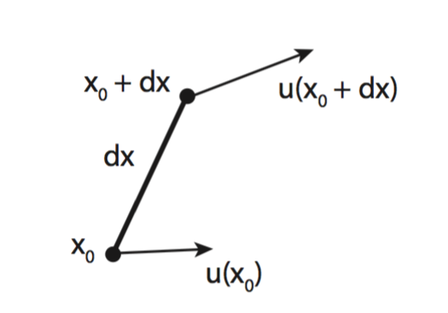
Deformations, Strains and Rotations
Infinitesimal deformation
Displacement field and its gradient
Displacement gradient

Slide 6
Deformations, Strains and Rotations
Infinitesimal Strain tensor
For a 3 component displacement field, write out all components of the strain tensor

Slide 7
Deformations, Strains and Rotations
Rotation tensor (again)
strain tensor (symmetric)
rotation tensor
(skew-symmetric)
For a 3 component displacement field, write out all components of the rotation tensor. Can you represent this as a cross product?

Slide 8

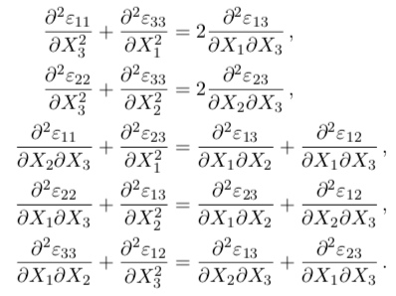
Compatibility conditions
For a 3 component displacement field, we can easily compute its spatial derivatives => strains and rotations. But does it work vice versa?
For 6 independent strain components, there are 9 strain-displacement equations. How to solve?
This guarantees that the strains can be integrated to give u, but it does not guarantee a unique u. Why?

Slide 9
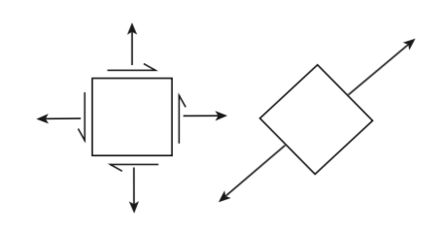
Principal Strains
The strain tensor can be rotated such that all the off-diagonal components vanish and we are left only with diagonal terms – principal strains

Slide 10
Principal Strains
2
2
0.5
Find the rotation angle that makes shear strain 0 and then what are the other components?
What is the maximum shear strain for this system?

Slide 11
Strain invariants

