Slide 1
Vector Calculus
Scalars and vectors
Dot products, cross products and dyadics
Tensors and matrices
Rotations and coordinate transformations

Slide 2
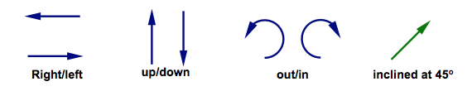
Vectors
In physical space, they have magnitude and direction
Not limited to physical space – you need a basis or coordinate system to describe vectors
Can be orthonormal if?
Are they always orthogonal?

Slide 3
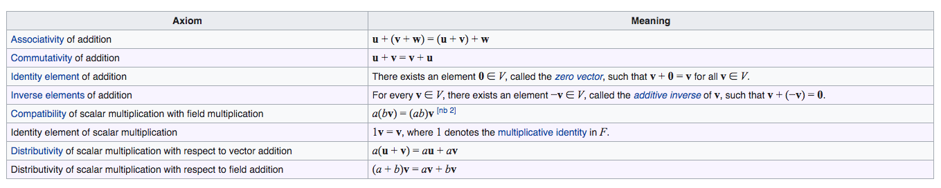
Rules for vectors
Is (finite) rotation a vector?

Slide 4
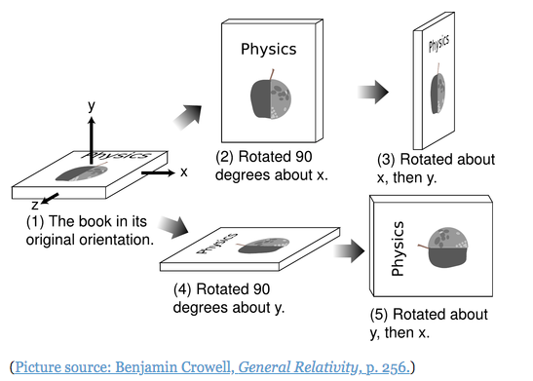
Rules for vectors

Slide 5
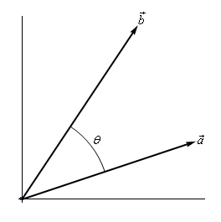
Dot, cross and dyadic products
Dot product – a projection
Tells us if vectors are parallel or at an angle

Slide 6

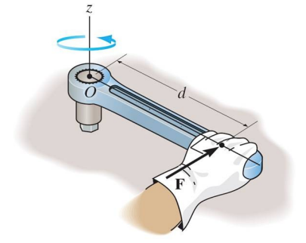
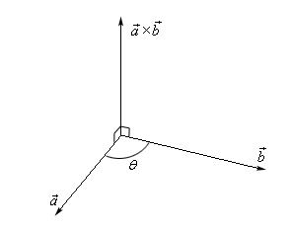
Dot, cross and dyadic products
Cross product – a rotation
Also tells us if vectors are parallel

Slide 7
Dot, cross and dyadic products
Dyadic product – make tensors
Write this out in matrix form

Slide 8
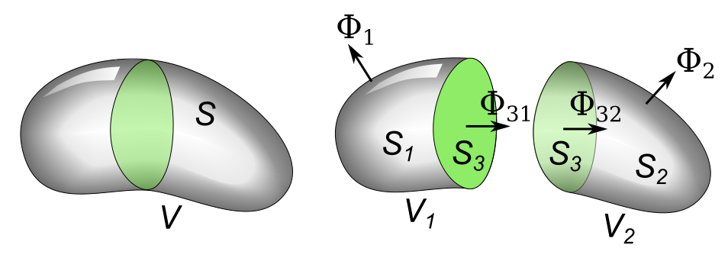
Vector calculus
Chain rule for differentiation
The Del operator – gradients, divergence and curl
Divergence theorem
We will use this in deriving Navier’s equation (solid mechanics)

Slide 9
Vector calculus
Problem sets for differentiation and integration (analytically and numerically)

Slide 10
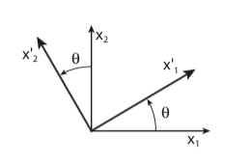
Rotating vectors
Coordinate transformations
Derive the individual components of the rotation matrix using the dot product of the rotated and original coordinate systems
How do we rotate tensors?

Slide 11
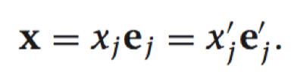
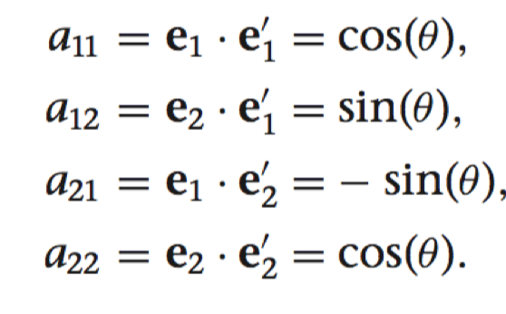
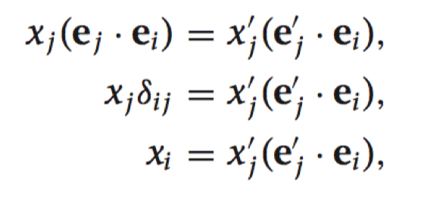
Rotating vectors
Coordinate transformations

Slide 12
Rotating Tensors
Vector rotations
For a tensor transformation from u -> v
Let’s rotate v

Slide 13
Rotating vectors
Coordinate transformations

Slide 14
Assignment
For the provided coastline and velocity vectors, rotate them onto a trench-based coordinate system (angle ~ 40º)
First derive a linear operation that allows you to rotate the given velocity vectors to any coordinate system, and then do it for the India-fixed reference frame given an Euler pole (N – 51.42º, E – 2.10º, rotation rate – 0.5146 º/Myr)
Reading Assignment: Meade and Loveless, (2009), BSSA

