Slide 1
Vector Calculus
Scalars and vectors
Dot products, cross products and dyadics
Tensors and matrices
Rotations and coordinate transformations
Notes:
ILOs
You will use Einstein summation convention to write vectors and tensors
Can calculate dot, cross and dyadic products given 2 vectors or tensors
Rotate vectors and tensors between different coordinate systems

Slide 2
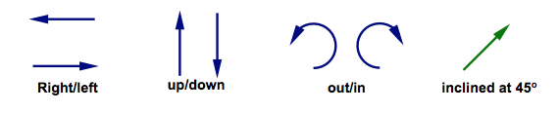
Vectors
In physical space, they have magnitude and direction
Not limited to physical space – you need a basis or coordinate system to describe vectors
Can be orthonormal if?
Are they always orthogonal?
Notes:
Talk about linear independence and orthogonality. Non-orthogonal bases can still act as bases to describe a vector space.
Linear independence if a₁e₁ + a₂e₂ + a₃e₃ + ….. = 0 for non-trivial a_{i}

Slide 3
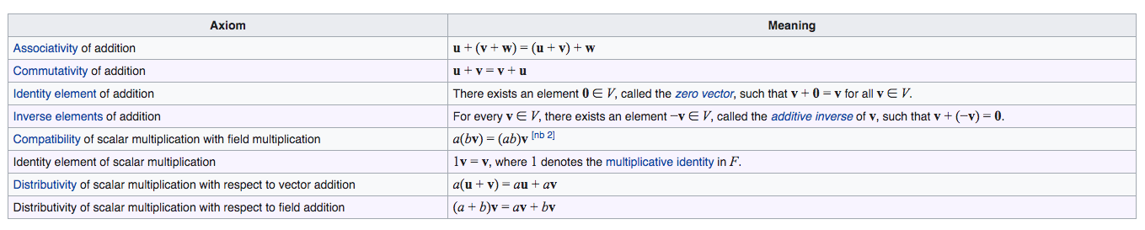
Rules for vectors
Is (finite) rotation a vector?

Slide 4
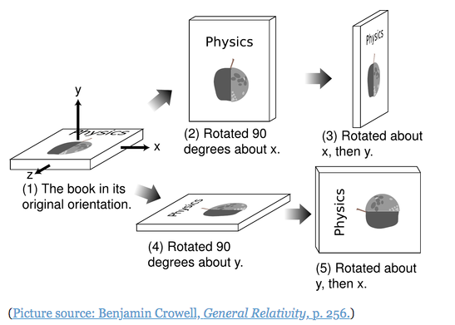
Rules for vectors
Notes:
How to multiply vectors?

Slide 5
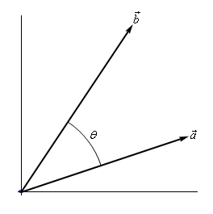
Vector Multiplication
Dot product – a projection
Tells us if vectors are parallel or at an angle

Slide 6

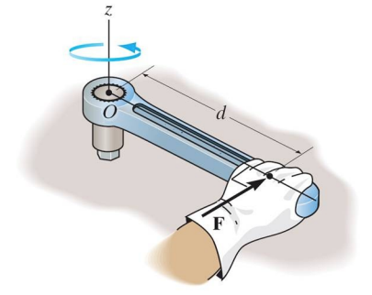
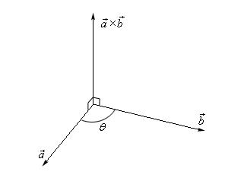
Dot, cross and dyadic products
Cross product – a rotation
Also tells us if vectors are parallel

Slide 7
Dot, cross and dyadic products
Dyadic product – make tensors
Write this out in matrix form

Slide 8
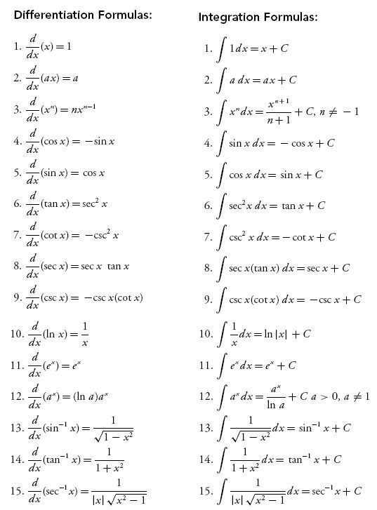
Vector calculus
Chain rule for differentiation

Slide 9
Vector calculus
Problem set for differentiation of a scalar field (analytically and numerically)
Compute the derivative of f(x) = 2x² - 6x + 3 for -5<x<5 and plot f, f’
Compute the derivative of f(x) = (5x – 8)^{0.5} for 2<x<5 and plot f, f’
Compute the derivative of f(x) = (x^{2/3})(1-x²) for -1<x<1 and plot f, f’
The timeseries of a tide gauge reading can be described by the function z(t) = (6t^{1/3})/(4t+1). Determine when sea level is rising, and when is it falling?

Slide 10
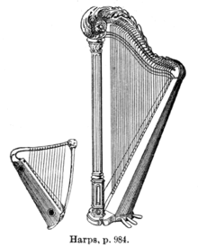
Gradients of vector fields
We look at taking derivatives of scalar fields. Now we will look at how to work with gradients of vector fields.
We do this with the help of the del or nabla operator
In addition to gradients, del can also be used to find out if vector fields are convergent/divergent or rotating/circulating

Slide 11
Gradients of scalar and vector fields
Problem set for differentiation of 2-d fields (numerically)
Compute the partial derivatives of f(x,y) = exp(-(x²+y²)) for -5<x,y<5. Plot f(x,y) in the given domain, and the gradient vector in a grid. Comment on the pattern the gradient makes.
Given a vector field, here it is the horizontal velocities of deforming blocks given as
v_{x}(x,y) = mx/r² + 2ay*cos(a*xy), v_{y}(x,y) = my/r² + 2ax*cos(a*xy), where [0 < r² = x²+y² < 3] and a = 0.7, m = 3
Compute the gradients of each component of this field.
Plot the vector field and the gradient of each component separately.
Notes:
Break up the problem and build it up

Slide 12
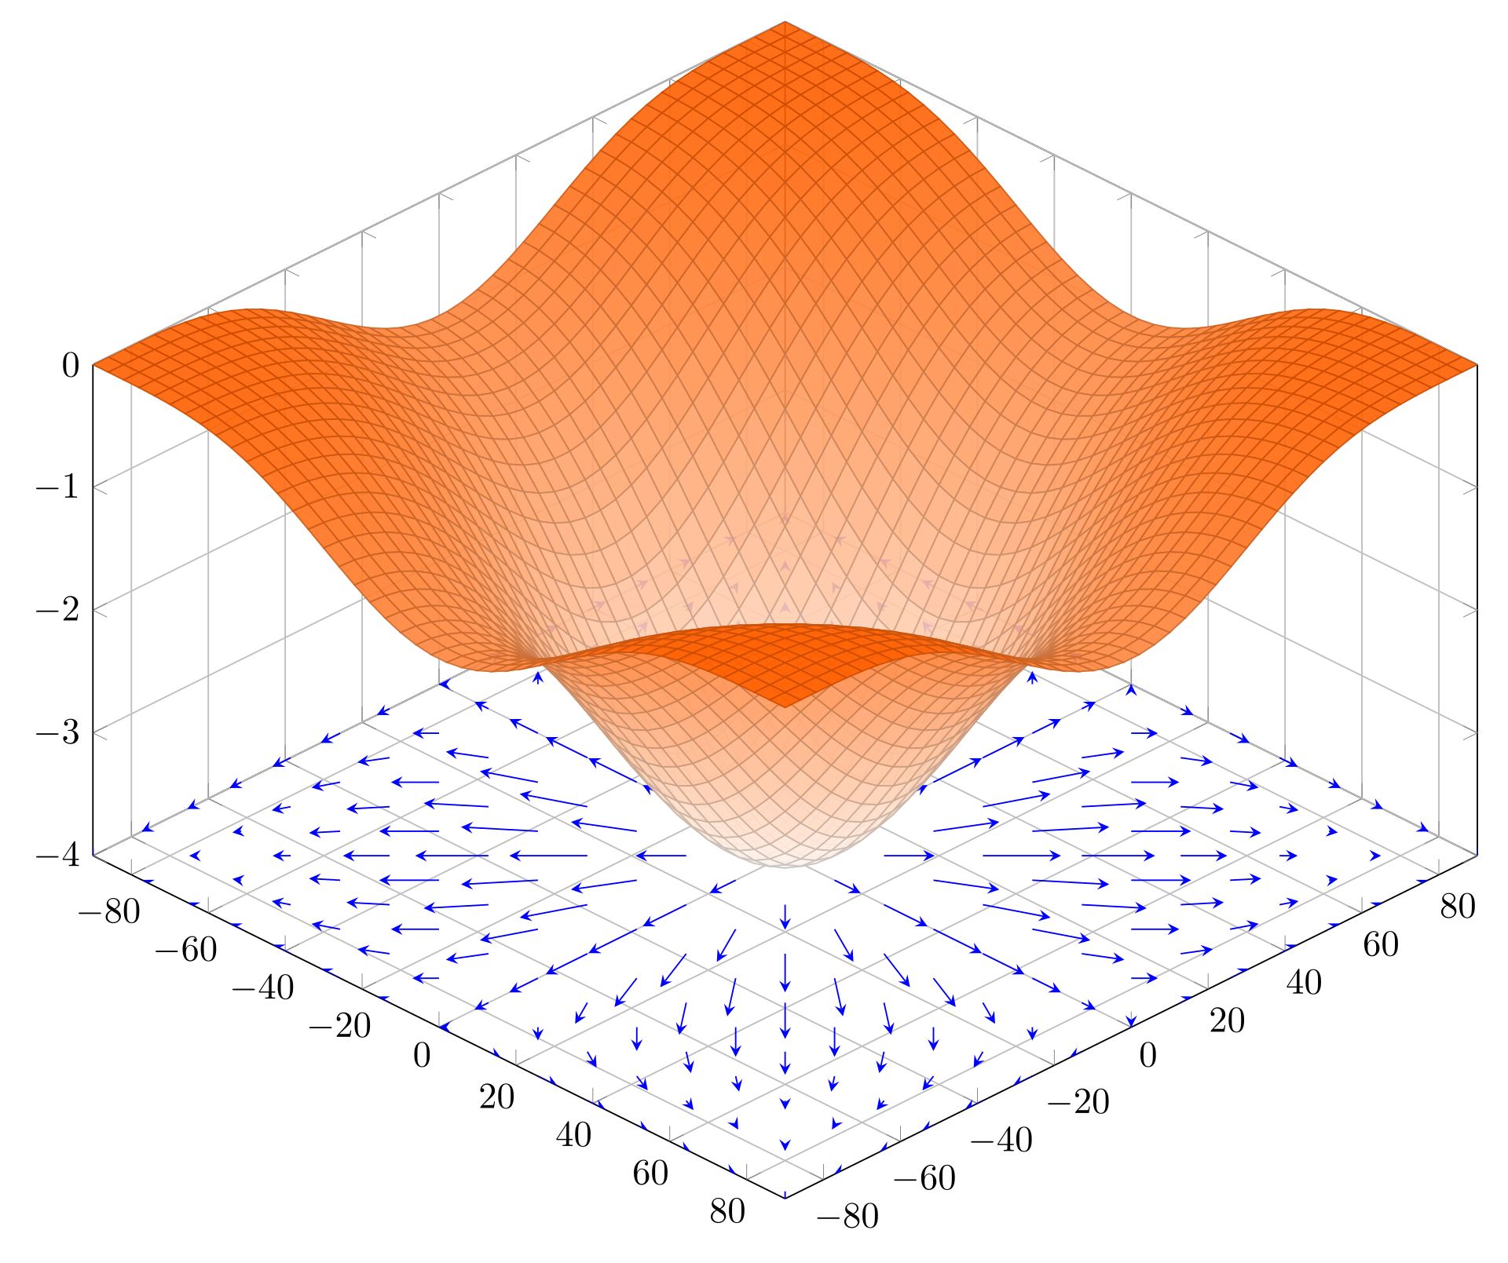
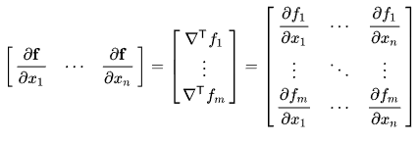
The del (nabla) operator
Gradient (scalar field)
Gradient (vector field)
- An example is the Jacobian or the design matrix in inverse problems
- Also think of strain tensors

Slide 13
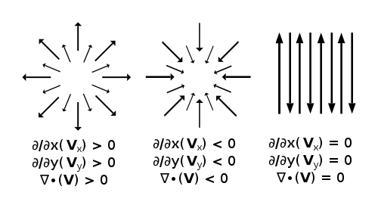
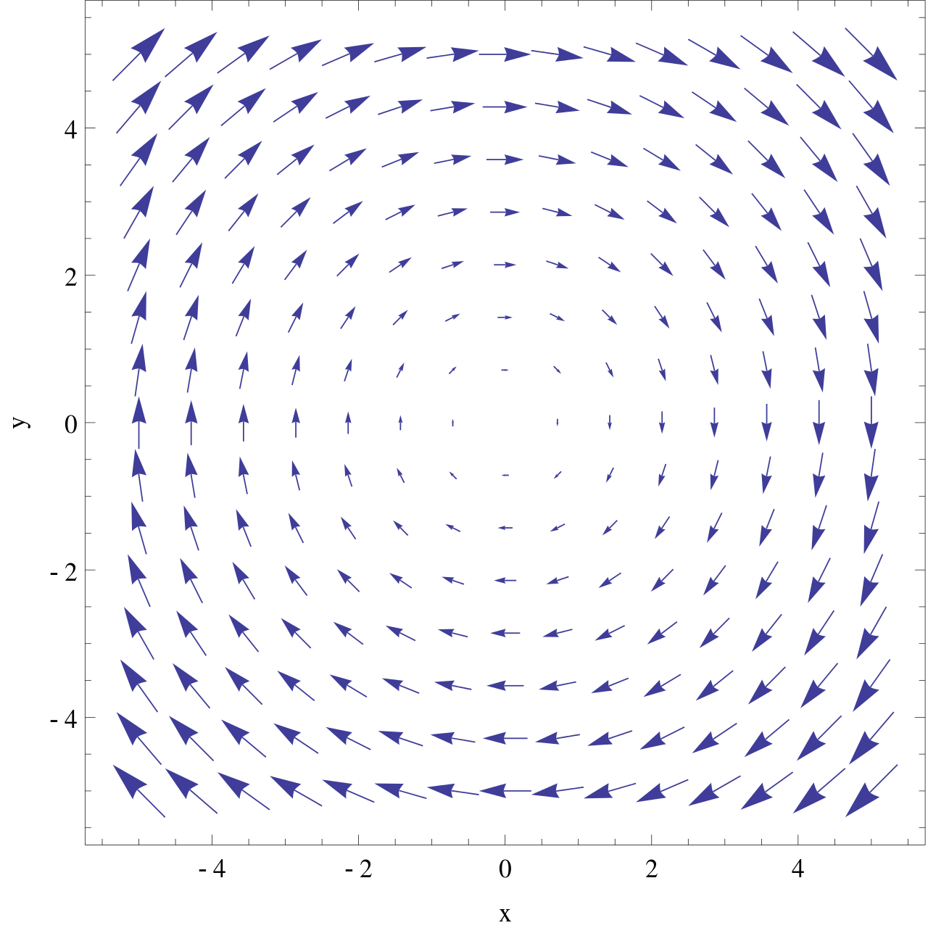
The del (nabla) operator
Divergence
Curl

Slide 14
Vector calculus
Problem set (solve analytically and numerically)
The temperature field at any point in a lake is given by T(x,y,z) = sin(yz) + log(1+x²) for all x,y,z. Plot this scalar field at the lake surface (z=0) and at 1 unit below the surface (z=1).
Compute the gradient of T(x,y,z). Plot this vector field at the lake surface.
At the point (1,1,0) on the lake surface, a boat is moving in the <3,1,0> direction. First calculate the unit vector for the boat’s motion, and then compute the directional directive of the temperature field as seen by the boat. Hint: directional derivatives are projections of the gradient vector along some unit vector.

Slide 15
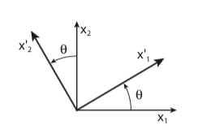
Rotating vectors
Coordinate transformations
Derive the individual components of the rotation matrix using the dot product of the rotated and original coordinate systems
How do we rotate tensors?
Notes:
What do you rotate about?

Slide 16
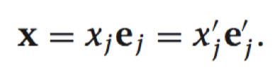
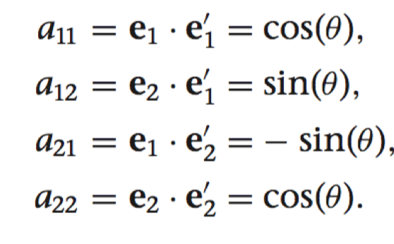
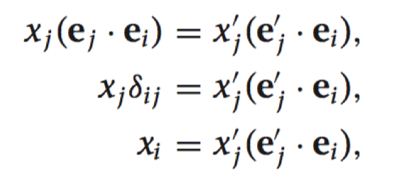
Rotating vectors
Coordinate transformations

Slide 17
Rotating Tensors
Vector rotations
For a tensor transformation from u -> v
Let’s rotate v

Slide 18
Rotating vectors
Coordinate transformations
For a fault with dip = 30º, calculate the unit vector in the dip direction (d) and in the direction normal to the plane (n).
This fault exists in a stress field given by a symmetric stress tensor [s₂₂,s₂₃,s₃₃]. Compute the traction vector on this fault plane. Hint: traction vectors are the projection of the stress tensor onto a given plane. And a plane is uniquely described by the vector normal to it i.e. (n)
Project this computed traction vector onto the dip direction (d) and the fault-normal direction (n). These are the shear-traction and normal-traction respectively. Compare these expressions with the components you would have obtained simply by rotating the stress tensor by the dip angle. Hint: [S’] = [R][S][R’]
Notes:
Break it into a number of steps -

Slide 19
Assignment
For the provided polygons and velocity vectors in a spherical coordinate system, first project them onto a cartesian coordinate system. Plot the original and transformed data.
The data represent the motion of the India-Eurasia collision as seen in the GPS-derived velocity field. Rotate the data and the polygons by 20º to a fault-based coordinate system.
How would you estimate the motion of all the sites relative to an India-fixed coordinate system?

Slide 20





Vector calculus and plate tectonics
z
Motion is a vector quantity
All motion is with respect to an origin
Velocity is the time derivative of the displacement vector
x
y

Slide 21
Reference frames and relative motion
A
B
Blocks move relative to an origin/reference frame
You can decide where that origin is
A
B
A
B

Slide 22
Reference frames and relative motion
Initial
Origin fixed
A fixed
A
A
A
B
B
B

Slide 23

Reference frames and relative motion
10 mm/yr
15 mm/yr
A
B
C
Find

Slide 24
Reference frames and circuit closure
1
2
3
1
2
3

Slide 25
Rotations on a spherical Earth

Slide 28
Assignment
First derive a linear operation that allows you to rotate the given velocity vectors to any coordinate system, for a known euler vector. Hint: rewrite the cross product as a multiplication of a matrix and a vector.
Now use this linear operation to predict the velocity field in the Indian subcontinent given an Euler pole (N – 51.42º, E – 2.10º, rotation rate – 0.5146 º/Myr). Compare the predicted velocities with the observed velocities.
Subtract this predicted velocity field at all sites and visualize the new transformed velocity field. What do you notice?
Repeat steps 2 and 3 by choosing the Eurasian Euler pole.
Reading Assignment:
Kreemer and Holt, (2001), A no-net-rotation model of present-day surface motions, GRL
Murray and Segall, (2001), ﻿Modeling broadscale deformation in northern California and Nevada from plate motions and elastic strain accumulation, GRL
Notes:
Shift assignment part 2 to next week
Introduce rotations on a sphere

Slide 29
