Slide 1
Introduction to Solid Mechanics
Displacements and deformation
Strains and rotations

Slide 2
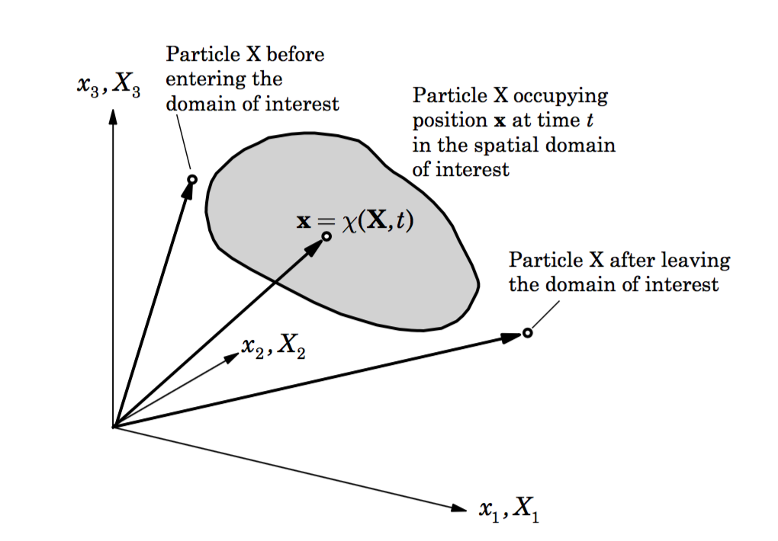
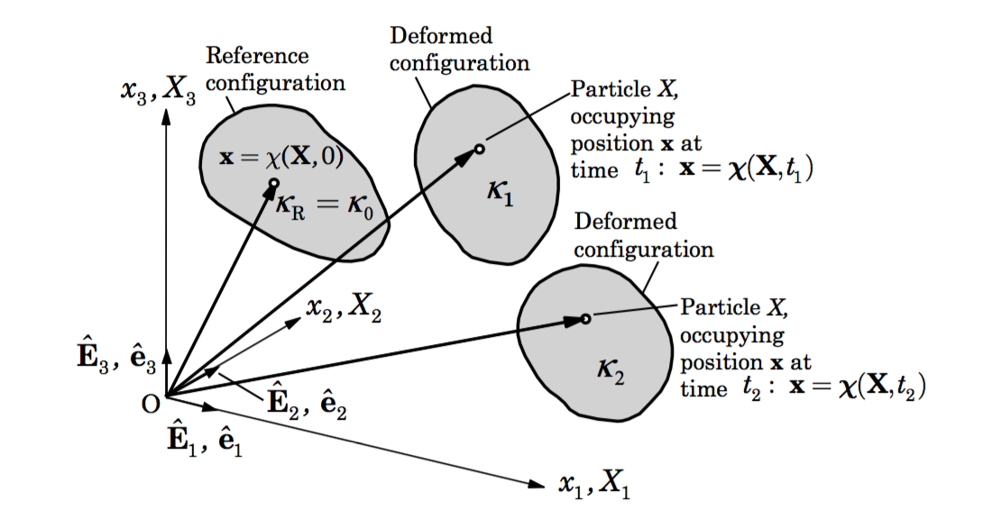
Displacements and deformations
Material and Spatial descriptions
x = χ(X,t)
X = X(x,t) = χ⁻¹(x,t)
X – undeformed configuration
Motion described in terms of X
x – deformed configuration
Motion described in terms of x
Notes:
Big difference is in the material frame we care about the mapping –chi. We need to know where the particle came from since it is tagged. In the spatial frame, we have no idea where things came from, just that it is now there.

Slide 3
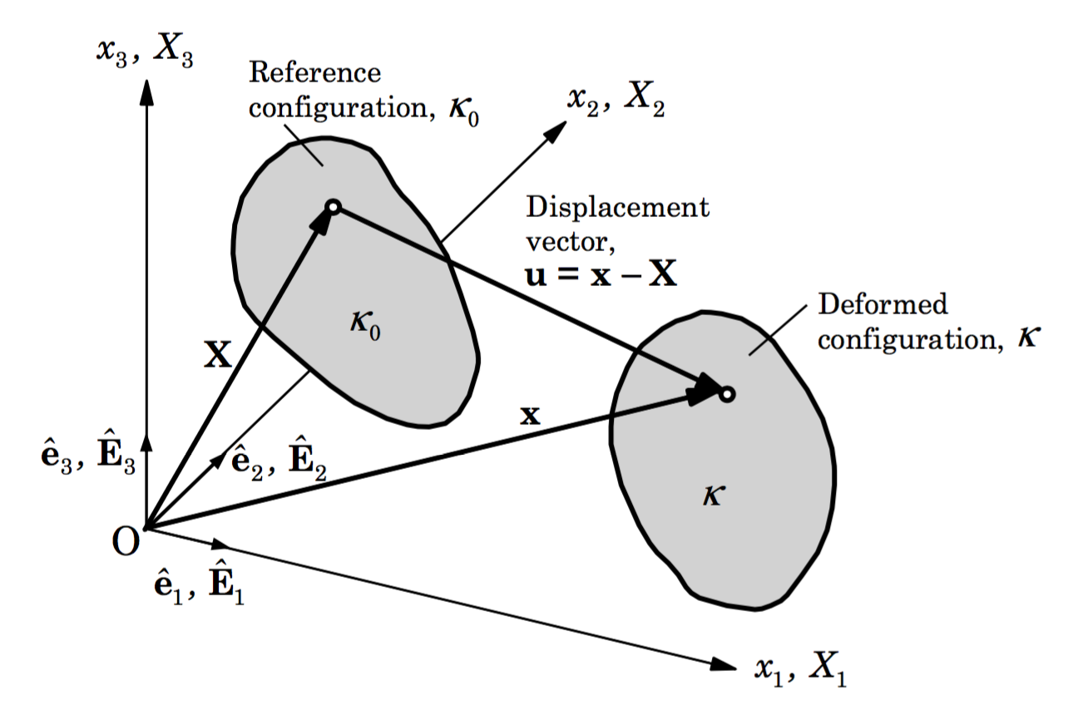
Displacements and deformations
Displacement field
Lagrangian – GPS, levelling, weather balloons, device moves with the medium
Eulerian – pitot tubes, air temp, OBP, common in fluid mechanics (maybe InSAR)
Notes:
Discuss steady fluid flow through a constricting pipe – the time derivative of velocity is 0 (spatially steady field), however the fluid particles itself experience a change in velocity from the open channel to the convergent zone

Slide 4
Displacements and deformations
In typical geophysical studies, displacements are small such that the material and spatial descriptions are nearly identical. But in geodynamics, where we simulate large deformations and changing configurations, this distinction is important.
When we calculate the material derivative of some quantity that is being advected, we get -
advection
Time derivative for a particle
(using spatial description – x, not X)
Notes:
Motivate why they should care about this – landslides, glaciers, any flow problems

Slide 5
Differing derivatives based on coordinate system

Slide 6
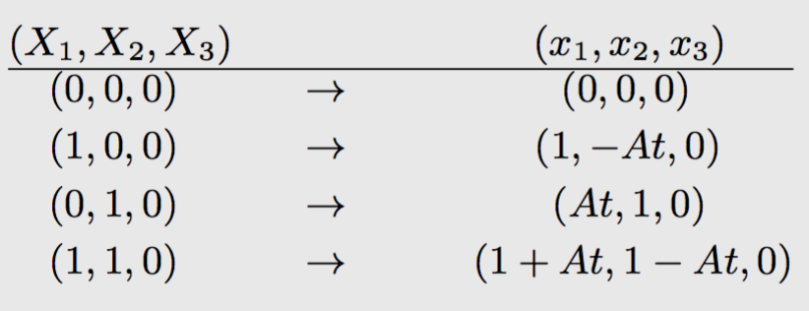
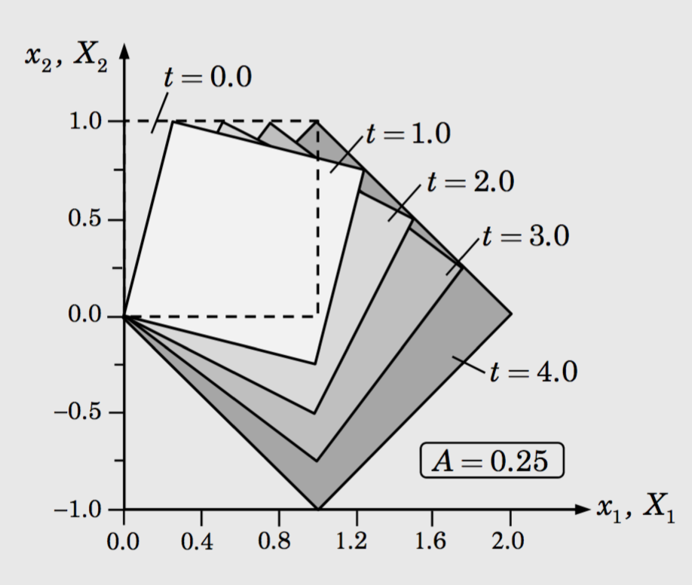
Differing derivatives based on coordinate system

Slide 7
Deformations, Strains and Rotations
Deformation gradient (for coordinates)
Displacement gradient
What does it mean when F = I?

Slide 8
Deformations, Strains and Rotations
Deformation gradient (for coordinates)
Strain tensors

Slide 9
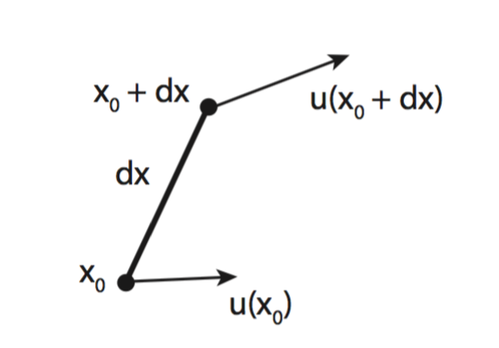
Deformations, Strains and Rotations
Infinitesimal deformation
Displacement field and its gradient
Displacement gradient

Slide 10
Deformations, Strains and Rotations
Infinitesimal Strain tensor
For a 3 component displacement field, write out all components of the strain tensor

Slide 11
Deformations, Strains and Rotations
Rotation tensor (again)
strain tensor (symmetric)
rotation tensor
(skew-symmetric)
For a 3 component displacement field, write out all components of the rotation tensor. Can you represent this as a cross product?

Slide 12
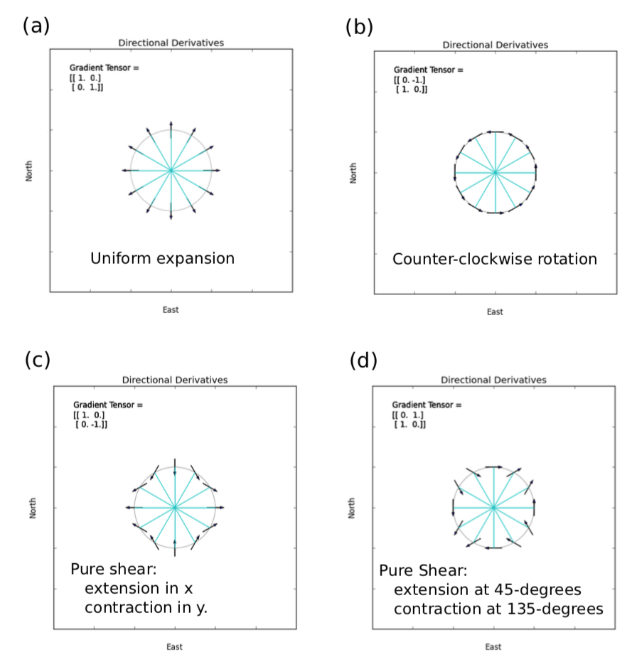
Decomposing the displacement gradient

Slide 13
Compatibility conditions
For a 3 component displacement field, we can easily compute its spatial derivatives => strains and rotations. But does it work vice versa?

Slide 14

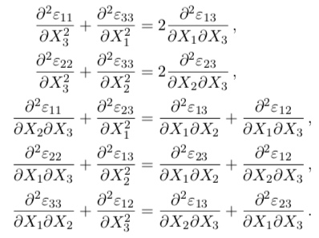
Compatibility conditions
For 6 independent strain components, there are 9 strain-displacement equations. How to solve?
This guarantees that the strains can be integrated to give u, but it does not guarantee a unique u. Why?

Slide 15
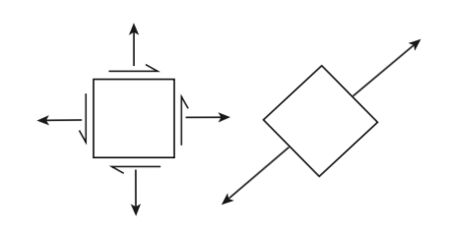
Principal Strains
The strain tensor can be rotated such that all the off-diagonal components vanish and we are left only with diagonal terms – principal strains

Slide 16
Principal Strains
The strain tensor can be rotated such that all the off-diagonal components vanish and we are left only with diagonal terms – principal strains

Slide 17
Principal Strains
The strain tensor can be rotated such that all the off-diagonal components vanish and we are left only with diagonal terms – principal strains

Slide 18
Principal Strains
2
2
Find the rotation angle that makes shear strain 0 and then what are the other components?
What is the maximum shear strain for this system?

Slide 19
Strain invariants

Slide 20
Assignments
Calculate the horizontal strain components from the displacement field from the Palu landslides. Plot the trace of the strain tensor and overlay it with the principal strain axes - interpret this geologically.
Using the potential field given to you, derive the displacement field numerically and compare it to the analytical solution. What does the potential function represent? Compute the strains and rotational components of this displacement field.

