Slide 1
SBA LOAN ANALYSIS
End-to-end analytics using Python, MySQL & Power BI
Capstone Project Presentation
Mallika T
Data preparation • SQL analysis • Interactive dashboards
SBA Loan Analysis • Capstone Project
1/12

Slide 2
Business Problem & Objectives
Why this analysis matters
1
Track approvals
2
Monitor risk
Understand how SBA loan approvals are distributed across years, states and businesses.
Examine loan status and recorded charge-offs to support portfolio monitoring.
3
Measure impact
4
Enable decisions
Explore business characteristics, loan terms and jobs supported.
Convert raw loan records into clear summaries that decision-makers can explore.
Who uses it: the lending and policy team
SBA Loan Analysis • Capstone Project
2/12

Slide 3
Dataset Description
Source, size and what each part means
Item | Detail | What it means
Source | U.S. Small Business Administration loan approval and default data (CSV) data.sba.gov/dataset/7a-504-foia | Official public loan data from a U.S. government agency.
Size | 5,000 rows × 18 columns | 5,000 loans, each described by 18 details.
One row | One loan | One approved loan. No duplicate rows, so no double counting.
Period | Approvals from FY2020 to FY2026 | The fiscal years in which the loans were approved.
Key fields | Approval amount, interest rate, term, state, business type, business age, status, charge-off amount, jobs | The first fields describe the loan and borrower. Status and charge-off show the result.
Charge-offs | 89 records (status CHGOFF) | Loans written off as a loss: 1.78% of all loans.
SBA Loan Analysis • Capstone Project
3/12

Slide 4
Project Workflow
How the data moves through the project
1
SOURCE CSV
2
PYTHON
3
MYSQL
4
POWER BI
5,000 loans × 18 columns
SBA approval and default data
One row = one loan
Load CSV with Pandas
Fix dates and blanks
Summarise results
Store cleaned data
Fact table + 4 dimensions
8 reusable views
Star schema model
DAX measures
3-page dashboard
→
→
→
Goal: preserve data quality, answer business questions, and communicate findings clearly.
SBA Loan Analysis • Capstone Project
4/12

Slide 5
Data Cleaning & Preprocessing
What was checked and what was changed
Check | Before | After
Dataset size | 5,000 × 18 | 5,000 × 18
Missing values (total) | 9,036 | 9,033
BusinessType missing | 1 | 0 (Unknown)
BusinessAge missing | 2 | 0 (Unknown)
PaidInFullDate missing | 4,122 | 4,122 retained
ChargeOffDate missing | 4,911 | 4,911 retained
Duplicate rows | 0 | 0
Date fields parsed using day-month-year format; outcome dates were not artificially filled.
SBA Loan Analysis • Capstone Project
5/12

Slide 6
SQL Analysis & Business Questions
MySQL database: sba_loan_analysis
Aggregation & logic
8 reusable views
GROUP BY, CASE, aggregate functions, NULLIF and subqueries
Status
Year
Processing method
State
Business age
Loan term
Jobs
Interest rate
Joins
JOIN logic to combine state summaries with loan information
Ranking
STATE RANKING BY APPROVALS
RANK() to compare state-level approval totals
California, Texas and Florida
SBA Loan Analysis • Capstone Project
6/12

Slide 7
Data Model: Star Schema
One fact table connected to four dimensions
dim_state
dim_approval_date
FACT TABLE
fact_sba_loan
dim_business
dim_loan_details
5,000 fact rows • 4 active dimension relationships
SBA Loan Analysis • Capstone Project
7/12

Slide 8
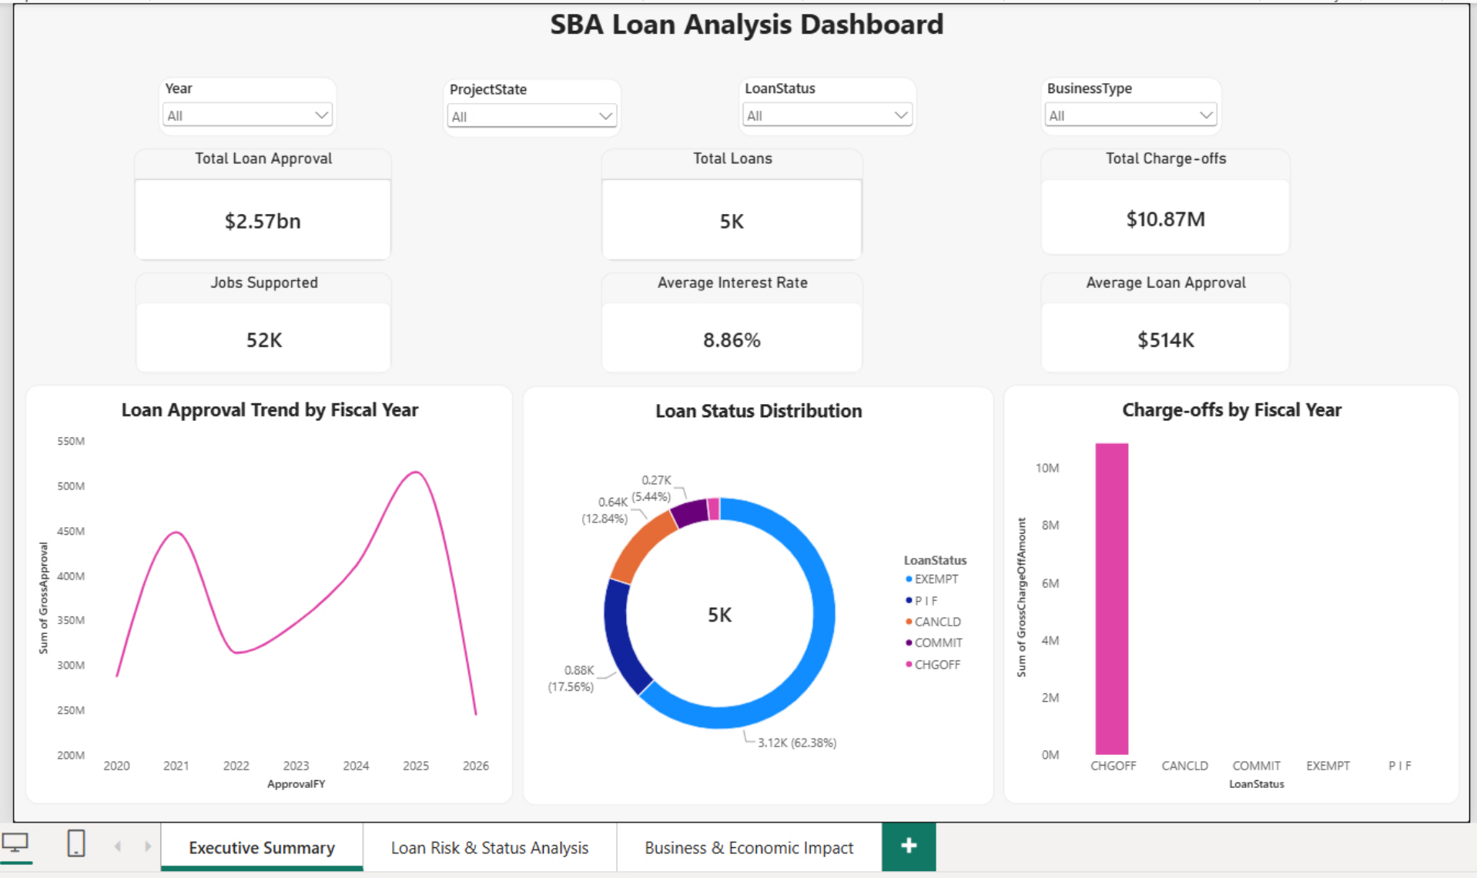
Power BI Dashboard — Executive Summary
Page 1 of 3
Key takeaways
Slicers for year, state, status and business type
Approvals peaked in FY2025
EXEMPT loans are 62% of all loans
SBA Loan Analysis • Capstone Project
8/12

Slide 9
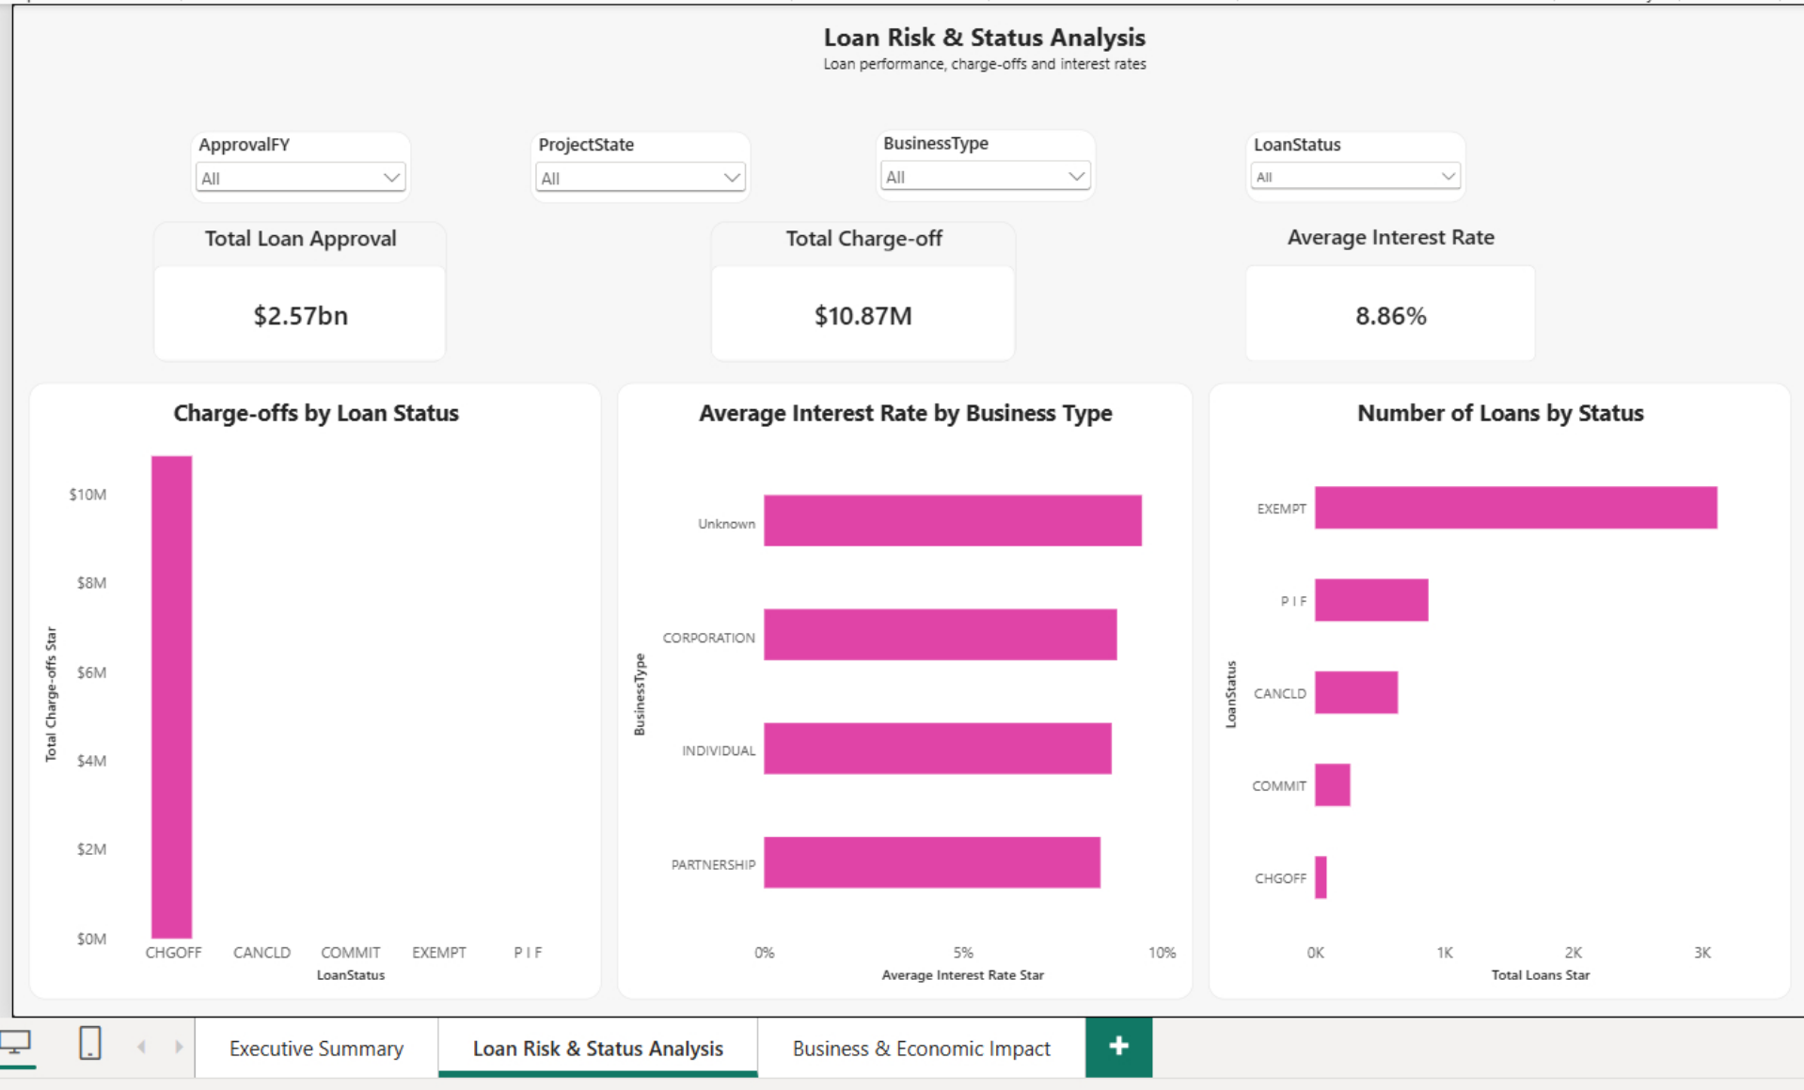
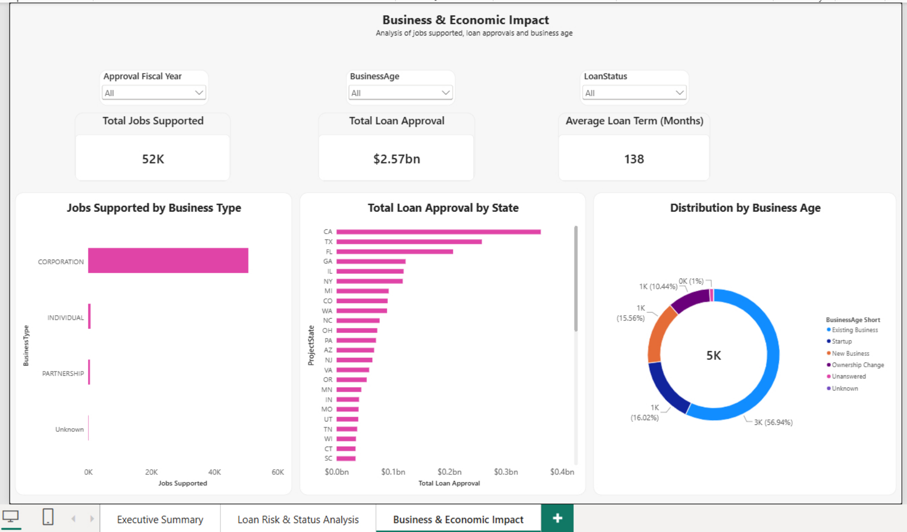
Power BI Dashboard — Analysis Pages
Pages 2 and 3 of the report
PAGE 2 — LOAN RISK & STATUS
PAGE 3 — BUSINESS & ECONOMIC IMPACT
Charge-offs appear only in CHGOFF loans
Interest rates range from about 8% to 9.5%
EXEMPT has the most loans
Corporations support the most jobs
CA, TX and FL lead approvals
57% are existing businesses
SBA Loan Analysis • Capstone Project
9/12

Slide 10
Key Insights
What the analysis shows
TOTAL APPROVAL
TOTAL LOANS
CHARGE-OFFS
JOBS SUPPORTED
$2.57B
5,000
$10.87M
52K
Loans by status (number of records)
EXEMPT is the largest recorded status: 3,119 loans (62.38%).
P I F accounts for 878 loans (17.56%).
CHGOFF appears in 89 records (1.78%); this is a record share, not a dollar rate.
Average approval per loan is about $513,861; median approval is $198,000.
SBA Loan Analysis • Capstone Project
10/12

Slide 11
Recommendations
Actions supported by the analysis
1
Confirm status definitions
Confirm the official data-dictionary definitions for every loan status, especially EXEMPT.
2
Track counts and dollars together
Monitor charge-off counts and dollar amounts together; avoid interpreting record share as loss rate.
3
Check fiscal-year coverage
Use fiscal-year coverage checks before comparing annual totals; identify partial years.
4
Reconcile KPIs with SQL
Reconcile Power BI KPI values with SQL results using the same filters.
5
Keep date fields typed
Keep date fields typed consistently for dependable time-based reporting.
SBA Loan Analysis • Capstone Project
11/12

Slide 12
Learnings & Next Steps
Learnings
Next steps
Connected Python data preparation, MySQL analysis and Power BI reporting.
Learned star schema modelling for BI.
Strengthen data-dictionary validation and expand time-based analysis.
Predict charge-off risk.
Refresh the data every quarter.
GitHub repository: https://github.com/mallika057/SBA-Loan-Analysis
Thank you
SBA Loan Analysis • Capstone Project
12/12

