Slide 1
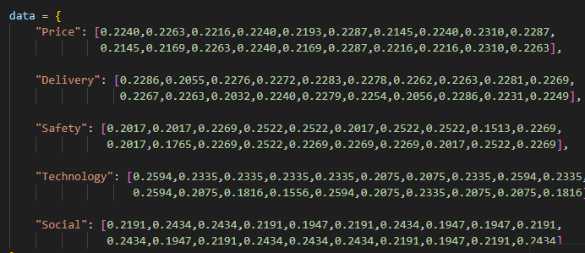
Input Decision Matrix
• 20 logistics providers
• 5 evaluation criteria:
Price,
Delivery
Safety,
Technology
Social
• Values are normalized between 0 and 1
• This table is called the decision matrix in multi‑criteria decision making.

Slide 2
Fuzzy AHP Weight Computation
This code computes the criteria weights using the Fuzzy Analytic Hierarchy Process. A fuzzy pairwise comparison matrix is defined using triangular fuzzy numbers to represent the relative importance between criteria such as price, delivery, safety, technology, and social sustainability. The geometric mean method is then applied to aggregate the comparisons and obtain fuzzy priority values. These values are normalized and defuzzified to produce final crisp weights, which are later used in the TOPSIS model

Slide 3
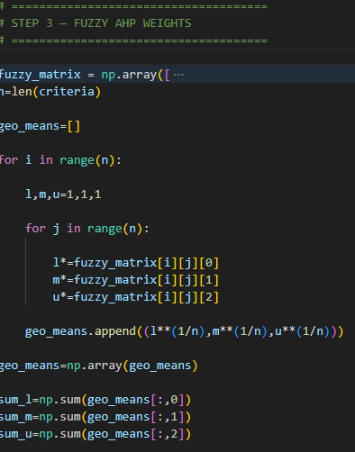
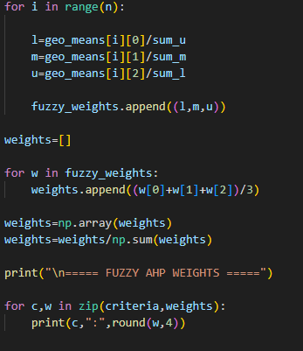
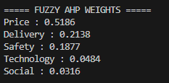

Slide 4

TOPSIS Weighted Matrix
Each criterion value is multiplied by its weight:
v_ij = w_j × x_ij
This creates a weighted decision matrix where more important criteria have greater impact on the final ranking.

Slide 5

Ideal, Anti‑Ideal Solutions and Distance Calculation
Ideal solution = best value for each criterion
Anti‑ideal solution = worst value for each criterion
The best provider should be closest to the ideal solution and farthest from the worst solution.
S+ = distance from ideal solution
S− = distance from worst solution

Slide 6

Closeness Score and Ranking
Formula:
Ci = S− / (S+ + S−)
Higher score means the provider is closer to the ideal solution.
Providers are ranked based on this score.

Slide 7
Fuzzy Inference System
Criteria are converted into linguistic values (Low, Medium, High)
Fuzzy rules simulate expert reasoning
Example rule:
IF price is low AND delivery is high AND safety is high THEN score is good.

Slide 8
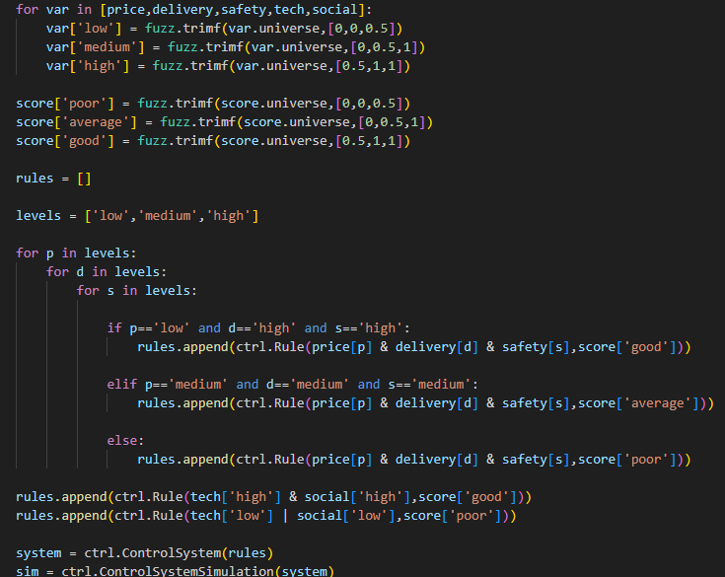

Slide 9
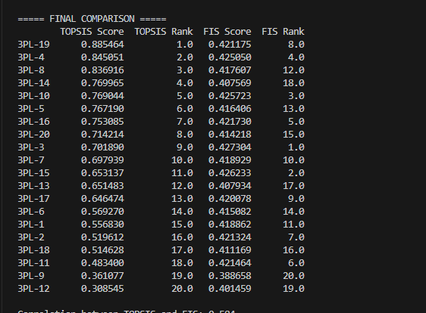
Model Comparison
This table compares:
• TOPSIS score and rank
• FIS score and rank
It helps determine whether mathematical ranking and fuzzy reasoning produce similar results.

Slide 10
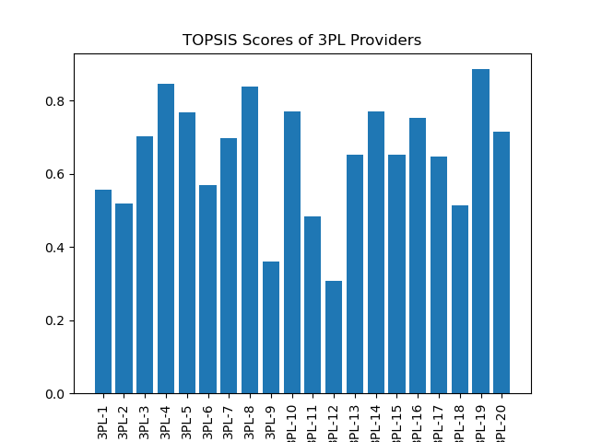
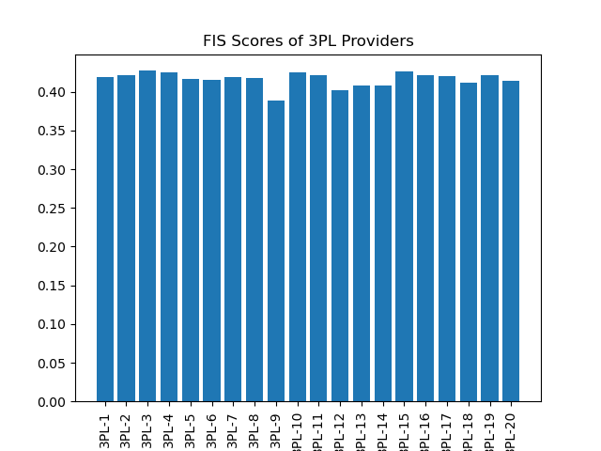
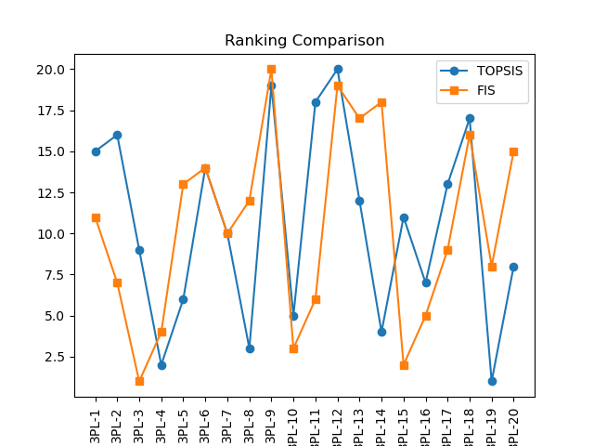

Slide 11
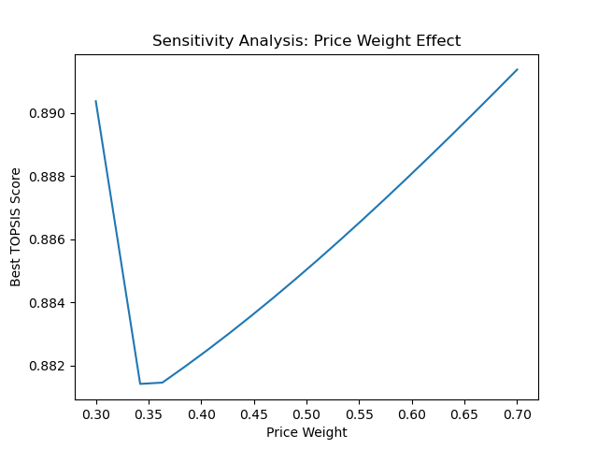
Sensitivity Analysis
Price weight is varied between 0.3 and 0.7.
TOPSIS ranking is recalculated each time.
This checks whether the decision changes when criterion importance changes.

Slide 12
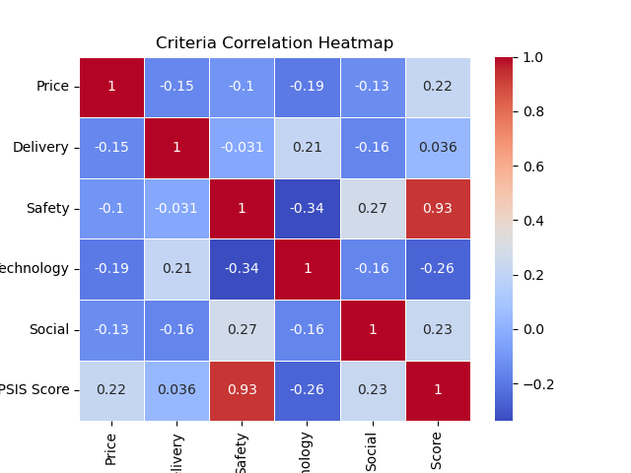
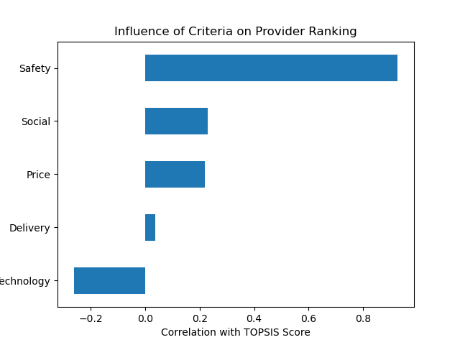
Correlation and Criteria Influence
Correlation heatmap shows relationships between criteria and TOPSIS score.
The importance graph highlights which criteria influence rankings most.

Slide 13
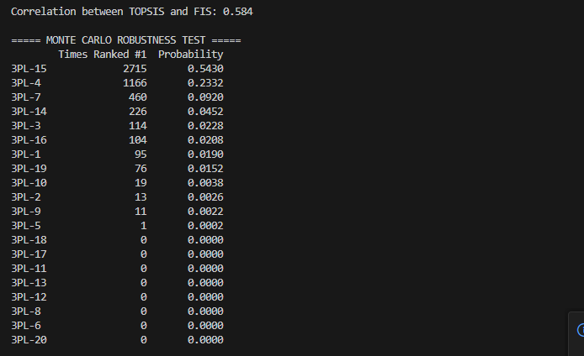
Monte Carlo Robustness Test
• 5000 simulations are run
• Random weights are
generated each time
• TOPSIS ranking is
recalculated
The provider that appears most often as rank #1 is considered the most robust choice.

Slide 14
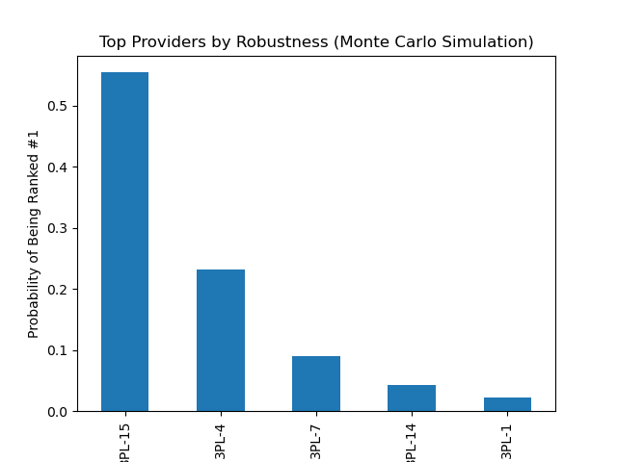

Slide 15
Final Insights
• TOPSIS identifies the mathematically optimal provider
• Fuzzy system models human expert reasoning
• Sensitivity analysis checks stability
• Monte Carlo simulation identifies robust providers
Together these methods create a comprehensive decision support system.

