Slide 1


VISVESVARAYA TECHNOLOGICAL UNIVERSITY BELAGAVI, KARNATAKA-590 018
GOVERNMENT S.K.S.J.INSTITUTE
OF TECHNOLOGY BENGALURU
DEPARTMENT OF ELECTRONICS AND COMMUNICATION
PROJECT SEMINAR ON
“Impulse Noise Removal from MR Images for Radiosurgery Applications"
Under the guidance of
Dr. Rangaraju H G
Project Submitted by
BUVAN B S (1SK17EC004)
DEVIKA U (1SK17EC007)
MALLIKARJUN GOKAK (1SK17EC022)
UME ATHIBA (1SK17EC044)

Slide 2
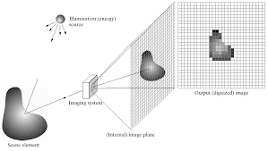
INTRODUCTION
INTRODUCTION
OBJECTIVES
DOMAIN CONCEPT :
Image processing is a method to perform some operations on an image, in order to get an enhanced image or to extract some useful information from it.
A digital image is a representation of a two dimensional image as a finite set of digital values, called picture elements or pixels.
LITERATURE SURVEY
BLOCK DIAGRAM
METHODOLOGY
SOFTWARE REQUIREMENTS
RESULTS AND DISCUSSION
APPLICATIONS
REFERENCE
Fig.1. : Image formation model

Slide 3
INTRODUCTION
OBJECTIVES
Medical images are affected by different types of noise such as Gaussian, Impulse, Speckle and Poisson noises.
Noises can be produced from different types of medical image instruments such as MR, CT, X-ray, ultrasound, etc.
Therefore, Image De-noising techniques are necessary to prevent this type of corruption from digital images especially medical images.
The important property of a good image de-noising model is that it should completely remove noise as far as possible as well as preserve edges.
LITERATURE SURVEY
BLOCK DIAGRAM
METHODOLOGY
SOFTWARE REQUIREMENTS
RESULTS AND DISCUSSION
APPLICATIONS
REFERENCE

Slide 4
INTRODUCTION
OBJECTIVES
IMPULSE NOISE :
it is called as data drop noise.
Impulse Noise can divided into two types - Fixed Valued Impulse Noise and Random Valued Impulse noise.
Fixed valued Impulse noise :
Fixed valued Impulse noise can also be named as salt and pepper noise.
For 8-bit gray scale noisy image, typical value 255 assign for salt noise and 0 assign for pepper noise.
Either 0 or 255.
LITERATURE SURVEY
BLOCK DIAGRAM
METHODOLOGY
SOFTWARE REQUIREMENTS
RESULTS AND DISCUSSION
APPLICATIONS
REFERENCE

Slide 5


INTRODUCTION
OBJECTIVES
LITERATURE SURVEY
(a) Original Image
(b) Image after addition of salt and pepper noise
BLOCK DIAGRAM
METHODOLOGY
120 | 138 | 176
211 | 204 | 212
81 | 65 | 98
120 | 138 | 176
0 | 204 | 212
81 | 65 | 98
SOFTWARE REQUIREMENTS
RESULTS AND DISCUSSION
(c) Pixels before corruption
(d) Pixels after corruption
APPLICATIONS
Fig.2. : Example of an image containing salt and pepper noise
REFERENCE

Slide 6

INTRODUCTION
OBJECTIVES
Random Valued Impulse Noise:
For gray scale images, a pixel may get noisy with a probability of 𝑝, where a value in the range of 0 to (𝐿 − 1) randomly replaces the original pixel.
Range 0-255.
LITERATURE SURVEY
BLOCK DIAGRAM
METHODOLOGY
SOFTWARE REQUIREMENTS
RESULTS AND DISCUSSION
APPLICATIONS
REFERENCE

Slide 7
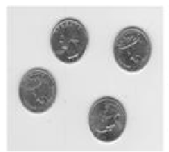
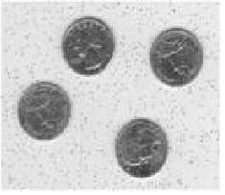
INTRODUCTION
OBJECTIVES
LITERATURE SURVEY
BLOCK DIAGRAM
Original Image
(b) Image after addition of impulse noise
METHODOLOGY
120 | 138 | 176
211 | 204 | 212
81 | 65 | 98
120 | 138 | 176
211 | 204 | 212
121 | 65 | 98
SOFTWARE REQUIREMENTS
RESULTS AND DISCUSSION
(c) Pixels before corruption
(d) Pixels after corruption
APPLICATIONS
Fig.3. : Example of an image containing random valued impulse noise
REFERENCE

Slide 8
INTRODUCTION
OBJECTIVES
OBJECTIVES
To remove Random valued Impulse Noise from MRI Images.
To calculate SSIM(Structural Similarity Index) and PSNR(Peak Signal to Noise Ratio) values for different noise densities ranging from 5% to 40% to assess the quality of restored images.
To achieve the better accuracy in restoring images compare to the available literature.
LITERATURE SURVEY
BLOCK DIAGRAM
METHODOLOGY
SOFTWARE REQUIREMENTS
RESULTS AND DISCUSSION
APPLICATIONS
REFERENCE

Slide 9
INTRODUCTION
LITERATURE SURVEY
OBJECTIVES
Author | Title | Algorithm/Concept
M. Mafi, H. Martin and M. Adjouadi | High Impulse Noise Intensity Removal In MRI Images, 2017. | Combines the strengths of the median filter and mean filters
M. Nadeem, Ayyaz Hussain, Asim Munir, M. Habib and M. Tahir Naseem | Removal of Random Valued Impulse Noise from Grayscale images using Quadrant based Spatially Adaptive Fuzzy Filter, Signal Processing, 2019. | An adaptive switching mechanism that detects the noisy pixels in the degraded image and restores those pixels by using a fuzzy rule-based directional median operation leaving noiseless pixels unaltered.
Vikas Gupta, Vijayshri Chaurasia and Madhu Shandilya | Random-valued impulse noise removal using adaptive dual threshold median ﬁlter, 2014. | Median filter with adaptive dual threshold.
T. Matsubara, V.G. Moshnyaga, K. Hashimoto. | A FPGA implementation of low-complexity noise removal, 2010. | This paper proposes a noise detector which uses dynamically defined thresholds (T_{low} and T_{high}) to identify corrupted pixels which sets the binary flag ‘S’. Median filter is activated only if the binary flag is ‘1’.
LITERATURE SURVEY
BLOCK DIAGRAM
METHODOLOGY
SOFTWARE REQUIREMENTS
RESULTS AND DISCUSSION
APPLICATIONS
REFERENCE

Slide 10
INTRODUCTION
OBJECTIVES
Author | Title | Algorithm/Concept
C. Lien, C. Huang, P. Chen and Y. Lin | An Efficient De-noising Architecture for Removal of Impulse Noise in Images, 2013. | A decision-tree-based impulse detector and an edge-preserving image filter.
Setu Garg, Ritu Vijay, Shabana Urooj, | Statistical Approach to Compare Image De-noising Techniques in Medical Images and MR Images, 2019. | Image de-noising techniques in medical images are compared using statistical parameters such as Peak signal to Noise Ratio (PSNR) and Root mean square error (RMSE).
LITERATURE SURVEY
BLOCK DIAGRAM
METHODOLOGY
SOFTWARE REQUIREMENTS
RESULTS AND DISCUSSION
APPLICATIONS
REFERENCE

Slide 11
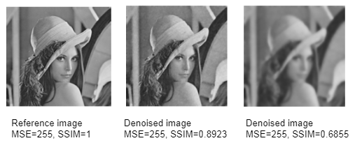
INTRODUCTION
Structural Similarity Index(SSIM):
OBJECTIVES
SSIM is a recently proposed image fidelity measure which has proved highly effective in measuring the fidelity of signals. An image quality metric that assesses the visual impact of three characteristics of an image: luminance, contrast and structure.
LITERATURE SURVEY
BLOCK DIAGRAM
METHODOLOGY
SOFTWARE REQUIREMENTS
RESULTS AND DISCUSSION
APPLICATIONS
Fig. 5 Denoised images showing values MSE values and SSIM index values
REFERENCE

Slide 12
INTRODUCTION
BLOCK DIAGRAM
OBJECTIVES
Import MR Image
LITERATURE SURVEY
Insert Impulse noise with a particular noise intensity
BLOCK DIAGRAM
METHODOLOGY
Calculate PSNR and SSIM
SOFTWARE REQUIREMENTS
Remove Impulse Noise with the proposed algorithm
RESULTS AND DISCUSSION
APPLICATIONS
Visualize the output image and calculate PSNR and SSIM
after noise removal
REFERENCE

Slide 13


INTRODUCTION
Peak signal noise ratio (PSNR)
PSNR is ratio of signal power to noise power. High value of PSNR indicates better filtering of the image.
OBJECTIVES
LITERATURE SURVEY
BLOCK DIAGRAM
METHODOLOGY
Structural Similarity Index (SSIM)
SSIM is an image quality metric that assesses the visual impact of three characteristics of an image: luminance, contrast and structure.
SOFTWARE REQUIREMENTS
RESULTS AND DISCUSSION
APPLICATIONS
REFERENCE

Slide 14
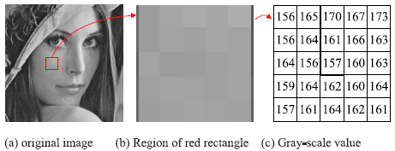
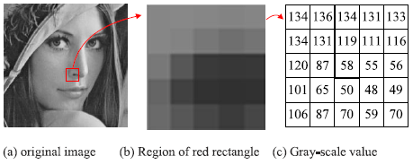
INTRODUCTION
OBJECTIVES
Smooth and Non-Smooth region of an Image:
LITERATURE SURVEY
BLOCK DIAGRAM
METHODOLOGY
SOFTWARE REQUIREMENTS
Fig. 8. A smooth region in Lena.
Fig. 9. A non-smooth region in Lena.
The pixel values in a smooth region should be close or locally slightly varying.
If there are noisy values, edges, or blocks in this region, the distribution of the pixel
values is different.
RESULTS AND DISCUSSION
APPLICATIONS
REFERENCE

Slide 15
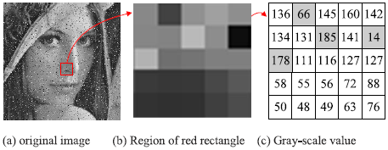
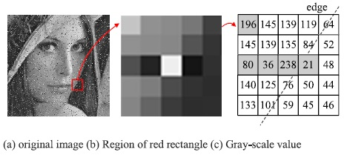
INTRODUCTION
Differentiating regions in a noisy Image:
OBJECTIVES
LITERATURE SURVEY
BLOCK DIAGRAM
METHODOLOGY
Fig. 10. The difference between noisy and neighboring pixels in Lena.
Fig. 11. The edge region in Lena.
SOFTWARE REQUIREMENTS
The pixel values in a smooth region should be close or locally slightly varying.
To conclude that a pixel is noisy or situated on an edge is difficult.
RESULTS AND DISCUSSION
APPLICATIONS
REFERENCE

Slide 16
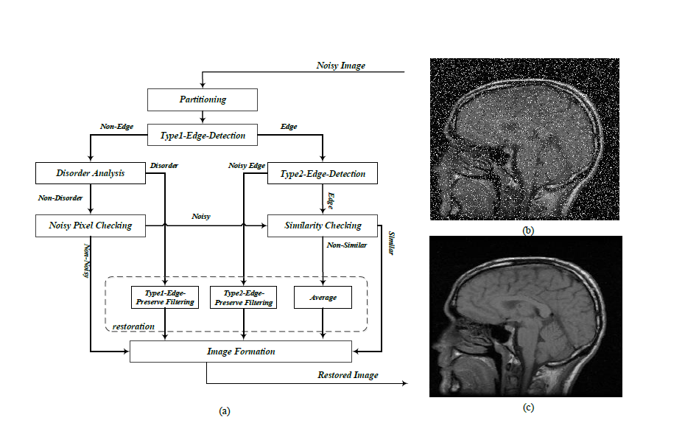
INTRODUCTION
METHODOLOGY
OBJECTIVES
LITERATURE SURVEY
BLOCK DIAGRAM
METHODOLOGY
SOFTWARE REQUIREMENTS
RESULTS AND DISCUSSION
APPLICATIONS
Fig.3. : (a) General structure of the proposed algorithm, (b) a sample noisy image, (c) the de-noised image.
REFERENCE

Slide 17
INTRODUCTION
Partitioning:
The input image is partitioned into 3×3 block are called 𝑃₁, 𝑃₂, …,P₉, where 𝑃₅ is the central pixel.
5×5 blocks the pixels are called as 𝑃₁, 𝑃₂, …, 𝑃₂₅, where 𝑃₁₃ is the central pixel.
The sorted pixel values are called 𝐹₁, 𝐹₂, …, 𝐹₉. Partitioning of pixels in different size blocks can be useful for the next processing stages.
Edge Detection:
Type1-Edge-detection:
Type2-Edge-detection:
OBJECTIVES
LITERATURE SURVEY
BLOCK DIAGRAM
METHODOLOGY
SOFTWARE REQUIREMENTS
RESULTS AND DISCUSSION
Fig. 4 Pixel numbers and edge directions in
Type2-Edge-Detectionwindow
APPLICATIONS
The minimum value, in all four directions, 𝐷𝑚𝑖𝑛 = (𝐷𝑖|𝑖=1,…,4), shows the most probable edge direction, if 𝐷_{𝑚𝑖𝑛}>𝑇₂, it would be labeled as a noisy edge pixel.
REFERENCE

Slide 18
INTRODUCTION
3. Disorder Analysis:
4. Noisy Pixel Checking:
5. Similarity Checking:
It is done when Type2-Edge-Detection and Noisy-Pixel-Checking have true conditions.
Absolute differences between the central pixel (P₅) and its eight neighbors (P₁, P₂, P₃, P₄, P₆, P₇, P₈) i.e, |P₅-P₁|, |P₅-P₂|,… |P₅-P₈| are calculated to determine the similarity amount. Using threshold 𝑇₄, these absolute differences determine similarity or non-similarity among these 8 pairs.
If the number of the similar pixel around a pixel becomes less than a threshold (𝑇₅), then it is considered to be a noisy pixel.
OBJECTIVES
LITERATURE SURVEY
BLOCK DIAGRAM
METHODOLOGY
SOFTWARE REQUIREMENTS
RESULTS AND DISCUSSION
APPLICATIONS
REFERENCE

Slide 19
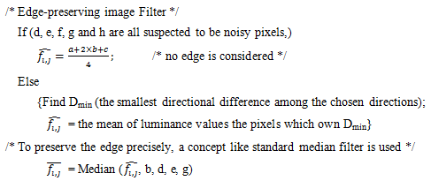
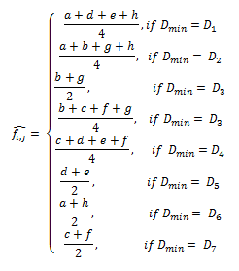
INTRODUCTION
6. Restoration:
Averaging: P₅ = (F₄ + F₅ + F₆) / 3
In the Type1-Edge-Preserve Filtering step, the noisy pixels are restored using the direction of the edge.
OBJECTIVES
LITERATURE SURVEY
BLOCK DIAGRAM
METHODOLOGY
SOFTWARE REQUIREMENTS
Fig. 5(b). Pseudocode of type-1 edge-preserving image filter
D₁ = |d-h|+|a-e|
D₂ = |a-g|+|b-h|
D₃ = |b-g| × 2
D₄ = |b-f|+|c-g|
D₅ = |c-d|+|e-f|
D₆ = |d-e| × 2
D₇ = |a-h| × 2
D₈ = |c-f| × 2
Fig. 5(a). Dataflow of edge-preserving
image filter
RESULTS AND DISCUSSION
APPLICATIONS
REFERENCE

Slide 20
INTRODUCTION
Noisy pixels which are detected in edge areas are restored with Type2-Edge-Preserve Filtering.
In a 5×5 block, four main directions including horizontal, vertical, diagonal, and anti-diagonal, are considered. All pixels corresponding to each direction are considered.
Sum of absolute differences between each pixel and their corresponding average is calculated.
In this step central pixel isn’t considered in final results because this pixel is a noisy pixel.
Next to determine the possible direction of the edge, the minimum value in four directions is computed. Finally restoring is performed by taking a median operation on directions which is determined in the previous step.
7. Image Formation:
Noise-free pixels detected in the previous steps as well as restored pixels are placed back in order to form the noise-free image.
OBJECTIVES
LITERATURE SURVEY
BLOCK DIAGRAM
METHODOLOGY
SOFTWARE REQUIREMENTS
RESULTS AND DISCUSSION
APPLICATIONS
REFERENCE

Slide 21
INTRODUCTION
SOFTWARE REQUIREMENTS:
OBJECTIVES
MATLAB R2015a is used for image acquisition, noise removal and displaying the output.
LITERATURE SURVEY
Functions Used:
BLOCK DIAGRAM
imread(filename) : reads the image from the file specified by filename.
imshow(I) : displays the grayscale image I in a figure.
METHODOLOGY
SOFTWARE REQUIREMENTS
User Defined Functions:
addRVIN: To add random valued impulse noise to the MR Image.
RESULTS AND DISCUSSION
APPLICATIONS
REFERENCE

Slide 22
INTRODUCTION
RESULTS AND DISCUSSION:
OBJECTIVES
MATLAB Code Analysis:
MATLAB code is written for removing Random valued impulse noise (RVIN) using the proposed algorithm.
Input MRI images can be of any size. We have used MR images of size 256x256 for demonstration.
LITERATURE SURVEY
BLOCK DIAGRAM
METHODOLOGY
SOFTWARE REQUIREMENTS
RESULTS AND DISCUSSION
Fig. 6. Output for noise density, ND = 15%
APPLICATIONS
Input:
MR image from the system.
Noise density of RVIN.
Output:
De-noised MR image.
PSNR and SSIM values before the removal of noise.
PSNR and SSIM values after the removal of noise.
SSIM map of MR image before and after the removal of noise.
REFERENCE

Slide 23
INTRODUCTION
OBJECTIVES
LITERATURE SURVEY
Table.1. PSNR and SSIM values for different noise densities:
Noise Density | PSNR | SSIM
5% | 34.4652 | 0.98679
10% | 33.1445 | 0.97773
15% | 32.2243 | 0.96635
20% | 30.7072 | 0.95098
30% | 27.9889 | 0.88391
40% | 25.2303 | 0.76120
BLOCK DIAGRAM
METHODOLOGY
SOFTWARE REQUIREMENTS
RESULTS AND DISCUSSION
APPLICATIONS
REFERENCE

Slide 24
INTRODUCTION
Simulation results:
OBJECTIVES
LITERATURE SURVEY
BLOCK DIAGRAM
METHODOLOGY
SOFTWARE REQUIREMENTS
Fig. 7. Four sample original images and their noisy versions. Peak signal‐to‐noise ratio (dB) values mentioned for noisy images.
RESULTS AND DISCUSSION
APPLICATIONS
REFERENCE
Fig.8. De-noising of images of Fig. 7. using the proposed method. Peak signal‐to‐noise ratio (dB) values are indicated for denoised images.

Slide 25
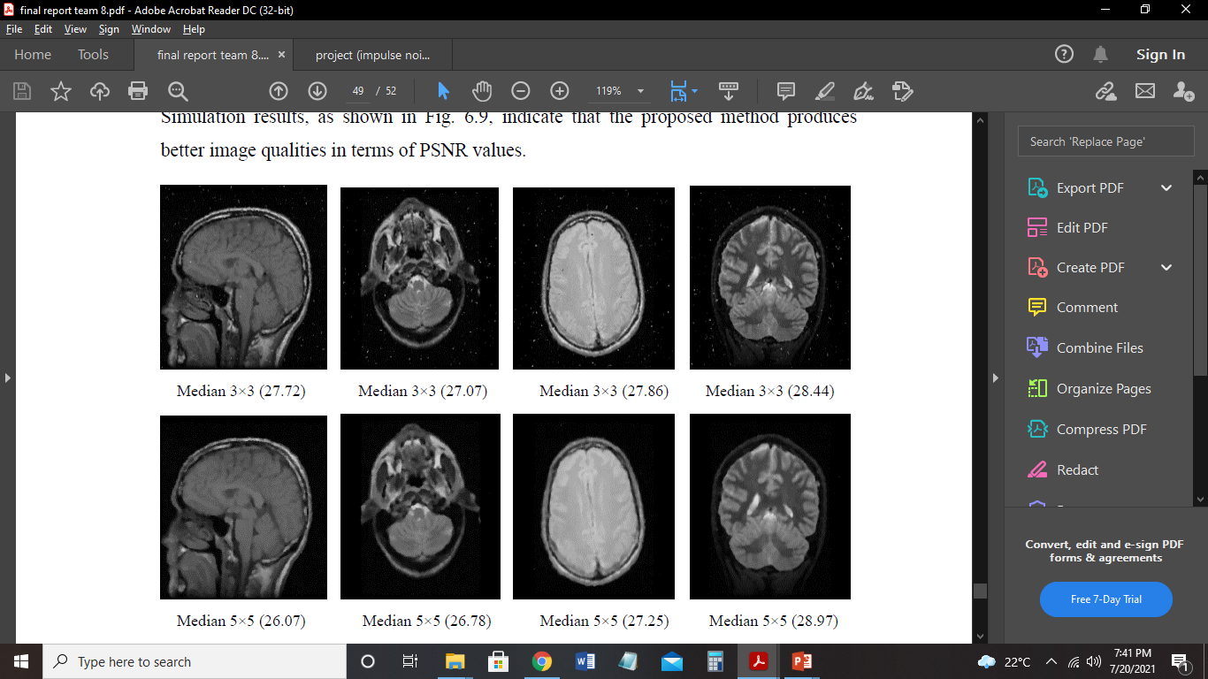
INTRODUCTION
Comparison with State-of-the Art Methods:
OBJECTIVES
There are quite a few studies in the literature about Impulse Noise removal from MR Images. Two hardware architectures, proposed in LCNR and DTBDM are used for removal of the impulse noises. Also, 3 × 3 and 5 × 5 median filters are used for comparison.
LITERATURE SURVEY
BLOCK DIAGRAM
METHODOLOGY
SOFTWARE REQUIREMENTS
RESULTS AND DISCUSSION
APPLICATIONS
REFERENCE

Slide 26
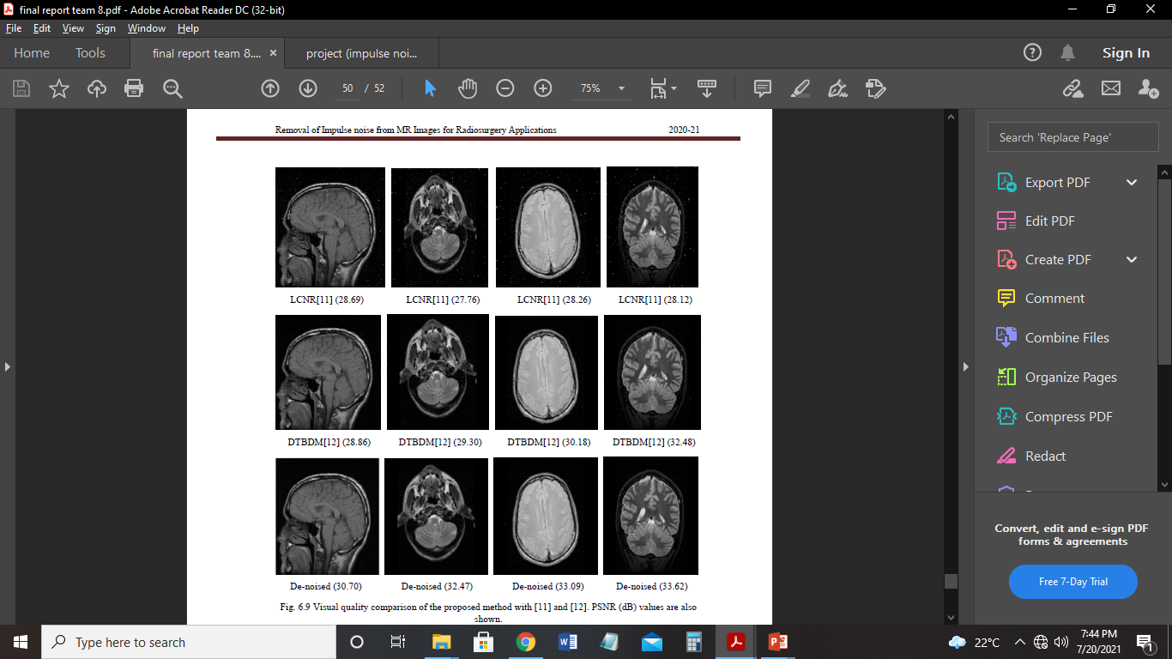
INTRODUCTION
OBJECTIVES
LITERATURE SURVEY
BLOCK DIAGRAM
METHODOLOGY
SOFTWARE REQUIREMENTS
RESULTS AND DISCUSSION
APPLICATIONS
Fig.8 Visual quality comparison of the proposed method with median filters, LCNR, DTBDM and PSNR (dB) values are also shown.
REFERENCE

Slide 27
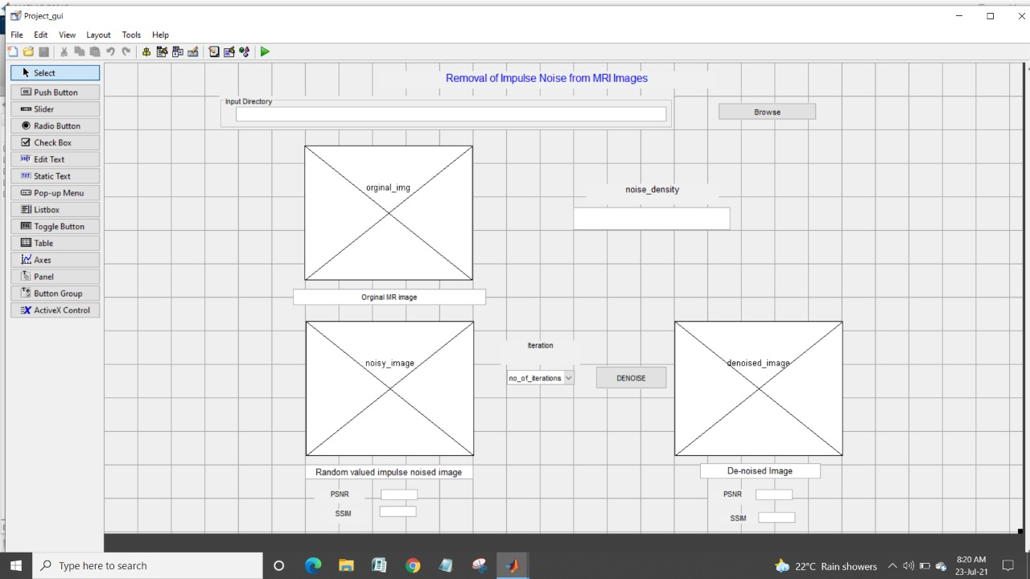
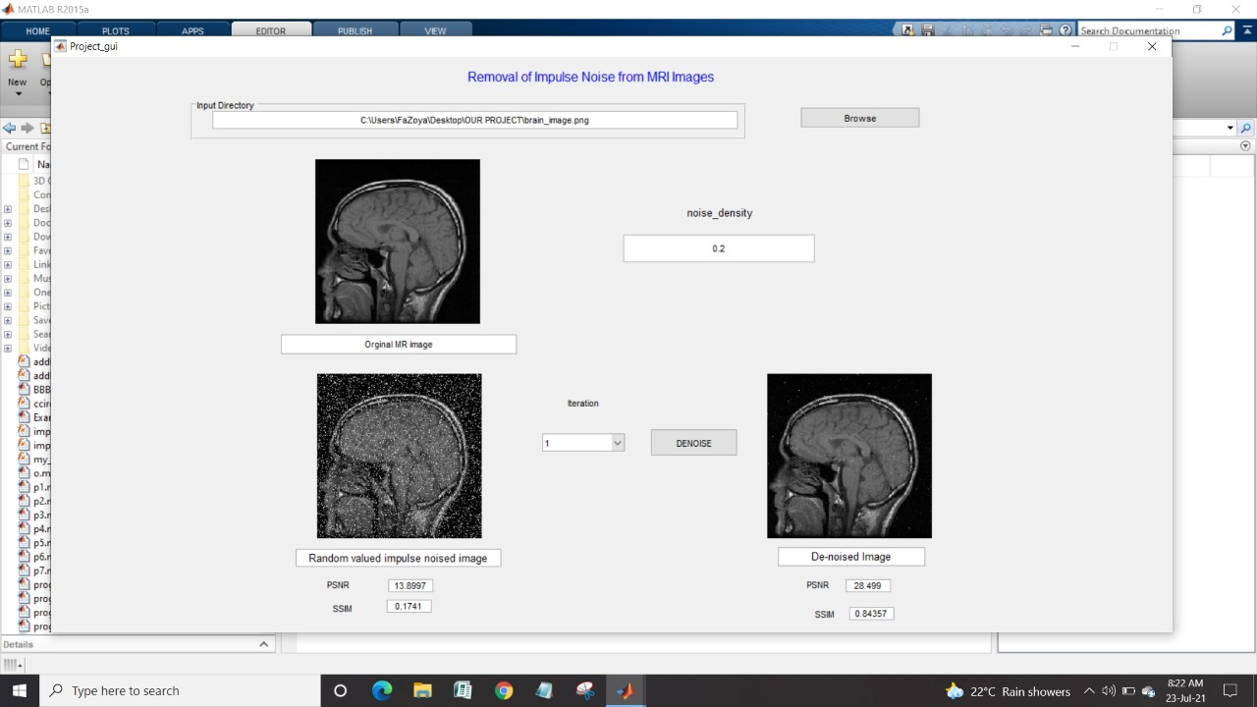
INTRODUCTION
GUI Simulation
OBJECTIVES
LITERATURE SURVEY
BLOCK DIAGRAM
METHODOLOGY
SOFTWARE REQUIREMENTS
RESULTS AND DISCUSSION
APPLICATIONS
REFERENCE
Fig. 5.7 GUI before and after execution, for noise density ND = 20%

Slide 28
INTRODUCTION
APPLICATIONS
OBJECTIVES
The proposed filtering method allows edge detection algorithms to become immune and resilient to noise.
It enhances image segmentation, object recognition, feature extraction and pattern classification.
It helps in deriving structural and functional measurements in medical imaging specially MRI images.
Hardware implementation of this project can be used as a part of the medical image capturing instruments for enhancement and segmentation of MR images before during surgical operation in radiography and radiosurgery.
LITERATURE SURVEY
BLOCK DIAGRAM
METHODOLOGY
SOFTWARE REQUIREMENTS
RESULTS AND DISCUSSION
APPLICATIONS
REFERENCE

Slide 29
INTRODUCTION
REFFERENCES
OBJECTIVES
[1]. Yanqiu Zeng , Baocan Zhang, Wei Zhao, Shixiao Xiao, Guokai Zhang , Haiping Ren , Wenbing Zhao, Yonghong Peng, Yutian Xiao, Yiwen Lu, Yongshuo Zong, and Yimin Ding, Magnetic Resonance Image Denoising Algorithm Based on Cartoon, Texture, and Residual Parts, Hindawi Computational and Mathematical Methods in Medicine Volume 2020, Article ID 1405647.
[2]. Alisha P B, Gnana Sheela K, Image Denoising Techniques-An Overview, IOSR Journal of Electronics and Communication Engineering (IOSR-JECE), e-ISSN: 2278-2834,p- ISSN: 2278-8735.Volume 11, Issue 1, Feb .2016.
[3]. Zohreh HosseinKhani, Mohsen Hajabdollahi, Nader Karimi, S.M. Reza Soroushmehr, Shahram Shirani, Shadrokh Samavi and Kayvan Najarian, Real-Time Impulse Noise Removal from MR Images for Radiosurgery Applications, International Journal of Circuit Theory and Applications, January 2019.
[4]. R.Sai Vidhya, P.Ashritha, M.Ajay Kumar, Rajesha.N, Image Noise Declining Approaches by Adopting Effective Filters, 2019 IEEE.
[5]. B..Deepa, Dr.M.G.Sumithra, Comparative Analysis of Noise Removal Techniques in MRI Brain Images, 2015 IEEE International Conference on Computational Intelligence and Computing Research.
LITERATURE SURVEY
BLOCK DIAGRAM
METHODOLOGY
SOFTWARE REQUIREMENTS
RESULTS AND DISCUSSION
APPLICATIONS
REFERENCE

Slide 30
INTRODUCTION
[6]. Shilpi Gupta, Ramesh Kumar Sunkaria, Real-Time Salt and Pepper Noise Removal from Medical Images Using A Modified Weighted Average Filtering, 2017 Fourth International Conference on Image Information Processing (ICIIP)
[7].Hanafy M. Ali (March 14th 2018). MRI Medical Image Denoising by Fundamental Filters, High-Resolution Neuroimaging - Basic Physical Principles and Clinical Applications, Ahmet Mesrur Halefoğlu, IntechOpen, DOI: 10.5772/intechopen.72427.
[8]. Setu Garg, Ritu Vijay, Shabana Urooj, Statistical Approach to Compare Image Denoising Techniques in Medical Images and MR Images, 2019, International Conference on Pervasive Computing Advances and Applications, 2019.
[9]. D. Chowdhury, S. Panda and S. Dutta, "Eradication of Salt and Pepper Noise from a Tumorous MRI image using SNPRB Filter," 2019 International Conference on Opto-Electronics and Applied Optics (Optronix), Kolkata, India, 2019, pp. 1-6.
OBJECTIVES
LITERATURE SURVEY
BLOCK DIAGRAM
METHODOLOGY
SOFTWARE REQUIREMENTS
RESULTS AND DISCUSSION
APPLICATIONS
REFERENCE

Slide 31
INTRODUCTION
OBJECTIVES
LITERATURE SURVEY
THANK
YOU
BLOCK DIAGRAM
METHODOLOGY
SOFTWARE REQUIREMENTS
RESULTS AND DISCUSSION
APPLICATIONS
REFERENCE

