Slide 1
HTML / CSS / JS
An impossibly fast introduction!

Slide 2
HTML

Slide 3
HTML Anatomy
HTML describes the structure of web pages using markup with elements as the basic building blocks of HTML pages.
<!DOCTYPE html> ------------------------------------------------------------------- Doctype declaration
<html> --------------------------------------------------------------------------------- Root element
<head> --------------------------------------------------------------------------------- Header section/meta info
<title>Title of page</title>
<meta charset="UTF-8">
<meta name=”description” content=”blah blah blah”/> ------------------------- For SEO
<meta name="keywords" content="HTML,CSS,JavaScript">
<meta name="author" content="John Doe">
<meta name="viewport" content="width=device-width, initial-scale=1.0">--- for responsiveness
<link rel="icon" type="image/png" href="/favicon.png"/> ------------ favicon
<link rel=”stylesheet” href=”../css/abc.css”/> -------------------------- Importing External CSS
</head>
<body> ---------------------------------------------------------------------------------` Content
<p>This text is bold</p>
<script src=”../abc/script.js”></script> --------------------------------------- Importing JS file in the end
</body>
</html>

Slide 4

Who maintains HTML Standards?
The World Wide Web Consortium (W3C) is the main international standards organization for the World Wide Web. Founded in 1994.
W3C vs WHATWG! Later WHATWG was founded by individuals of Apple, Mozilla and Opera, then major browser vendors, in 2004, after a W3C workshop. They were becoming increasingly concerned about the W3C’s direction with XHTML and lack of interest in HTML, and disregard for the needs of real-world web developers. And the Web Hypertext Application Technology Working Group was born and they started to work on a separate standard for the new HTML 5. Google & Microsoft joined in later.
Now, W3C and WHATWG work together on HTML and DOM, in the WHATWG repositories, to produce a Living Standard and Recommendation/Drafts.
WHATWG maintains the HTML and DOM Living Standards
Ref: W3C vs WHATWG

Slide 5
For Reference: Why XHTML Failed?
With the noted exceptions of most HTML browsers having built in support for SVG, Canvas, and MathML. The confidence of built in support for emerging protocols and interfaces trumped the browser game.
XHTML processed JavaScript differently than the way a browser parser was configured to process.
And CSS processing? XHTML requires a very specific CSS syntax to be properly processed in a browser. Make the smallest mistake and the document renders dead on delivery.
The advantages of XML are many, including namespaces, faster parsing, smaller and more mobile friendly, but Strict parsing requirements for XHTML resulting in aborted, dead documents more often.

Slide 6
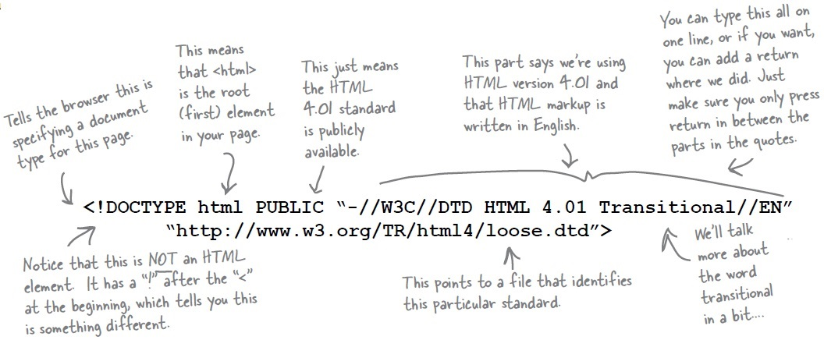
Why DOCTYPE declaration
If browser can’t determine the type of document, it switches to quirks mode.
This means, with the changes in layout mode, it also switches off most of the browser features that have been invented since IE5, and browser attempts to render code based on a ‘best-guess’ basis.
HTML 4 - <!DOCTYPE HTML PUBLIC "-//W3C//DTD HTML 4.01 Frameset//EN" "http://www.w3.org/TR/html4/frameset.dtd">
HTML 5 - <!DOCTYPE html>

Slide 7
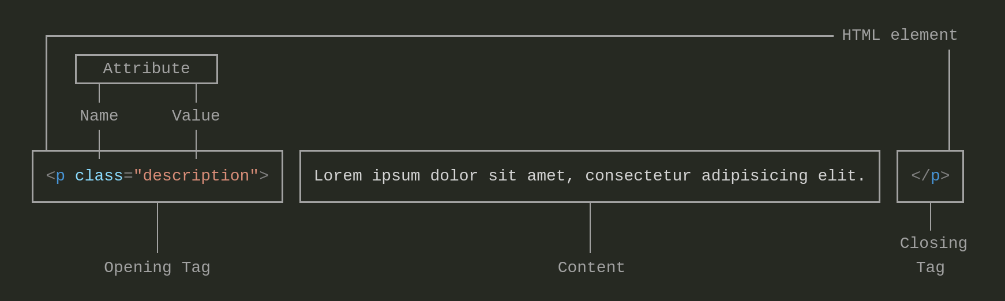
HTML Tags
Container Elements <p></p>,<div></div>
Empty Elements <br>, <hr/>, <img src=”something.jpg” />
  No closing tag needed for empty elements, but still its recommended to add / at the end of the opening tag.

Slide 8
Attributes
Global Attributes
  contenteditable <p contenteditable="true">Edit this content</p>
  class
  id
  title <div title="This is tooltip">Hover me for tooltip</div>
  style <span style="background: #ffe7e8;"></span>
  tabindex <input type="text" tabindex="2">
  draggable <div draggable=true>Drag me</div>
Other important attributes
  lang <html lang="en-US">
  alt <img src="img_girl.jpg" alt="Girl with a jacket">
Event attributes (Ref: HTML Events)
  onclick, onmouseover, onresize, onchange, onblur, onkeydown, ondragstart, ondrop

Slide 9
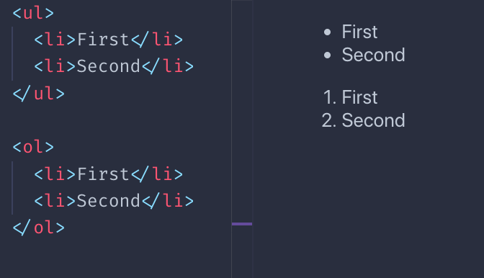
Lists and Menus
Using UL for menu
  Putting things in a UL element is a semantic way of saying the elements children ( <li> ) are list items and therefore a logical group. Which gives the chunk of html more structure/meaning than just a bunch of div tags. And even unstyled browser can display it logically.

Slide 10
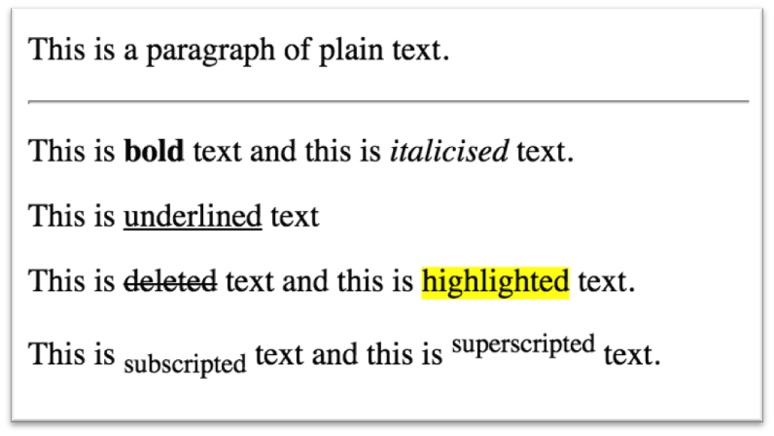
HTML Formatting tags
<strong> is used for bold (strong) text / <b>
<em> is used for italicised (emphasised) text / <i>
<u> is used for underlined text
<del> is used for deleted text
<sub> is used for subscripted text
<sup> is used for superscripted text
<mark> is used for marked/highlighted text
<hr> is used for a horizontal rule (line) as seen below
<br> is for new line

Slide 11
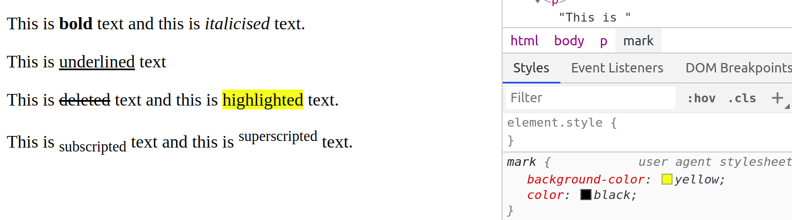
User Agent Stylesheet
User Agent will have a default style sheet that presents documents in a reasonable manner.
“User agents must apply a default style sheet (or behave as if they did)” and that “a user agent’s default style sheet should present the elements of the document language in ways that satisfy general presentation expectations for the document language.”
Chrome User Agent Stylesheet 2015

Slide 12
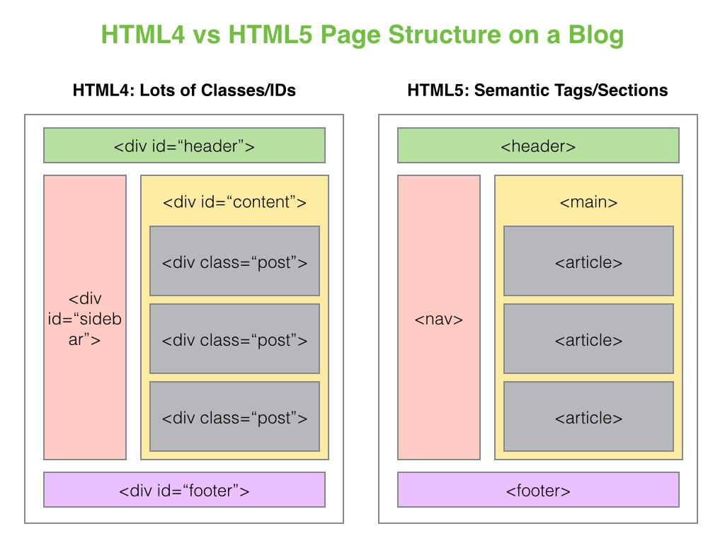
HTML4 vs HTML5

Slide 13

HTML5
New semantic elements
  <header>, <footer>, <article>, <section>, <aside> etc.
New attributes of form elements
  number, date, time, calendar, and range.
New graphic elements
  <svg> and <canvas>
New multimedia elements
  <audio> and <video>
New APIs
  Geolocation, Drag and Drop, Local Storage etc

Slide 14

Lots of Semantic elements
But why?
<article>, <aside>, <details>, <figcaption>, <figure>, <footer>, <header>, <main>, <mark>, <nav>, <section>, <summary>, <time>
Greater accessibility.
  For search engines and assistive tools, the use of section, article, nav, header, footer etc helps to index correct page contents, optimize the page (eg when the network is slow), read the content appropriately for the people with vision problem etc.
Ref: HTML5 Semantics

Slide 15
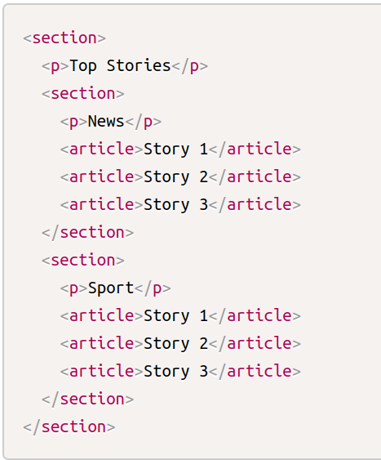
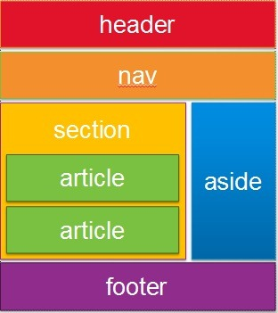
<section>, <article>, <aside>
An <article> is intended to be independently distributable or reusable.
A <section> is a thematic grouping of content.
The <aside> is for content that is not part of the flow of the text in which it appears, however still related in some way, like sidebar.

Slide 16
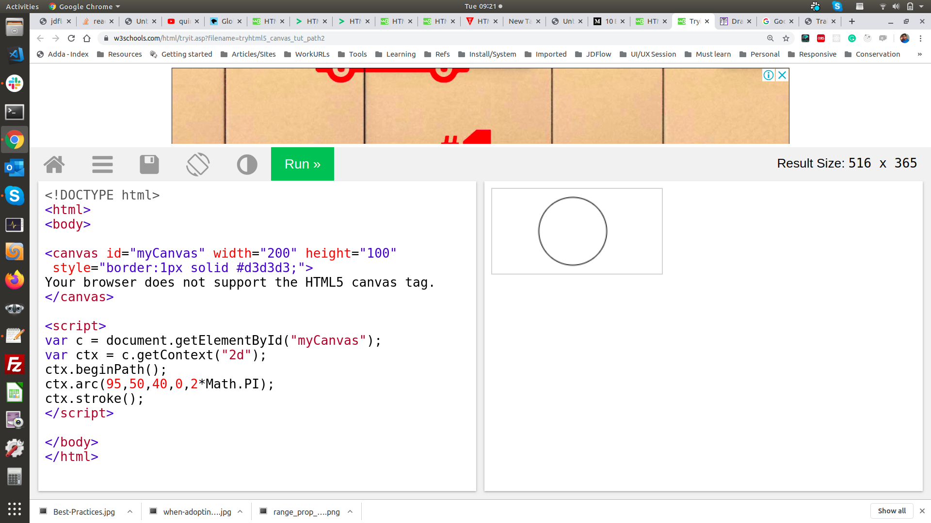
Canvas
https://lab.hakim.se/trail/03/

Slide 17
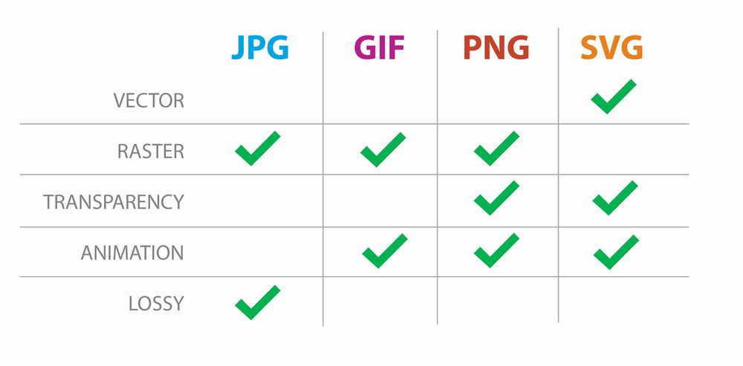


Image formats
Ref: JPEG Images
Ref: SVG Images
Ref: Image Formats for Web

Slide 18

Best HTML Practices
SEO Benefits
Use proper document structure though it may work even without html tag
Declare the correct doctype
Semantic tags to be used
h1-h6 to be used meaningfully - One h1 per page
Always close tags even if it is empty tag
Validate the document https://validator.w3.org/
Alt to be used approporatly and use the right keywords in images.
Meta tags for every page
Use lowercase markup
Place script tags at the bottom
Remove anything that slows down the site
Avoid inline css
Mobile Friendliness

Slide 19
CSS

Slide 20
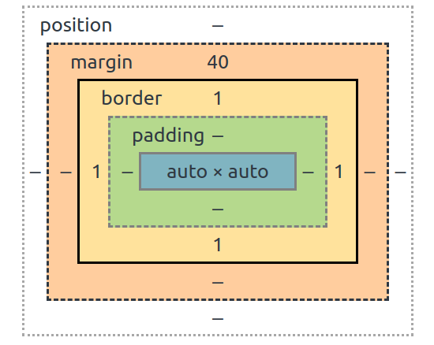
CSS Box Model & Structure
selector {
property: value;
property: value;
...
property: value;
} CSS

Slide 21
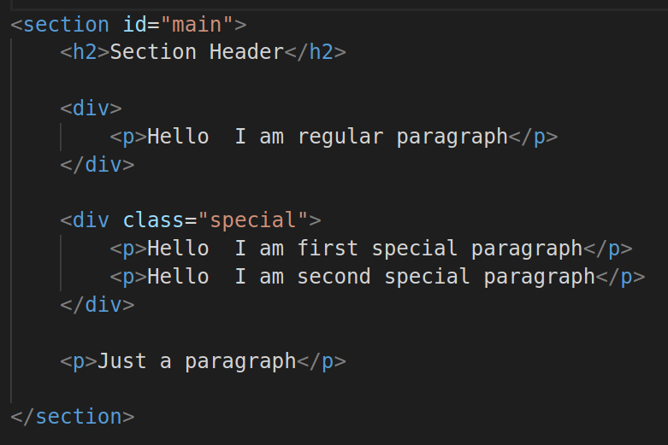
Selectors
Class Selector
.special {
text-transform:uppercase;
}
ID Selector
#main {
background-color: red;
color:white;
}
Element Selector
p {
background: blue;
}
Combo Selector
#main p {}
#main div.special p {}
Pseudo Class Selector
div.special:hover {
background:blue
}

Slide 22
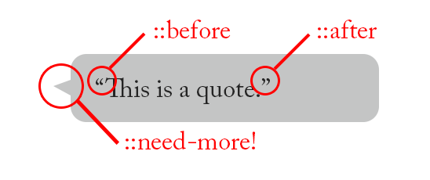
Pseudo Classes, Pseudo Elements
:active,
:focus
:disabled,
:checked,
:first-child,
:nth-child(n),
:last-child,
::before
::after

Slide 23
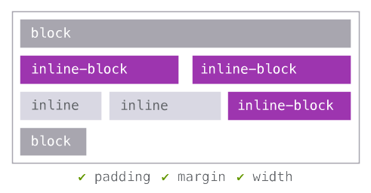
Display types
display:none
  script, style, title etc
display:table, flex/grid
Inline elements – no width, height, top/bottom padding, top/bottom margin
  a, span, img, strong
Inline-block - button, input

Slide 24
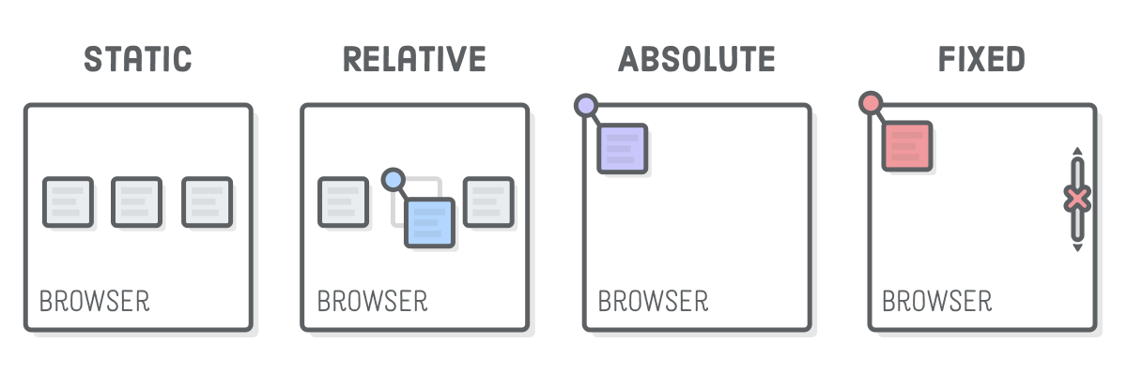
Positioning
div {
position:relative
}

Slide 25
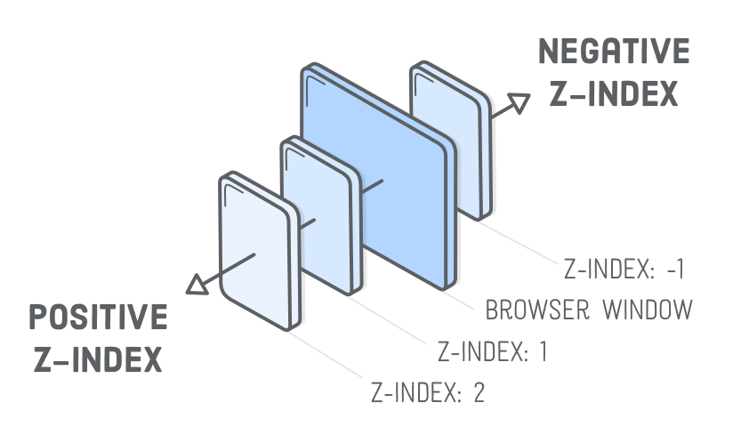
z-index
The z-index property specifies the stack order of an element.
An element with greater stack order is always in front of an element with a lower stack order.
Note: z-index only works on positioned elements

Slide 26
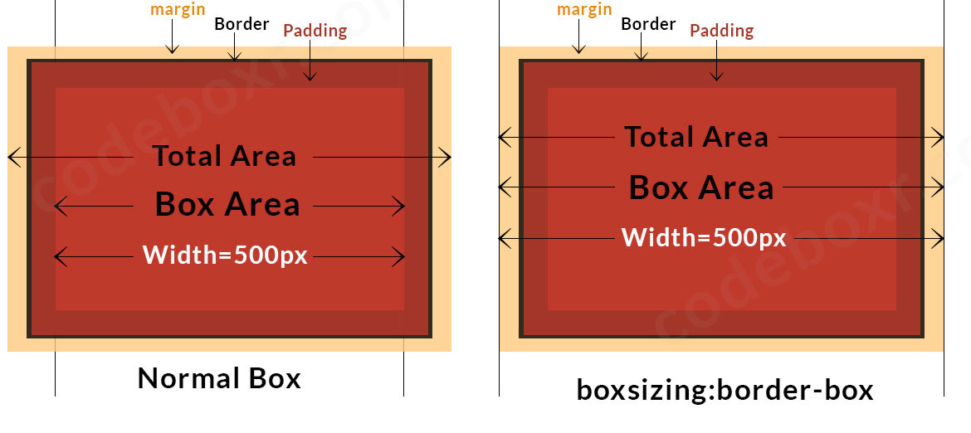
Box Sizing

Slide 27
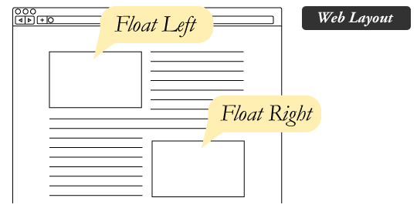
CSS Float

Slide 28
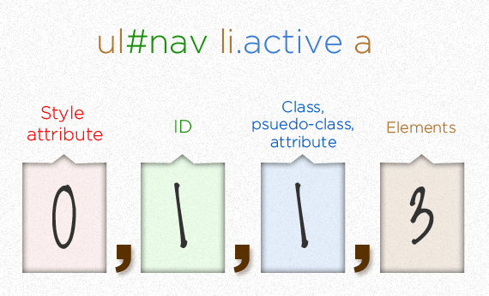
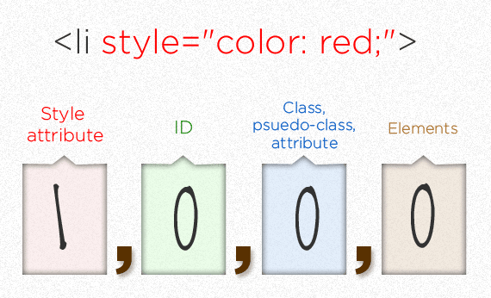
CSS Specificity
li {
color: red !important;
}

Slide 29
CSS3
Modules include:
borders (border-radius, box-shadow)
backgrounds (multiple backgrounds)
box-shadow
text-shadow
color (HSL colors, HSLA colors, opacity, RGBA colors)
Also:
media queries
multi-column layout
Web fonts
CSS3
Modules include:
Borders (border-radius, box-shadow)
Backgrounds (multiple backgrounds)
Color (HSL colors, HSLA colors, opacity, RGBA colors)
Also:
media queries
multi-column layout
Web fonts

Slide 30
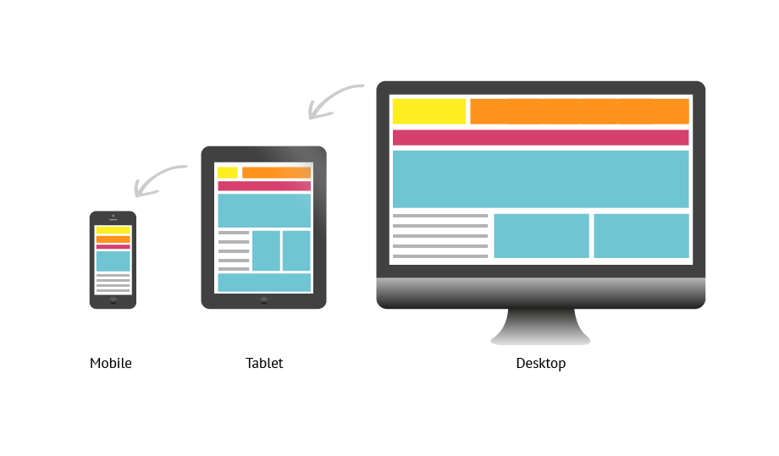
Responsive Design

Slide 31
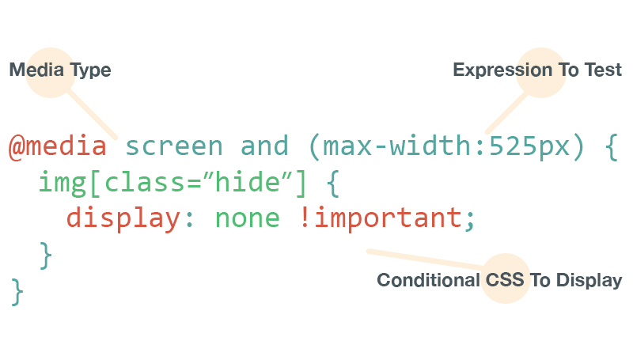
Media Query

Slide 32
not(JavaScript)

Slide 33
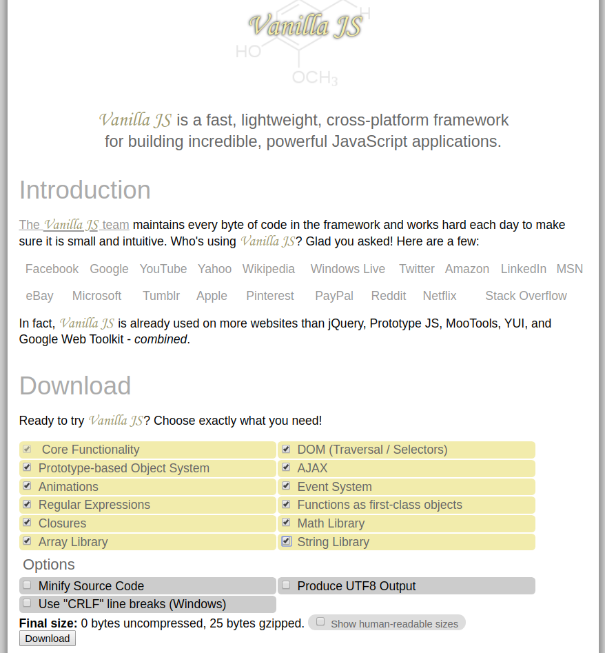
React vs VanillaJS!

Slide 34

JavaScript and the Browser War
1993 - Mosaic Web Browser, 1994 - Netscape Navigator
1995 - Brendon Eich - LiveScript – Later renamed to JavaScript
1995 - Microsoft Internet Explorer – Introduced JScript
1996 - Netscape submitted JavaScript to ECMA Int. for standardization
2000s - Microsoft gained user share by 95%, and JScript became a standard
- Microsoft stopped collaborating with ECMA
2004 - Firefox entered the game and gained popularity
2005 - Mozilla joined ECMA and continued standardisation which Netscape did
2008 - Google Chrome debuted with V8 JS Engine which is significantly faster
2008 - ECMAScript5
2015 - ECMAScript6
2008 | Firefox | IE | Chrome | Safari
Sep | 42.6% | 49% | 3.1% | 2.7%
2020 | Firefox | IE | Chrome | Opera | Safari
Jan | 9.1% | 3% | 81.9% | 1.3% | 3.3%

Slide 35
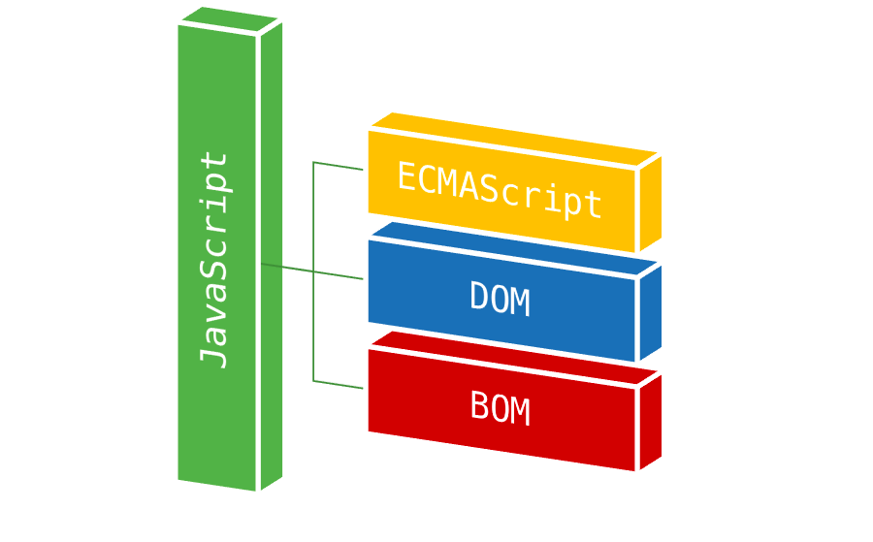
JavaScript

Slide 36
Document Object Model
"The Document Object Model (DOM) is a platform / interface that allows programs and scripts to dynamically access and update the content, structure, and style of a document."
  Core DOM - standard model for all document types
  XML DOM - standard model for XML documents
  HTML DOM - standard model for HTML documents
The HTML DOM is a standard object model and programming interface for HTML. It defines:
  The HTML elements as objects
  The properties of all HTML elements
  The methods to access all HTML elements
  The events for all HTML elements

Slide 37
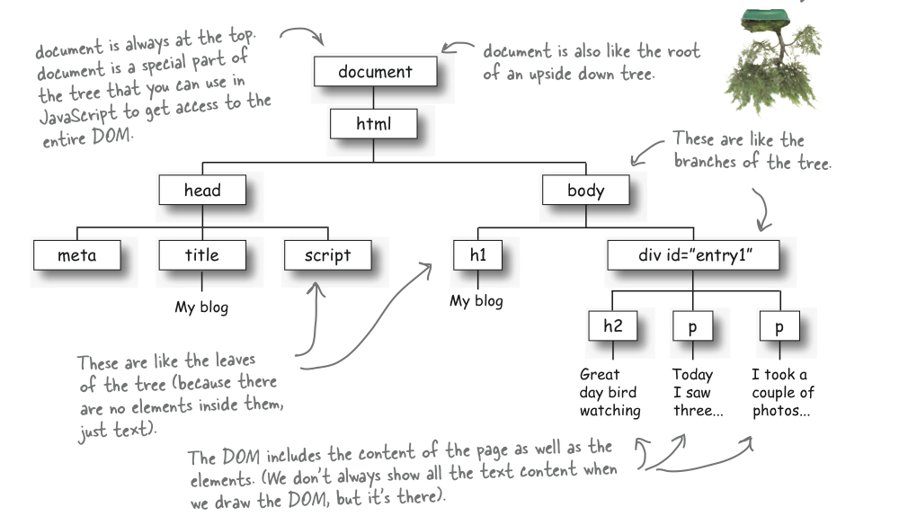
HTML DOM

Slide 38
DOM Operations
Access/Find the elements/nodes
  document.getElementById("demo")
  document.getElementsByTagName(“div”)
  document.getElementsByClassName(“special”)
  document.querySelectorAll("p.intro"), document.querySelector("p.intro");
  document.scripts
  document.title
  .parentNode
  .childNodes[nodenumber]
  .firstChild, .lastChild
  .nextSibling, .previousSibling
Adding/Deleting Elements
  var element = document.createElement("p")
  document.appendChild(element), document.getElementById("demo").appendChild(para)
  document.removeChild(element)

Slide 39
DOM - JS Operations
Modify/Update elements
  document.querySelector("p.intro").innerHTML = “new html content”;
  document.querySelector("p.intro").id = “New id”; (attributes)
  document.getElementById("demo").style.color = “red”
  document.title = “abcd”
  document.images[0].src
Ref: DOM

Slide 40
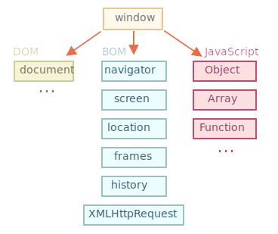
BOM
Ref: BOM

Slide 41
BOM Operations
window.innerHeight, window.outerHeight
window.innerWidth, window.outerwidth
  outerWidth / outerHeight - includes padding, border
  innerWidth / innerHeight - includes padding but not border
window.location (window.location and document.location are same)
  window.location.pathname
  window.location.href – full url of current page
  window.location.reload()
window.history
window.navigator
window.screen – screen size of the user
const timeout = setTimeout(callback, delay); // delay in ms // clearTimeout(timeout);
const interval = setInterval(callback, delay); // delay in ms // clearInterval(interval);

Slide 42
That’s it for now!

