Slide 1

Introduction to Synthesis March 2023
For this lecture, material from Lebanese International University has been used
Mohamad Attieh, Ali Ibrahim, and Adnan Harb
Contact: adnan.harb@liu.edu.lb

Slide 2


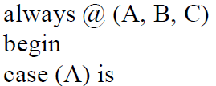
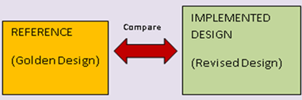






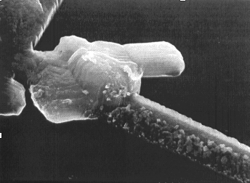


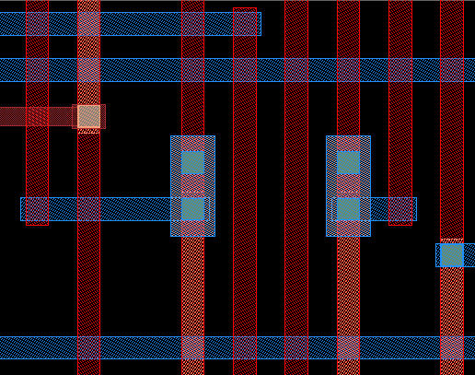
Cadence® Digital Realization of the RTL-to-GDSII Flow
Design Specification
CTS
RTL Coding
Routing
Functional Simulation
Parasitic Extraction
Logic Synthesis
Static Timing Analysis/
Optimization
Floor Planning
Signal Integrity
Logic Equivalency Checking
IR-drop/Electromigration
Power Planning
Gate-Level Simulation
Placement
Signoff-Checks
GDSII

Slide 3
Lecture Outline
This lecture is organized as follows:
Part A: Includes a general explanation of the synthesis theory
Part B: Introduces the design rule constraints
Part C: Provides some tips on script preparation before the synthesis
Part D: Explains the synthesis steps using Genus tool
Part E: Presents the Design for Testability Process

Slide 4
Part A: The Synthesis Theory

Slide 5
The Synthesis Theory
Definition:
Logic Synthesis is the process of transforming Hardware Description Language (HDL) code into a logic circuit based on:
a standard-cell library
user-specified optimization/timing constraints.
“Source: Cadence Customer Training Course RTLtoGDSII, Version: 5.0”

Slide 6
The Synthesis Theory
The Synthesis process consists of three main stages which are:
LOGIC SYNTHESIS
=
TRANSLATION
+
MAPPING
+
OPTIMIZATION
TRANSLATION
Translation is the first step of the logical synthesis where the RTL is converted to a general library netlist. During translation, the following operations are performed:
HDL syntax checking
Optimizes HDL
Conversion of HDL into functional Boolean equivalent
Mapping of the arithmetic, sequential, and combinational function

Slide 7
MAPPING
During mapping, the tool maps the generic Boolean netlist generated from the translation step, into the available gates in the standard cell library. The Boolean functions are mapped into technology-specific primitive functions.
OPTIMIZATION
In the optimization step, the mapping are modified in order to meet specific design goals such as speed, area, and power consumption

Slide 8
The Digital Design Flow
Product requirement
Compare
Physical Synthesis
Behavioral/RTL description
Compare
Physical Description
RTL synthesis
Compare
Tape out
Gate-level netlist
Back end
Front end

Slide 9
The RTL Synthesis Flow
Specification
Scan insertion and RTL synthesis
RTL behavioral description
Gate-level netlist
RTL functional verification
Result
Simulation or Formal Verification
NO
ok
NO
Library Data
Block B
ok
Debug
RTL Synthesis (Logic synthesis)
Yes
Design environment and constraints
Pre-layout STA and power analysis
Gate-level netlist
No
ok
Yes
Simulation or Formal verification
Block A
Physical Synthesis
NO
YES
ok

Slide 10
Logic Synthesis Environment
The following must be provided to synthesis tools:
Design environment
Design constraints
Gate-level netlist
Technology library
RTL code
Design environment
Technology library
Synthesizer
Design constraints
Gate-level netlist

Slide 11
Design Environment
Specify those directly influence
design synthesis and optimization results
External operating conditions (PVT) include
manufacturing process
worst case: setup-time violations
best case: hold-time violations
operating conditions: voltage and temperature
I/O port attributes contain
drive strength of input port
capacitive loading of output port
design rule constraints: fanin, fanout
Statistical wire-load model provides a wire-load model for processing the pre-layout static timing analysis.

Slide 12
Design Constraints
clock signal specification
period, duty cycle
transition time, skew
Delay specifications
input delay, output delay
maximum, minimum delay for combinational circuits
Timing exception
false path: instruct the synthesis to ignore a particular path for timing optimization
multicycle path: inform the synthesis tool regarding the number of clock cycles that a particular path requires to reach its endpoint
Path grouping: bundle together critical paths in calculating a cost function

Slide 13
The Architecture of Logic Synthesis Tools
Parsing
RTL source
Front end
Elaboration
Analysis/Translation
Logic Optimization
Technology-independent synthesis
Back end
Technology-dependent synthesis
Technology Library
Optimized gate-level netlist

Slide 14
Logic Synthesis Tools: Front end
Parsing phase
checks the syntax of the source code
creates internal components
Elaboration phase (to construct a complete description of the input circuit)
connects the internal components
unrolls loops
expands generate-loops
sets up parameters passing for tasks and functions
and so on

Slide 15
Logic Synthesis Tools: Back end
Analysis/translation prepares for technology-independent logic synthesis.
managing the design hierarchy
extracting finite-state machine (FSM)
exploring resource sharing and so on.
Logic optimization creates a new gate network that computes the functions specified by a set of Boolean functions, one per primary output.
Netlist generation generates a gate-level netlist.

Slide 16
Logic Optimization
Major concerns when synthesizing a logic gate network:
functional metric: such as fan-in, fan-out, and others.
non-functional metrics: such as area, power, and delay.
Two phases of logic synthesis:
technology-independent logic optimization
technology-dependent logic optimization
The process of translating from a technology-independent to a technology-dependent gate network is called library binding.

Slide 17
Technology-Independent Logic Optimization
Technology-independent logic synthesis
Simplification rewrites a single function in the network to the literals of that network.
Restructuring the network creates new function nodes that can be used as common factors and collapses sections of the network into a single node.
Restructuring delay changes the factorization of a subnetwork to reduce the number of function nodes through which delay-critical signal must pass.

Slide 18
Technology-Independent Logic Optimization
An example of simplification could be by expressing the network with newly created functions and variables.
For example:
S = xyz + ab, and T = xyz + ac
the new function is denoted by F = xyz therefore:
S = F + ab
T = F + ac

Slide 19
Technology-Independent Logic Optimization
An example of the restructuring the network is when the divisor of the logical function is replaced by a new literal.
For example:
S = xyz + xyw ab, let u = xy and v = z + w
then we will have:
S = uv + ab

Slide 20
Technology-Independent Logic Optimization
An example of the restructuring delay is by factorization which take place following three different steps: 1) generating the common factors, 2) selecting the factors to be substituted in the network, and then 3) reconstructing the network with the new factors.
For example:
S = xyz + xyw + ab,
Can be factorized into:
S = xy(z+w) + ab

Slide 21
Technology Mapping
A two-step approach
The network is decomposed into nodes with no nodes more than k inputs, where k is determined by the fan-in of each LUT.
The number of nodes is reduced by combining some of them taking into account the special features of LUTs.
t u
t u
f₁
f₁
z'
z'
v
g
v w
u x y'
g
w u
x y'
f
3
f₃
f₂
f₂
Mapping to 4 LUTs
Mapping to only 3 LUTs

Slide 22
Technology-Dependent Logic Optimization
This task involves selecting the most cost-effective combination of primitive logic elements from a given library to cover a Boolean network.
The optimization process aims to minimize both the area and delay of the system.

Slide 23
Summary on the Synthesis-Tool Tasks
Synthesis tools at least perform the following critical tasks:
Detect and eliminate redundant logic
Detect combinational feedback loops
Exploit don’t-care conditions
Detect unused states
Detect and collapse equivalent states
Make state assignments
Synthesize optimal, multilevel logic subject to constraints.

Slide 24
The Physical Synthesis Flow
No
ok
Back to logic synthesis
Gate-level netlist
Yes
Detailed routing
Library Description
Placement
Clock tree insertion
Post-layout timing analysis
Technology Constraints
Global routing
No
Back to logic synthesis
ok
Yes
Formal verification
(Scan vs. CT inserted)
Tape out
Formal verification
(Scan vs. CT inserted)
Technology Parameters
Post-global routing timing analysis

Slide 25
Importance of Physical Synthesis
These same challenges ripple back from block-level synthesis to “unit-level” synthesis environments run by individual logic designers, often resulting in almost no correlation between what an RTL designer sees at the unit level and what the physical design team sees in P&R.

Slide 26
Importance of Physical Synthesis
As correlation from P&R to unit-level synthesis degrades, more and more iterations are required between unit-level synthesis, block-level synthesis, and P&R, adding yet more pressure to achieve a fast turnaround time of each of these tasks by keeping block sizes small. A new generation of synthesis tool is needed to close this SoC “design productivity gap” one that is:
• Scalable and has the parallelism to handle a large volume of blocks
• Tightly correlated to P&R
• Capable of enabling unit-level physical synthesis with a full understanding of P&R at the block level
Cadence has developed a next-generation logical and physical synthesis tool, the GenusTM Synthesis Solution, that is architected from the ground up to comprehensively address the design productivity gap.

Slide 27
Physical Design using GenusTM Synthesis tool
Physical synthesis tool delivers up to a 10X boost in RTL design productivity with up to 5X faster
The solution can scale its capacity to well beyond 10 million instances flat. It also delivers tight timing and wire length correlation to within 5% of the place and route.

Slide 28
Physical Synthesis Flows
Modern synthesis tools like Genus offer three physical-related flows. They provide increasing accuracy in predicting the wire lengths.
The simple PLE flow uses technology information and cell areas from the LEF libraries instead of from the synthesis technology libraries. The PLE flow uses parasitic resistance and capacitance values from the LEF libraries or the capacitance tables (if available) when estimating the wire lengths.

Slide 29
Physical Synthesis Flows
The Genus-Physical flow uses in addition a complete placement and considers congestion and legal placement as a cost function during the RTL-to-gates phase, to create a better netlist. This flow requires access to the Innovus Place & Route tool

Slide 30
Physical Information Files
floorplan file
Capacitance Table
Genus
LEF libraries
Innovus Database
DEF file

Slide 31
Part B: Design Rule Constraints

Slide 32
Constraint Definition
Performs logic and gate-level synthesis and optimization on the design.
Optimization is controlled by user-specified constraints:
Obtain the smallest possible circuit
Fastest design
Any other design requirement
The constraints describe:
Goals for the optimization process
Force specified outputs to meet timing requirements
Value for components area and speed used during synthesis and optimization are obtained from manufacturer libraries.

Slide 33
Major Design Rule Constraints
Design Rule Constraints
Maximum Transition Time Fanout Capacitance
Cell Degradation
Minimum Capacitance
set_db max_transition
set_db max_fanout
set_db max_capacitance
set_db cell_degradation
set_db min_capacitance

Slide 34
Major Design Optimization Constraints
Optimization constraints
Area
Speed
Power/Leakage
set_db leakage_power_effort
create _clock
set_input_delay
set_output_delay
set_max_area
set_db lp_power_analysis_effort
set_db power_optimization_effort
set_db lp_power_unit nw
set_max_delay
set_min_delay

Slide 35
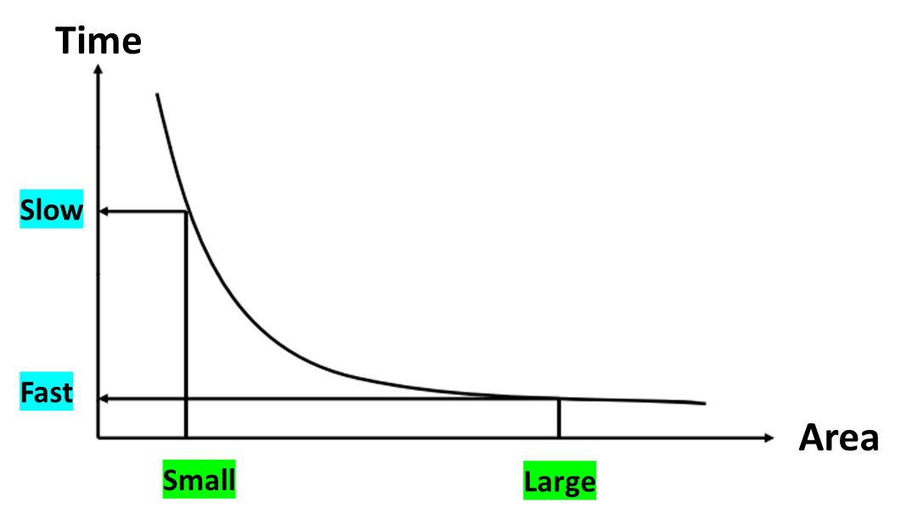
Power vs Area
Power
Power optimization is not enabled by default.
Optimizes power constraints for leakage power and dynamic power set by the attributes
max_leakage_power & max_dynamic_power.
Area
smallest design that satisfies the timing constraint by default
set_max_area
logic in the non-critical paths is automatically downsized to save area
The design goal is defined by the user constraint

Slide 36
Part C: Before your Start – Prepare your Script

Slide 37
Scripting
Scripting is the most efficient way of automating the tasks that are performed with any tool.
To support scripting at both a basic and advanced level, Genus uses the standard scripting language, Tool Control Language (TCL).
In most cases, a Genus script consists of a series of Genus commands listed in a file, in the same format that is used interactively.

Slide 38
Script Example
#-------------------------------------------------------------------------------
# Info and path setup
#-------------------------------------------------------------------------------
if {[file exists /proc/cpuinfo]} {
sh grep "model name" /proc/cpuinfo
sh grep "cpu MHz" /proc/cpuinfo
}
puts "Hostname : [info hostname]"
set DESIGN "clock_divider"
set DATE [clock format [clock seconds] -format "%b%d-%T"]
set OUTPUTS_PATH ./results
set REPORTS_PATH ./reports
set_db init_hdl_search_path ../rtl/
set_db lib_search_path ../pdk/
#-------------------------------------------------------------------------------
# General Attributes
#-------------------------------------------------------------------------------
set_db information_level 9
set_db lp_insert_clock_gating true
set_db hdl_language vhdl
set_db hdl_vhdl_read_version 1993
#---------------------------------------------------------------------------
#Power root attributes
#--------------------------------------------------------------------------------------------
set_db lp_power_analysis_effort high
set_db lp_power_unit mW
set_db power_optimization_effort medium
set_db leakage_power_effort low
#-------------------------------------------------------------------------------
# Library setup
#---------------------------------------------------------------------------
set_db library { ../pdk/xh018/diglibs/D_CELLS_JIHD/v4_1/liberty_LPMOS/v4_1_1/PVT_1_80V_range/D_CELLS_JIHD_LPMOS_slow_1_62V_125C.lib \
../pdk/xh018/diglibs/IO_CELLS_F3V/v2_1/liberty_UPF_LPMOS/v2_1_0/PVT_1_80V_3_30V_range/IO_CELLS_F3V_LPMOS_UPF_slow_1_62V_3_00V_125C.lib }
set_db lef_library { ../pdk/xh018/cadence/v8_0/techLEF/v8_0_1_1/xh018_xx51_HD_MET5_METMID.lef \
../pdk/xh018/diglibs/D_CELLS_JIHD/v4_1/LEF/v4_1_1/xh018_D_CELLS_JIHD.lef \
../pdk/xh018/diglibs/D_CELLS_JIHD/v4_1/LEF/v4_1_1/xh018_xx51_MET5_METMID_D_CELLS_JIHD_mprobe.lef \
../pdk/xh018/diglibs/IO_CELLS_F3V/v2_1/LEF/v2_1_1/xh018_xx51_MET5_METMID_IO_CELLS_F3V.lef \
../pdk/xh018/spram/XSPRAMLP_128X16_M8P/v4_0_2/xh018_1151_LPMOS_MET5_METMID/LEF/XSPRAMLP_128X16_M8P.lef }
set_db cap_table_file { ../pdk/xh018/cadence/v8_0/capTbl/v8_0_1/xh018_xx51_MET5_METMID_typ.capTbl }
#___________________________________________________________________________________________
#clock
#-------------------------------------------------------------------------------------
create_clock -name clk -period 10 -waveform {0 5} [get_ports "clk"]
set_clock_transition -rise 0.1 [get_clocks "clk"]
set_clock_transition -fall 0.1 [get_clocks "clk"]
set_clock_uncertainty 0.01 [get_ports "clk"]
set_input_delay -max 1.0 [get_ports "reset"] -clock [get_clocks "clk"]
set_output_delay -max 1.0 [get_ports "clock_out"] -clock [get_clocks "clk"]
#-------------------------------------------------------------------------------
# Read design
#-------------------------------------------------------------
read_hdl -vhdl clock_divider.vhd
elaborate ${DESIGN}
syn_gen
syn_map
syn_opt
write_hdl > results/clock_divider.vhd
write_hdl > clock_divider_netlist.v
write_sdc > clock_divider_sdc.sdc
syn_opt -physical
gui_show

Slide 39
Strategy For The Script
Path and information
General Attribute
Power Attribute
Library attribute
Clock
Set search path and timing library
Apply constraints
Load HDL files
Perform Elaboration
Synthesis
Analyze
Export Design

Slide 40
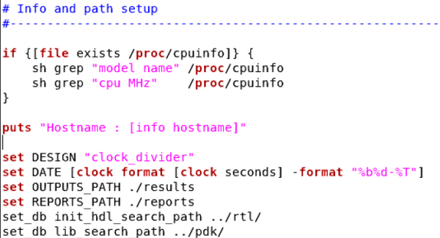
Information and Path Setup
First, give the location for the code as the above figure
set_db init_hdl_search <destination>
Then search for the library path
set_db lib_search_path <destination>

Slide 41
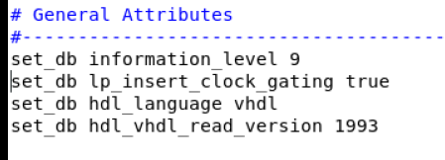
General Attribute
Define how detailed information you want to see in the terminal or
log files (normally you may have enough information by 5 to 7):
set_db information_level 9
Controls whether to generate clock-gating logic by using basic libcells if no usable integrated clock-gating cells are available in the library
set_db lp_insert_clock_gating true

Slide 42
General Attribute
Specifies the VHDL version to be used when reading VHDL designs
set_db hdl_vhdl_read_version 1993
If your design consists of just one type of HDL file in “Configuring the Environment – native parameters”, set your flow default hdl language:
(hdl_language {v2001 | v1995 | vhdl | sv} Default: v2001)
set_db hdl_language vhdl

Slide 43
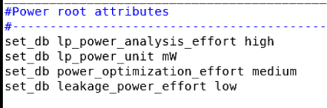
Power Attributes
Specify attributes for the power optimization

Slide 44
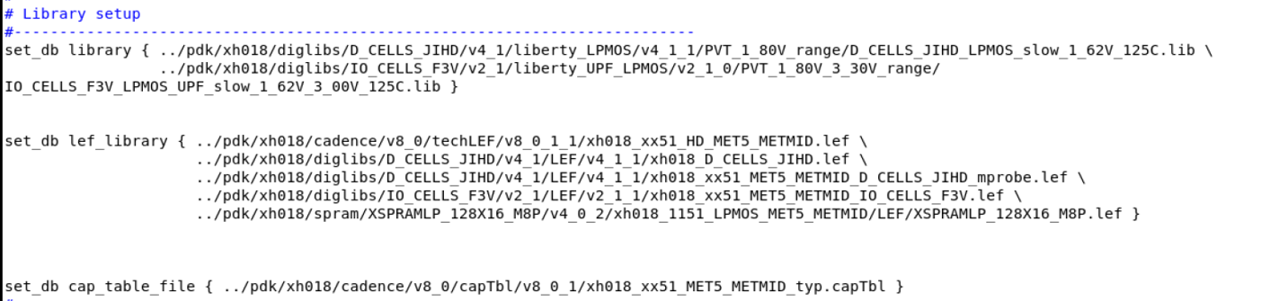
Library Setup
Define the attributes which specify the various libraries and LEFs for following
the flow in the design: Notice that these libraries are to be used as the specific target library from the technology to which you decide to map
set_db library { ../LIB/lib1.lib \ ../LIB/lib2.lib} /
set_db lef_library { ../LEF/lef1.lef \ ../LEF/lef2.lef} /
Specify the cap tables:
set_db cap_table_file capfile

Slide 45


Setting Effort Levels Prior to Synthesis
You can change the default effort levels for synthesis by using attributes.
Generic Synthesis (syn_generic command) effort level | set_db syn_generic_effort <low|medium|high|express>
The optimization effort for the mapping stage (syn_map command) | set_db syn_map_effort <low|medium|high|express>
The optimization effort to use for incremental optimization (syn_opt command) | set_db syn_global_effort <none | low | medium | high | express>
To specify the global effort for all synthesis commands, use | set_db syn_global_effort <none | low | medium | high | express>
Default effort is:
Medium for generic.
High for mapping and optimization.
None for global.
Use the option express to enable express flow for both logical and physical synthesis.
The express flow enables early feasibility analysis with much faster runtimes and reasonable quality of results.
“Source: Cadence Customer Training Course RTLtoGDSII, Version: 5.0”
Notes:
This page does not contain notes.

Slide 46
Timing Constraints
To accurately set up timing constraints, you need to specify the following:
Clock
I/O Timing requirements
Combinational path delay requirements
Timing exceptions
Clocks: To define a clock command is used, and the create_generated_clock is used command is used to define an internally generated clock. A few specifications of the clock include clock source, clock period, duty cycle, clock name, etc.

Slide 47
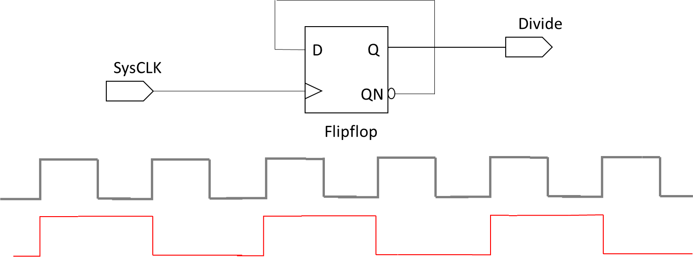
Building a Clock
Create a clock and divide by 2 generated clock example is given bellow
create_clock –name SYSCLK_NAME –period 2 -waveform {0 1} {get_ports SYSCLK}
create_generated_clock –name DIVIDE -source {get_ports SYSCLK} divide_by 2 {get_pinsFF1/Q}

Slide 48
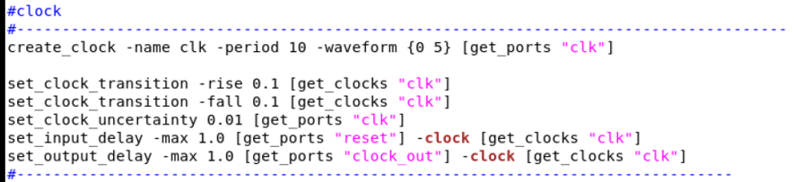
Clock commands
Specify clock signal

Slide 49
Part D: Synthesize Your Design using Genus tool

Slide 50
Inputs and Outputs of Genus Synthesis Solution
Inputs | Outputs
RTL: Verilog, VHDL, directives, pragmas, SystemVerilog | Optimized netlist
Constraints: .sdc | LEC dofile
Library: .lib or .ldb | ATPG, ScanDEF, and others
Power Intent: CPF, UPF/IEEE 1801 (Optional) | Constraints: .sdc
Physical: Captable, QRC Technology file, LEF, DEF (Optional) | Physical design input files
Tech LEF or Captable
or QRC
.SDC
Libcells LEF, DEF
RTL
.cpf / .upf
.lib / .ldb
Genus Synthesis Solution
Logic Verification Using LEC Dofiles
.SDC
Physical Design Input Files
Optimized Netlist
ScanDEF
ATPG
Required Inputs
Optional Inputs
Outputs
“Source: Cadence Customer Training Course RTLtoGDSII, Version: 5.0”
Notes:
This page does not contain notes.

Slide 51
Genus Synthesis Flow
Set technology library and initial setup (read_libs)
Use read_mmmc if running MMMC flow
Read HDL files
read_hdl ${RTL_LIST}
Elaborate the design
elaborate
Initialize the design (init_design)
(Optional, only required if MMMC file is read)
Set timing and design constraints
read_sdc
If running MMMC flow, constraints are specified in MMMC file
Apply Optimization Directives
Modify Optimization Directives
syn_generic <-physical>
syn_map <-physical>
syn_opt <-spatial>
Report and Analyze
Synthesis Steps
Write Output Files
Optional Steps
Checking the Results
Constraints Meet?
Output Files
No
Netlist/DB Handoff, SDC
Yes
Place-and-Route
“Source: Cadence Customer Training Course RTLtoGDSII, Version: 5.0”
Notes:
This page does not contain notes.

Slide 52
Part E: Design for Testability

Slide 53

What Is DFT?
Design for Test (DFT) techniques provide measures to comprehensively test the manufactured device for quality and coverage.
Design for Testability (DFT) makes it possible to:
Assure the detection of all faults in a circuit.
Reduce the cost and time associated with test development.
Reduce the execution time of performing a test on fabricated chips.
Different faults in DFT:
Stuck-At faults
Transition faults
Stuck open and Shorts
Bridging faults
“Source: Cadence Customer Training Course RTLtoGDSII, Version: 5.0”
Notes:
This page does not contain notes.

Slide 54
Design with Test Circuit
data_out
data_in
scan_in
scan_out
shift_enable
clock
“Source: Cadence Customer Training Course RTLtoGDSII, Version: 5.0”
Notes:
Any inferred register, or any instantiated edge-triggered registers that pass the DFT rule checks, are mapped to their scan equivalent cell when the scan connection engine runs.
Remapping of instantiated edge-triggered registers that pass the DFT rule checks to their scan equivalent cells occurs prior to placement only.
The test process refers to testing the ASIC for manufacturing defects on the automatic test equipment (ATE). It is the process of analyzing the logic on the chip to detect logic faults. The test process puts the circuit into one of the three test modes:
Capture mode This is the part of the test process that analyzes the combinational logic on the chip. The registers act first as pseudo-primary inputs (using ATPG-generated test data) and then as pseudo-primary outputs (capturing the output of the combinational logic).
Scan-shift mode This is the part of the test process in which registers act as shift registers in a scan chain. Test vector data is shifted into the scan chain registers, and the captured data from capture mode are shifted out of the scan registers.
System mode This is the normal or intended operation of the circuit. Any logic dedicated for DFT purposes is not active in the system mode.

Slide 55
RTL Top-Down DFT Flow
Read target libraries/MMMC file
Read HDL files
Elaborate design
Initialize the design (Optional, only required if MMMC file is read)
Modify Constraints
Set timing and design constraints (If running MMMC flow, constraints are specified in MMMC file)
Shift enable
Test mode
Internal clocks as test clocks
DFT-controllable constraints
Abstract scan segments
Modify Optimization Directives
Apply Optimization Directives
Set up for DFT rule checker
Run DFT rule checker and report registers
Fix DFT violations
Test point insertion
Shadow logic insertion
Add testability logic
General Steps
Synthesize design and map to scan (syn_generic <–physical>, syn_map <–physical>)
DFT Steps
Set up DFT configuration constraints and preview scan chains
Scan chains
Number of scan chains
Length of scan chains
Control data lockup elements
Optional Steps
Connect scan chains
No
Run incremental optimization (syn_opt <–spatial>)
Checking the Results
Constraints Meet?
Analyze the design
Output Files
Netlist/DB Handoff, SDC ScanDEF, ATPG, abstraction model
Yes
“Source: Cadence Customer Training Course RTLtoGDSII, Version: 5.0”
Notes:
The Cadence Genus Synthesis Solution provides a full-scan DFT solution including the following:
DFT rule checking
DFT rule violation fixing
Scan mapping during optimization
Scan chain configuration and connection
The main DFT techniques available today are given below:
Scan insertion
Programmable Memory BIST insertion
Logic BIST insertion
Boundary scan insertion
Scan compression
At-Speed Test using On-Product Clock Generation Logic (OPCG)
Scan insertion is one of the most used DFT techniques to detect stuck-at faults.
Scan insertion replaces the flip-flops in the design with special flops that contain built-in logic targeted for testability. Scan logic lets you control and observe the sequential state of the design through the test pins during the test mode. This helps in generating a high quality and compact test pattern set for the design using an Automatic Test Pattern Generator (ATPG) tool.

Slide 56
Modus Test Disciplines
Correct-by-design test structures using Genus™:
Verify (and optionally enforce) compliance with test design rules.
Full range of tests for all types of digital testing.
Diagnostics for fault isolation, failure analysis, and process monitoring.
Test
Synthesis
Test
Analysis
Test Generation
Test Diagnostics
“Source: Cadence Customer Training Course RTLtoGDSII, Version: 5.0”
Notes:
Modus Test software is a fully integrated suite of tools designed from the beginning to interact and work with each other. Modus Test tools have already proven their ability to handle the next generations of nanometer technology.
Modus Test tools have embedded in them our expertise and 30+ years of experience in all four of the disciplines of test, and is a complete tool suite supporting all four disciplines:
Test Synthesis – The process of inserting test logic into a design to help to make it testable.
Test Analysis – The process of identifying the test logic and verifying that it has been inserted and integrated correctly, and identifying any design characteristics that will create testing problems.
Test Generation –The process of creating test vectors that are applied at the tester.
Test Diagnostics – The process of working backward from failure miscompares to the probable cause, and to help in the production and yield management of semiconductor lines.
We will focus on the traditional ATPG disciplines of Test Analysis and Test Generation.

Slide 57
Modus Test ATPG Flow
Build Model
Verilog Libraries
Netlist
Build Test Mode
Prepare for ATPG
Fix
Violations
Verify Test Structures
Internal Scan, Boundary Scan,
MemoryBIST, etc.
Build Fault Model (Add Faults)
Create and Commit Logic Tests
Scan, Logic, Transition, IDDQ,
Memory BIST, etc.
Major Inputs/Outputs
Processing Steps
Run ATPG
Xcelium™
SimVision™
Voltus™
Write Vectors for Verification
and Manufacturing
Patterns to ATE
“Source: Cadence Customer Training Course RTLtoGDSII, Version: 5.0”
Notes:
This is the basic recommended Modus Test flow.

