Slide 1

B.Tech in CSE (AI & ML) (2024-2028)
Semester- V
UE24AM320A–Capstone Project Phase-1
Review-1
Project Title : Monocular Vision-Based Predictive Digital Twin for Road Infrastructure Maintenance Optimisation
Project ID : PW26_VK_02
Project Guide : Dr. Vidhya K
Project Team : Krishna G Pai (PES1UG24AM372)
Aryaman DK (PES1UG24AM344)
Kshitij Satish Shetty (PES1UG24AM143)
Mallikarjuna Rao R.V (PES1UG24AM155)

Slide 2
Monocular Vision-Based Predictive Digital Twin for Road Infrastructure Maintenance Optimisation
Outline
Problem Statement
Introduction, Objectives & Proposed Pipeline
Scope and Feasibility study
Applications/Use cases
Background Study & Research Gap
Implementation: status & plan
Capstone (Phase-I & II) Timeline
Novelty claims, Evaluation plan & Risks
References

Slide 3
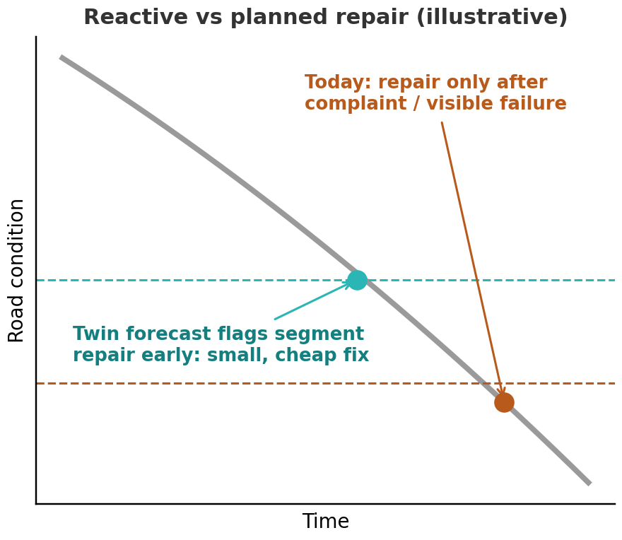
Monocular Vision-Based Predictive Digital Twin for Road Infrastructure Maintenance Optimisation
Problem Statement
Road departments fix roads only after damage is reported or visible.
No simple way to track how roads worsen or to decide what to fix first on a limited budget.
Digital twins today need drones or LiDAR, which ward-level bodies cannot afford.
Phone/dashcam tools detect damage but rarely show how reliable their measurements are.
Core question: can a phone or dashcam alone support good repair decisions despite measurement errors?
Fig. 1: Reactive vs planned repair: a forecast lets us act earlier at lower cost (illustrative)

Slide 4
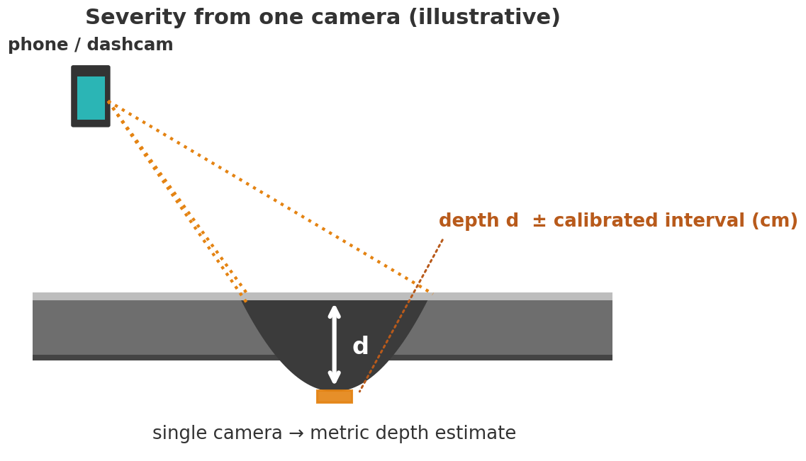
Monocular Vision-Based Predictive Digital Twin for Road Infrastructure Maintenance Optimisation
Introduction
A digital twin (live virtual copy) of real roads, built from phone/dashcam video, that shows condition, predicts decline and plans repairs within budget.
Our three contributions:
1. Pothole depth from one camera, with a stated error range
2. Real monthly road data from India, and the effect of cheap sensing on decisions
3. Budget-limited repair planning that accounts for measurement errors
Not new: damage detection, the overall pipeline, budget planning in general.
Fig. 2: Estimating pothole depth from one camera, with a calibrated error range (illustrative)

Slide 5
Monocular Vision-Based Predictive Digital Twin for Road Infrastructure Maintenance Optimisation
Objectives & Proposed Pipeline
Phone / dashcam video
GPS + timestamp
Detection
Finds damage in video
Segmentation
Outlines the damage
Severity
Depth and size with error range
Twin database
Condition, history, photos
Forecast
Predicts how it worsens
Repair planner
Picks repairs within budget
Fig. 3: Proposed pipeline, from video to repair plan
Objectives (orange boxes: our main new ideas)
Detect and outline road damage using public datasets (base step)
Estimate pothole severity from one camera, with an error range
Build a twin of 2-3 real road segments from monthly visits, keeping real and simulated data separate
Forecast how each segment will worsen, with its uncertainty
Plan repairs within a fixed budget, allowing for measurement errors
Measure what cheap sensing costs in repair quality

Slide 6
Monocular Vision-Based Predictive Digital Twin for Road Infrastructure Maintenance Optimisation
Scope and Feasibility study
Scope
2-3 real road segments (or a campus road), recorded monthly for 4-6+ months
Potholes and cracks: severity (depth in cm) with an error range
Forecast of how each segment will worsen
Budget-based repair planner and a map dashboard for "what if" plans
Out of scope: drones, LiDAR and 3D building models (BIM)
Feasibility & Challenges
Feasible: public datasets, free tools, and a phone as the only sensor
Few snapshots: simple trend forecasts, not complex AI
Noisy sensing: a similar low-cost detector scored only F1 0.54, so the planner allows for errors
Lighting and weather: we calibrate and test in varied conditions

Slide 7
Monocular Vision-Based Predictive Digital Twin for Road Infrastructure Maintenance Optimisation
Applications/Use cases
Repair prioritisation
Budget-aware choice of which damaged segments to fix first for ward-level bodies
Low-cost monitoring
Condition tracking from phones or dashcams, with no UAV, LiDAR or embedded sensors
What-if planning
Map dashboard: segment condition, history, forecast and alternative repair schedules
Sensing investment
Quantifies how much decision quality is lost with cheap versus higher-grade data
Open research data
Labelled real longitudinal Indian dataset, with real and simulated data kept apart
Campus and private roads
Asset-condition tracking where municipal access is limited (also our pilot fallback)

Slide 8
Monocular Vision-Based Predictive Digital Twin for Road Infrastructure Maintenance Optimisation
Background: Twin & Low-Cost Sensing
Paper (ref, year) | Method | Contribution | Limitation / gap vs ours
[1] Finland AI digital twin, 2026 | 4-layer twin: YOLOv12, DeepLabV3+, LSTM, Grey Wolf Optimizer, BIM | Detect-predict-plan chain in one platform | Mainly cracks; needs LiDAR/RGB-D; limited scale
[2] GNN digital twin, arXiv 2025 | Segment graph + GNN on UAV/LiDAR/sensor data | Scalable twin with predictive maintenance | Conceptual prototype; data scarcity; preprint
[3] IMU digital twin, Future Internet 2025 | Vehicle IMU + parallel GRU in a fog/edge twin | Low-cost anomaly classification | IMU only; 22% of potholes missed; no scheduling
[4] Dash-cam PCI, Infrastructures 2026 | YOLOv8 distresses to PCI, vs manual and PASER | Dashcam sensing validated vs manual survey | Stops at scoring: no depth, forecast or schedule
[5] On-edge distress detection, 2026 | YOLOv8n on board the vehicle, 41 FPS | Cheap on-vehicle detection | Average F1 only 0.54; detection only

Slide 9
Monocular Vision-Based Predictive Digital Twin for Road Infrastructure Maintenance Optimisation
Background: Depth & Severity
Paper (ref, year) | Method | Contribution | Limitation / gap vs ours
[6] LiDAR-guided smartphone depth, 2026 | iPhone RGB + LiDAR, MiDaS/DPT; ~25k pairs (Lahore) | Accurate phone pothole depth | Needs LiDAR guidance; one phone, one city
[7] YOLOv8 + monocular depth, India, 2025 | Fine-tuned YOLOv8 + monocular depth for L/W/D | Repair prioritisation on Indian roads | Scale and accuracy limits; dataset unclear
[8] Video pothole detection and area, arXiv 2025 | ACSH-YOLOv8, BoT-SORT, Depth Anything V2 metric depth, Kalman smoothing | Area stays stable across frames; 76.6% AP50 | No ground truth (consistency only); area not depth; preprint
[9] Segmentation + depth, Neural Comput. Appl. 2026 | YOLOv8-seg + depth map; new dashcam dataset (Saudi Arabia) | Location, area and relative depth from a dashcam | Depth is relative, not in cm; single frame, no tracking
[10] Mobile crowd sensing, Spatial Inf. Res. 2025 | Phone app + GPS; Mask R-CNN, YOLOv3, SSD; ~1,400 images | Phone-to-map anomaly pipeline; 74.6% mAP at IoU 0.5 | No depth, history or prioritisation; data on request

Slide 10
Monocular Vision-Based Predictive Digital Twin for Road Infrastructure Maintenance Optimisation
Background: Forecasting & Optimisation
Paper (ref, year) | Method | Contribution | Limitation / gap vs ours
[11] Distress-level prediction with UQ, Appl. Sci. 2025 | Causal analysis + Monte Carlo Dropout intervals | Uncertainty-aware forecast incl. potholes | No scheduling step; not phone-derived
[12] Nepal highway hazard model, 2025 | Markov hazard model + monsoon rainfall | Probabilistic forecasting with limited data | Section-level indices; no vision data
[13] Network-level GA planning, 2024 | Single-objective GA, 5-year horizon, budget sensitivity | Budget-limited maintenance schedule | Deterministic; assumes clean agency data
[14] AI maintenance optimisation, IJPRT 2026 | LightGBM IRI forecast (5 years) + GA scheduler; LTPP data | Forecast linked to a budget-constrained scheduler | Errors accumulate; needs instrumented IRI surveys
[15] Cambodia probabilistic + GA, Infrastructures 2025 | Mixed Markov hazard model (Bayesian) + GA vs greedy; 6,085 sections | Uncertainty-aware budget planning; GA beat greedy | Only two inspection rounds; costly FWD testing

Slide 11
Monocular Vision-Based Predictive Digital Twin for Road Infrastructure Maintenance Optimisation
Background: Twin, Prioritisation & Scheduling
Paper (ref, year) | Method | Contribution | Limitation / gap vs ours
[16] Road Pavement Digital Twin blueprint, J. Comput. Civ. Eng. 2026 | Multilayer twin: real-time monitoring, hybrid physics/AI analytics; 3 km Finland case | Concrete twin blueprint, deployed on a real road | Rich sensing (strain gauges, GPR, FWD): far costlier than phone-only
[17] Multi-sensor fusion for road-condition twins, ISPRS 2026 | Smartphone IMU + GPS + camera; late fusion in a web twin | Low-cost mapped monitoring on ordinary phones | Multimodal, not monocular; no metric severity or scheduling
[18] ML for pavement condition and priority, Sci. Rep. 2026 | RF, XGBoost, SVM, ResNet etc. to 5 priority classes | ML-to-maintenance-priority pipeline | Clean tabular inputs; no twin, no sensing uncertainty
[19] UGV fleets for pothole repair, Autom. Constr. 2025 | CRISP-DM, GIS, twin simulation, fleet scheduling | Repair-operation planning from pothole dimensions | Simulated robot fleets, not municipal budget allocation
[20] Surrogate modelling for maintenance scheduling, 2025 | ML surrogates for traffic-flow inside optimisation; probabilistic deterioration | Lightweight, practical optimisation | Uncertainty in deterioration, not in camera measurements

Slide 12
Monocular Vision-Based Predictive Digital Twin for Road Infrastructure Maintenance Optimisation
Background: Research Gap
Our contribution | Closest prior work | How we differ
1. Calibrated monocular severity | Refs 6-9 (depth), 4 (dash-cam PCI), 17 (smartphone multi-sensor) | Camera-only; cm error with calibrated intervals across phones, heights, weather; vs stereo and tape depth
2. Real longitudinal data + value of cheap sensing | Refs 1, 16 (twins), 3 (Greek IMU data), 10 (crowd snapshots), 12 (Nepal records) | 4-6+ real monthly snapshots; real vs simulated labelled; cheap vs higher-grade comparison
3. Uncertainty-aware repair scheduling | Refs 13-15 (GA scheduling), 1-2 (twin optimisers), 11 (UQ forecast), 18-20 | Robust/stochastic optimiser fed calibrated uncertainty; vs worst-first and deterministic knapsack; regret vs oracle
Gap: low-cost systems stop at detection or scoring, uncertainty-aware forecasts are not linked to vision sensing, and budget optimisers assume clean data. Few, if any, of the 20 reviewed papers propagate calibrated monocular severity uncertainty through a forecast into a budget-constrained schedule on real municipal data.

Slide 13
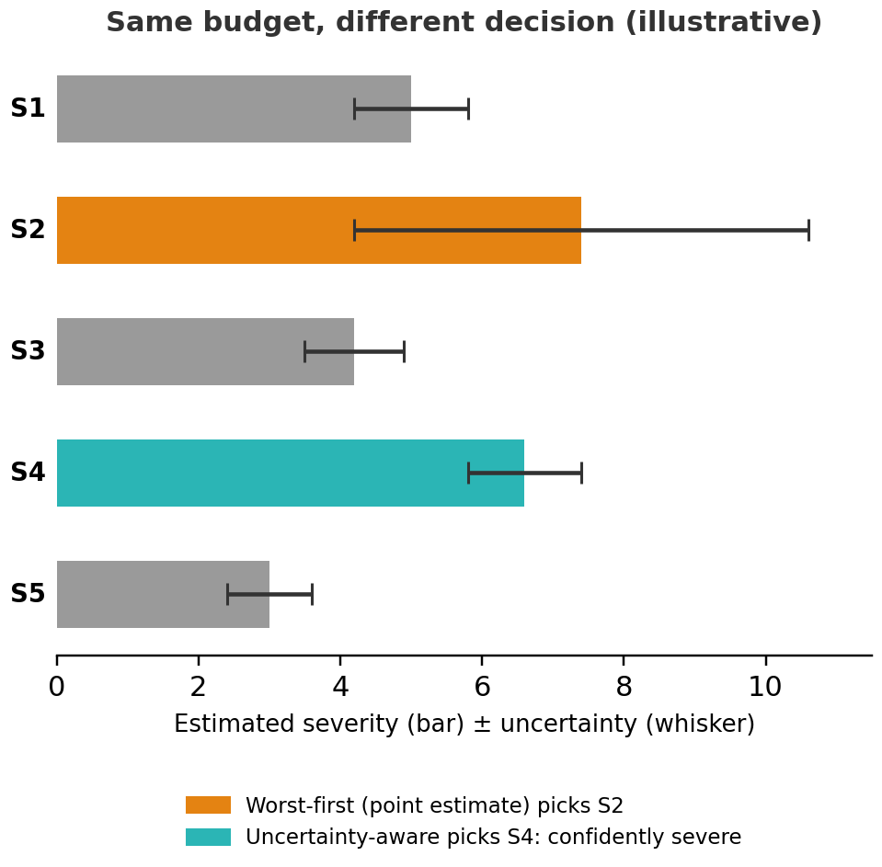
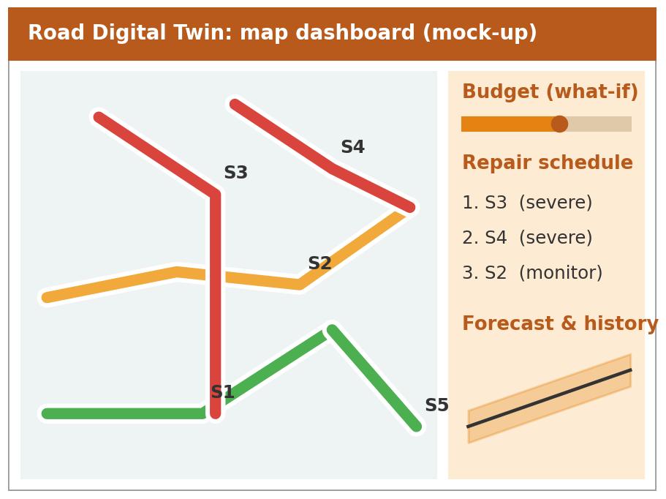
Monocular Vision-Based Predictive Digital Twin for Road Infrastructure Maintenance Optimisation
Core Idea: Illustrated
Fig. 4: Same budget, different decision: allowing for measurement uncertainty changes which segment is funded (illustrative)
Fig. 5: Mock-up of the map dashboard showing condition, forecast and what-if repair plans (not real data)

Slide 14
Monocular Vision-Based Predictive Digital Twin for Road Infrastructure Maintenance Optimisation
Implementation: Status & Plan
Work done so far
Literature survey: 20 papers (2025-26 focus) consolidated
One-page gap statement and revised novelty claims
Architecture and tech stack chosen
Datasets identified; licences and Pothole-600 format to verify
Layer | Choice
Detection | YOLOv8 or RT-DETR (RDD2022)
Segmentation | U-Net or SegFormer (Pothole Mix)
Depth / severity | Pretrained metric depth, fine-tuned; conformal intervals (Pothole-600)
Twin store | SQLite early; PostgreSQL/PostGIS later
Forecasting | Trend / Markov / regression; XGBoost or Random Forest
Optimisation | Knapsack, robust or stochastic; PuLP / OR-Tools
Frontend | Map dashboard with what-if schedule

Slide 15
Monocular Vision-Based Predictive Digital Twin for Road Infrastructure Maintenance Optimisation
Capstone (Phase-I & II) Timeline
Stage | M1 | M2 | M3 | M4 | M5 | M6 | M7 | M8 | M9 | M10 | M11 | M12
Literature survey, gap statement
Pilot site (guide confirmed)
Detection + segmentation backbone
Novelty 1: calibrated severity
Novelty 2: field collection + twin DB
Novelty 3: optimiser + baselines
Evaluation, ablations, cheap-sensing study
Write-up and submission
Months counted from the start of Phase-I. Review-1 falls within the literature-survey and gap-statement stage.

Slide 16
Monocular Vision-Based Predictive Digital Twin for Road Infrastructure Maintenance Optimisation
Task Allocation (Proposed)
Member | SRN | Proposed focus
Krishna G Pai | PES1UG24AM372 | Detection and segmentation backbone; twin database
Aryaman DK | PES1UG24AM344 | Monocular severity and calibration (Novelty 1)
Kshitij Satish Shetty | PES1UG24AM143 | Field data collection and deterioration forecasting (Novelty 2)
Mallikarjuna Rao R.V. | PES1UG24AM155 | Uncertainty-aware repair optimiser and dashboard (Novelty 3)
Shared by all: literature survey, evaluation and ablations, write-up. Allocation is a proposal to be confirmed with the guide.

Slide 17
Monocular Vision-Based Predictive Digital Twin for Road Infrastructure Maintenance Optimisation
Novelty Claims & Evaluation Plan
Claim | Success looks like | Baselines / ablations
1. Reliable severity from one camera | Depth error (cm) and error-range coverage; tested across phones, heights, light, weather and on separate dashcam footage | No calibration (Depth Anything V2 as-is); stereo ground truth
2. Real monthly dataset | 4-6+ verified monthly records per segment; forecast error; real and simulated data labelled | Last-value; straight-line trend; real-only vs combined
3. Error-aware repair planning | Better road condition after N months at equal budget; closer to the ideal plan | Worst-first; basic budget selection; random; robust vs stochastic
Value of cheap sensing | Repair quality lost vs higher-grade data | Cheap input vs tape-measured or LiDAR-grade data

Slide 18
Monocular Vision-Based Predictive Digital Twin for Road Infrastructure Maintenance Optimisation
References
[1] AI-driven digital twin architecture for proactive pavement maintenance in Finland, 2026
[2] Digital twin-driven pavement health monitoring with GNNs, arXiv 2511.02957, 2025
[3] Digital twins and deep learning on IMU signals, Future Internet 17(10):436, 2025
[4] Del Serrone et al., AI-driven dash-cam pavement condition assessment, Infrastructures, 2026
[5] On-edge AI technique for road pavement distress detection, Elsevier, 2026
[6] Smartphone pothole depth with monocular RGB and LiDAR guidance, 2026
[7] Fine-tuned YOLOv8 and monocular depth on Indian roadways, Springer, 2025
[8] Wang et al., Video-based pothole detection and area estimation with depth map and Kalman smoothing, arXiv 2505.21049, 2025
[9] Baroudi et al., Pothole detection and characterization: segmentation and depth, Neural Comput. Appl. 38, 2026
[10] Jana et al., Mobile crowd sensing for road anomaly detection using deep learning, Spatial Inf. Res. 33:51, 2025
[11] Distress-level deterioration prediction with causal analysis and UQ, Appl. Sci. 15(20):11250, 2025
[12] Shakya et al., Pavement deterioration on Nepal national highways, Infrastructures 10(3):52, 2025
[13] Yamany et al., Network-level maintenance planning using GA, Innov. Infrastruct. Solut. 9:208, 2024
[14] Optimizing pavement maintenance with AI: optimization + ML framework, Int. J. Pavement Res. Technol., 2026
[15] Sovanneth et al., Pavement maintenance planning in Cambodia: probabilistic model + GA, Infrastructures 10(10):261, 2025
Also surveyed: pothole evaluation with deep learning, machine vision and fuzzy logic (Case Stud. Constr. Mater. 22, 2025); AI-driven preventive maintenance for asphalt pavements (Medziagotyra, 2026); POMDP-based condition-based PMS (KAIST)

Slide 19
Monocular Vision-Based Predictive Digital Twin for Road Infrastructure Maintenance Optimisation
References (contd.)
[16] Talaghat, Golroo, Rasti, Shahhosseini. Road Pavement Digital Twin: A Blueprint with a Case Study. J. Comput. Civ. Eng. 40(3):05026001, 2026. DOI 10.1061/JCCEE5.CPENG-7187
[17] Satheesan, Li, Chapman. Multi-Sensor Spatial Data Fusion for Road Condition Monitoring Digital Twins. ISPRS Archives XLIX-B4-2026:521-528. DOI 10.5194/isprs-archives-XLIX-B4-2026-521-2026
[18] Gupta et al. Intelligent Pavement Management: ML Framework for Condition Classification and Maintenance Prioritization. Sci. Rep. 16:19475, 2026. DOI 10.1038/s41598-026-49953-7
[19] Mehta, Yusuf, Ghafari. Data-Driven Framework for Pothole Repair Automation Using UGV Fleets. Autom. Constr. 174:106176, 2025. DOI 10.1016/j.autcon.2025.106176
[20] Prajapati, Guler. Surrogate-Modeling for Pavement Maintenance Scheduling. Data Sci. Transp. 7:23, 2025. DOI 10.1007/s42421-025-00134-4

Slide 20
Thank You

