Slide 1
B.Tech. in CSE (AI & ML) (2024-2028)
Semester- V
UE24AM320A–Capstone Project Phase-1
Review-2
Project Title : Monocular Vision-Based Predictive Digital Twin for Road Infrastructure Maintenance Optimisation
Project ID : PW26_VK_02
Project Guide : Dr. Vidhya K
Project Team : Krishna G Pai (PES1UG24AM372)
Aryaman DK (PES1UG24AM344)
Kshitij Satish Shetty (PES1UG24AM143)
Mallikarjuna Rao R.V (PES1UG24AM155)

Slide 2
Monocular Vision-Based Predictive Digital Twin for Road Maintenance
Outline
Introduction
Suggestions from Review – 1
Scope and Objectives
Extended Literature Survey
Requirement Specification
Architecture / Block Diagram
Further Implementation
Capstone (Phase-I & Phase-II) Project Timeline
Any other information
References

Slide 3
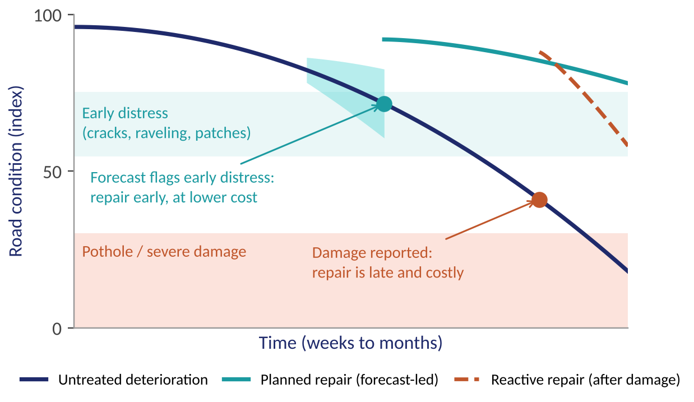
Monocular Vision-Based Predictive Digital Twin for Road Maintenance
Introduction
Problem
Roads are repaired after damage is reported; detection alone is reactive
No low-cost way to track how individual road cells change over time
Phone / dashcam tools rarely state how reliable their measurements are
Our idea
A predictive road digital twin from ordinary geotagged dashcam video: measure distress, track fixed cells, forecast progression, rank repairs
Fig. 1: Reactive versus forecast-led repair (illustrative sketch, not measured data).
Our question: given early visible distress now, how likely is this cell to progress to a pothole or worse within the next k weeks?

Slide 4
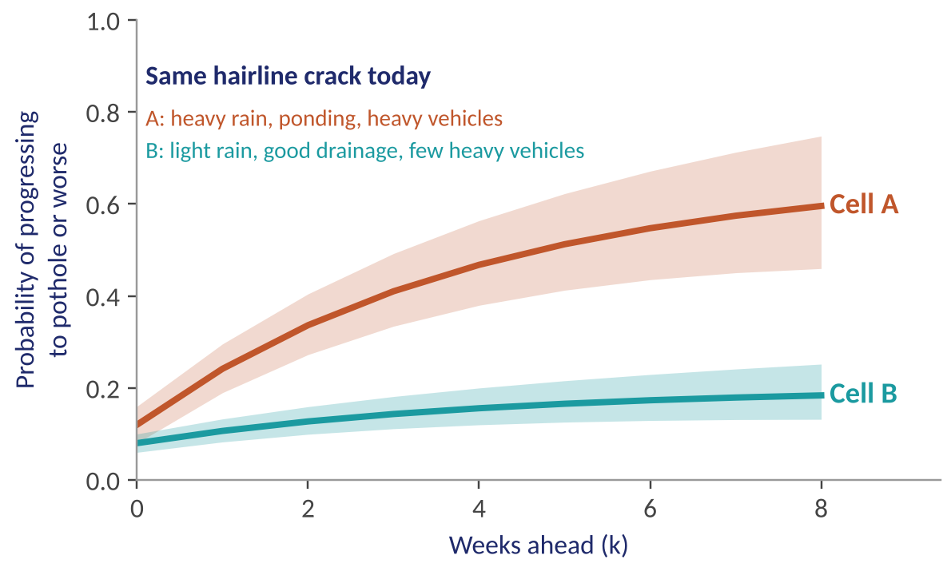
Monocular Vision-Based Predictive Digital Twin for Road Maintenance
Introduction (contd.)
What we contribute
1
Depth from one camera, with an error range
2
Four roads, fixed 20 m cells, repeat surveys
3
Weather + video traffic proxy + repair log
4
Uncertainty-aware progression forecast
5
Risk-ranked repair priority
Fig. 2: Same visible crack, different predicted future: context changes the risk (illustrative).
Scope note: Phase-I validates what the study window can measure, early-distress progression on four roads. A new detector and pre-distress prediction are positioned as natural extensions.
Notes:
Talking point: we build on existing detectors rather than claim a new one; the contribution is the validated chain from depth to repair priority.

Slide 5
Monocular Vision-Based Predictive Digital Twin for Road Maintenance
Suggestions from Review - 1
Table 1: Panel suggestions from Review-1 and how each one is built into the plan.
Environmental factors
Incorporated
Historical weather by GPS and date (7/30/90-day lookbacks, Open-Meteo / ERA5); effects learned over time within one climate.
Traffic-based deterioration
Incorporated
Heavy-vehicle exposure from map attributes (road class, truck restrictions, bus routes, land use), cross-checked with a relative index from our survey videos (heavy-vehicle fraction, averaged over visits). Cell-level stress features (junctions, bus stops, speed breakers). A proxy, not axle load.
Road curvature and driving behaviour
Phased
Curvature from OpenStreetMap as a descriptive covariate where a real curve exists; behaviour and wheel-load studies planned as an extension with vehicle-dynamics data.
Predicting before visible damage
Phased
Phase-I forecasts progression of early distress (cracks, raveling, patches); pre-distress prediction follows naturally once a longer record exists.
Depth with ground truth and error range
Incorporated
About 15-20 physically measured potholes, evaluation grouped by pothole, conformal / jackknife+ intervals with honest coverage and width.
With thanks to the panel: all five suggestions shaped the design; scope is phased to what the study window can validate.
Notes:
Diplomatic framing (use if the panel pushes back):
- Thank the panel first: every suggestion changed the design.
- Environment and traffic: incorporated as covariates; state that all four roads share one climate, so effects are learned over time, and traffic is a relative proxy.
- Curvature and driving behaviour: "We agree this is valuable. In Phase-I we include curvature as a descriptive covariate where a real curve exists, and we plan the behaviour and wheel-load study as the next phase once vehicle-dynamics data is available."
- Predicting before visible damage: "We start with early-distress progression because we can validate it with repeated surveys, and it is the first step toward earlier prediction."
- Depth: fully incorporated with physical ground truth and an error range.

Slide 6
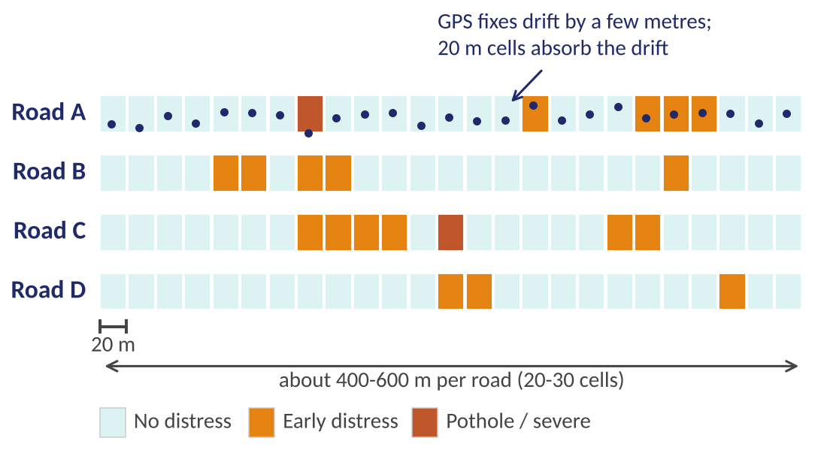
Monocular Vision-Based Predictive Digital Twin for Road Maintenance
Scope and Objective
Project goals
Detect and segment road distress from geotagged dashcam video
Estimate pothole depth with an uncertainty range, validated on measured potholes
Track the same 20 m cells across repeated surveys
Forecast progression of early distress using weather and traffic context
Rank cells for repair by risk, severity and uncertainty
Fig. 3: Four monitored roads split into fixed 20 m cells (illustrative layout, not measured data).
In scope: 4 roads, one per teammate; weekly surveys (6-12 rounds); repair-event log
Planned extensions: curve and driver-behaviour study, pre-distress prediction, wider surveys
Notes:
Framing: the extensions are sequenced after Phase-I so that each claim is backed by measurements. Large LSTM forecasters and a 50-100 segment survey become sensible once the four-road pipeline works; Google Maps congestion stays optional.

Slide 7
Monocular Vision-Based Predictive Digital Twin for Road Maintenance
Extended Literature Survey
Paper / product | Approach | Strength | Limitation / gap vs ours
[4] Dash-cam pavement condition, Infrastructures 2026 | YOLOv8 distresses to PCI; compared with manual survey and PASER | Dashcam sensing validated against manual survey | Stops at scoring: no depth, forecast or scheduling
[8] Video pothole detection and area, arXiv 2025 | ACSH-YOLOv8, BoT-SORT, Depth Anything V2 metric depth, Kalman smoothing | Area stable across frames; 76.6% AP50 | No ground truth; area not depth; preprint
[11] Distress-level prediction with UQ, Appl. Sci. 2025 | Causal analysis + Monte Carlo Dropout intervals | Uncertainty-aware forecast including potholes | Not phone-derived; no scheduling step
[12] Nepal highway deterioration, Infrastructures 2025 | Markov hazard model + monsoon rainfall | Probabilistic forecast with limited data | Section-level indices; no vision data
Table 2: Closest works compared (20 papers were surveyed in Review-1; these four are closest to our chain: vision sensing, depth, uncertainty-aware forecasting, context).

Slide 8
Monocular Vision-Based Predictive Digital Twin for Road Maintenance
Literature Survey: Categories, Conclusion
A) Supports our hypothesis
A) Against / limits
B) Alternative approaches
[4] Dashcam condition scoring can match manual surveys
[8] Metric monocular depth is feasible on video
[11], [12] Uncertainty- and rainfall-aware forecasts work with limited data
[8] Depth not validated against measured ground truth
[5] Low-cost on-vehicle detector reaches only F1 0.54: measurement noise is real
[12] Small data limits model complexity
[3] Vehicle IMU twins (misses 22% of potholes)
[16] Sensor-rich pavement twin (strain gauges, GPR): far costlier
Drone / LiDAR twins: unaffordable for ward-level bodies

Slide 9
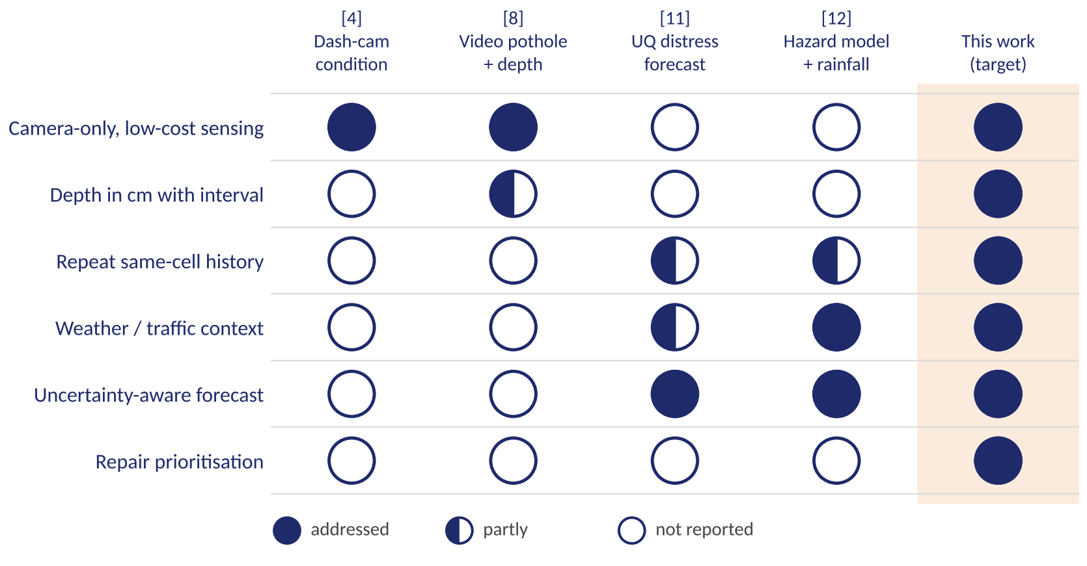
Monocular Vision-Based Predictive Digital Twin for Road Maintenance
Literature Survey: Gap at a Glance
Reading the figure
Prior work covers pieces of the chain: sensing, depth, or forecasting
Our contribution is the validated integration, with uncertainty carried end to end
Novelty is a hypothesis; the extended survey will confirm or refine it
Filled = addressed, half = partly, empty = not reported. "This work" is the target we will validate.
Fig. 4: Capability coverage of the closest works [4] [8] [11] [12], read from their reported methods and limitations in the Review-1 survey.

Slide 10
Monocular Vision-Based Predictive Digital Twin for Road Maintenance
Requirement Specification
Functional requirements
Non-functional requirements
FR1
Import video with GPS / time data
Reproducibility: fixed protocol, stable IDs, versioned data
FR2
Detect and segment distress; map to fixed cells
Traceability: output linked to video, frame, GPS, labels
FR3
Estimate pothole depth with an uncertainty range
Robustness: flags poor footage and GPS misalignment
FR4
Keep cell history across visits; log repairs
FR5
Attach historical weather, map-based heavy-vehicle exposure and video traffic proxies
Privacy: blur faces and plates before sharing
FR6
Estimate short-horizon progression probability
Usability: shows risk, history, confidence and reason
FR7
Rank cells for repair by risk, severity, uncertainty

Slide 11
Monocular Vision-Based Predictive Digital Twin for Road Maintenance
Proposed Architecture / Block Diagram
Capture
Dashcam video + GPX
Perception
Distress segmentation + depth with interval
Cell mapping
GPS map matching to 20 m cells
Context
Weather lookbacks + video traffic proxy
Dashboard
History, risk, confidence
Repair priority
Risk x severity x uncertainty
Progression forecast
Probability with uncertainty
Cell state
History + repair log
Depth uncertainty flows downstream: depth interval, then severity, then progression risk, then repair ranking
Fig. 5: Proposed architecture, from dashcam video to repair priority; depth uncertainty flows downstream.

Slide 12
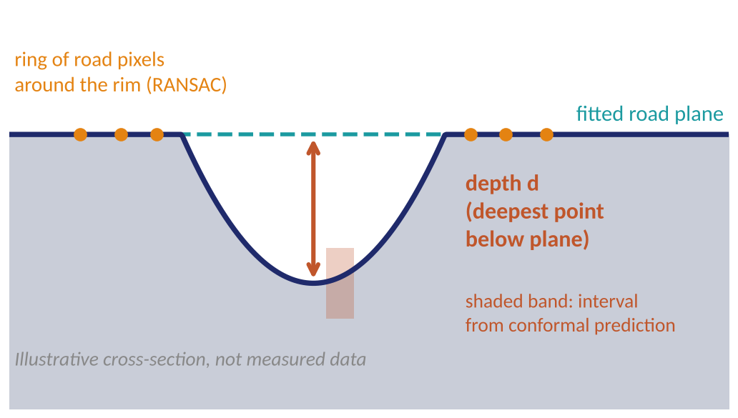
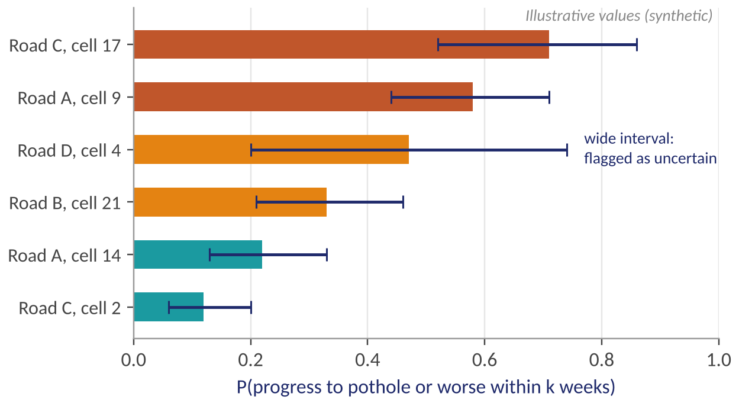
Monocular Vision-Based Predictive Digital Twin for Road Maintenance
Architecture: Depth and Early-Warning Modules
Fig. 7: Per-cell progression probability with credible intervals (synthetic values).
Fig. 6: Depth from a road-plane fit, reported with an interval (illustrative).
Segment
Metric depth
Plane fit
Interval
Video state
Weather
Traffic proxy
Cell stress
Depth pipeline steps
Inputs to the forecast model

Slide 13
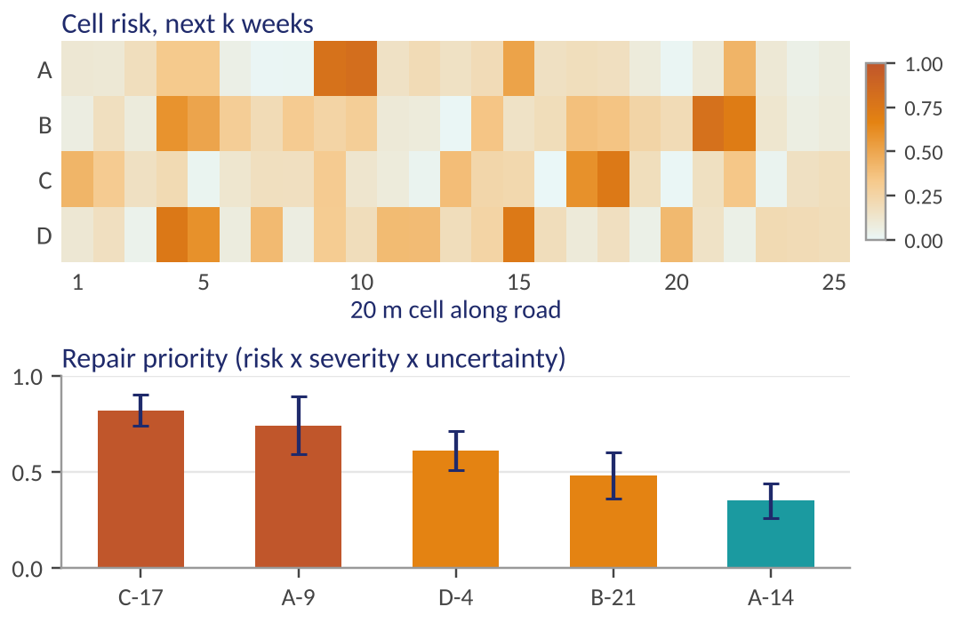
Monocular Vision-Based Predictive Digital Twin for Road Maintenance
Further Implementation
4
road segments
20 m
cells, fixed grid
6-12
survey rounds
15-20
measured potholes
Component | Method choice
Perception | YOLO segmentation fine-tuned on RDD2022 + our frames
Depth | Depth Anything V2 metric, camera calibration, road-plane fit
Uncertainty | Cross-conformal / jackknife+, leave-one-pothole-out
Cells + context | GPX map matching; Open-Meteo weather; OSM road attributes + YOLO/ByteTrack heavy-vehicle index
Forecast | Bayesian / hazard model vs persistence and trend baselines
Fig. 8: Dashboard mock-up with synthetic data; the live demo shows this view updating from a new video.
Table 3: Method choices for each component.

Slide 14
Monocular Vision-Based Predictive Digital Twin for Road Maintenance
Capstone (Phase-I & Phase-II) Project Timeline
Stage | M1 | M2 | M3 | M4 | M5 | M6 | M7 | M8 | M9 | M10 | M11 | M12
Literature survey, novelty check
Freeze protocol, calibrate, pilot capture
Repeat field surveys (weekly)
Perception + depth, measured potholes
Forecast + baselines + ablation
Prioritisation + dashboard
Evaluation, report, demo
Fig. 9: Project Gantt chart. Months counted from the start of Phase-I. Field surveys start immediately: the longitudinal data cannot be recreated later.

Slide 15
Monocular Vision-Based Predictive Digital Twin for Road Maintenance
Task Allocation
Member | SRN | Road | Proposed focus
Krishna G Pai | PES1UG24AM372 | Road A | Detection and segmentation backbone; twin database
Aryaman DK | PES1UG24AM344 | Road B | Monocular depth, calibration and uncertainty
Kshitij Satish Shetty | PES1UG24AM143 | Road C | Field capture, weather/traffic features, progression forecast
Mallikarjuna Rao R.V. | PES1UG24AM155 | Road D | Physical pothole measurements, repair priority and dashboard
Table 4: Task allocation. Shared by all: road ownership and repeat surveys, label review, evaluation, report. Road and role assignment to be confirmed with the guide.

Slide 16
Monocular Vision-Based Predictive Digital Twin for Road Maintenance
Novelty Claims and Evaluation Plan
Candidate contribution | Evidence required | Baseline / ablation
Cell-level longitudinal twin | Repeatable cell mapping and same-cell history | Manual audit of cell assignment
Monocular depth with uncertainty | Error, bias, interval coverage vs measured potholes | Uncalibrated depth model as-is
Uncertainty passed downstream | Impact on severity, risk and priority | Point-depth-only pipeline
Weather + traffic context | Ablation: visual only, +weather, +traffic, both | Persistence, trend, no-covariate model
Repair-aware history | Repairs logged; transitions censored | Ignoring repairs
Table 5: Claims, evidence and baselines. Tests: chronological holdout and leave-one-segment-out (pilot, wide uncertainty). Novelty is a hypothesis pending the extended survey.

Slide 17
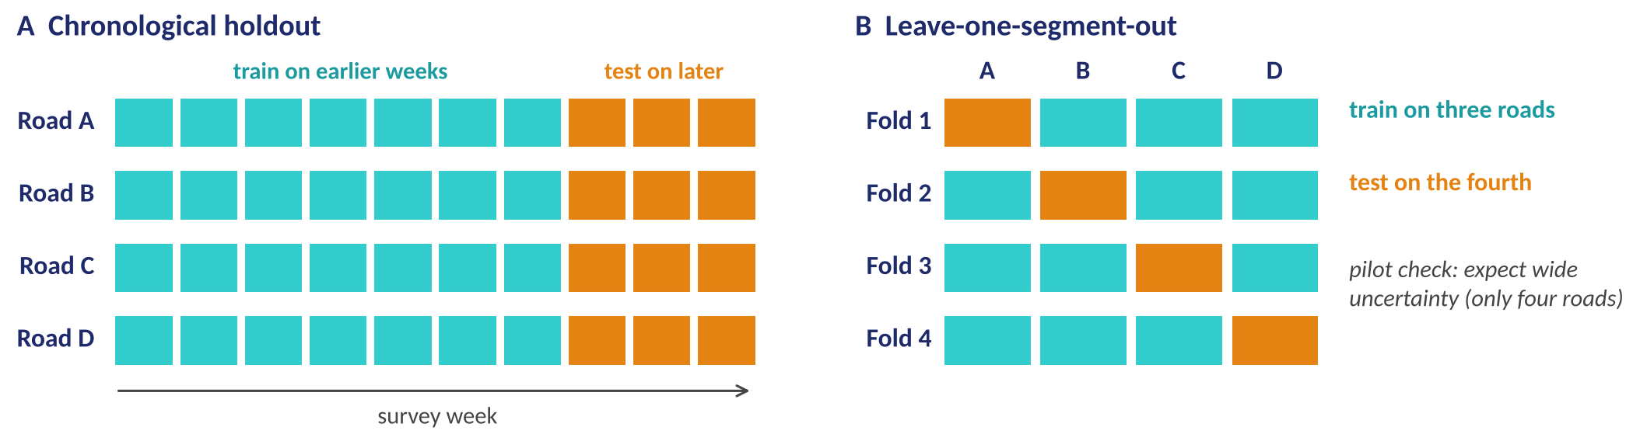
Monocular Vision-Based Predictive Digital Twin for Road Maintenance
Evaluation Design
Fig. 10: Evaluation splits: earlier weeks train and later weeks test (A); three roads train and the fourth tests (B).
Does context help? Ablation on held-out data
Baselines: persistence, simple trend, no-covariate model. Any gain from context is reported as found, large or modest.
Visual only
+ Weather
+ Traffic
+ Both

Slide 18
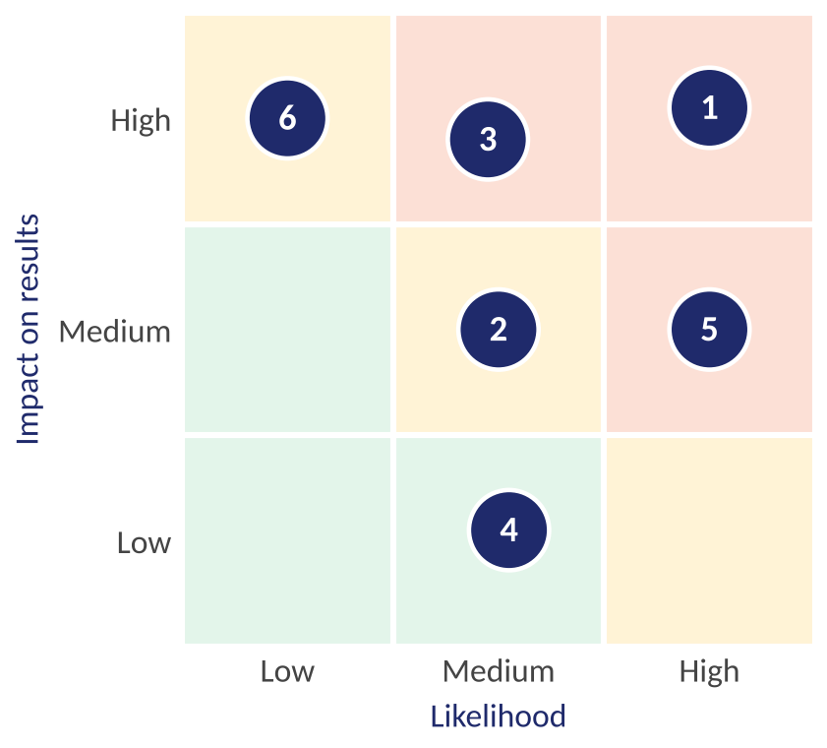
Monocular Vision-Based Predictive Digital Twin for Road Maintenance
Any other information: Risks and Limitations
1
Few progression events: start early, survey weekly, report a pilot with wide intervals
2
GPS drift: 20 m cells, map matching, landmark realignment
3
Few measured potholes: group by pothole, leave-one-out, honest intervals
4
Weak traffic proxy: state it is a proxy, add cell stress features, report ablation
5
One climate: learn effects over time; drainage differs between roads
6
Capture differences: one shared protocol, mount, calibration, cell grid
Fig. 11: Risk matrix: numbers key to the mitigations at right.
Limitations we state openly
Four roads, one climate: findings scoped accordingly
Traffic is a relative proxy, not axle load
Weather grid is coarse
Depth accuracy bounded by monocular geometry

Slide 19
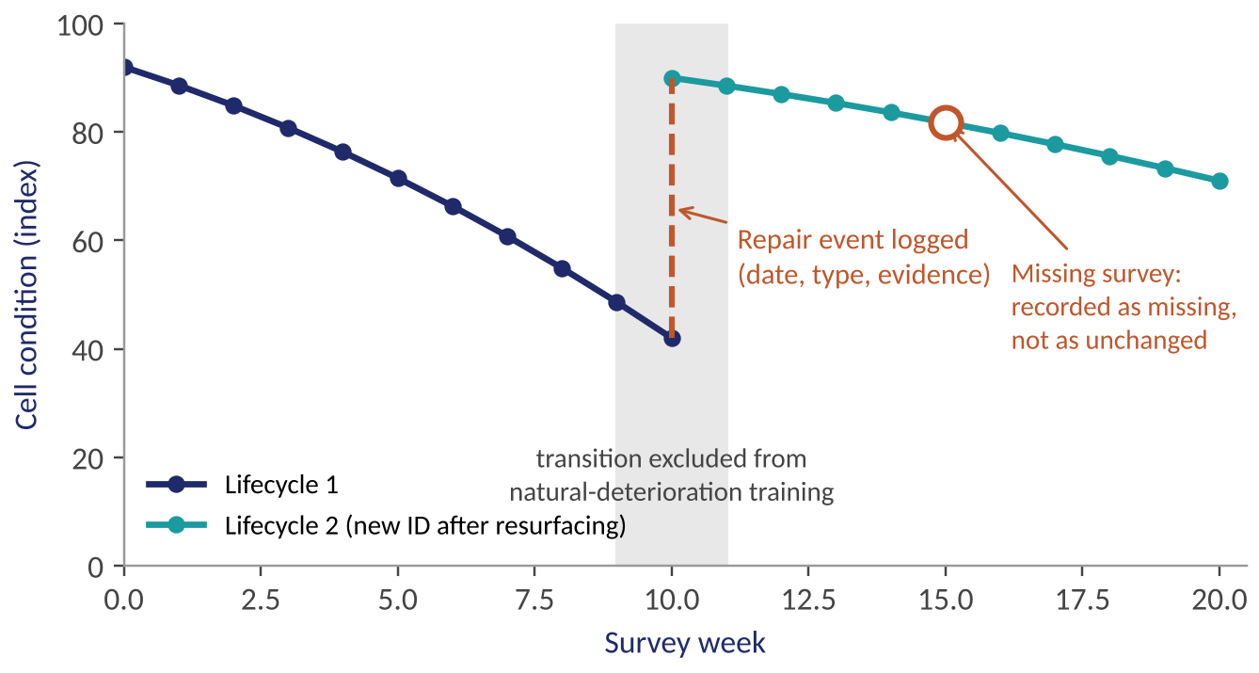
Monocular Vision-Based Predictive Digital Twin for Road Maintenance
Any other information: Repair Handling
Repair-event policy
Patching: keep Cell_ID, log the event, separate pre / post
Resurfacing: new lifecycle ID
Reconstruction: close lifecycle, start a new one
Unknown date: record a range and confidence
Not accessible: missing survey, not "unchanged"
Fig. 12: A repair is an event, not a natural improvement: it closes a lifecycle and the transition is excluded from training (illustrative).

Slide 20
Monocular Vision-Based Predictive Digital Twin for Road Maintenance
References
[3] "Digital twins and deep learning on IMU signals," Future Internet, vol. 17, no. 10, p. 436, 2025.
[4] Del Serrone et al., "AI-driven dash-cam pavement condition assessment," Infrastructures, 2026.
[5] "On-edge AI technique for road pavement distress detection," Elsevier, 2026.
[8] Wang et al., "Video-based pothole detection and area estimation with depth map and Kalman smoothing," arXiv:2505.21049, 2025.
[11] "Distress-level deterioration prediction with causal analysis and uncertainty quantification," Appl. Sci., vol. 15, no. 20, p. 11250, 2025.
[12] Shakya et al., "Pavement deterioration on Nepal national highways," Infrastructures, vol. 10, no. 3, p. 52, 2025.
[16] Talaghat et al., "Road pavement digital twin: A blueprint with a case study," J. Comput. Civ. Eng., vol. 40, no. 3, Art. 05026001, 2026.
[21] L. Yang et al., "Depth Anything V2," in Proc. NeurIPS, 2024.
[22] Y. Zhang et al., "ByteTrack: Multi-object tracking by associating every detection box," in Proc. ECCV, 2022.
[23] D. Arya et al., "RDD2022: A multi-national image dataset for automatic road damage detection," Geosci. Data J., 2024.
[24] H. Hersbach et al., "The ERA5 global reanalysis," Q. J. R. Meteorol. Soc., vol. 146, no. 730, pp. 1999-2049, 2020.
[25] R. F. Barber et al., "Predictive inference with the jackknife+," Ann. Statist., vol. 49, no. 1, 2021.
Verify all entries and licences before submission.

Slide 21
Thank You

